Slide 1


R&P Onboarding Sessions
January 2025
Session 1 of 4
R&P Core Services
January 8, 2025

Slide 2

Introduction
Sarah Evans, MRS Assistant Director, R&P Training, will be your facilitator today.
The materials for USCCB/MRS’ R&P Onboarding Sessions were created by USCCB/MRS’ R&P Technical Assistance (TA) Team

Slide 3
Housekeeping Items
Resources for each service
First webinar in an R&P onboarding webinar series
Disclaimers: make sure you’re clear on your internal agency policies!
1 hour with Q&A at the end
Technical issues: put a message in the chat
Note 1.10.25: The poll on slide 25 was updated after the initial webinar
This webinar will not focus on case file documentation or R&P fund disbursement. The case example we will use will not focus on the unique needs of a co-sponsorship case, an attached refugee minor case, or a cash-based case. These aspects of case management will be covered in future webinars!
Notes:
Disclaimers:
- This training is supplemental to training staff receives at the affiliate office
This webinar is focusing on services, not case file documentation or R&P fund disbursement
This webinar only touches on R&P services for refugee cases.
The case example we will use will not focus on the unique needs of a co-sponsorship case, an attached refugee minor case, or a cash-based model case
- Other USCCB/MRS webinars will specifically focus on these aspects of case management

Slide 4
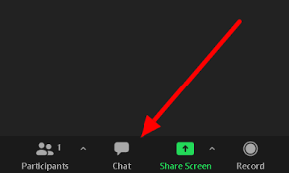
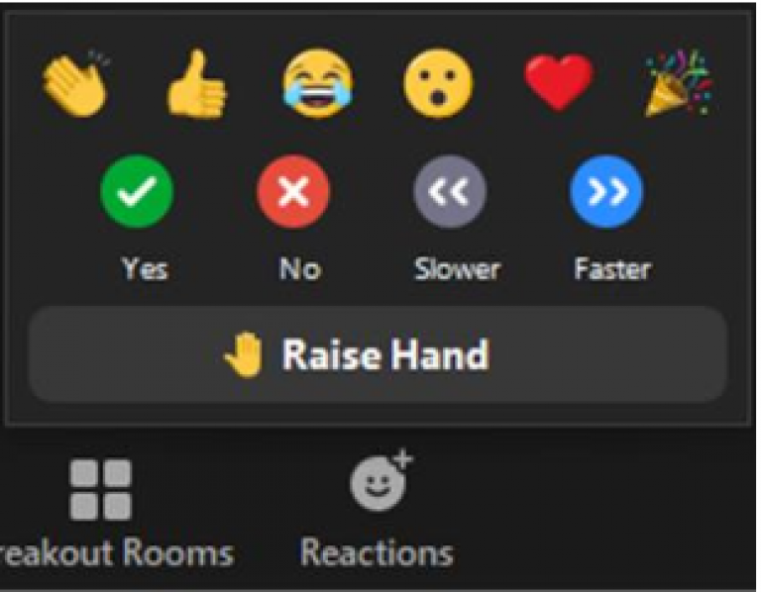
Zoom Features
CHAT
RAISE HAND
Notes:
We request your active participation throughout this meeting (you only get out what you put in!)

Slide 5
Agenda
Learning Objectives
R&P Service Timeline and Case Scenario
Pre-Arrival Services
Post-Arrival Services (first 72 hours to 7 days)
Post-Arrival Services (10 days to 90 days)
Q&A
For this webinar, we will focus on several core services – the USCCB/MRS FY25 R&P Case File Monitoring Tool (on MRSConnect) goes through documentation requirements and timeframes for all core R&P services

Slide 6
Learning Objectives
Know what the R&P core services are and the timelines for service completion
Learn some best practices for various core services
Understand practical application of core services in the context of a case example

Slide 7
October 2024 – CA Changes to Service Delivery (non-cash-based R&P cases)
Updates to the R&P Cooperative Agreement (CA) – October 2024
Slide 1 of 2
All FY2025 arrivals on/after October 1, 2024 will receive up to $1,650 in direct assistance
FY2025 flex fund policies were approved by USCCB/MRS
Reminder: no R&P Additional Direct Assistance (ADA) in FY25
New requirements - applies to all FY25 arrivals on/after 12/1/2024 (slide 1 of 2):
Limitation of Responsibilities clause – unusually high arrivals – requires case note, prioritization of refugee well-being (will cover more in next week’s onboarding session)
Working to simplify documentation requirements in case files
Service plan no longer REQUIRED to be completed DURING intake appointment
“Sufficient seasonally appropriate linens” must be given, rather than a specific number of blankets/sheets

Slide 8
October 2024 – CA Changes to Service Delivery (non-cash-based R&P cases)
Slide 2 of 2
Updates to the R&P Cooperative Agreement (CA) – October 2024
New service requirements – USCCB will monitor for FY25 arrivals on/after 12/1/2024 (slide 2 of 2):
Revised Language – Following Up on EADs Lost in the Mail
Revised language – CO topic -“Role of the Local Resettlement Agency”
AR-11 process updates
USCCB updates:
In FY2025, service plans are still required for all adult case members; service plans are no longer required for attached refugee minor children (M-code M2-M7)

Slide 9
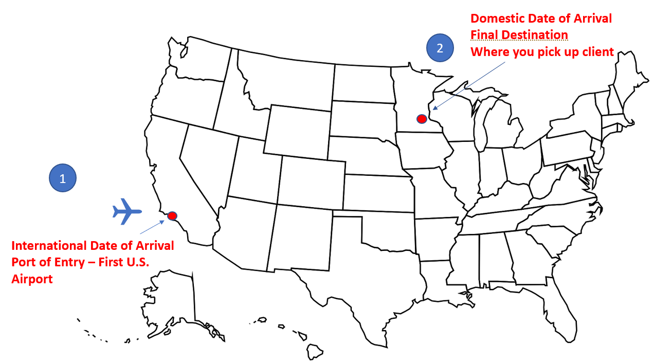
Understanding Service Completion Dates
Jan 8
International arrival: Family arrives at port of entry
90-Day R&P Period begins
Jan 9
Domestic Arrival: Family arrives in MN
Jan 10
Initial home visit may be required on this day (example: if US Tie met client alone at airport)
Day 1 for service delivery
Airport Pickup
Zoom poll
Resources:
R&P Case File Monitoring Tool
Notes:
Zoom Poll:
When calculating the 90-day R&P service period for this case. which date is day 1?
Jan 8 (date of international arrival)
Jan 9 (date of domestic arrival)

Slide 10
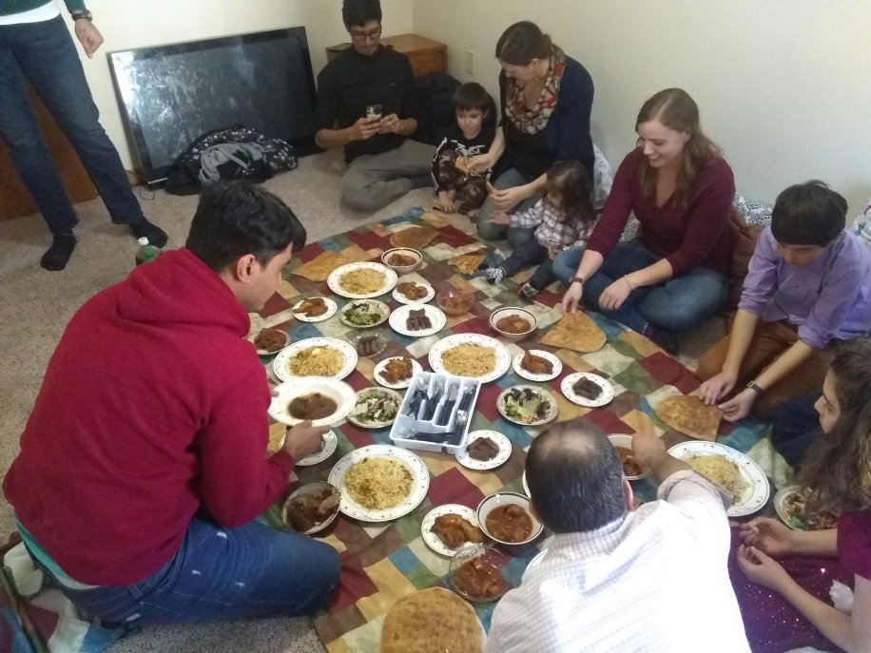
Co-Sponsorship and R&P Core Services
What is it?
A group of community members (volunteers) support a newly-arrived refugee household by helping your agency deliver certain R&P core services. They commit to supporting the household for at least 90 days.
Your resettlement agency matches group with a newcomer family enrolled in the R&P program
Community group commits to providing:
8+ R&P Core Services
In-kind and/or cash donations
Circles of Care (Co-Sponsorship Program)
Catholic Charities, Diocese of Springfield
Notes:
Resettlement agencies with co-sponsor programs match a group of volunteers (whether from a parish, civic organization, or handful of neighbors) with an individual/family enrolled in the Reception and Placement Program.
During the first 90 days, the community group partners with your agency to provide volunteer services (including a minimum of 8 core R&P services) as well as in-kind or cash donations.

Slide 11
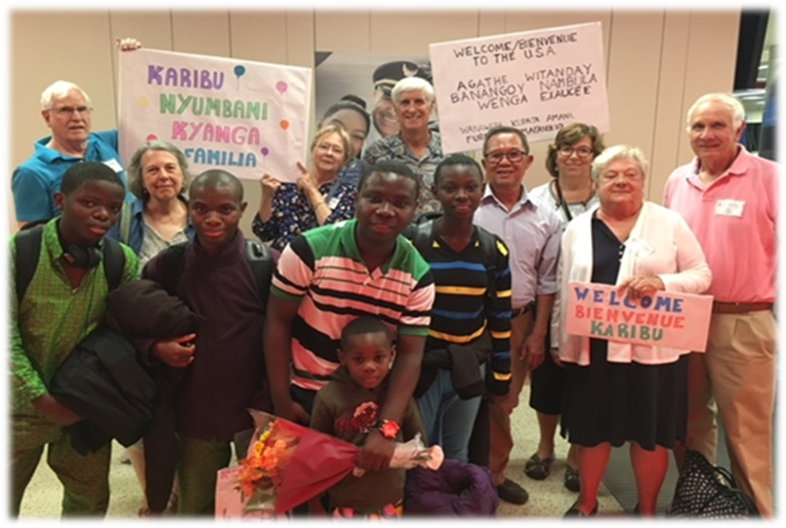
Co-Sponsorship & 15 R&P Delegable Core Services
Pre-Arrival & Arrival
Assist in locating safe, sanitary and decent housing
Set up housing with essential furnishings
Stock the pantry with groceries/food assistance
Airport pickup with appropriate interpretation
Provide culturally appropriate, ready to eat meal
Post Arrival
Seasonably appropriate clothing (work, school, everyday)
Transportation assistance
Social security card application
Public benefits: Cash Assistance, Medicaid, SNAP
School enrollment
Selective service registration (if applicable)
ELL enrollment
Health screenings/Immunizations
Additional Public benefits: SSI, WIC (if applicable)
Cultural Orientation Provision & Assessment
Groups can take full responsibility for or actively help you to deliver any 8 of the 15 listed core services!
The signed co-sponsor agreement should be put in the R&P case file within 30 calendar days of domestic arrival
Community Sponsorship Initiative
Catholic Charities of Boston
Notes:
For now, please take a brief look at the 15 core services that you can delegate to community groups. You can either fully delegate these core services OR perform them in active collaboration with a community group
An examples of active collaboration would be having volunteers make welcome signs and assist in airport pickup. Another example for English language learning could be having volunteers accompany or drive clients to their English classes, helping with enrollment into a program, or providing English language learning materials.

Slide 12
Case Scenario
After living in a refugee camp for 6 years, Andre and his family (a P2 refugee case of 5) will be resettled to the United States. The family will arrive in Minneapolis, Minnesota in January 2025.
ANDRE
Knows English
College degree
Work experience as a medical assistant
MARY
No English
No education
Wants education for children
Wants to open a clothes shop
JOSEPH
19 years old
Excited to travel to America
PIERRE
7 years old
Excited to go to school in America
HELENE
66 years old
Hypertension
Limited mobility
Notes:
- We are going to go through the R&P core services in the context of a case scenario. The family we will be discussing today throughout our presentation is a family of 6 coming to Minnesota. This is a fake case and we do not have an affiliate in Minneapolis so this is purely for educational purposes.
- Even before family arrives, important to thoroughly review all of their information to understand the case makeup and any unique needs.
- After living in a refugee camp for 6 years, Andre and his family (a P2 refugee case of 5) will be resettled to the United States. The family will arrive in Minneapolis, Minnesota in July.
- Andre is excited to use his English skills in America. He also hopes his college degree and work experience as a medical assistant will help him get a job after arrival.
- His wife, Mary, is worried about communicating in America, because she doesn't speak English. She never went to school, but hopes her children can go to school in America. She is also excited to maybe open a shop to sell hand-sewn clothes, just like she did in Congo.
- Joseph is 19 years old and Pierre is 7 years old. They are both excited to travel and go to school in America.
- The grandmother, Helene, is 66 years old and will also be traveling with the family. She hopes to receive medical treatment for her hypertension. She has limited mobility and needs a walker or wheelchair to get around.
- The case manager closely reviews the case's biodata, and puts copies of the case biodata, assurance form, and arrival notices into the case's R&P case file.

Slide 13
Pre-Arrival Services

Slide 14
Home Safety Checklist
Several days before the family's arrival, the case manager completes the Home Safety Checklist for the temporary housing for the family. As part of the checklist, the case manager considers:
Accessibility: housing must accommodate Helene's mobility challenges. The housing coordinator found an Airbnb with a wheelchair ramp to the door and a ground floor bedroom.
Adequate Space: the case manager understands local housing authority policies and family makeup and ensures there are sufficient bedrooms
Safety, Functionality, and No Visible Health Hazards: the case manager answers "No" for several Checklist items (there is no smoke detector upstairs, and one bathroom faucet isn’t working) and creates a plan to address right away (also noted on the Home Safety Checklist)
Affordability: Since this is temporary housing, affordability is not a main consideration. For permanent housing, the case manager considers local job placement options and potential monthly earnings of all employable adults, to ensure housing payments will leave enough money for other expenses
Resources:
RF21: Home Safety Checklist
Notes:
Requirements (info to supplement what’s already on the slide):
Checklist must be complete before arrival or no later than the family's first day in the home
Accessible: must accommodate a client with a disability.
Safe, Functional, and No visible health or safety hazards: Outlined in the Checklist (appliances, locks, smoke detectors, light, heat, water, etc. are functional and making sure there are no visible health hazards such as mold, rodents, insects).
Affordable: Family can afford the payment by the end of the R&P Period. If the case manager predicts that the total monthly income of 3 working adults will be $6,000, we would strive to find housing that is less than $2,000 a month to leave money for other expenses (not always possible to find affordable housing in all parts of the country, but ideally).

Slide 15
Material Needs Support & Home Supply Checklist
Before family's arrival, the case manager works with volunteers to gather all furniture and household items on the Home Supply Checklist. The case manager notes on form which items were purchased using R&P funds and which were donated (estimating value using the Goodwill Donation Value Guide)
Zoom poll
Since family is temporarily staying in an AirBnb with many household items, the case manager only provides the items required upon arrival:
Beds and bedding items
Personal hygiene items including bath towels and toiletries
Kitchen items including cookware and cooking and eating utensils
Baby items, must be provided at a minimum for clients upon arrival.
Before airport pickup, the case manager coordinates with volunteers to deliver the ready-to-eat food (chicken stew, rice, and vegetables).
Resources:
RF22 - Housing Supply Checklist
The family does not refuse any items, so the case manager marks given items as "Accepted" on form
Notes:
Requirements (info to supplement what’s already on the slide):
Checklist due before arrival or no later than the first date in the home.
Many agencies involve volunteers in gathering, transporting, and furnishing the home with the required items.
If donated, estimate $ value using set standard
This checklist covers furniture, specific household items, food, and clothing
Zoom poll: What other necessities should the case manager have provided?
A) Weather appropriate clothing
B) Pantry items to help feed the family until they receive food stamps
C) Anything the family asks for
D) A & B
E) All of the above

Slide 16
Class A Health Conditions
Acute Health Requirements or Class A physical health conditions:
Must be seen by the Public Health Dept within 7 days of arrival
Requires pre-coordination to schedule visit
Class A Mental Health Conditions:
Need a waiver from a local provider before they can enter the US
Must follow up with this provider within 30 days of arrival
Type in the Chat: What are some best practices to prepare for Helene's arrival since you are aware of her health conditions (even though they are not Class A conditions)?
Notes:
No one in our case has a Class A Health or Mental Health condition, but if they did, certain pre-arrival services would have to be completed. Your agency would be made aware that a client has a Class A condition during the assurance process.
In both cases, coordination would have to occur prior to the client's arrival, and your case notes should demonstrate this.
Preparation for Helene: accessible housing, thinking through the types of medical referrals she may need (and transportation needs)

Slide 17

FIRST 72 HOURS

Slide 18
Airport Pickup
Welcome & Check-In
Case manager and interpreter welcome the family at the airport in the evening. Case manager checks how family is doing and if there are immediate concerns.
Seasonal Clothing
The case manager brought some winter supplies (coats, hats, boots) to the airport, but the family has already arrived in winter clothing. The family confirms they do not need other donated clothing or shoes.
Pocket Money
At home, all adults receive and sign for pocket money
Contacts
Case manager provides their phone number, office emergency contact, and 911. The case manager explains to only call 911 in a serious emergency. Family arrived with a working phone.
Food
Case manager serves the volunteer-provided meal and shows where other food in the home is. Several days worth of food is provided.
Follow-Up Plan
Case manager tells family what time they will be returning to help the family get settled. Case manager will need to arrange transportation for the case for all appointments.
Notes:
Immediate concerns may include: How is everyone feeling? Are there any immediate questions or concerns? Does the family have a working phone with Sim card?
Interpretation provided
Seasonal clothing as needed to meet immediate needs
Pocket Money
Emergency contact info (911 and Agency contact)
Food: culturally appropriate, prepared meal and additional food to meet immediate needs

Slide 19
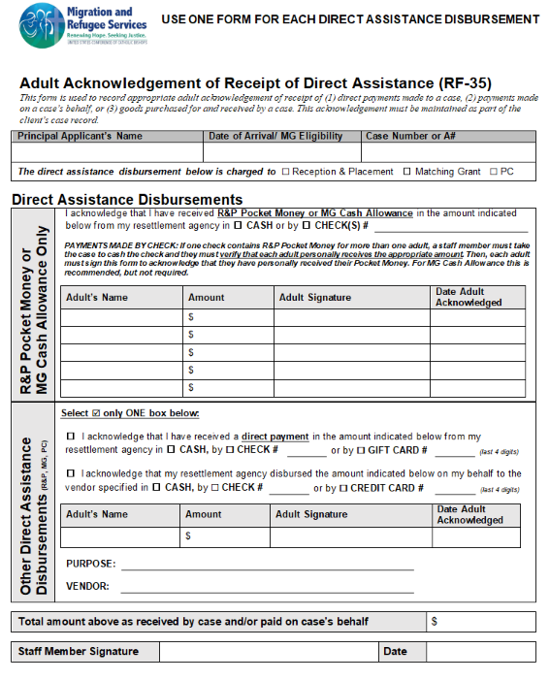
Pocket Money
All adults must receive pocket money in first 24 hours
Each adult must sign Adult Acknowledgement of Receipt of Direct Assistance form
Resources:
RF-35 Acknowledgment of Receipt of Direct Assistance

Slide 20

Initial Home Visit and Report
Case arrived in Minnesota on THURS., 1/9. The case manager returns for a home visit the next day with an interpreter and checks in on how family is feeling physically and emotionally.
Zoom poll
The case manager completes Housing and Personal Safety Orientation with all family members covering:
An instructional walk-through of the home: how to safely operate electricity, water, thermostat, and all kitchen appliances
Location of the fire extinguishers and smoke detectors and how to operate
Emergency escape route in case of a fire
When and how to call 911
Notes:
Home visit and report completed next calendar day after arrival.
Assess well-being, living conditions, and immediate needs
During same visit, Complete Housing and Personal Safety Orientation
When and how to call 911: only emergency situations (crimes or violence, serious medical issues, fires, other life-threatening situation). Practice saying "No English. I speak..." to lead into call.
Other topics may be covered as well, but this is the minimum of what should be covered
CM completes the report based on personal observations and the family's verbal responses to questions
Zoom Poll:
This case arrived on THURS., Jan 9. The interpreter notes that this case qualifies for an initial home visit within 72 hours (no ARMs on case, met at airport with interpretation, has a working phone), and the interpreter asks if the initial home visit can be completed on MON., Jan. 13. Would a visit on January 13th be on-time, or late?
On-Time
Late

Slide 21

Initial Home Visit and Report
The case manager asks about immediate needs and concerns, filling out the RF-32 Initial Home Visit Report.
Mary is concerned about food, and the case manager explains they will visit the local store and food pantry together, and soon they will apply for food stamps.
The case manager also follows up about the faucet and smoke detector, calling the property manager with Andre.
Resources:
RF-32: Initial Home Visit Report
Emergency and Safety Presentation (San Antonio)
Notes:
Home visit and report completed within timeframe.
Assess well-being, living conditions, and immediate needs
During same visit, Complete Housing and Personal Safety Orientation
When and how to call 911: only emergency situations (crimes or violence, serious medical issues, fires, other life-threatening situation). Practice saying "No English. I speak..." to lead into call.
Other topics may be covered as well, but this is the minimum of what should be covered
CM completes the report based on personal observations and the family's verbal responses to questions

Slide 22

WITHIN 7 WORKING DAYS

Slide 23

Client Intake
The case manager meets the family in the office within 7 working days of arrival, sending a message before to remind family to bring all identifying and immigration documentation they have to the meeting. The case manager makes copies of all identifying documents (including the assurance form from MRIS and the clients’ I-94s) to keep on file.
The case manager completes one Client Intake form, filling in the basic information of all household members.
Using the agency's documents, the case manager explains the Agency Grievance Policy, Client Rights and Responsibilities, and R&P Financial Assistance the family will receive for the service period.
Notes:
Intake must be completed within 7 working days of client's arrival
Documents include: birth certificates, IDs, I-94, and DOS-Issued Transportation Letter (or SIV Visa). Asking them to bring the full contents of their IOM bag can be helpful.
Verify refugee documentation and fill in basic case info.

Slide 24
Client Intake
The case manager explains the Roles and Responsibilities of the Resettlement Agency for R&P clients. The case manager begins to set professional boundaries by explaining core services, times and methods of communication, and expectation to work as a team. The case manager discusses the travel loan checklist, and has each adult sign a copy of the checklist.
The case manager reminds family of Emergency Contacts and leads family in practicing their Address and Phone Number in English.
Adults sign the agency's Informed Consent document, consenting to services.
The case manager can use the intake appointment with the family to complete the Service Plan – see next slides.
Resources:
Client Intake Form RF-6
MRS Case Management Manual
Guidelines for Ethical and Effective Case Management Webinar
Role of the Resettlement Agency (Settle In video, factsheet, and podcast)
Notes:
Intake must be completed within 5 working days of client's arrival
Documents include: birth certificates, IDs, I-94, and DOS-Issued Transportation Letter (or SIV Visa). Asking them to bring the full contents of their IOM bag can be helpful.
Verify refugee documentation and fill in basic case info.

Slide 25
R&P Service Plan
During intake, Andre and Helene work with the case manager to create their individual plans with services they will need to receive. Andre and Helene also set goals they want to achieve.
In the R&P service plans (1 per adult), the case manager identifies needs for Andre and Helene.
Andre needs to get a job. His goal is to get a certification so he can work in the medical field.
Helene needs to receive health services. Her goal is to learn English.
After the discussion, Andre and Helene sign the service plans.
Zoom poll
Resource
USCCB R&P Service Plan form (MRS Connect)
Notes:
Zoom poll: What R&P Service Plan requirements did the case worker miss?
A) Case manager did not discuss/develop service plan with all adults in the case
B) Children (Pierre) were not included in the service plan
C) Not all adults (Mary and Joseph) in the case signed the service plan
D) All of the above
E) A + C
Additional Information:
Staff holds a discussion with all adult members of the case to develop a plan about what services the clients need and will receive as well as set goals
R&P Service Plan requirements:
Service plan can be a dynamic document. Clients’ progress towards goals must be documented in the case log
All expenditures of federal money on the case and any provision of in-kind goods or services should clearly relate to needs identified in service plan
Service plan must clearly document an assessment of each adult’s employability. If case has employable adult, it must be clear how affiliate will assist them to find early employment
Children must be included in the service plan
Service plan must contain signatures from all adults in the case
Affiliates may use the USCCB R&P Service Plan form or their own template. If using their own form, affiliate form must contain at minimum all info on USCCB form. A copy should be kept in the case file.

Slide 26
Public Benefits Applications
Cash Assistance
Temporary Assistance for Needy Families (TANF): financial assistance for low- income families with children (TANF State Directory)
Food Stamps
Supplemental Nutritional Assistance Program (SNAP): funds for food purchases for low-income households (SNAP State Directory)
Medical Assistance
Medicaid: health coverage for low-income adults, children, pregnant women, and people with disabilities (Medicaid State Directory)
Refugee Medical Assistance (RMA): provides short-term medical assistance to refugees not eligible for Medicaid (up to 12 months from date of arrival)
Refugee Cash Assistance (RCA): financial assistance for refugees who are not eligible for other programs (up to 12 months from date of arrival)
Notes:
- Must determine eligibility and assist clients with Public Benefits applications in first 7 working days
- Requirements to enroll vary by state. Check with your local public benefits office or online to determine eligibility
- Emphasize to client they should share with you any mailings or other correspondence that comes from the benefits offices
- Case File Documentation needed: Copy of applications; All notifications, letters, and communications from benefits office; Case Notes of: application submission date, any correspondence received, approval or denial, and start date of benefits

Slide 27
WITHIN 10 CALENDAR DAYS

Slide 28
Change of Address
The case manager meets with the family for a check-in to explain how to file a change of address with Department of Homeland Security and with the U.S. Postal Service.
The case manager creates myUSCIS accounts for the adults, and completes change of address forms online for Andre, Mary, and Helene.
The case manager prints out the 3 AR-11 confirmation pages and puts them in the case file.
Poll: Were there any required change of address tasks the case manager did not complete? (Hint: what else is Joseph eligible for?)
Zoom poll
Resources
Department of Homeland Security (USCIS) change of address page
USPS Change of Address online form
Selective Service Change of Address online form
Notes:
Zoom poll: What did the case manager miss when providing this service?
A) Nothing
B) Filling out AR-11 forms for all members of the case (no AR-11 form was filled out for the children - Joseph and Pierre!)
C) Filling out USPS change of address for all members of the case
D) Filling change of address with the Selective Service (no change of address with the Selective Service for Joseph, who is 19 years old)

Slide 29
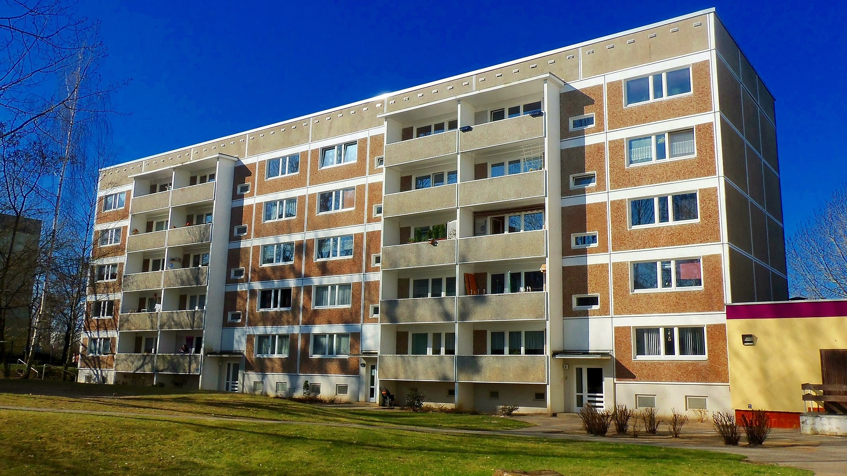
2 Week Move
After 2 weeks in the United States, the family moves from temporary housing to permanent housing in a new apartment.
Type in the Chat: What services does the case manager have to provide related to the move and why?
Notes:
Hint: Look at item 17 (NEW Home Visit report within 1 calendar day if case moved…) on the RF-24 for list of required items: Home Visit Form, Interpretation (HV only), Safety Checklist, AR-11 filing assistance

Slide 30
WITHIN 30 CALENDAR DAYS

Slide 31

Employment Services
The case manager meets with the family to discuss how the family can become self-sufficient.
Because Andre has work experience in the medical field, he is interested to get a job at a hospital. The case manager explains to Andre that while his past work experience and English skills are valuable, it may be difficult to obtain employment in the medical field at first. The case manager tells Andre his first job in the US might be in a different field.
To pay for all expenses, Mary will have to get a job too. However, she is worried about the cost of childcare in the United States.
Resource
4 Tips for Effective Employer Conversations

Slide 32

English Language Classes
During the employment appointment, Mary tells her case manager she wants to learn English before she gets a job. Joseph is offered ESL classes, but says he does not want to commit to them before he knows if he’ll be working or attending school.
The case manager explains both Mary and Andre would benefit from English classes and follows up to enroll them in an ESL program.
The case manager accompanies Mary and Andre to their enrollment meeting and helps them fill out the required paperwork. After a week, Mary and Andre begin attending English classes.
Type in the chat: What are some things the case manager should consider when enrolling clients in an ESL program?
Resources
Literacy Minnesota
Northstar Digital Literacy
Notes:
Question: What are some things the case worker should consider when enrolling clients in an ESL program? (put your answers in the chat / raise your hand to answer verbally)
Answers:
Location (where English classes are offered; should be close to family home or have access to transportation)
Time (duration for class attendance – English classes before they get a job; may not be able to continue after getting a job; Mary might be able to continue if she gets a part time job and Helene / Joseph looks after Pierre)
English level (ESL program should have classes for different levels; Mary knows no English while Andre knows some English)
Comfort level (case manager should accompany them to their first English class)
Additional Information:
Your office needs to assist all non-exempt adults with enrollment in English language programs
Clients can enroll in the office’s English language classes (if offered), ESL classes offered by a community college etc.
Assistance to enroll can include:
Providing information regarding English as a Second Language classes
Making referrals
Submitting enrollment information for the client(s)
Physically accompanying the client to the enrollment meeting
Factors to consider when enrolling clients in an ESL program:
Location (where English classes are offered; should be close to family home or have access to transportation)
Time (duration for class attendance – English classes before they get a job; may not be able to continue after getting a job; Mary might be able to continue if she gets a part time job and Helene / Joseph looks after Pierre)
English level (ESL program should have classes for different levels; Mary knows no English while Andre knows some English)

Slide 33

School Enrollment
The case manager connects the parents and Pierre with the agency's school specialist.
The school specialist enrolls Pierre in school, because he is 7 years old.
His brother, Joseph, is 19 years old, which means he reached Minnesota's school-leaving age.
His mother wants Joseph to go to college, but the family does not have enough resources.
Type in the Chat: What are some solutions the case manager can suggest for Joseph’s situation?
Resources
Raising Children in a New Country: An Illustrated Handbook
Raising Children in a New Country: A Toolkit for Working with Newcomer Parents
Notes:
For Joseph: GED, high school, working to save money

Slide 34
Selective Service Registration
Chatterfall!
Joseph decides to work for a few years until he can save enough money to go to college.
The case manager also helps him enroll in English classes with his parents.
Type in the Chat - True or False: The case manager completed all services needed for Jospeh
Resource
Selective Service registration online form
Notes:
Answer: False. Joseph is a male between the ages of 18-25 (he is 19 years old). This means he needs to register for the Selective Service by filling out an online form. The case file should include:
A case note documenting Selective Service registration
A copy of the Selective Service paperwork submitted on client’s behalf
If client moves within service period, additional case notes and forms indicating the client’s address was updated with the Selective Service
Additional Information:
If you have a case where a client is a male between the ages of 18-25, your office staff should assist the client to register for the Selective Service
All male clients, ages 18 – 25, need to register with the Selective Service
Staff should help clients who are eligible register by filling out an online form
Case file should include:
A case note documenting Selective Service registration
A copy of the Selective Service paperwork submitted on client’s behalf
If client moves within service period, additional case notes and forms indicating the client’s address was updated with the Selective Service

Slide 35
Cultural Orientation
The case manager schedules the adults in the family for Cultural Orientation, so the family can learn the knowledge and skills needed to adapt to their new lives in the United States.
During Cultural Orientation, the case manager covers all required Cultural Orientation topics with the family.
Type in the chat - True or False: The clients do not need to be assessed on their knowledge of Cultural Orientation topics
Resources
Cultural Orientation in Times of High Arrivals webinar (MRSConnect)
CORE Model CO Assessment
Cultural Orientation Resource Exchange (CORE)
SettleIn website

Slide 36
30-Day Home Visit
On a phone call with the case manager, Andre reports that he started working and that the family is doing well.
Based on this conversation, the case manager decides to count this as the 30-day home visit.
Type in the Chat -True or False: The agency is in compliance with the 30-day home visit requirement.
Resource
USCCB 30 Day Home Visit form (MRS Connect)
Notes:
Answer: False. To make sure the family is doing well, the case manager should complete the 30-day home visit in the client’s home. This is also to make sure follow up for services needed happened and to assess the welfare, living conditions, and needs of the refugee case members.
Additional information:
Staff need to complete a home visit by 30th day after arrival (best practice is to do the visit as close as possible to 30th day) to make sure family is doing well and follow up on any services needed
Staff can use USCCB’s 30 Day Home Visit form to assess the welfare, living conditions, and needs of the refugee case members
Staff should make a case note about the 30 day home visit and reference the USCCB (or the office’s) form in the case note. The form should be kept in the case file.

Slide 37
Social Security and EAD Follow-Up
The case manager uses the R&P Case File Monitoring Tool to track when the clients should receive their social security cards and EADs.
Within three weeks after arrival, the affiliate office receives the EADs and SS cards in the mail for all family members except Helene. What should the office do to follow up on Helene’s missing EAD and SS cards?
Zoom poll
If USCIS responds that Helene’s EAD was lost in the mail, USCIS may request that Helene file for a replacement EAD. Please review USCCB’s guidance around agency assistance with USCIS documentation.
Resources:
FY25 R&P Case File Monitoring Tool
USCCB guidance around I-765 completion – 11.12.24Resettlement Connection
Notes:
Zoom Poll:
What should the office do to follow up on Helen's missing EAD and SS cards?
SS card - contact local SS office and request appointment/follow-up
EAD - submit Helen's name to USCCB in monthly delayed-EAD spreadsheet
All of the above

Slide 38
WITHIN 90 CALENDAR DAYS OF INTERNATIONAL DATE OF ARRIVAL

Slide 39
Health Screening
The case manager schedules an initial health screening for the family to ensure everyone is in good health condition.
Helene also needs to receive medical follow up for her hypertension and mobility issues.
The health screening requires multiple appointments.
When the case manager calls to schedule the first appointment, the health clinic doesn't have an appointment available until the family’s 45th day in the U.S. Is this still compliant?
Resources
Understanding U.S. Domestic Medical Screening for Refugees and Other Newcomers webinar (Switchboard)
Medicaid non-emergency transportation
Notes:
Yes – health screening is still taking place within 90-day R&P service period. If health screening couldn’t be scheduled until after day 90, the case file would need to document the reason for delays, and document all discussions had with the clients/logistics about how they would attend the appointment.

Slide 40
Immigration Information
During an appointment, the case manager talks to the adults in the family about immigration information. The case manager explains permanent residency status as well as family reunification procedures.
Zoom poll
Mary wants to bring her father to the United States and file an Affidavit of Relationship (AOR). The case manager refers Mary to the agency's immigration team.
Resource
Family Reunification: Overview of the AOR (Affidavit of Relationship) Programs webinar (MRS Connect)
After a few weeks, the case manager calls Mary and learns that the immigration team explained the process and helped her fill out the AOR form.
Notes:
Zoom poll: What pieces of information should the case manager put in the case log related to this immigration service?
A) client expressed need to fill out AOR
B) providing information and referring Mary to immigration team
C) call with Mary mentioning completion of AOR application
D) A and C
Additional information:
Immigration information is different for refugees than for SIVs
Agency should discuss immigration information with each adult member of the refugee / SIV case
Refugee:
Permanent resident alien status
Family reunification procedures
Filing an Affidavit of Relationship (AOR)
Case log should document whether client expressed need to fill out AOR and how affiliate assisted with the process (providing information, making a referral, submitting application for the client, or physically accompanying the client to meeting about process)
SIV:
Family reunification procedures
Filing an I-130
Case log should document whether client expressed need to file an I-130 and how affiliate assisted with the process (providing information, making a referral, submitting application for the client, or physically accompanying the client to meeting about process)

Slide 41

Other Services
During an appointment, the case manager tells the family that Helene qualifies for Social Security Income (SSI) cash assistance benefits.
The case manager submits SSI enrollment information for Helene and accompanies her to the enrollment meeting.
Resource
Public Benefits for Refugees and Other Humanitarian Immigrants Overview Template (must have a Switchboard account)
Notes:
Question: Why does Helene qualify for SSI benefits? (put answer in the chat)
Answer: Helene is 66 years old + Helene has a disability (adults 65 and older qualify for SSI as well as adults with disabilities)
Additional information:
The case manager also separately determined that no one on the case is eligible for WIC benefits, because no one on the case is pregnant, a new mother, infant, or child younger than 5 years old.
Staff should help clients enroll in additional assistance services they qualify for, as applicable. This enrollment assistance includes
Providing information
Making a referral
Submitting enrollment information for the client
Physically accompanying the client to the enrollment meeting
Supplemental Security Income (SSI):
Provides cash assistance to adults who are 65 or older and/or disabled adults and children
If case has one or more members eligible for SSI, case log should clearly document the client(s) were assisted to enroll in SSI
Assistance to enroll can include providing information, making a referral, submitting enrollment information for the client, or physically accompanying the client to the enrollment meeting
Special Supplemental Nutrition Program for Women, Infants, and Children (WIC):
Provides assistance to pregnant women, new mothers, infants, and children up to age 5
If case has one or more members eligible for WIC, case log should clearly document the client(s) were assisted to enroll in WIC
Assistance to enroll can include providing information, making a referral, submitting enrollment information for the client, or physically accompanying the client to the enrollment meeting

Slide 42
R&P Period Report
On the 10th day after the end of the R&P period, the case manager fills out and submits the R&P period report in MRIS. This report captures client info at day 90.
The case manager also makes a case note that the report was submitted and that the case is closed.
Chatterfall!
True or False: Filling out the R&P Period Report on the 10th day after the end of the R&P period is in compliance with USCCB requirements
Resource
Improving R&P Period Report Accuracy e-learning course (MRS Connect)
Notes:
Answer: False. The R&P Period Report needs to be submitted in MIRS within 7 days of the end of the R&P period
Zoom poll: What steps did the case manager miss when completing the R&P period report process?
A) No meeting with the family to explain the case closure (also correct, but not required)
B) No documentation in case file about case closure conversation with the family (also correct, but not required)
C) Case note is missing the date of submission in MRIS (correct and required)
D) No copy of the USCCB approved R&P Period Report in the case file (correct and required)
Additional information:
End of service report that captures all services provided during R&P period
This report determines:
All R&P core services were made available to the refugee in accordance with the R&P Cooperative Agreement
Whether the refugee household had income in excess of expenses at the end of the R&P period
That each refugee was enrolled in other appropriate social services as needed
Also captures each refugee’s social security number
Agency needs to submit this report in MRIS (alerts tab -> double click on R&P Period Report for __case #____ to open the report) within 7 days of end of R&P period
Report should be corroborated by evidence in case file and by documented conversations with the clients. A case note should indicate date of submission in MRIS, that the report has been submitted, and that the case is closed. A copy of the USCCB approved R&P Period Report should be kept in the case file.

Slide 43

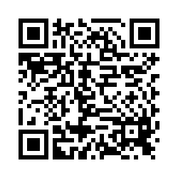
https://Qualtrics.ca1.qualtrics.com/jfe/form/SV_cGaaiIY0Qzn4blQ
Feedback Survey
Questions?
Please put questions in the Q&A box or raise your hand.
Notes:
Thank you everyone for your participation today (we covered a lot!)
Reminders:
- Meeting recording and power point slides will be put up on MRSConnect in the next few days
- Be on the lookout in the Resettlement Connection newsletter for the following webinars in this onboarding series (next webinar is on
I will stay on the call for 5-10 minutes for anyone who has any outstanding questions. If you don’t have any questions, feel free to hop off and thank you again for your time!

