Slide 1
FY25 Network Call
December 4th, 2024

Slide 2
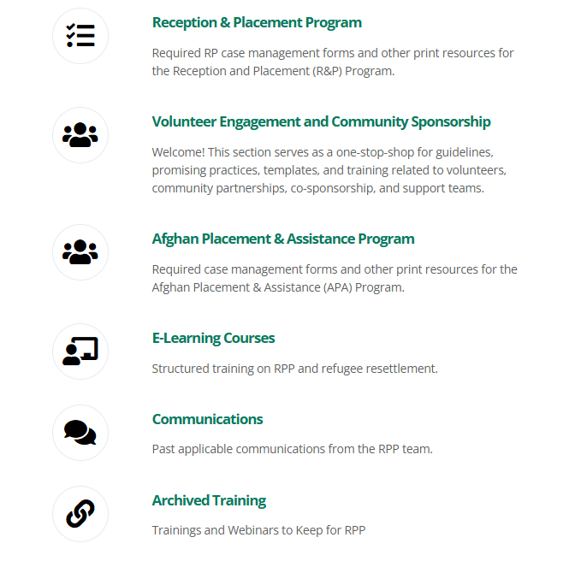
Webinar Recording on MRSConnect
All webinars for the fiscal year are saved under Archived Training.

Slide 3
Introduction
Rebecca Hailemeskel
MRS Assistant Director, Remote Placement and Outreach
Pollycarp Odoyo Lyes Benarbane
Remote Placement Coordinator Remote Placement Specialist
Nathaniel Boorom Tiara Njie
Remote Placement Coordinator Remote Placement Coordinator

Slide 4
Agenda
FY24 Recap
Collaboration Opportunities
FY25 Presidential Determination Update
FY25 R&P Program Update
FY25 Cooperative Agreement Update
FY25 Funding Update
New Initiatives
Q&A

Slide 5
FY 2024 Recap
USCCB onboarded five new RPCPs
Valley, AL
McKinleyville, CA
Biloxi, MS
Forest, MS
Columbus, MS
69 cases/204 individuals resettled
65 cases/194 individuals – UST cases
4 cases/10 individuals – NUST cases

Slide 6
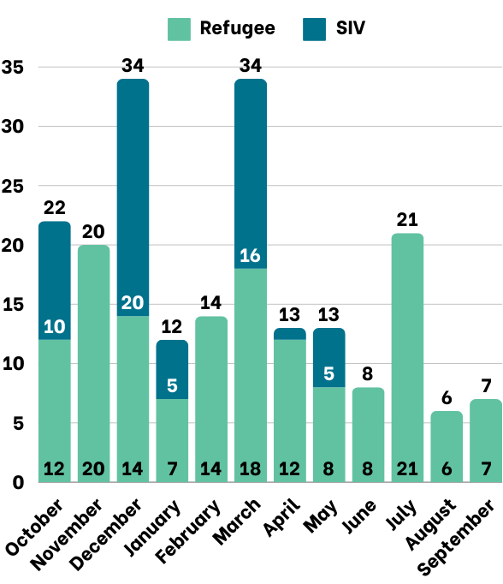
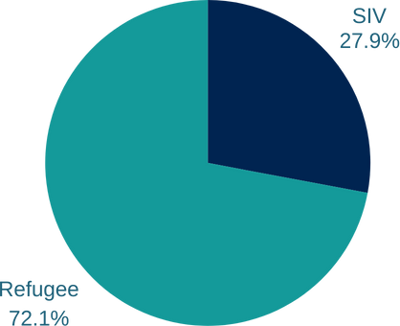
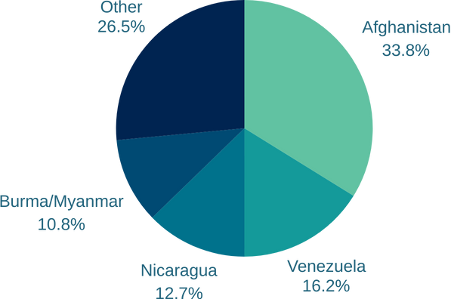
FY 2024 Remote Placement Arrivals
Arrivals by Month
Refugee & SIV Arrivals
Arrivals by Nationality

Slide 7
Collaborative Efforts
RPCPs Newsletter Contributions
Opportunity to share the following via the newsletter:
Accomplishments/Success Stories/Testimonials
Challenges Faced and Lessons Learned
Best Practices
Reminder: Read the weekly newsletter for important program updates!

Slide 8
Presidential Determination Update
Signed by President Biden on September 30th, 2024
The President-elect has remarked that he will reinstate a moratorium on travel to the United States come January
It is not clear if or when resettlement would be resumed if it were stopped at the beginning of his next term
Admissions target of 125,000 refugees over the next year
This target will likely be significantly reduced. It is possible that Trump will set the new target to a number that meets our current number of national arrivals
Expected to receive an increased caseload of the Latin American population
During the first Trump Administration, the historical allocation of refugee admissions by region was replaced with an allocation based on certain characteristics, such as those persecuted on account of religion; it is possible there will be a return to allocating admissions in this way

Slide 9
FY25 R&P Program Update
R&P Funding
Anticipate to likely receive full FY25 funding on next Cooperative Agreement for HQ and affiliate staff, should be early January.
If received, USCCB will continue to provide payments to partners under normal procedures
This is not set in stone until we officially receive the funding from PRM

Slide 10
FY 2025 Cooperative Agreement Update
72-hour window for initial home visits to be completed unless any of the following apply:
no affiliate staff/volunteer present at airport; or
no case members have access to a phone; or
the case includes an ARM (M2, M3, M5, or M6)
Quarterly Consultations to be completed at least twice during the fiscal year
Refugees must now receive assistance to change their address via individual myUSCIS accounts on my.USCIS.gov
Contact your assigned Coordinator for further questions/assistance
Clarification of service due date: PRM requires that the service process begins, not necessarily has to be completed by the deadline
Increased client and administrative per capita amounts

Slide 11
Funding Updates
Updated per capita amounts:
Client direct assistance: $1650 per case member
Administrative per capita: $1350 per case member
Discontinuation of ADA and ERMA funding
Other available resources
Refugee Resettlement Emergency Housing Relief Fund
Reach out to your assigned Coordinator for more information

Slide 12
New Programs/Initiatives
New database system coming soon
MRIS will be discontinued
IRIS will replace MRIS
Individual site capacities to be collected for FY 2025

Slide 13
TA Team Introduction
Negena Haidary
National Housing Coordinator
NHaidary@usccb.org | (202) 541-3154
Provides technical assistance and resource hub for Refugee Housing (trainings, COPs, etc.)
Elena Tothazan
Cultural Orientation Coordinator
ETothazan@usccb.org | (202) 541-3220
Provides technical assistance for Cultural Orientation and Accountability to Affected Populations
Sarah Evans
Assistant Director, R&P Training
SEvans@usccb.org | (202) 541-3385
Supervises R&P TA team, leads on escalating R&P clients’ documentation issues to federal partners
Kim Lemieux Gonzalez, LGSW
Refugee Child Protection Coordinator
KLemieux@usccb.org | (202) 541-5408
Provides training and technical assistance on attached refugee minor (ARM) cases, ARM evaluation review
Masuma Ebrahimi
R&P Data Specialist
MEbrahimi@usccb.org | (202) 541-3268
Provides training and technical assistance with R&P Period Report and locating I-94 forms

Slide 14
Upcoming Webinars
R&P Program Refresher Webinar
Webinar topic suggestions (Please share your suggestions in the chat)

Slide 15
Questions?
Please add questions to the Q&A box or raise your hand.

