Slide 1
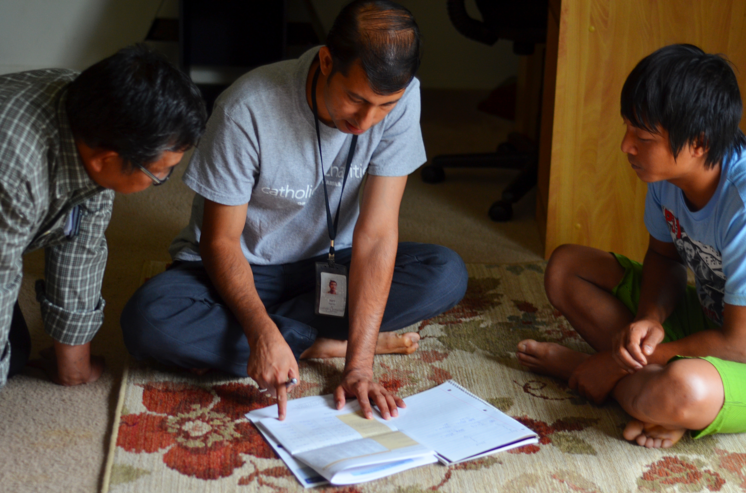
Combating Misinformation in Resettlement
December 10, 2024

Slide 2
Today’s Agenda
1
Learning Objectives
2
Common Client Misinformation Overview
5
Resources
3
Expectation Management Strategies
6
Q&A
4
Affiliate Guest Speaker Strategies

Slide 3
Identify common misconceptions that clients bring into their resettlement process
1
Learning
Objectives
Describe strategies USCCB/MRS affiliates have used to successfully reframe client expectations
By the end of this session, you will be able to:
2
Outline how your agency will equip staff to manage misinformation and unrealistic expectations from clients, especially around housing
3

Slide 4
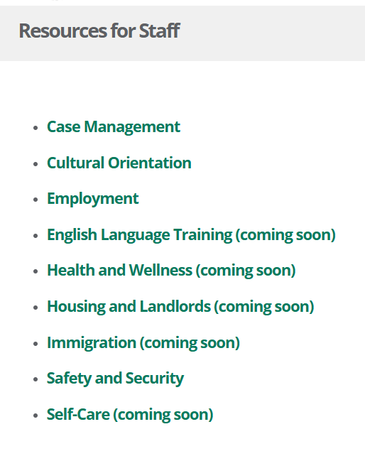
Webinar Materials on MRSConnect
All webinars are saved on our new
Staff Training tile.
Today’s webinar will also be saved on our Resources for Staff tile under
Case Management.

Slide 5
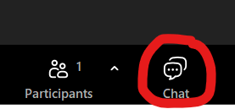
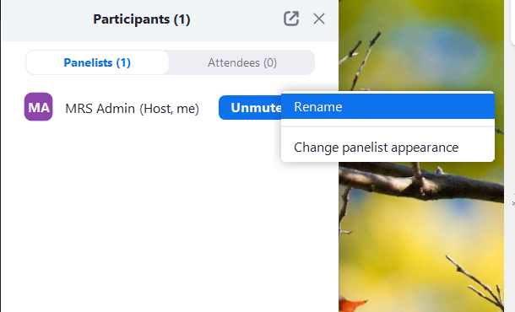
Zoom Features
CHAT
Q&A BOX
RENAME

Slide 6
Common Client Misinformation Overview
A
B
Role of the Resettlement Agency and Case Manager
Resettlement agency should provide services or materials outside the R&P program requirements
Resettlement agency should be responsible for all expenses (rent, utilities, etc.) for 3 months, 6 months, 1 year etc.
Case managers should always be responsive, including outside normal business hours
Housing
Clients have high housing expectations (ex: getting a house instead of an apartment, having multiple housing options etc.)
Clients refuse agency-selected housing despite initially agreeing, which may result in lease termination and burning bridges with landlords
Clients expect the resettlement agency to cover financial penalties due to breaking a lease or damaging property
C
D
E
Public Assistance & Budgeting
Clients expect the same services and public benefits as refugees resettled before them or resettled in other U.S. states
Clients expect high level of financial assistance and lack understanding benefits vary from state to state, are limited and based on resettlement agency programs and capacity
Public Transportation
Some clients believe they will be provided with a car after arrival. Non-US tie cases compare experiences with US tie cases, who have a US tie who can provide transportation and / or a car.
Cultural Adjustment
Clients are shocked by U.S. cultural norms, such as women needing to work for the family to become self-sufficient

Slide 7
Notes:
Can view the CORE Cultural Adjustment U-Curve here: https://coresourceexchange.org/wp-content/uploads/2020/02/Cultural-Adjustment-U-Curve.pdf

Slide 8
Expectation Management Strategies
Set clear expectations from the beginning
All staff should be aware of and repeat the same messaging
Show long term impact of current decisions
Review client rights and responsibilities policy
Provide accurate educational resources early in the service period (i.e. SettleIn)
Communicate achievable goals and timelines

Slide 9
Expectation Management Strategies
Ask questions and guide the conversation while implementing trauma informed approach
Practice empathetic listening & responding with concern and reflective statements
Foster open communication
Respond with empathy instead of only correcting
Use a strengths-based approach and refer clients as needed

Slide 10
SCR Affiliate Strategies
Utilize community leaders to:
Relate to clients culturally and linguistically
Address specific misconceptions about the R&P program
Act as a bridge between the clients and resettlement agency
Create avenues for client engagement by:
Organizing workshops for clients to learn about R&P and ask questions
Collecting and using client feedback
Collaborating with local organizations

Slide 11
Sacramento Affiliate Strategies
Address misinformation in Cultural Orientation by:
Managing expectations
Showing ways misinformation can spread
Using knowledge as a tool
Keep information consistent and build client trust by:
Ensuring frequent and clear communication between staff members and between staff and clients
Defining staff roles and responsibilities

Slide 12
Equipping Staff to Manage Expectations
Reflect on the strategies discussed today and choose ones that fit your context
Ensure all staff are trained on client rights and responsibilities shared at intake
Create and provide scripts for staff to handle common client questions, using a shared document for consistency across the team
Use MRS Connect resources to adopt and train on relevant strategies for combating client misinformation
Regularly test staff knowledge and responsibilities, integrating this into annual training plans

Slide 13
Resources
Strategies to Combat Client Misinformation USCCB/MRS resource on MRS Connect listing out specific client misconceptions (grouped by CO topic) and strategies to combat those specific misconceptions. Don’t forget to use the Roles and Responsibilities Visual Task List Example underneath the strategies resource!)
Service Delivery Approaches when Working with Refugees: CORE learning opportunity for staff to understand different approaches to delivering services
Switchboard Motivational Interviewing Podcast: learning opportunity on different methods and strategies to providing services and working with clients in difficult situations from a social worker perspective

Slide 14
Resources
Navigating Identity and Inclusion in Refugee Resettlement: CORE training course for staff to reflect on their own identity and how this affects their interactions with clients from different backgrounds.
Overseas CO Objectives and Indicators: CORE resource showing what refugees are expected to know after completing overseas CO. This can be used to repeat and reinforce the information clients are learning in overseas CO!
Housing Policy : USCCB launched a template for local offices to customize and adopt as an agency housing policy. This introductory document is best used to mitigate challenges associated with misunderstanding R&P housing services.

Slide 15
What is one strategy you learned today that you will use moving forward?

Slide 16
Questions?

Slide 17
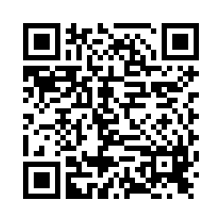
Please share your thoughts.
Anonymous Survey
You can scan this QR code with your phone’s camera.
Or, there is a link to the same survey in the chat.
Notes:
7

