Slide 1
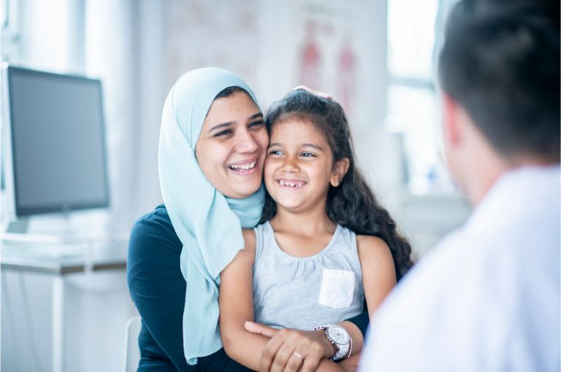

FY25 Q1 Cultural Orientation Community of Practice (CO CoP)
November 19, 2024

Slide 2
Today’s Agenda
CO Updates
Working with Latin American Clients in CO
1
2
Open Space
Q&A
3
4

Slide 3

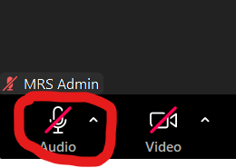
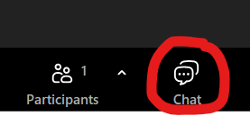
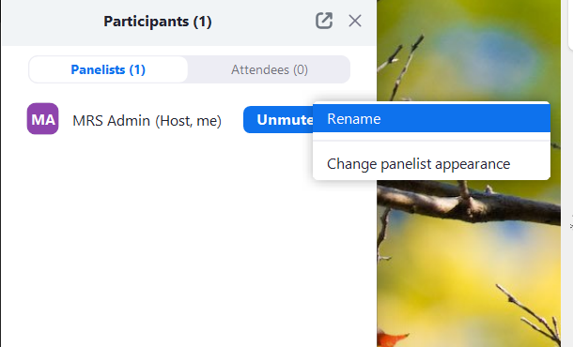
Zoom Features
CHAT
MUTE / UNMUTE
RENAME

Slide 4


Over the past 3 months, what have you been working on for CO?
ⓘ Start presenting to display the poll results on this slide.

Slide 5

USCCB/MRS CO Updates
Affiliates with the highest CO CoP attendance for FY24:
Catholic Charities of Louisville
Catholic Charities of Southern Nevada
Catholic Charities of Oregon
Catholic Community Services of Utah

Slide 6
USCCB/MRS CO Updates
CO / AAP Needs Assessment Summary Results
63% have a person dedicated to CO
~ 50% have 0-2 years of experience and the other 50% have 3+ years of experience
Overseas CO updates from RSCs

Slide 7
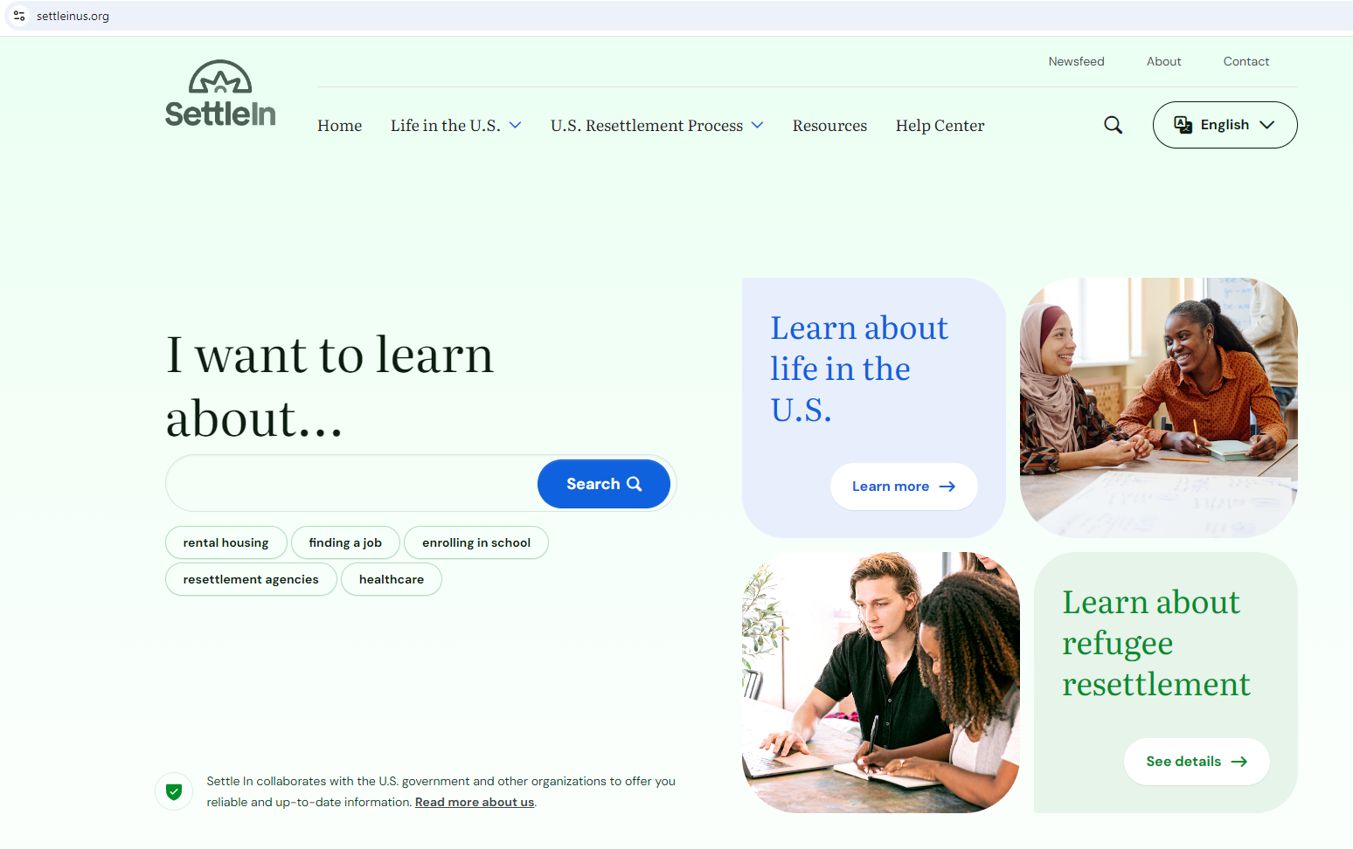
CORE CO Updates
Sign up for the CORE Connection newsletter to stay updated!
Settle In website redesign!
CORE CO Assessment Revisions Task Force updates

Slide 8

Discussion: Working with Latin American Clients in CO

Slide 9
LAC Survey Results Overview
SUCCESSES
Clients want to work and find jobs right away after arrival
Easy community integration due to existing Latino communities in the U.S.
Clients are open to learn and adjust easier to life in the U.S.
Engaged and willing to participate in R&P
CHALLENGES
Lack of English language skills
High housing expectations; outmigration; and inappropriate noise levels
Difficult employment for single mothers; documentation delays
Difficulty understanding U.S. gender roles and punctuality
Confusion about benefits among mixed-status households
ETC.

Slide 10
LAC Survey Results Overview
HELPFUL DOMESTIC CO INFORMATION
Importance of learning English
Understanding landlord relationships and retaining first housing
Accepting first job offer, job seeking strategies and skills, babysitting services for single parents
Understanding laws about domestic violence and child neglect
Understanding public assistance eligibility based on legal status in mixed-status households
Trusting civil authorities for personal safety

Slide 11
Strengths
Challenges
Language barrier
Using public transportation, work shifts and security at night
Harder for them to know their rights based on their legal status
and how to communicate their legal status and rights to the
community (especially in border states where Latino population
is undocumented and not many had refugee status before)
Solution: affiliate office re-training local community service
providers (public benefits office, hospital and health clinic etc.)
about what refugee status is as a legal status and what services
clients have a legal right to because of their refugee status
Obtain employment right away after arrival (sometimes two jobs),
so no time for ESL, CO, etc.
Housing rules, relationship with landlord
Difficulty navigating the healthcare system
Eagerness and appreciation to come to the U.S.
Basic knowledge about use of email
Family values Resilience Open-minded
Cultural pride Ambitious Eager to learn
Willing to work any job and work hard
Clients are more laid back than other client groups
Openness / more familiarity about U.S. culture
Eagerness to learn English
Easier to integrate (employment) into the community
due to existing Latino population

Slide 12
Strengths
Challenges
No certificates for professional experience and needing to start
from zero when it comes to employment / (re)certification in the
same or different professions for clients
Solution: affiliate office opening up and offering professional
or re-certification opportunities / classes for clients outside of CO
(ex: classes for clients to recertify as beauticians)
Family separation (poor mental health because they miss family)
Hard for single moms to work because of daycare needs
Adjustment to a new system
Difficulty using transportation
Solution: creating a step-by-step video to show how to take
local public transportation system (CO providers translated /
had voiceover for the video in Spanish)

Slide 13
Best Practices
Resources

Slide 14
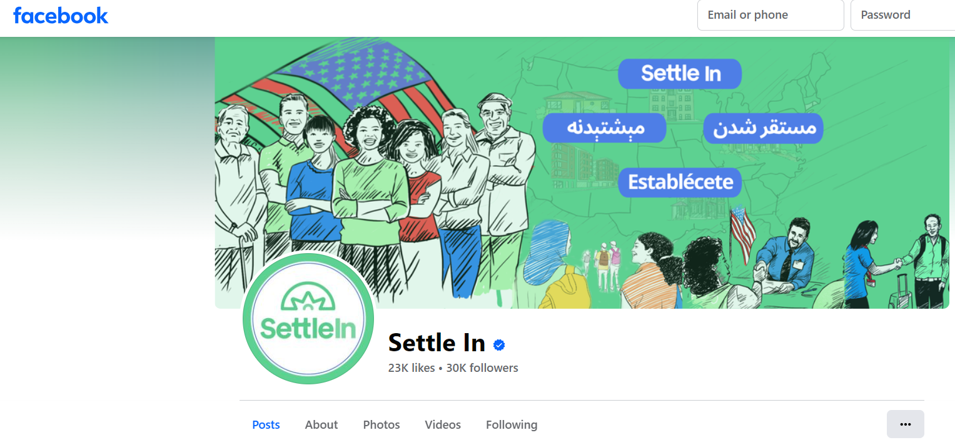
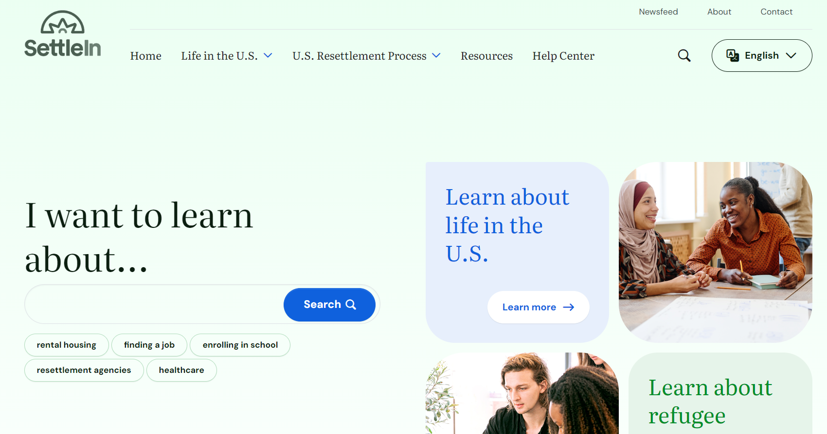
Helpful Resources
Settle In website: videos and other resources on CO topics in Spanish
Settle In Facebook page: live videos and two-way communication on CO topics with Spanish-speaking clients. Refugees can message the Settle In Spanish-speaking team via Facebook Messenger. Clients can watch previous live events in Spanish.
Settle In Help Center: resources and content in Spanish
Outside of working with Latin American cases, see the Cultural Competency and Soft Skills Trainings & Resources resource on MRS Connect for serving clients with different backgrounds

Slide 15
Open Space: Questions / Thoughts for the Group

Slide 16
Reminders
Last CO CoP Meeting Poll Results:
Frequency: quarterly
Format: big group and small group discussions
Topics (tentative):
Working with Latin American Clients (Q1)
Family Reunification / AORs (Q2)
Budgeting and Employment (Q3)
Cultural Adjustment (Q4)
CO CoP Recordings and Presentations on MRS Connect:
Reception & Placement
R&P Topics
Cultural Orientation
Community of Practice Calls

Slide 17
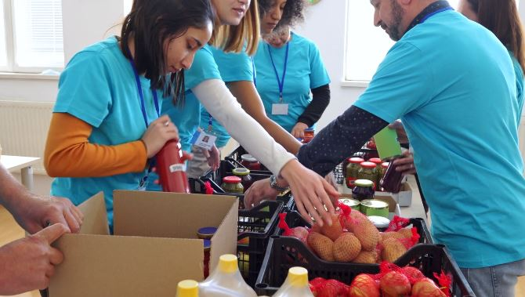
Questions?
Email etothazan@usccb.org
Next CO CoP meeting: February 18 @ 3:00pm EST

