Slide 1
Best Practice for High Needs Cases

Slide 2
Meet the Presenters
We Speak YOUR Name of Central Florida, Inc.
Leticia Ubillus, MS
Gisella Ubillus, MSW
Catholic Charities
Diocese of Arlington
Cindy Aldana, MSW
Jennifer Hernandez, BSW

Slide 3
Inter-collaboration
Working with external and internal organizations:​
Schools
Child Protective Services (CPS)
Law Enforcement
Clinics
Shelters
Outside organizations
Inside your own agency
Notes:
Inter-collaboration is crucial when working with high-needs clients. A few organizations that we have collaborated with to better serve our clients have been in schools, CPS, law enforcement, clinics, shelters, outside organizations, and inside our own agency. A few examples when working with schools are when we speak with the school’s registrar, school social worker, or the family liaison. With CPS, we have worked closely with the CPS caseworker when cases have been screened in by providing additional information or by mediating between the sponsor and the CPS case worker. Regarding law enforcement, we have worked closely with police officers/detectives to provide additional information regarding a youth runaway or when cooperating with open investigations involving the sponsor or the youth, and also providing psychoeducation to law enforcement regarding USCCB and ORR policies. We have collaborated with local low-cost clinics by providing referrals to our clients. Within our own agency, we have collaborated with other programs, such as Hogar Legal, CCDA food pantries, and Education Workforce and Development, by providing referrals on a needs-based basis. An example of working with outside organizations would be referring clients to Food for Others and Women Giving Back, along with many other outside organizations.

Slide 4
How to build trust and rapport
Knowing your client and their needs
Communication
Reliable
Emotional support
Recognize client’s individualities
Professionalism
Notes:
A few ways we case managers can build trust and rapport with clients are by knowing our clients and their needs, communicating with our clients professionally and effectively, being reliable, supporting the client emotionally, recognizing our client's individualities, and being professional. For example, when a case manager is assigned a case, the case manager should review the client’s ORR documents to assess if there are any Child Level Events (SIRs) or medical and mental health concerns, as well as their background, before initiating contact with the sponsor/youth. During the initial home visit, the case manager should speak with the client and assess the client and their needs without assuming the client’s needs. During the home visits, we enjoy asking the sponsor and youth about their interests and their hobbies. This allows us to be personable with the client and to eliminate any fears the client may have with social workers. Sometimes, clients fear social workers because of the misconception that social workers “take children away”. Some examples of when we have demonstrated emotional support would be when the case managers have gone to the sponsor’s home to mediate conversations between the sponsor and the youth or between HHMs if needed, attending school hearings, medical appointments, or court hearings if asked by the sponsor. It can be difficult to provide additional in-person support to clients depending on the case manager’s caseload, but this allows the case manager to build a professional relationship between us and the clients. It is important to understand that all of our clients are individuals and may have encountered different traumas and obstacles in life.

Slide 5
Confidentiality
Mandated Reporters
Follow State CPS guidelines
Follow USCCB protocols (United States Conference of Catholic Bishops, 2024)
Follow your agency’s protocols
What would you do as the case manager?
There is currently an open investigation against the youth. Jerry (age 16) disclosed to the case manager that he had sexual relations with a minor (age 12), but he did not disclose the information to the detective. Should the case manager contact the detective and disclose the information the youth disclosed to the case manager?
Notes:
During client interaction, the case managers should inform the client that everything shared between the client and the case manager is confidential UNLESS the client is at risk of harming themselves or if anyone else is in danger. As case managers, we are mandated reporters; therefore, we must report any incidents of child abuse to CPS. The case managers should review their state-mandated reporter guide. Additionally, it is best practice for the case manager to review and follow their agency and USCCB protocols.
We would like to hear from the audience. What would you do in this situation as the case manager? Would you break client confidentiality, or would you keep the conversation between you and the client confidential?
Cindy will talk about her case and the steps she took.

Slide 6
Barriers and Limitations
Cultural differences
Clients suffering from cultural shock
Language
Indigenous languages
Lack of resources available to clients who do not speak English
Economic barriers
Pro-bono attorneys are at capacity, and the sponsors are unable to hire private attorneys
The sponsors work longer days and hours
Stigmas
Mental health
Misconception between the sponsor’s community regarding schools and court hearings
School enrollment
Sponsors are having difficulty in enrolling youths who are aging out
Online enrollment
Notes:
Certain barriers and limitations our clients face can include cultural differences, different languages, economic barriers, stigmas, school enrollment, etc. Regarding cultural differences, we have experienced youths who come to the United States and experience cultural shock. For example, we had a youth who was experiencing anxiety at her new school due to being in a new environment with people from all different backgrounds. The case manager provided psychoeducation to the youth regarding cultures and bullying and provided the youth with reassurance. Additionally, the case manager created a safety plan with the youth regarding reporting protocols within the school.
Regarding language barriers, the case managers have ensured that the sponsor and youth are provided with post-release services in their preferred language by contacting the ORR language line, cyracom, or colleagues within our agency.
Regarding economic barriers, we have encountered sponsors becoming frustrated with the lack of response from pro-bono attorneys due to full capacity. The case managers have provided reassurance and encouragement for the sponsor to continue calling. The case managers have also provided psychoeducation to the sponsor by leaving detailed voicemails and continuing to advocate for the youths. Additionally, the case managers will continue to provide additional legal resources for the sponsor to call. Due to the sponsor’s financial circumstances, sponsors have to work longer hours. Therefore, the sponsors have less availability for appointments such as medical, mental, school, or PRS home visits. The case managers will do their best to accommodate the sponsor’s work schedule by scheduling home visits in the evening after the sponsor gets off of work or during the weekend.
We have experienced some clients portraying mental health negatively due to a lack of understanding. We, as case managers, work to provide psychoeducation regarding the importance of seeking mental health services and by labeling mental health in a positive way. We have provided referrals to mental health clinics depending on the youth’s needs, resulting in the sponsor and/or youth being connected to mental health services.
With school enrollment, we have faced barriers with our youths who are close to aging out due to the schools' presenting obstacles towards the sponsor. For example, some schools require sponsors to obtain legal guardianship before the sponsor can enroll the youth in school. Some schools require the sponsors to have their names on the lease. Some clients are unable to obtain this because they are subleasing. HS/PRS CCDA has connected with family liaisons and the local welcome centers to try and build professional relationships to facilitate a smoother process for the families.

Slide 7
Documentation
Coverage Plans: What CC-Arlington does when a case manager goes on leave or on vacation​
Case Notes: Working with high needs cases, it is very important to update case notes each time there is client interaction or talking with outside organizations.​
Remembering the five W’s
Who, what, when, where, why, and how
Authorization for Release of Records (A-5 Form)
Notes:
Working with high-needs clients may require more attention to case notes. Documenting all communication pertaining to the case is very important. Case aids provide additional support to our case manager by ensuring that all documentation is accurate and free of errors. An example of one of our cases was when a youth had an open investigation by the local law enforcement, and the detective on the case asked to view the youth’s case notes and NOCs. The case manager kept the case notes up to date after every interaction with any party involved in case there was a search warrant. Additionally, the case manager worked closely with the program director, who then consulted with the agency’s legal counsel.
Cindy

Slide 8
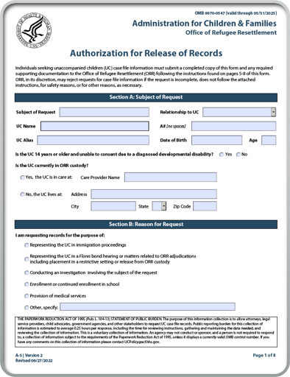
Authorization for Release of Records A-5
UCRecords@acf.hhs.gov
Ask your CSS for this form when needed
Notes:
Subrecipient staff are not to release Personally Identifiable Information (PII such as name and/or A#) to people who are not the child or sponsor without the sponsor's consent. Please see ORR Policy 5.10.1.2 which further elaborates on the policy. ​
If another government agency or law enforcement requests this information, they will be required to have the sponsor sign an A-5 form. There are instances in which ORR may release, or approve sharing of PII without an authorizing signature, however, these instances are rare.
The asking party (detective/attorney/etc) will need to fill out the form and it is critical that the sponsor’s signature is obtained in order for the asking party to receive the document requested. The asking party will need to email it to the on-screen email.
Cindy

Slide 9
Best Practice for Our Team
Coverage Plans: What CC-Arlington does when a case manager goes on leave or on vacation​
Case staffing among colleagues ​
Notes:
To keep our team organized and prepared for when a case manager is on leave. The case manager will create a document (coverage plan) with a synopsis of all the high-needs cases in case the client reaches out to the designated case manager on standby. The case manager will provide their clients with the designated case manager’s work contact information. Before the case manager leaves, the case manager must ensure that all case notes are updated with the most recent contact.
When one of our case managers has a complex case in which they need additional support, the case manager will reach out to our colleagues to staff the case to obtain feedback or to inquire about different approaches to best assist our clients. When the case becomes too complex, we reach out to CSS for further guidance. Shoutout to Katie for always providing support <3.
Cindy

Slide 10
Boundaries
Turning off our work cellphone during out-of-office hours and on the weekends
Letting clients know our work schedule
Giving our clients a list of emergency contacts
Self-care
Notes:
A few examples that we do as case managers to set boundaries with our clients is to turn off our cellphones during out-of-office hours and on the weekends to prevent burnout and client enablement. For example, if we answer a client’s phone call in the late evening or on the weekends, the client might think that the case manager may be available 24/7.
Reminding the clients of our work schedule has helped tremendously in avoiding non-emergency phone calls during out-of-office hours.
With the help of our case aids, the case aids created a cheat sheet with a list of emergency phone numbers such as 911, the local non-emergency police department number, the 988 Suicide and Crisis Lifeline, the Poison Control phone number, NCMEC, the ORR hotline, and the EOIR hotline. The form also has the steps the sponsor must take when they are calling the specific phone numbers. On the back page of the document is a list of important tips for keeping in contact with the case manager.
Self care is SUPER important when working with high needs clients. It can be extremely difficult to hear our clients stories and not want to take it home with us. However, it is important to always practice self-care to avoid vicarious trauma and burnout. A few examples that we enjoy doing are spending time with our loved ones or our pets, reading, doing fun activities, binge-watching our favorite shows, building legos, or hanging out with our team outside of work hours.
Jen

Slide 11
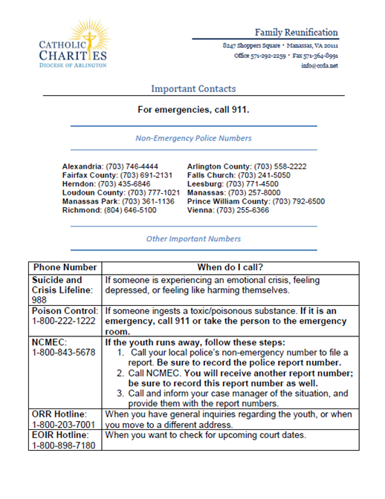
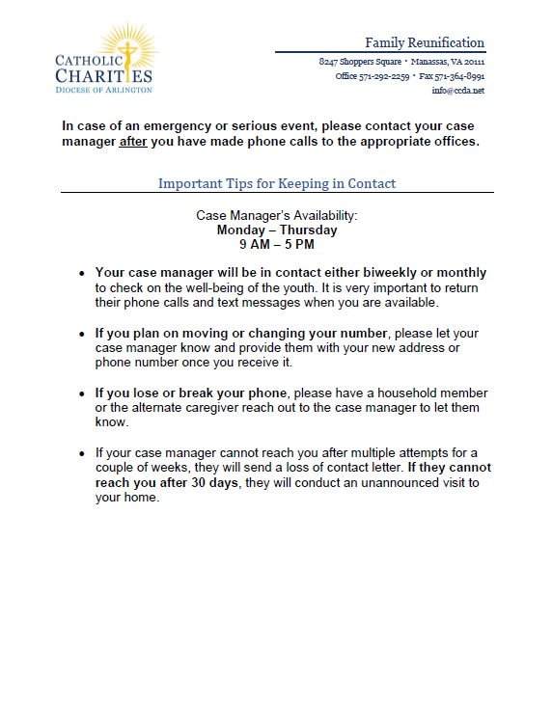
Notes:
Jen

Slide 12
Trauma-Informed Care Trainings
Trainings/resources available to case managers:​
ORR Learning Center​
Switchboardta.org
Notes:
Here are a few websites that offer free trauma-informed trainings.
Cindy

Slide 13
Introduction
Our Mission
To increase the quality-of-life and self-sufficiency of individuals, families, and communities confronted by social, cultural and economic challenges through the power self-advocacy.
Our Vision
To create a shared culture of respect, acceptance, and stability for everyone.

Slide 14
Initial Assessment
Review Records:
Case managers and clinical supervisors begin with a thorough review of the existing records focusing on the reason for referral with a sharpened lens that targets safety and wellbeing.
Individualized Plan:
Here is where the critical thinking begins. A preliminary plan is developed that includes consideration to the community and the geographical location of the family, the language spoken, the socioeconomic status of the household, and sponsor’s and the support network’s capacity to navigate resources.
Notes:
This is the general scope of the process to identify what are those High Needs that need to be targeted from the onset of the case assignment. Of course, the assessment process continues through the life of the case with each and every interaction.

Slide 15
Building Relationships
Partnerships:
WSYNCF partners with local organizations to facilitate access to services.
Care and Compassion:
Emphasize the importance of care and compassion in building these relationships.
Transmitting the commitment with the population served.
Notes:
Speak to how and what it takes to establish and maintain relationships that begin and end with the people WSYNCF serves. There is a clear understanding with those we partner with about the needs and the sponsor and minor are clear that they are supported to the maximum degree possible.

Slide 16
Navigating Resources
Community Resources:
Identify the appropriate resources that best fit the need.
Utilizing community resources effectively.
Support Systems:
Building strong support systems with alternate caregiver, family and friends, and external stakeholder for minors and sponsors.
Notes:
Expand on what it means for WSYNCF to identify community resources for High Needs cases in a way to models for families ways to trust, utilize, and follow through with the network of community resources needed to meet what are urgent or life saving interventions. There is value in expanding the knowledge beyond the sponsor and the minor in most instances because at WSYNCF we understand that it takes 360 degrees of support to meet emerging needs and heal physically, mentally, and emotionally.

Slide 17
Case Management Team
Roles:
Care Manager and Care Aide Specialist work in unison.
Coordination:
Ensuring coordinated efforts to secure access to high needs services.
Follow up with the specified high-risk need(s) within 48-72 hours.
Notes:
SO what does it take from an organizational lens to meet these High Needs? Our approach is….

Slide 18
Meeting High Needs- Examples
Need for neurologists
Access
Providers within the WSYNCF understand the population served and exercise a commitment to do the ‘most good’.
Need for prescription medication
Providers share the values of WSYNCF- responsive, trauma informed, culturally equipped, and ready to meet the needs in hand usually at moments notice.
Medical Needs
Notes:
How WSYNCF ensures access to necessary medical services.

Slide 19
Mental Health and Behavioral Needs
Assessment:
Identifying mental health and behavioral needs.
Interventions:
Strategies for effective interventions and support.
Notes:
Keep or delete. I was not sure what to add or edit from this one. You can acknowledge that medical need is one aspect and that there are time when Behavioral and Mental health need are urgent making them high needs. Once you decide- change the bullets in the slide.

Slide 20
Success Stories
Examples:
Share success stories of high needs cases managed by CCDA.
Impact:
Highlight the positive impact on minors and their sponsors.
Notes:
Jennifer:
The youth disclosed to the case manager that she no longer wanted to live with the sponsor because she was being forced to work. Additionally, the youth disclosed to the case manager suicidal ideations and a history of self-harm. The case manager provided emotional support to the sponsor, youth, and caregiver to mediate between all parties. The case manager reported the allegations to CPS, called the 988 Suicide and Crisis Lifeline, and also submitted an OTIP. The case manager successfully connected the youth with a case manager at the Ethiopian Community Development Council (ECDC). The caregiver confirmed that she submitted an application for Medicaid and financial assistance. Additionally, the youth stated that has received additional financial support through the ECDC case manager.
Cindy:
The youth moved out of state with her aunt since there is an active CPS investigation against the sponsor for alleged sexual abuse. I have been checking in on the youth and the new caregiver on a weekly basis and provided local food pantry resources. In October, the youth shared that the new caregiver would need to move out of her apartment by 10/22/2024, leaving the youth without a placement. I have been researching housing resources for the youth until I got connected with the Latin American Youth Center (LAYC) Host home program. They are able to help out with my youth and will soon conduct an intake with the youth.
The shelter case manager submitted an OTIP referral regarding the youth’s case. The shelter case manager emailed this CM to update that the youth is OTIP eligible and provided a digital copy of the letter. This CM met with Christina Manzanares (Region 3 Coordinator, Trafficking Services) to connect the youth with an ASPIRE case manager to help the youth apply for the benefits he is eligible for.

Slide 21
Carmen’s Story
Carmen
Age: 15 years old
COO: Guatemala
Sponsor: Cat 1 (Mother)
High Need identified:
The minor suffers from epileptic seizures
Notes:
Give examples

Slide 22
Impact on Carmen and her support system
Notes:
What was the impact?

Slide 23
Summary
Record review and assessment are vital for identifying high needs.
Creating an individualized plan requires critical thinking and action.
Strong relationships and a supportive network of caregivers, family, and professionals are essential.
Equipping the care team with resources and fostering teamwork between the Care Manager and Case Aide Specialist is crucial.
Celebrating positive outcomes, such as Carmen's story, highlights our shared commitment to success where safety and wellbeing needs are met.
Notes:
Q&A

Slide 24
Conclusion
Inter-collaboration is crucial when working with high needs cases.
Building trust and rapport with the client is essential for getting to know your client and their needs.
Remembering client confidentiality but also understanding that as case managers, we are mandated reporters and must report incidents of abuse.
Implementing boundaries with our clients is necessary to avoid vicarious trauma and burnout.
If it’s not documented, it did not happen!
We highly encourage lifelong learning by attending conferences, online or in-person training, and being open to learning new things daily.
Notes:
QA

Slide 25
References
United States Conference of Catholic Bishops. (2024) Home Study and Post Release Services Program Operations Manual. pg.15 2.2.2 Safety and Confidentiality.
Notes:
QA

