Slide 1
FY24 Q4 Cultural Orientation Community of Practice (CO CoP)
August 20, 2024

Slide 2
Today’s Agenda
CO Updates
Digital Technology & Literacy in CO
1
2
CO CoPs in FY25
Q&A
3
4

Slide 3
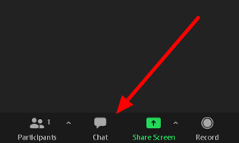
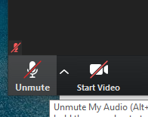
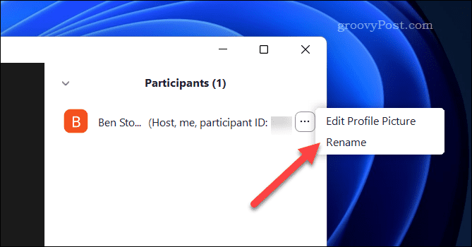
Zoom Features
CHAT
MUTE / UNMUTE
RENAME

Slide 4
Over the past 3 months, what have you been working on for CO?
ⓘ Start presenting to display the poll results on this slide.

Slide 5
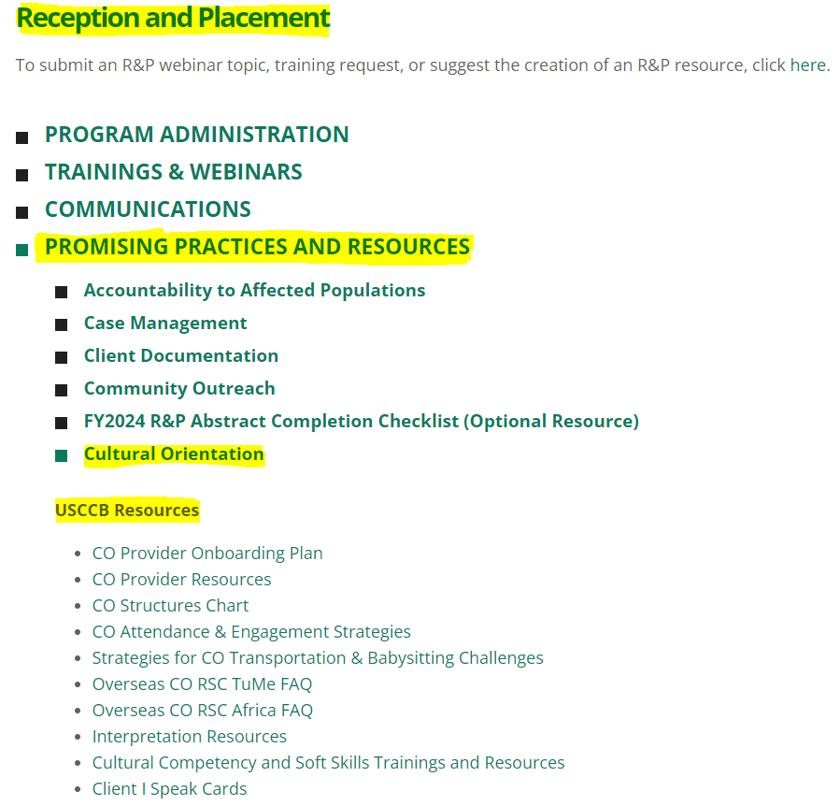
USCCB/MRS CO Updates
USCCB/MRS CO Resources on MRS Connect
CO / AAP Needs Assessment (please complete by August 30!)
Travel Loans Resources in July CO email listserv

Slide 6
CORE CO Updates
Sign up for the CORE Connection newsletter to stay updated!
CORE New Resettlement Pathways FAQ webpage now available!
Quick Poll!
CORE CO Assessment Revisions Task Force has started working on CO Assessment revisions

Slide 7
What CO topics should questions ask about on the revised CO assessment? Please rank in order of importance (top: most important; bottom: least important)
ⓘ Start presenting to display the poll results on this slide.

Slide 8
Digital Technology & Literacy in CO Discussion

Slide 9
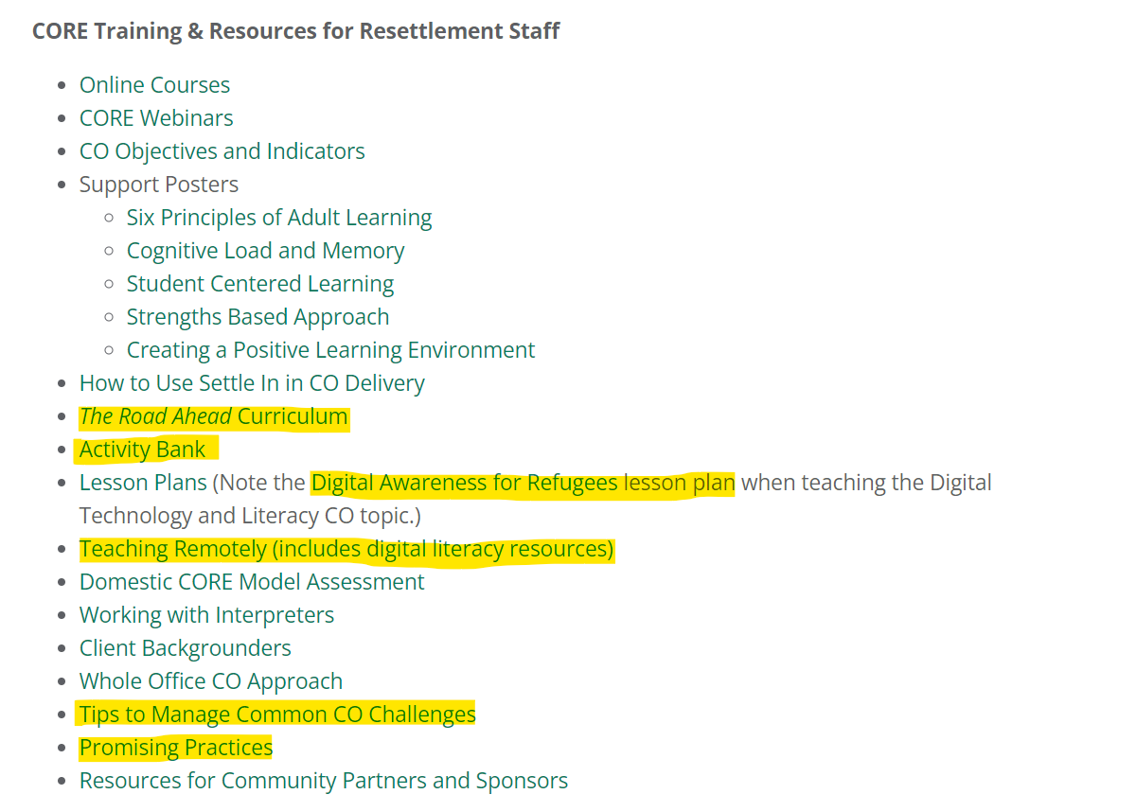
Digital Literacy Resources
FOR STAFF:
CO resources on MRS Connect
R&P -> Promising Practices and Resources -> Cultural Orientation -> CORE Training & Resources for Resettlement Staff
CORE’s Digital Technology and Literacy knowledge exchange recording
CORE Promising Practices on Integrating Digital Technology in CO
See CORE Digital Literacy Assessment to assess client digital literacy
CORE’s The Road Ahead Session 4 PPT slides on Digital Technology and Literacy
CORE Activity Bank Digital Technology and Literacy activities
CORE External Resources (technology section)

Slide 10
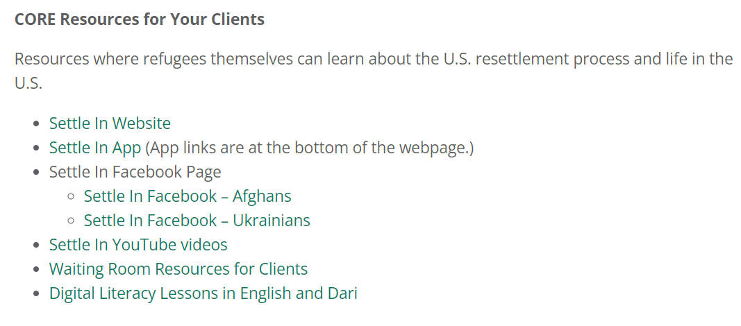
Digital Literacy Resources
FOR CLIENTS:
CO resources on MRS Connect
R&P -> Promising Practices and Resources -> Cultural Orientation -> CORE Resources for Your Clients
Digital Literacy for Refugees in the U.S. webpage (factsheet and podcast on the webpage)
CORE SettleIn mobile app (available on Apple and Android; can be downloaded and then used offline / without Wi-Fi)
CORE SettleIn Facebook (Afghans and Ukrainians)

Slide 11
Zoom Poll
CO CoP Meetings in FY25

Slide 12
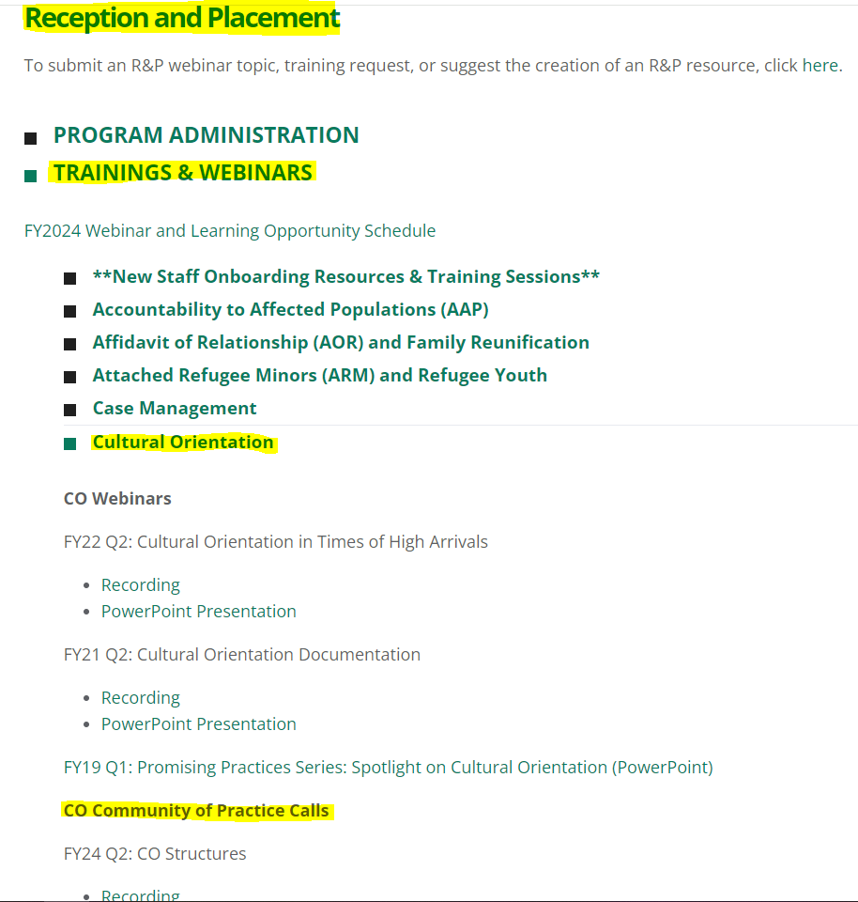
CO CoP Recordings and Presentations

Slide 13
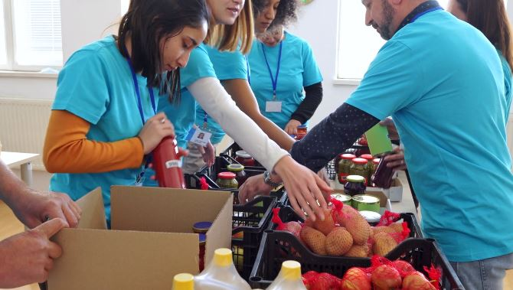
Questions?
Email etothazan@usccb.org
Next CO CoP meeting: TBD

