Slide 1



Pre-MG Enrollment

Slide 2
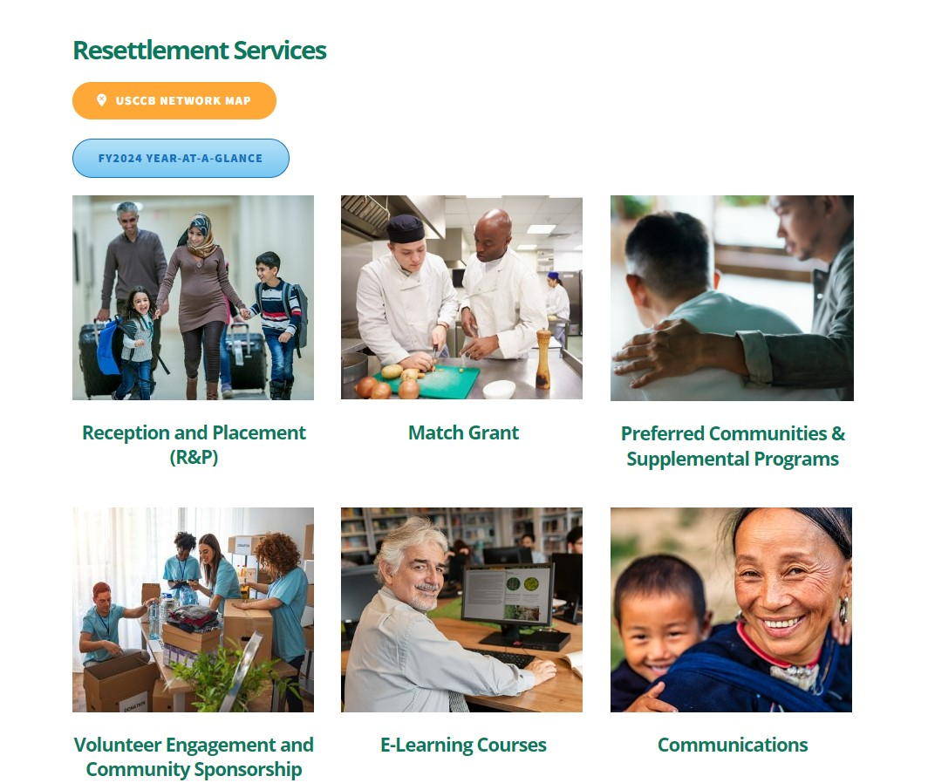
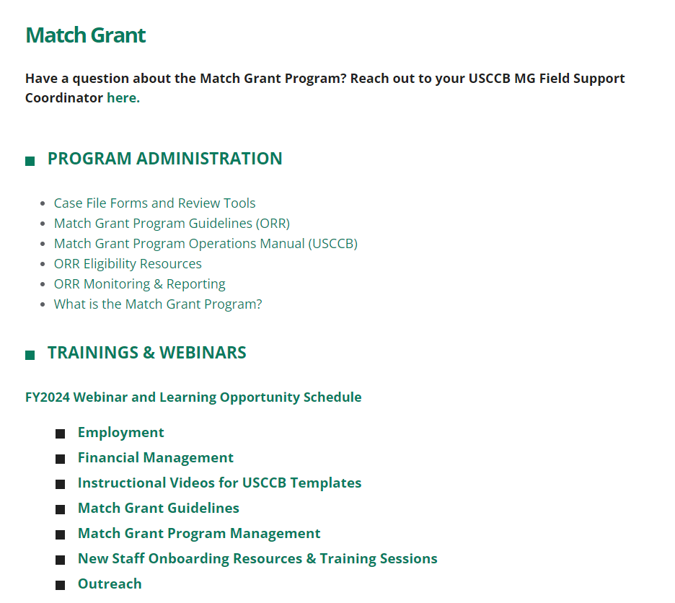
Webinar Recording on MRSConnect
All webinars for the fiscal year are saved on the Communications tile.
Today’s webinar will also be saved here on the Match Grant page.

Slide 3

Understand the criteria for determining MG eligibility and effectively assess client fit.
01
Learning Objectives
Gain proficiency in conducting a thorough pre-enrollment analysis, including the use of essential forms and determining service periods.
02
By the end of this webinar, you will be able to do the following:
Master the ORR waiver process, including the steps, required documentation, and identifying scenarios that necessitate a waiver.
03
Identify and avoid frequent mistakes during the handoff from R&P to MG to ensure a seamless transition and accurate enrollment.
04

Slide 4
Determining MG Eligibility
For details, see Determining MG Eligibility
and Service Duration webinar on MRSConnect
Staff must evaluate client eligibility for MG enrollment
Case cannot already be economically self-sufficient
At least one case member must be employable and willing/able to work
Between 18-64 and determined by your agency to be an able wage earner
All case members must have a MG eligible status
Case members must live together in the same household
None of the individuals can be receiving cash assistance (RCA, TANF, SSI)
Cannot include elderly or disabled individuals expected to receive SSI within nine months of arrival
Agency must have a reasonable expectation of employment authorization within MG service period
Notes:
So our two main themes in thinking about eligibility:
Is potential client in an ORR eligible population and are they a good fit for MG?
Can’t already be earning enough money to cover expenses (they’ve already reached the goal of the program), slot should be given to someone we can help become SS– some cases already working but not earning enough money to be SS
We will look at a sample form in a few slides to screen for employability
Also something I’ve seen that’s been confusing is the emphasis on one case member
More than one employable adult is ok! We just need one, should try to join cases who are family members living and sharing same space/ expenses (R&P cases separated)
MG eligible status – talk about this next
Household– sometimes we see cases of large families split into diff housing– we’d have to split along those lines
No cash assistance (TANF, RCA, SSI) vs. Ok assistance (food/medical)
Etc.
We have a webinar mostly on these criteria, more detailed on MRS Connect

Slide 5
Enrollment Deadlines
IMMIGRATION STATUS | ENROLLMENT DEADLINE
Refugees, Amerasians, R&P SIVs, Afghan Humanitarian Parolees | Within 31 days of the date of eligibility (Date of eligibility + 30 days)
Cuban/Haitian Entrants, Asylees, Victims of Trafficking, walk-in SIVs, Ukrainian Humanitarian Parolees | Within 90 days of the date of eligibility (Date of eligibility + 89 days)
Enrollment window calculation starts on the date of eligibility!

Slide 6
Assessing your agency’s screening process
Pipeline to MG: What does your referral process look like? Who is responsible for identifying potential MG clients?
R&P resettles client or non-R&P client walks in
MG/R&P staff assess client’s eligibility and fit for program
Staff offer MG as a potential program, conduct pre-enrollment analysis
MG enrollment and continued orientation
Notes:
Marci-- not full MG staff, joint R&P/MG staff member, review prior to arrival but have flexibility once they come and switch cases
Alba-- R&P separate, One MG case manager (review biodata, make sure to refer internally before talking to the client about MG, no discussing finances, have MG CM attend R&P screening)
Explaining overlap R&P/MG finances, uniform implementation of the Client Agreement (Serving Challenges)
(overall issue of clients speaking to each other, managing expectations)
Cubans especially good employable clients, but issue of opening that avenue

Slide 7
Assessing your agency’s screening process
Screening for MG: What criteria do you use to determine whether a case is a good fit?
R&P resettles client or non-R&P client walks in
MG/R&P staff assess client’s eligibility and fit for program
Staff offer MG as a potential program, conduct pre-enrollment analysis
MG enrollment and continued orientation

Slide 8
Sample Eligibility and Assessment Form
Notes:
Sample form on MRS Connect
Your agency should have its own assessment criteria for determining client fit for MG.
Can use USCCB’s sample eligibility and assessment form, or your own agency’s version.
One side on eligibility criteria we’ve discussed
(other side) NOT just about ORR eligibility → must see if they’d be a good fit, you can adapt these questions to your employment scene, what kind of jobs you see in your community, issues that may come up with accepting certain jobs

Slide 9
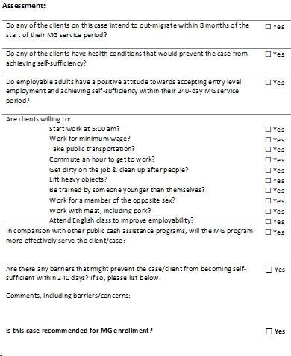
MG Eligibility & Assessment questionnaire
Do you use the USCCB template?
Does your eligibility screening reflect challenges you see with clients?
Does your agency screen candidates before offering MG?

Slide 10

Screening Examples
Large Families
Based on cost of living in your area, how many employable adults are needed for a large family to become self-sufficient?
Single Cases
Is there affordable housing for single individuals in your area? Are they willing to live with roommates?
Elderly clients or cases with physical limitations
Are there jobs in your area/with your partner employers that can accomodate limited physical capacity?
Work Interest
Did the client express interest in working before learning about the MG financial incentives? Do they want only one specific type of job?

Slide 11
Assessing your agency’s screening process
Presentation of MG: How and when do you present MG as an option to clients? What aspects of the MG program do you discuss first: benefits or requirements?
R&P resettles client or non-R&P client walks in
MG/R&P staff assess client’s eligibility and fit for program
Staff offer MG as a potential program, conduct pre-enrollment analysis
MG enrollment and continued orientation

Slide 12
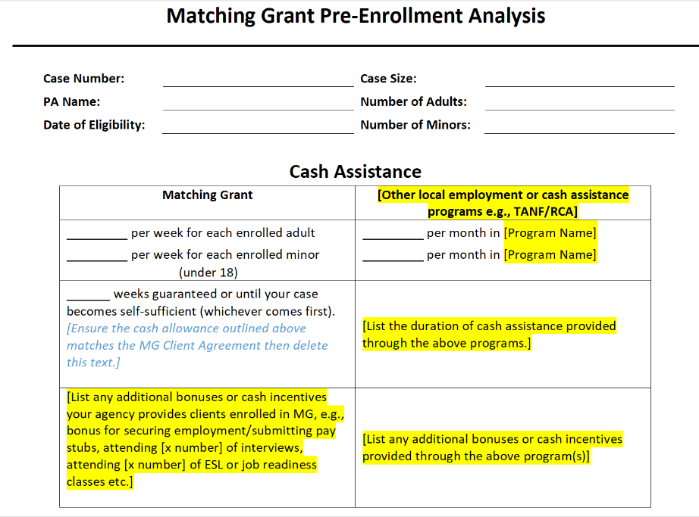
Pre-enrollment Analysis
Things to keep in mind:
Ensure this document is accurate for the case composition
Remember that your agency decides which cases are offered MG as an option
Use this document as the first step in establishing MG expectations

Slide 13
Determining “Day 1”
“Day 1” of the MG service period differs depending on how long after the date of eligibility the case is enrolled
“Regular” Enrollment
Case enrolled within
31 days of eligibility
Day 1 is date of eligibility
“Later” Enrollment
Case enrolled 32 or more days from eligibility
Day 1 is date of enrollment
Gives cases enrolled later the benefit of a full 240-day MG period

Slide 14
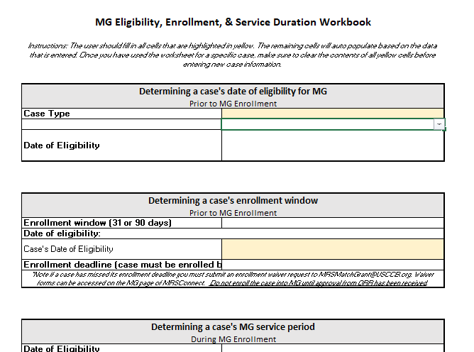
Eligibility, Enrollment,
& Service Duration Workbook!
Notes:
https://mrsconnect.org/resettlement-services/match-grant/case-file-forms/#1

Slide 15
Enrolling after enrollment window Enrollment of a case after their 31-day or 90-day enrollment window has ended.
1
Enrollment of Case Resettled by a Non-USCCB Resettlement Agency
Secondary migration
Local transfer due to lack of capacity
Special circumstances transfer
Enrollment Waivers
2
Approval from ORR must be secured before enrolling clients into Match Grant in the following circumstances:
Long Distance Enrollment Enrollments or job placements outside a local office’s 100-mile service radius. Will not be approved for any sites on a Performance Improvement Plan (PIP).
3
Joining Cases Joining cases with different eligibility dates
4

Slide 16
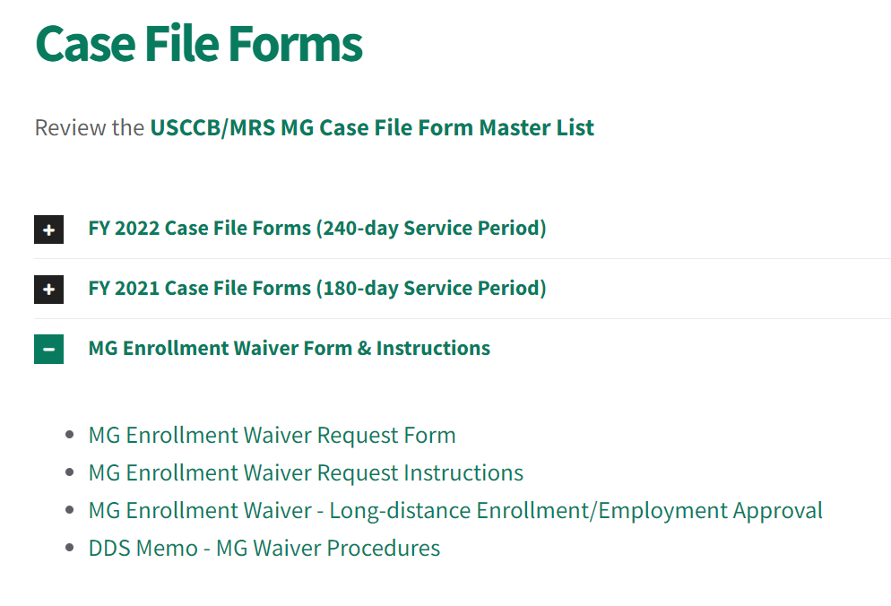
Submitting Waiver Requests
Locate MG Enrollment Waiver Request Form and Instructions on MRSConnect.
Complete the Waiver Request Form according to the instructions for your specific circumstance.
Submit form and eligibility documentation for each case member to MRSMatchGrant@usccb.org.

Slide 17
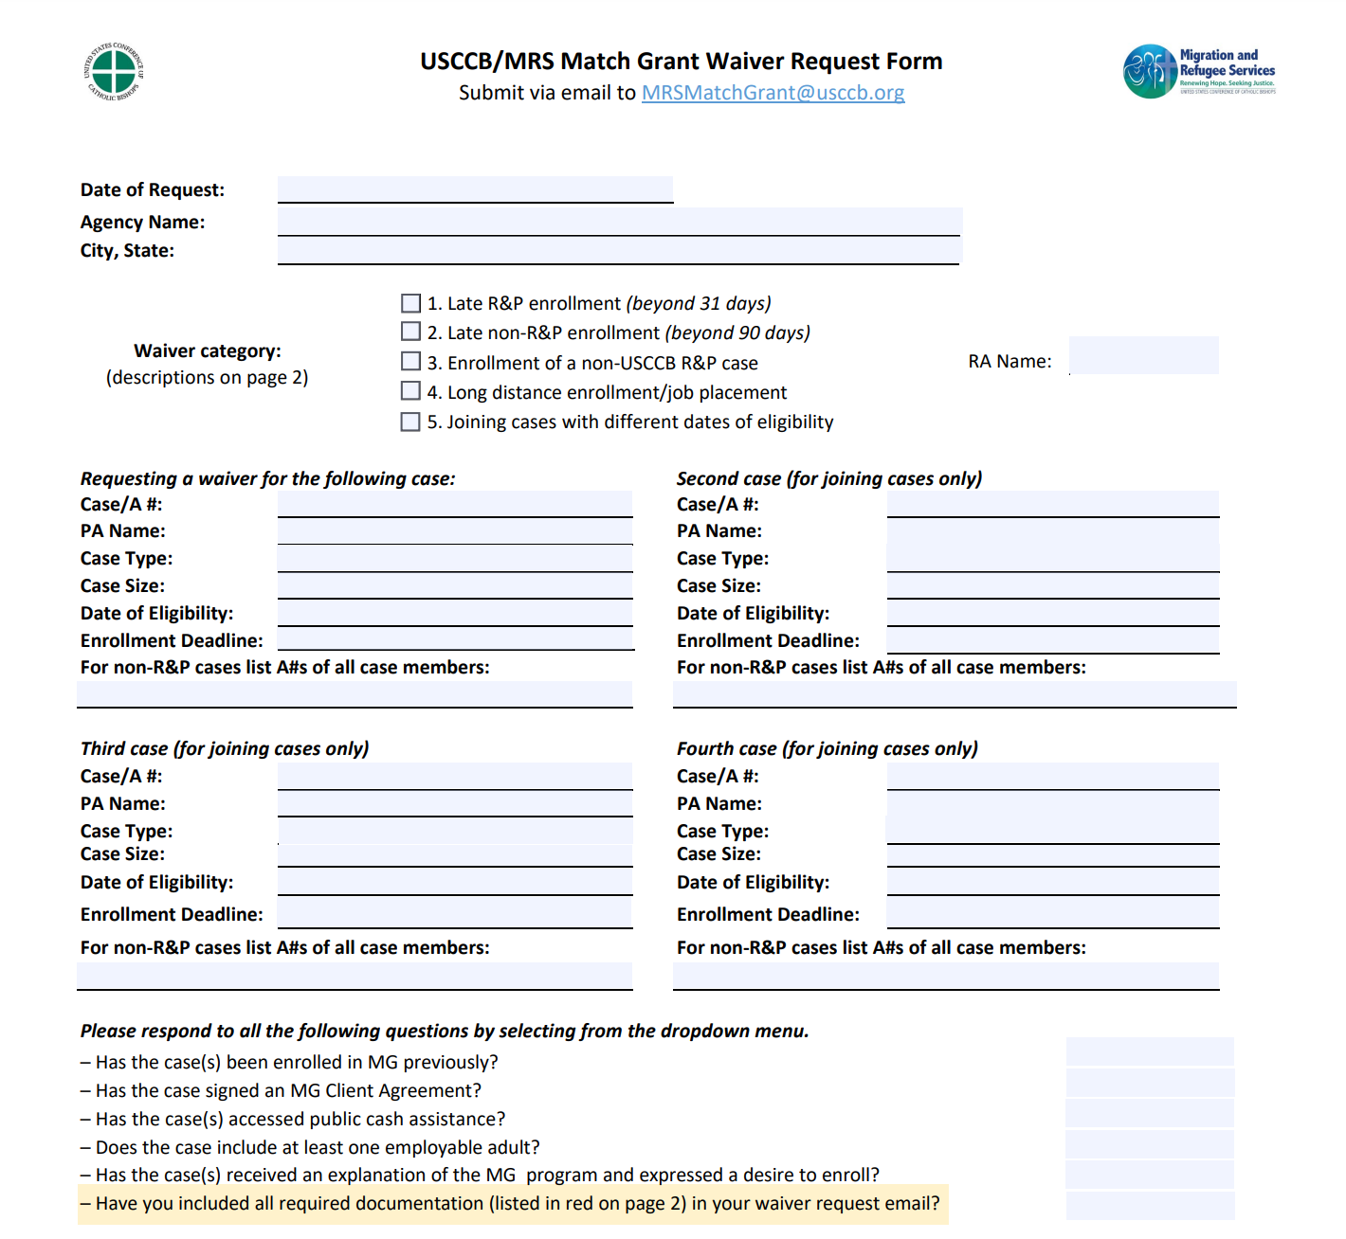

Slide 18
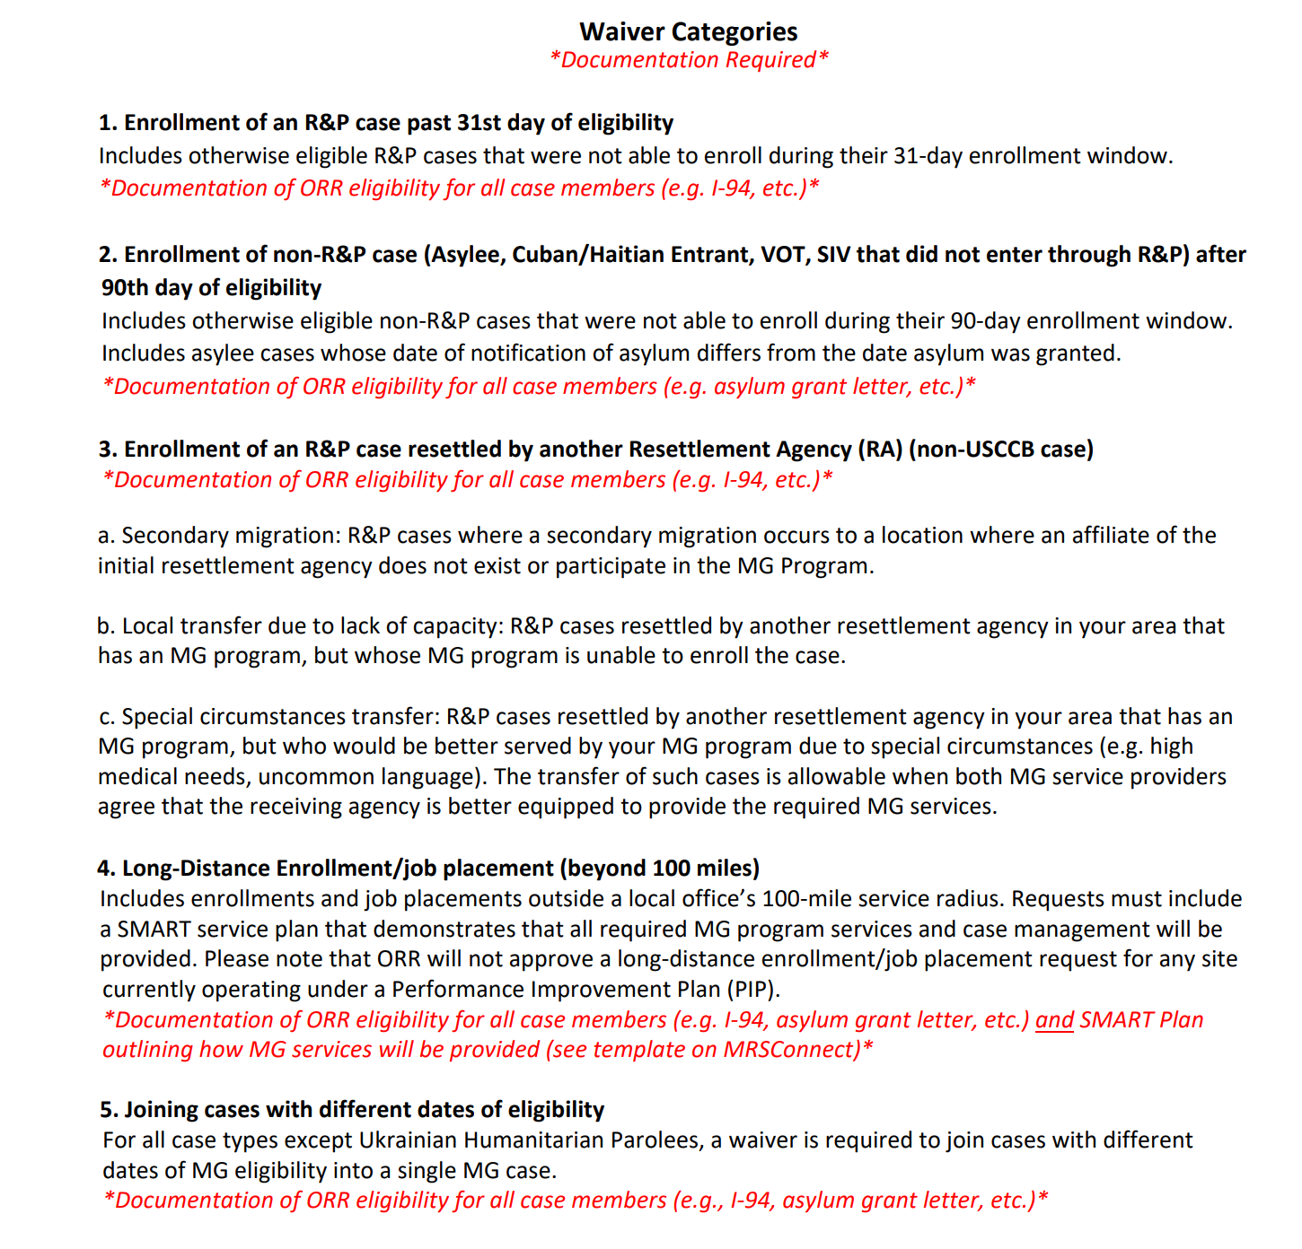

Slide 19
Frequent Mistakes During Handoff
Who is responsible for requirements that overlap between R&P and MG
Not sharing sufficient details about the case
Inaccurately describing the MG program
Date of enrollment = date client signs their MG Client Agreement
Not the date you submit the enrollment form in MRIS

Slide 20

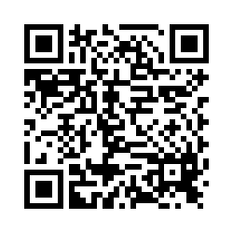
Please share your thoughts.
Anonymous Survey
You can scan this QR code with your phone’s camera.
Or, there is a link to the same survey in the chat.
Notes:
7

Slide 21




Thank you!
Do you have any questions?

