Slide 1





Match Grant
Eligibility, Service Duration, Waivers & Enrollments

Slide 2

Introduction
Dina Eldawy
Field Support Coordinator, Match Grant
Notes:
Recording of onboarding sessions on MRS Connect under Training section (new staff onboarding)

Slide 3
Zoom Features
Interact with presenters and attendees by:
Typing and asking questions in the chat box
Raising your hand
Zoom toolbar is at the bottom of your screen!
The Zoom toolbar is at the bottom of your screen!

Slide 4
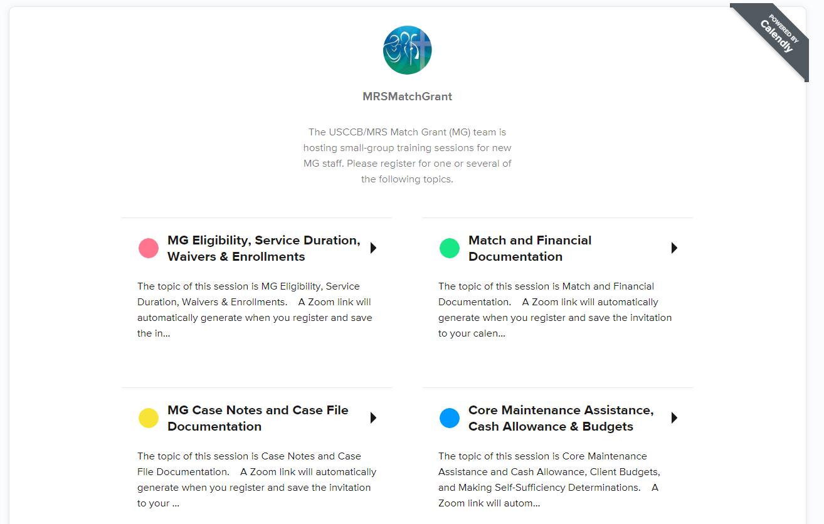
8/7/2024 @ 2:00 EST
9/24/2024 @ 2:00 EST
9/4/2024 @ 2:00 pm EST

Slide 5
Today’s Agenda
1
MG Eligible Populations
2
Determining MG Eligibility
3
Enrollment Timing
4
MG Service Period
5
Waivers
6
Submitting Enrollments in MRIS

Slide 6
Describe eligibility criteria for MG program enrollment
1
Learning
Objectives
Identify the enrollment windows and dates of eligibility for the different ORR-eligible populations
2
Calculate the duration of the MG service period, based on when a client was enrolled into the program
3
By the end of this onboarding session, you will be able to:
Identify the circumstances for which enrollment waivers are required
4
Understand how to enroll clients in MG through the MRIS portal
5

Slide 7
MG Eligible Populations
Refugees
Asylees
Certain Amerasians from Vietnam
Victims of Trafficking and family members with derivative visas
Special Immigrant Visa (SIV) holders
Afghan Humanitarian Parolees *
Ukrainian Humanitarian Parolees *
Cuban and Haitian Entrants (only select enrollments permitted – will discuss)
All case members must possess an eligible status to be enrolled MG.

Slide 8
Cuban and Haitian Entrant Enrollments
USCCB has lifted the MG enrollment suspension for select Cuban and Haitian Entrants whose EAD applications are part of USCIS’ streamlined process for (c)(11) applicants: paroled in the public interest.
  Clients must be ORR eligible
  Their ORR eligibility (parole period) must be valid for a minimum of 8 months after their date of MG enrollment
  The client must have either already received their Employment Authorization Document (EAD) or be able to demonstrate that they have already applied for their EAD using the (c)(11) category
RefugeeEligibility@acf.hhs.gov

Slide 9
Afghan & Ukrainian Humanitarian Parolees
Most Afghan and Ukrainian Humanitarian Parolees who entered the U.S. after September 30, 2023 are not eligible for ORR-funded benefits and services (including MG)
Exceptions:
  Spouse or child (unmarried and under the age of 21) of an individual paroled before October 1, 2023
  Parent, legal guardian, or primary caregiver of unaccompanied refugee minor or unaccompanied child paroled before October 1, 2023.
Afghan and Ukrainian Humanitarian Parolees who entered U.S. on or before September 30, 2023 are eligible for MG enrollment after September 30, 2023
  Must be enrolled within their MG enrollment window

Slide 10
Ukrainian Humanitarian Parolees: UPDATE
As of April 24, 2024, the Senate approved:
A provision extending ORR eligibility to Ukrainian parolees who entered the United States between February 24, 2022, September 30, 2024 (applying retroactively to those who have entered since October 1, 2023).

Slide 11
Children without an eligible status (including U.S. citizen children)
Children without a MG-eligible status may be enrolled into MG if:
  Born before or during the first 31 days of parent’s MG enrollment
                and
  In a two-parent household: Both parents must have a MG eligible status
  In a single-parent household: Parent has a MG eligible status

Slide 12
MG Eligible Populations
U.S. Citizen Children: Examples
Scenario 1:
A household consists of an asylee mother, U.S. citizen father, and a five-year-old U.S. citizen child. Can the U.S. citizen child be enrolled into MG?
Scenario 2:
A household consists of an SIV holder father and a nine-year-old U.S. citizen child. The mother is deceased. Can the U.S. citizen child be enrolled into MG?
Scenario 3:
A refugee client is enrolled into MG on 1/1/2021. She gives birth to a U.S. citizen child on 3/1/2021. Can the child be enrolled into MG?
No.
Yes.
No.

Slide 13
Determining MG Eligibility
For details, see Determining MG Eligibility
and Service Duration webinar on MRSConnect
Staff must evaluate client eligibility for MG enrollment
Case cannot already be economically self-sufficient
At least one case member must be employable and willing/able to work
  Between 18-64 and determined by your agency to be an able wage earner
All case members must have a MG eligible status
Case members must live together in the same household
None of the individuals can be receiving cash assistance (RCA, TANF, SSI)
Cannot include elderly or disabled individuals expected to receive SSI within nine months of arrival
Agency must have a reasonable expectation of employment authorization within MG service period

Slide 14
Determining MG Eligibility
Sample Eligibility and Assessment Form

Slide 15
Date of Eligibility
IMMIGRATION STATUS | DATE OF ELIGIBLITY
Refugee | Date of U.S. arrival
Asylee | Date of final grant of asylum
Cuban/Haitian Entrants | The date a Cuban/Haitian is granted parole as a Cuban/Haitian Entrant or is granted a special status under the immigration laws for nationals of Cuba/Haiti
Certain Amerasians from Vietnam | Date of U.S. arrival
Trafficking Victims | Date of the certification or eligibility letter
SIVs | Date of U.S. arrival or the date of adjustment of status for those applying for Special Immigrant status within the U.S. Note: For SIVs or those applying for Special Immigrant status who remained on a Safe Haven, their eligibility date is their date of entry into the community, rather than their date of U.S. arrival.¹
Afghan Humanitarian Parolees * | October 1, 2021, or their date of entry into the community, whichever is later.
Ukrainian Humanitarian Parolees * | May 21, 2022, or the individual’s date of humanitarian parole, whichever is later.

Slide 16
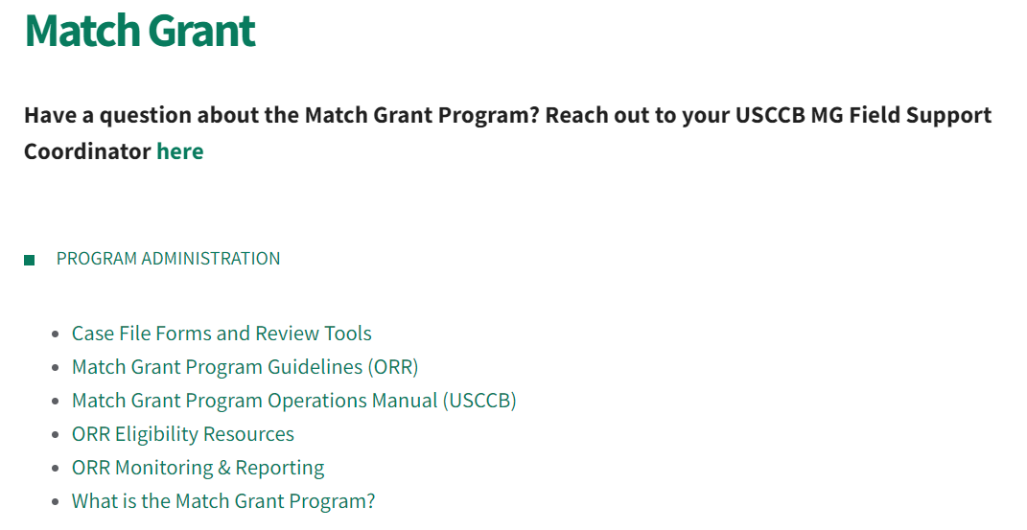
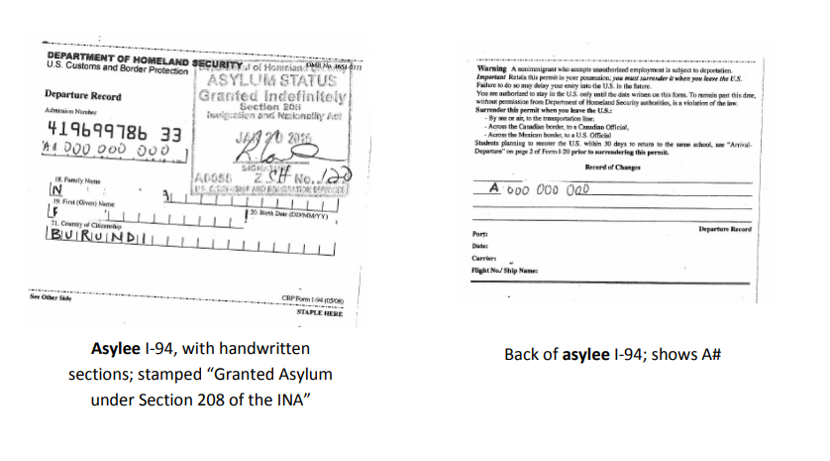
Eligibility Documentation Resources
MRS Connect – ORR Eligibility Resources
Visual Guide to Documentation

Slide 17
Enrollment Deadlines
IMMIGRATION STATUS | ENROLLMENT DEADLINE
Refugees, Amerasians, R&P SIVs, Afghan Humanitarian Parolees | Within 31 days of the date of eligibility (Date of eligibility + 30 days)
Cuban/Haitian Entrants, Asylees, Victims of Trafficking, walk-in SIVs, Ukrainian Humanitarian Parolees | Within 90 days of the date of eligibility (Date of eligibility + 89 days)
Enrollment window calculation starts on the date of eligibility!

Slide 18
Enrollment Window | ORR Eligible Populations | Corresponding Eligibility Date
31 days | Refugees R&P SIVs Amerasians Afghan Humanitarian Parolees | U.S. arrival U.S. arrival / adjustment of status U.S. arrival Oct. 1, 2021 or date of entry
90 days | Asylees* Walk-In SIVs Cuban/ Haitian Entrants* Victims of Trafficking Ukrainian Humanitarian Parolees | Final grant of asylum (judge's order) U.S. arrival/ adjustment of status Grant of parole or special status Certification / eligibility letter May 21, 2022 or date of parole
Organizing Criteria

Slide 19
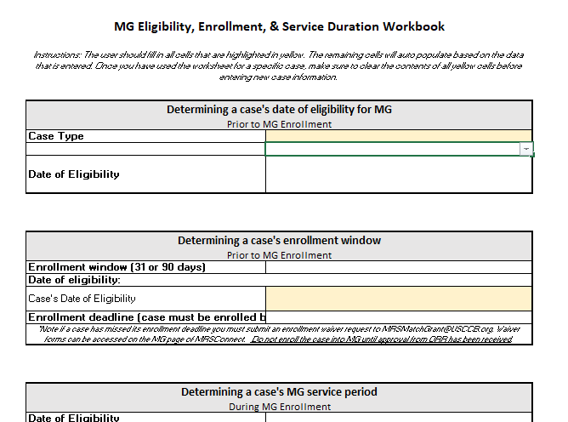
Eligibility, Enrollment,
& Service Duration Workbook!

Slide 20
MG Service Period Duration
The MG service period is 240 days
Clients can be removed from MG for out-migrating, accessing public cash assistance, or not complying with MG program requirements
If a case is self-sufficient at day 180, do not close their case (unless for one of the reasons above)
    Continue case management
    Assist with job upgrades or trainings
    Meet again at day 240 for another budget and self-sufficiency determination

Slide 21
Determining “Day 1”
“Day 1” of the MG service period differs depending on how long after the date of eligibility the case is enrolled
“Regular” Enrollment
Case enrolled within
31 days of eligibility
Day 1 is date of eligibility
“Late” Enrollment
Case enrolled 32 or more days from eligibility
Day 1 is date of enrollment
Gives cases enrolled later the benefit of a full 240-day MG period

Slide 22
Regular vs Later Enrollment:
Use Date of Enrollment as “Day 1” of Service Period
Date of Eligibility
Day 31
Backdate to Date of Eligibility as “Day 1” of Service Period

Slide 23
Examples
Scenario #1:
An asylee client is granted asylum on 12/13/2021 and is enrolled in MG on 3/1/2022, 79 days after becoming eligible for the MG program.
When does the client’s MG service period begin?
Answer:
Day 1 of the service period is 3/1/2022.
Because this client was enrolled more than 31 days from program eligibility, the client’s MG service period will begin on the date of enrollment.

Slide 24
Examples
Scenario #2:
A Ukrainian Humanitarian Parolee client is granted parole on 6/1/2022 and walks into your agency on 6/20/2022. The client is enrolled in MG on 6/29/2022, 29 days after becoming eligible for the MG program.
When does the client’s MG service period begin?
Answer:
Day 1 of the service period is 6/1/2022.
Because this client was enrolled within 31 days from program eligibility, the client’s MG service period will begin on the date of eligibility, which is the date the case was granted parole.

Slide 25
Eligibility, Enrollment,
& Service Duration Workbook!

Slide 26
Enrolling after enrollment window
Enrollment of a case after their 31-day or 90-day enrollment window has ended.
1
Enrollment Waivers
Enrollment of Case Resettled by a Non-USCCB Resettlement Agency
  Secondary migration
  Local transfer due to lack of capacity
  Special circumstances transfer
2
Approval from ORR must be secured before enrolling clients into Match Grant in the following circumstances:
Long Distance Enrollment
Enrollments or job placements outside a local office’s 100-mile service radius. Will not be approved for any sites on a Performance Improvement Plan (PIP).
3
Combining cases with different dates of eligibility– reach out to your FSC!

Slide 27
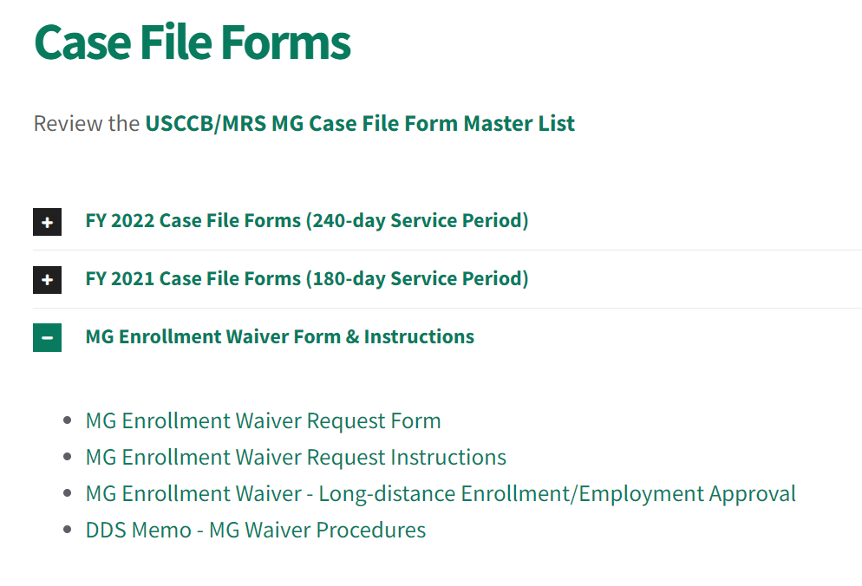
Submitting Waiver Requests
Locate MG Enrollment Waiver Request Form and
Instructions on MRSConnect.
Complete the Waiver Request Form
according to the instructions for your
specific circumstance.
Submit form and eligibility
documentation for each case
member to
MRSMatchGrant@usccb.org.

Slide 28
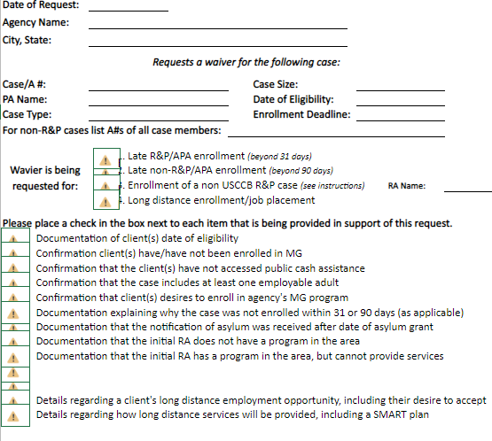

Slide 29
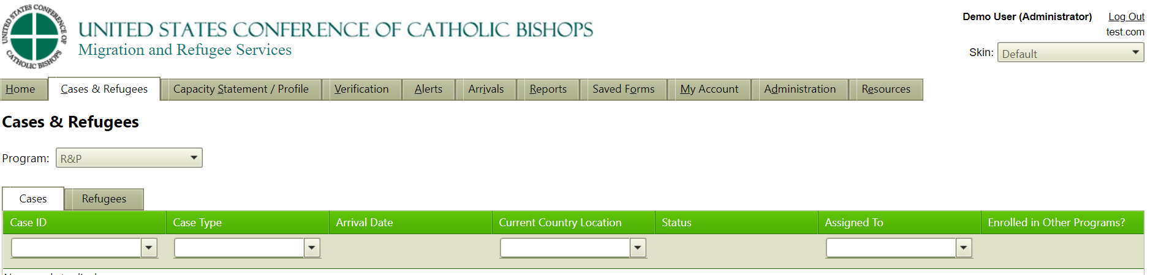
MG Enrollment in MRIS

Slide 30
MG Enrollment Alerts in MRIS

Slide 31
Frequent Enrollment Mistakes
Enrolling R&P cases using the “Enroll New Non-R&P/Secondary Migrant MG Case” button
Date of enrollment = date client signs their MG Client Agreement
  Not the date you submit the enrollment form in MRIS
Not updating the enrollment month on enrollment form when needed
Not selecting all required checkboxes:
  “To the best of my knowledge, none of the following conditions are true.”
  “A staff member presented all available service options to this case (verbally and in writing) prior to MG enrollment.”

Slide 32



Thank you!
Do you have any questions?

Slide 33
Field Support Coordinators!
Marco Mossad | Catriona Davenport | Sean Hardiman | Dina Eldawy
(202) 541-3247 | (202) 541-3448 | (202) 541-3214 | 202-541-3083
mmossad@usccb.org | cdavenport@usccb.org | shardiman@usccb.org | deldawy@usccb.org
Phoenix, AZ (PHX) | Atlanta, GA (ATL) | Miami, FL (MIA) | Charlotte, NC (CHL)
Ft. Wayne, IN (FTW) | Des Moines, IA (DM) | Palm Beach, FL (PMB) | New York, NY (NY)
South Bend, IN (SBD) | Louisville, KY (L) | St. Augustine, FL (STA) | Rochester, NY (ROC)
Indianapolis, IN (IND) | Winona, MN (WIN) | Chicago, IL (CHI) | Rockville Centre, NY (RVC)
Kansas City, KS (KCK) | Columbia, MO (CLA) | Rockford, IL (RCK) | Syracuse, NY (SY)
Salt Lake City, UT (SLC) | Lincoln, NE (LIN) | Lansing, MI (LAN) | Amarillo, TX (AMA)
Arlington, VA (ARL) | Portland, OR (P) | Cincinnati, OH (CIN) | Dallas, TX (DAL)
Richmond, VA (RIC) | Erie, PA (E) | Cleveland, OH (CLV) | Ft. Worth, TX (FWT)
Newport News, VA (HAM) | Harrisburg, PA (HBG) | Dayton, OH (DAY) | Galveston/Houston, TX (GAL)
Roanoke, VA (ROA) | Nashville, TN (NSH) |  | San Antonio, TX (SA)

