Slide 1
PRS Best Practices
Presenters:
Patricia Zaragoza - ICA PRS Lead Case Manager
Yaw Agbenu - ICA PRS Assistant Director
Nicole Ramirez Vasquez - Catholic Charities PRS Supervisor Case Manager

Slide 2
LEARNING OBJECTIVES
LEARNING OBJECTIVE -1-
Best Practices for a New Case Manager
Best Practices for a Case Manager
LEARNING OBJECTIVE -2-
Best Practices for a Seasoned Case Manager
Best Practices for a
Program Supervisor
LEARNING OBJECTIVE -3-
LEARNING OBJECTIVE -4-

Slide 3
LEARNING OBJECTIVES (cont.)
LEARNING OBJECTIVE -5-
Best Practices for Case File Maintenance
LEARNING OBJECTIVE -6-
Best Practices for Case Notes
Best Practices Methods
(Trauma-Informed Care & Evidence Based Approach)
LEARNING OBJECTIVE -7-

Slide 4
Defining “Best Practice”
Best practices are sets of methods and techniques that produce optimal results, increase efficiency, and develop structured processes.
A best practice is the most efficient and effective course of action in a particular situation.
We will review best practices in PRS by reviewing some topics and situations that may occur within PRS.
Your participation is strongly encouraged!

Slide 5
01
Best Practices for a Case Manager

Slide 6
Review the Proper Documentation
Download the documents & reports from the UC Portal.
Thoroughly review each document & report.
File the documents & reports.
Double check that you have saved the right documents & reports.
(refer to the USCCB File Checklist for the complete list of documents & reports; MRIS Connect)

Slide 7
Update case notes weekly to avoid falling behind.
Maintain organization
& plan in advance.

Slide 8
Case Management & Quality of Service
Assure that the sponsor and the minor know what post release services is and what the program helps with.
Make sure that the sponsor and minor know what post release services cannot help with.
It’s completely acceptable to go above and beyond; but know that there are limitations and boundaries for case managers.
Communicate with the minors and the sponsors in a clear and concise manner.
Set expectations with the sponsor by reviewing what their role and responsibilities are.
Set expectations with the minor by reviewing what your role and responsibilities as a case manager are.

Slide 10
Case Management & Quality of Service (cont.)
Don’t leave an appointment, without scheduling the next one.
Follow the guidelines for PRS levels and the level assessment.
Build on the necessary skills for risk assessment including rapport building, active listening, observation, and effective questioning.
Don’t loose heart for what you do!

Slide 11
“Think Safety, Act Safely”

Slide 12
Case Manager Safety Tips:
Plan ahead
(Google map the area, Get there a few minutes
earlier, Avoid visiting the home in the evening,
etc.)
Know the risks involved for every home visit.
- Does the sponsor have any
pets?
- Take health precautions. Are
there any health factors?
- Determine if the case has
high risk factors.
Communicate with your Supervisor.
Wear the proper outfit (pants, no heels, avoid jewelry, etc.)
Be aware of your surroundings in and outside of the home.
Park where it’s easy to get out.
Make sure your phone is always charged and with you.
If a home visit is starting to feel dangerous, trust your gut feelings and leave.

Slide 13
The minor is not enrolled in school and expressed a desire to attend school. However, the minor disclosed to the case manager that the sponsor does not want to enroll the minor in school. When asked about this during a home visit, the case manager noticed the sponsor’s aggressive change in behavior and noticed that the sponsor began to clinch his fist. What should the case manager do to incorporate best practices in safety?
“Think Safety, Act Safely”
- Example Scenario-

Slide 14
Communicate with your supervisor(s) and team.
Maintain Great Communication
Checking in with your supervisor and team on a weekly basis to begin
Follow up with an email to the CSS with a case update and what the plan of action will be.

Slide 15
Communicate with your Child Services Specialist (CSS)
Have a question? Make sure you ask your supervisor or team first before you ask your CSS. They might know the answer.
Check out the POM before you ask.
Clear & effective communication can prevent complication or miscommunication about a case.
Follow up with an email summarizing the action plan for a case after speaking with a CSS.

Slide 16
02
Best Practices for a New Case Manager

Slide 17
Best Practices for New Case Managers
Manage your time effectively
Plan ahead
Calendar everything
Be realistic.
Stay organized.
Find your own method to this madness.
Another case manager’s way of organizing may not work for you and that’s okay.
Pay attention to the details.
Double check your work! Make sure that you write for clear comprehension, spelling, and grammar.
Re-read emails for potential missed details.
Utilize the training and POM already provided by USCCB before going to Supervisor and CSS with questions.
Thoroughly review the weekly and monthly newsletters that USCCB provides.

Slide 18
03
Best Practices for a Seasoned Case Manager

Slide 19
Best Practices for Seasoned Case Managers
You don’t know it all! Keep an open mind to expanding your skills and learning.
Communication with Supervisor(s), team, and CSS.
It may seem that we’ve been doing this forever, however, communication must remain clear and effective.
Avoid burn outs!
Seek relevant training.
Take appropriate breaks within your weekly schedule.
Communicate if you are on the verge of burn out.

Slide 20
04
Best Practices for a Program Supervisor

Slide 21
Best Practices for Supervisors
1. Deliver great quality assurance.
2. Regular report reviews.
3. Review reports before submitting to MRIS.
4. Review NOC’s before being submitted.
5. Conduct routine case file reviews.
6. Make staff supervision a routine.
7. Check-in with your case managers and staff on a regular basis individually.
8. Have Team Meetings on a regular basis (weekly).

Slide 22
05
Best Practices for Case File Maintenance

Slide 23
Best Practices for Case File Maintenance
Create a template folder with organized categories, such as the 14-day report, internal documents, shelter documents, etc.
Create case files and downloading documents when a case is assigned or before you attempt to communicate with the family.
Designate a staff member (ideally a case aide) to create case files when the case referral is received.
Maintain a case tracking system or tool to include caseload per case manager, case types, report due dates, and other case-related information.
Maintain a document tracker based on the HS/PRS Case File Checklist.
Name the title of files and documents consistently across all platforms.
Implement regular peer and team reviews.
Make sure files and documents are properly password protected.
Identify referral resources to target service and regional gaps.

Slide 24
06
Best Practices for Case Notes

Slide 25
Best Practices for Case Notes
Make sure that the proper information is in your notes
(refer to the USCCB Case File Checklist)
Don’t fall behind! Make sure you are setting aside some time in your calendar to make necessary updates to your notes.
TIPS:
1. First thing you to do before your day begins, and the last thing to do before your day ends.
2. Set admin days/hours to your schedule to work on case notes of the week.
Make sure to introduce yourself in the case notes-based on your job title and initials. Ex. Case manager AB,CD.
Do not use full names when writing your case notes; always regard the minor and others with their initials. Ex. The minor A.B., CD or Staff AB, CD.
Make sure to case note consents from the sponsors and the family before making a referral or advocacy.

Slide 26
07
Best Practices Methods (Trauma-Informed Care & Evidence Based Approach)

Slide 27
Methods
Trauma-Informed Practices
Evidence-Based Practices

Slide 28
Trauma-Informed Best Practices:
Trauma-Informed Practices (TIP): is a strengths-based approach that aims to understand and respond to the impact of trauma on people's lives. It emphasizes physical, psychological, and emotional safety for everyone, and aims to empower individuals to re-establish control of their lives. (Trauma Informed Practice | PLYMOUTH.GOV.UK, n.d.)
Researchers have defined TIP as a set of practices that address the impact of trauma by creating a safe and caring environment (Nea, n.d.)
Trauma Informed Care (TIC) = Trauma Informed Practices (TIP)

Slide 29
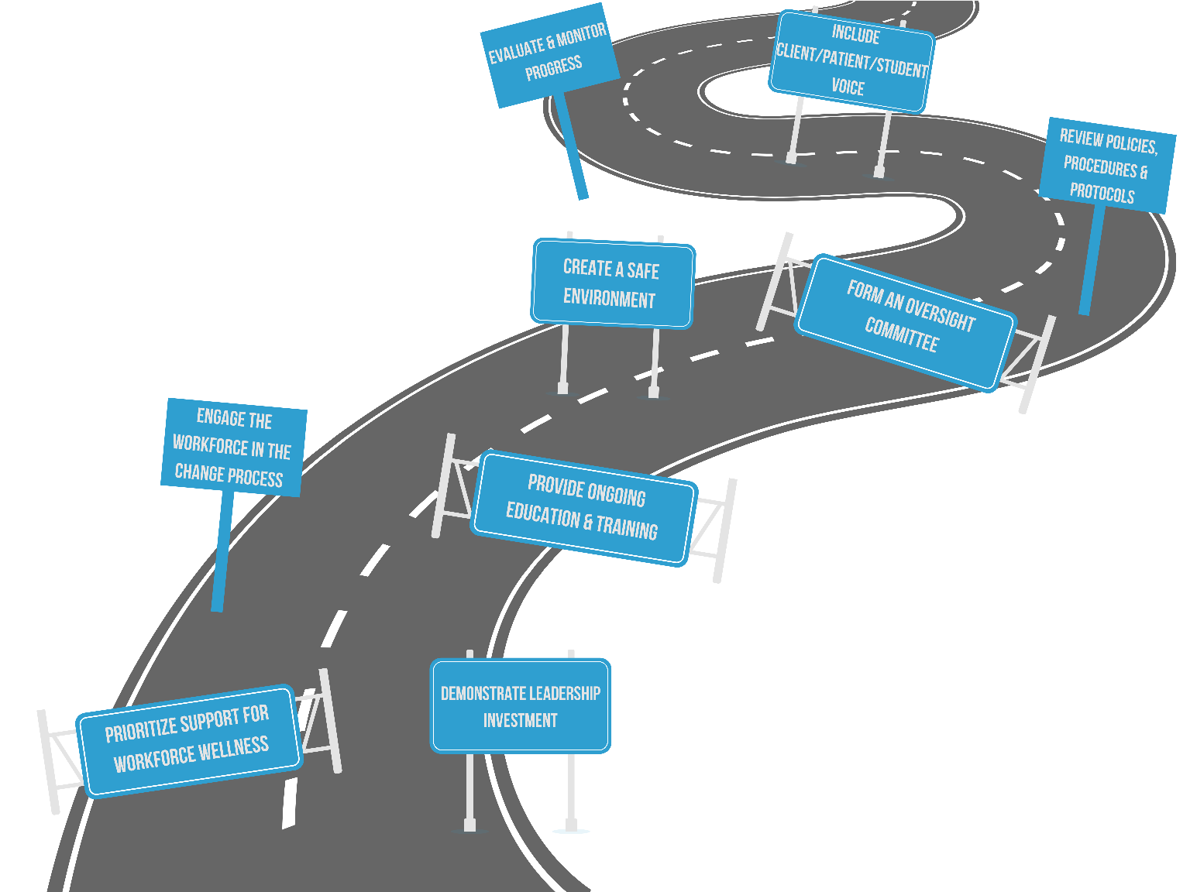
Six Core Principles
Scenario:
A 15-year-old minor does not want to go to school. They are nonrespondent and unwilling to share any information with you in front of the sponsor. You speak with the sponsor about the situation and notice they are frustrated and upset.
Using the six core principles,
What would you do in this situation, and how would you approach the family?
Principles:
Safety
Trustworthiness and Transparency
Peer Support
Collaboration and Mutuality
Empowerment, Voice and Choice
Cultural, Historical, and Gender Issues

Slide 30
Evidence-Based Practice
Evidence-based practice (EBP) refers to the process where the practitioner combines well-researched interventions with clinical experience and ethics, and client preferences and culture to guide and inform the delivery of treatments and services (Guides: SOCW 6305 - Social Work Research: Evidence-Based Social Work Resources, n.d.)
What does it mean?
Decisions are based on our client’s cultural and individual perspectives, and their preferences.
We are also considering our client’s environment and specific circumstances.
We value their priorities of needs instead of our own.
Goal:
To promote and create safe environments where the clients feel empowered and in control.

Slide 31
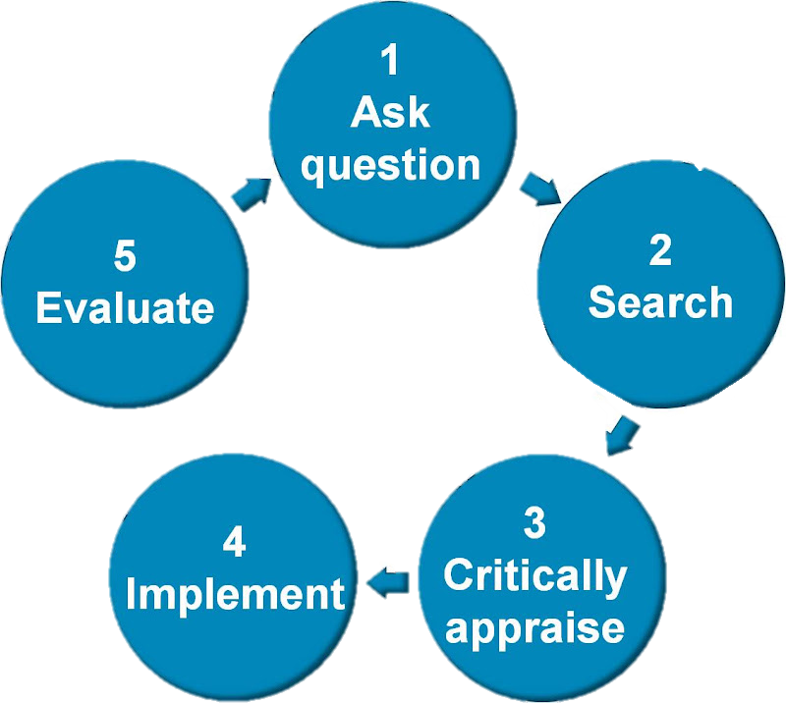
The 5 A’s for EBP
2. ACQUIRE
1. ASK
Do we have information ready to share or do we need to consult/research?
What resources are there available
What are the laws regarding the request?
What is it that we may want to address?
What does the family need or may want to get from PRS?
3. APPRAISE
4. APPLY
Consult with the sponsor on their limitations/barriers.
Can the sponsor have easy access to the resource or what other barriers could they encounter?
Any positive/negative impact can this information can have on the client?
Create an action plans/goals and modify based on the client’s feedback.
Create with the minor/sponsor a few realistic goals and set healthy expectation.
5. ASSESS
Use monthly check-ins to check on progress and status of each goals/referrals.
Assess for any other barriers, experiences.

Slide 32
Scenario
Using the steps above, how would you support a family or a minor who is going through similar situation?

Slide 33
Thanks!
Do you have any questions?
Notes:
This slide is for the last slide of the entire presentation.

Slide 34
Resources!
(Source: SAMHSA's Concept of Trauma and Guidance for a Trauma-Informed Approach (2014), p10. Pub ID#: SMA14-4884.)
American Speech-Language-Hearing Association. (n.d.). Evidence-Based Practice (EBP).https://www.asha.org/research/ebp/#:~:text=The%20goal%20of%20evidence%2Dbased%20practice%20(EBP)%20is,and%20choices%20of%20the%20individuals%20we%20serve.
Guides: SOCW 6305 - Social Work Research: Evidence-Based Social Work Resources. (n.d.).https://guides.lib.uh.edu/socw6305/socialworkEBP#:~:text=Evidence%2Dbased%20practice%20(EBP),(Social%20Work%20Policy%20Institute).
Nea. (n.d.). Trauma-Informed Practices | NEA. https://www.nea.org/professional-excellence/student-engagement/tools-tips/trauma-informed-practices#:~:text=Trauma%2DInformed%20Practices%20(TIP),of%20educators%20in%20the%20field.
Researchers have defined TIP as a set of practices that address the impact of trauma by creating a safe and caring environment (Nea, n.d.)
Spring, B. & Hitchcock, K. (2009) Evidence-based practice in psychology. In I.B. Weiner & W.E. Craighead (Eds.) Corsini’s Encyclopedia of Psychology, 4th edition (pp. 603-607). New York:Wiley.
Trauma Informed Practice | PLYMOUTH.GOV.UK. (n.d.). Plymouth City Council. https://www.plymouth.gov.uk/trauma-informedpractice#:~:text=Trauma%2DInformed%20Practice%20is%20a,establish%20control%20of%20their%20lives.
What is Trauma-Informed Care? (2024, May 29). University at Buffalo School of Social Work - University at Buffalo. https://socialwork.buffalo.edu/social-research/institutes-centers/institute-on-trauma-and-trauma-informed-care/what-is-trauma-informed-care.html
USCCB POM and USCCB Trainings on MRIS Connect
Notes:
This slide is for the last slide of the entire presentation.

