Slide 1


Match Grant Deep Dive: Self-Sufficiency Plans
May 30, 2024

Slide 2
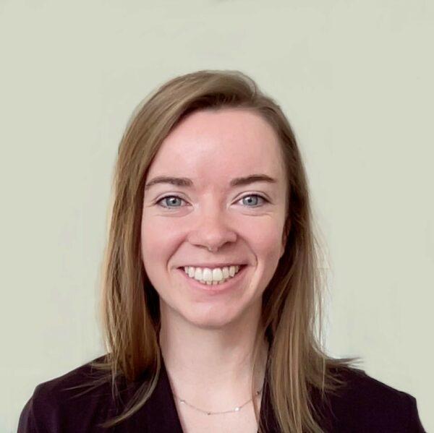
Introduction
Match Grant Field Support Coordinator, Catriona Davenport, is our facilitator today!
Catriona

Slide 3

Zoom Features
Interact with presenter and attendees by:
Typing comments in the chat
Raise your hand if you want to ask a question verbally
The Zoom
toolbar is at the bottom of your
screen!

Slide 4

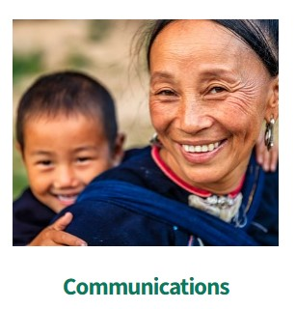


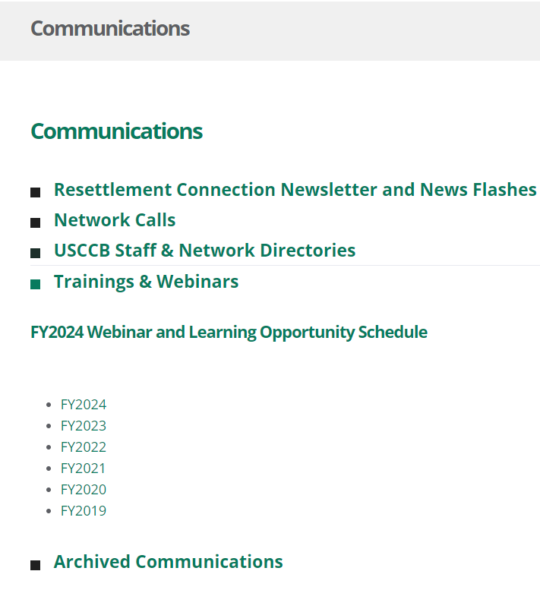
After the Webinar
Slides
  Recording

Slide 5

Agenda
Review the Elements of a Match Grant Self-Sufficiency Plan
Interview a Client to Discuss their Barriers to Self-Sufficiency
Develop a Match Grant Self-Sufficiency Plan based on the Client’s Specific Barriers

Slide 6

Learning Objectives
Complete MG Self-Sufficiency Plans in accordance with MG program requirements
Develop barriers and action steps that are tailored to the individualized needs of clients

Slide 7
Part I: What is a Self-Sufficiency Plan?

Slide 8

Matching Grant (MG) Program Goal
Assist clients to achieve economic self-sufficiency through employment within the 240-day MG program service period. The MG program is designed to be an alternative to public cash assistance.
Economic Self-Sufficiency = earning a total household income through employment that:
    Enables the case to fully support itself
    Exceeds the TANF eligibility threshold for your state

Slide 9

Although the goal of MG is to achieve economic self-sufficiency, your agency should work with all case members to promote self-sufficiency, not just employable adults.

Slide 10
Barriers to Self-Sufficiency
The purpose of the Self-Sufficiency Plan is to:
Work with the client to identify any existing barriers to self-sufficiency
Develop goals to assist clients overcome these barriers, and
Ensure that the services provided are appropriate to the client and administered in a planned, effective, and timely manner

Slide 11

REMINDER!
A separate Match Grant Self-Sufficiency Plan must be completed for all members of the Match Grant case, including children and non-employable adults.

Slide 12
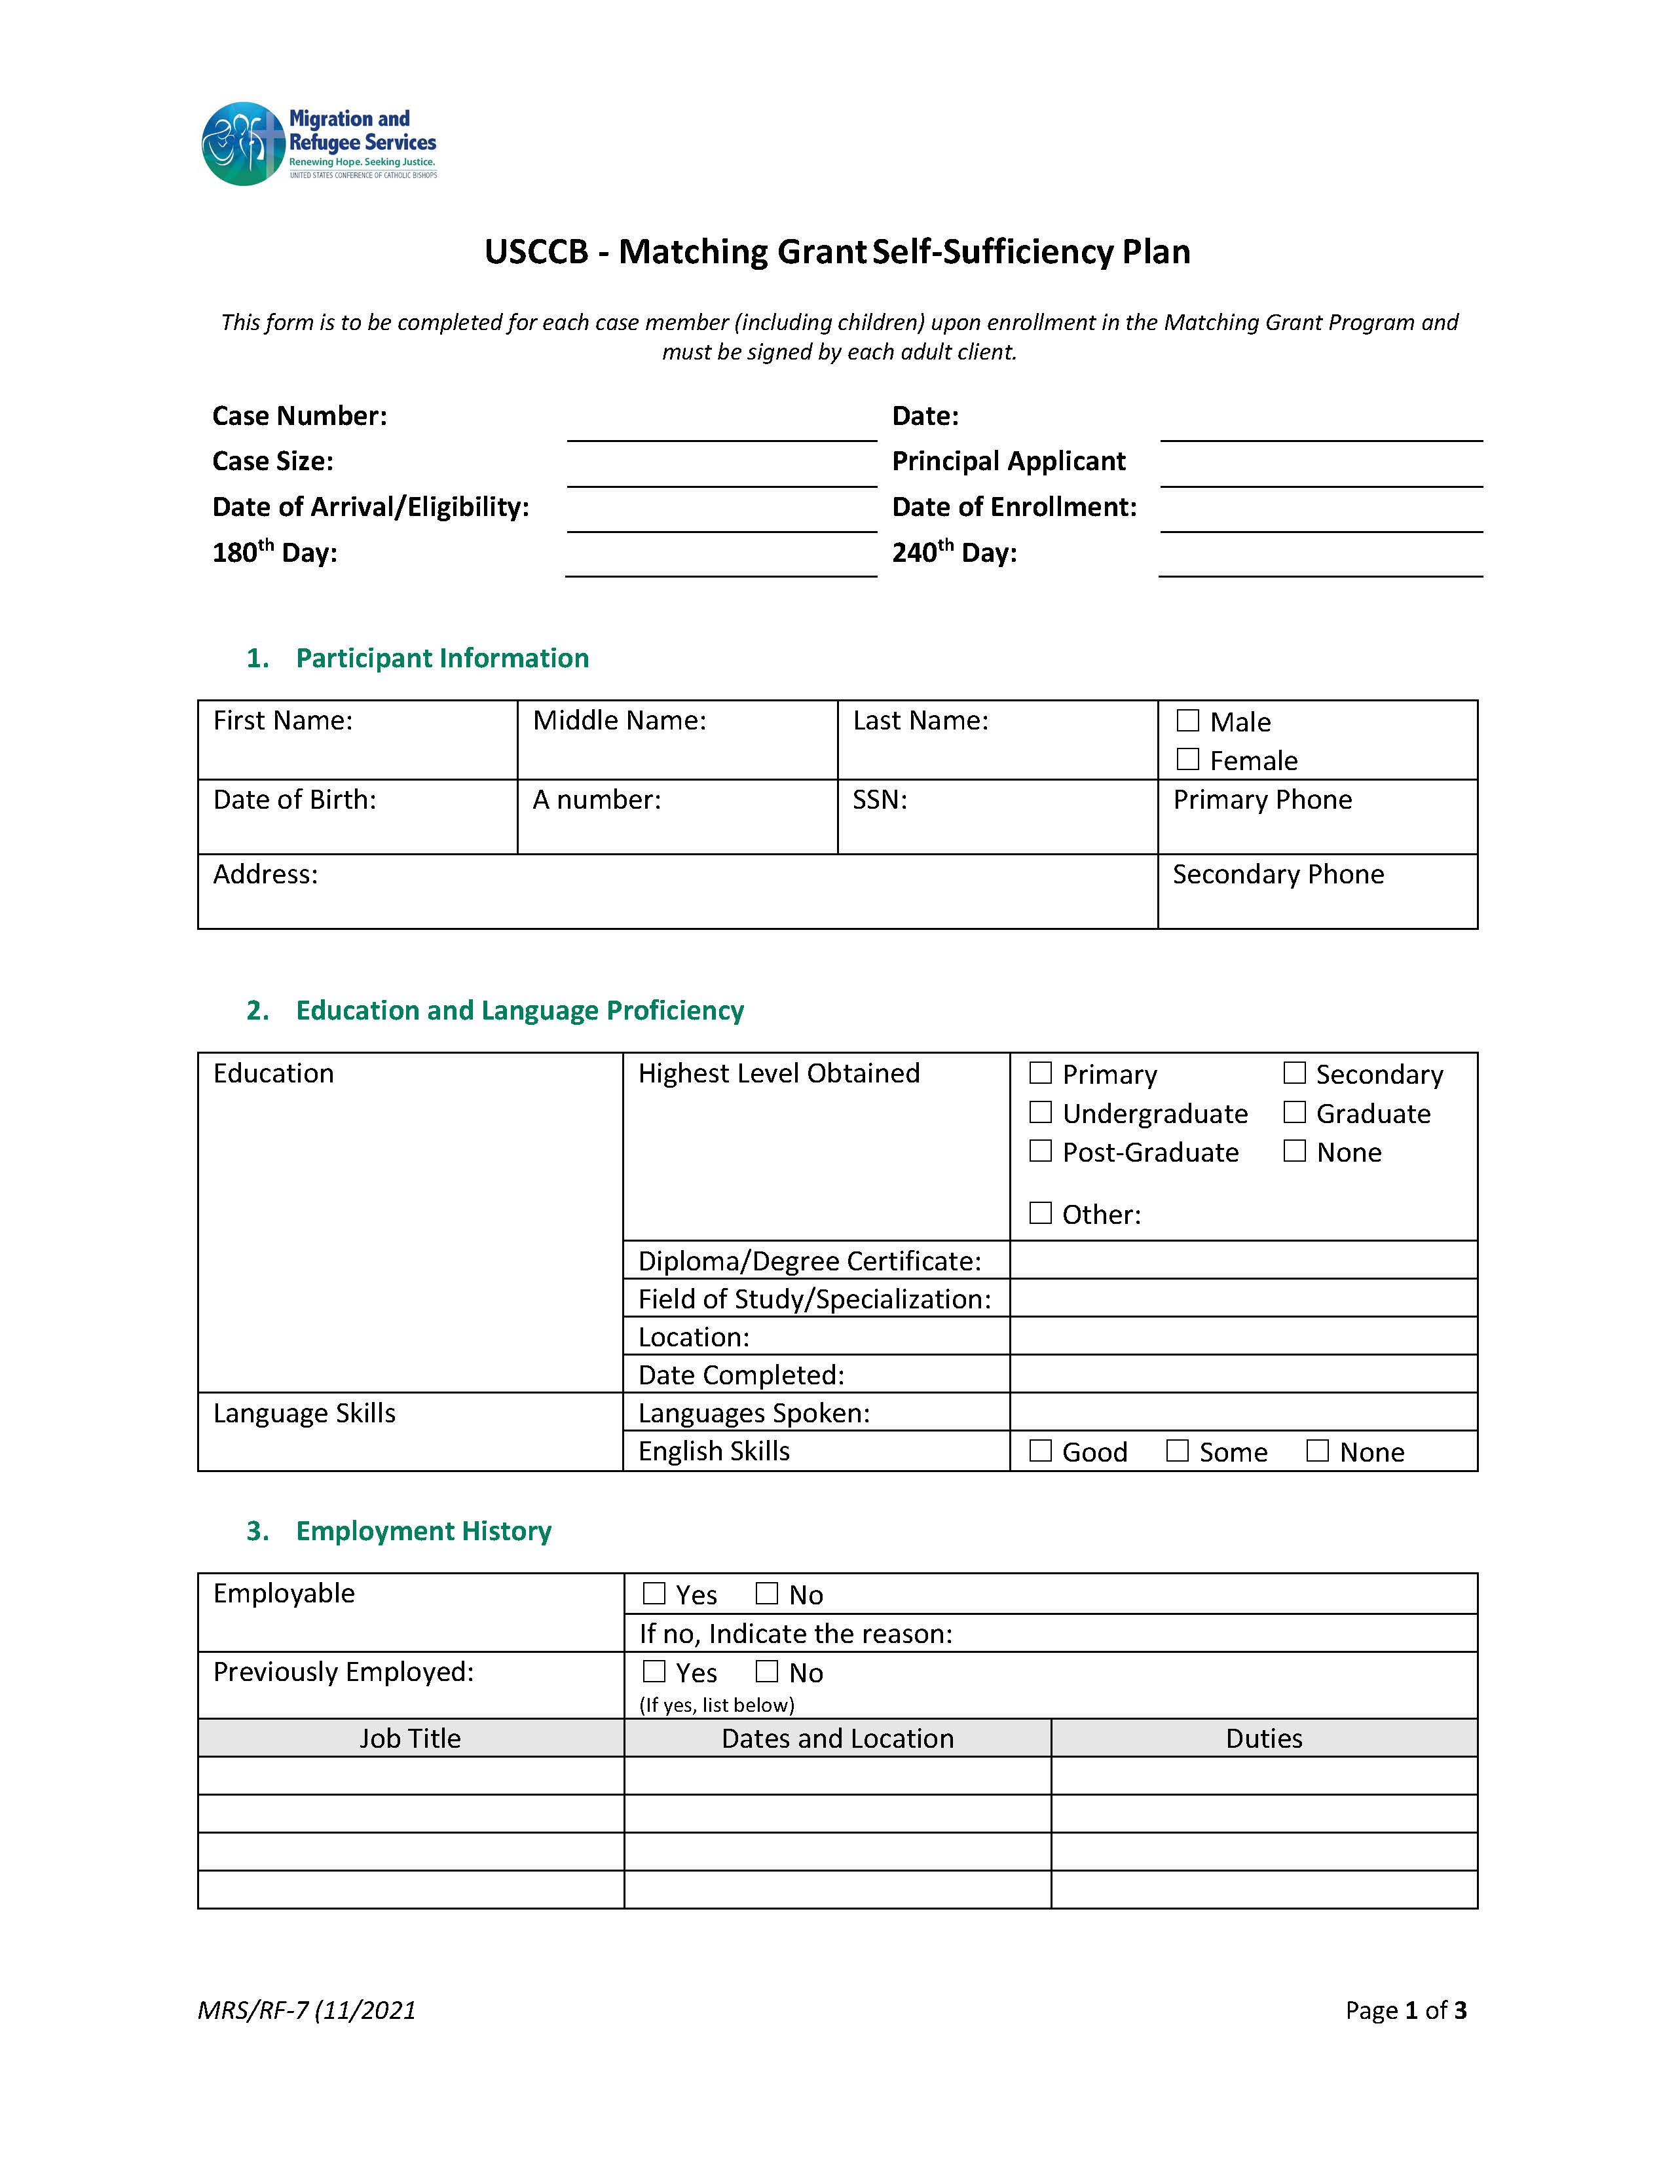
Documentation Spotlight:
Page 1 of the USCCB Template SSP
Case Details: Information about the Case
1. Participant Information: Information about the person whom you are filling the form out for (which case member)
2. Education and Language Proficiency: This section must be completed for all case members, even minor children.
3. Employment History: Indicate if the case member is employable or not (employable = age 18-64, and willing to seek employment). If client is not employable, indicate the reason why. Examples of why a client may not be employable include: staying home to care for children, medically unable to work, minor child, etc. For employable adults, include previous work history, including informal work.

Slide 13
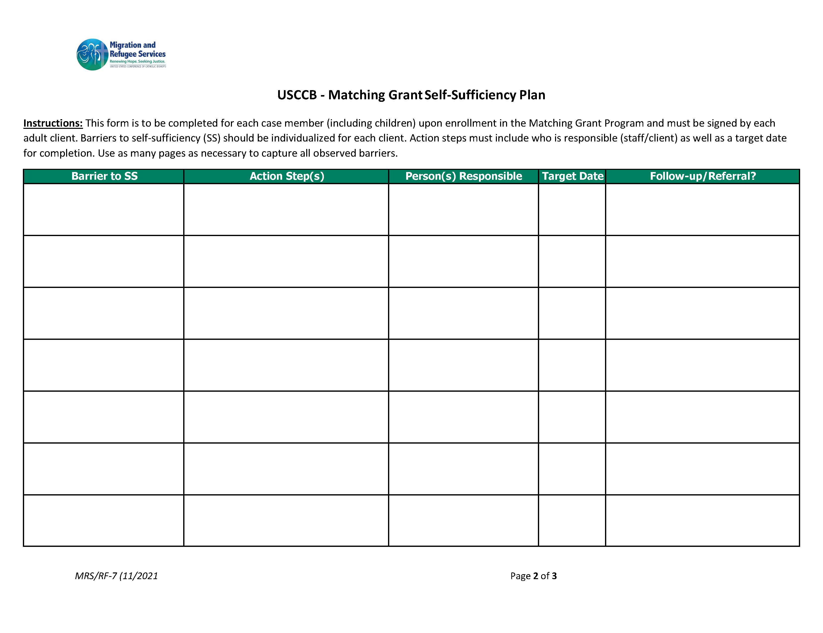
Documentation Spotlight:
Page 2 of the USCCB Template SSP
Target Date:
When do you expect to be able to address this barrier by? There may be multiple dates if there are multiple action steps. The target date should be an actual date, not ASAP.
Who is responsible for addressing the barrier? Clients should have a role in addressing their barriers.
What barriers to self-sufficiency exist for this specific individual?
How can your agency and the client address the barriers to self-sufficiency?
Do you need to refer the matter to anyone else to complete this step? Will you need to follow up with anyone? There is almost always follow-up!

Slide 14
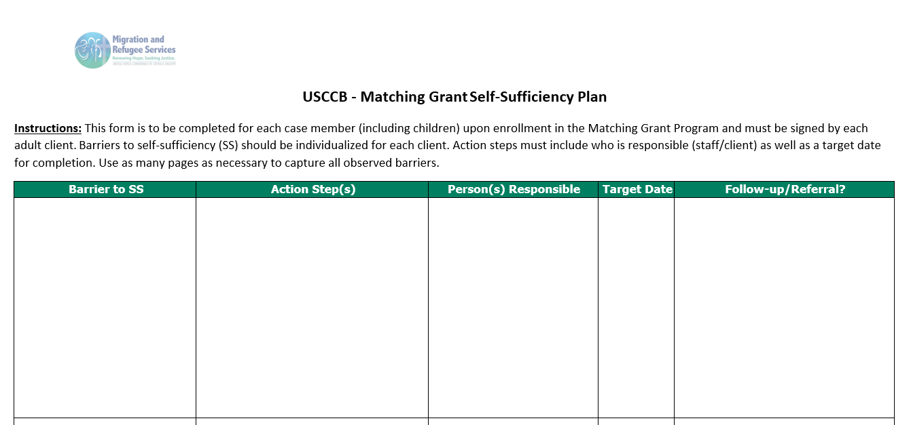
Documentation Spotlight:
Page 2 of the USCCB Template SSP
Transportation – client is unfamiliar with public transportation system in Appleville.
Provide client with monthly bus pass
Arrange bus training with transportation volunteer
Attend bus training
Use bus to come to the office for JRT
MG Case Manager
MG CM and transportation volunteer
Client and transportation volunteer
Client
5/31/24 and monthly until SS.
6/7/24
6/14/24
6/28/24
CM will follow-up with the client on 6/14/24 to make sure they attended bus training and if they have any questions. CM will check in with client after they use the bus to come to the office to see how it went.

Slide 15
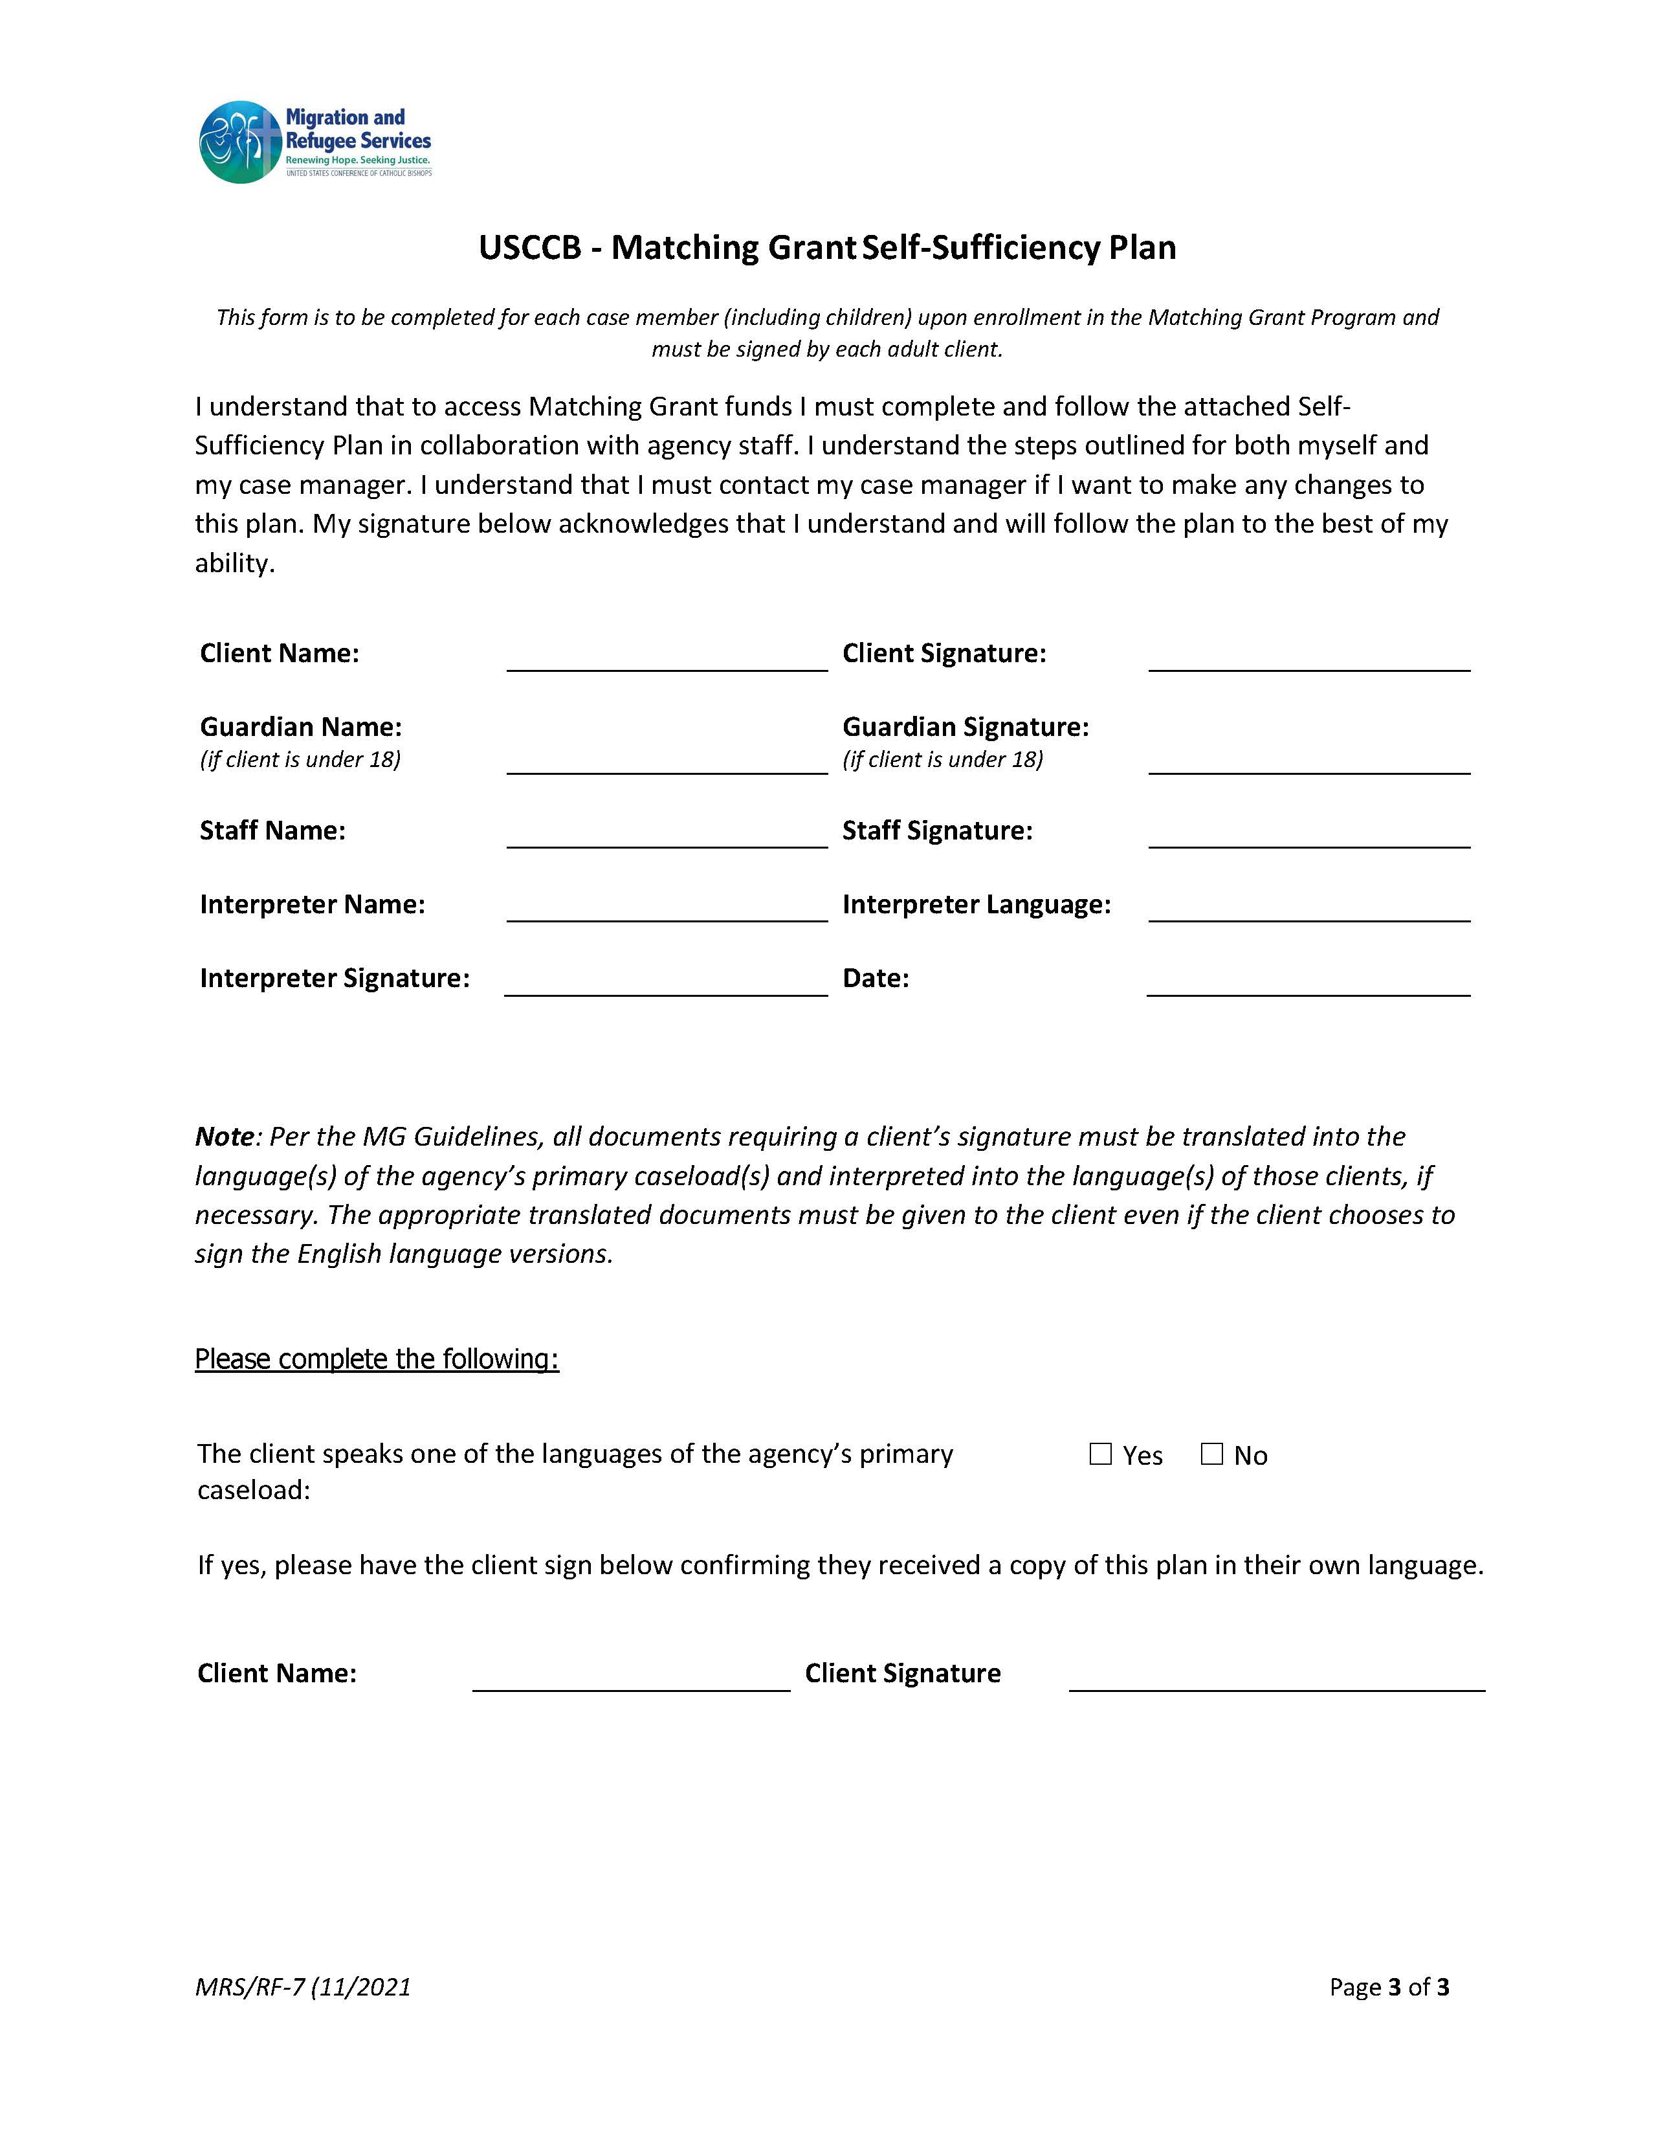
Documentation Spotlight:
Page 3 of USCCB Template SSP
Client Name and Signature: The name of the client on whose behalf the form was filled out for, and their signature. If the form is completed for a minor, then the client signature line will be empty, and their guardian will complete the Guardian Name and Signature section as well.
Staff Name and Signature: The name and signature of the staff member who helped the client to complete the form.
Interpreter Name, Language, Signature, and Date: The interpreter’s name, the language they interpreted in, their signature, and the date the service was provided. For agencies using telephonic interpreters, please add their ID number as the Interpreter’s Name, and list ‘Telephonic Interpreter’ on the signature line.
Primary Caseload Language: If a client speaks one of the languages of your agency’s primary caseload, they must receive a copy of the form in that language. Indicate in the check box if the client speaks one of the languages of your agency’s primary caseload. If the client does, they must sign the bottom of the form to indicate they received a copy of the form in their own language.

Slide 16
Part II: Developing Tailored Barriers

Slide 17

Instructions:
You will now be assigned to a breakout room with other attendees.
You will meet your “client” and get to know them and their unique barriers.
You will develop a SSP (page 2 only) identifying and addressing approx. 2-3 barriers for the client.
Your group will share one barrier and how you plan to address it with the larger group after the breakout group.

Slide 18


Client #1
Client #2
Primary Applicant (Marie)
Minor Child (Benjamin)
Refugee from the DRC
29 years old and is not married
Has one child (Benjamin, 8)
Speaks fluent Kinyarwanda
Does not speak English
Has no formal education and cannot read or write yet
Has no formal work experience but is a talented cook, and has managed a household for several years
She is willing to work and has no health issues
Marie’s parents and her younger sister live in the same apartment complex as Marie. Marie’s parents are both working, and her sister is a full-time student
Benjamin is Marie’s son
He is a refugee and is eight years old
Benjamin speaks Kinyarwanda
He is very active and enjoys playing soccer
Will be starting school in August but his mom would like him to meet other children in the area before he starts
Benjamin has a health issue that he has been dealing with
His R&P case manager tells you he is seeing the doctor regularly for the issue

Slide 19
Information about Appleville
The main industries in Appleville are shiftwork at Amazon’s warehouse, housekeeping at local hotels, and home help positions.
To be eligible for home help positions, applicants must have participated in an 8-week training course.
Appleville is home to many other Congolese families and many live in the same apartment complex as Marie.

Slide 20
Part III: Sharing the Results

Slide 21

Share one barrier you found for your client, and how you plan to address it with them.

Slide 22
Part IV: Resources

Slide 23
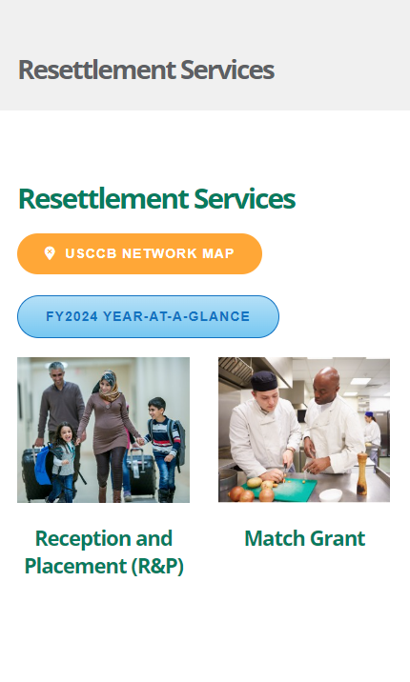
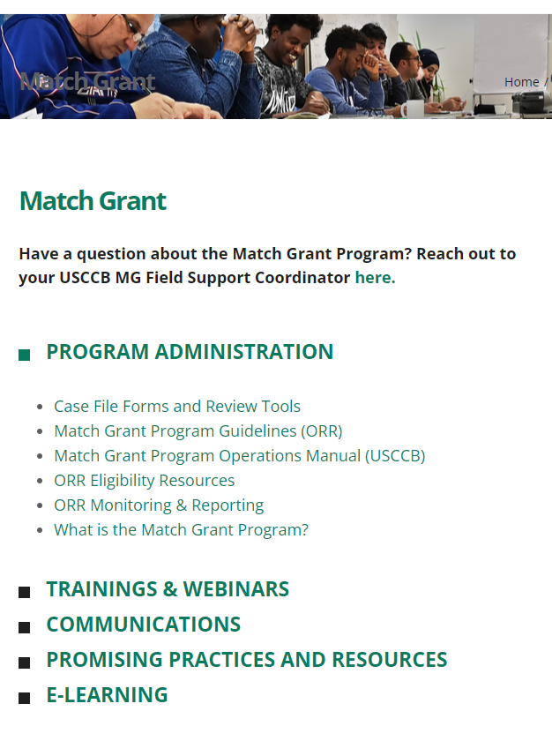
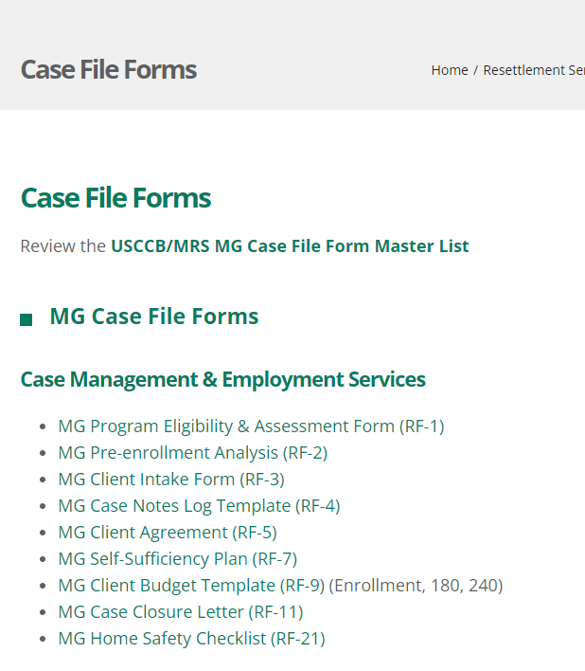


USCCB Template Document

Slide 24
Questions?

Slide 25
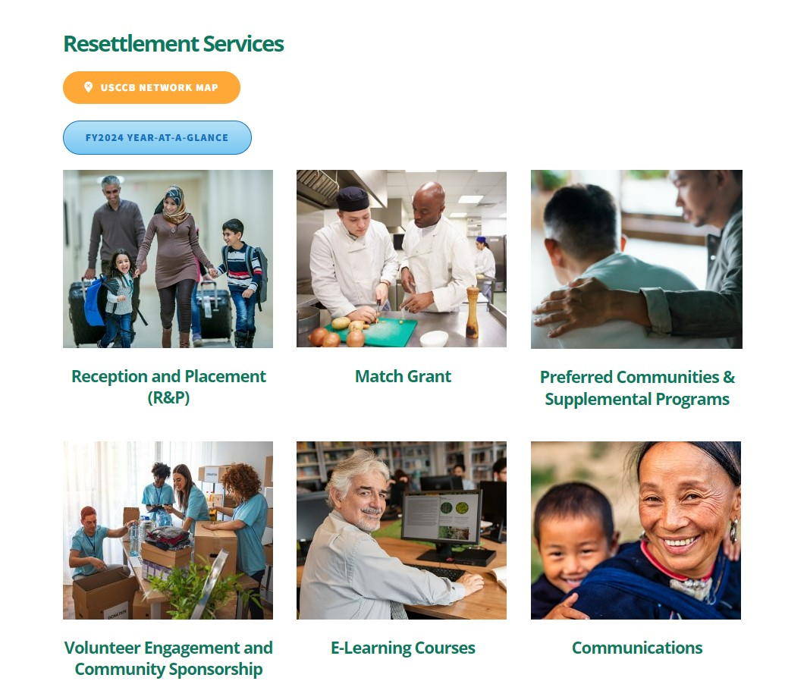
Webinar Recording on MRSConnect
All webinars for the fiscal year are saved on the Communications tile.

Slide 26

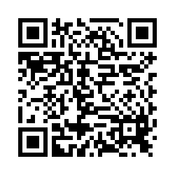
Please share your thoughts.
Anonymous Survey
You can scan this QR code with your phone’s camera.
Or, there is a link to the same survey in the chat.
Notes:
7

