Slide 1


Volunteer Recording Essentials
May 9, 2024

Slide 2
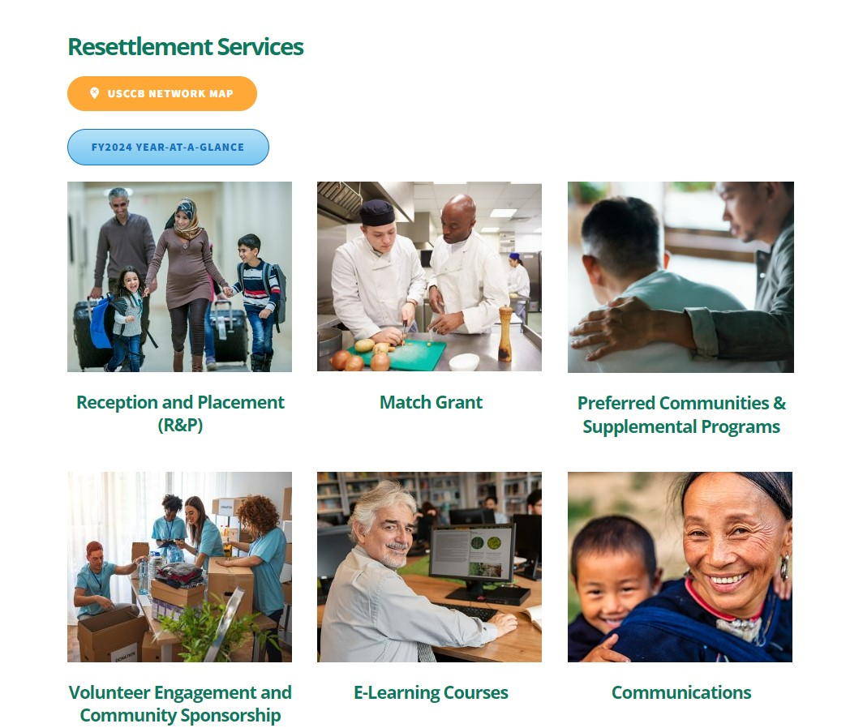
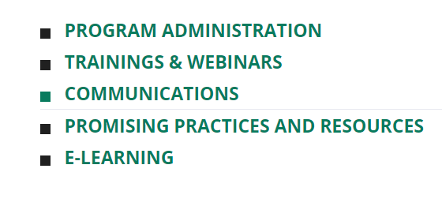
Webinar Recording on MRSConnect
All webinars for the fiscal year are saved on the Communications tile.
Today’s webinar will also be saved here on the R&P and Match Grant pages.

Slide 3

Introduction
Rebekah Korver, USCCB’s Community Sponsorship Coordinator, will be our facilitator today.
Rebekah

Slide 4
Identify the requirements for documenting volunteer time and mileage
1
Learning
Objectives
Review options for volunteer recording systems
2
By the end of this session, you will be able to:
Name strategies to incentivize volunteers completing volunteer services records
3

Slide 5
Volunteer Recordings Requirements
Baseline requirements:
Volunteers need to keep a record of their time and mileage in order for their time to count toward your program.
The record needs to be either signed by the individual or documented through a unique digital signature (login with username and password).
Copies of the records need to be in the case file for the relevant case.
The volunteer’s time should be valued at an hourly rate of your staff’s time to do similar work or what someone would be paid to do equivalent work in your local context.

Slide 6
Program Specific Requirements
Reception & Placement required form –
RF-20B: Volunteer Services Record
or equivalent
RF-20C: Summary of Cash & In-Kind Contributions and Volunteer Services,
or equivalent form, is optional for R&P
Match Grant required forms –
RF-20B: Volunteer Services Record
or equivalent
&
RF-20C: Summary of Cash & In-Kind Contributions and Volunteer Services
or equivalent

Slide 7
What volunteer activities count?
Rule of thumb: ask if you would charge staff time to the grant to do this same activity.
Religious activities never count.
Leave the burden of determining qualifying volunteer activities to staff – have volunteers report everything.

Slide 8
What about time with multiple cases?
Volunteers serving multiple cases at once should split their time across the cases.
Divide the time evenly between cases (e.g. 1 hour ÷ 2 cases = .5 hour per case).
Have the volunteer fill out a volunteer record for each case.

Slide 9
What about time with no particular case?
Time serving the program at large can be attributed as admin volunteering.
Volunteer can complete one admin record.
Admin records can be kept in a separate folder and included in totals reported to USCCB.

Slide 10
What about in-kind professional services?
In-kind professional services may be valued higher than general volunteer time.
Use the value of the volunteer’s professional time (invoice as proof).
If a professional donates time that isn’t in their professional expertise, count it as regular volunteer time.

Slide 11
What about mileage?
Mileage should be valued at the local rate that you reimburse mileage for staff (no higher than IRS rate).
Only count mileage that you would reimburse mileage for a staff member to do the same activity.
Driving related to wraparound services does not count.

Slide 12
What about Community Sponsorship?
Count each individual’s time, not the group’s.
Don’t count double for services that don’t require multiple people.
Only need to track for duration of grant period, not community sponsorship period.

Slide 13
Volunteer Recording Systems
Baseline requirements:
System should capture all volunteer time in one place but allow you to disaggregate by case and program.
Volunteers need to submit their own time and mileage into the system, confirming their donation to the program via a wet ink signature on a paper form or an e-signature or unique login (username and password) into a digital system.
System needs to allow for case-specific records to be included in the case file.

Slide 14
Recording System Options
Paper forms
Volunteer Database
WelcomeWorks (CS only)

Slide 15
Pros and Cons of Different Systems
Paper forms
Pros:
Low tech
Low cost
No digital literacy required of volunteers
Cons:
Typically requires more time and effort by volunteers and staff to collect
Time-intensive to aggregate reporting information
May be viewed as archaic by tech savvy volunteers
Databases
Pros:
Low effort collection for staff
Easy aggregation for reporting
Requires less time and effort for volunteers
Reduces chances that records will go missing
Cons:
Can be expensive
May require tech knowledge to set up
Can be difficult for less tech savvy volunteers to use

Slide 16
Volunteer Record Collection
Consider how you ask for volunteers to turn in their volunteer records.
Do you provide guidance on how to use your recording system that volunteers can refer back to?
Do you set a deadline for how long after an activity they have to turn in their volunteer record?
Do you follow-up with volunteers who fail to turn in their records?

Slide 17


What do you use to incentivize volunteers to turn in their volunteer records?
ⓘ Start presenting to display the poll results on this slide.

Slide 18
Tips for Collecting Volunteer Records
Make your system as user-friendly as possible.
Explain the significance and value of volunteer time to your program.
Let volunteers know the collective total of volunteer hours regularly.
Offer public recognition for the individual or community sponsor with the most records.
Offer a small prize when volunteers turn in records.
Set realistic expectations.

Slide 19
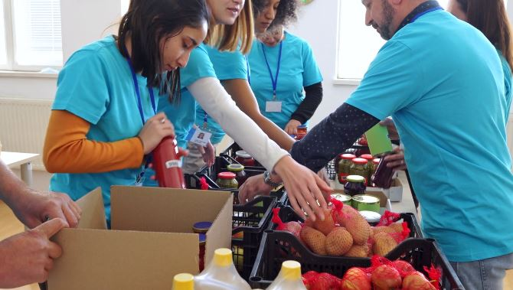
Questions?

Slide 20

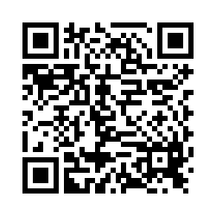
Please share your thoughts.
Anonymous Survey
You can scan this QR code with your phone’s camera.
Or, there is a link to the same survey in the chat.
Notes:
7

