Slide 1
FY24 Q3 Cultural Orientation Community of Practice (CO CoP)
May 21, 2024

Slide 2
Introduction
Elena will be our facilitator today.
Elena

Slide 3
Today’s Agenda
1
CO Updates
3
CO Documentation Discussion
2
CO and the FY24 R&P Redesign
4
R&P Performance Outcomes
5
Q&A

Slide 4
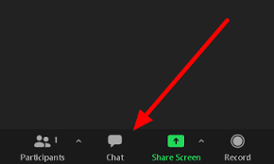
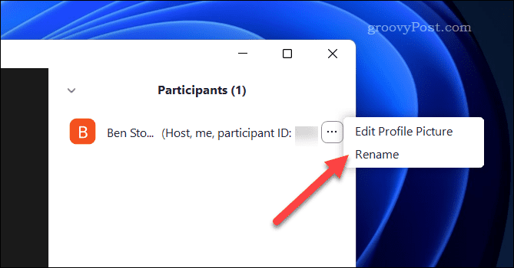
Zoom Features
CHAT
MUTE / UNMUTE
RENAME

Slide 5
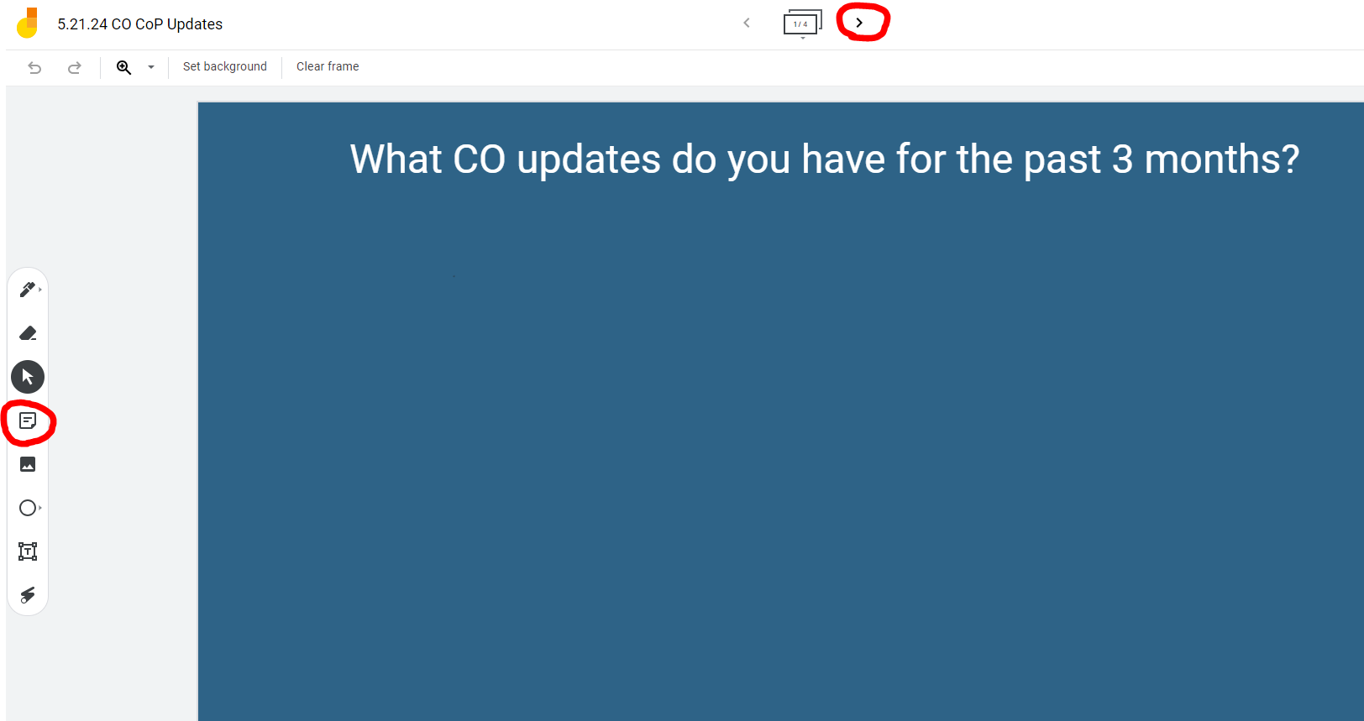
Affiliate CO Updates
Please use the Jamboard link in the chat to answer questions on slide 1 and 2
Notes:
Jamboard link: https://jamboard.google.com/d/1MTuiHO-YVuZf11TTTkqSKyhtvWQ8roLfxHu4t13gIQ0/edit?usp=sharing

Slide 6
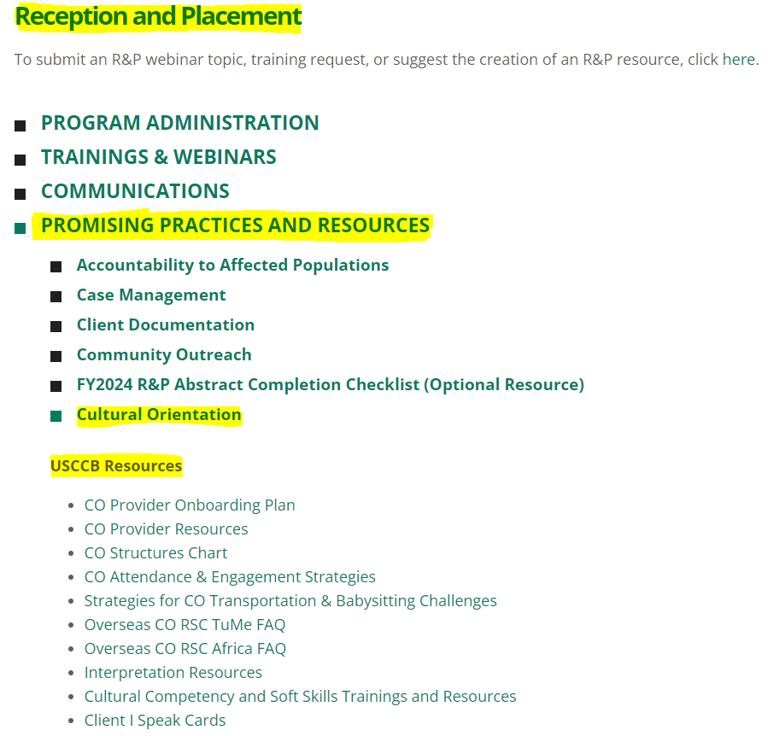
USCCB/MRS CO Updates
NEW USCCB/MRS CO Resources on MRS Connect
2 CO Working Group Updates
Latin American Arrivals Survey

Slide 7
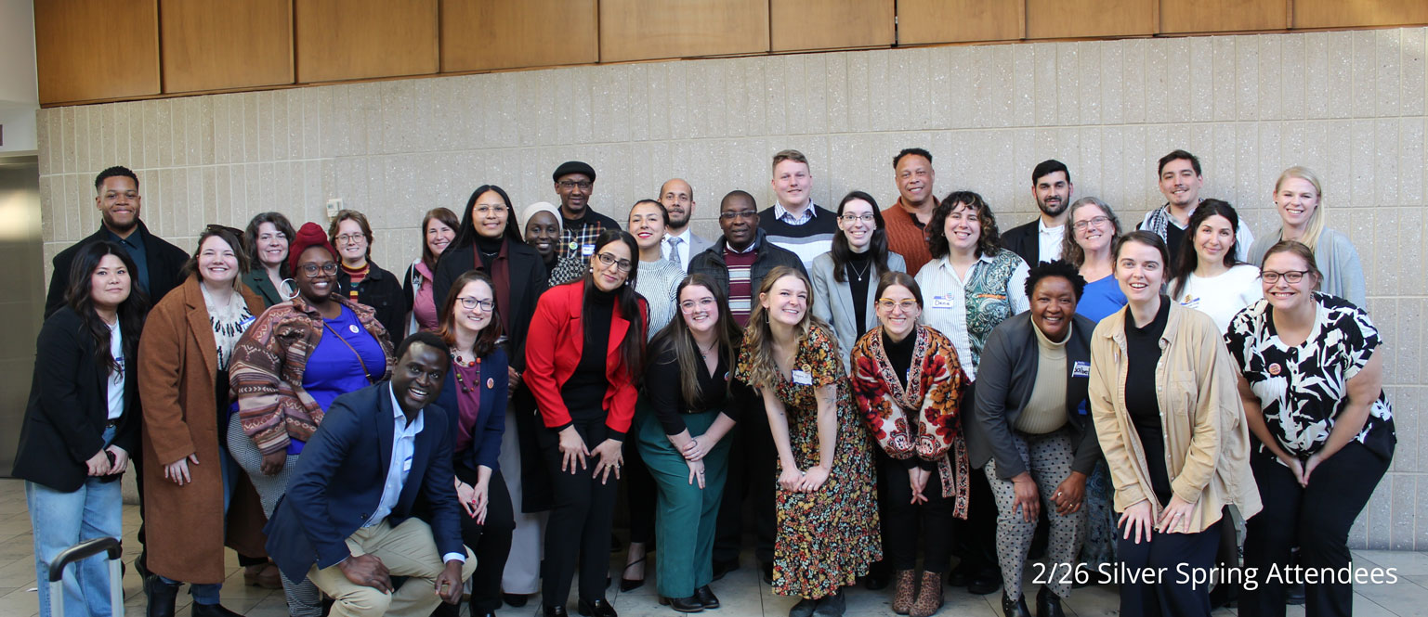
CORE CO Updates
CO Knowledge Exchange Workshops in February 2024
Notes:
- CORE’s The Road Ahead curriculum: https://coresourceexchange.org/the-road-ahead-a-domestic-cultural-orientation-curriculum/
- Sign up for the CORE Connection Newsletter at the bottom of this webpage: https://coresourceexchange.org/

Slide 8
CORE CO Updates
The Road Ahead CO curriculum (session plans and power point slides) now available in multiple languages!
Sign up for the CORE Connection newsletter to stay updated!
Notes:
- CORE’s The Road Ahead curriculum: https://coresourceexchange.org/the-road-ahead-a-domestic-cultural-orientation-curriculum/
- Sign up for the CORE Connection Newsletter at the bottom of this webpage: https://coresourceexchange.org/

Slide 9
CO in the FY24 R&P Redesign
Standard R&P | Cash-Based R&P | Virtual R&P (VR&P) | Remote Placement | Welcome Corps
Resettlement Agency provides CO using the CO Objectives & Indicators. CO Documentation: CORE Model Assessment and USCCB/MRS CO Checklist form (on MRS Connect) are required. No CO case notes for clients who arrived on or after April 1, 2024. R&P Period Reports is the same. | Resettlement Agency gives clients the USCCB/MRS CO Resource List for Cash-Based R&P Track along with the required USCCB/MRS Cash-Based R&P Client Resource Guide (RF-18D) form. Resettlement Agency can invite cashed-out clients to Standard R&P CO classes. CO Documentation: None (mark N/A for CO in R&P Period Reports) | USCCB/MRS virtual case managers discuss CO concepts as they deliver other virtual services. Clients can call IRC hotline with potentially CO-related urgent questions. CO Documentation: TBD | Community Partner provides CO. | Sponsor group provides CO.
Notes:
- USCCB/MRS High Arrivals & Cash-Based R&P webinar recording: https://usccb.zoom.us/rec/share/fuoKjralzXwOpvusu7-VuqPq-16YADlrGtVE-hgo5CcrGRCqoSuyOfBXtOU3GeKv.tzBNCPK01Pt9uTQo

Slide 10
CO Documentation Discussion
Notes:
Do you all feel like these changes and only needing to complete the CO Checklist and CORE Model Assessment will make it easier for you all to complete CO documentation?
How do you all feel about the CORE Model Assessment? Any ideas on other ways we could use to assess clients on their CO understanding?

Slide 11
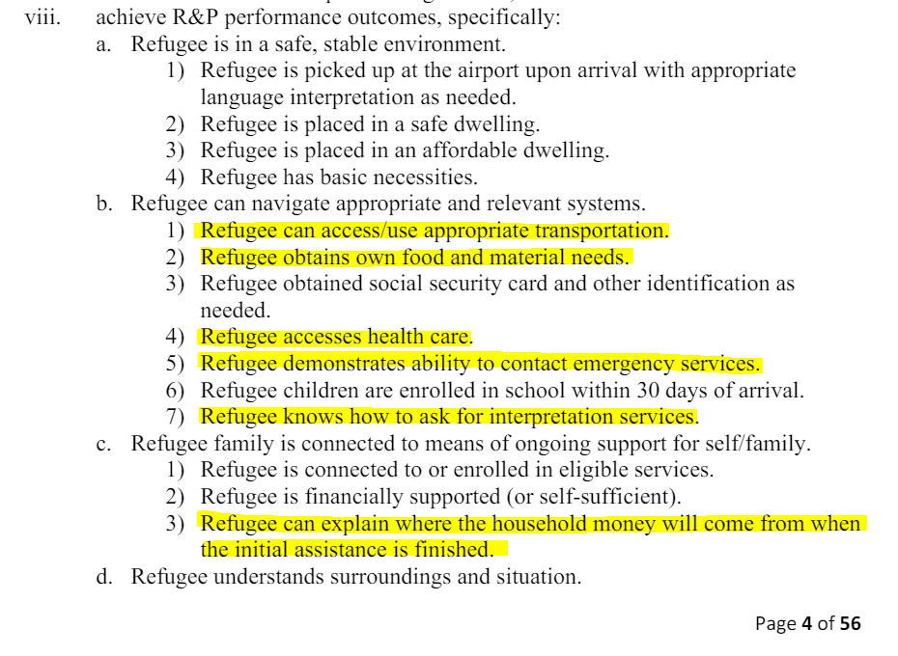
R&P Performance Outcomes
Notes:
R&P Performance Outcomes in R&P Cooperative Agreement on MRS Connect: https://mrsconnect.org/resettlement-services/reception-and-placement-rp/rp-cooperative-agreement/
Whole Office CO Approach: https://coresourceexchange.org/whole-office-approach-to-cultural-orientation/
CORE Activity Bank: https://coresourceexchange.org/activity-bank/
CORE The Road Ahead CO Curriculum: https://coresourceexchange.org/the-road-ahead-a-domestic-cultural-orientation-curriculum/

Slide 12
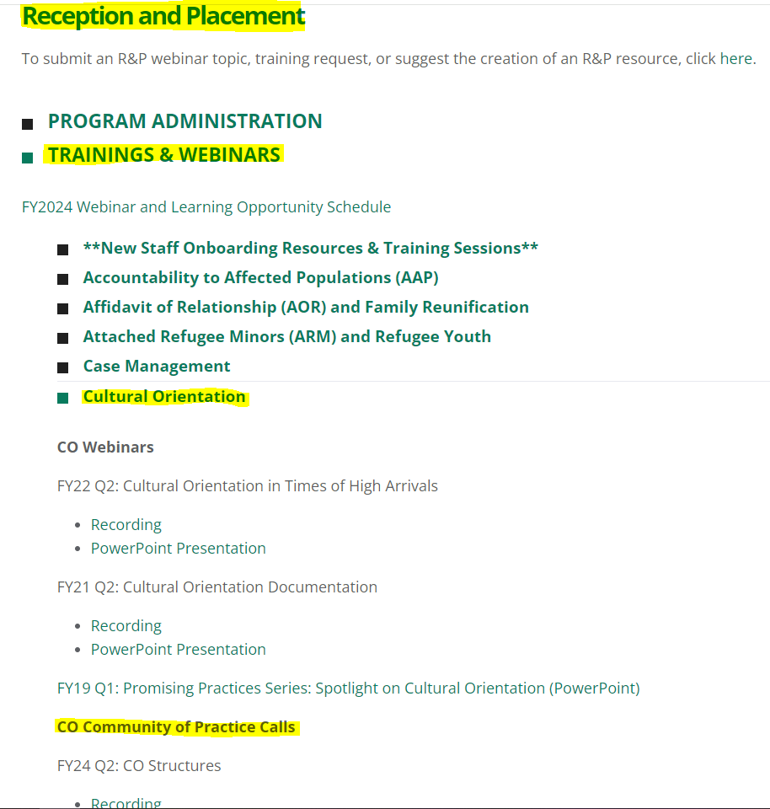
CO CoP Recordings and Presentations

Slide 13
Questions?
Email etothazan@usccb.org
Next CO CoP meeting: August 20 @ 3:00pm EST

