Slide 1


Completing the FY2025 R&P Abstracts
May 29, 2024

Slide 2

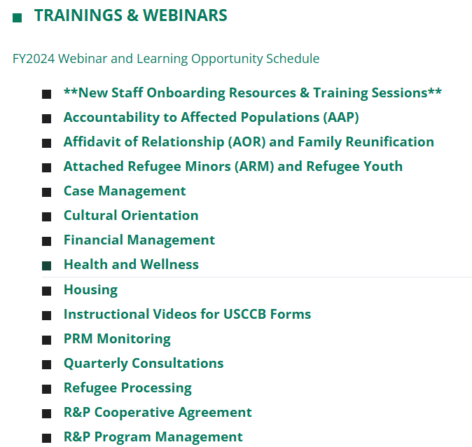
Webinar Recording on MRSConnect
All webinars for the fiscal year are saved on the Communications tile.
Today’s webinar will also be saved here on the R&P page.

Slide 3

Today’s Agenda
1
Intro to the Abstracts Review Process
2
Deep Dive Into the Abstracts Template
3
Understanding the Abstracts Supplement
4
Q&A Session

Slide 4
Understand the timeline for completing, revising, and submitting your FY25 R&P Abstract
Learning
Objectives
1
Describe the information needed to complete each of the four sections of the abstract
2
By the end of this session, you will be able to:
Identify additional information needed to complete the abstract supplement
3

Slide 5

Introduction to the USCCB
Abstracts Review Process
Timelines and expectations for the USCCB affiliate network

Slide 6

Ask the Audience!
Give me a thumbs up if you have been involved in completing affiliate abstracts.
We are about to turn the process on its head!

Slide 7
Piloting a New Process
What is Changing? And Why?!
In previous years, Resettlement Directors (RDs) received the affiliate abstracts, attended a webinar hosted by USCCB, completed their abstract on their own, and went through a 2–3-week process of engaging with their FSC
RDs had to remain on stand-by for the entire review period in case of last-minute questions from their Field Support Coordinator (FSC), Pre-Arrival Case Manager (PACM), or Grants and Programs Administrator (GPA).
The new process aims to:
Reduce the number of times RDs are contacted by USCCB regarding abstracts
Establish clear timelines, procedures, and due dates for affiliate staff
Provide more beneficial one-on-one time to RDs while the abstracts are still in draft form and well ahead of the submission deadline

Slide 8
Timeline for FY25 Abstracts
Prep + Initial Draft
Guided Review
Revise and Submit
WED 5/22:
Abstracts (including the abstract supplement) sent to RD
WED 5/29 (today!):
Abstracts webinar
Early June:
RD meets with agency staff (CEO, finance, medical CM, etc.) and stakeholders + complete first draft of abstract
MON 6/3-FRI 6/7:
USCCB team will contact RDs to schedule one-on-one abstract review calls
MON 6/3-FRI 6/14:
RD submits first draft to USCCB reviewer and attends abstracts call
During the Call:
USCCB team identifies follow-up actions for RD to take and due dates
By COB FRI 6/14:
RD completes follow-up and submits abstract to MRSReports@usccb.org
By COB WED 6/26:
PACM and Post-Arrival teams review abstracts
By COB TUE 7/2:
USCCB R&P managers review abstracts for any high-level changes that need to be made

Slide 9

Deep Dive Into the Affiliate Abstracts Template

Slide 10
The Four Sections of the Abstract
Basic Affiliate
Data
R&P Caseload Statistics
Cases with Significant Medical Conditions
Stakeholder Consultation Information
Office Name
Office Address
Sub-Office Info
Satellite Office Info
FY 2023 Actuals
FY 2024 Anticipated
FY 2025 Proposed
Nationality/Language
This is a New Section!
Verification Steps
Consulting Partners
Other Preparations
Consultation Data
Concerns + Solutions
Capacity Rationale
Local Coordination

Slide 11
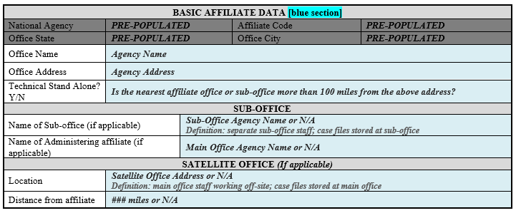
Basic Affiliate Data (blue section)
Tips for this section
Ensure you understand the distinction between a sub-office vs. a satellite office
Technical stand alone considers all same-state resettlement locations such as affiliates (even other USCCB sites) and sub-offices (including your own if you have one). Do not count satellite offices or remote placement community partners when assessing this for your agency.

Slide 12
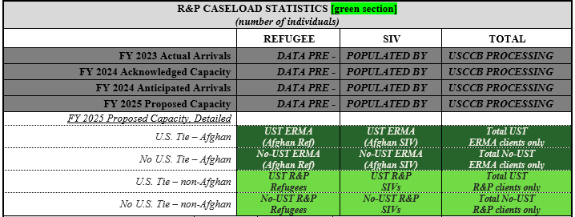
R&P Caseload Stats (green section)
Slide 1 of 2
Tips for this section
ERMA-funded (Afghan refugees + Afghan SIVs) vs. MRA-funded (all other refugee + SIV cases)
Note the U.S. tie vs. non-U.S. tie categories for each. Some groups (e.g., NUST SIVs) may be zero.
Use your best guess to quantify the number of clients that will fall into each sub-group. The total should add up to your FY 2025 proposed capacity

Slide 13
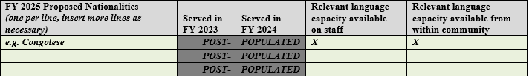
R&P Caseload Stats (green section)
Slide 2 of 2
Tips for this section
Your list of proposed nationalities can include new groups and groups your site has already resettled.
Language capacity within your community and on-staff will play a large role in whether you can successfully resettle clients of certain nationalities
After you submit your abstract to MRSReports, USCCB/MRS Processing staff will fill in whether or not you have served the various populations in FY23 and FY24, so no need for you to complete this data

Slide 14
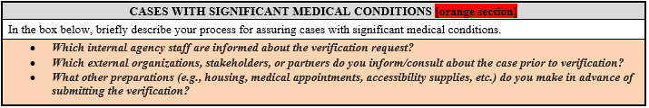
Significant Medicals (orange section)
Tips for this section
This is a new section on the affiliate abstracts. USCCB/MRS staff included guiding questions to assist you with drafting a description of your assurance (verification) process for medical cases.
Provide an answer to each question in the response box. Responses can be in narrative form or listed as bullet points under each question
You may need to consult with other staff at your agency if another person is closely involved in the day-to-day of serving medical cases.
Examples: Health Liaisons, AmeriCorps Vistas, Medical Case Managers, and/or community sponsors

Slide 15
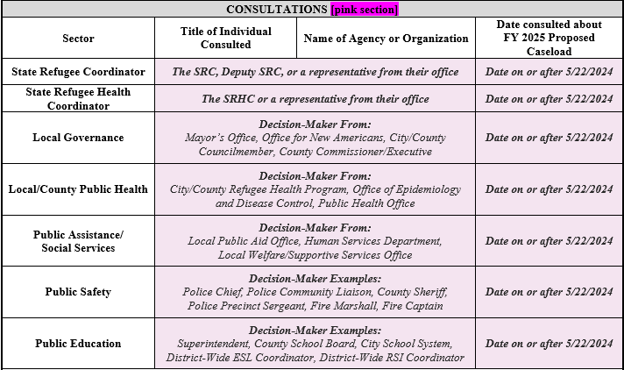
Consultations (pink section)
Slide 1 of 2
Tips for this section
The stakeholders (or sectors) are the same as for your Quarterly Consultation (QC).
As with regular QCs, consultation must occur via phone, video call, or in-person. An email does not meet the requirement.
As with regular QCs, reps must be decision-makers in their sector.
Reps do not need to be consulted at the same meeting (unlike with QCs, which must be simultaneous to be in full compliance)

Slide 16
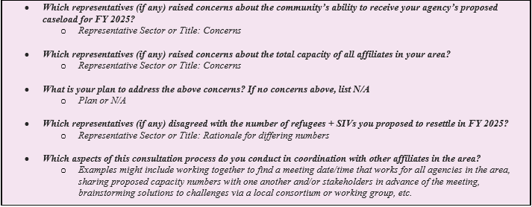
Consultations (pink section)
Slide 2 of 2
Tips for this section
Provide an answer to each question in the response box. PRM and USCCB strongly encourage you to use bullet points to concisely capture all of the required information.
It is okay (and in some locations, expected!) if you disagree with any of the stakeholders. Any concerns are important to share as this info helps PRM conduct their risk analysis in each geographic region

Slide 17

Understanding the
Abstracts Supplement

Slide 18
Four Sections of the Supplement
ERMA Local Capacity Develop. Funding
Financial Contribution to R&P
Co-Sponsors and Support Teams
Temporary Housing Statistics
Amount requested and description of each budget line item (admin funding only)
FY 2023 Actuals
FY 2024 Anticipated
FY 2025 Projected
DA vs. Admin Split
Projected number of co-sponsor groups, support teams, and clients supported
Quantifying the resources put towards securing temporary housing

Slide 19
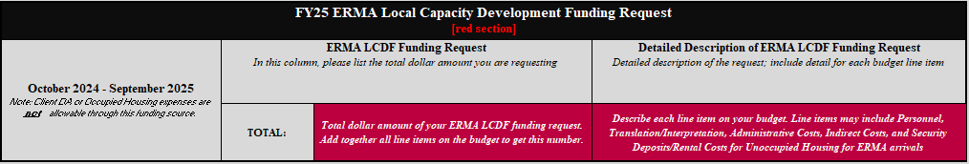
FY25 ERMA Capacity Funds (red section)
Tips for this section
It may be easier to start with identifying line items and estimating your costs for each of those, then tallying everything into a grand total
Each budget line item requires a description as evidence that the costs are 1) only for administrative purposes, and 2) only applicable to building capacity to serve ERMA-funded cases. These amounts and descriptions go in the box on the right.
Once you calculate your total administrative capacity development request as applicable to building capacity to resettle ERMA-funded cases, this number goes in the Total box (on the left)

Slide 20
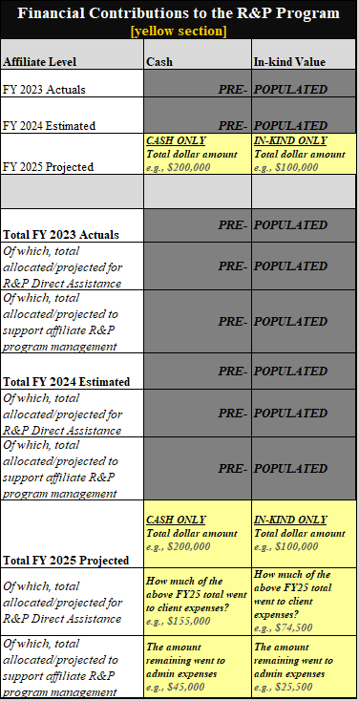
Finance Table (yellow section)
Slide 1 of 2
Tips for this section
If either FY23 or FY24 numbers look inaccurate, please update them accordingly
For FY25, you may need to consult with agency leadership and/or your agency’s finance staff to ensure the projections are fairly accurate
FY23 and FY24 are based on reported data submitted by your finance staff and/or your previous year’s abstract

Slide 21
Finance Table (yellow section)
Slide 2 of 2
Tips for this section
This table should only contain 1) private contributions – no federal funds, and 2) only the value of cash and in-kind in support of R&P
You may need to consult with agency leadership and/or your agency’s finance staff to ensure the projections are fairly accurate
Be mindful of the division between R&P Direct Assistance (i.e., funds given to or spent on behalf of clients) vs. R&P Program Management (i.e., admin funds)

Slide 22
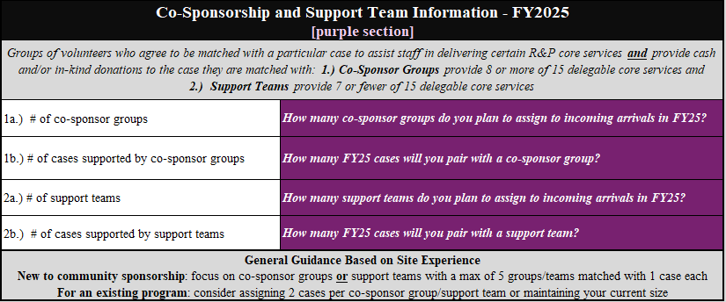
Community Sponsorship (purple section)
Tips for this section
Keep in mind the definitions of co-sponsor groups vs. support teams – this is based on the number of services provided by the group or team (8+ of the fifteen delegable services vs. 7 or fewer)
In general, most co-sponsor groups and support teams support 1 case per year

Slide 23
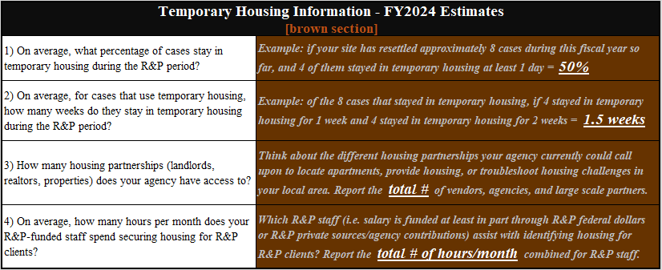
Temporary Housing Data (brown section)
Tips for this section
Double check that you are reporting the correct type/quantity of information (e.g., a percentage, number of weeks, etc.) for each question. Your best guess is totally fine!
This data will be used to demonstrate need for housing assistance in communities across the U.S.

Slide 24

Q&A Session
What questions do you have?

Slide 25
Do you have lingering questions?
Green Section: Contact your site’s USCCB/MRS Pre-Arrival Case Manager (PACM)
Blue, Orange, and Pink Sections: Contact your site’s USCCB/MRS R&P Field Support Coordinator (FSC)
Red and Yellow Sections: Contact the USCCB/MRS Grants and Programs Administrator (GPA) for R&P: Caiti Kelleghan (CKelleghan@usccb.org) – with your site’s R&P FSC in copy
Purple Section: Contact the USCCB/MRS Community Sponsorship Coordinator:
Rebekah Korver (Rkorver@usccb.org) – with your site’s R&P FSC in copy
Brown Section: Contact the USCCB/MRS National Housing Coordinator:
Negena Haidary (Nhaidary@usccb.org) – with your site’s R&P FSC in copy
Thank you for attending!

Slide 26
Webinar Recording on MRSConnect
All webinars for the fiscal year are saved on the Communications tile.
Today’s webinar will also be saved here on the R&P page.

Slide 27

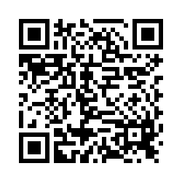
Please share your thoughts.
Anonymous Survey
You can scan this QR code with your phone’s camera.
Or, there is a link to the same survey in the chat.
Notes:
7

