Slide 1
High Arrivals and Cash-Based R&P
April 2024

Slide 2
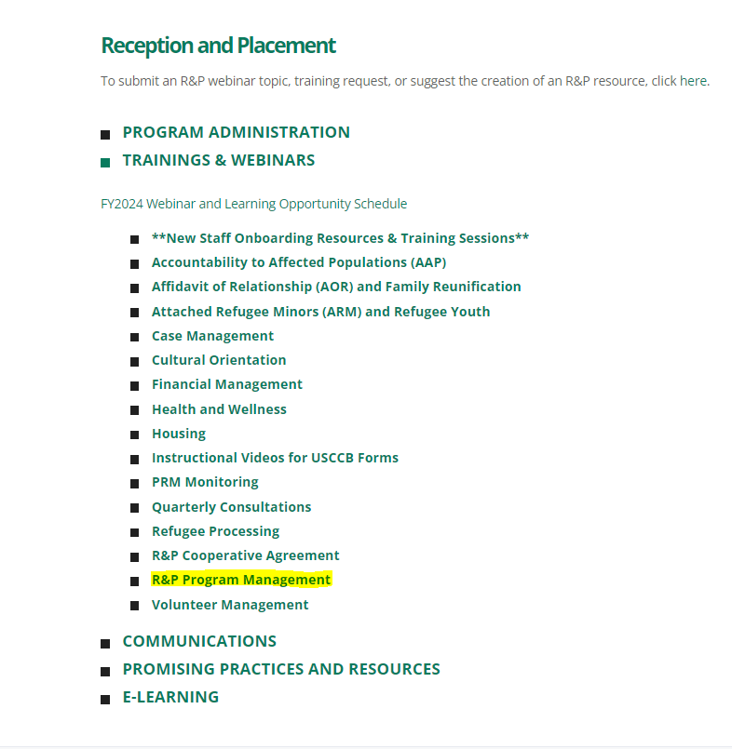
Webinar Recording on MRSConnect
All webinars for the fiscal year
Today’s webinar will also be saved on the R&P page

Slide 3
Today’s Agenda
Big Picture Considerations
Review of New Cash-Based R&P Process
Old vs. New Cash-Based Process for USCCB Affiliates
Overview of Cash-Based R&P:
Eligibility
Timeline
Resources on MRSConnect
Pre-arrival and post-arrival staff activities
Review of Cash-Based R&P Scenarios
Overview of Resettlement Pathways
Q&A

Slide 4
Learning Objectives
By the end of this 90-minute session, you will be able to:
1) Explain elements of the new the Cash-Based R&P program
2) Understand how cases can be assured to the new Cash-Based R&P program;
3) Outline USCCB expectations for service provision and documentation for R&P cases using Cash-based R&P

Slide 5
Big Picture Considerations
Current Situation in USRAP
Capacity Issues -- Limiting placement of cases with US Tie and uptick in outmigration
Financial challenges at the affiliate level – the R&P program has not kept up with costs
Desire to make full utilization of refugee slots available
Largely successful U4U and CHNV programs that have harnessed US-based support
PRM is redesigning Cash-Based R&P to:
Share the load with US Ties
Provide a client-centered R&P program, not one size fits all

Slide 6
NEW Cash-Based R&P Process
This PRM-designed Cash-Based R&P process will completely replace USCCB/MRS' previous R&P Cash-Based Model process for all arrivals (and new assurances) on/after May 1, 2024.
You will no longer complete SAM Assessments, and a decision to "reinstate" a client into service-based R&P will be up to PRM.
Cash-Based R&P:
New eligibility requirements
New process
New forms
New timelines

Slide 7
Overview of Cash-Based R&P
Cash-Based R&P: Clients who meet all eligibility criteria, including having U.S. Ties who can provide/secure client housing (and help navigate core services) without agency assistance - can receive their R&P direct assistance per-capita upfront.
Cash-Based R&P clients:
Will not receive agency assistance with finding/securing temporary or permanent housing
Will not have an R&P case manager
Will be counseled/given resources by R&P staff about how to complete core services independently/with their US Tie
Will receive a wellness check conducted by affiliate staff 30-60 days after arrival
Will be eligible for the same ORR services as service-based R&P clients, including Refugee Support Services and Match Grant
Who is NOT ELIGIBLE for Cash-Based R&P?
Cases without a US Tie in your location
Cases whose US Ties cannot, or will not, provide or secure temporary/permanent housing for the case
Cases with attached refugee minors (M-codes M2, M3, M5, M6, M7)
Cases with complex medical conditions, including behavioral health issues
Cases with Class A or Class B medical conditions

Slide 8
Overview of Cash-Based R&P Process
Before submitting assurance:
U.S. Tie Assessment
Within 7 working days of domestic arrival:
Service Plan Assessment, Cash-Based R&P Agreement, Cash-Based R&P Client Resource Guide
30-60 days after arrival:
Cash-Based R&P Wellness Check
Within 7 days of the 90th day: Submit R&P Period Report in MRIS
RSC will tell all clients overseas that Cash-Based R&P may be their resettlement pathway
Clients should receive/acknowledge R&P direct assistance per-capita promptly after signing Cash-Based R&P Agreement
Follow deadlines in R&P award letters for submitting billing, reporting
You will decide before you assure the case whether you intend to put a client in Cash-Based R&P or service-based R&P. This decision is based on biodata review and the US Tie Assessment.

Slide 9
Cash-Based R&P: Pre-Arrival
Receive an assurance request in MRIS → evaluate the case biodata for potential Cash-Based R&P eligibility
If biodata supports eligibility, reach out to the US Tie immediately to complete the USCCB/MRS Cash-Based R&P US Tie Assessment (RF-18A)
By the time you assure the case, you should know whether you plan to put the case into Cash-Based R&P or service-based R&P
Every month, you will report to USCCB/MRS which assured cases you intend to put into Cash-Based R&P.
Until this is built into MRIS assurance forms, info will be submitted via very simple spreadsheet to the USCCB/MRS pre-arrival team – more details coming soon.
There will also be a process to amend assurances

Slide 10
Assessing Cases for Cash-Based R&P
Cash-Based R&P relies on a thorough assessment of US Tie capacity and willingness, which will take significant staff resources
US Tie Assessment and biodata review are investments of time upfront to ensure the right cases are placed into Cash-Based R&P
USCCB/MRS will provide more in-depth training on using the US Tie Assessment, but will rely on your expertise in working with US Ties and local resources to make determinations

Slide 11
Cash-Based R&P: Post-Arrival
(within 7 working days of domestic arrival)
At the intake appointment:
R&P Service Plan Assessment (RF-18B)
Form will require Resettlement Director approval signature if case manager intends for the client to “switch” tracks (i.e., case was assured for Cash-Based R&P, but agency wants to shift them to Service-Based R&P)
Cash-Based R&P Agreement (RF-18C)
Cash-Based R&P Resource Guide (RF-18D)
Direct assistance given ASAP
Notify clients about 30-60 Day Wellness Check

Slide 12
Cash-Based R&P: Post-Arrival
(after case is enrolled in Cash-Based R&P)
Between day 30 and day 60 after arrival, affiliate staff will do a Wellness Check with clients, and complete the USCCB/MRS Cash-Based R&P Wellness Check Form (RF-18E)
If issues are identified during the wellness check:
Counsel clients about resources available (see previous slide)
If serious safety concerns are identified, notify USCCB/MRS to discuss options
Submit R&P Period Report for case within 7 days of the case’s 90th day
Any core services case members/US Tie completed independently – mark “N/A”
Ensure case file documentation is complete
Ensure financial billing is submitted timely in MRIS

Slide 13
Cash-Based R&P: Managing Client Expectations
Managing client and US Tie expectations:
Clients do not "opt into" Cash-Based R&P – they are placed into Cash-Based R&P by affiliate staff
Once all adult clients sign the Cash-Based R&P Agreement, the case cannot "revert" to service-based R&P without PRM approval
But resources do exist for clients who feel they need more support – IRC hotline, Cash-Based R&P Resource Guide, ability to access ORR services
PRM included the option for a signed US Tie Assessment form - helpful tool to underline seriousness of US Tie commitment
IRC Hotline: (201) 733- 2748

Slide 14
Cash-Based R&P Scenarios

Slide 15
Cash-Based R&P Scenarios:
Pre-Arrival – CB R&P Eligibility
1. We did the US Tie Assessment, and the US Tie cannot provide or assist with housing, either temporarily or permanently. Is this case still eligible for Cash-Based R&P?
No. US Tie assistance with both temporary (if needed) and permanent housing is a requirement for Cash-Based R&P.
2. We did the US Tie Assessment, and the US Tie can provide/assist with temporary housing, but cannot help with permanent housing. Is this case still eligible for Cash-Based R&P
No. To be eligible for Cash-Based R&P, the US Tie must agree to assist with both temporary (if needed) and permanent housing.
Note that "assist with housing” does not mean the US Tie must house clients in their (US Tie’s) dwelling, but it does mean the US Tie and case members are responsible for finding/securing housing for the case.

Slide 16
Cash-Based Model Scenarios:
Pre-Arrival – CBM Eligibility
3. We did the US Tie Assessment with the US Tie, and the US Tie is willing to house the case, but we do not believe their apartment is big enough for this size family (or there are other issues with the apartment). What should I do next?
Per PRM, in Cash-Based R&P, housing does not need to meet the exact standards of traditional expectations for R&P housing. The role of the affiliate is to counsel the US Tie about the standards for safe, sanitary, and affordable housing. During the US Tie Assessment, affiliate staff will make a determination if the housing provided is reasonable and safe.
4. We did the US Tie Assessment, and the US Tie agreed to provide housing. I just got the travel notification, and when I reached out to the US Tie to notify them of their family member’s arrival date, and the US Tie said they can no longer provide housing. (Or I can’t reach the US Tie at all!) What should I do next?
If you have capacity, you could resettle the case and serve through service-based R&P.
With limited capacity, you could inform USCCB that you can no longer resettle the case. At that point, the case may be resettled as a no US Tie case elsewhere.

Slide 17
Cash-Based Model Scenarios:
Pre-Arrival Issues – CBM Eligibility
5. I’m in Colorado, but I assured a case with a US Tie in Washington, DC, because the US Tie in DC could not provide housing. The US Tie has been calling my office nonstop, and I feel confident that the case will arrive, and then immediately leave for DC. What are my next steps?
Since this case does not have a US Tie in your service area (Colorado), they are not eligible for Cash-Based R&P from your office; this case would not be assured to Cash-Based R&P
Distinction between Cash-Based R&P and clients requesting the balance of their R&P funds

Slide 18
Cash-Based Model Scenarios:
Post-Arrival – CBM Eligibility
6. This case was assured for Cash-Based R&P, and their US Tie agreed to help with a lot of services. However, now that I’ve talked to this case at intake, I no longer think Cash-Based R&P is a good fit for this family - they seem to have more serious medical needs than their biodata indicated. What are my options?
Since this case has not yet signed the Cash-Based R&P Agreement, you can still “switch” them to service-based R&P without PRM approval
7. This case was assured for Cash-Based R&P, but when we did the intake appointment, the clients were very unhappy to hear they will not have a case manager. They are demanding that our office provide them with full R&P services, including a case manager. What should I tell them?
Agency has ability to place clients into Cash-Based R&P
Agency had discussion (+ potentially signed agreement) with US Tie
Emphasize the benefits of cash-based R&P – more flexibility, funding up front
Ask if you can complete the Service Plan Assessment/look at Resource Guide together, and see if they feel differently afterward
USCCB/MRS and PRM will support the agency if a grievance is filed

Slide 19
Cash-Based Model Scenarios:
Post-Arrival – CBM Service Provision
8. We enrolled a case in Cash-Based R&P, but the family is still calling us daily, requesting support from our case managers. What should we tell them?
Remind clients that they signed a Cash-Based R&P Agreement, and at the time of enrollment, you reviewed services they would need to complete. Review resources with clients.
9. We did the Wellness Check on a family in Cash-Based R&P, and there are a lot of outstanding issues for the case – their housing needs repairs, and the family says they still have not received their food stamps. What should we do?
Once a case has signed the Cash-Based R&P Agreement, the affiliate is not responsible for the R&P core services that the clients have agreed they (and/or their US Tie) will complete.
At the Wellness Check, staff should:
Counsel clients about how to meet outstanding needs - the Cash-Based R&P Resource Guide, IRC Hotline, ORR-funded support services, may be helpful to review here
Responsibility still remains with the clients and their US Tie to complete these actions.

Slide 20
Overview of Resettlement Pathways
(adapted from PRM-created resource)
 | Standard Resettlement | Cash-Based Resettlement | Virtual Resettlement (VR&P) | Remote Placement | Welcome Corps
Capacity and Consultation | Included in each affiliate's confirmed capacity for fiscal year; consultations with SRC at beginning of FY and if any subsequent increases | Included in each affiliate's confirmed capacity for fiscal year; consultations with SRC at beginning of FY and if any subsequent increases | Capacity determined by participating RAs in consultation with PRM; arrivals reported to SRCs monthly | Consultations with SRCs for new partners | Capacity determined by Community Sponsorship Hub in consultation with PRM; arrivals reported to SRCs monthly
Placement Location | No guarantee of placement with U.S. Tie | Guaranteed to be placed with U.S. Tie | Guaranteed to be placed with U.S. Tie | Placed in the same location as U.S. Tie or community partner | Placed in the same location as the sponsors

Slide 21
Overview of Resettlement Pathways (cont.)
(adapted from PRM-created resource)
 | Standard Resettlement | Cash-Based Resettlement | Virtual Resettlement (VR&P) | Remote Placement | Welcome Corps
R&P Per-Capita Funds | Resettlement agency manages R&P Per Capita Funds | Refugee receives entirety of R&P Per Capita Funds upon arrival | Refugee receives entirety of R&P Per Capita funds upon arrival | Community partner manages R&P Per Capita Funds | No R&P Per Capita; Sponsor Group pays bills for immediate needs on refugees’ behalf for up to 90 days
Housing | Resettlement agency responsible for securing housing | U.S. Tie responsible for securing housing | U.S. Tie responsible for securing housing | Community partner responsible for securing housing | Sponsor Group responsible for securing housing

Slide 22
Overview of Resettlement Pathways (cont.)
(adapted from PRM-created resource)
 | Standard Resettlement | Cash-Based Resettlement | Virtual Resettlement (VR&P) | Remote Placement | Welcome Corps
Case Management | Resettlement agency case manager | No resettlement agency case manager; refugee relies on U.S. Tie, hotline, and resource guide | Virtual resettlement agency case manager | Community partner and U.S. Tie support | Sponsor group support
Benefits and Services | Eligible for all refugee benefits, as applicable, from federal, state, and local providers | Eligible for all refugee benefits, as applicable, from federal, state, and local providers | Eligible for all refugee benefits, as applicable, from federal, state, and local providers | Eligible for all refugee benefits, as applicable, from federal, state, and local providers | Eligible for all refugee benefits, as applicable, from federal, state, and local providers

Slide 23
If you’re interested in Cash-Based R&P, here are the next steps
Develop Cash-Based R&P Policy (template coming soon!)
Update the Cash-Based R&P Resource Guide (RF-18D)
Decide what (if any) core services your agency elects to provide for all Cash-Based R&P cases (write into Service Plan Assessment)
Decide how Cash-Based R&P clients will be connected to ORR-funded services, agency services (e.g., for filing AORs)
While PRM is not requiring local consultation on Cash-Based R&P, USCCB/MRS strongly encourages affiliates to coordinate with other local agencies

Slide 24
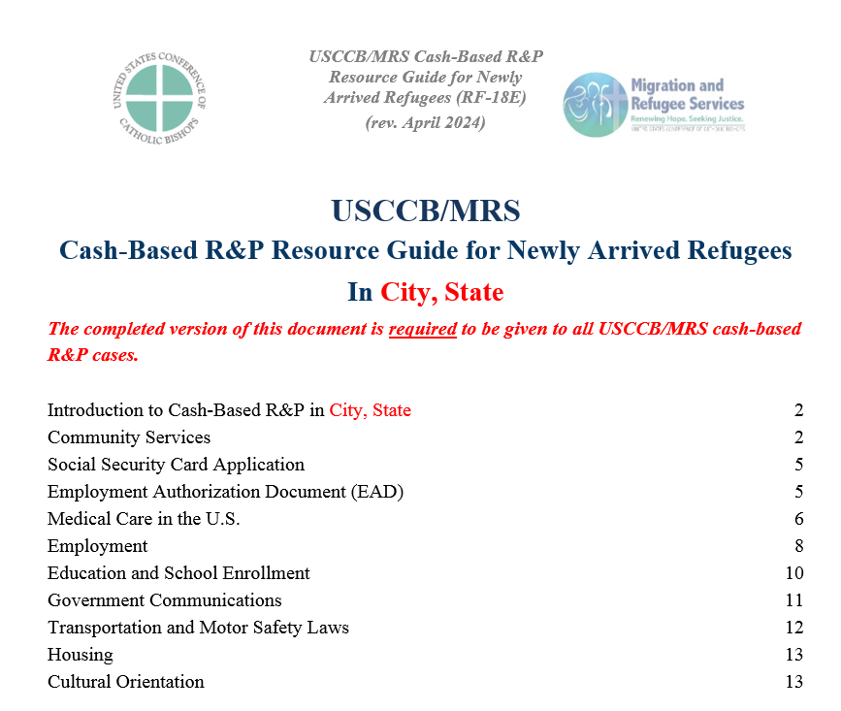
USCCB/MRS Cash-Based R&P Resources
Case File Forms on MRSConnect:
USCCB/MRS R&P US Tie Assessment (RF-18A) (rev. 04/2024)
Coming soon – USCCB/MRS R&P Service Plan Assessment (RF-18B)(rev. 04/2024)
USCCB/MRS Cash-Based R&P Agreement (RF-18C) (rev. 04/2024)
USCCB/MRS Cash-Based R&P Client Resource Guide (RF-18D) (rev. 04/2024)
USCCB/MRS Cash-Based R&P Wellness Check Form (RF-18E) (rev. 04/2024)
Still to come:
Cash-Based R&P Policy Template
R&P Service Plan Assessment (RF-18B)
R&P Cooperative Agreement with Cash-Based R&P language
USCCB/MRS Cash-Based R&P monitoring tool
Updated R&P POM
Please take the survey (link in the chat)

Slide 25
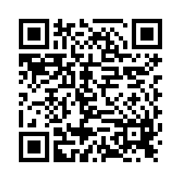
Please share your thoughts.
Anonymous Survey
You can scan this QR code with your phone’s camera.
Or, there is a link to the same survey in the chat.
Notes:
7

Slide 26
Questions?
Please add questions to the Q&A box or raise your hand.

