Slide 1


Kathy Jagow
Grants and Programs Administrator
USCCB
kjagow@usccb.org
Intro to Match Grant Reimbursements, Match, and the Supplemental Grant Period March 2024

Slide 2
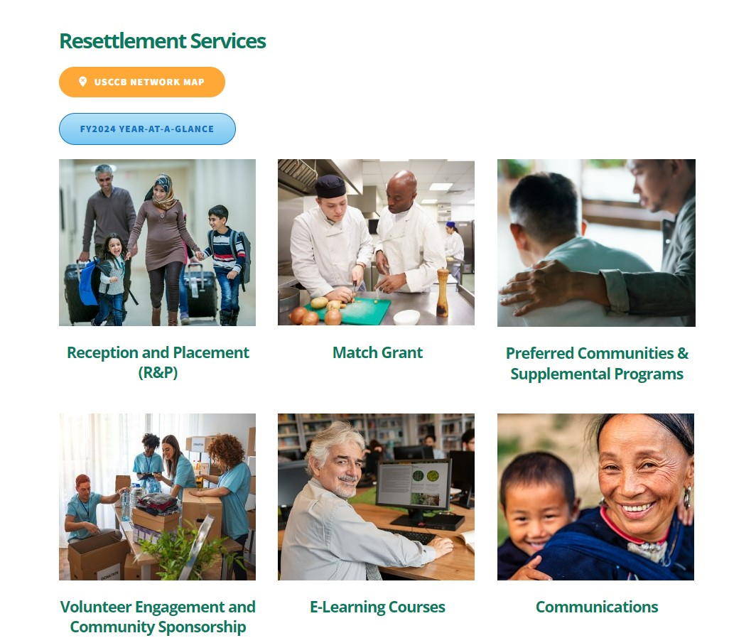
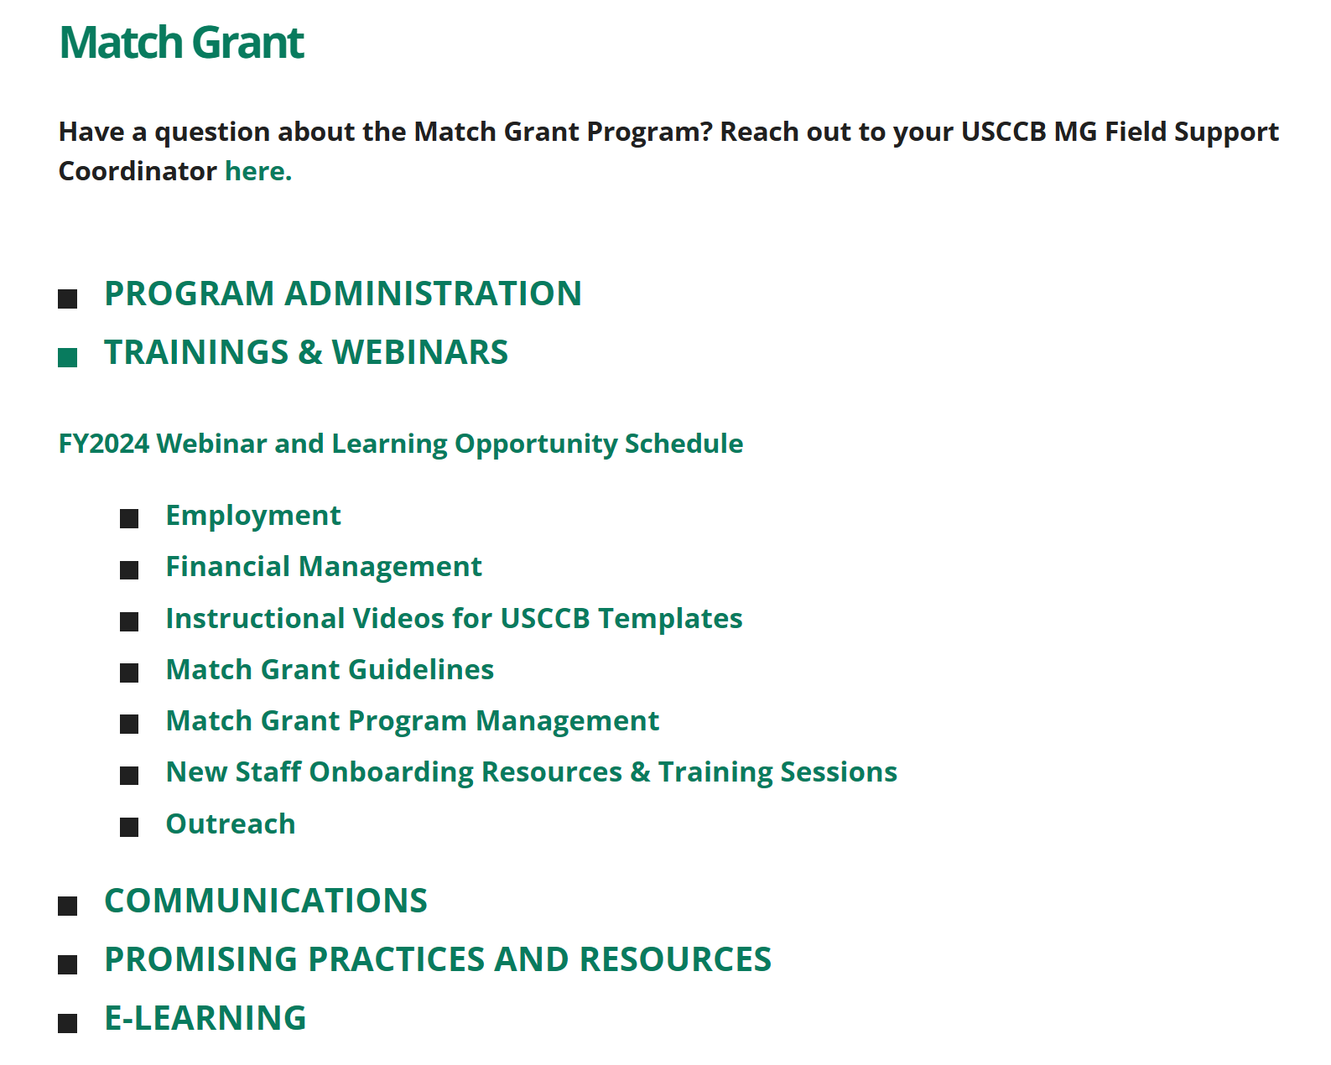
Webinar Recording on MRSConnect
All webinars for the fiscal year are saved on the Communications tile.
Today’s webinar will also be saved here on the MG page.

Slide 3
Today’s Agenda
1
Reimbursement Process and Resources
3
Supplemental Period
2
Reporting Match
4
Tracking Match Grant in MRIS – Match Grant Reports

Slide 4
Reimbursement Process Overview
Administrative and Direct Assistance (DA) expenses are billed together in one reimbursement form.
Two staff must be involved in the reimbursement process - Reimbursement Requests include both an administrative and a finance user.
The admin user creates the bill.
The Finance user double checks it and then approves it sending it to the USCCB Office of Finance and Accounting for payment.
Do not complete the Monthly Match Grant Reimbursement Request until after all of the direct assistance vouchers for that month’s reimbursement request are complete and approved by the Finance User. The vouchers inform and auto-populate sections of the monthly reimbursement request.

Slide 5
Reimbursement Directions
A step by step guide can be found at Match Grant Financial Forms Guide – MRIS Helpdesk (zendesk.com) and video instructions can be found at Direct Assistance Vouchers - (MRS-AD6) (usccb.org).
It is a best practice to stay up to date on billing, please submit within 45 days after the end of each month.
Stay up to date on paying out agreed upon client assistance.
If a mistake is made a revision to reduce funds or an addendum to increase funds can be made. However, you cannot revise an addendum or vice versa so be sure to have solid numbers when you make corrections.

Slide 6
Client Vouchers
Client Vouchers are used to bill direct assistance to the federal grant funds. They connect to the administrative reimbursement request.
They are normally filled out by case managers, supervisors, or administrators and must be approved by a finance user.
Client Acknowledgement of Receipt of Direct Assistance must be maintained in the client’s case file.
Vouchers are not used in MRIS for Direct Assistance that is being provided as Match. DA for Match must be typed in to the administrative reimbursement form. Back up documentation should be kept in client file.

Slide 7
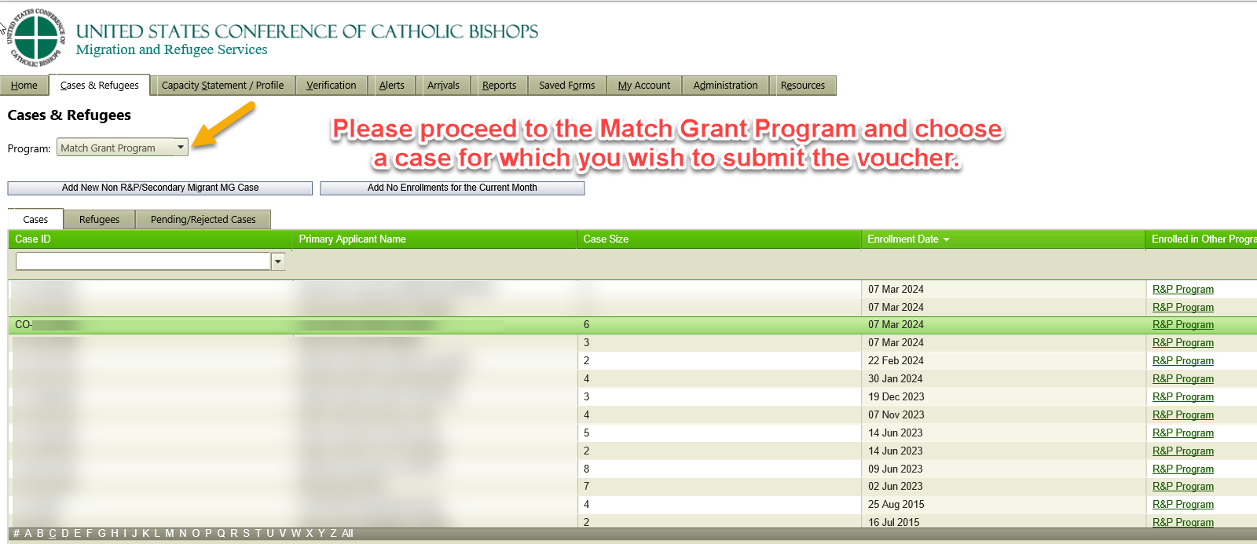
Click on Cases and Refugees and then choose Match Grant Program

Slide 8
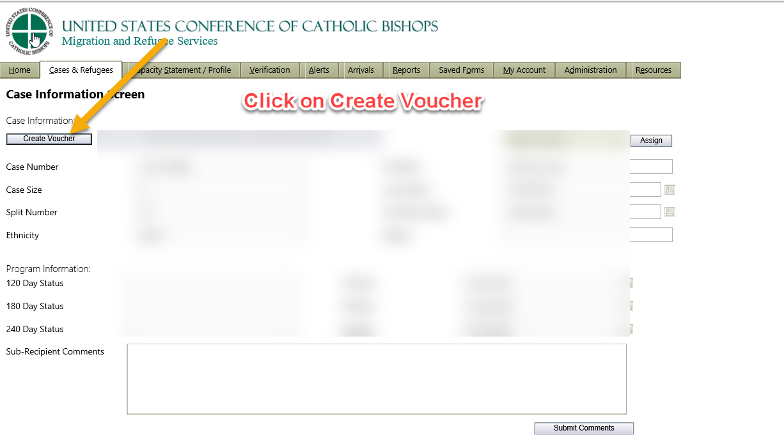

Slide 9
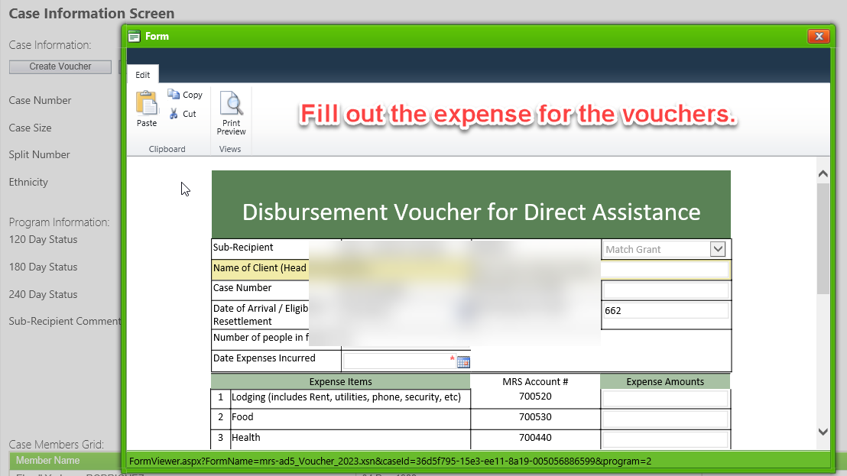

Slide 10
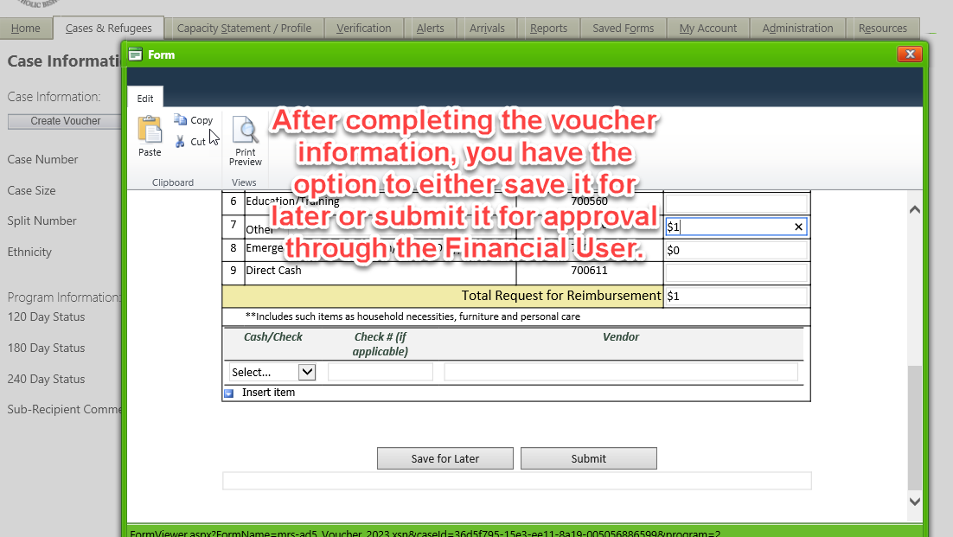

Slide 11
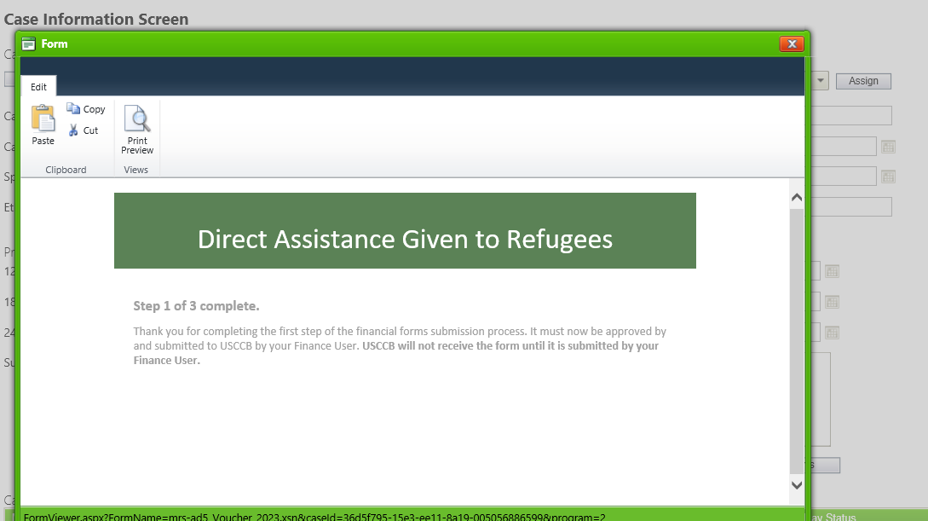

Slide 12
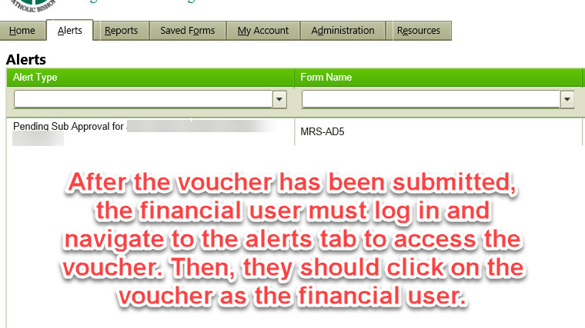

Slide 13
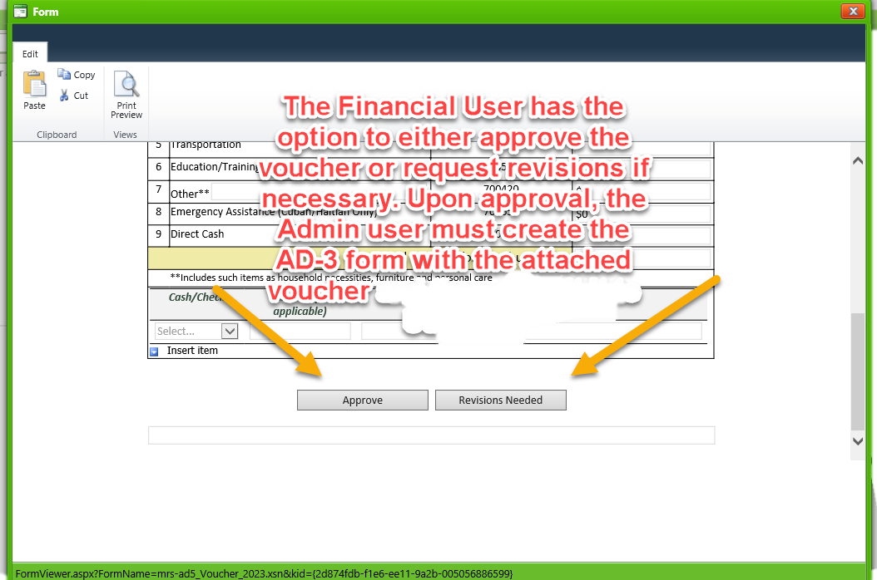

Slide 14
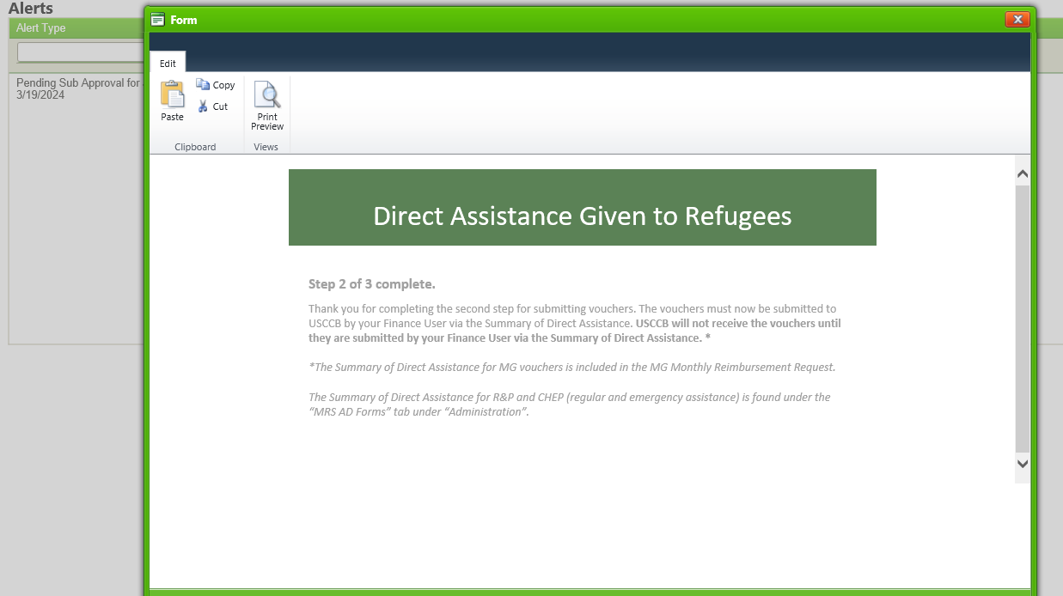

Slide 15
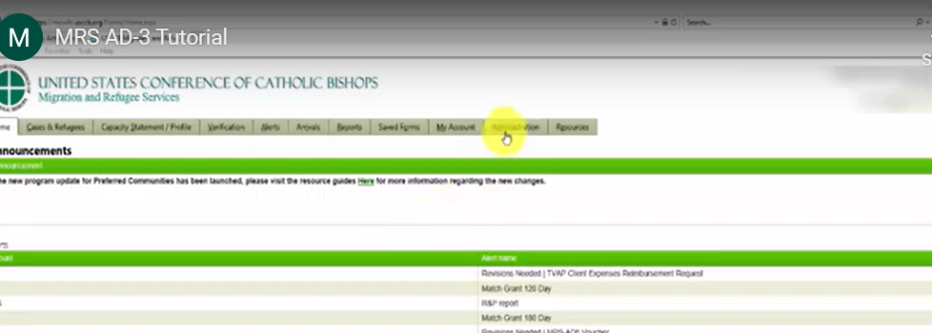
Creating Administrative Reimbursements
Click on Administration

Slide 16
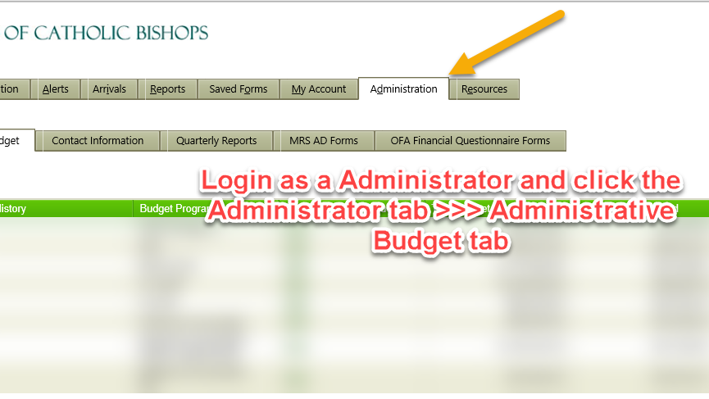

Slide 17
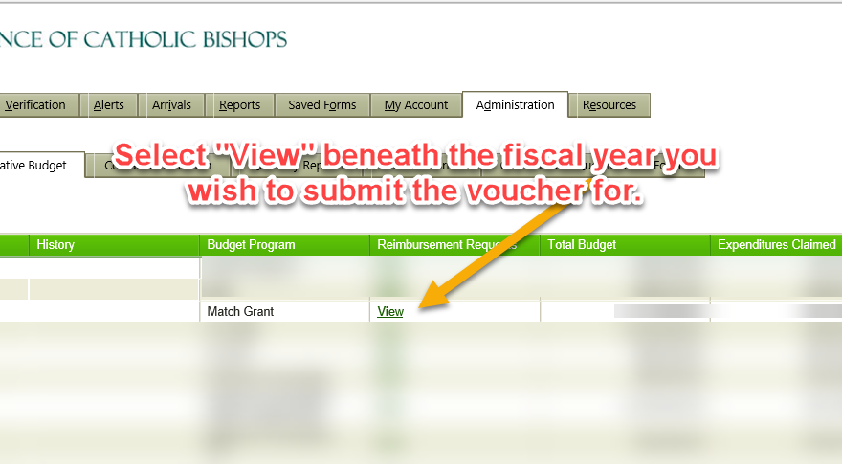

Slide 18
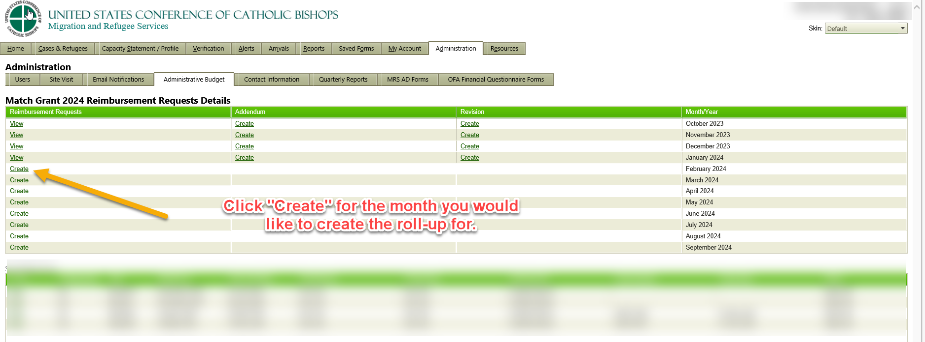

Slide 19
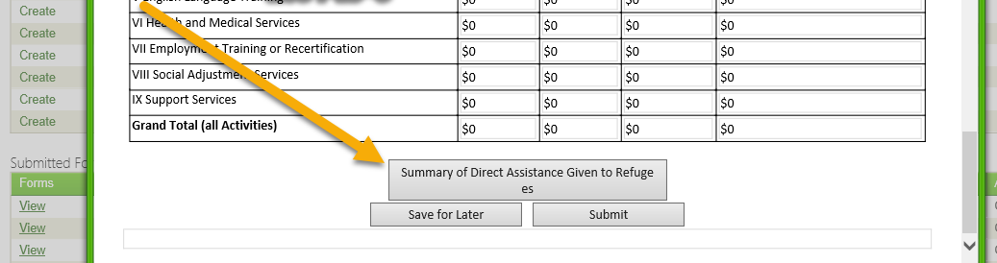
Click on Summary of Direct Assistance to Review all of the vouchers included in the Summary.

Slide 20
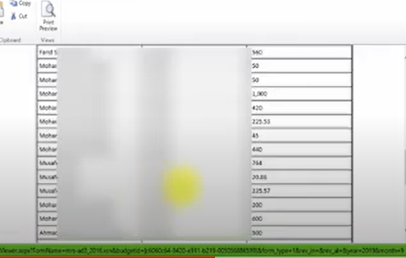
Review direct assistance

Slide 21
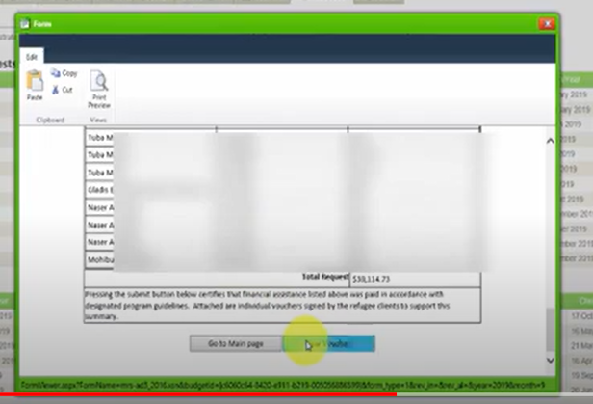
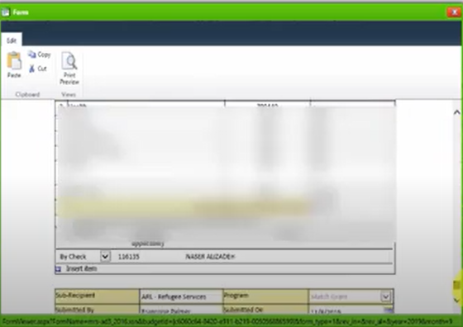
Review each voucher, you can remove those you do not wish to submit. Make sure the total in the Summary of Direct Assistance Form matches the amount listed as Direct Assistance on the reimbursement form in the federal column. If they do not match, you will get an error message.

Slide 22
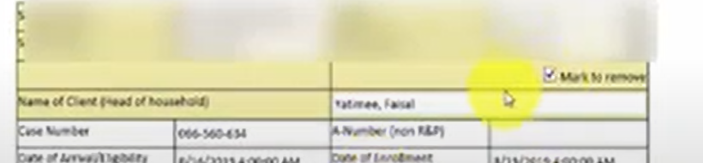
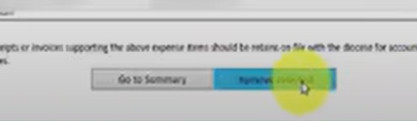
To remove a direct assistance voucher, check the remove form box on the voucher and then click remove voucher at the bottom of the page.

Slide 23
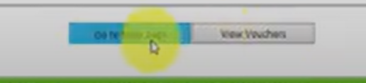
When you are done reviewing vouchers, click Go to Main Page at the bottom of the summary.

Slide 24
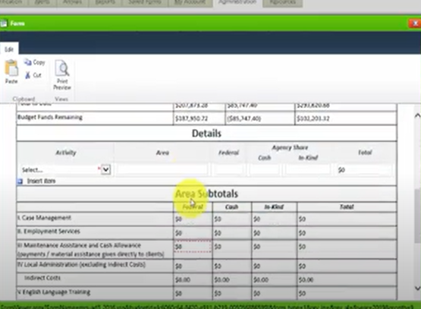
Fill out subtotals for administrative costs

Slide 25
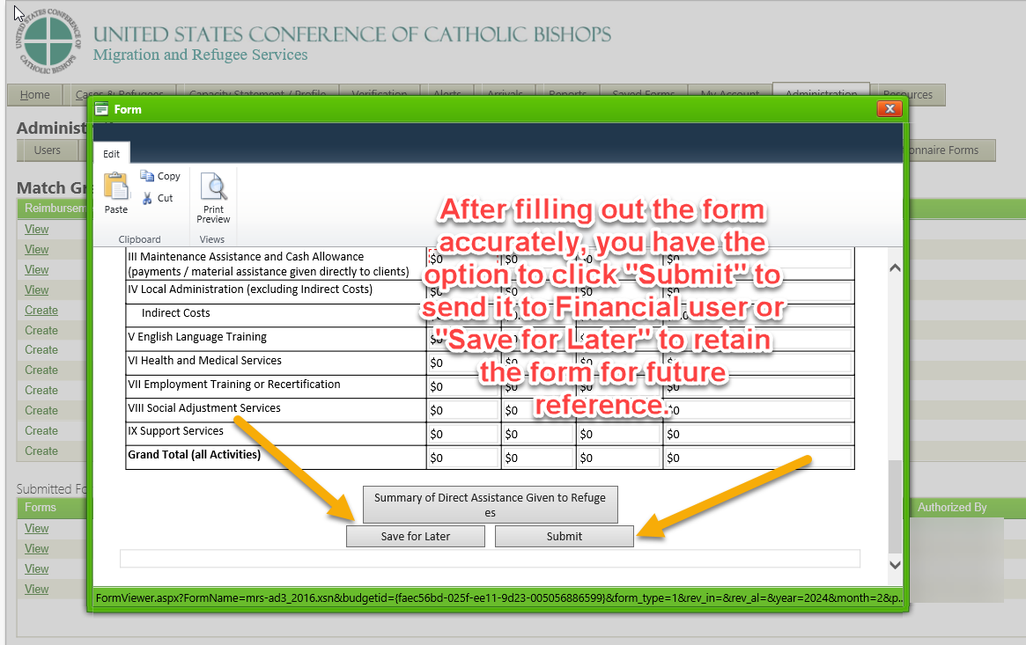

Slide 26
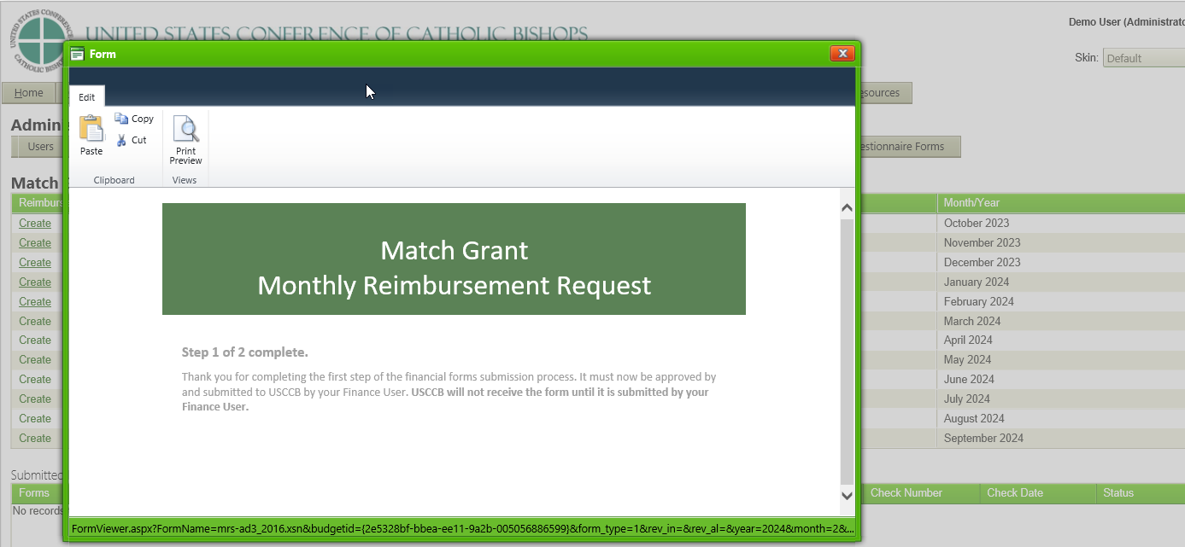

Slide 27
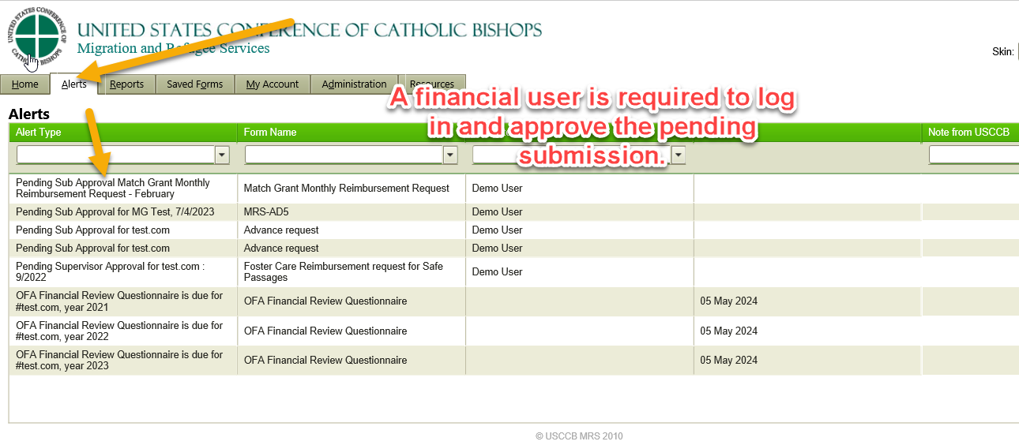

Slide 28
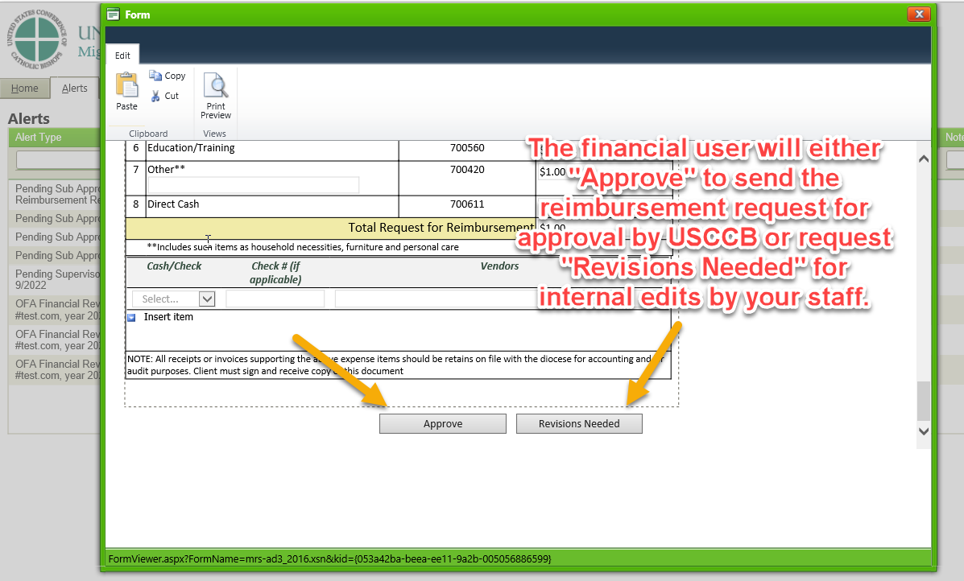

Slide 29
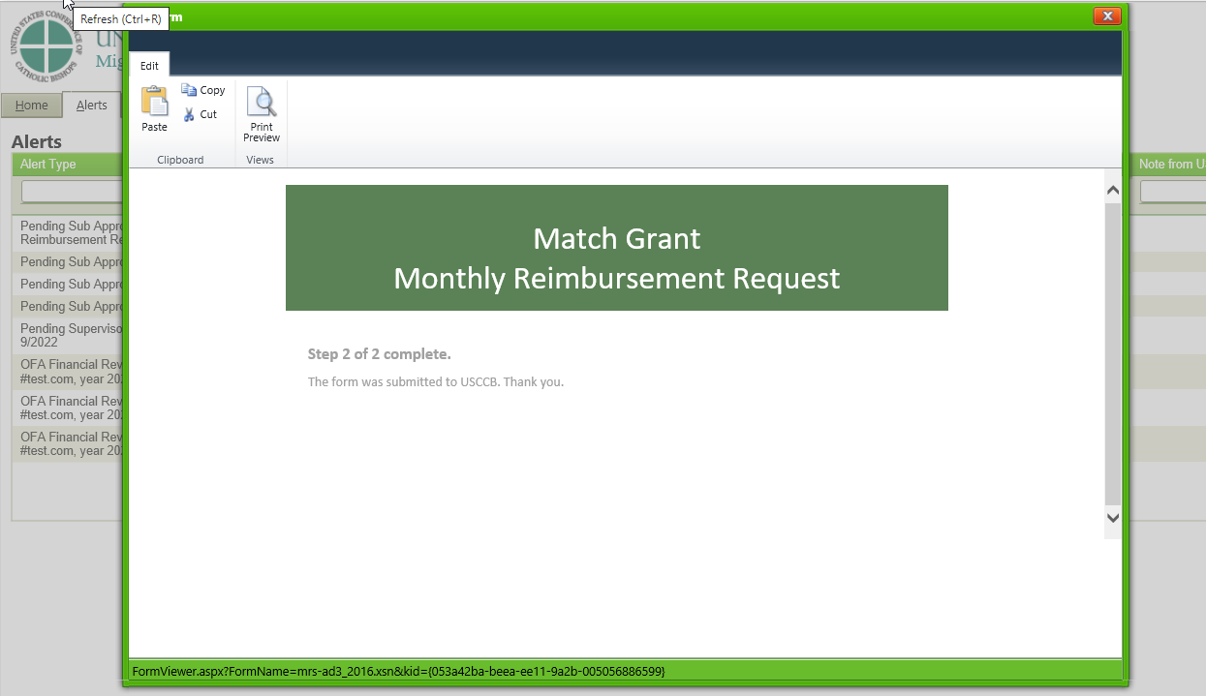

Slide 30
Funding Deadlines for FY23
Supplemental (Liquidation)
Deadline
5/31/2024
Date by which FY 2023 expenses must be incurred. Since the service period is 240 days from enrollment, clients are served during a supplemental time when the fiscal year has ended but client services are ongoing for that fiscal year – October to May
MRIS Final Submission Deadline
6/27/2024
Date by which all reimbursements must be completed in MRIS
Notes:
Affiliates have to spend all FY23 funds by May 31, 2024 and have until June 27, 2024 to bill USCCB for those funds. I recommend trying to get all billing in by 6/20 so you have a few days to fix any last minute problems.
All reimbursements need to be submitted successfully in MRIS by the deadline to avoid potentially not being reimbursed.
If sites are able to expedite the submission of final reimbursements before the deadline , this leaves some room in the event USCCB Accounting sends back invoices for revisions. It’s good to be aware of what’s been submitted and checking to make sure it’s been processed and paid particularly around grant close.

Slide 31
Available Funds in MRIS
Administrative Funds
Direct Assistance Funds
Geography and Population Funds
MRIS Budget Record
Total
$1600 per enrollment for projected capacity
$2,000 per ACTUAL enrollment
Lump sum
Notes:
What funds are available to you in MRIS.
1. USCCB historically receives funding from ORR on a quarterly basis, therefore, the MRIS budget record will include the admin listed in your award letter. As well as updated client DA based on actual enrollments. This is updated by USCCB staff every two weeks.
2. In recent years, due to the pandemic, ORR has had different guidance on the accessing of admin without enrollments. FY 2022 was the first year where program admin received is derived from projected enrollments listed in the award but isn’t tied to the actual number of enrollments. This was to ensure that sites can maintain capacity.
The total calculation of the MRIS account will be made up of:
$1600 per projected enrollment
$2000 per actual enrollment (updated by USCCB staff every two weeks)
Any GAP funds you were awarded

Slide 32
Basics of Matching Funds
The Match Grant Program requires that agencies raise one dollar for every two dollars spent on direct assistance.
Matching Funds are planned for when the grant budget is created. Sites should use the budget as a planning document and monitor how they are doing at raising match throughout the year.
Raising matching funds is a requirement of the program, it is not optional.
Match raised is reported on the Match Grant Monthly Reimbursement Requests. There is no separate report submission like R&P.

Slide 33
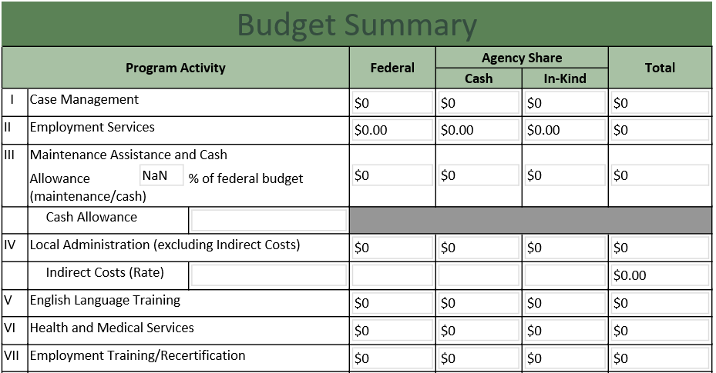
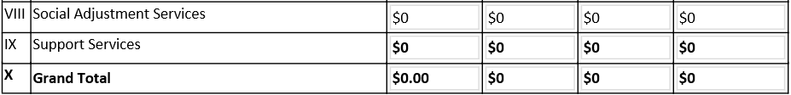
Reporting and Monitoring Match
Report in Monthly Reimbursement Requests
Create a Revision or Addendum to add or reduce previous month match
Utilize reports in MRIS to track match.
Report Match regularly. Do not wait to the end of the year to submit. USCCB reports Match to ORR quarterly.
​
​
Notes:
USCCB is required to report matching funds to ORR quarterly. The method by which Match is documented for the Match Grant Program is the monthly administrative reimbursement requests, which is different than the R&P program. In R&P the contributions are in a separate Cash & In-kind MRIS quarterly report.
When you submit the reimbursement you will see two additional columns for Agency Cash and In- Kind where the actual match should be entered.
If you need to change the amount of match you can do it through a revision or addendum within MRIS
Sites should have a mechanism to track match required

Slide 34
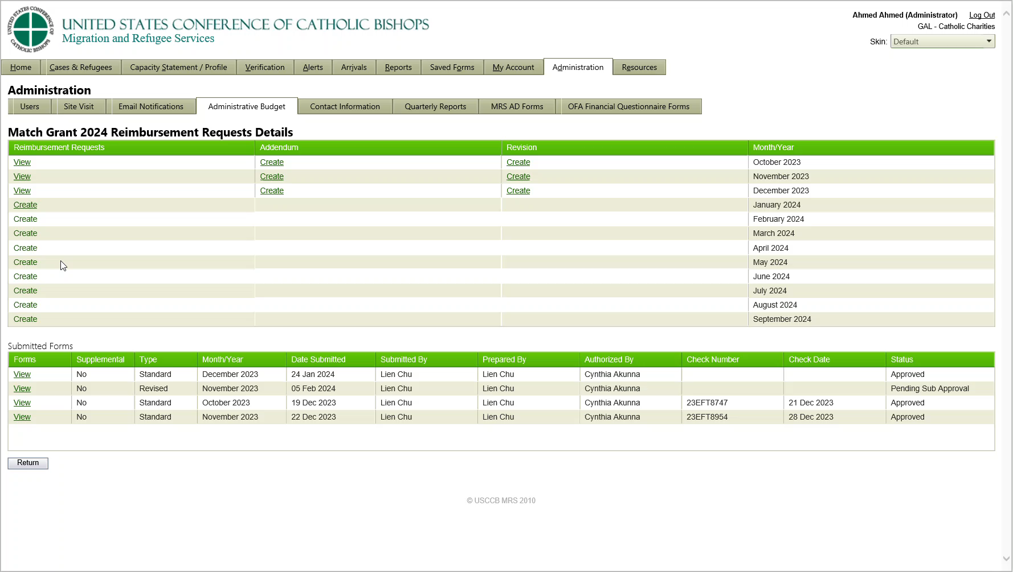
Video Example of how to enter Matching Funds

Slide 35

MG Match Requirement
For every $2 in federal funds spent on Client Direct Assistance, your agency must raise $1 in cash or in-kind contributions of goods and services from the community.
$2
$1
Federal funds spent on Client Direct Assistance
Agency match
Program Admin funds are not subject to the match requirement

Slide 36

Impact of Disallowance
For every $2 in federal funds spent on Client Direct Assistance, your agency must raise
$1 in cash or in-kind contributions of goods and services from the community.
Catholic Charities of Appleville | Funded
Federal funds spent on Client Direct Assistance: | $200,000
Minimum match requirement: | $100,000
Match contributed: | $80,000
This agency could potentially need to return $40,000 to ORR

Slide 37
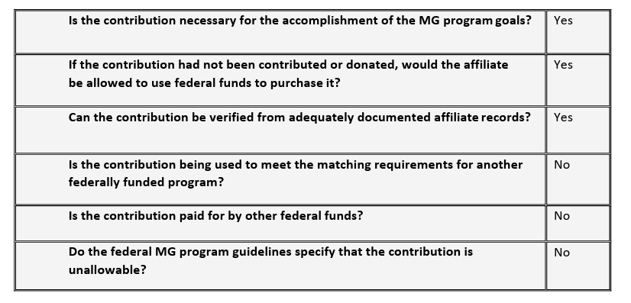
Matching Funds Eligibility Questions

Slide 38
Matching Funds Documentation
All documentation of cash contributions to a specific Match Grant case must be maintained in the client’s MG case file. This includes supporting documentation to verify the value of the purchase as well as match tracking documentation, such as the USCCB RF-20A and RF-20C. For cash given directly to the client a copy of the check and an RF-35 Adult Acknowledgement of Direct Assistance should be in the case file.
For vendor payments made by the affiliate on behalf of clients using private funds (e.g., rent) copies of the invoice (if applicable) as well as checks/check stubs or vouchers should be stored in the client case file.
Staff salaries should be supported by payroll and noted on a centralized matching spreadsheet (or tracking system).
For contributions to the Match Grant program operation or administration (e.g., spent on staff salaries or other local administration activities), affiliates need to maintain appropriate documentation in a centrally located file that can be reviewed during an on-site program review.
Volunteer time can be counted towards match, but it needs to be documented.
See Match Grant POM for guidance on MRS Connect.

Slide 39
What is the Supplemental Budget Period
Budget Period- The period for which the budget is prepared, and clients are enrolled. The FY23 budget period was 10/1/22 to 9/30/23). The FY24 Budget period runs from 10/1/23 to 9/30/24).
Supplemental Period- (10/1/23 to 5/31/24): The period of time after the budget period where FY 2023 clients are still being served and FY 2023 costs incurred. It is important during this time period to be tracking and managing the expenses related to the different fiscal years.
Notes:
The budget period for Match Grant is 12 months, it should include all the expenses for the clients enrolled from 9/30 to 10/1, even if those funds won’t be spent until the supplemental period.
Match Grant clients expenses are charged to the year they are enrolled, the supplemental period is the time when you are still serving FY23 clients and spending down the FY23 budget.
Clients enrolled after 10/1 23 are funded from the FY24 fiscal year budget.
During the supplemental period you will need to track which clients are FY23 and which clients are FY24 and bill direct assistance, admin, and staff expenses accordingly. Match funds will also need to be properly allocated. For example, if an FY23 client receives rides from a volunteer the value of the volunteer’s time is applied to the FY23 match.

Slide 40
Supplemental Period
Funds $$$$ | Oct 2023 | Nov 2023 | Dec 2023 | Jan 2024 | Feb 2024 | March 2024 | April 2024 | May 2024 | June 2024 | July 2024 | Aug 2024 | Sept 2024 | Oct 2024 | Nov 2024 | Dec 2024
FY 2023
FY 2024
FY 2025
$ Usage Decreasing
$ Usage Increasing
$ Usage Decreasing
$ Usage Increasing
Notes:
This visual illustrates how an average site would be spending/allocating funds across fiscal years.
In the middle in green here we have FY 2024. When you began FY 2024 you were still serving FY 2023 clients for up to 240 days depending on when your last enrollment was so as your FY 2023 fund usage was decreasing your FY 2024 fund usage is increasing as you get more enrollments. FY 2023 funding usage would have completely stopped after you finished serving your last FY 2023 client. Similarly when FY 2025 begins you’ll still be serving FY 2024 clients and your FY 2024 usage will decrease while your FY 2025 funding increases and stop completely when you’ve finished serving your last FY 2024 client.

Slide 41
Client Costs are billed to the Program Year Clients were enrolled in.
FY 2023 Client Costs
FY 24 Client Costs
Clients enrolled on or before 9/30/23 are receiving services until they reach the end of their 240-day service period.
Direct assistance funds and the costs of serving these clients should be billed to the FY23 budget.
New clients enrolled on or after 10/1/23 are in the FY24 fiscal year
Costs are billed to the FY24 budget.
MRIS will only add vouchers to the reimbursements for the year the clients are enrolled.

Slide 42
Supplemental Challenges
Direct assistance, matching funds, staff time and administrative costs need to be billed to the correct fiscal year.
Our funders prefer that whenever possible direct costs are tracked and billed instead of billing based on allocation methods.
Example:
Staff time needs to be tracked and proportionally charged to the correct grant year. USCCB has staff record time worked on each grant when they fill out timesheets.

Slide 43
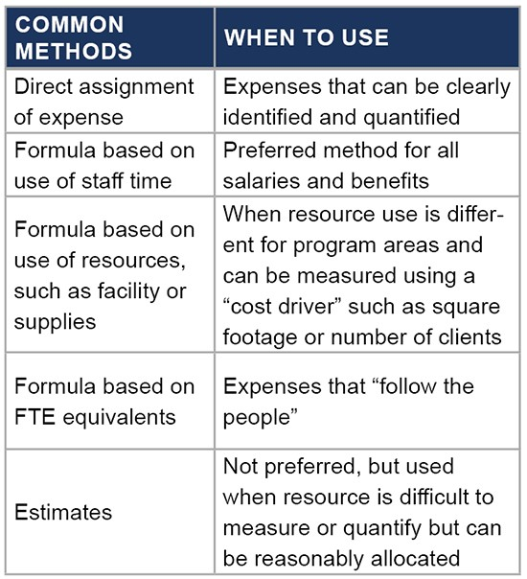


Cost Allocation between Program Years
Propel Nonprofits has an online article about this topic that shares this chart and several ways of dividing costs:
True Program Costs: Program Budget and Allocation Template and Resource - Propel Nonprofits and a video Cost Allocation Primer Video - Propel Nonprofits that provides a quick overview of four methods.

Slide 44
Example of Allocation of administrative costs from St. Vincent Catholic Charities in Lansing, MI: Agency counts ALL individuals currently enrolled in MG, but only count individuals who are in their 180-240 days as a quarter of a person. So they consider 1-180 days as ‘ACTIVE’ client and 180-240 days ‘INACTIVE’ (they do not require as much staff time). Then they prorate it via percentage as per the example below:
Counting clients
FY23
50 ‘Active’ (in their 1-179 days) Clients = 50
20 ‘Inactive’ (in their 180-240 days) clients = 5
50+5= 55 ‘Active’
FY24
50 ‘Active’
TOTAL
55+50= 105 (total ‘Active’ client)
Percentage
FY23
55/105= 52.38%
FY24
50/105= 47.62%

Slide 45
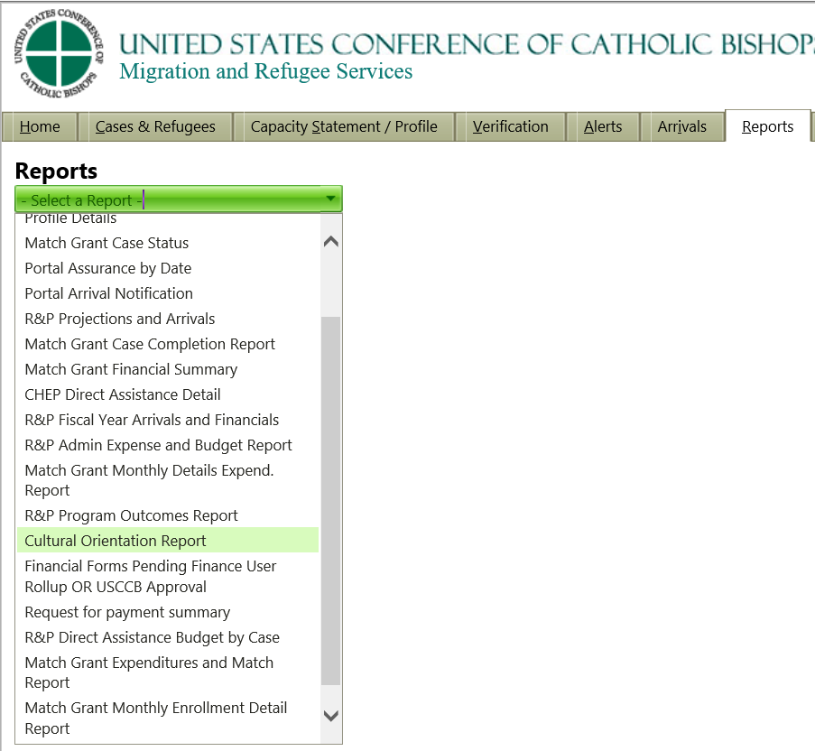
How to track spending and reimbursements - Match Grant Reports In MRIS
Match Grant Financial Summary
Match Grant Monthly Detail Expenditures Report
Match Grant Expenditures and Match Report
Payment Status Reports
Notes:
MRIS includes some financial reports that may be a useful tool for you that I'd like to go through quickly.
To find the reports, choose the report tab at the top of the MRIS Screen and you'll see a long list that applies to all the USCCB grants. Within that there are three related to Match Grant.
Match Grant Financial Summary
Match Grant Monthly Detail Expenditure Reports
Match Grant Expenditure and Match Report

Slide 46
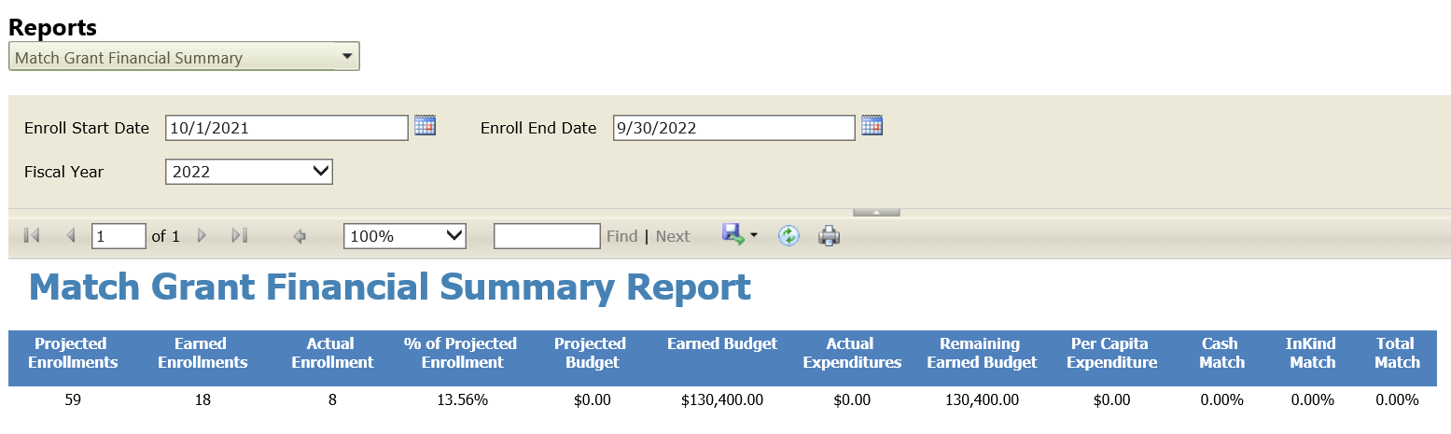
Match Grant Financial Summary
*Please note that the report is not yet updated to reflect that required match is based on funds spend on direct assistance.
Notes:
The First of these reports is called the "Match Grant Financial Summary". This report is a basic snapshot of your enrollments, spending, and match.
It includes :
Projected enrollment
Earned Enrollments
Actual Enrollments
% of Projected Enrollment
Projected Budget
Earned Budget
Actual Expenditures
Remaining Earned Budget
Cash Match
In-Kind Match
Total Match

Slide 47
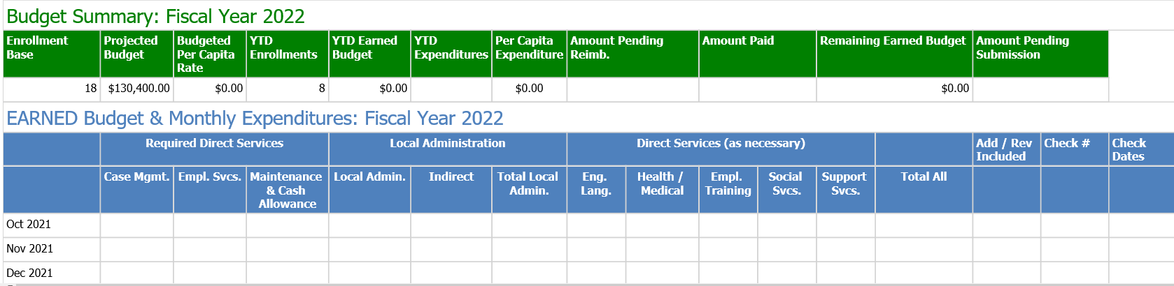
Match Grant Monthly Detailed Expenditures
Notes:
The second report is called the Match Grant Monthly Detailed Expenditure Report. This report is a general snapshot of your Direct Services and Administration costs listed by month. It’s a helpful report to compare with your budget submission to see whether costs are in-line or require budget adjustments, etc.
It includes:
Direct Services broken into categories
Local Administration broken into categories
Check Numbers and Dates

Slide 48
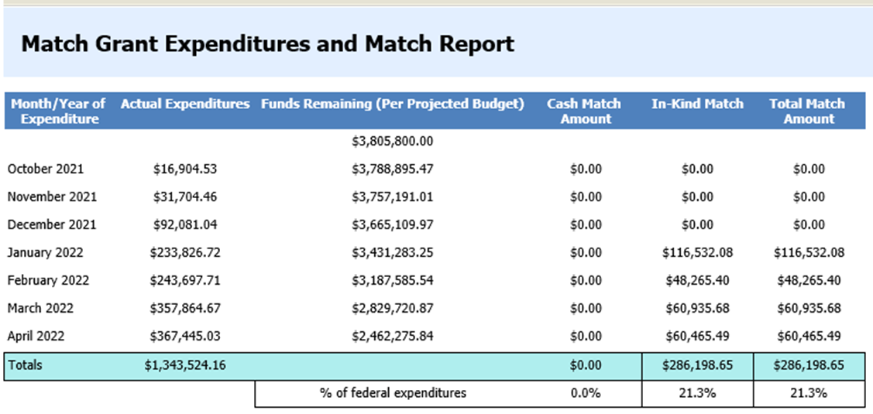
Match Grant Expenditures and Match Report
*Please note that the report is not yet updated to reflect that required match is based on funds spend on direct assistance. Percentage on bottom of report is not accurate reflection of required match.
Notes:
The third report is called Match Grant Expenditures and Match Report. This report is a snap shot of your total actual federal expenditures vs your match and provides you with what % your match is of your federal expenditures.
USCCB is required to report the matching funds to ORR. Over Covid we were allowed to waive some match, we do not anticipate this occurring in the future.
1. This report does not reflect the change made in 2022 to match only being required on DA. But it’s still a helpful summary of match by Month. The report is on MRIS’s list of items to update, but we expect it could take several months for the changes to be made. We will be sending out quarterly emails regarding agency match totals to help track totals in the mean time.

Slide 49
Recommendations for Active Budget Management to Avoid Overspending
Direct assistance required to be provided to each case is clear to caseworkers
Direct assistance provided is tracked for each case in such a way case management and finance staff can clearly see what is still left to spend
Proper documentation of expenses is maintained in case file
Agency tracks admin spending to ensure it does not ever use direct assistance funds for admin purposes. MRIS is not set up to prevent this.
Full program year is taken into account when funds are spent – Funds are planned for 18 months of service to account for supplemental period.

Slide 50
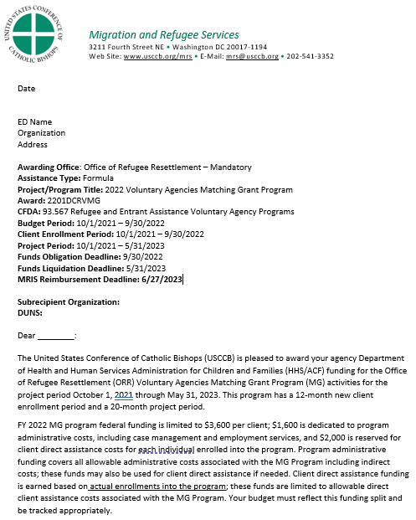
Award Letters
Basic Grant Information
Grant Periods
Deadlines
Projected Funding
Terms and Conditions
Reporting Requirements
Notes:
One of your guiding documents for the Match Grant program is the Notice of Award Letter from USCCB. Similar to R&P, this outlines the funding mechanism for the budget period and other important requirements of the grant. There is a sample grant letter in the MG Administration and Finance Folder in your binder.
1. USCCB releases funding award letters based on funding received by ORR. Because funding has been historically disbursed on a quarterly basis, there will typically be the initial notice of award and subsequent award letters reflecting updated funding.
2. All relevant staff in your organization should have access to these award letters because it contains details and deadlines related to program funding.
3. It is important to stay on top of checking the MRIS Reimbursement Deadline on each updated award letter.
Some other very important information included is:
Basic award information like the funding agency and CFDA number which your Finance office will need for auditors.
Grant Period and deadlines that we went over earlier
Terms and Conditions provide links and references to the other program guiding documents like the MG Guidelines and the MG Program Operations Manual.

Slide 51
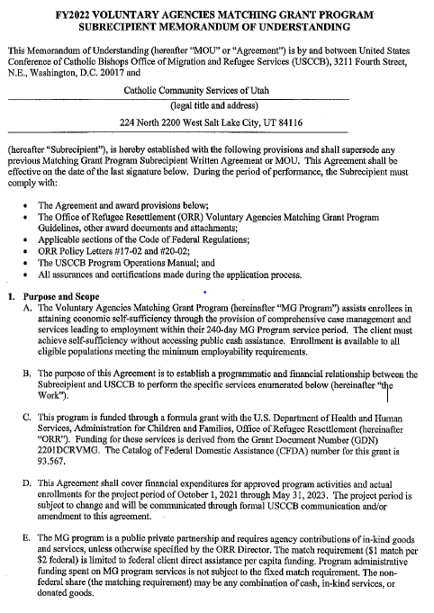
Memorandum of Understanding
(MOU)
Formal Agreement between Affiliate and USCCB signed by both parties
Details required policies and regulations
Purpose, Scope, and Statement of Work
Additional Terms and Conditions
Reimbursement of Costs
On Site Reviews
Duration and Termination
Notes:
Another important document you'll receive from USCCB is the Memorandum of Understanding or MOU that is the formal agreement between USCCB and the subrecipient signed by both parties. There is a sample MOU in the MG Administration and Finance Folder in your binder.
1. You will want to make sure that agency management, legal and finance offices are aware of and understand the terms listed within the MOU.
Some important information included in the MOU is:
Required Policies and Regulations which references adherence to applicable Federal Regulations and ORR Policy Letters.
Purpose, Scope, and Statement of Work outline the general scope of the program and references where on MRSConnect your agency can find pertinent program documents.
Additional Terms and Conditions
Reimbursement of Costs – this is where USCCB lists the per capita requirements for the grant year, so you’ll need to pay extra attention to this section each year. It also references the budget requirement as well as matching element of the program.
On Site Reviews outlines the potential monitoring of ORR and/or USCCB in a given year and the need for complete and accurate case files for review.

Slide 52
Other Payment related reminders
A Financial Questionnaires will be in MRIS in February or March. It needs to be filled out or eventually payments will be stopped unless it is completed. The Questionnaire is part of the Office of Finance and Accounting (OFA)’s adherence to government rules on oversight that goes over internal controls, audit questions, and other fiscal matters.
Make sure your agency’s Sam.gov registration is kept up to date. If your Sam.gov registration expires USCCB has to wait until it is re-activated to resume payments.
Notes:
Make sure your Questionnaire and Sam.gov registration are up to date

Slide 53
Reimbursement Resources
MRIS Guides on a variety of topics - MRIS Helpdesk (zendesk.com)
Link to put in a ticket for MRIS help or to request training from MRIS staff – Submit a request – MRIS Helpdesk (zendesk.com)
Video Tutorials - Video Tutorials – MRIS Helpdesk (zendesk.com)
Be Aware of Deadlines and the alerts in MRIS
Ignore the Match Grant Budget Guide on the MRIS site. It dates from when Match Grant budgets were created in MRIS instead of Excel.
Notes:
Resources are available if you encounter issues or have new staff who need training
1. MRIS Guides are available on a variety of topics and can be found in the "Resource" Tab. It will ask you what topic and you can choose the grant that you're interested in
2. There is also a link in MRIS to schedule a one on one training with MRIS Help Staff which can be particularly helpful if you are a new program or have new staff on boarding
3. General Inquiries can be sent to MRISHelp@usccb.org
4. You can also find the Match Grant Reimbursement Guidelines document that goes through the submission process for both admin and direct assistance. Unlike R&P, admin, DA and match are included in the monthly reimbursements.

Slide 54
Who do I ask for help
If your question is a technical issue with MRIS, contact the helpdesk. For example: Unsubmitted voucher needs to be deleted (only vouchers not yet sent to USCCB can be deleted) or questions about how to run a report.
If you have a billing or federal allowability question such as about IDC or a payment problem contact the GPA team.
Notes:
Advice on questions

Slide 55
Name, Title and Contact Information | Area of Specialty
Ann Franken Associate Director, Grants and Programs Administration Phone: (202) 541-3478 Email: AFranken@usccb.org | -All ORS grant activity oversight -Grant award updates -USCCB HQ fiscal budget oversight and analysis -Affiliate fiscal reporting to funder oversight
Caitlin Kelleghan Grants and Programs Administrator Phone: (202) 541-3451 Email: CKelleghan@usccb.org | -PRM Funded Programs (R&P and Resettlement Academy) -Affiliate fiscal oversight and technical assistance · -Affiliate reimbursement inquiries · -Affiliate budget coordination and review · -Affiliate financial analysis oversight and reporting data to funder
Kathy Jagow Grants and Programs Administrator Phone: (202) 541-3230 Email: KJagow@usccb.org | -ORR Funded Programs (Match Grant and Preferred Communities) -Affiliate fiscal oversight and technical assistance -Affiliate reimbursement inquiries -Affiliate budget coordination and review · -Affiliate financial analysis oversight and reporting data to funder
Zorica Omazic Grant Monitor Phone: (202) 541-3159 Email: ZOmazic@usccb.org | -Affiliate-level manual reimbursements in MRIS · -Per Capita reimbursement review/approval in MRIS · -Affiliate budget and abstract coordination
Ha Nguy Budget and Information Specialist Telephone: (202) 541- 3234 Email: HNguy@usccb.org | -MRIS budget record creation and updates · -Subrecipient IDC coordination with Office of Finance and Accounting (OFA) · -Memorandum of Understanding (MOU) and notice of award issuance
GPA Team and Responsibilities
Notes:
This is a breakdown of each GPA team member and their individual responsibilities.
.

Slide 56
Webinar Recording on MRSConnect
All webinars for the fiscal year are saved on the Communications tile.
Today’s webinar will also be saved here on the MG page.

Slide 57

Questions?
Notes:
Last slide

Slide 58

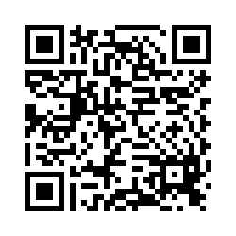
Please share your thoughts.
Anonymous Survey
You can scan this QR code with your phone’s camera.
Or, there is a link to the same survey in the chat.
Notes:
7

