Slide 1


R&P Funding and Reimbursement
Caiti Kelleghan
CKelleghan@usccb.org

Slide 2
Understand Various R&P Funding Streams
1
Learning
Objectives
Understand ERMA Funding Associated with R&P
2
By the end of this session, you will be able to:
Understand How Each Funding Stream is Reimbursed
3
Understand Reimbursement Resources Available in MRIS
4

Slide 3
Funding Categories
R&P Administrative (Admin): covers affiliate administrative costs to meet the program objectives.
2. Direct Assistance (DA): Funding at $1,325 per individual to cover cash disbursement to or purchases on behalf of clients. (R&P or ERMA funded).
3. Additional Direct Assistance (ADA): Direct assistance above the regular DA per capita managed by the affiliate based on client need (R&P or ERMA funded).
4. ERMA Capacity Development Funding (ERMA CDF): Additional Admin funds for administrative costs tied to serving ERMA clients.

Slide 4

Emergency Refugee Migration Assistance (ERMA)
PRM funding source created to support relocation efforts of Afghans.
Separate funding stream from R&P.
Funds Direct Assistance, ADA, and ERMA CDF for costs associated with ERMA eligible clients.
MRS Connect Resources: ERMA Guidance Document, ERMA Network Call, and ERMA Cooperative Agreement
4

Slide 5


Administrative Funding
Funded by R&P
Awarded in quarterly tranches
Use limited to actual administrative expenses incurred
80% of estimated funding guaranteed

Slide 6
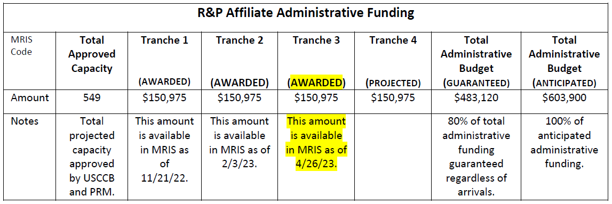
Administrative Award Chart

Slide 7
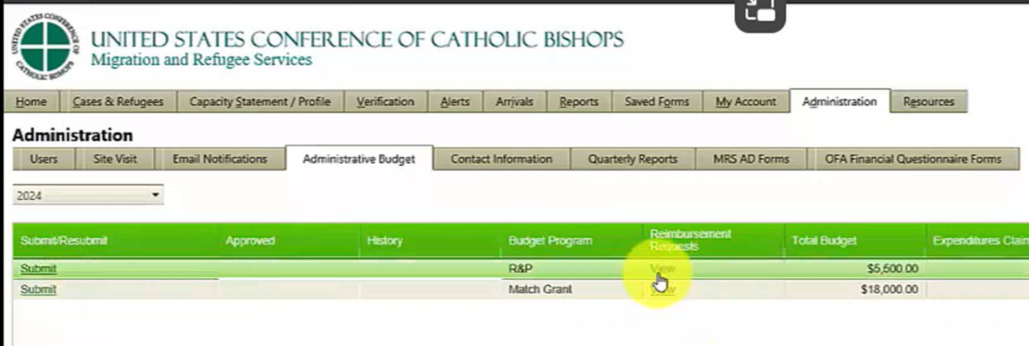
MRIS Administrative Reimbursement User Role: Administrator
7

Slide 8
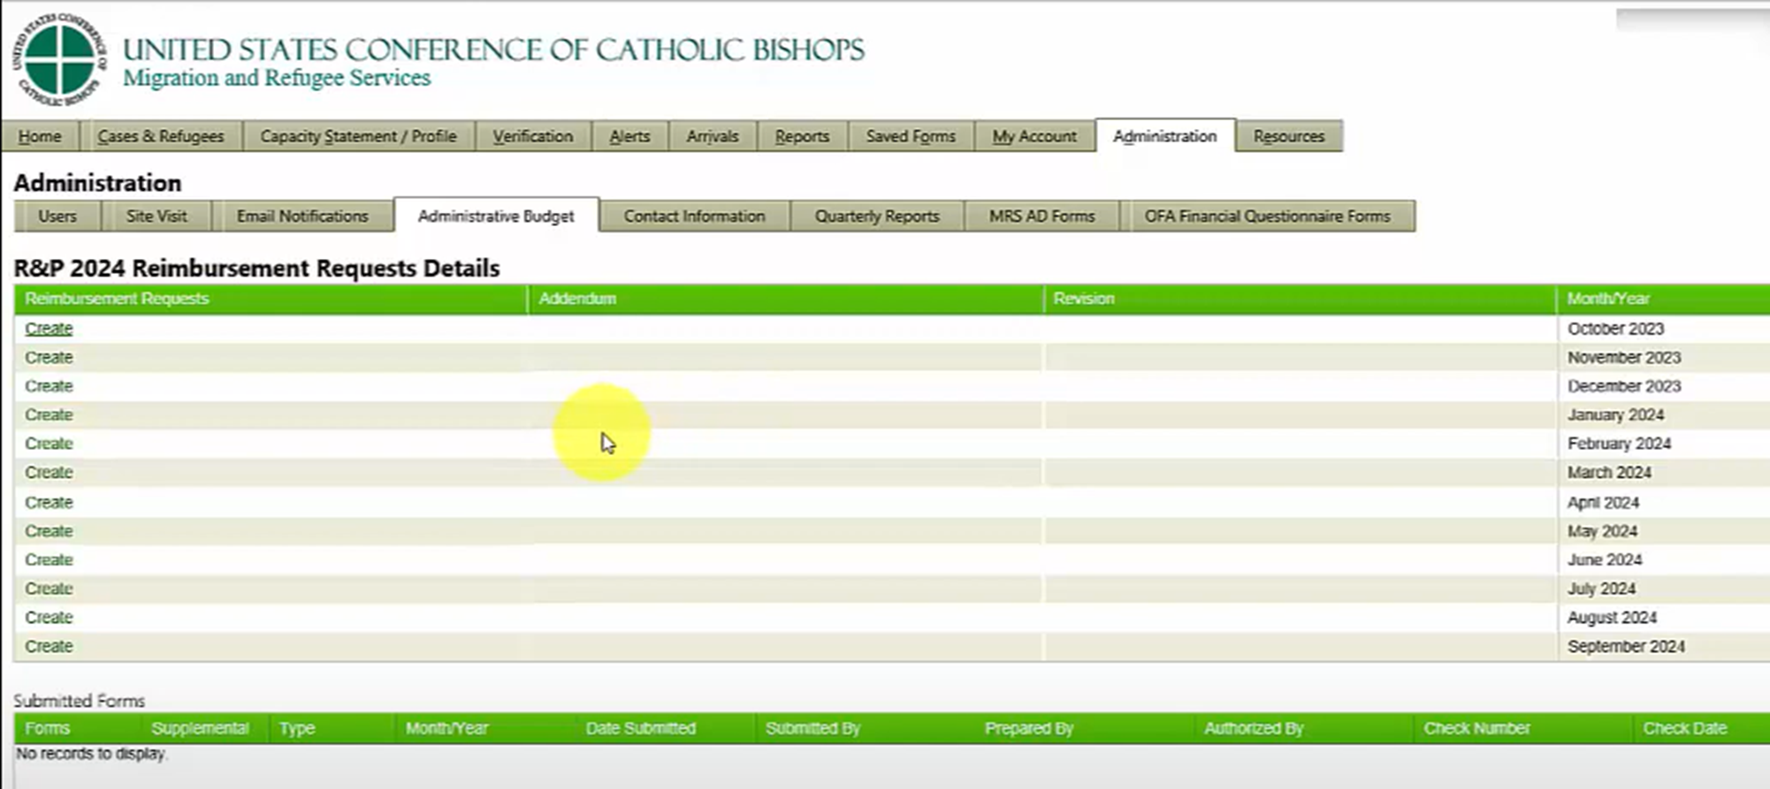
MRIS Administrative Reimbursement User Role: Administrator
8

Slide 9
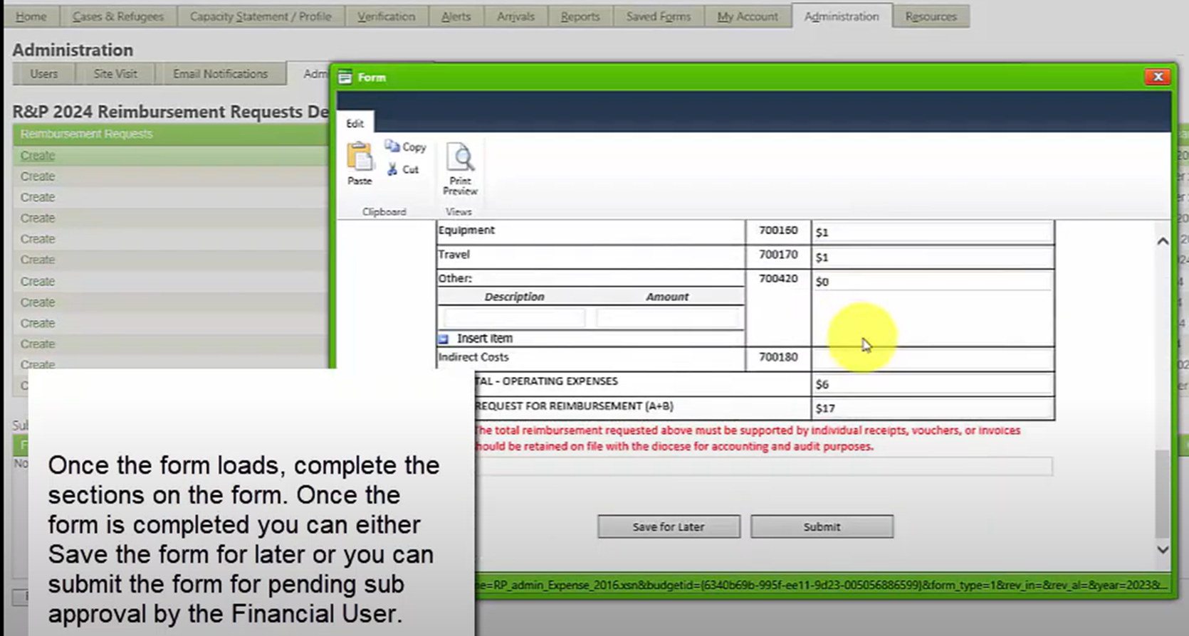
MRIS Administrative Reimbursement User Role: Administrator
9

Slide 10
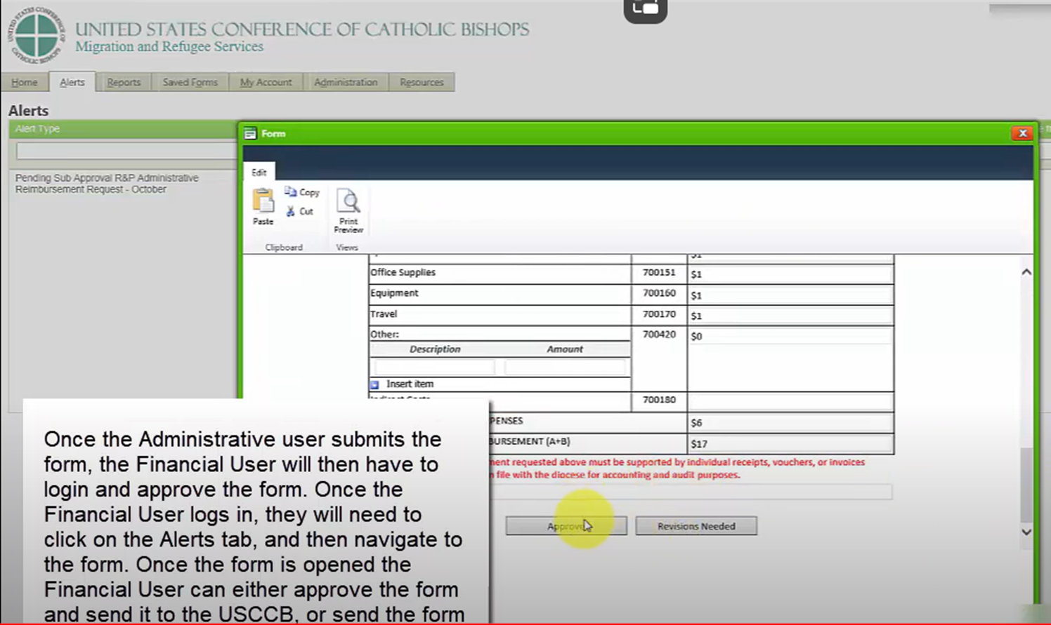
MRIS Administrative Reimbursement User Role: Finance User
10

Slide 11
Direct Assistance Funding
Awarded at $1,325 per client upon arrival
Funded by R&P or ERMA depending on client type
MRIS determines client type and allocates DA automatically
ERMA and R&P DA flex funds managed separately

Slide 12
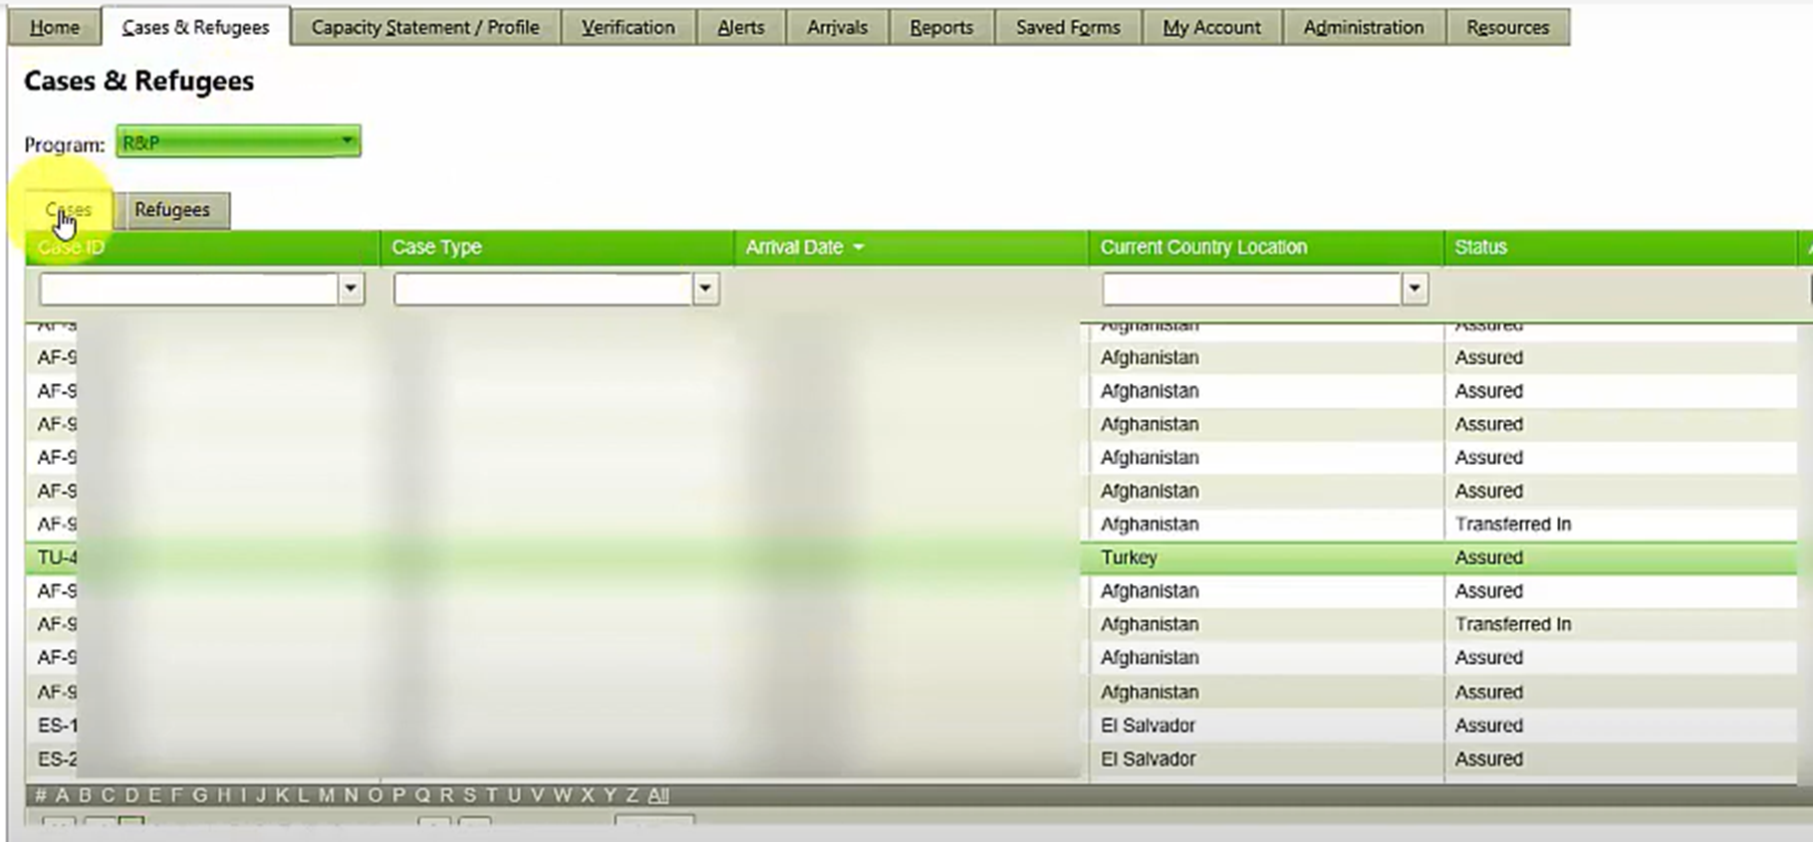
Direct Assistance Reimbursement
User Roles: Case Manager, Supervisor, Administrator

Slide 13
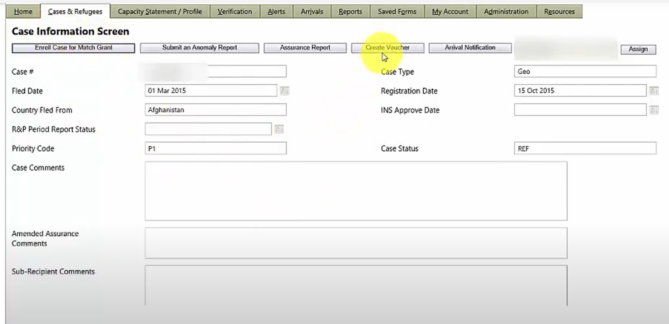
Direct Assistance Reimbursement
User Roles: Case Manager, Supervisor, Administrator

Slide 14
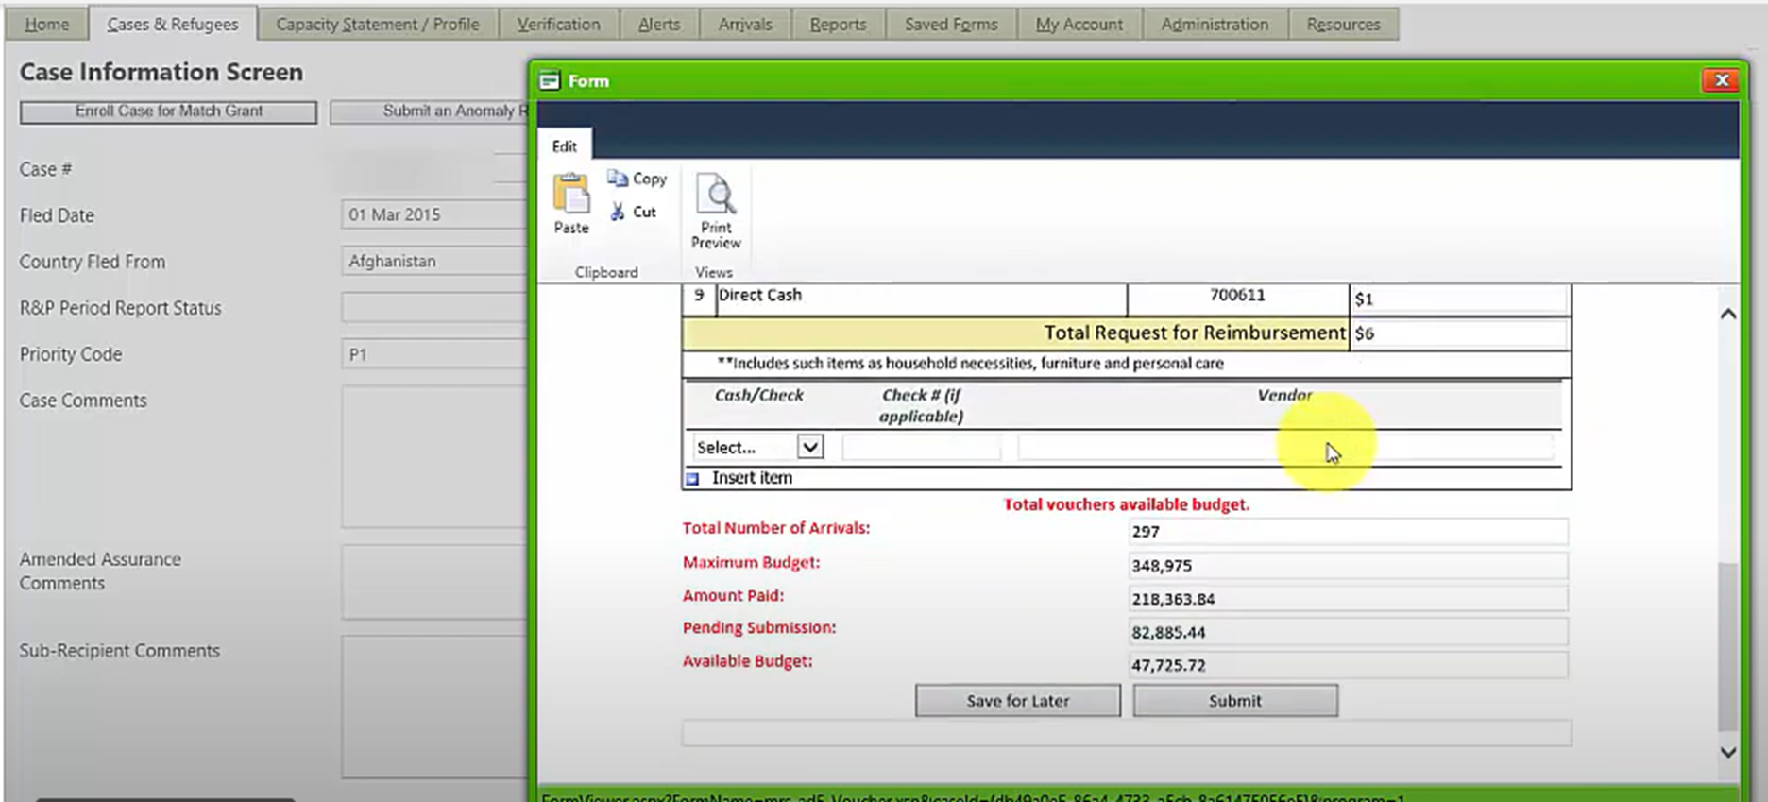
Direct Assistance Reimbursement
User Roles: Case Manager, Supervisor, Administrator

Slide 15
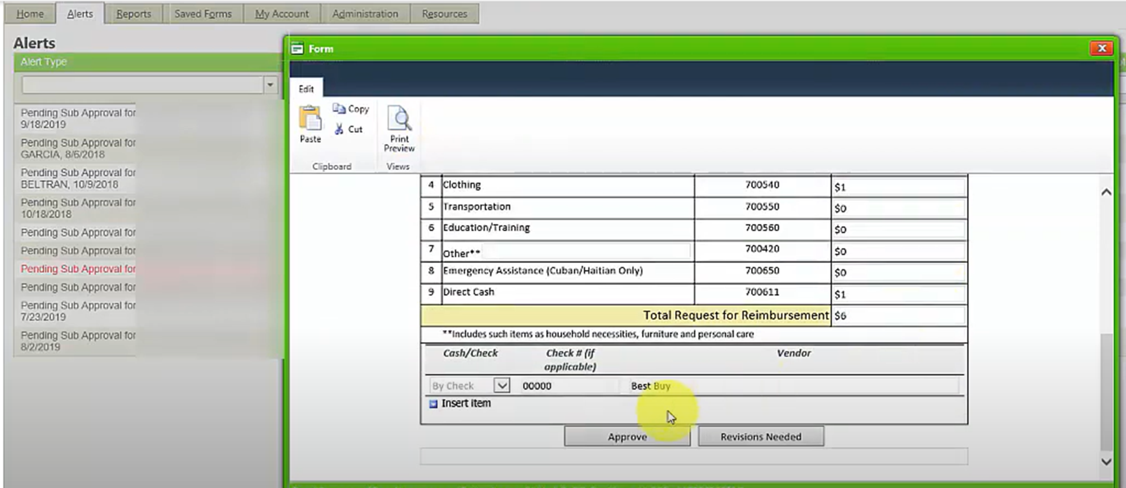
Direct Assistance Reimbursement
User Role: Finance User Step 1

Slide 16
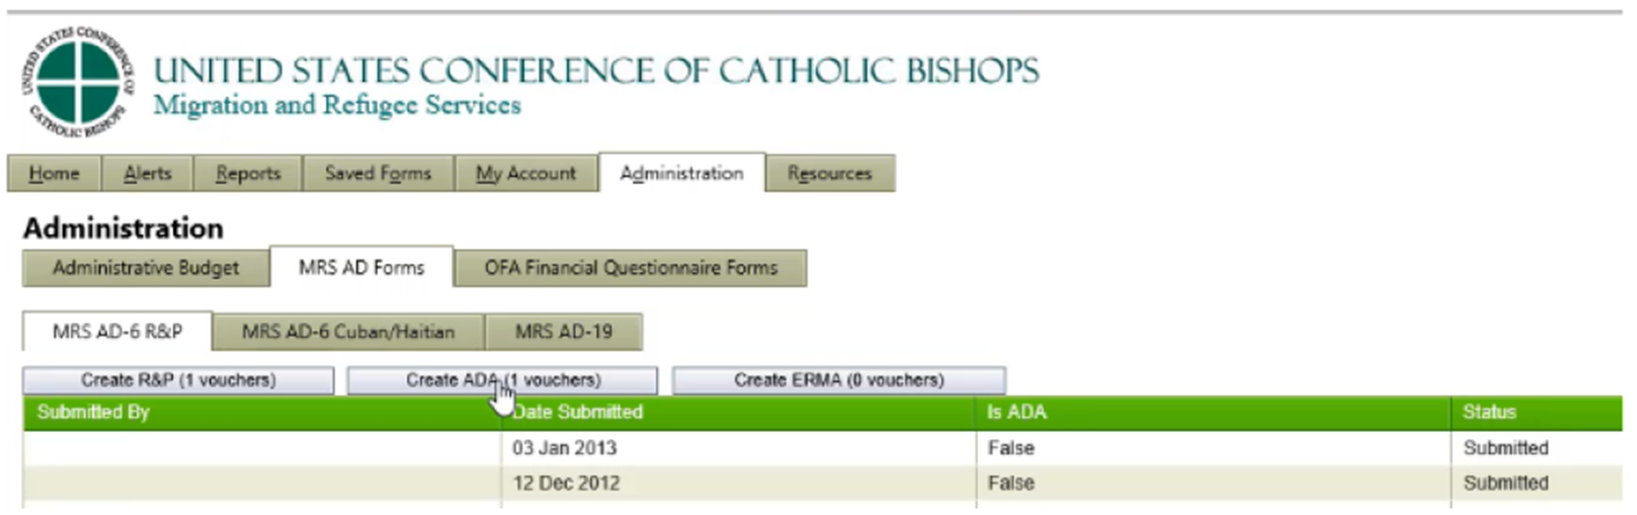
Direct Assistance Reimbursement
User Role: Finance User Step 2

Slide 17
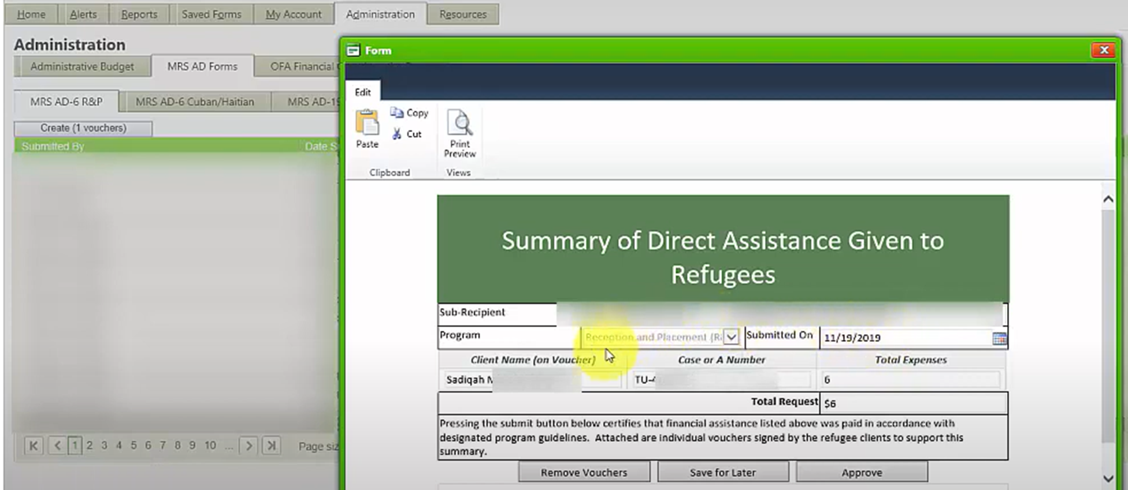
Direct Assistance Reimbursement
User Role: Finance User Step 2

Slide 18
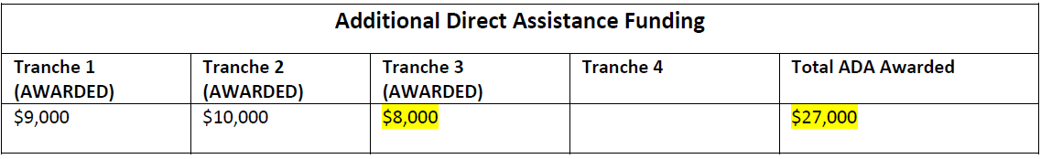
Additional Direct Assistance (ADA)
Funded to support needs of most vulnerable cases
Guidelines on MRS Connect
NEW: ERMA ADA will be available April 1st, 2024

Slide 19
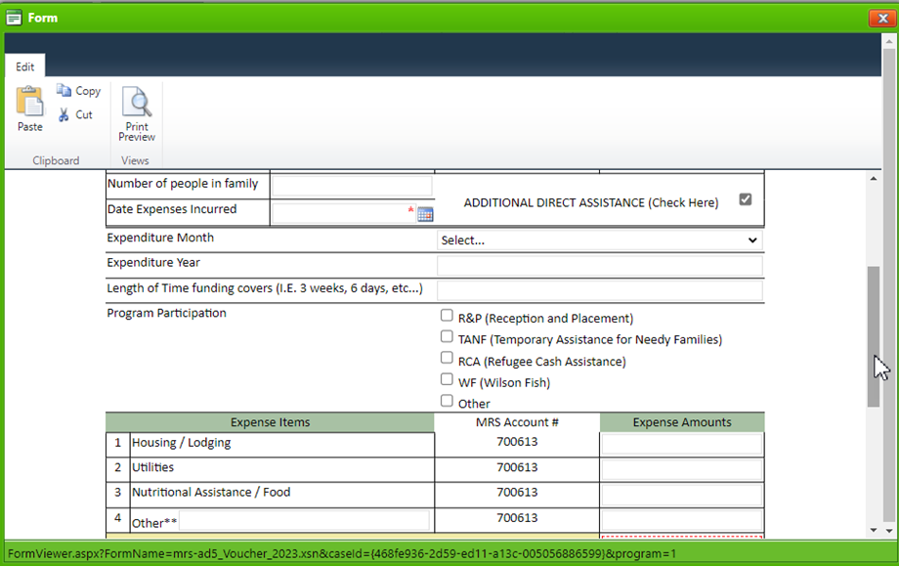
ADA Reimbursement
User Role: Case Manager, Supervisor, Administrator

Slide 20
ADA Reimbursement
User Role: Finance User

Slide 21
ERMA Capacity Development Funding (CDF)
ERMA funding to support administrative costs associated with serving ERMA clients
Must be tracked separately from R&P
Will be reimbursable in MRIS
Proposal submitted but not yet awarded

Slide 22


MRIS Reimbursement Revisions
Administrative Expenses
Adding- Complete an Addendum
Removing- Complete a Revision
Direct Assistance Expenses
DA reimbursements must be manually revised by USCCB OFA. Email GPA to coordinate process.
Watch for Revision Request from USCCB in MRIS

Slide 23

FY 2024 Funding Periods
FY 2024 Funding Periods
Budget Period:
The period of funding clients are tied to by arrival date.
October 1, 2023
to
September 30, 2024
Supplemental Period:
The period after end of FY 2024 where FY 2025 has begun, but FY 2024 clients are still being served.
October 1, 2024
to
December 29, 2024

Slide 24
Supplemental Period Allocation
Funds $$$$ | Oct 2023 | Nov 2023 | Dec 2023 | Jan 2024 | Feb 2024 | March 2024 | April 2024 | May 2024 | June 2024 | July 2024 | Aug 2024 | Sept 2024 | Oct 2024 | Nov 2024 | Dec 2024
FY 2023
FY 2024
FY 2025
$ Usage Decreasing
$ Usage Increasing
$ Usage Decreasing
$ Usage Increasing

Slide 25

FY 2024 Funding Deadlines
Deadline to Incur Costs
12/29/2024
MRIS Final Submission Deadline
2/4/2025

Slide 26
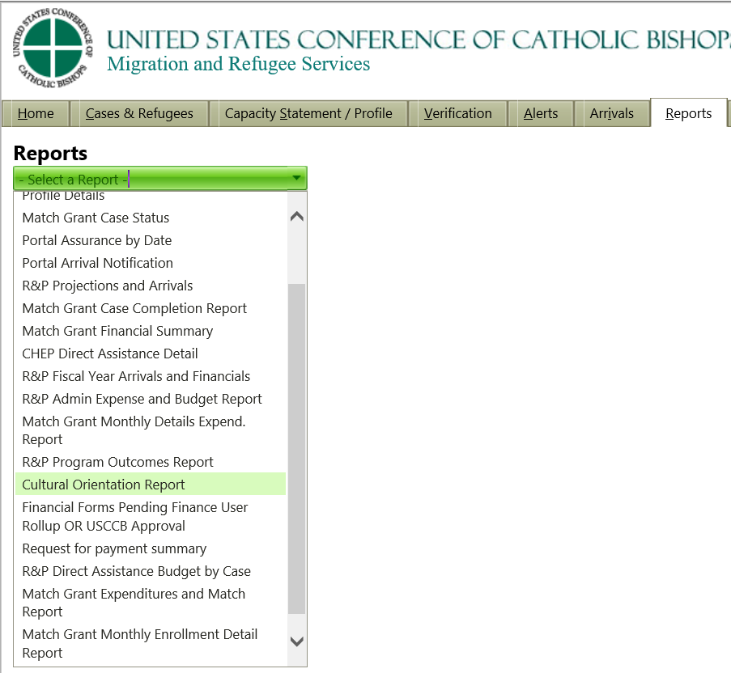
R&P Financial Reports In MRIS
R&P Admin Expense and Budget Report
R&P Direct Assistance Budget By case
R&P Direct Assistance Overview - ERMA
Request for Payment Summary

Slide 27
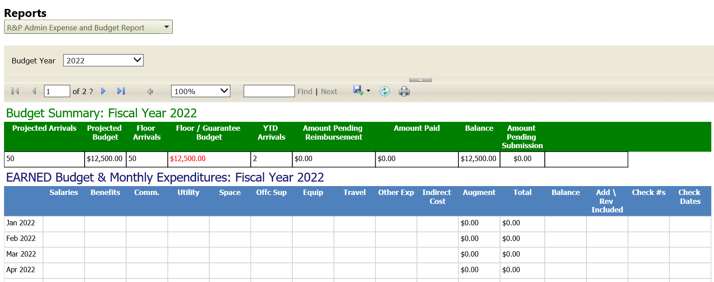
R&P Admin Expense and Budget Report

Slide 28
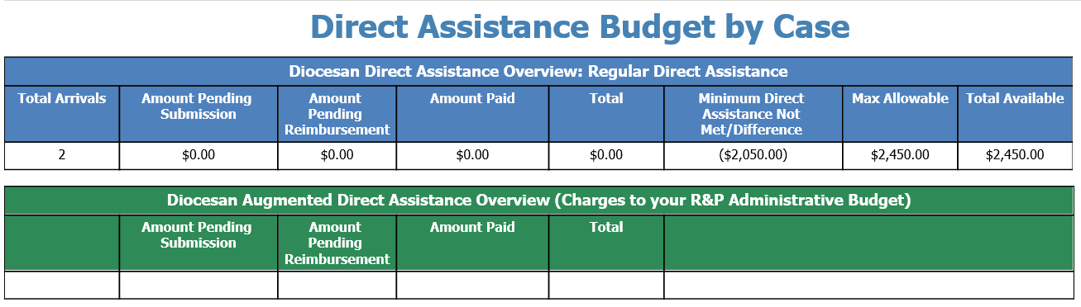
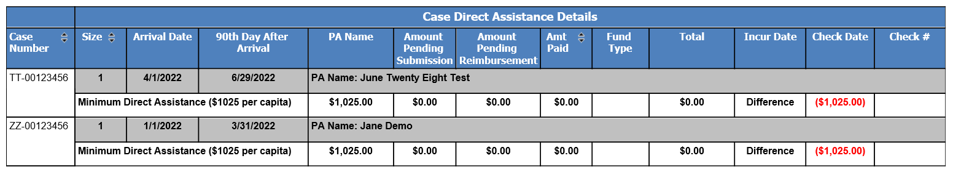
R&P Direct Assistance Budget By Case

Slide 29
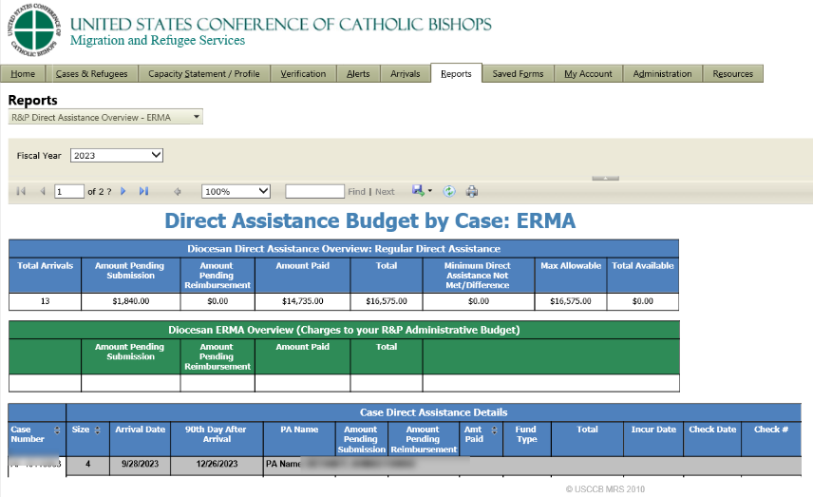
R&P Direct Assistance Overview - ERMA

Slide 30
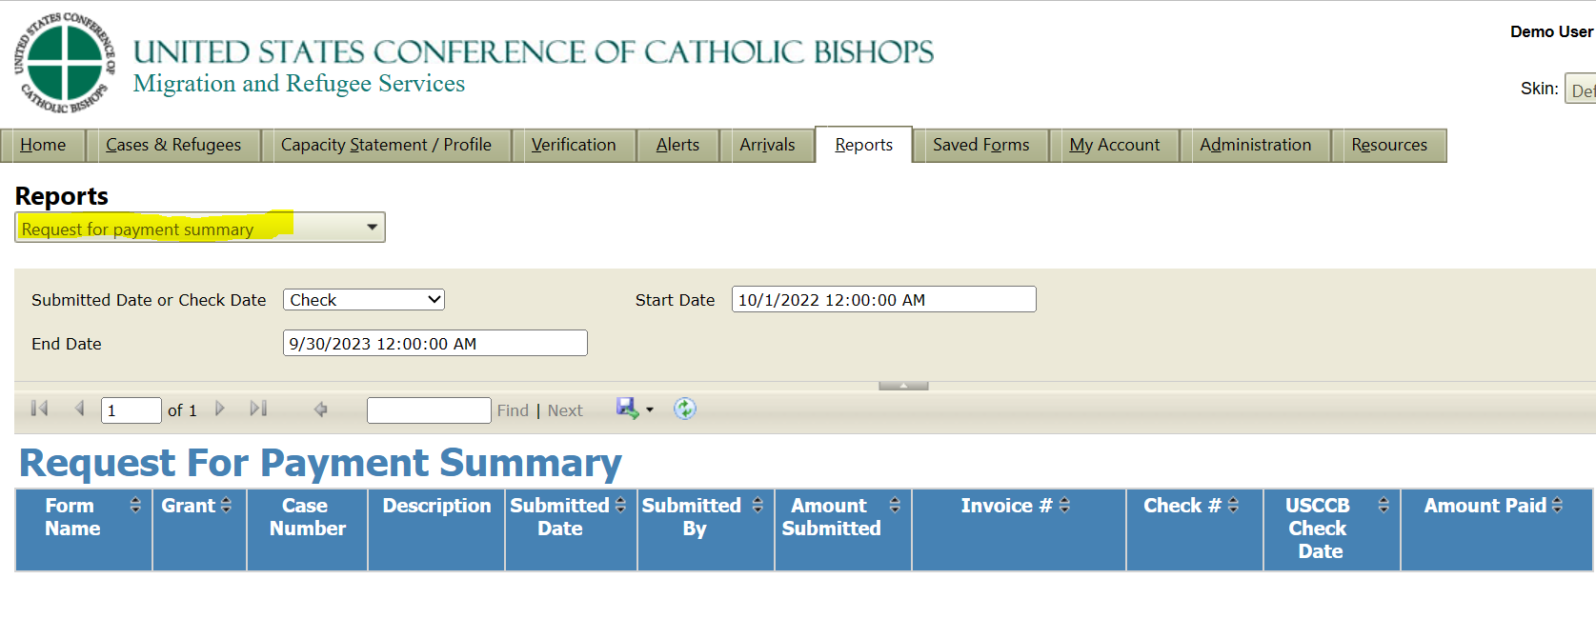
Request for Payment Summary Report

Slide 31
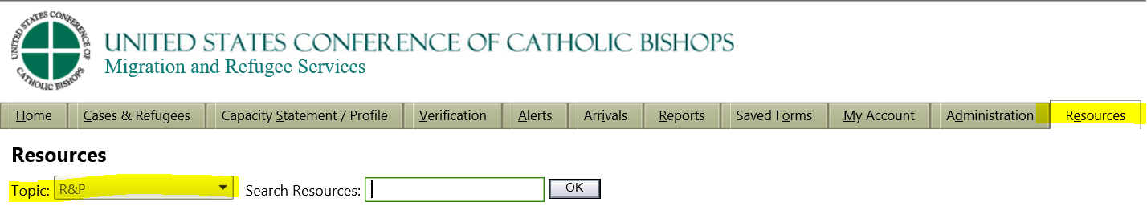
Reimbursement Resources
MRIS Guides on a variety of topics
Submit trouble tickets to MRIS Helpdesk (zendesk.com)
Email MRIS Help Desk at Support@mrishelpdesk.zendesk.com
Be Aware of Deadlines on Award Documents

Slide 32
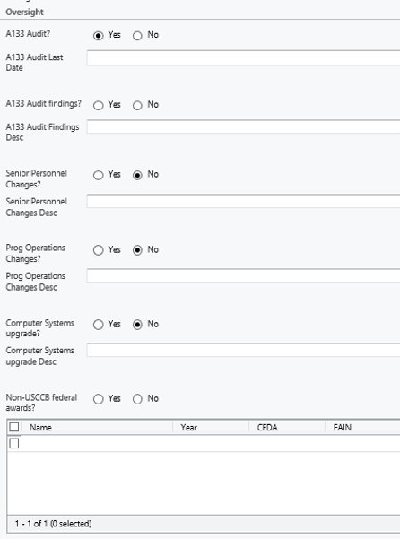
Office of Finance and Accounting Questionnaire
Annual Submission in MRIS
Access Form Through Alert in MRIS
Ensures Compliance with Federal Requirements
Not Submitting Results in Payment Hold

Slide 33

Questions?

