Slide 1


Changes to the Cooperative Agreement FY24
March 21, 2024

Slide 2
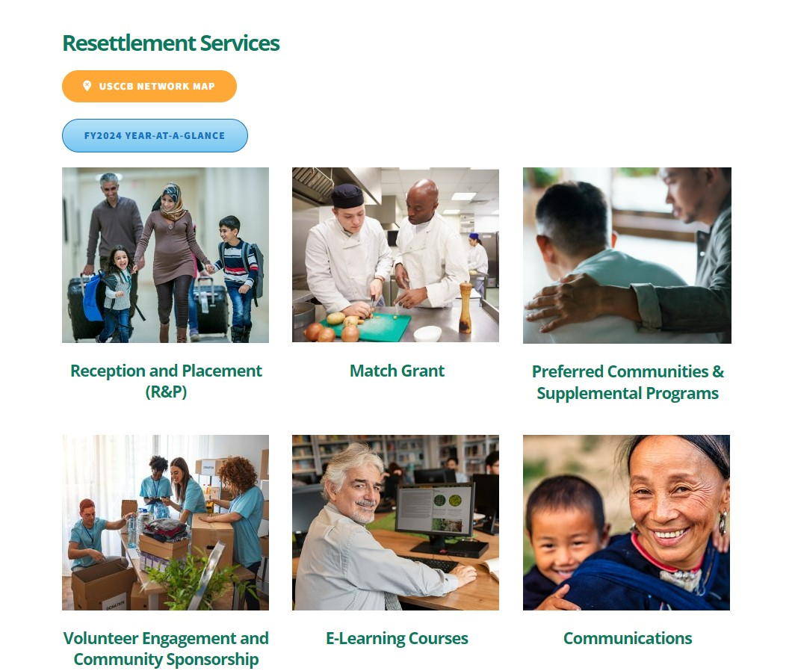
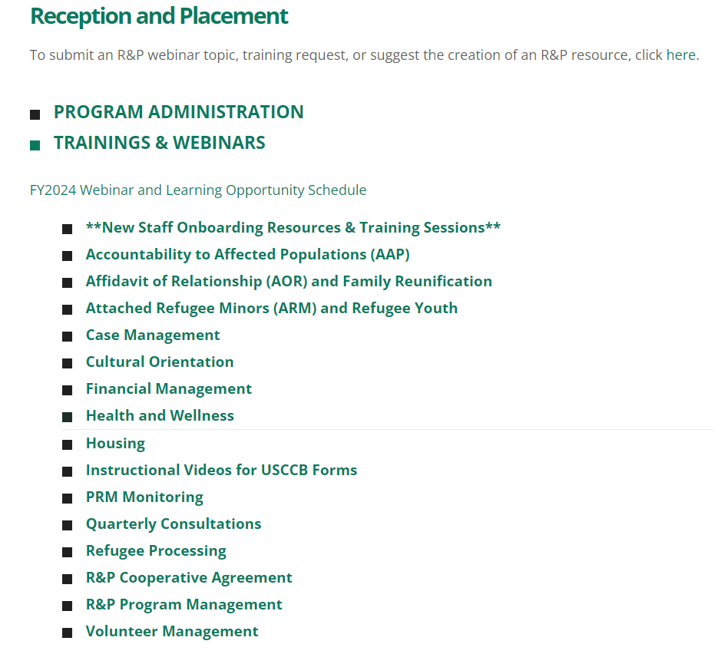
Webinar Recording on MRSConnect
Today’s webinar will also be saved on the R&P page.
All webinars for the fiscal year.

Slide 3


Today’s Agenda
1
What to Expect for the Rest of FY24
2
Changes to the Cooperative Agreement
3
USCCB Reframe of Case File Compliance
4
Follow-Up Info From Live Q&A Session
Updated following the webinar in response to unanswered questions. See Slide #23 for clarifications.

Slide 4
List key changes to the R&P Cooperative Agreement (CA)
Learning
Objectives
1
Discuss how CA changes impact case management, documentation, and program administration
2
By the end of this session, you will be able to:
Describe the timeline for implementing CA changes
3

Slide 5

Ask the Audience!
What do you currently expect for the rest of FY24?
It’s okay if you’re not sure. Today we will try to make sense of this.

Slide 6
What USCCB/MRS Anticipates
FY24 Themes
New Programming
Documentation
Safety and stability for our clients includes a durable status in the U.S.
Welcome Corps and Private Sponsorship
Extended timelines to complete/document certain services
Clients and staff would benefit from a revamp of the R&P Program
Co-Sponsorship, Cash-Based Model, Launch of Virtual R&P
More flexibility in what is considered compliant case file documentation
Support via processing improvements, increased UST commitment
Extended verification timeline, revised UST Assessment
Reduced R&P period report data, remote management visits

Slide 7



Changes to the R&P Cooperative Agreement
Administrative Implementation Date: April 1, 2024
Service Implementation Date: arrivals on or after April 1, 2024

Slide 8
#1: New Definitions
Resettlement Director
U.S. Tie (UST)
Required Participants
“…the affiliate staff member who manages or oversees the R&P Program at that affiliate…”
– R&P FY24 CA pg. 21
“…an individual who has been identified by the [client] as a family member or friend and who is currently living in the United States…”
– R&P FY24 CA pg. 21
Big Takeaway: the person designated as RD may have a different title within your agency
Examples we have seen: Program Director, Program Manager, or Assistant Director
Big Takeaways: The UST must have a close and personal relationship with the refugee
The UST is expected to assist in supporting the refugee after arrival as determined by the affiliate in consultation with the SRC/SRHC.

Slide 9
#2: Administrative Clarifications
Administrative funds (aka affiliate capacity per capita) can be used to hold empty housing for up to 60 days before the unit is occupied by an R&P client. – R&P FY24 CA pg. 7
When an affiliate notifies USCCB of observed or alleged instances of fraud, bribery, waste, and abuse, USCCB has 24-hours to pass that along to PRM. This applies to instances both internal or external to your organization. – R&P FY24 CA pg. 36
Expanded the section on limitation of responsibility to perform core services to note that affiliates should document any systemic or intentional optimization of services that does not fall within the service due dates outlined in the CA. – R&P FY24 CA pg. 36

Slide 10
#3: R&P Period Reports
Originally communicated as a PRM Program Announcement; now formalized in the technical instructions (a separate document) – R&P FY24 CA pg. 49
No longer required to answer case-level questions 2-6 and member-level question 1
These questions include:
Core services provided/not provided
Sources of income
Income exceeds household expenses
Case can identify income after R&P ends
Total amount of R&P funds provided to/spent on behalf of the case
SSN for each member (this must still be included somewhere else in the file)
Still required to provide answers to the remaining questions on the R&P Period Report
These questions include:
General case info (post-arrival SIV, post-arrival transfer, co-sponsor support)
General individual information (name, address)
Out-migration (entire case or individuals)
Employment status
Education status
On-going services
CO questions (adults only)

Slide 11
#4: Remote Placement
Old Guidance
New Guidance
Remote placement community partners must be at least 100 miles away from the closest same-state affiliate.
Remote placement community partners must be at least 50 miles away from the closest same-state affiliate. – R&P FY24 CA pg. 20
Big Takeaway: R&P affiliates still maintain a 100-mile placement radius regardless of whether a remote placement community partner opens within 50 miles, therefore some affiliates might have an overlapping service area with a nearby community partner. The goal is to eliminate (where possible) staff travel time to cases that are placed more than 50 miles away from the affiliate office.

Slide 12
#5: Community Sponsorship
Co-sponsor groups can also be established by informal collections of community members like friends, neighbors, or community members who do not know one another but are placed in a group by the affiliate. – R&P FY24 CA pg. 20
Support Team has been added back to the list of community sponsorship definitions (a big win for your volunteer groups!). – R&P FY24 CA pg. 21
Refugee Welcome Collective (RWC) resources have been added along with recommendations for effective community sponsorship. – R&P FY24 CA pg. 30

Slide 13
#6: Reception and Housing
New Timelines/Due Dates
New Guidance/Resources
Required Participants
State-Level
State Refugee Coordinator
State Refugee Health Coordinator
Local/County Level
Governance
Public Health
Welfare/Social Services
Public Safety (law enforcement)
Public Education
Housing must comply with local, state, and federal standards instead of the stricter standards
USCCB/MRS recommends using a combination of what makes sense in the local context to keep clients safe but also keep housing affordable
– R&P FY24 CA pg. 38
Refugee Housing Solutions (RHS) resources have been added
– R&P FY24 CA pg. 39
Initial home visit may occur up to 72 hours after arrival for all cases except:
Attached Refugee Minors (ARMs), or
Cases with no access to a phone, or
Cases who were not met at the airport by affiliate staff or volunteers
– R&P FY24 CA pg. 37
Food allowance updated to reflect up to 72 hours to align with initial home visit – R&P FY24 CA pg. 40

Slide 14
#7: Other Timeline Updates
Pocket Money
Intake Interview
Health Screening
Pocket money is required within 24 hours of arrival and is no longer required throughout the first 30 days as needed.
No change needed, USCCB’s network already provides within 24 hours
– R&P FY24 CA pg. 40
Intake interview due date extended from five working days to seven working days to align with the timeline to apply for public benefits.
– R&P FY24 CA pg. 40
Health screenings are now due by day 90 instead of day 30
If the appointment will occur after day 90, documentation of the expected timeframe and logistical plans to ensure clients attend their appointment
– R&P FY24 CA pg. 43
Slide 1 of 2

Slide 15
#7: Timeline Updates (cont’d)
Social Security Cards
Employment Authorization
Wait 3 weeks after arrival before following up with the local SSA office within 3 working days
Limitation of responsibility to perform core services: If you have a local process established that consistently works, new CA language allows you to use that local process instead of the timeframe outlined in the CA, but you must document it in the case note log how individual refugee well-being was prioritized and considered.
– R&P FY24 CA pg. 41
Wait 4 weeks after arrival before following up with USCIS + document all delays in the case file
If the issue remains unresolved after working with USCIS, elevate the issue to USCCB/MRS so we can follow up based on PRM established protocols.
For EADs and Social Security cards, please document all delays in the case file!
– R&P FY24 CA pg. 41
Slide 2 of 2

Slide 16
#8: Process Clarifications
Assisting clients with filing change of address forms. – R&P FY24 CA pg. 42
Still Required: Must help clients file AR-11s with the Department of Homeland Security and Selective Service (if applicable to the client) within 10 calendar days of arrival and each move
No longer required to assist clients with filing address changes with the U.S. Post Office.
New Requirement: Must orient clients to the process of completing change of address forms with the U.S. Post Office.
Service plans no longer required for children; monitoring of the plan’s progress no longer needs to be documented on the service plan itself – R&P FY24 CA pg. 42-43
Exception: USCCB still requires service plans for Attached Refugee Minors (ARMs)
CO topics revised, updated, and expanded, including a new section on digital literacy + CORE resources are emphasized – R&P FY24 CA pg. 45

Slide 17
#9: Interpretation Documentation
The Case’s U.S. Tie
Independent
Interpreter (in-person or virtual)
Staff member who speaks the client’s language
No Interpreter Required
Compliant During Airport Pickup and Housing/Personal Safety Orientation
Required for intake interview, initial home visit, 30-day home visit, service plan creation, and CO. Required for other services if client is present (except when UST is compliant)
No interpretation required if client is not present. Case note or case file form must indicate N/A for interpretation.
– R&P FY24 CA pg. 37
– R&P FY24 CA pg. 40-42, 45
– R&P FY24 CA pg. 19, 48

Slide 18
#10: Monitoring Changes
New Director Monitoring is now Remote Management Visit
While it doesn’t reset the 3-year cycle like a full on-site review (OSR), it does satisfy the requirement for USCCB to conduct a specialized leadership/management assessment and training for new RDs.
Streamlined report that is faster to draft and easier to read
No Program Strengthening Plan (PSP)!
Ability to postpone USCCB monitoring that is scheduled within the 12-month period following a PRM monitoring based on the compliance rating:
Compliant or Mostly Compliant: USCCB can postpone the OSR for up to 1 year after PRM’s monitoring even if that pushes it beyond the regular 3-year cycle.
Partially Compliant or Not Compliant: USCCB can postpone the OSR for up to 6 months after the original OSR month even if that pushes it beyond the regular 3-year cycle.

Slide 19

USCCB Reframe of Case File Documentation Compliance

Slide 20
More Flexible Case Log
Old Guidance
New Guidance
USCCB required affiliate staff to write a case note and include applicable forms for most R&P services in order to consider the case file documentation compliant.
For most services, the new R&P Case File Monitoring Tool (RF-24) indicates that either a comprehensive case note or a fully-completed form is compliant documentation.
Certain forms are still required by PRM or USCCB: These forms are mentioned in the “Required Case File Forms” section and the “R&P Financial Documentation” section of the Case File Monitoring Tool.
Interpretation requirement separated from service: USCCB’s R&P monitoring team no longer considers interpretation provision as part of determining whether a service was provided vs. not provided. Documentation and provision of interpretation is measured as a separate compliance metric.

Slide 21

New Case File Forms
Initial Home Visit Report (RF-32)
R&P Service Plan (RF-7)
Cultural Orientation Checklist (RF-23)
Case File Monitoring Tool (RF-24)
Addendum to the CFMT (RF-24 Add.)
These documents can be found on MRSConnect under R&P > Program Administration

Slide 22
Earmarked Funds
Old Guidance
New Guidance
When making direct payments to clients, if the file indicated in any way a specific purpose for funds, the file must also include receipts as evidence of what the funds were spent on.
Earmarked funds issued as direct payments to clients no longer require receipts as additional evidence of what the funds were spent on. As with pocket money, client signature on USCCB form RF-35 constitutes the evidence.
Example: Affiliate ABC issues a check to a client for $250 and notes on the check and on the financial summary sheet (RF-19) that the check consists of $100 pocket money + $150 for groceries. The affiliate no longer needs to include a receipt in the case file to show that the client spent $150 on groceries. Client signature on the RF-35 serves as the evidence.

Slide 23
Follow-Up from Live Q&A Session
USCCB’s implementation date for all changes is Monday, April 1, 2024. Slide #7 was updated to reflect this guidance.
Administrative changes go into effect April 1st
Service-related changes go into effect for cases arriving on or after April 1st
USCCB still requires service plans for Attached Refugee Minor (ARM) cases due to their high vulnerability and strong need for regular and personal contact. See Slide #16 for more details.
Case files must document whether a client was present who needs appropriate interpretation. If no client is present during the service, the case notes or the case file form(s) must indicate N/A for interpretation. See Slide #17 for more details.
Slides have been updated to reflect this additional information

Slide 24

What questions do you have?

Slide 25
Do you have lingering questions?
Office Hours for R&P Changes: USCCB/MRS Leadership will offer office hours Wednesdays 3/27, 4/3, and 4/10. Check the News Flash sent out on Monday, 3/18 for the meeting link (no need to register).
Office Hours for CO: Elena Tothazan (our CO Coordinator) will offer office hours every Friday from 1-2pm EST in April and May! Check Resettlement Connection on 3/26 for details and the meeting link.
R&P Team: Contact your USCCB/MRS Pre-Arrival Case Manager (PACM) for pre-arrival/processing questions or your R&P Field Support Coordinator (FSC) for post-arrival questions.
Thank you for attending!

Slide 26
Webinar Recording on MRSConnect
Today’s webinar will also be saved on the R&P page.
All webinars for the fiscal year.

Slide 27

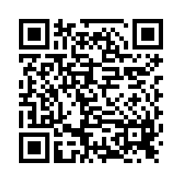
Please share your thoughts.
Anonymous Survey
You can scan this QR code with your phone’s camera.
Or, there is a link to the same survey in the chat.
Notes:
7

