Slide 1


Serving Challenging Match Grant Cases
2/1/2024

Slide 2



Presenter
Dina Eldawy
Match Grant Field Support Coordinator

Slide 3

Zoom Features
Interact with presenter and attendees by:
Answering poll questions
Typing comments in the chat
Typing questions in the Q&A box
Raise your hand if you want to ask a question verbally
The Zoom
toolbar is at the bottom of your
screen!

Slide 4

Anonymous Survey
Please share your thoughts at the end of the webinar.
Do you agree with this statement? Today’s webinar met my training needs on this topic.
Was there something specific you learned today or enjoyed about the webinar?
What was missing from today’s webinar, or how could we make this topic easier for you?

Slide 5
Agenda
Today we'll review:
Common challenges we face with clients
Case cannot already be economically self-sufficient
1
MG Program Operations Manual
2
Interventions to ensure compliance
3
How to incentivize early self-sufficiency
Slides and webinar recording will be posted on MRSConnect

Slide 6
Describe recommended strategies for working with clients who refuse employment offers or refuse to share proof of employment
Learning
Objectives:
By the end of this webinar,
you will be able to:
Understand how to encourage client compliance and sanction clients for non-compliance by utilizing your agency’s MG Client Agreement and Sanctioning Policy
Describe how to utilize incentives and bonuses
Understand program requirements for self-employed clients and clients in informal employment**

Slide 7
What are some challenges working with Match Grant clients?
Brainstorm and please pop answers in the chat!

Slide 8
Common Challenges
“Employable” adults that later change their mind about wanting to work
Refusing reasonable job offers
Waiting for a specific job
Large families with only one adult willing to work
Working under the table
Working but refusing to share start date or bring pay stubs
Input from US ties/ sponsors
Community rumors (telling new arrivals to not work or not share information with case managers to continue receiving assistance)

Slide 9
Approaching challenging cases through a combination of interventions:
Screening
Client Agreement & Sanctioning Policy
Incentivizing Self-Sufficiency
Refreshers
on MG Expectations
Assess Trends
Sanctioning
Non-Compliant Cases

Slide 10
Screening
Update eligibility screening to reflect client-specific challenges your agency faces

Slide 11
Assessing your agency’s screening process
Pipeline to MG: What does your referral process look like? Who is responsible for identifying potential MG clients?
R&P resettles client or
non-R&P client walks in
MG/R&P staff assess client’s eligibility and fit for program
Staff offer MG as
a potential program, conduct pre-enrollment analysis
MG enrollment and continued orientation

Slide 12
Assessing your agency’s screening process
Screening for MG: What criteria do you use to determine whether a case is a good fit?
R&P resettles client or
non-R&P client walks in
MG/R&P staff assess client’s eligibility and fit for program
Staff offer MG as
a potential program, conduct pre-enrollment analysis
MG enrollment and continued orientation

Slide 13
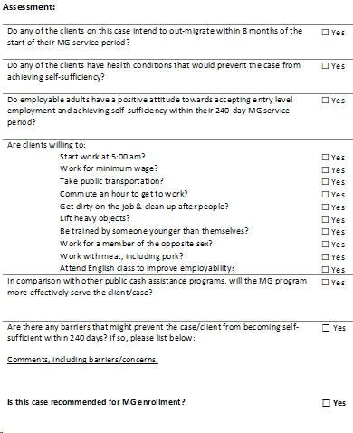
MG Eligibility & Assessment questionnaire
Do you use the USCCB template?
Does your eligibility screening reflect challenges you see with clients?
Does your agency screen candidates before offering MG?

Slide 14

Screening Examples
Large Families
Based on cost of living in your area, how many employable adults are needed for a large family to become self-sufficient?
Single Cases
Is there affordable housing for single individuals in your area? Are they willing to live with roommates?
Elderly clients or cases with physical limitations
Are there jobs in your area/with your partner employers that can accomodate limited physical capacity?
Work Interest
Did the client express interest in working before learning about the MG financial incentives? Do they want only one specific type of job?

Slide 15
Assessing your agency’s screening process
Presentation of MG: How and when do you present MG as an option to clients? What aspects of the MG program do you discuss first: benefits or requirements?
R&P resettles client or
non-R&P client walks in
MG/R&P staff assess client’s eligibility and fit for program
Staff offer MG as
a potential program, conduct pre-enrollment analysis
MG enrollment and continued orientation

Slide 16
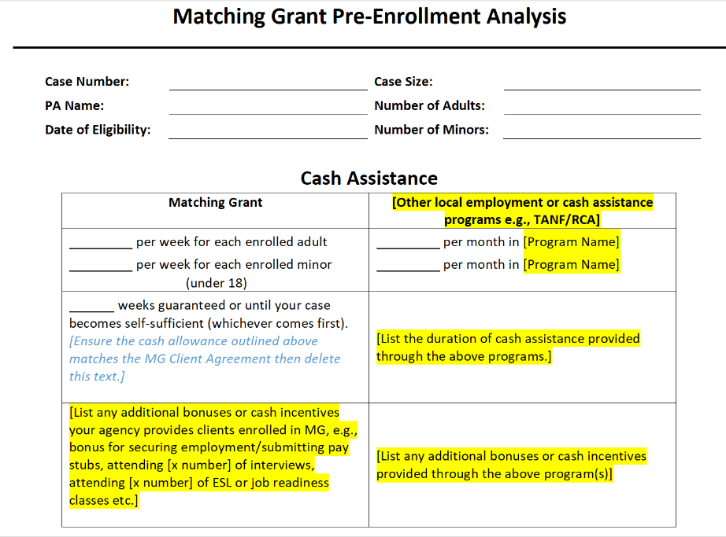
Pre-enrollment Analysis
Things to keep in mind:
Ensure this document is accurate for the case composition
Remember that your agency decides which cases are offered MG as an option
Use this document as the first step in establishing MG expectations

Slide 17
Client Agreement and Sanctioning Policy
Key documents for ensuring client compliance

Slide 18
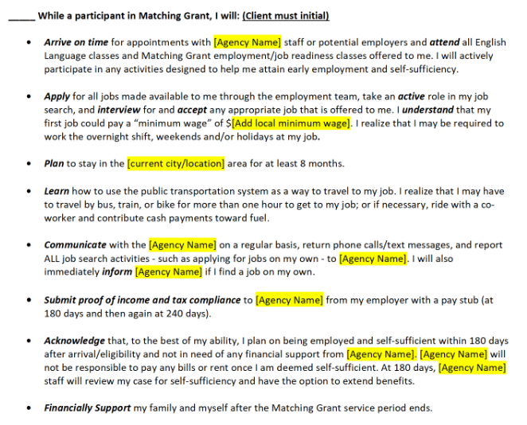
Client Agreement
Things to keep in mind:
Contract that binds both the agency and the client to a set of expectations / responsibilities
Ensure client receives copy in own language and policy is interpreted line-by-line
USCCB template but can edit to reflect compliance issues you see at your site (plus bonus policies)

Slide 19
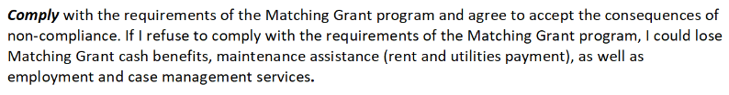
Client Agreement Sanctioning
While participating in Match Grant, I will (Client signs):

Slide 20
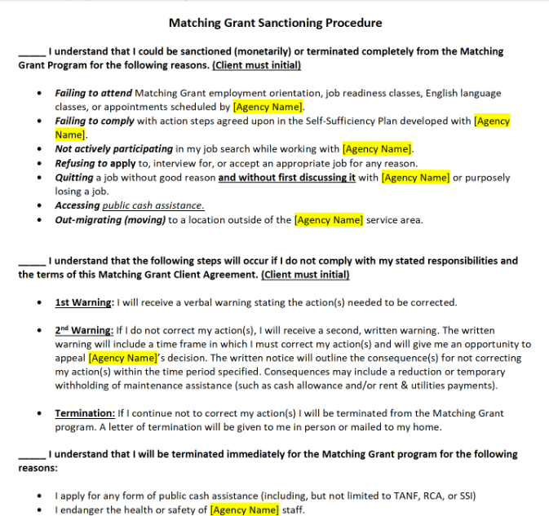
Sanctioning Policy
Things to keep in mind:
Explains consequences of non-compliance with the Client Agreement (interpretation to ensure understanding)
Staff must stick to what is outlined in your site's policy (can update*)
Sanctioning is meant to give clients an opportunity to return to compliance (not necessarily immediate removal)

Slide 21
Next Step: USCCB Document Review
In late February/March, USCCB will ask affiliates to submit their
Client Agreement, Sanctioning Policy, and Pre-enrollment Analysis forms to USCCB.
Your MG Field Support Coordinator will work with you to update or strengthen these policies if needed.

Slide 22
Incentivizing
Self-Sufficiency
Instituting bonus policies and positive reinforcement

Slide 23
How does your agency incentivize clients to accept and retain jobs?
Brainstorm and please pop answers in the chat!

Slide 24
Bonuses and Support Services
Instituting employment bonuses along with self-sufficiency benchmarks will emphasize agency's expectations
Highlighting role models and success stories in the community can provide clients a way of looking forward to self-sufficiency
Women's engagement circles and expanding employment opportunities can accommodate cultural barriers

Slide 25

Employment Bonuses:
Different types of bonuses to consider:
Proof of employment bonus
Early employment bonus
Employment retention bonus
flat amount or different amounts depending on how early in the service period client starts job (given at job start or Day 180)
if still employed by day 240
disburse small stipend or gift card when clients bring in pay stubs to encourage transparency
Bonuses can be cash, gift cards, or high value items (laptops, smart watches etc.)

Slide 26

Policy Changes:
Consider policy changes to offer more than minimum requirements to incentivize compliance :
Cash allowance and/or core maintenance for all clients through day 180 regardless of self-sufficiency status (clients know they will continue to receive financial assistance even after starting work)
Have a generous “date of self-sufficiency” cut-off for financial assistance (eg 30 days after job start)
All policies and bonuses should be clearly outlined in Client Agreement and applied consistently to all MG cases

Slide 27

Positive Reinforcement:
Celebrate self-sufficiency
Highlight success stories in job readiness or along highly visible places within agency
Connect clients with former MG clients or community leaders as mentors
Example: Hallway walls, office spaces with client pictures and stories in different languages
Example: Women's support groups within cultural community
Example: bell ringing after completing budget together, biannual MG completion ceremony

Slide 28
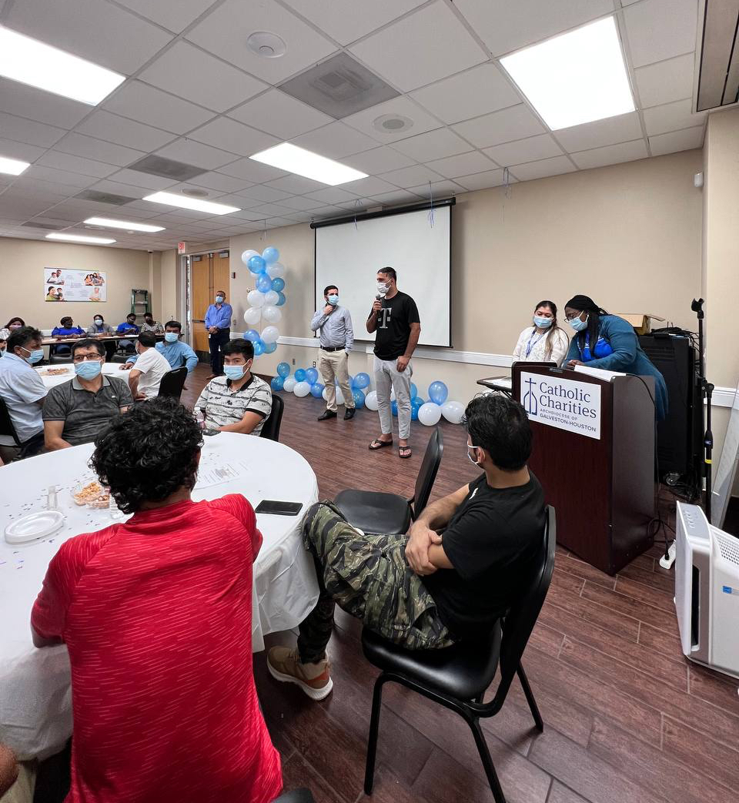
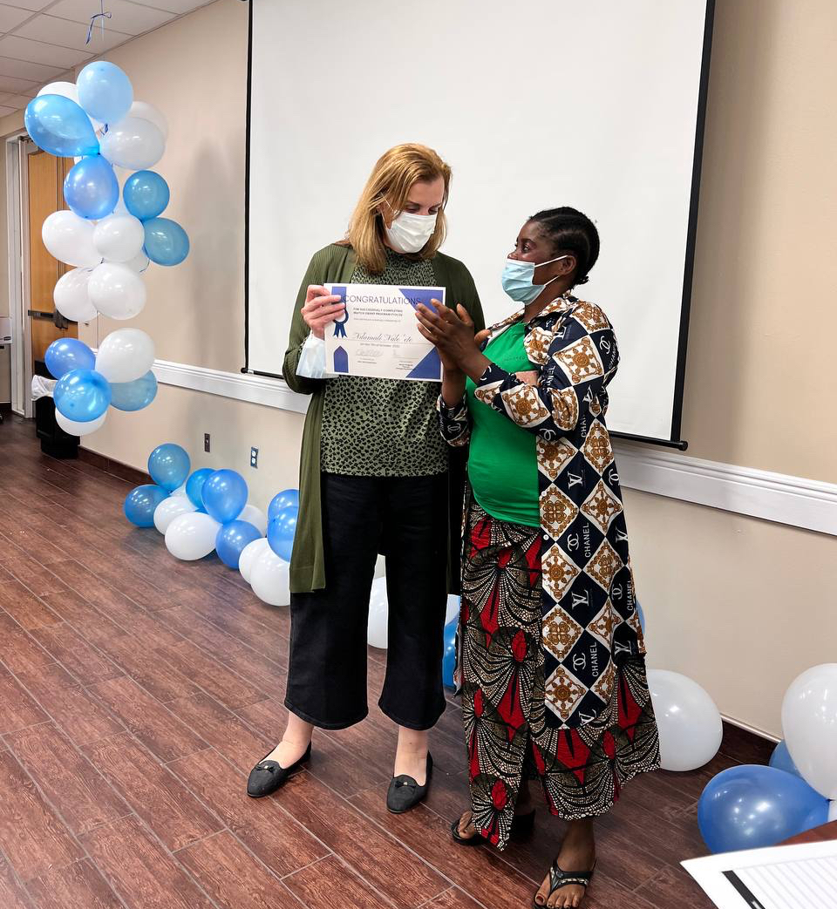
Catholic Charities of Galveston-Houston— MG Graduation Party

Slide 29

Expand Employment Opportunities:
Build up employer network to diversify jobs
Pre-literate clients
Creative placement partnerships
Sewing class plus placement (targeting women)
Women who have never had formal employment
Flexible work hours for parents
Workhouses that organize carpools, deduct wages for transportation accomodation
Employee trainers and mentors within language groups

Slide 30
Refresh Expectations on MG Requirements
Reminding clients about importance of early employment and their commitments as MG clients

Slide 31
Budgets as a Financial Literacy Tool
Enrollment Budget
How much does the case need to make per month to cover own expenses?
Reminder that MG will end eventually.
180-Day Budget
Where does the case stand now?
Reminder that MG will end soon.
If case is not compliant, should be sanctioned?
240-Day Budget
Case is closed.
Recommended to meet in advance to remind case that MG is ending and agency assistance will cease.
Incorporating budget discussions before actual 180/240 benchmarks

Slide 32
Putting it all together:
Enrollment
Orientation
First few months
JRT, Job Placement Services, ESL
150 days
Check-in, pre-budget discussion
180 days
Budget discussion & potential bonus
What else can MG provide until the end?
210 days
Check-in, still SS? Not SS?
Discuss MG program ending soon
240 days
Budget discussion & potential bonus
Clients prepared for the end of program
Check-ins to emphasize expectations timeline of program, importance of early employment
Example: Bring in paystubs on X date (one-month post job start) check-in so client can receive next cash allowance voucher and a bonus on Day 180.

Slide 33
Sanctioning Clients

Slide 34
Things to remember regarding sanctioning:
“In situations where sanctions are applied, the client must receive written notice detailing the reasons for sanctioning and providing a reasonable opportunity for appeal prior to the termination of any benefits.” – MG Guidelines p. 20
Your agency cannot withhold financial assistance without first going through steps of Sanctioning Policy
Sanctioning Policy holds clients accountable to the requirements outlined in the Client Agreement
Enforcing sanctioning discourages future non-compliance from this case and other cases

Slide 35

Sanctioning letter should include:
Sanctioning Letter Example
Compliance issue
Steps and timeline for returning to compliance
Consequences of any continued non-compliance, including withholding of financial assistance if applicable
Instructions for appealing decision
You have not attended
job readiness class in
more than one month
Within two weeks we expect you to resume attending job readiness class and actively participating in the job search.
If you do not resume attendance within two weeks, the agency will withhold your MG cash allowance and rent payments.
You may appeal this sanctioning within five days by contacting Appeals@CC.org.

Slide 36
Internal Timeline and Parameters to Sanction
Examples!
Issue first warning if:
Case refuses two job offers
Case quits one job without notifying agency
Case does not attend one month of ESL/ JRT
Agency learns that case member has been working without notifying staff

Slide 37
Withholding Financial Assistance
Documentation: Can be a case note or another letter
Notice of Next Steps
Client has not done X, so agency will withhold cash allowance as of ___(date).
Client has ___ (timeline) to become compliant with the program.
In the meantime, you can withhold cash allowance. Sanctioning does not mean immediate removal!

Slide 38
Common sanctioning questions:
What happens when one case member becomes compliant, do we still sanction the whole case?
Yes, agency should sanction until whole case becomes compliant.
What happens if a client briefly complies, then become non-compliant again? Do we start the process over or pick up from the previous sanctioning process?
Same compliance issue? You would start a different process for a different compliance issue
When client returns to compliance, do we return any cash allowance/core maintenance assistance that was withheld?
Yes, unless a case is formally terminated from the MG program, all financial assistance withheld must be returned once the client returns to compliance.

Slide 39
Assessing Trends in Non-Compliance
Strengthen your MG program in the long term

Slide 40
Assessing Trends
Take time to reflect on frequent areas of client non-compliance in your MG program
Your MG Client Agreement, Sanctioning Policy, screening procedures, and bonus policies can be updated at any time (discuss with MG FSC)
Any changes will apply to clients that sign that Client Agreement/Sanctioning Policy moving forward (cannot retroactively change for active cases)

Slide 41
Examples
Scenario #1:
A case manager is aware that a client has started a job but is refusing to bring in paystubs in a timely fashion. What can they do to ensure compliance?
Answer #1:
  Emphasis on this requirement at enrollment
  Pay stub bonuses
  Meetings to collect pay stubs two weeks ahead of 180/240
  Does your site have a clear policy? (ex. Clients have one month post-job start to collect paystubs and determine self-sufficiency)

Slide 42
Examples
Scenario #2:
Your client is joining a community that is generally well-established and are known to talk to each other about benefits. You can tell that the community has encouraged MG clients to delay working to get more MG financial assistance—what kind of interventions can you think of for this case?
Answer #2:
Focus on requirements ahead of discussing benefits during pre-enrollment analysis
Emphasis on sanctioning policy during enrollment
Immediate sanctioning of cases exhibiting non-compliance to set precedent
Large early employment bonuses
Shifting perception of MG by having self-sufficiency celebrations (food &giveaways)

Slide 43
Examples
Scenario #3:
Your MG program notices a trend of out-migration within specific communities. What kind of interventions can you think of to prevent this or encourage clients to stay?
Answer #3:
Update pre-enrollment analysis to include additional questions about likelihood of outmigration
  Do they have family elsewhere?
  Do they have a stable housing situation? (sponsor breakdowns)
  Interest in remaining the area
  Level of happiness in current city
  Are they connected to community here?
  Does your agency offer community resources, referrals, or mentors?

Slide 44


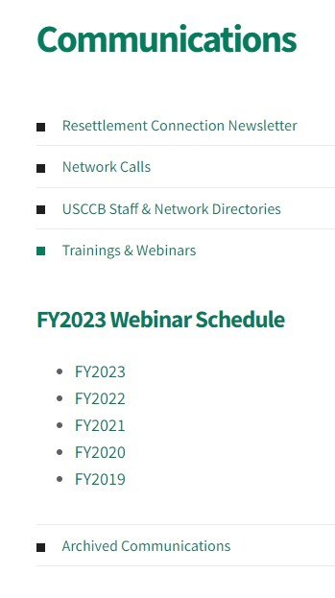
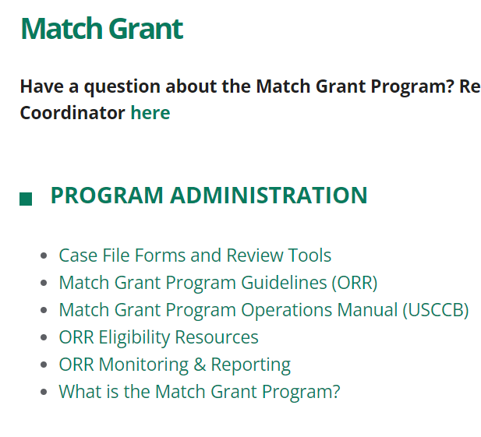


MRS Connect Resources!
Slides & Recording
  Case File Documents

Slide 45
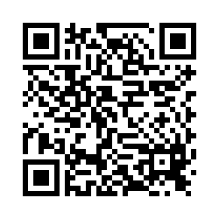
Please share your thoughts.
Anonymous Survey
You can scan this QR code with your phone’s camera.
Or, there is a link to the same survey in the chat.

Slide 46

Questions?
Please add questions to the Q&A box or raise your hand.

