Slide 1
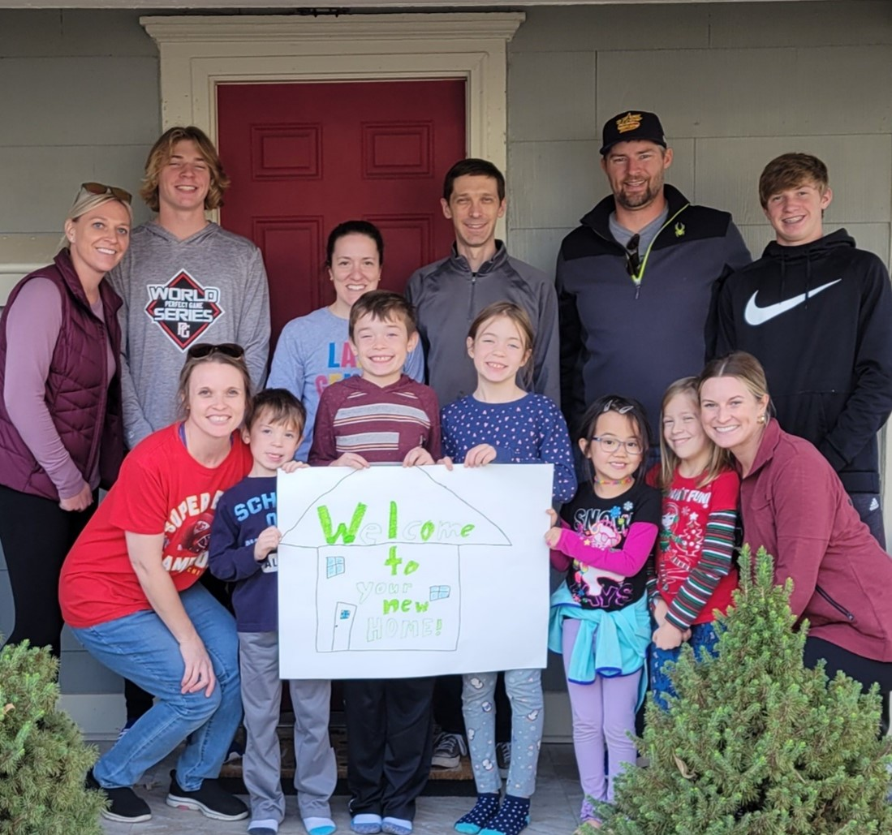
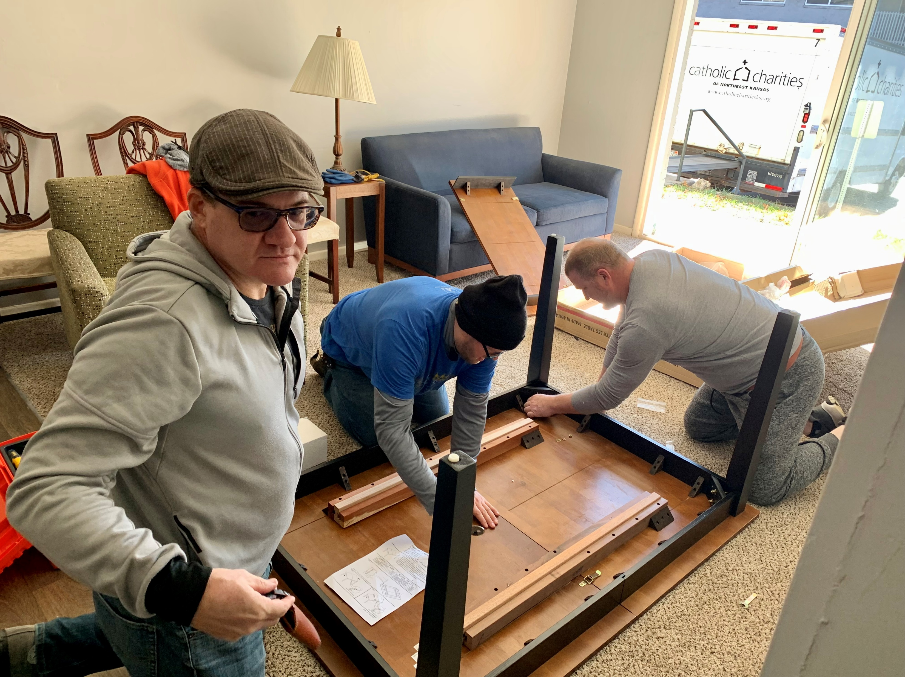
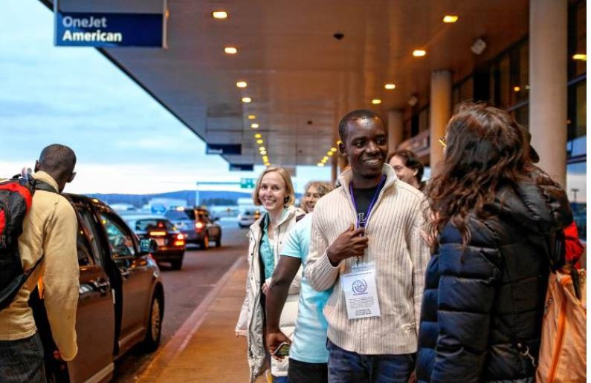
The Power of Volunteers:
Leveraging the Local Community to Identify Safe & Affordable Housing
December 14, 2023

Slide 2
Housekeeping Rules

Slide 3
Anonymous Survey
Please share your thoughts at the end of the webinar.
Do you agree with this statement? Today’s webinar met my training needs on this topic.
Was there something specific you learned today or enjoyed about the webinar?
What was missing from today’s webinar, or how could we make this topic easier for you?
Notes:
7

Slide 4
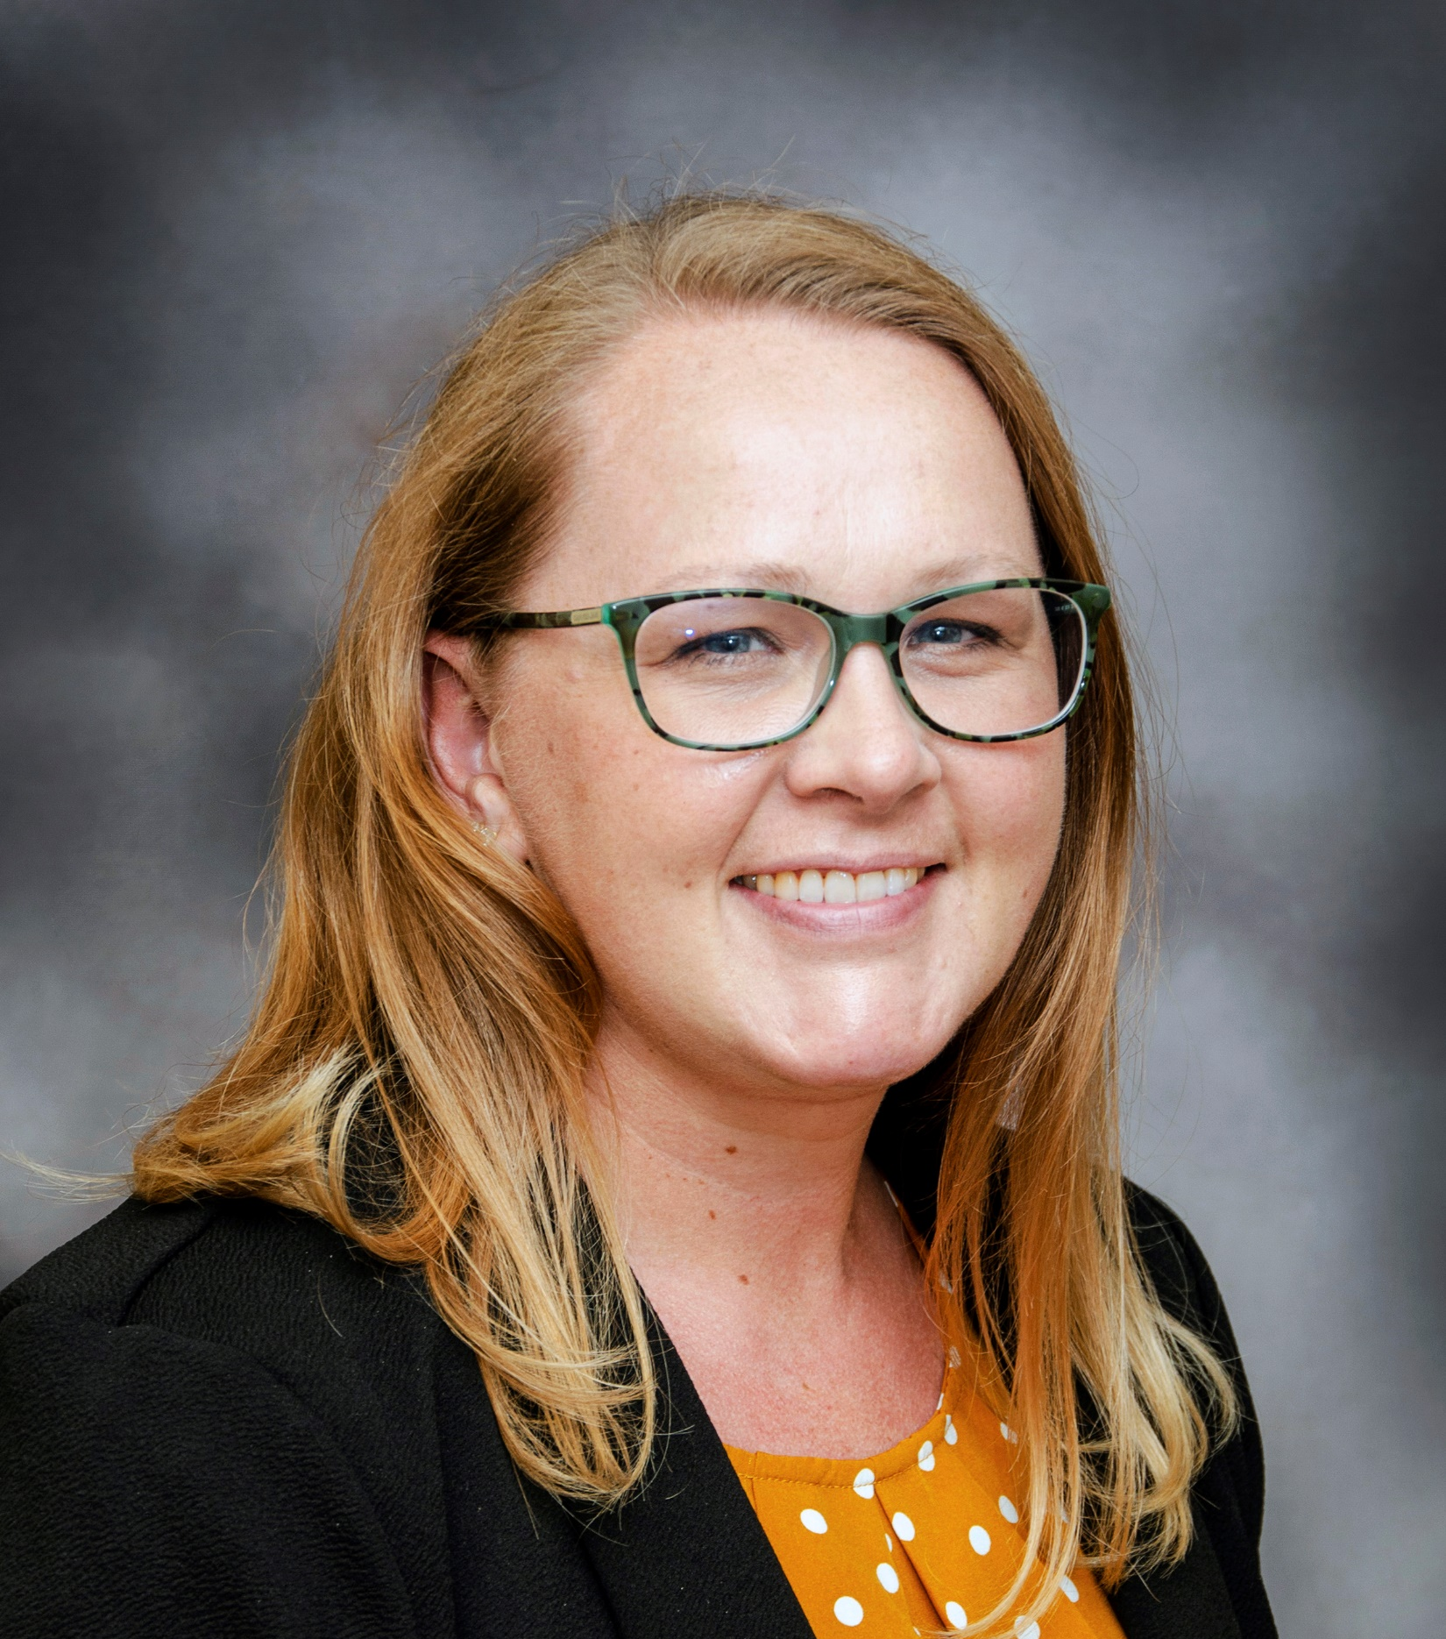
Introductions
Negena
Phil
Negena Haidary will be our first speaker today.
Philip D’Agati, Jennifer Verkap-Ruthven, and Tara DeGrave will be our panelists.
National Housing Coordinator, USCCB/MRS
Program Manager, Community Sponsorship & Engagement Catholic Charities Boston
Jennifer
Tara
Associate Director
Catholic Charities Green Bay
Director, Catholic Immigration Services
Little Rock

Slide 5
Learning Objectives
1
Discover the wide range of ways in which USCCB resettlement affiliates are working with volunteers and local community partners to identify safe and affordable housing
2
Identity how your agency can leverage members of the local community to expand client housing options
3
Learn tools and techniques to facilitate the successful inclusion of volunteers in your agency’s housing searches

Slide 6
Capacity & Reach
Negena Haidary
USCCB | National Housing Coordinator

Slide 7
Key Points
Training and Sensitization
Guidelines
Boundaries and Expectations
Target Demographic and Specific Recruitment
Housing Support Ideas

Slide 8
Training and Sensitization
Inform volunteers of the issues and challenges related to affordable refugee housing amidst systematic delays, language barriers, and the overall shortage of affordable homes.
Highlight cultural sensitivity training to teach volunteers of the backgrounds our clients come with to raise awareness in ensuring tasks are approached with empathy and understanding
Provide opportunities to shadow staff conducting outreach or performing the tasks you’d like them to replicate

Slide 9
Guidelines
Provide documentation identifying steps of the task
Reference for current/new volunteers to use as their first point of reference while working through a situation
Operating Procedure is a great tool; consider it a living document that you can modify as your experience working with volunteers in the housing arena grows
Ensures consistency of volunteer contribution

Slide 10
Boundaries and Expectations
Clarify the specifics to ensure volunteers understand what they are responsible for and where that responsibility ends
Welcome Input: Once a volunteer is familiar with their role, autonomy can be achieved further by establishing check-ins to hear their ideas and suggestions based on field experience
Maintain ongoing communication and frame feedback positively to focus on improvement

Slide 11
Who would fit such a role best?
Any Volunteer (Individuals or groups)
With support and clear expectations of the role, anything is possible.
Retired Estate Agents
Possesses years of knowledge on trends in US housing market
Understanding of legal transactions

Slide 12
Recruitment
Offer to present at upcoming meetings or events to:
Introduce your mission and goals
Educate on the Resettlement process and what that looks like for a refugee coming into your community
Share existing Challenges and Barriers
Specify ways they can help agency staff while extending their life experience in a different yet meaningful way

Slide 13
How can volunteers support?
Property Research
Task: Volunteer can investigate local market and curate a list of affordable and attainable housing options with key details: Average pricing, eligibility requirements, leasing contact information and anything else of relevance.
Educational Outreach
Task: Host new and former landlords/community workshops to present on the goals of Resettlement Agencies, what that role looks like as clients integrate into their new lives, and what incoming needs and flexibilities are going to be required to ensure we help them reach a quality one
Community Outreach
Task: Create or update marketing geared towards the interests of landlords. Have them attend local events on your behalf to raise awareness of your agency and serving population. Overall continuous commitment to advocate in their circles and stay alert on unventured outlets

Slide 14
Additional ways…
Resource Navigation
Volunteers can build housing centered support networks with a main purpose of collaborate with resettlement agencies within the initial R&P period.
Case Management Support
Drafting administrative documentation, Housing Applications, creating email templates for landlord/online outreach.
Temporary Housing Solutions
Relationship building with local community partners (e.g., colleges, retreat centers). Safe & affordable short-term solutions to allow time to plan the long term.

Slide 15
Tara DeGrave
Green Bay, WI

Slide 16
Current Housing Situation in Green Bay
Lack of adequate temporary housing
Impact of Packer games
Why we do temporary housing: migration, choice
Length of time in temporary housing: 7-10 days
Lack of Permanent Housing
Lack of landlords willing to work with no credit
No rental history, double security deposits
Little inventory in our community of affordable/attainable units

Slide 17
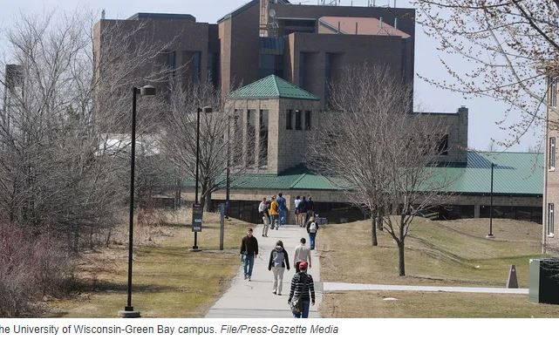
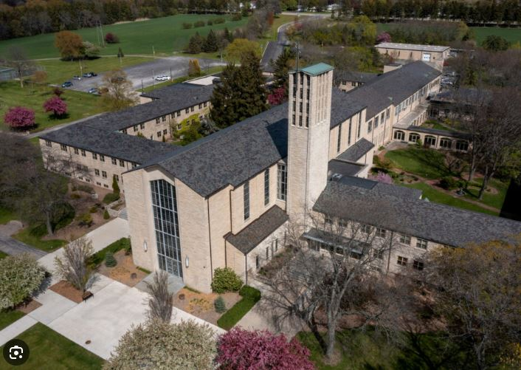
Creative Solutions for Temporary Housing
University of Wisconsin-Green Bay:
Rent vacant furnished apartments on campus
Pay a daily per person rate; invoiced at end of stay
St. Norbert Abbey (Retreat center)
No cost to us
Abbey provides us with availability date
With both, the Packers do not impact availability!
Notes:
How did we form these relationships?- with UWGB and the Abbey, these relationships were sought during the beginning of APA, Fall 2021 at the beginning of Packer season, when we had trouble finding any available airbnbs or hotels during home packer game weekends.
At the time our resettlement work with Afghans was in the news and social media nearly daily and people wanted to help. With UWGB and our willingness to pay a fee, that helped- they had noted in the news that students on campus were down so we suspected that they had open space.
In WI we know that landlords/apts don’t want to be vacant during winter months. We sat as a team and started to think of any places we could think of that may have open space. For SNC, this is developing overtime and part of the interest for SNC is that we are willing to pay for rent.

Slide 18
How did we initiate/form these relationships?
For UWGB and the Abbey Retreat Center:
Relationships sought during beginning of APA and Packer season
Team Brainstorming on what community partners may have vacancies
UWGB: Leveraged knowledge from news
Lower # of students on campus = open space
The Abbey: Through research, learned that retreats did not occur all 12 months = Certain months with open space
How we maintain/strengthen our relationships
Regular contact, being intentional about thanking, being available to answer questions and concerns
!
Notes:
How did we form these relationships?- with UWGB and the Abbey, these relationships were sought during the beginning of APA, Fall 2021 at the beginning of Packer season, when we had trouble finding any available airbnbs or hotels during home packer game weekends. At the time our resettlement work with Afghans was in the news and social media nearly daily and people wanted to help.
With UWGB and our willingness to pay a fee, that helped- they had noted in the news that students on campus were down so we suspected that they had open space. In WI we know that landlords/apts don’t want to be vacant during winter months.
We sat as a team and started to think of any places we could think of that may have open space.
For SNC, this is developing overtime and part of the interest for SNC is that we are willing to pay for rent.
maintaining the relationships: regular contact with them. being intentional that we thank them in person when we see them at different places in the community. While guests are there asking for feedback, answering their questions, and ensuring that the experience goes smoothly.

Slide 19
Challenges, tips, and advice
For UWGB and the Abbey Retreat Center
Renovations at both UWGB and the Abbey
Minimal support from administration; partner staffing changes
Preparing Clients with what they need for temporary housing. research, learned that retreats did
For UWGB and the Abbey Retreat Center
Intentionally nuture relationships overtime
Keep the conversation going
Keep your eyes open for additional/new partnerships
Example: We are approaching another college that owns houses. Our strategy: house refugee family for 3 months and adopt certain aspects of “Every College a Refuge” Model
. research, learned that retreats did
Notes:
Challenges:
renovations (had at both UWGB and SNA), lack of support from administration or changes in staff(UWGB).
learning what we did not know- making sure we are preparing clients with what to do when they need things and where to go.
availability
Advice:
nurture relationships overtime- and keep the conversations going. we are hopeful to have additional partnerships with other places
Seek Future Partnerships:
another college that owns houses to ideally have a refugee reside there for the first 3 months and adopt aspects of the Every College A Refuge Model.

Slide 20
Questions for Catholic Charities of Green Bay?

Slide 21
Jennifer Verkap-Ruthven
Little Rock, AR

Slide 22
Current Housing Situation in Little Rock
49% of rentals are $701 - $1,000/month
887 sq ft – average apartment size
Limited housing after tornado
45% of households are renter occupied
https://www.rentcafe.com/average-rent-market-trends/us/ar/little-rock/

Slide 23
Housing Volunteer and Sponsor Teams
Sponsor Teams (ST) – groups from different faith congregations who “adopted” a family.
These ST’s were able to raise funds from their own congregations and communities
Housing volunteer came from The Interfaith Center of Little Rock

Slide 24
How we used our housing volunteer and Sponsor Teams
CCA
Assigned cases to Sponsor Teams and then oversaw the case
Told housing volunteer about cases sizes and housing needs
Volunteer
Searched for housing using sites like Zillow and spoke to landlords
Created a working document or spreadsheet that was shared with Sponsor Teams and CCA.
ST
Viewed the housing and communicated with landlord again
Showed the housing to the Afghan families for approval
Chose a specific neighborhood to target to keep Afghans together
The document was consistently updated with data such as address, unit size, price, etc.
Furnished the houses and assisted with some rental costs
Used some direct assistance money to cover multiple months of rent
Provided guidance with signing a lease and moving costs

Slide 25
Communication with things moving so quickly
Sponsor Teams understanding the program and how to speak to the landlords
Sponsor Teams ensuring affordability of rent for clients
Challenges

Slide 26
Questions for Catholic Charities of Arkansas?

Slide 27
Philip D’Agati
Boston, MA

Slide 28
Boston’s Real Estate Reality
Third most expensive metro area in US: $3000/mo.
Inventory is low; Lowest among affordable units
Rental market is competitive, fast-paced, aggressive

Slide 29
Preparing Community Sponsorship Teams
Provide Facts
Provide Options
Provide Stories
Success is a team effort!
Provide Tools

Slide 30
Provide Facts
Cost
Average cost for apartment needed
Likelihood of securing in their community
Lease
Will need a Guarantor
Will need cost to secure & immediate action
Condition
Safe/Secure vs. Location, location, location
Code vs. Perfection

Slide 31
Provide Options
Housing Options
Flexibility in Apartment size
Types of properties
Housing Locations
Know your City
Know your neighboring communities

Slide 32
Provide Stories
How have other teams done it?
What Resources helped?
What have we done to help?

Slide 33
Provide Tools
Standards
Housing Safety Checklist
Local Code Checklist
Landlords
Letter explaining Resettlement Program
Agency References
Real Estate
Connect with housing volunteers
Build a network

Slide 34
Value of Team Collaboration
Housing assets within Parish Communities.
Volunteers with Real Estate Expertise.
Never too many Cooks in the kitchen.
Power of Networking for housing.

Slide 35
Challenges of Team Collaboration
The Volunteer’s standard
The Guarantor issue
Landlord Relations
Perceptions of communities

Slide 36
Strategies for Success in Housing with Volunteers
Get a Realtor(s)
Landlords Relations
Turn Volunteers into References.
Let Volunteers Seal the deal
Lend Volunteers

Slide 37
Questions for Catholic Charities – Boston?

Slide 38
Contact me!
Negena Haidary
National Housing Coordinator, USCCB/MRS
Nhaidary@usccb.org
Thank you!

Slide 39
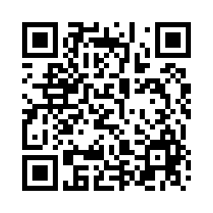
Please share your thoughts.
Anonymous Survey
You can scan this QR code with your phone’s camera.
Or, there is a link to the same survey in the chat.
Notes:
7

