Slide 1
Introducing Hotel Engine
October 17, 2023

Slide 2
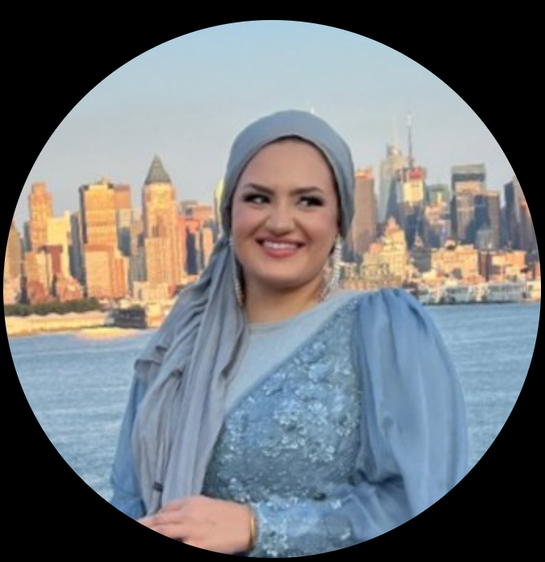
Introduction
Negena Haidary, USCCB/MRS’ National Housing Coordinator, will be our facilitator today.
If your team hasn’t met Negena yet, please get in touch! nhaidary@usccb.org

Slide 3
USCCB/MRS and CCUSA – Housing Resources
For USCCB/MRS resettlement affiliates - https://mrsconnect.org/
Housing Resources on MRSConnect (MRSConnect → R&P → Promising Practices and Resources → Housing)
Check out today's and the consecutive Resettlement Connections to find the registration link for USCCB/MRS’ FIRST Housing Community of Practice (CoP) on:
THURS., October 26th from 3-4pm Eastern
Next Upcoming COP: WED., December 20
Has your team spoken to USCCB/MRS’ National Housing Coordinator, Negena Haidary (nhaidary@usccb.org)?
Please send an email to Negena (nhaidary@usccb.org) if you'd like to be connected to the Hotel Engine team!
For CCUSA member agencies- https://ccconnect.net/
Multiple Communities of Practice (CoPs), including a Housing CoP
Recorded webinars and other resources on CCConnect!

Slide 4
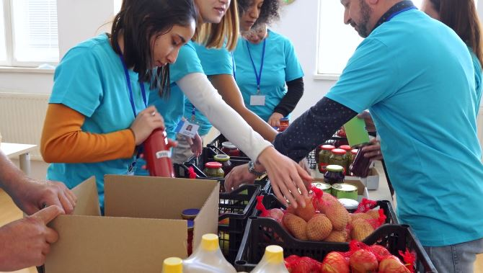
Questions?

