Slide 1
FY23 Q4 Cultural Orientation Community of Practice (CO CoP)
September 26, 2023

Slide 2
Introduction
Elena will be our facilitator today.
Elena

Slide 3
Today’s Agenda
1
Domestic CO Overview
3
Overseas CO Overview
2
USCCB / MRS Domestic CO Staff Presentations
4
RSC TuMe Overseas CO Staff Presentations
5
Q&A and FAQs

Slide 4
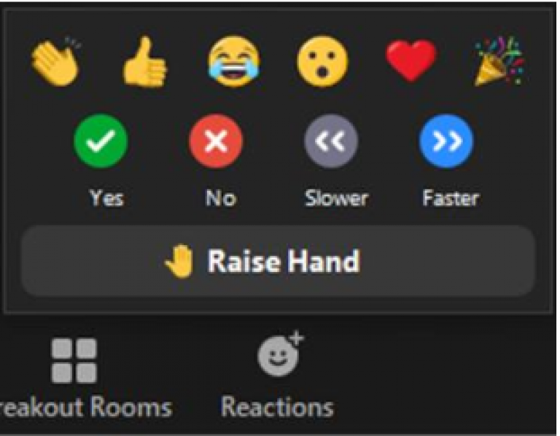
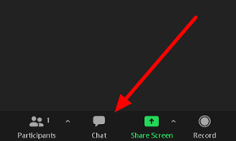
Zoom Features
CHAT
RAISE HAND
MUTE / UNMUTE

Slide 5
CO Knowledge Exchange Expectations

Slide 6
USCCB / MRS & Domestic CO
Every adult refugee (18+) must receive Cultural Orientation (CO) within 90 days after arrival with appropriate interpretation
The Reception and Placement (R&P) Cooperative Agreement lists out all refugee resettlement services affiliate offices must provide to refugee families (airport pickup, housing, support with employment, Cultural Orientation etc.)
Domestic CO covers 15 topics (see next slide) based on the domestic CO Objectives and Indicators (CO O&Is)
All USCCB / MRS affiliates provide CO to refugee families as required by the R&P Cooperative Agreement
After completing CO, each adult refugee will take the domestic CORE CO Model Assessment to demonstrate their knowledge on CO topics. Staff will follow up with clients based on missed assessment questions.

Slide 7
Domestic CO Topics
Cultural Adjustment
Education
Employment
Housing
Newcomer Rights and Responsibilities
Role of the Local Resettlement Agency
Learning English
Transportation
U.S. Laws
Public Assistance
Safety
Budgeting and Personal Finance
Your New Community
Health and Hygiene MERGED!
Digital Technology and Literacy NEW!

Slide 8
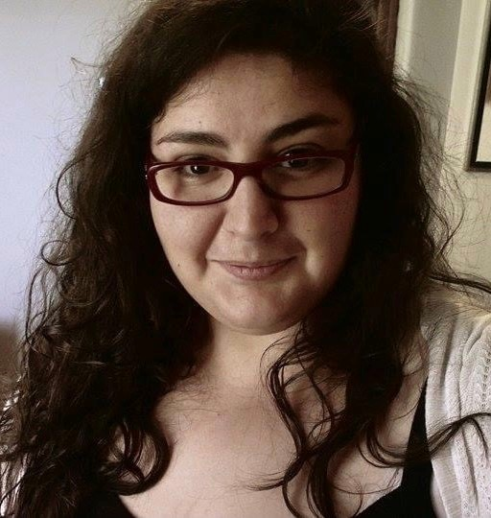
Domestic CO: USCCB / MRS Presenters
Rasha
Catholic Charities of the Archdiocese of Galveston-Houston

Slide 9
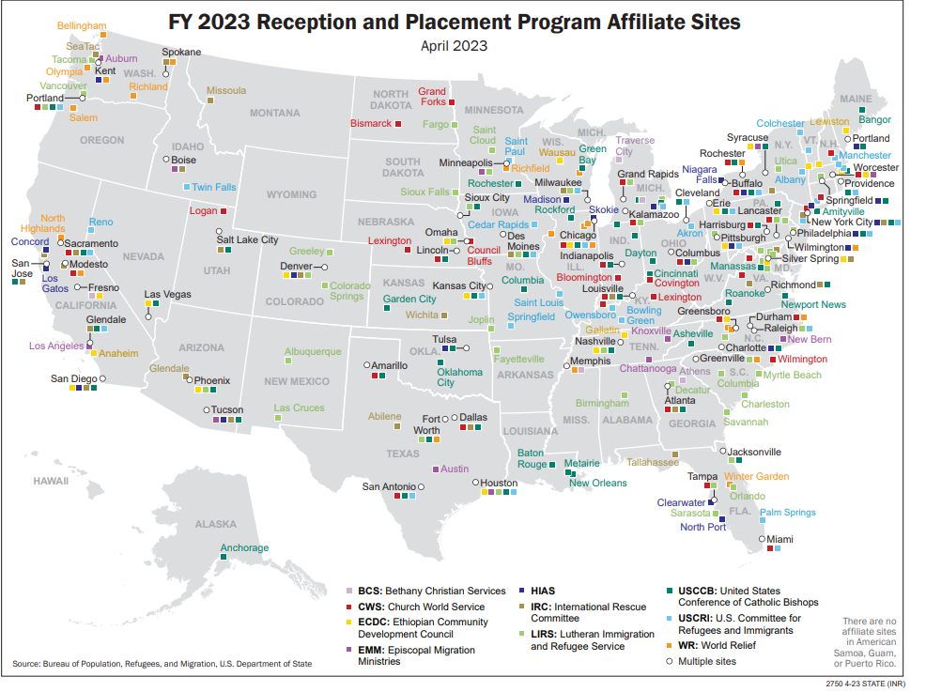
Rasha

Slide 10
CO Program Structure
Timeline: CO is completed within 90 days after arrival. Our office conducts one CO session within the first 30 days after arrival. CO concepts are revisited in other orientations and appointments.
Presenters: Our office has one CO specialist who leads CO sessions. Other staff members from our office will come to share information about their programs (vocational training, health promotion etc.) After CO is complete, case managers will conduct follow-up orientations.
Method: Clients complete CO in person at the office. Clients who speak the same language attend the same CO session as a group (4-15 people). Interpretation is provided.

Slide 11
CO Content
DOMESTIC CO TOPICS
Cultural Adjustment
Education
Employment
Housing
Newcomer Rights and Responsibilities
Role of the Local Resettlement Agency
Learning English
Transportation
U.S. Laws
Public Assistance
Safety
Budgeting and Personal Finance
Your New Community
Health
Hygiene
CO Topics Covered: Our office covers all 15 CO topics, as required by the R&P Cooperative Agreement
CO Specialist completes activities, such as putting together a budget, when and how to call 911, how to ask for interpretation etc.

Slide 12
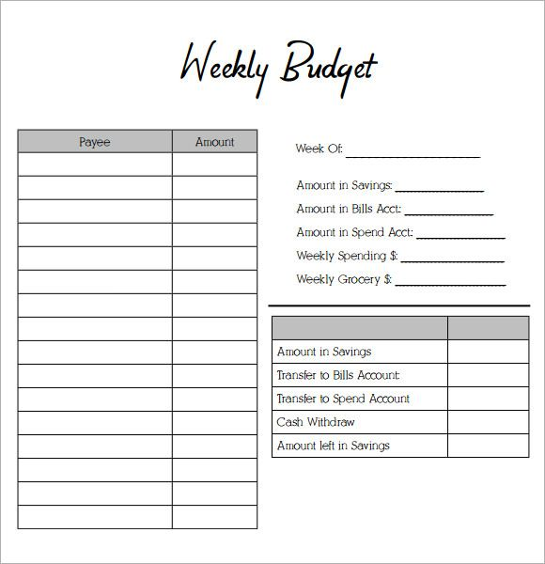
CO Budget Activity
CO Specialist explains activity to interpreter beforehand
CO Specialist covers the topic of budgeting and finance and explains income sources
CO Specialist gives clients the printed budget template and explains the numbers are close to the income a newly arrived family would earn.
CO Specialist recommends clients use their own income numbers if they already started working.
CO Specialist uses a weekly budget template with clients who find a monthly budget challenging. The clients using the weekly budget can still learn the same budgeting concepts.

Slide 13
CO Best Practices
Accommodating client needs (disability, illness, work schedule etc.) by doing CO in the client home
Interactive activities and assignments during CO
Having CO sessions with only one language group. This minimizes disruptions and helps clients build community during CO.
CO concepts are revisited in other orientations and appointments (ex: school impact program where education CO concepts are reinforced)

Slide 14
CO Trends with RSC TuMe Clients
Males from Syria, Afghanistan, and Iraq cases tend to be in charge of decision-making, which means they are more engaged during CO (especially when talking about employment, U.S. laws etc.)
When CO Specialists ask female clients questions, they tend to defer to the males for answers
Female clients are less likely to attend CO, even after explaining this is a program requirement.

Slide 15
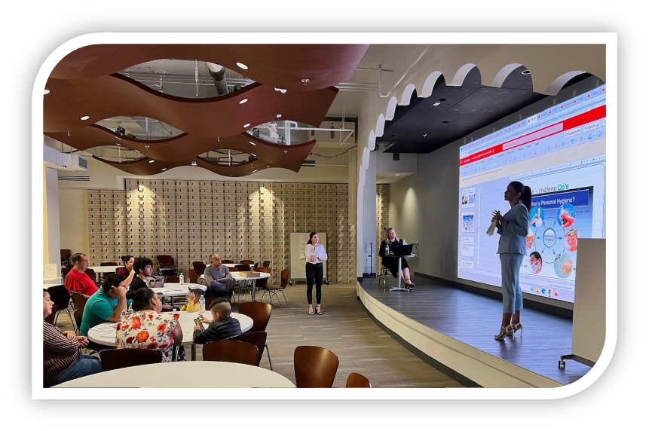
Domestic CO: USCCB / MRS Presenters
Catholic Charities Bureau, Inc. Jacksonville Regional Office

Slide 16
Hellai

Slide 17
CO Program Structure
Timeline: CO is completed within 90 days after arrival on a bi-weekly basis
Presenters: Our office has a dedicated intern to provide CO. Case managers also help deliver CO when needed.
Method: Clients complete CO one-on-one in their home or at the office. There are multiple CO sessions, including public transportation orientation and a grocery store field trip. Interpretation is provided.

Slide 18
CO Content
DOMESTIC CO TOPICS
Cultural Adjustment
Education
Employment
Housing
Newcomer Rights and Responsibilities
Role of the Local Resettlement Agency
Learning English
Transportation
U.S. Laws
Public Assistance
Safety
Budgeting and Personal Finance
Your New Community
Health
Hygiene
CO Topics Covered: Our office covers all 15 CO topics, as required by the R&P Cooperative Agreement. We have 15 power points (a power point for each CO topic)
CO content includes CORE and Switchboard materials, as well as videos

Slide 19
CO Best Practices
Delivering the CORE CO Model Assessment as a pre-assessment before the beginning of CO. The same assessment is delivered to clients after they complete CO.
Interactive activities and videos during CO
Scheduling clients who live in the same building for the same CO session. Clients can help each other use public transportation to come to the office for CO and other services.
Providing snacks and goodie bags to clients during CO

Slide 20
CO Trends with RSC TuMe Clients
Delivering culturally sensitive information can be difficult with clients from Afghanistan and Syria. Utilizing staff from those countries to deliver CO ensures sensitive CO topics are covered in a more culturally appropriate way

Slide 21
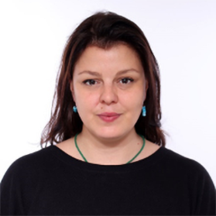
RSC TuME & Overseas CO
RSC TuME
Istanbul Office
Our CO Team consists of 10 CO Trainers responsible for delivering CO sessions in Istanbul and Beirut. They work in tandem with the CO Admin team and a Digital Content Developer, who handle the logistics and scheduling operations, develop training materials, and ensure that all activities run smoothly.
Ecem

Slide 22
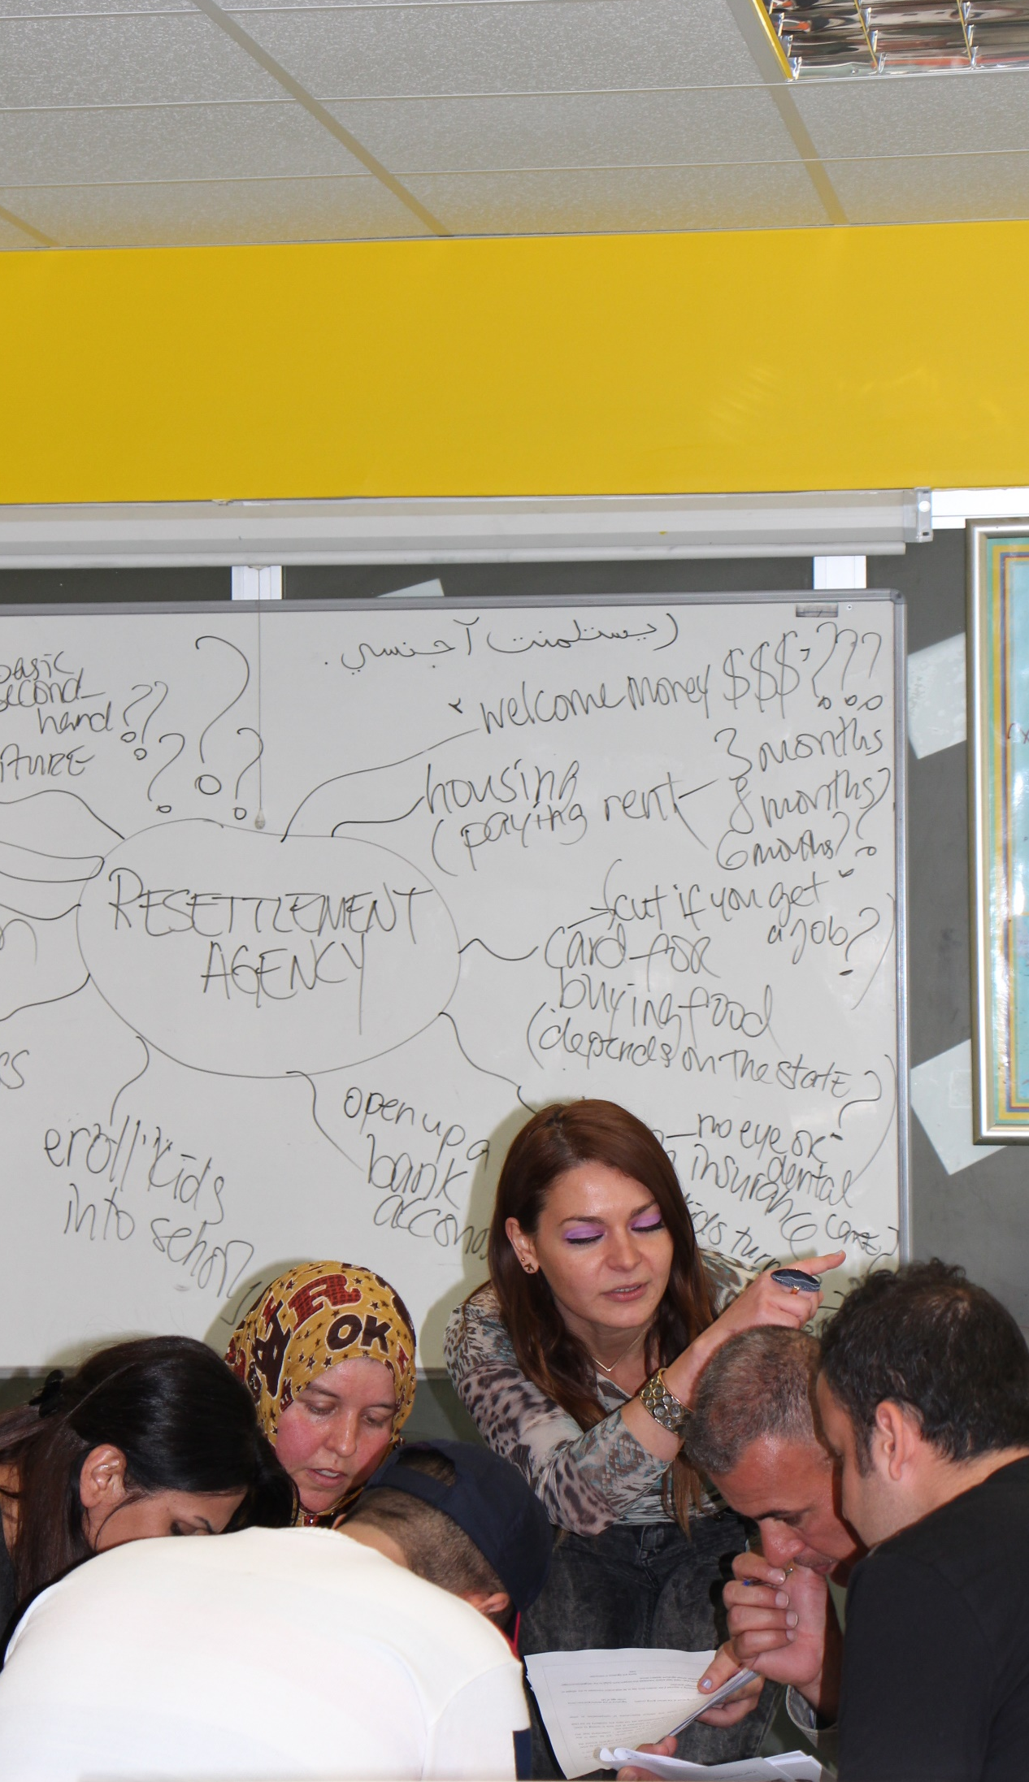
RSC TuME - CO Training Structure
In-Person CO
3 days in Turkey, 2 days in Lebanon
Telephonic CO
Remote CO
2 days on Webex
Training Assessment
With Pre- and Post-Tests & SurveyMonkey

Slide 23
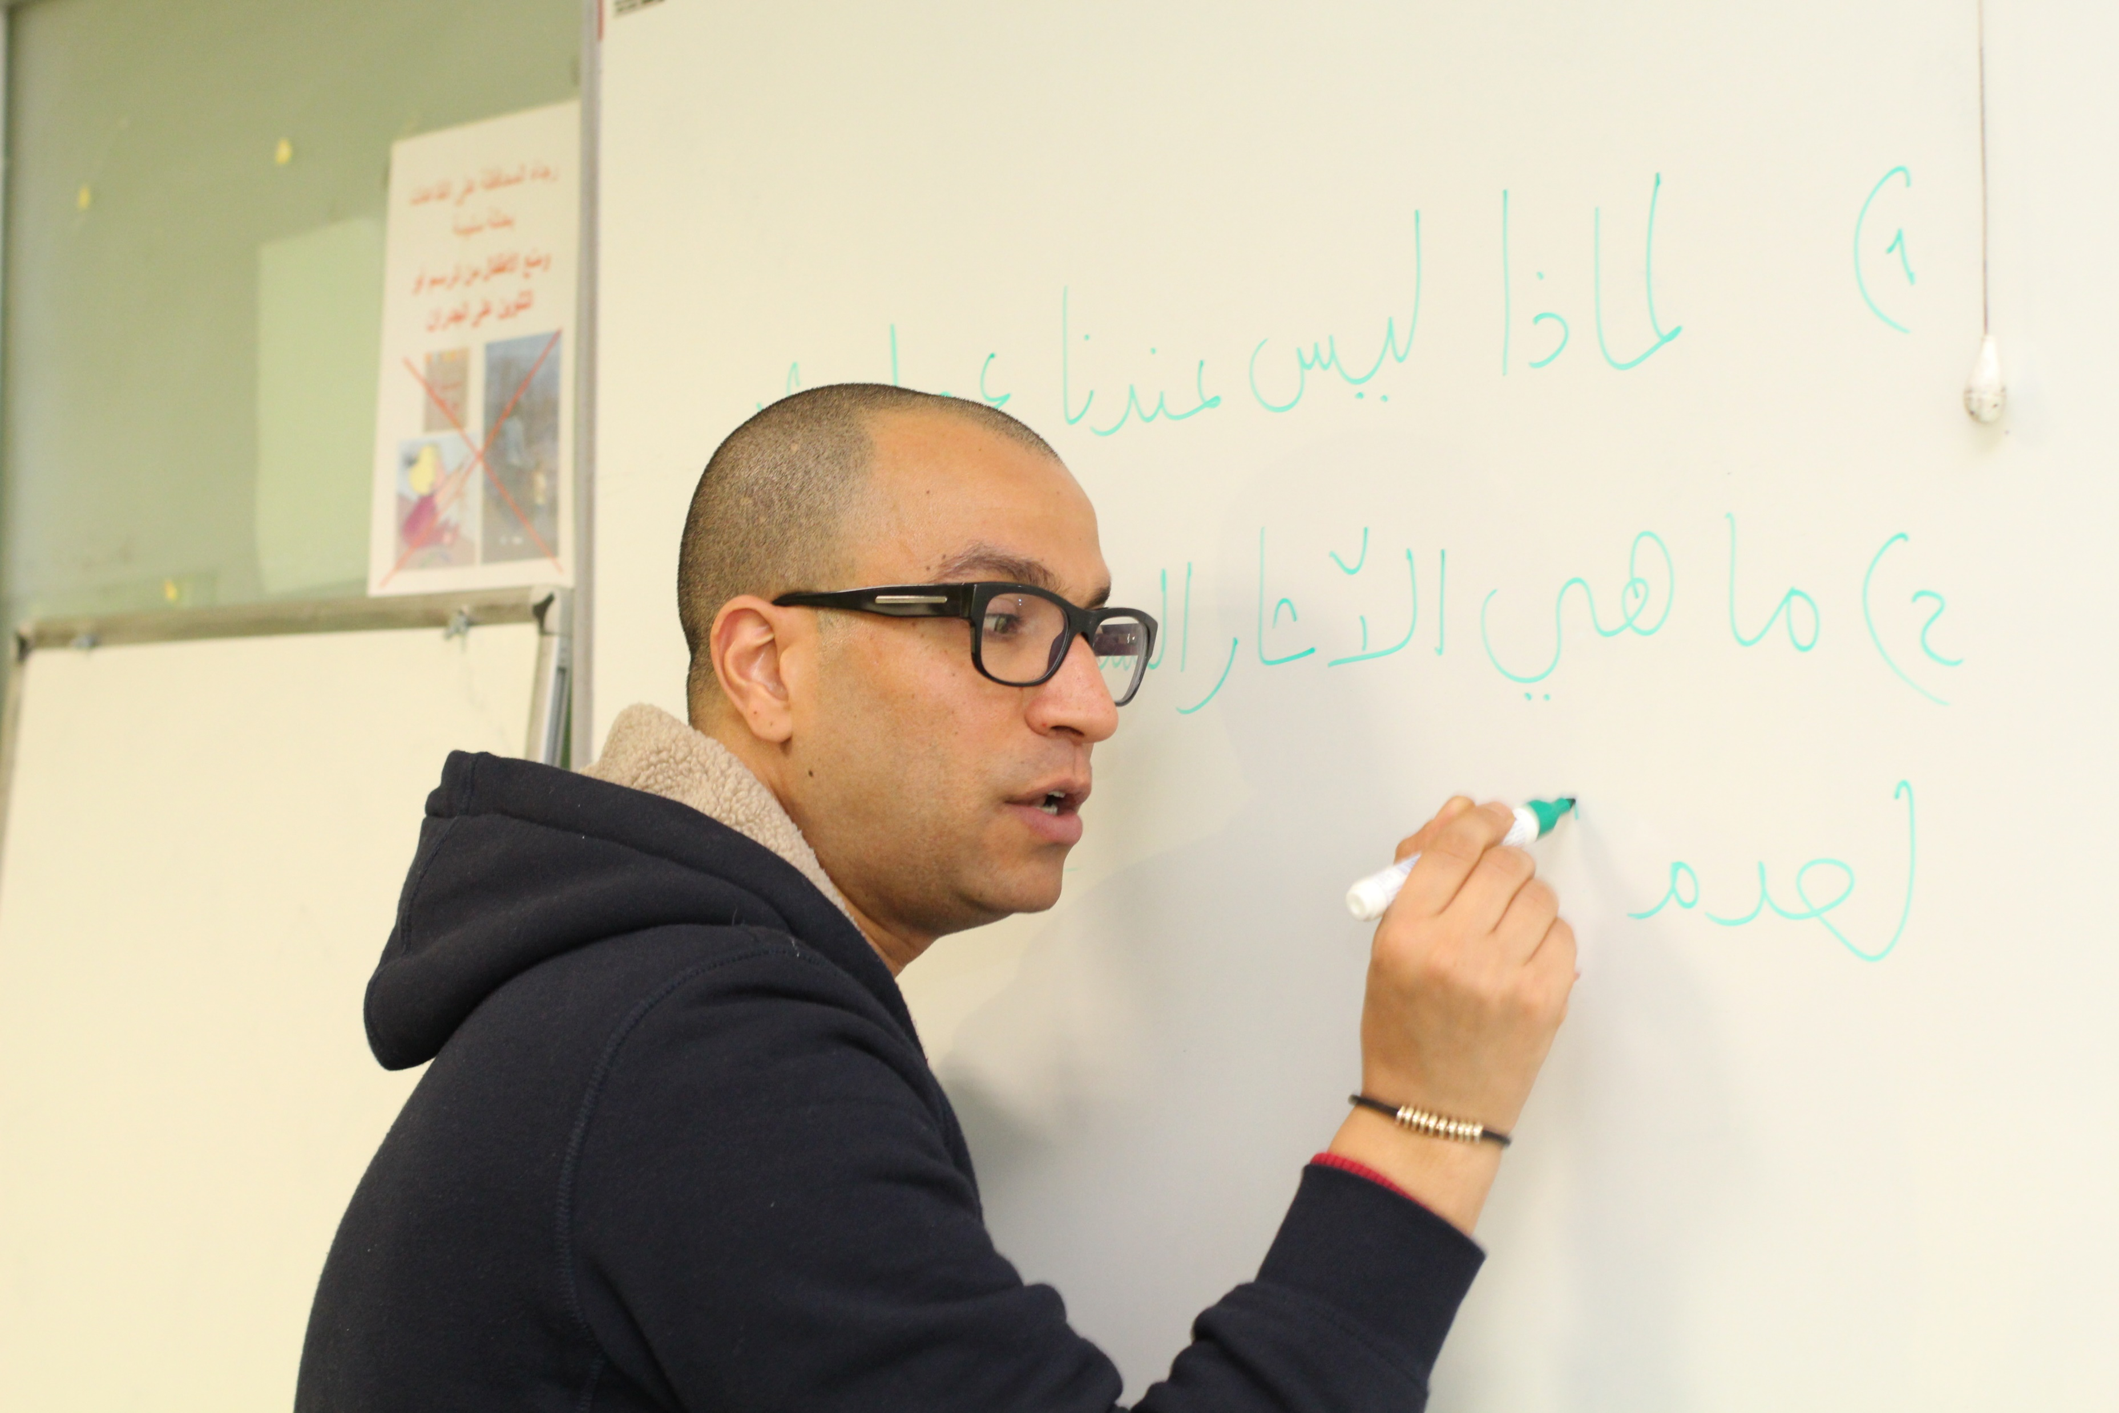
RSC TuME - CO Training Approach
Interactive
E.g., The Whisper Game (Resettlement Agency Activity)
Activity-Based
E.g., Four Corners
(Rights and Responsibilities Activity)
Learner-Centric
E.g., Back to the Future (Employment Activity)

Slide 24
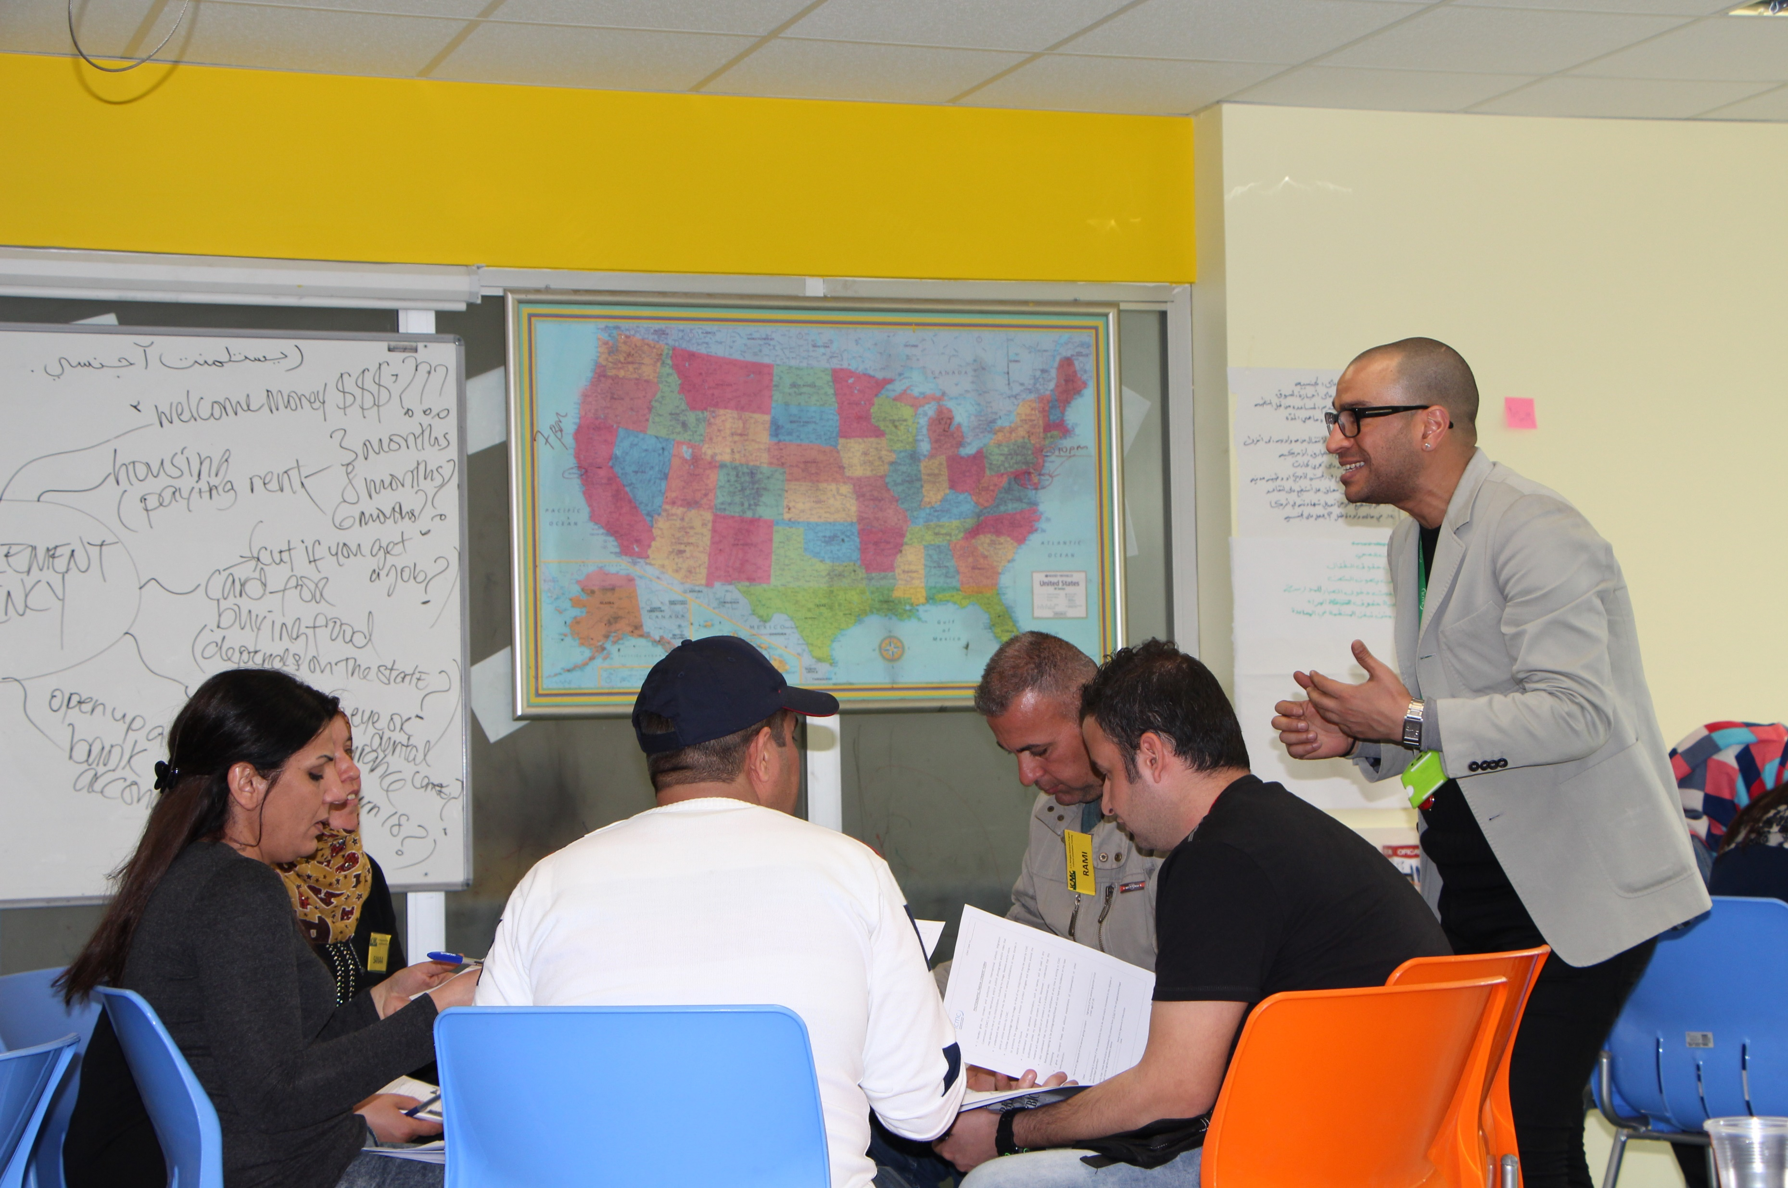
Objectives, Indicators, and Content
CO TOPICS
Role of the Local Resettlement Agency
Public Assistance
Housing
Learning English
Education
Employment
Health
U.S. Laws
Rights and Responsibilities
Legal Status
Travel
Cultural Adjustment

Slide 25
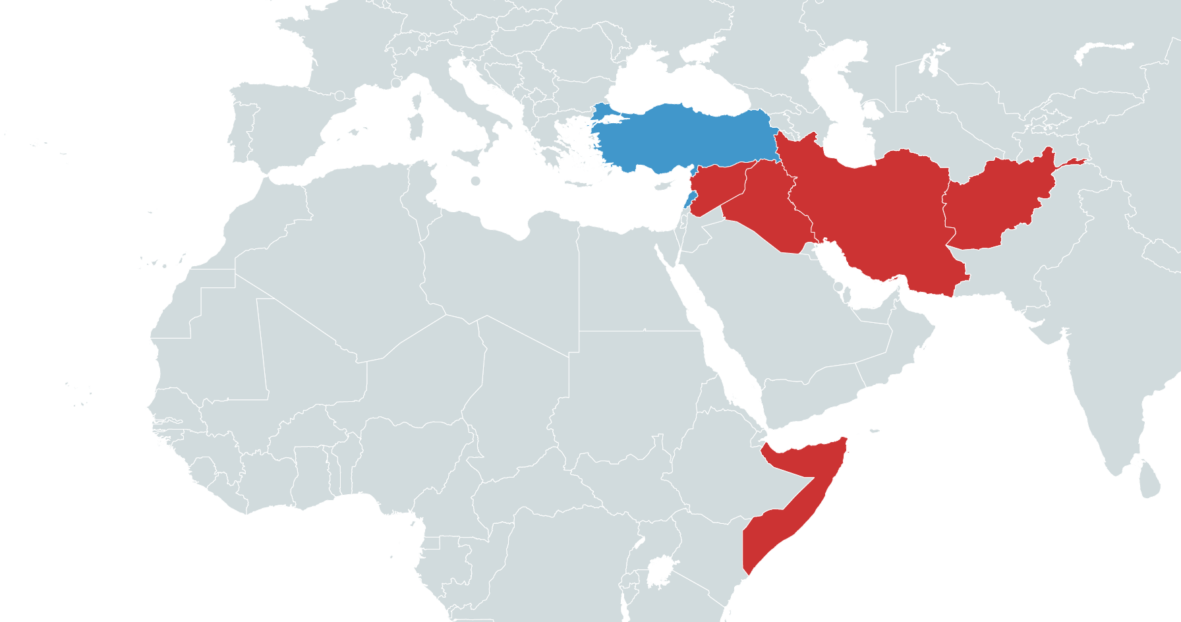
RSC TuME Client Populations
Arabic and Farsi speaking populations from Iraq, Syria, Afghanistan, Iran, Somalia mainly comprise our participant groups.
We work with interpreters: Most of our sessions are done in Farsi and Arabic.

Slide 26
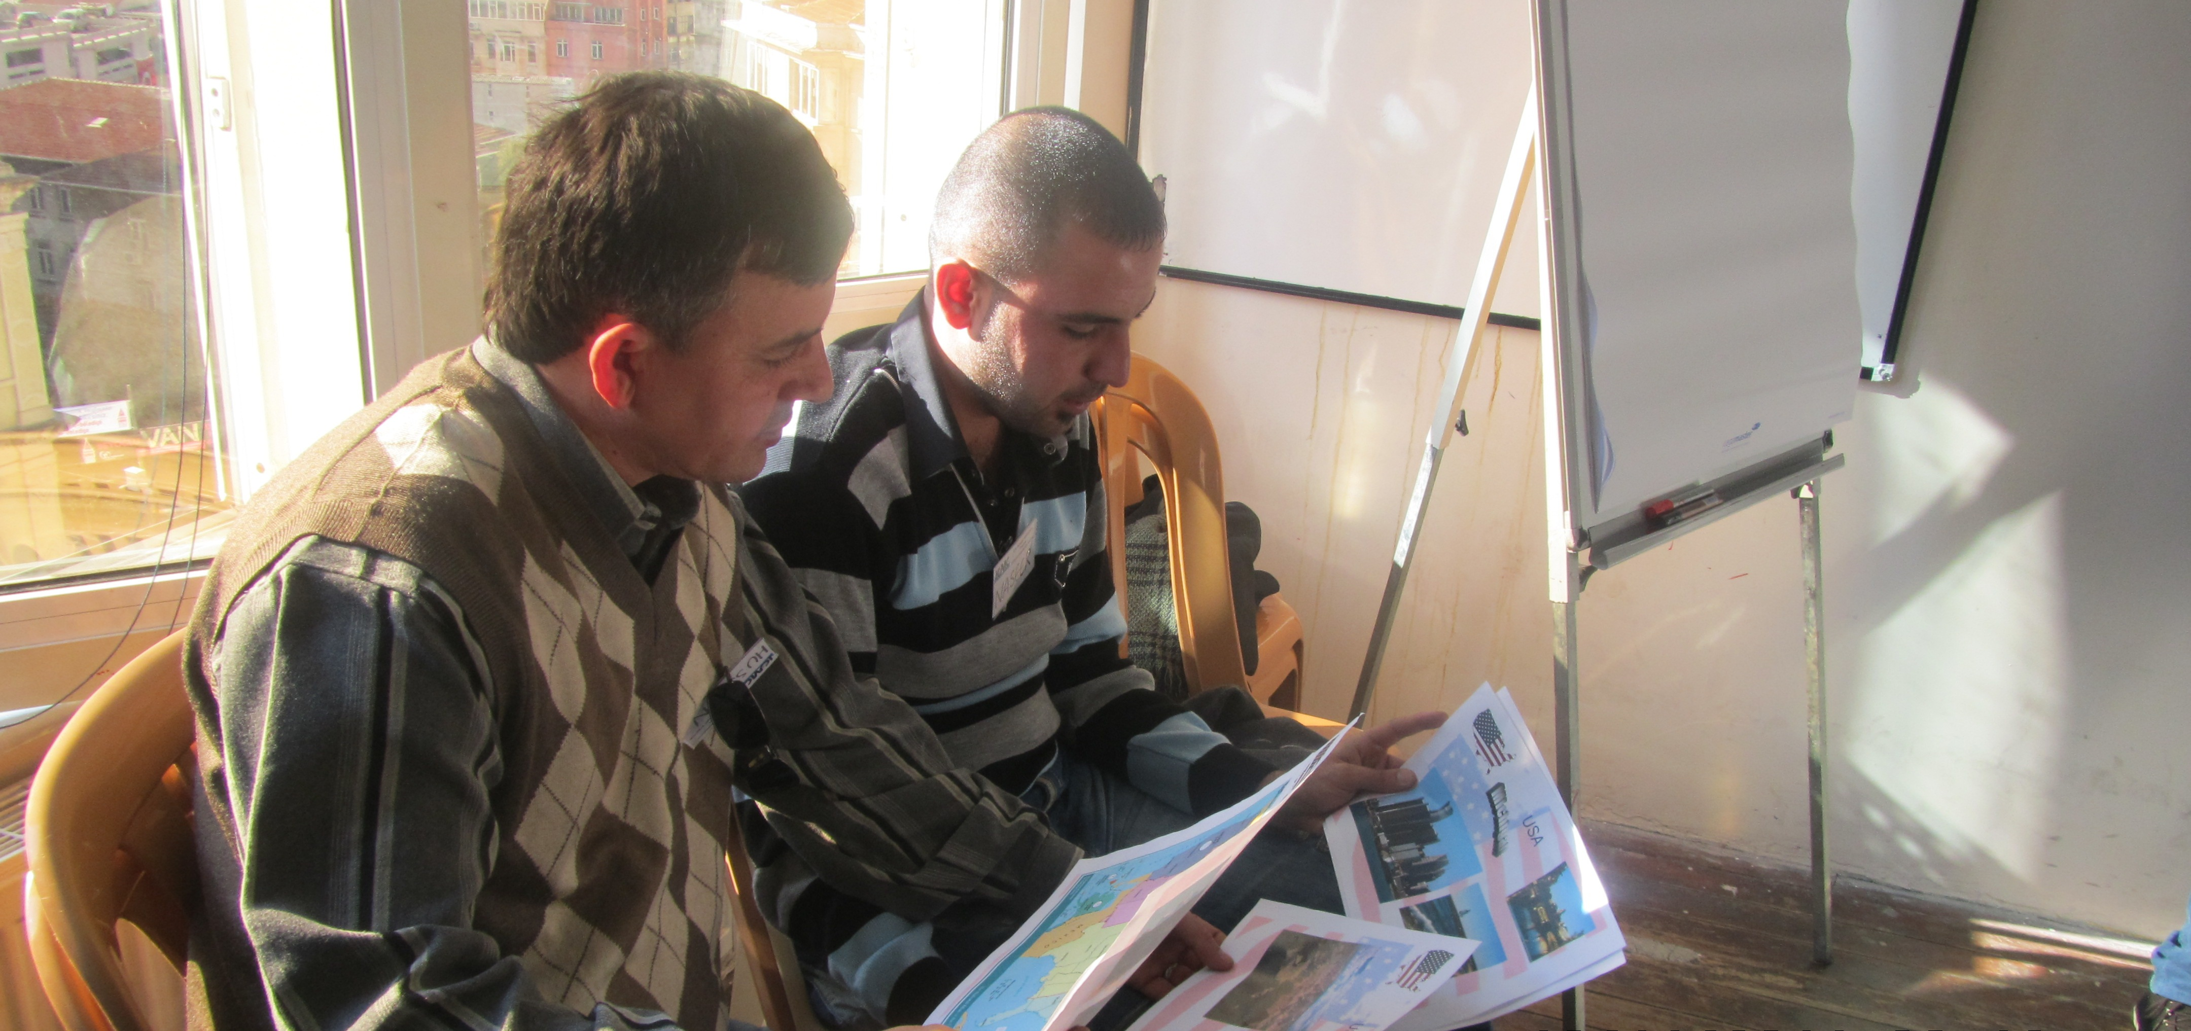
Main Challenges of RSC TuME CO Trainers
Deteriorating living conditions for refugees in Turkey and Lebanon.
Questions for which we cannot provide a clear answer as the correct information changes depending on the state.
These include questions on subjects such as:
The types, durations and amounts of assistance​
Housing: “What if we do not like our house?”​ or “I do not want to share my house.”​
Higher education: university diploma recognition and credit recognition to continue studying in the U.S.
Family reunification​

Slide 27
Open Q&A

Slide 28
Frequently Asked Questions (FAQs)

Slide 29
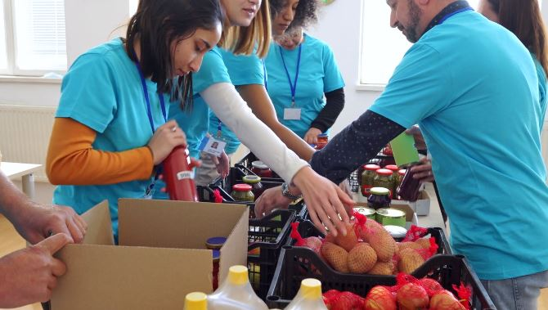
Questions?

