Slide 1


Match Grant Day 1-240
Common MG Findings
Date: 8/8/2023

Slide 2

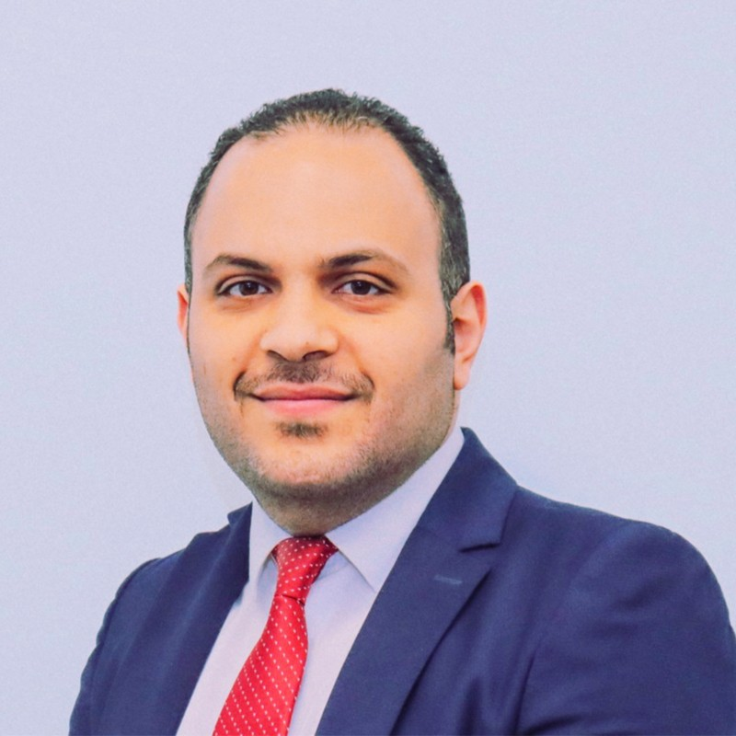

Presenters
Dina Eldawy
Match Grant Field Support Coordinator
Marco Mossad
Match Grant Field Support Coordinator

Slide 3

Zoom Features
Interact with presenter and attendees by:
Answering poll questions
Typing comments in the chat
Typing questions in the Q&A box
Raise your hand if you want to ask a question verbally
The Zoom
toolbar is at the bottom of your
screen!

Slide 4
Agenda
Today we'll review:
MG Core Services Overview
Case cannot already be economically self-sufficient
1
MG Program Operations Manual
2
MG Service Period: Day 1-240
ORR Status and Documentation Guide
Case File Documentation
2. Common MG Findings
Slides and webinar recording will be posted on MRSConnect
3
Resources: MRS Connect

Slide 5
Understand MG core services and required case file documentation
Learning
Objectives:
By the end of this webinar,
you will be able to:
Describe the intake and enrollment process for MG clients
Explain the 180-day and 240-day budget and self-sufficiency determination process
Identify common compliance issues in MG case files and how to avoid them

Slide 6
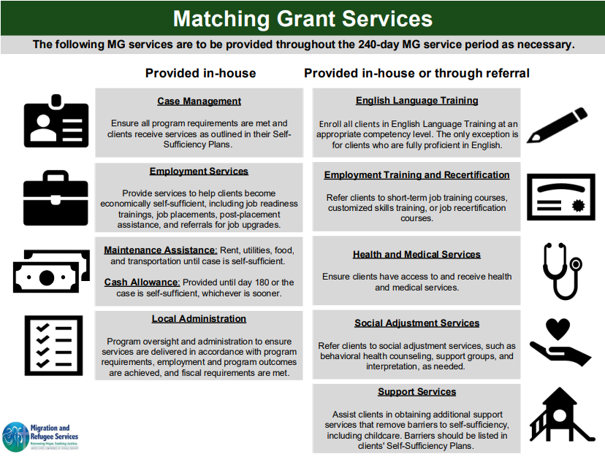

Slide 7
Case Noting Requirements
Date
(One) Program/ Funder
Service Mode
Who Interpreted
Activity
Staff Name
Purpose
Outcome
Next Steps
Office
Home Visit
Phone Call
Email

Slide 8
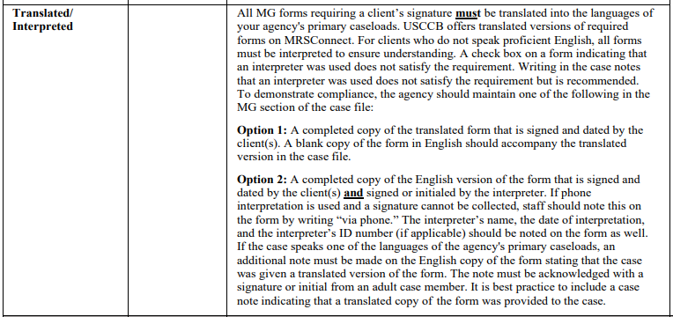
Translation & Interpretation Requirements
If 20% or more of cases speak given language
Client Agreement and Sanctioning Policy
Enrollment, 180, 240 Budgets
Self-Sufficiency Plans

Slide 9
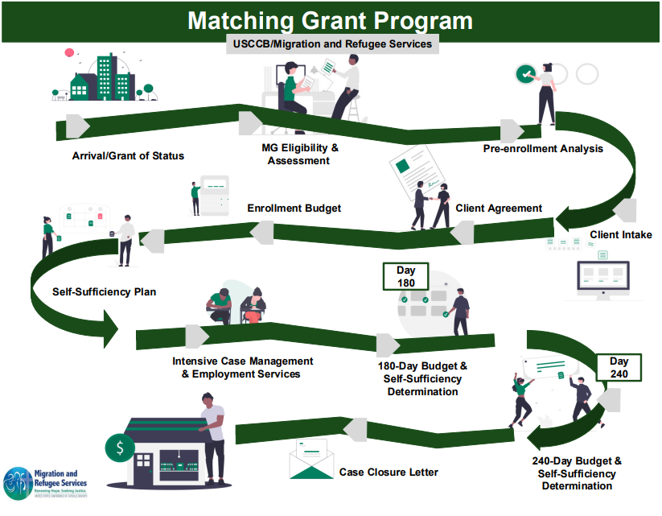
Enrollment Date/ shortly after:

Slide 10
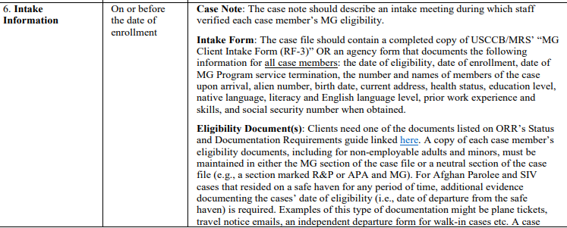
Client Intake (Requirements + Findings)
ORR resources and USCCB Webinar on MRS Connect

Slide 11
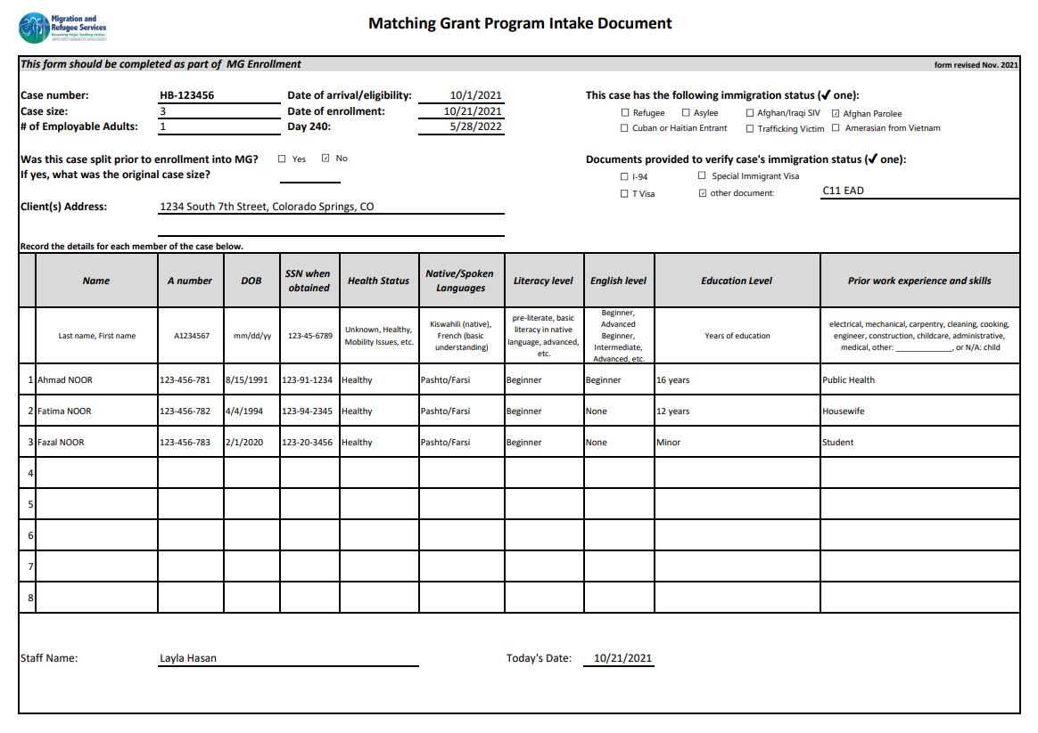

Slide 12
Sample Case Note: What could be improved?
Date: 6/1/23
Mode: N/A
Had intake meeting. The family is from Afghanistan and they live at XX address. The case size is 3 people, a husband, wife, and one child. The family is healthy and adjusting to the new environment. The husband (PA) will be the working adult of the family while spouse will be a stay-at-home parent because they have a child too young to enroll in school.

Slide 13
Compliant Case Note
Date: 6/1/23
Mode: In Office
MG Intake
CM went over MG Eligibility questions and documents and determined that the case is eligible for the MG program. During intake, CM discussed clients’ education, employment history and health status, identified transferable job skills the clients have and confirmed the clients are ready to work. The family is from Afghanistan and they live at XX address. The case size is 3 people, a husband, wife, and one child. The family is healthy and adjusting to the new environment. The husband (PA) will be the working adult of the family while spouse will be a stay-at-home parent because they have a child too young to enroll in school. Both adult clients speak English so no interpretation needed.

Slide 14
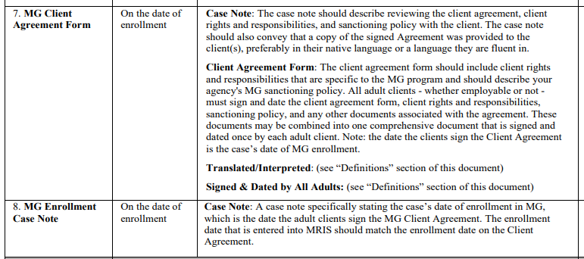
Client Agreement (Requirements + Findings)

Slide 15
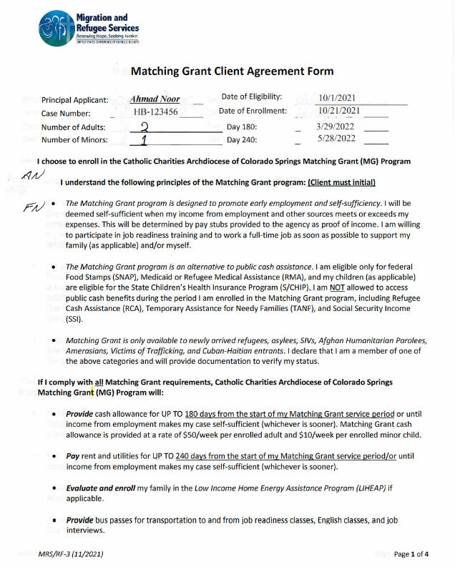
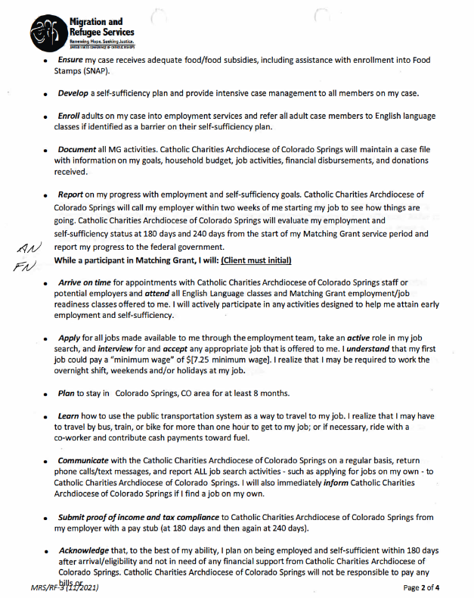

Slide 16
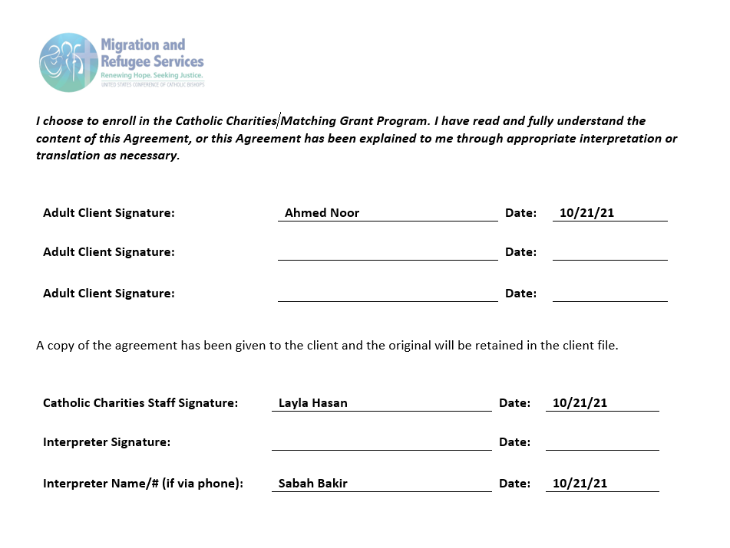
Sample Client Agreement Signature Page

Slide 17
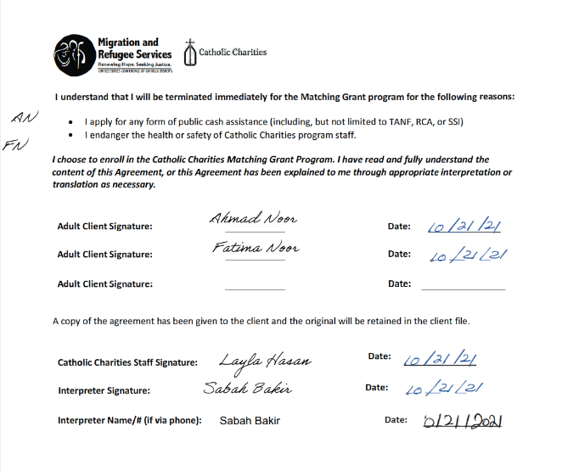
Compliant Client Agreement Signature Page

Slide 18
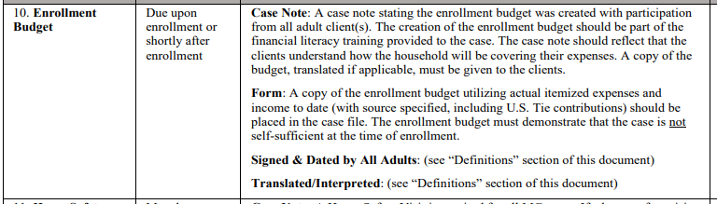
Enrollment Budget (Requirements + Findings)
Budget Webinar on MRS Connect

Slide 19
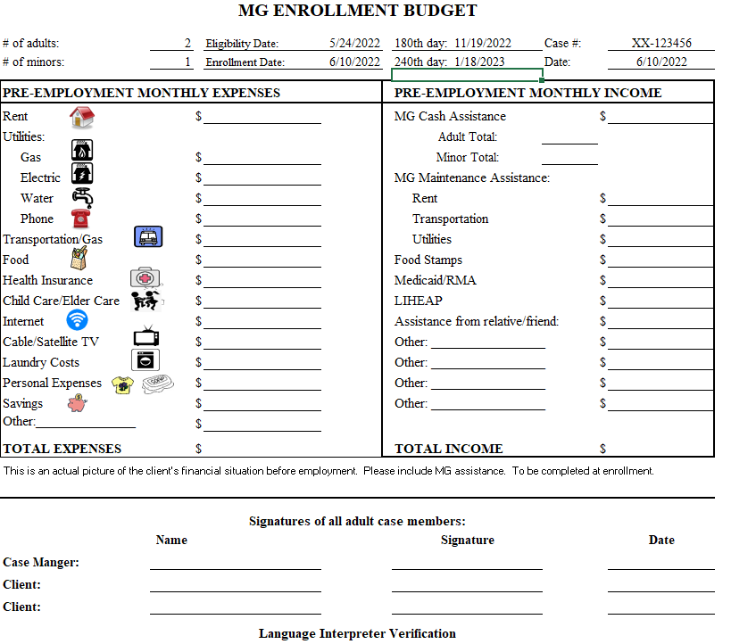
1,450
440
400
0
40
100
0
1,450
Sample Enrollment Budget
50
45
45
100
575
575
25
25
0
0
50
200 (PA’s aunt)
0
0
125
0
2420
2835
Signed by ALL adults
Dated
Interpretation

Slide 20
Compliant Case Note
Date: 6/1/23
Mode: Over the phone
Together with the adult clients, the CM developed the Enrollment Budget to show the clients how much money they would need to earn to become self-sufficient. Based on the budget, the case’s monthly expenses are $2,420 and the client must earn more to be self-sufficient. The adult clients indicated they understood the budget and signed the budget form confirming this understanding. The clients received a copy of the Enrollment Budget. The PA speaks English and did not need an interpreter, he interpreted for his wife.

Slide 21
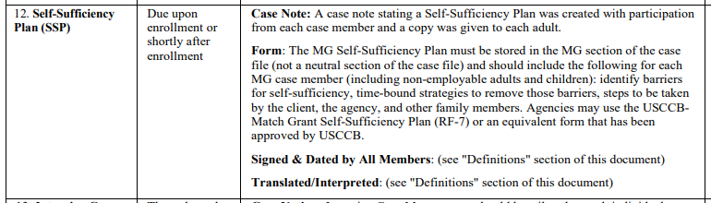
Self-Sufficiency Plans (Requirements + Findings)
SSPs go hand in hand with Intensive Case Management
(Roadmap of service provision)

Slide 22
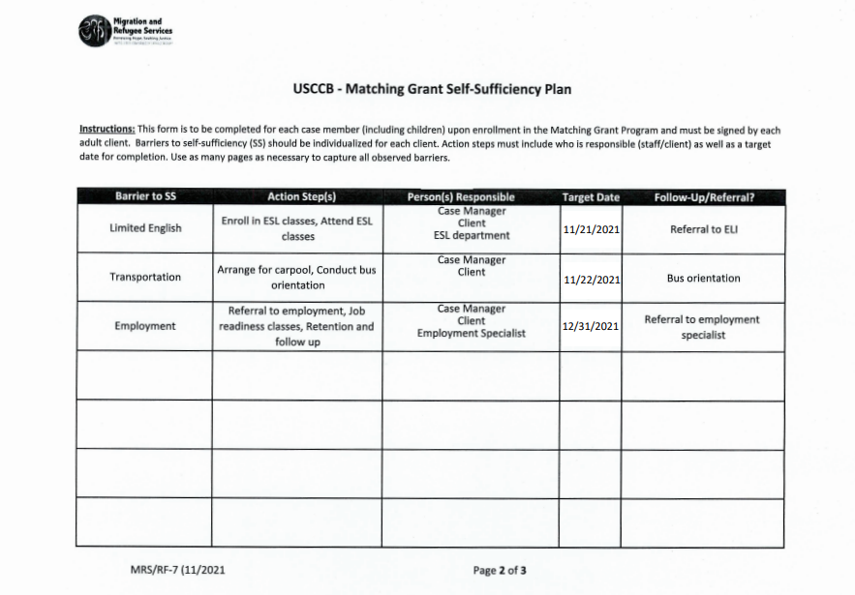
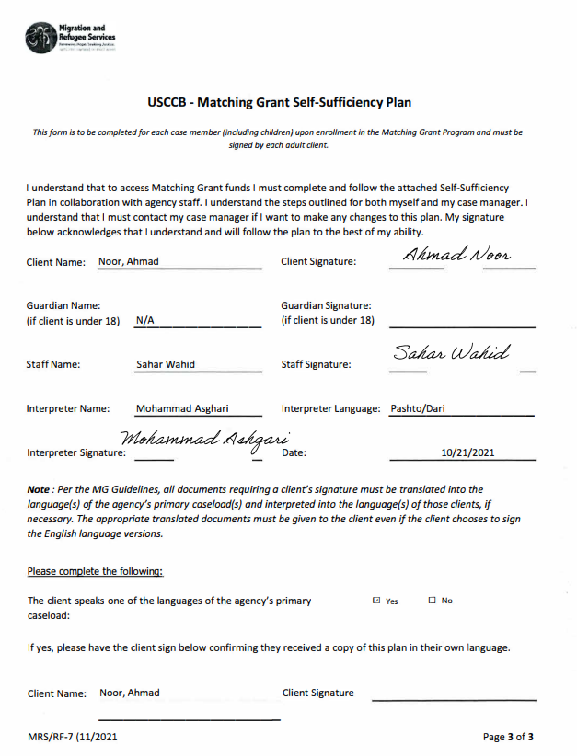
Adult SSP

Slide 23
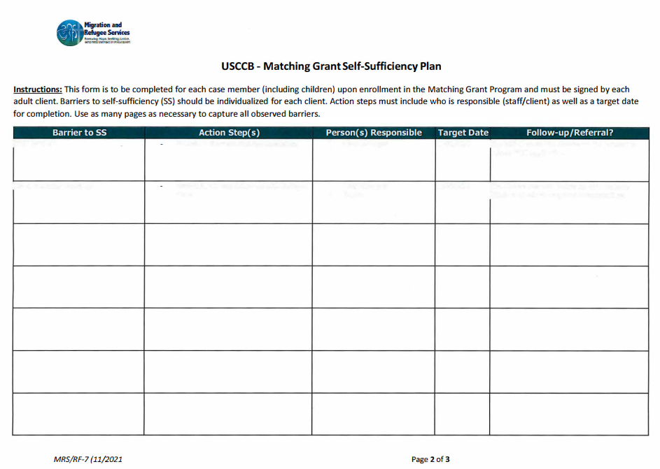
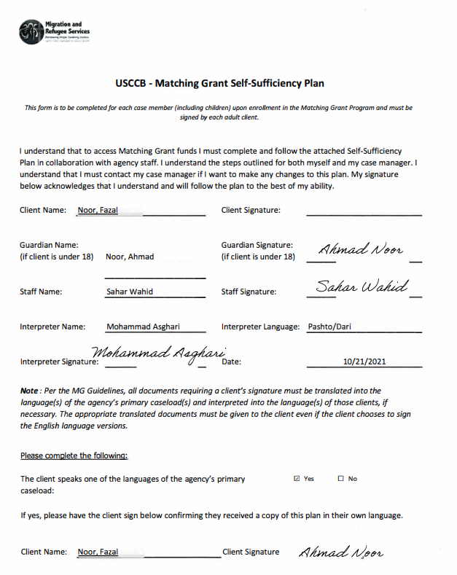
Minor's SSP
School Supplies
Connect family to donation center
CM, In-Kind Specialist
8/6/21
School start, monthly drop-offs
Childcare
Connect with housing day care program
CM, Housing complex
8/6/21
Referral to daycare program

Slide 24

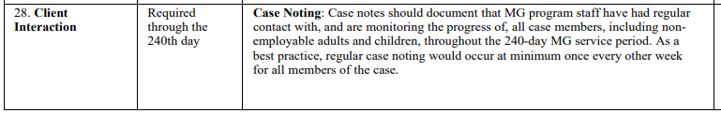

Intensive Case Management + Client Interactions
Not just the PA!

Slide 25
Enrollment Date/ shortly after:
Until 240 Day

Slide 26
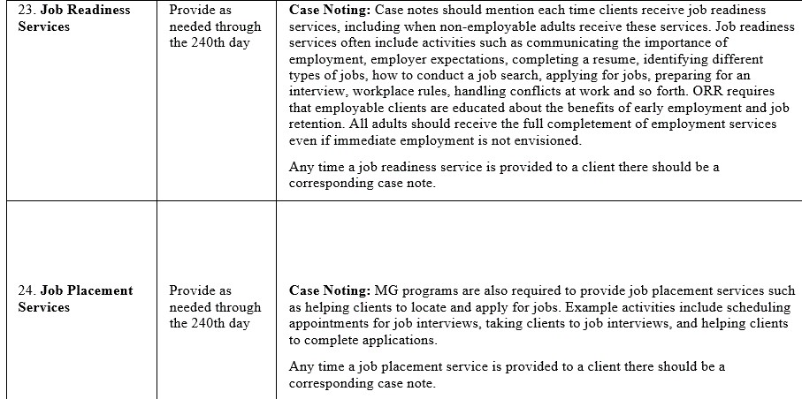

Employment Services Requirements

Slide 27
Example of Job Readiness Topics
Introduction and setting goals
“Working in the US” warmup/intro
Short-term vs. long-term goals
US Work Culture
US Time Culture
Work Etiquette
Expectations of Employees
Using the internet
Using your network (relatives, friends, agency)
Job Applications and Resumes
Job Application Workshop
How to Interview
Learn about the job and the company
Financial Literacy
Setting financial goals
Understanding your paycheck

Slide 28
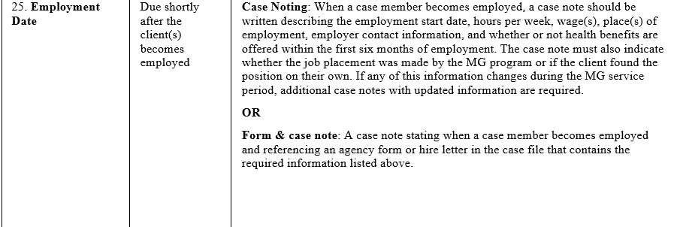
Employment Information

Slide 29
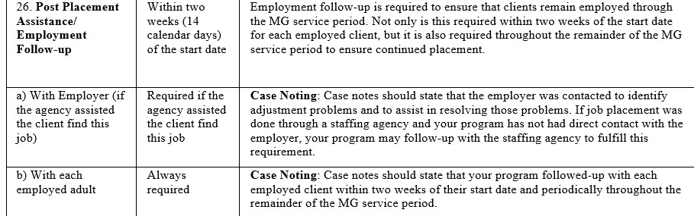
Post-Placement Assistance

Slide 30

Quiz: Is the following case note sufficient or not, and why?
Two Weeks Follow-up/Employer
Ghulam contacted Good Heart Specialty Foods, HR Manager Maria McDonald to follow up on client’s employment status.
Max then talked to Ahmad to share a copy of his paystub. Copy in client’s e-file. The client also established a bank account; his U.S. tie assisted Ahmad to open a bank account. In addition, the U.S. tie took Ahmad to DPS to obtain a DL. The client overall is adjusting well.
The answer is no. The CM did not mention the employment start date, the hourly rate, the place of employment, the employer contact information, and the health insurance benefit

Slide 31
Client Budgets: 180, 240, and Adjusted
Use net income, based on verifiable proof of employment
180-day budgets, 240-day budgets, and adjusted budgets must contain a self-sufficiency determination
Any ongoing MG assistance should be listed on budget, but should not be included in calculation of client income when determining self-sufficiency

Slide 32
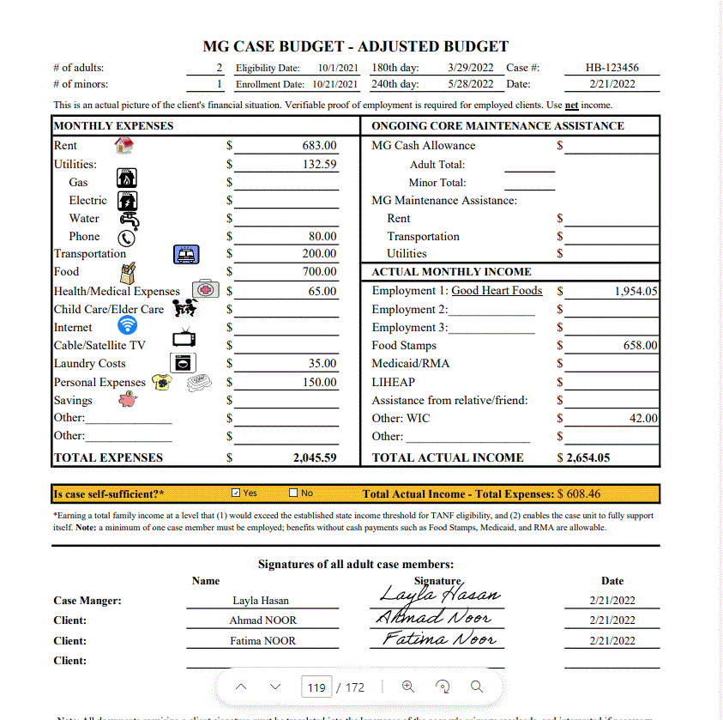
Sample: Adjusted Budget
Agencies have different policy!
Adjusted budgets are important for major changes to the client's financial situation (moves out of U.S. tie's house, starts job and becomes self-sufficient, etc.)

Slide 33
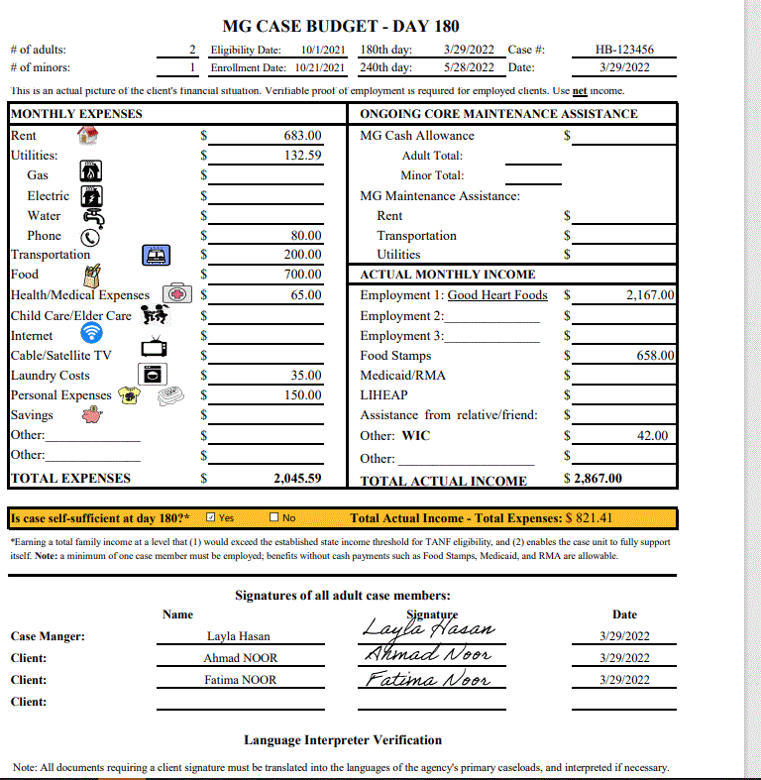
Sample: 180-Day Budget
List ongoing MG assistance on budget, but do not include it in the income calculation when determining self-sufficiency
Signatures of CM, all adults, and interpreters

Slide 34
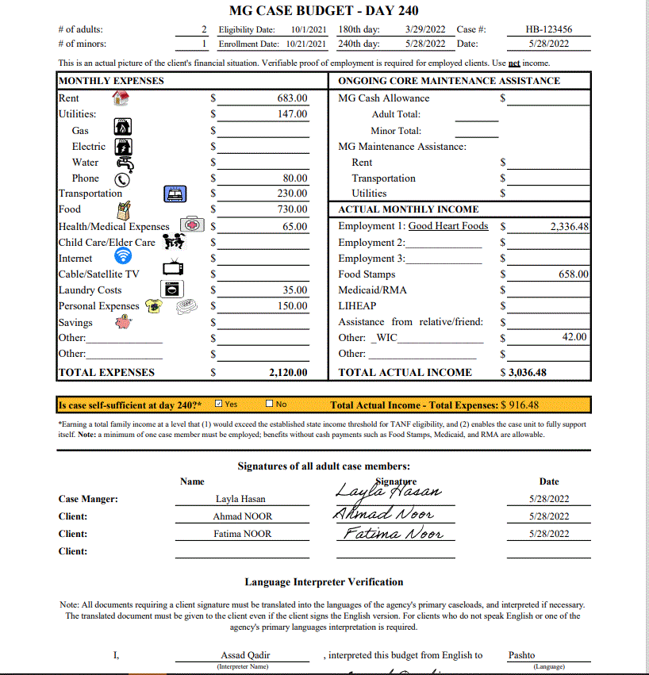
Sample: 240-Day Budget
Employment income:
Must be based on verifiable proof of employment (pay stub)
Must be net income
Must use accurate calculation of net income, not round number estimate
Income for all adults from all jobs

Slide 35
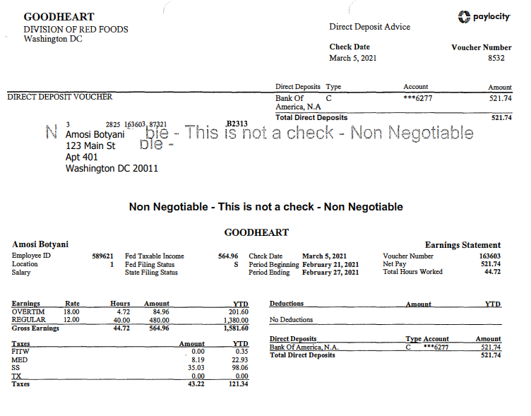
Understanding Pay Stubs
Must show:
Client’s employment
Hours worked
Wage
Compliance with U.S. Federal Tax Regulations
Budgets use net income, not gross income

Slide 36
Budget common findings
Not including MRIS report in file
Not including income from pay stub or proof of employment within the required timeframe (from within 30 days)
Including gross income instead of net income
Unclear calculation of monthly income
Not case noting significant financial changes (adjusted budgets)
Inaccurately including the ongoing MG assistance in the income calculation
Many clients don't understand they're still in MG if they’re self-sufficient at day 180

Slide 37
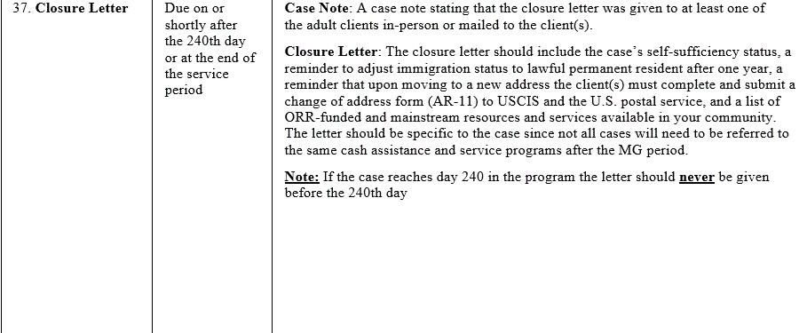
Case Closure Letter

Slide 38
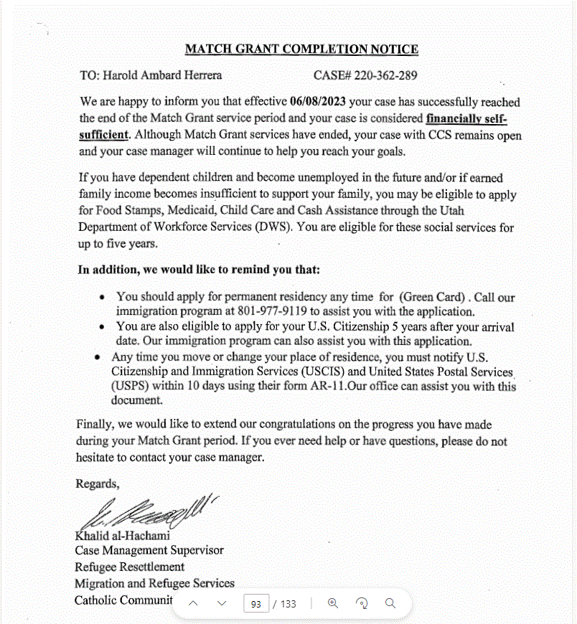




Sample Case Closure Letter

Slide 39


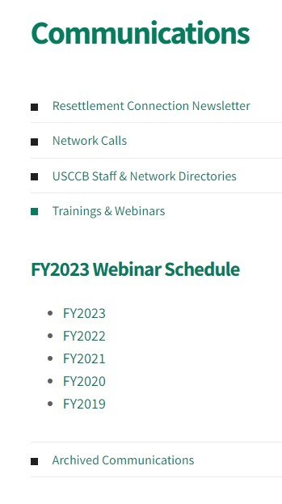
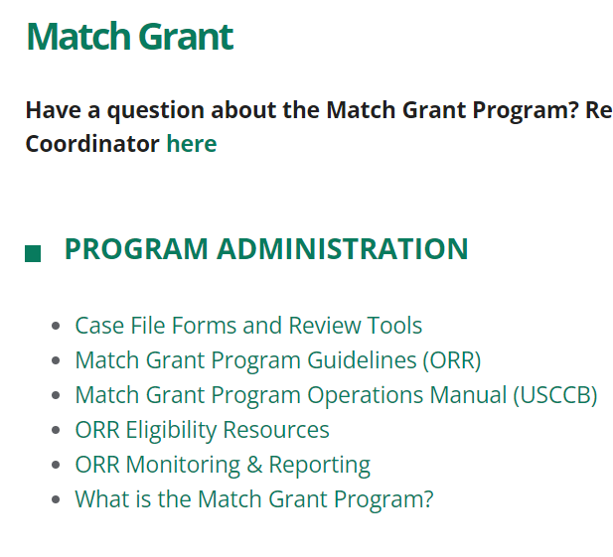


MRS Connect Resources!
Slides & Recording
Case File Documents

Slide 40

Questions?
Please add questions to the Q&A box or raise your hand.

Slide 41
What MG programmatic requirements are still confusing to you?

