Slide 1
Best Practices for Writing Effective Case Notes
March 2023

Slide 2
Presenters
Raquel Kubicz
Reception & Placement Field Support Specialist
Sean Hardiman
Match Grant Field Support Coordinator
Notes:
Raquel and Sean will introduce themselves and their titles

Slide 3
Zoom Features
Interact with presenters and attendees by:
Typing questions in the Q&A box
Raise your hand if you want to ask a question verbally at the end
The Zoom
toolbar is at the bottom of your screen!
Notes:
Interact with presenters and attendees by:
Typing and asking questions in the chat box
Unmute yourself and ask a question at the end

Slide 4
Learning Objectives
Writing clear, detailed case notes is one of the most important skills for a case manager. During this webinar, USCCB/MRS staff will describe some general principles of quality case noting and will share examples of exceptional case notes from real affiliate files.
By the end of this session, you will be able to:
Describe the “SOAP” method of case noting
List strategies for successful review of case notes
Identify what is missing from example case notes
Notes:
Writing clear, detailed case notes is one of the most important skills for a case manager. During this webinar, USCCB/MRS staff will describe some general principles of quality case noting and will share examples of exceptional case notes from real affiliate files.
By the end of this session, you will be able to:
Describe the “SOAP” method of case noting
List strategies for successful review of case notes
Identify what is missing from example case notes

Slide 5
Agenda
USCCB/MRS Case Management Manual
Why is it important to write good case notes?
Guidelines on Case Notes
What to Include in a Case Note
Case Note Language
Example Case Note Format
SOAP Method
Example SOAP Method Case Note
Common Mistakes
Example of a Common Mistake
What is Missing?
What are some best practices?
Best Practices to Keep in Mind
Questions
Notes:
Agenda
We will be going over
The case management manual
why its important to write good case notes
Case Note Guidelines
What to include in a case note
The Format of a case note
The SOAP Method and an example
Common mistakes we see when monitoring and an example
An activity where you can tell us what is missing
Sharing best practices
Best practices that USCCB recommends
And we will have time for questions at the end of the presentation so be sure to save all of your burning questions until the end

Slide 6
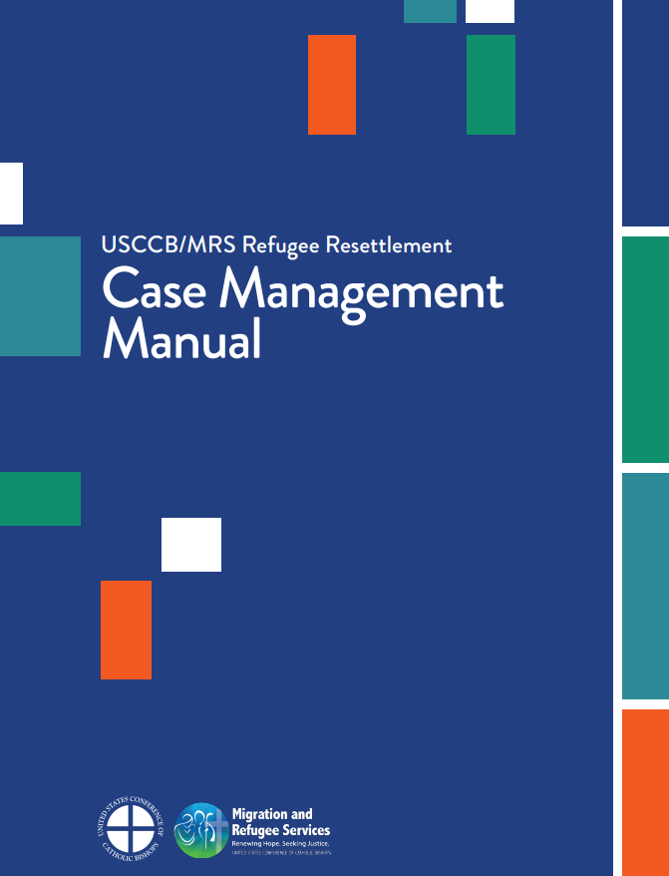
USCCB Case Management Manual
The information in this webinar is based on the new USCCB/MRS Refugee Resettlement Case Management Manual, which covers:
Basic social work concepts
Social work ethics
Case management in resettlement programs
Case recording
MRS-Case-Management-Manual.pdf (mrsconnect.org)
Notes:
Learning Objectives
Talking about some general principles of quality case noting
Have examples of real case notes

Slide 7
Why is it important to write good case notes?
Write in the chat!
Notes:
Why is it important to write good case notes?
Write in the chat why you think its important to have good case notes

Slide 8
Why is it important to write good case notes?
"If it wasn't recorded, it didn't happen."
Provides a paper trail for proof of services
Record for USCCB and PRM monitoring
Protects caseworker/site in the case of client grievances
Provides explanation for any delays or issues that may be encountered
Notes:
Why is it important to write good case notes?
An important phrase to remember: “If it wasn’t recorded, it didn’t happen”
Provides proof with a record of services
Explains delays
Important to check CA and MG Guidelines but for some services, the completion of services are dependent on the Prescence of case notes
However, it is important to record EVERYTHING that happens even if they are small details especially when it comes to service delays

Slide 9
Why is it important to write good case notes?
In R&P and Match Grant, the provision of some core services are dependent on the presence of case notes*
Evidence of transportation
Evidence of the provision of immigration info (assessment for AOR/I-130 eligibility)
Assistance of enrollment in ESL, Employment Services
Housing and Personal Safety Orientation
Reception services: airport reception, ready-to-eat-meal, food allowance, appropriate clothing, etc.
And MORE!
*Please refer to the FY23 Cooperative Agreement and the Match Grant Guidelines for a comprehensive list of which services require case noting
Notes:
Why is it important to write good case notes?
Important to check CA and MG Guidelines but for some services, the completion of services are dependent on the Prescence of case notes
However, it is important to record EVERYTHING that happens even if they are small details especially when it comes to service delays

Slide 10
What to Include in a Case Note
WHEN -> the date that the actions in the notes are taking place
WHERE-> the location, including if it was remote/in office
HOW-> method of contact including LANGUAGE INTERPRETATION
WHO-> case manager that logged the case note and who was present when the activities in the note occurred
WHAT-> what occurred (i.e. core services that were completed) and other details that are important to the case; also include the grant (R&P, MG)
Notes:
What to Include in a case note
These are the 5 things to include in the case note
When the actions in the case note took place
Where the case note is taking place even if it is remote or in office
How the case is being contacted such as an email, phone call, or home visit
This includes like I mentioned earlier, Language Interpretation
Who the case manager handling the actions in the note is and who was present when the actions were taking place
For example, if it is a home visit you can note that not only were you (the case manager) and the client were present but other members of the case, the interpreter (if applicable), and anyone else who may be present

Slide 11
Guidelines on Case Notes
R&P Cooperative Agreement
Match Grant Guidelines
"The [case note log] may include case notes; and a clear and detailed record of Reception Services... Material Needs Support... other Services...This record may be included in the case log and/or elsewhere in the case file, but must include case-specific detail sufficient to constitute a complete record and demonstrate the use of appropriate interpretation."
FY2023 R&P Cooperative Agreement, p. 42, section e, subsections 1, 2, 3, & 4
"All services required through the MG Program must be documented as MG regardless the provider or funder."
MG Guidelines page 6, section A.1
USCCB's MG Program Operations Manual
"The case note log should document regular interaction/contact with the MG case and progress of case members in attaining the identified goals during the 240-day service period."
MG Program Operations Manual page 45, section 3.1
Notes:
Guidelines on Case Notes
These are quotes directly from the Cooperative Agreement for R&P and the Guidelines and USCCB Operations Manual for Match Grant
The Cooperative Agreement states that the case notes must be clear and detailed and it must also include case specific details as well as appropriate interpretation
Interpretation is very important even if the client speaks English or if the Case Manager speaks the client’s language.
It must be documented for EVERY case note even it was stated in a previous note
For the Match Grant Guidelines, all MG services must be documented as MG regardless of the grant
USCCB’s Match Grant Program Operations Manual echos a similar requirement seen in the R&P CA in that all interactions and contacts with the case must be documented

Slide 12
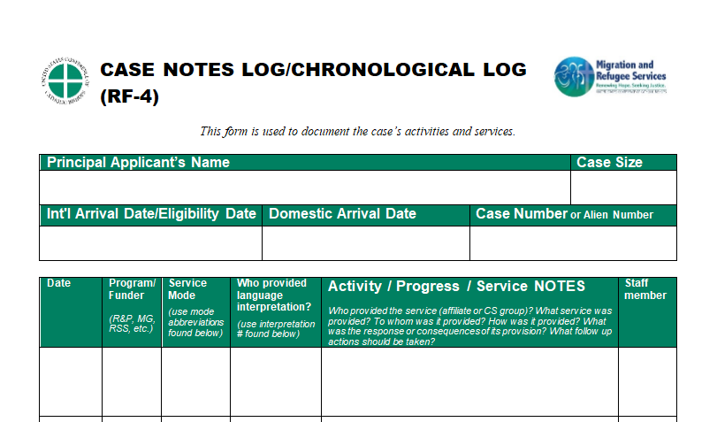
Notes:
What to Include in a case note
The case note log at the end should tell a story
It should make sense to anyone who is reading it even if they are not directly involved in the case
Spell out acronyms in the beginning case notes before using them
Can be easy to confuse with other acronyms such as DHS which can mean Department of Homeland Security or Department of Human Services
Use professional language
Base the note on facts instead of personal opinions or assumptions
Write observations and information that the client and others involved in the case are telling you
Avoid emotive language
For example, saying that a client made you angry because they did something you didn’t like

Slide 13
What to Include in a Case Note
Case notes should tell a full story that anyone can read and understand without having to work directly with the case.
.
Spell out local acronyms of organizations and services in the beginning before using them
.
Use professional terminology and not slang, cliches, or metaphors
.
Based on facts and avoid bias by leaving out opinions and assumptions
..
Stay away from including emotive language
Notes:
What to Include in a case note
The case note log at the end should tell a story
It should make sense to anyone who is reading it even if they are not directly involved in the case
Spell out acronyms in the beginning case notes before using them
Can be easy to confuse with other acronyms such as DHS which can mean Department of Homeland Security or Department of Human Services
Use professional language
Base the note on facts instead of personal opinions or assumptions
Write observations and information that the client and others involved in the case are telling you
Avoid emotive language
For example, saying that a client made you angry because they did something you didn’t like

Slide 14
Case Note Language
Strong Verbs to Use
Words to Avoid
Advised
Assessed
Clarified
Counseled
Discussed
Encouraged
Identified
Recommended
Referred
Summarized
Supported
Urged
Abnormal
Anxious
Dangerous
Delusional
Demanding
Hysterical
Immature
Impulsive
Irrational
Troubled
Unfit
Notes:
Case Note Language
Not going to read all of these but some good verbs to use when writing case notes and also some descriptors to avoid
The words to avoid show tie into avoiding emotive language and avoiding personal opinions

Slide 15
Example Case Note Format
Date | Program/Funder | Service Mode | Who provided language Interpretation? | Activity/Progress/ Service Notes | Staff Member
3/28/2023 | R&P | Home Visit | Case Manager | Case Manager (CM) Felix met for a scheduled 24-hour home visit today. Client said things were going well. The home was clean. The appliances were in well working order. CM went over the Housing and Personal safety orientation with client. Client appeared to understand orientation topics well. CM helped client fill out a service plan for the R&P period. | Case Manager Felix
Notes:
Example Case Note Format
Here is an example of what a complete case note is in the USCCB formatting
Some affiliates have different case note forms they are required to use but all of them must have the required information seen here
Here you can clearly see space for the Date, Program/Funder, Language Interpretation, the Note itself, and the Staff Member who provided the services in the note

Slide 16
The SOAP Method
Subjective -> info collected from clients through self-reporting
Objective -> info collected through observation, examination, and data collection
Assessment -> statement of professional opinion based on the subjective and objective info
Plan -> statement of plan moving forward in the R&P period
All information on the SOAP Method was found in USCCB's new Case Management Manual
Notes:
The SOAP Method
This is the SOAP Method which stands for Subjective, Objective, Assessment, and Plan.
It is a method of structuring your case notes to ensure that your notes are well structured and based on observations that are significant to your clients’ needs
Subjective is info collected from clients through self reporting
So if a client tells you they are not feeling well, questions about a service, record that and explicitly state that the client said that or include a direct quote from the client
Objective is info collected through observation, examination, and data collection
This is not only things that you observe but also things that other professionals related to the case have observed such as a doctor stating that the client needs a certain medical procedure after a health screening
Assessment is a professional opinion based off of the info collected through subjective and objective information
With this you need to be mindful of not including personal opinions or biases. The professional opinion of the situation should only be based on the info you collected in the previous two steps
It can sometimes be difficult to not make an assumption based off of the information especially when collecting subjective information from the client but it is important to remember to only record the subjective information you receive from the client as well as record objective information gathered from observation.
It is also important to remember to record what is important to know and not what you think might be nice to know

Slide 17
Example SOAP Method Case Note
Subjective
Case Manager (CM) Felix met for a scheduled 24-hour home visit today. Client said things were going well. The home was clean. The appliances were in well working order. CM went over the Housing and Personal safety orientation with client. Client appeared to understand orientation topics well. CM helped client fill out a service plan for the R&P period.
Objective
Assessment
Plan
Notes:
Example SOAP Method Case Note
Here is an example of what a case note using the SOAP structure looks like.
Just a disclaimer though: this is a very simple and short case note just created for visualization purposes and most case notes - especially one related to the 24 hour home visit – should include more detail.
You can see what letter each section corresponds to with the highlighters and how it clearly lays out the facts of the situation, what the client has said, the assessment based on the objective and subjective facts and then the plan section includes the service plan
If there are other notes after the service plan, the Plan section can be anything like “We will follow up on the SNAP/Medicare, SSN application” “Tomorrow we will continue Cultural Orientation training” and things like that that lead into other core services or show that there will be a follow up on an outstanding application
More information about the SOAP method and other case documentation methods can be found in our new USCCB Case Management Manual on MRSConnect
So now that we went over things to include in a case note and the SOAP Method, I am going to pass you onto my colleague Sean to talk about some common mistakes we see in case notes.

Slide 18
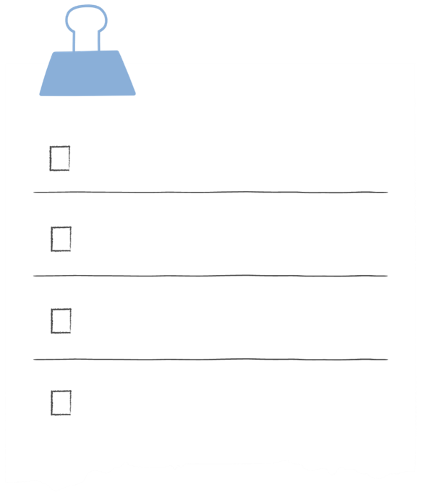
Common Mistakes
Case worker includes opinion not based off evidence
Vague notes
Missing information
Unexplained acronyms
Unclear language
Template not updated with correct information

Slide 19
Example of a Common Mistake
Date | Program/Funder | Service Mode | Who provided language Interpretation? | Activity/Progress/ Service Notes | Staff Member
2/23/23 |  | Home Visit | Case Manager | Met with the client who seemed agitated during our conversation. She said that she went to LDT but unsure of starting work. Client gave me a reason why. | Case Manager Felix

Slide 20
What is Missing?
Date | Program/Funder | Service Mode | Who provided language Interpretation? | Activity/Progress/ Service Notes | Staff Member
2/23/23 | R&P | Home Visit | EMP Specialist Danny Gonzales | Met to conduct employment orientation at the office. | EMP Specialist Danny Gonzales

Slide 21
Corrections
Date | Program/Funder | Service Mode | Who provided language Interpretation? | Activity/Progress/ Service Notes | Staff Member
2/23/23 | R&P | Office | EMP Specialist Danny Gonzales | Met with all three adult clients today to conduct employment orientation. The U.S. job market, current available employment opportunities, job placement process, and tax compliance was discussed. | EMP Specialist Danny Gonzales

Slide 22
What is Missing?
Case Worker Maria met with the family and completed the SSP for each client. The SSP was completed with the adults on the case, Ahmad and Fatima, who understand a little English. Daryl promised to help them improve their language skills. Ahmad is ready to start with any job, as soon as he receives his documents. The family has a one-year-old child who will need the necessary immunizations and be referred for a well-being child assessment. MG caseworker is following up with the CHH to obtain the family’s benefits.

Slide 23
Corrections
Case Worker Maria met with the family and completed the SSP for each client. The SSP was completed with Ahmad and Fatima in Pashto using an interpreter. The U.S. tie (Daryl) promised to help them improve their language skills. Ahmad is ready to start with any job, as soon as he receives his documents. The family has a one-year-old child who will need the necessary immunizations and be referred for a well-being child assessment. MG caseworker is following up with the Colorado Health and Human Services (CHH) to obtain the family’s benefits.
Date: 03/28/2020
Service Mode: Office
Funder: MG
Staff Member: Case Worker Maria

Slide 24
What is Missing?
5/11/2022 R&P
Staff Member: Case Manager Emily
Discussion
Client said he can't make the meeting.

Slide 25
What is Missing?
5/11/2022 R&P
Staff Member: Case Manager Emily
Canceled Appointment
Client called Case Manager Emily to say he cannot attend the meeting to discuss his program enrollment options today. He said that he was feeling sick and seemed disappointed to cancel again. Case Manager rescheduled the meeting for 05/13/2022 at 2pm. No interpreter due to his high level of English

Slide 26
What are some best practices you use to write case notes?
Write in the chat!

Slide 27
Best Practices to Keep in Mind
Complete case notes as soon as possible
Helps maintain accuracy of the interaction taken place
Reminds the author of follow ups that were discussed and possible scheduling or calls that need to be made
Ensures program requirements are being met
Dedicating specific time to writing case notes
Scheduled supervisor and/or peer reviews

Slide 28
How do you set aside time to write case notes?
Write in the chat!

Slide 29
How do you remember/ keep track of what happened during meetings with clients?
Write in the chat!

Slide 30
Questions?
Please add questions to the Q&A box or raise your hand.

