Slide 1

R&P Common Findings
August 29, 2023

Slide 2

Zoom Features
Interact with presenters and attendees by:
Typing questions in the Q&A box
Raise your hand if you want to ask a question verbally at the end
The Zoom
toolbar is at the bottom of your screen!
Notes:
Interact with presenters and attendees by:
Typing and asking questions in the chat box
Unmute yourself and ask a question at the end

Slide 3
Today’s Agenda
1
USCCB’s On-Site Review (OSR) Activities
4
3 Common Challenging Findings
How to Resolve/Avoid Them
2
Review of the top 10 R&P Common Findings
5
Program Strengthening Plans (PSPs)
3
R&P Findings and Recommendations
- How to Resolve/Avoid Them
6
Resources & Other Materials

Slide 4
Understand how USCCB supports local affiliates through the on-site review process
1
Learning
Objectives
2
Describe areas that need strengthening that are commonly found during on-site reviews
By the end of this session, you will be able to:
Identify strategies to avoid these common findings in your site’s services and documentation
3

Slide 5
Case File Reviews
15 – 20 client case files per affiliate site
Review of affiliate
policy documents
USCCB On-Site Review (OSR) Activities
Home Visits
4 – 6 client interviews
Staff Interviews
The common findings being shared in this webinar are from the information collected from USCCB on-site reviews conducted within the last three years,
FY 2021 – FY 2023.
R&P Period Reports
Diocesan Quarterly Narrative Reports

Slide 6
Of the following categories listed, where do most common findings come from?
Please use the Zoom poll feature to submit your answer
Poll Question
Home Visits
Immigration Information/AOR Provision
Financial Documentation
Material Needs Support

Slide 7
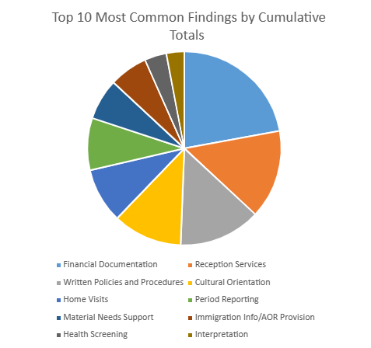
Top 10 Common R&P Findings
1. Financial Documentation
(22%)
2. Reception Services
(14%)
3. Written Policies and Procedures
(13%)
4. Cultural Orientation
(11%)

Slide 8


#1: Financial Documentation
Missing receipts and invoices.
Incomplete record of client acknowledgement of receipt of per-capita funds
Lack of evidence that clients received timely pocket money.
Incomplete or missing documentation of cash and in-kind contributions (RF-20A)
Files missing client signatures acknowledging each contribution.

Slide 9

Recommendations
Source Documentation
Ensure procedures involve case managers copying financial receipts, bills, invoices, and checks related to the case into case file.
Review and discuss cash disbursement policies with staff
Expense Disbursements
Cash and In-Kind Contributions
Create internal procedures for documenting and tracking cash and in-kind contributions.
Staff review of internal agency forms, or USCCB forms (RF-20A, 20B, and 20C)
Staff checks with case managers if financial vouchers are signed and Adult Acknowledgement sheets are signed during 24hr visits
Volunteers
Create an excel tracking sheeting to use internally to track R&P funds/expenses during the service period
Community Sponsorship: Sharing Promising Practices and Lessons Learned - Zoom
Staff review and discussion of cash disbursement policies
Include a copy of the volunteer hours tracking sheet in the case file
Resources
R&P Cooperative Agreement
USCCB webinars/training
R&P and MG Financial Documentation - Zoom
Cash and In-kind Contributions Webinar Part 1
Cash and In-Kind Contributions Webinar Part 2
Adult-Acknowledgement-of-Receipt-of-Direct-Assistance-RF-35.mp4

Slide 10

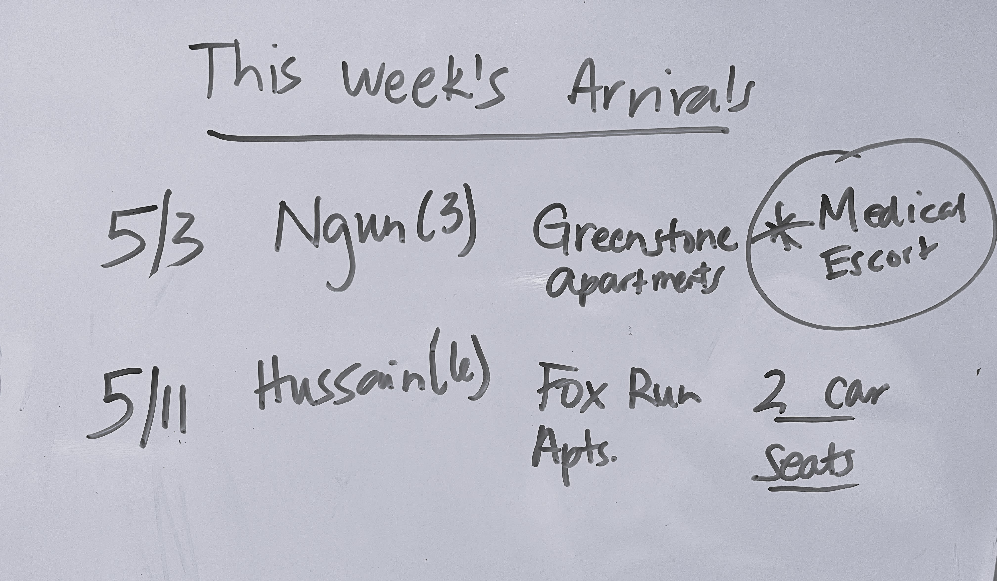
#2: Reception Services
Lack of proper evidence of airport reception.
Culturally appropriate ready-to-eat meal upon arrival were not received. Clients were provided with a fast-food meal.
Lack of evidence of the Home & Personal Safety Orientations being provided.
Housing supply checklist:
  Missing required information to be captured in detail as indicated on the USCCB/MRS Form.
  Incomplete checklists
Housing safety checklists were not documented as provided in instances where there was a move to permanent housing.

Slide 11
Recommendations
Pre-Arrival
Out-Migration
Add a flyer to discuss the effects of out-migration in the clients’ Welcome Packet
Staff training on internal procedures in completing requirements for reception services, including review of forms.
Site supervisors following up with case managers to ensure they fulfill reception services requirements.
Revise the CO curriculum to explain the effects of moving
Information added to the 30 and 90 day checklists used by case managers that goes over out-migration with client.
Meal plan: Work with community volunteers and co-sponsors to ensure hot meal(s) for arrival/first week.
Arrival
Discuss with case management staff the need to document the provision of cultural appropriate food, hot meals, and other reception services.
Staff resource: List of grocery stores or community food programs in the areas that would have cultural appropriate items.
Resources
R&P Cooperative Agreement
USCCB webinars/training
R&P Onboarding Session #1: R&P Core Services - Zoom
(Pre-arrival services)
R&P Onboarding Session #2: R&P Case File Documentation - Zoom
(Detailed Record of Reception Services)

Slide 12

#3: Written Policies and Procedures
Review these annually!
Training evidence provided did not capture all required information for a training log,
including training outcomes.
Affiliate staff did not collect client feedback surveys from clients as outlined in the affiliate AAP policy.
The affiliate was not implementing all required components of the Accountability to Affected Populations (AAP) framework and staff were not aware of all aspects of the program’s AAP plan.
The R&P disbursement policy is out-of-date and reflects a $925 minimum per-capita instead of the required minimum per-capita of $1025 for FY2022 and $1075 for FY2023.

Slide 13
Recommendations
Written Policies & Procedures
AAP Resources
AAP – USCCB Community (mrsconnect.org)
Includes a USCCB Affiliate Plan Template with guided questions to develop or update your current AAP plan.
FY23-USCCB-Affiliate-AAP-Plan-Template.docx (live.com)
Create a Quality Assurance Coordinator position that focuses on internal file reviews
Review them annually.
Reviewing and revising policies based on feedback from USCCB
The Quality Assurance Coordinator facilitate trainings for R&P staff on how to properly document actions in the case file and ensure quality reporting.
USCCB/MRS Trainings
Affiliate-Staff-Training-Plan-Requirements-and-Checklist-FY2023.docx (live.com)
Affiliate-Staff-Training-Record-Sample-FY2023.docx (live.com)
Policy Templates – USCCB Community (mrsconnect.org)

Slide 14

#4: Cultural Orientation
Client did not recall being provided with information concerning the roles and responsibilities of agency and client. None of the clients understood the effects of moving.
During case interview, none of the adult case members were aware of how to contact emergency services or ask for interpretation.
Completed service period case files reviewed did not contain a complete record of assessment of refugee understanding of orientation topics.
Affiliate case files consistently lacked sufficient evidence of compliance with CO assessment.

Slide 15
Recommendations
Cultural Orientation Materials
Affiliate Procedures
Develop additional orientation materials for clients (PPT slides and handouts) focused on cultural orientation requirements
USCCB/MRS Training
Update internal CO policy and final CO assessment to match CORE assessment standards
Include CO checklist in all case files for each adult who completes cultural orientation
Internal CO Assessment training with caseworkers
Change processes to increase client/caseworkers interaction that reiterates how to contact emergency services, home address, phone number, etc.
Update agency's case note template to include pre/post CO assessment
Cultural Orientation and Community Integration in Times of High Arrivals - Zoom
(USCCB requirements)
Cultural Orientation Documentation - Zoom
(USCCB requirements & How to Document)
Promising Practices Series on Cultural Orientation
Cultural Orientation Objectives and Indicators - CORE (coresourceexchange.org)
Consult with USCCB's Cultural Orientation Coordinator Elena Tothazanwith etothazan@usccb.org

Slide 16
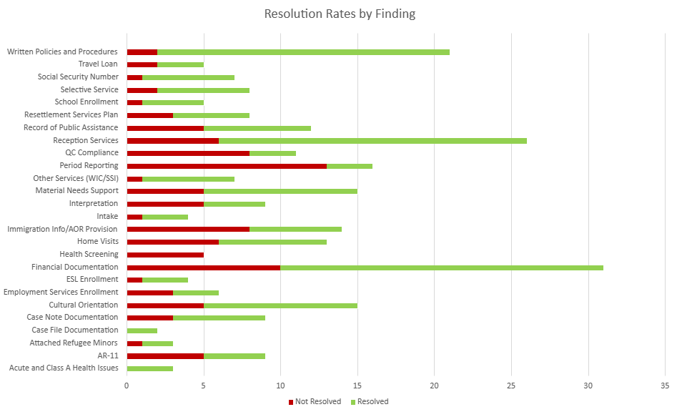
Top 3 Challenging R&P Findings
Health Screening
R&P Period Reporting
Quarterly Consultation
Compliance

Slide 17

Quarterly Consultations
Quarterly consultations held did not have a local public safety representative present.
Local governance was invited but did not participate in the scheduled quarterly consultation meeting.
The QC attendance records and meeting minutes reviewed indicated that at least one required participant was not in attendance at these meetings. In addition, from the minutes it was not always clear that all required topics were discussed.

Slide 18
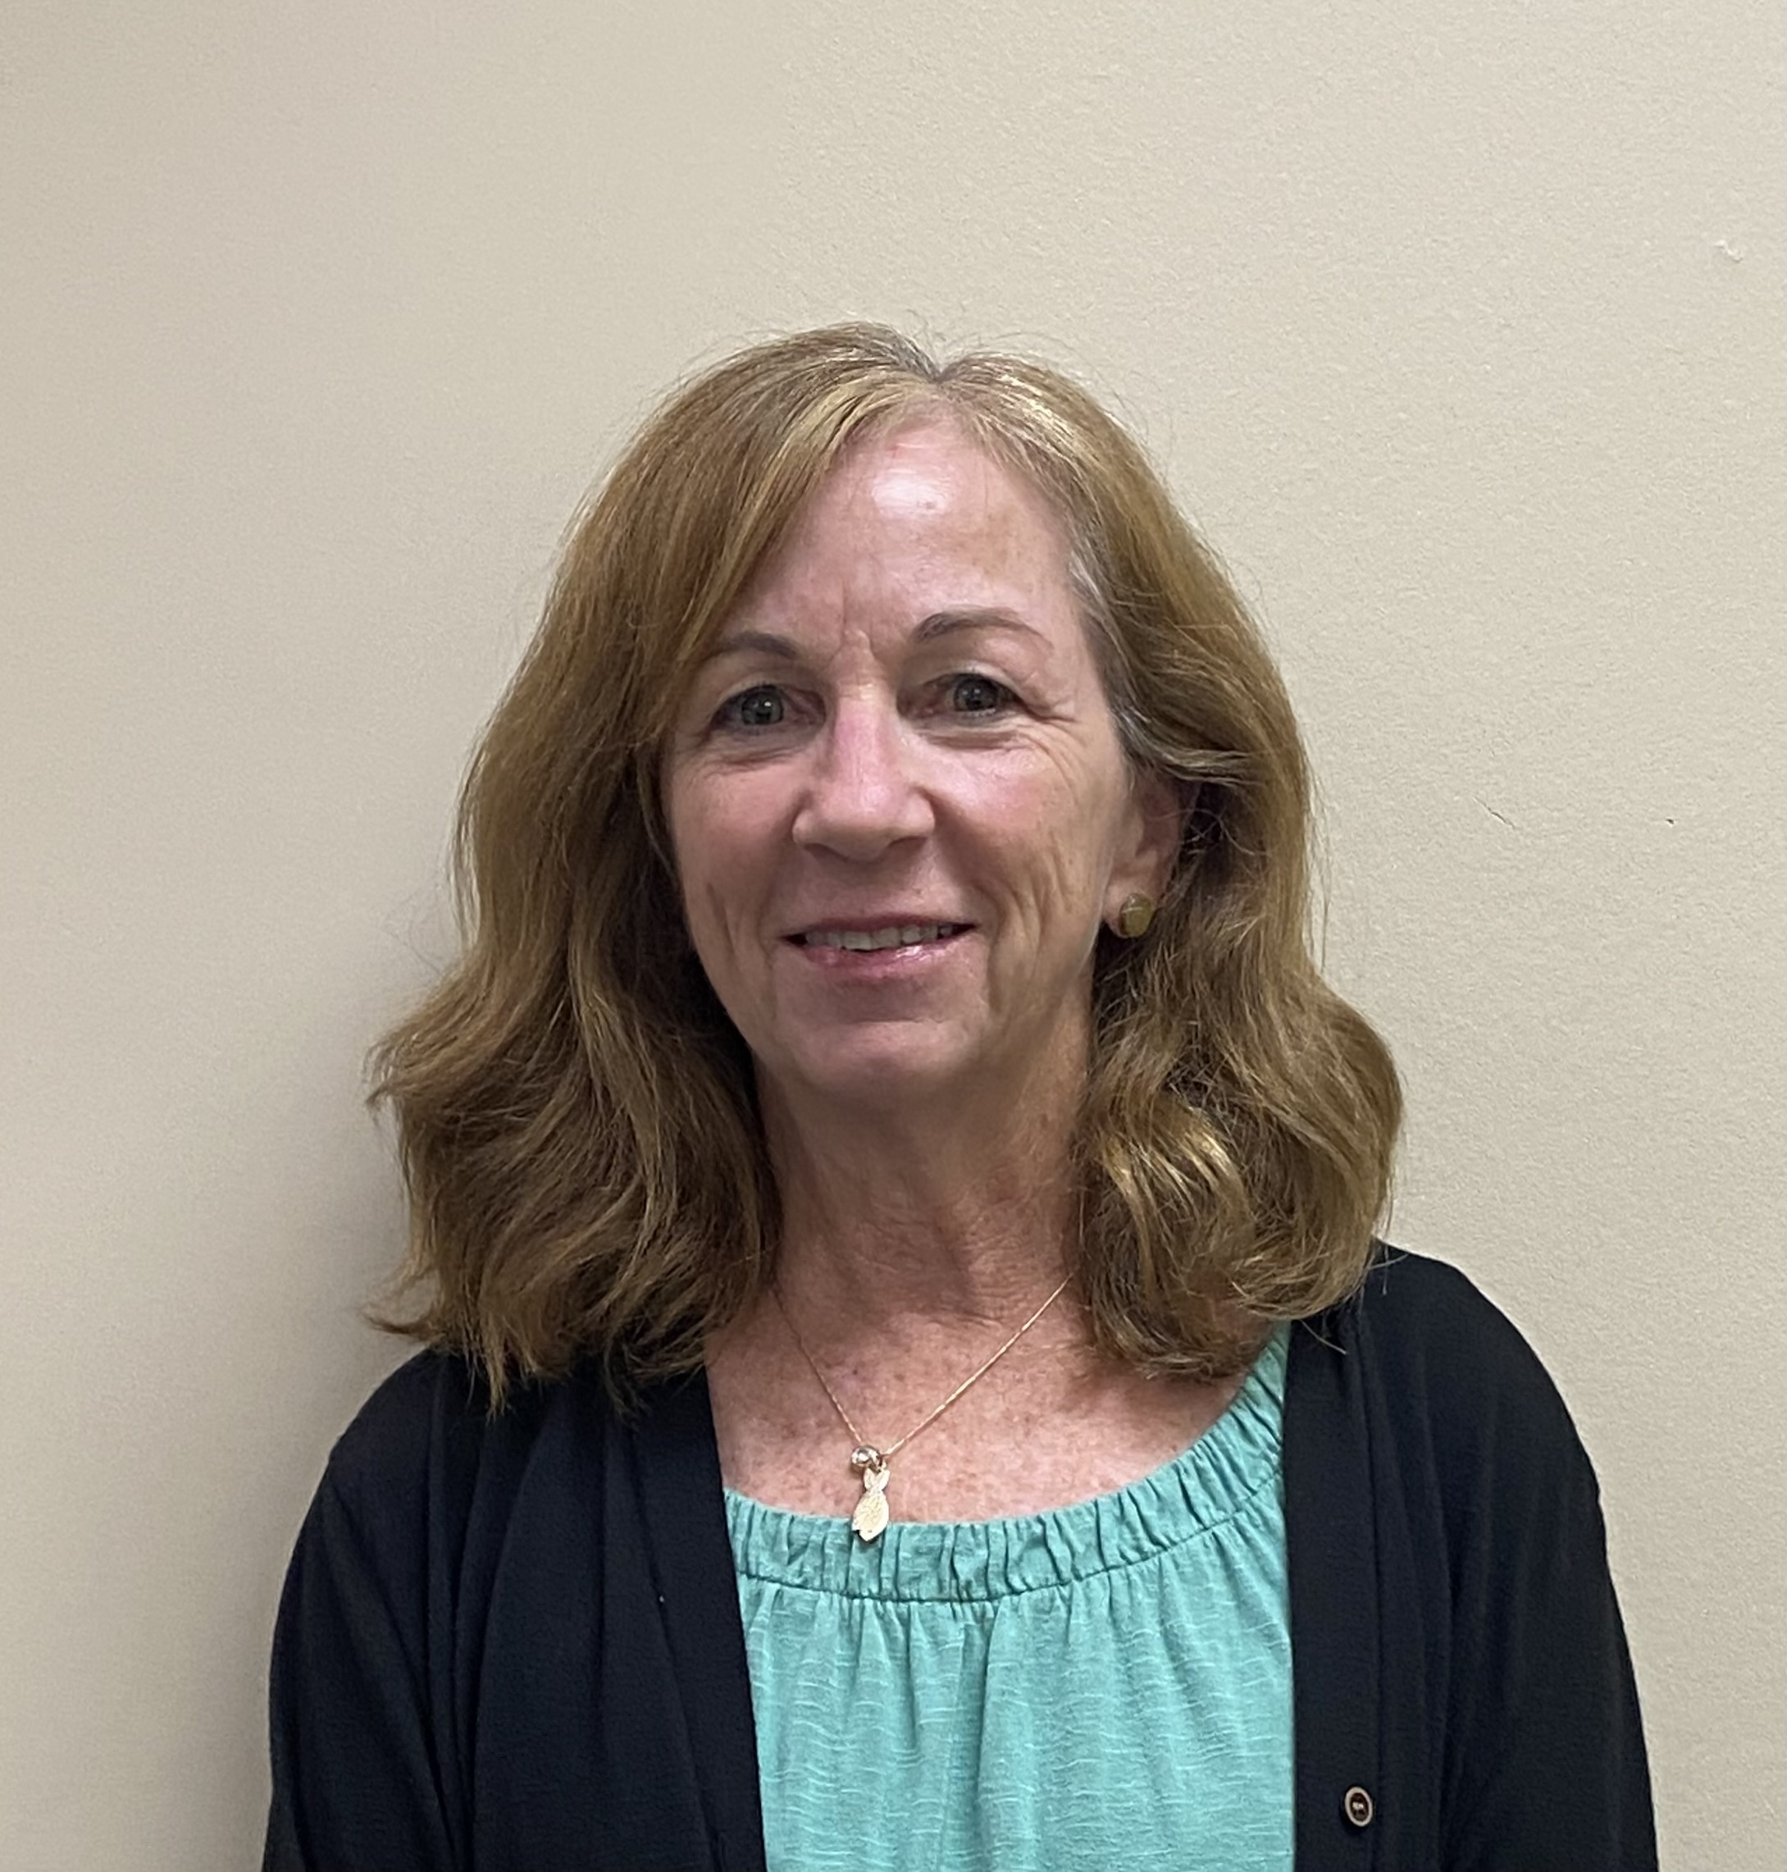
Quarterly Consultations
How has your agency overcome challenges with Quarterly Consultations?
Laura Jones, Assistant Regional Director
Refugee Services
Catholic Charities Diocese of Charolette.

Slide 19

Health Screenings
Case files documented delays in health screening provision and inconsistent case noting of the reason for delay.
Case files were missing case note documentation of initial health screening and immunizations.
Files that had completed their 30th day after arrival did not have evidence of the provision of immunizations or a health screening.
Solutions:
Meeting with the State Refugee Office to increase the number of health screening providers in your local area.
Meet with local public health representatives to discuss issues/concerns regarding refugee health screenings and delays. Include the State Refugee Health Coordinator in these discussions.
Updated the R&P Case Note template! include 3 sections for health screening appointments.
  Date health screening was scheduled
  Date health screening occurred
  Date of second health screening

Slide 20

R&P Period Reporting
Submitted period report were either inaccurate or contained discrepancies that could not be verified, when compared with the information contained in the case file
Case files submitted an R&P Period Report to MRIS that was inaccurate and did not fully reflect the delays or services not provided in the case file.
Not all R&P Period Reports accurately reflect service delivery when compared to the case note logs.
Case files reviewed were either missing, had incorrect, or lately submitted R&P Period Reports in the case file.

Slide 21
R&P Period Reporting
Tips from Hiba Alsbonge, R&P Program Supervisor from Catholic Charities Diocese of Erie
Review the case log prior to completing the R&P report to make sure it accurately reflects all services provided.
Compare case notes with the R&P Period Report to ensure accuracy of the report data.
We (Erie staff) use the USCCB case file monitoring tool to outline the services documented in the case log.
If any service was not completed or late, ensure that the case notes clearly reflect the reason for the delay and submit as delayed provision.
Send a reminder e-mail to all program staff members in advance of the R&P submission due date to ensure services provided are all documented in the case log along with evidence of documents in the file.
Ensure that R&P staff have a good understanding of the provisions in the R&P Cooperative Agreement including updates to the current fiscal year.
We reach out to our R&P Data Specialist for support in case you have questions on how to submit an accurate Report
Attend USCCB trainings/webinars
Improving Period Report Accuracy eLearning Course
Joe-Ann Touma, R&P Data Specialist, jtouma@usccb.org

Slide 22

What questions do you have about common findings?

Slide 23

Program Strengthening Plan (PSP)
Program Strengthening Plan (or PSP) provided to affiliate sites when OSR monitoring report is sent.
  Findings from the OSR monitoring
  Utilized to resolve findings after an OSR
  A "litmus test" for further support or growth in certain areas
  PSPs for both USCCB/MRS monitoring and PRM monitoring
Notes:
A Program Strengthening Plan or PSP is a document given to a site when the OSR monitoring report is sent
Contains all of the findings from the monitoring
Used to see how a site resolves findings after an OSR
A "litmus test" to see if a site needs support or growth in certain areas
There are PSPs for both USCCB/MRS monitoring and PRM monitoring

Slide 24
Structure of a PSP
Column that contains the findings from the OSR report
Column that contains the action that the site will take to resolve the finding; this is the ONLY column the site will have to fill out
Column that contains information about any updates USCCB/MRS receives (ie. File submission, meeting, email, etc.)
Column that contains the Resolution status; findings can be marked as 'Resolved' or 'Not Resolved'

Slide 25
PSP Process
Mostly Compliant/Compliant Sites
Partially Compliant Sites
USCCB sends monitoring report and PSP with findings. Main point of contact for the PSP is the R&P Field Support Specialist (FSS)
30 business days to fill out the Program Strengthening Actions section and send back to USCCB/MRS
  Site can meet with the FSS during this time to discuss possible PSAs to include
FSS either approves or sends it back for edits
When approved the PSP is finalized, and the site has a 90-day period to implement the actions in the PSA
After 90 days, site RD and any staff have a phone call with the FSS to discuss progress
  Site will also submit supporting documents such as policies, staff training logs, and QC attendance and minutes if requested by FSS
FSS reviews notes from the meeting and any requested supporting documents and sets resolution statuses for findings
FSS sends back the complete PSP to the site.
USCCB sends monitoring report and PSP with findings. Main point of contact for the PSP is the R&P Field Support Specialist (FSS)
30 business days to fill out the Program Strengthening Actions section and send back to USCCB/MRS
  Site can meet with the FSS during this time to discuss possible PSAs to include
FSS either approves or sends it back for edits
When approved the PSP is finalized, and the site has a 90-day period to implement the actions in the PSA
After 90 days, site will submit at least 5 case files that are requested by the FSS; site has 5 business days to submit
  Site will also submit supporting documents such as policies, staff training logs, and QC attendance and minutes if requested by FSS
FSS reviews the case files and any requested supporting documents and set resolution statuses for findings
FSS sends back the complete PSP to the site.
Notes:
For Mostly Compliant/Compliant Sites:
Site is sent report and PSP with findings. Main point of contact for the PSP is the R&P Field Support Specialist (FSS)
Site has 30 business days to fill out the Program Strengthening Actions section and send back to USCCB/MRS
Site can meet with the FSS during this time to discuss possible PSAs to include
Once sent back, FSS either approves or sends it back for edits
When approved the PSP is finalized and the site has a 90-day period to implement the actions in the PSA
After 90 days, site RD and any staff working on the PSP have an hour long phone call with the FSS to discuss progress
Site will also submit supporting documents such as policies, staff training logs, and QC attendance and minutes if requested by FSS
The FSS will review notes from the meeting and any requested supporting documents and set resolution statuses for findings
FSS sends back the complete PSP to the site.
For Partially Compliant Sites:
Site is sent report and PSP with findings. Main point of contact for the PSP is the R&P Field Support Specialist (FSS)
Site has 30 business days to fill out the Program Strengthening Actions section and send back to USCCB/MRS
Site can meet with the FSS during this time to discuss possible PSAs to include
Once sent back, FSS either approves or sends it back for edits
When approved the PSP is finalized and the site has a 90-day period to implement the actions in the PSA
After 90 days, site will submit at least 5 case files that are requested by the FSS; site has 5 business days to submit
Site will also submit supporting documents such as policies, staff training logs, and QC attendance and minutes if requested by FSS
The FSS will review the case files and any requested supporting documents and set resolution statuses for findings
FSS sends back the complete PSP to the site.

Slide 26
Purpose of the PSP
A PSP is a way to track your progress following an OSR.
Provides a structure to set goals and discover areas where support is needed
Demonstrates the hard work and progress of your site's staff
Strengthens the network as a whole and to ensure affiliates are abiding by guidelines set in the R&P Cooperative Agreement
Contact the R&P Field Support Specialist and your respective R&P Field Support Coordinator with any questions and to request support.
  Raquel Kubicz, rkubicz@usccb.org
Notes:
A PSP is a way for your site, USCCB/MRS and PRM to track your progress following an OSR
It is a structured way to set goals and discover areas where you need support
Your site is encouraged to reach out to the R&P Field Support Specialist and your site's R&P Field Support Coordinator at any time during the process with any questions and to request support
It is a way to demonstrate the hard work and progress your site's staff has been working on
The PSP process helps to strengthen the network as a whole and to ensure that affiliates are abiding by guidelines set in the R&P Cooperative Agreement

Slide 27

Additional Resources
Upcoming USCCB Webinars/Trainings:
Reminder: You need to be logged into MRS connect to access the resources/materials linked in this presentation.
FY23-RP-Case-File-Monitoring-Tool-rev.-March-2023-corrected-dropdown.xlsx (live.com)
FY23-RP-CFMT-Addendum-rev.-April-2023.docx (live.com)
Case File Forms – USCCB Community (mrsconnect.org)
PRM Monitoring Prep – USCCB Community (mrsconnect.org)
USCCB Webinar: Effectively CompletingR&P PeriodReports
THURS., Sept 7, 2023 l 2:00 – 3:00 pm EST
Target audience: R&P affiliate staff
Reminder:
USCCB R&P Period Report - Office Hours
Upcoming office hours:
Tuesday, September 5, 2023 l 2P-3P ET
Tuesday, September 19, 20203 l 2P-3P ET
Registration not required. Join each meeting here.
(see link in Resettlement Connection Newsletter)
CORE Webinar: Register Today: Introducing the NewDomesticCultural Orientation Curriculum - CORE (coresourceexchange.org)

Slide 28

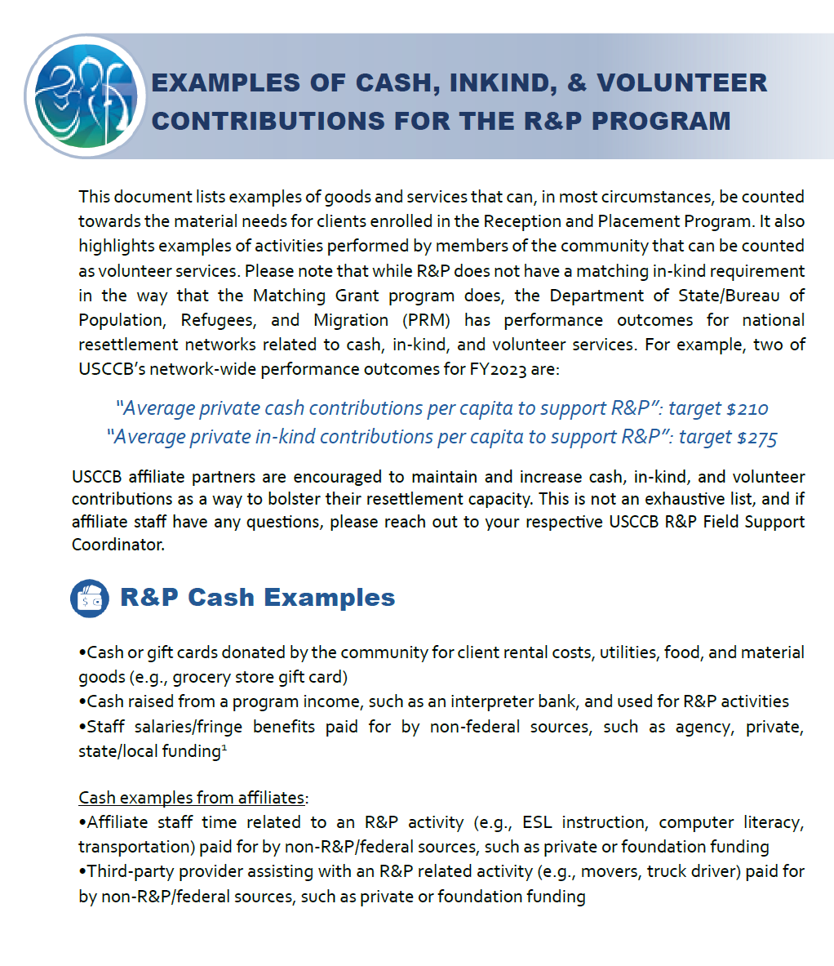
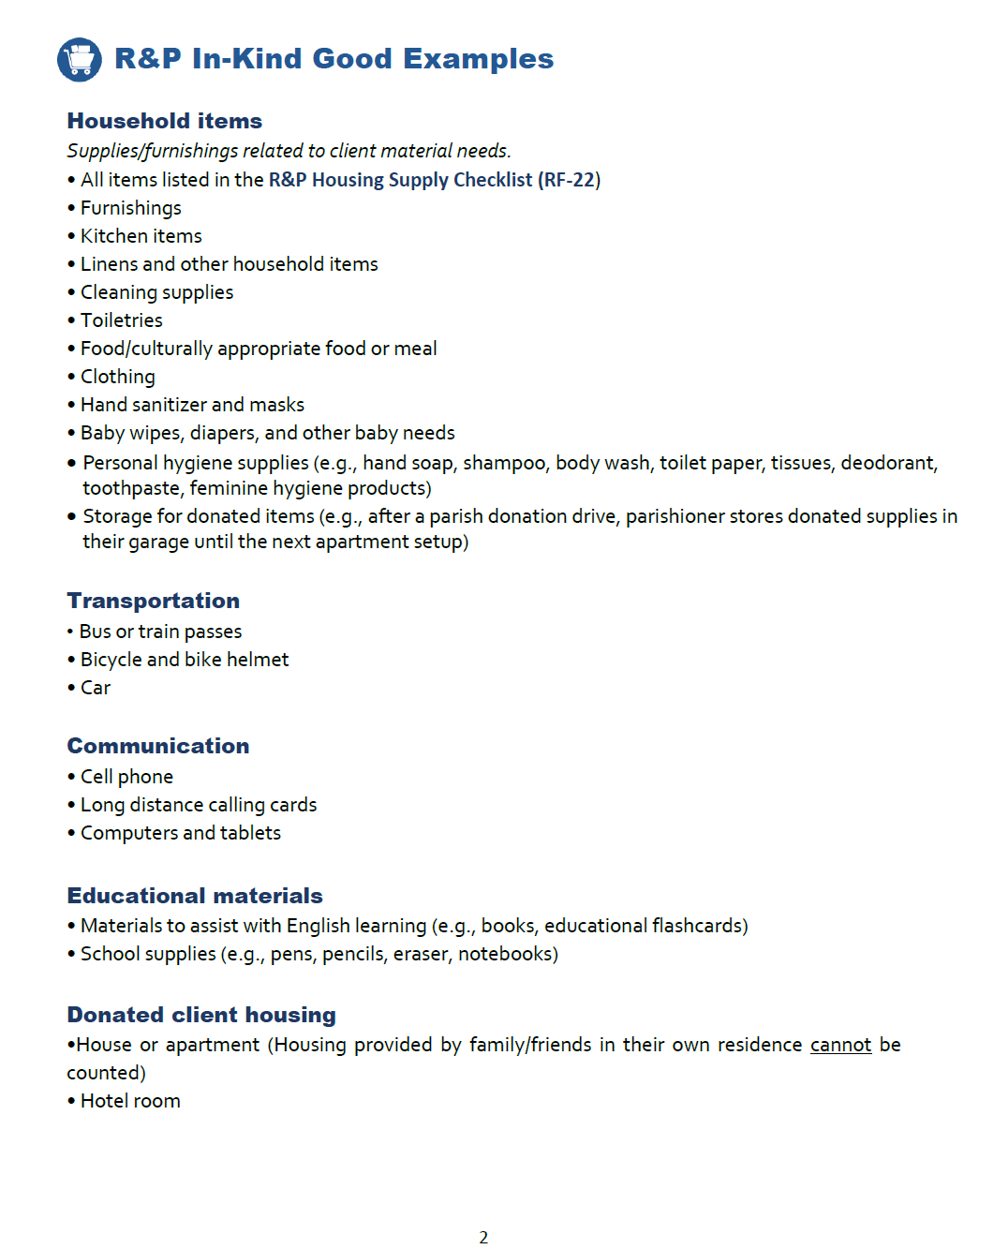
New R&P Reference Tool

Slide 29

Thank you for attending!

