Slide 1
FY23 Q3 CO CoP
June 7, 2023
Notes:
Warm up:
Name
Agency / location
1 thing you are thankful / grateful for today

Slide 2
Introduction
Elena Tothazan
Cultural Orientation Coordinator

Slide 3
Agenda
Warm up and introductions
Network and USCCB CO Updates
CO Barriers and Solutions Breakout Rooms Discussion
Wrap up and Q&A

Slide 4
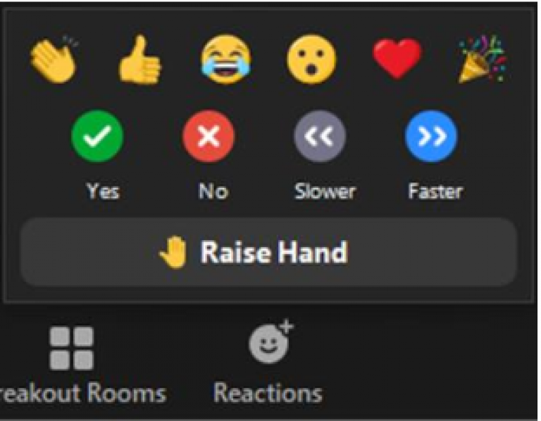
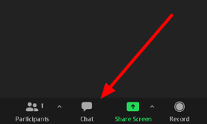
Zoom Features
CHAT
MUTE / UNMUTE
TEXT ANNOTATION TOOL
RAISE HAND

Slide 5
Network CO Updates

Slide 6
USCCB CO Updates
CO Objectives and Indicators (O&Is) have been revised
DOMESTIC CO TOPICS
Budgeting and Personal Finance
Cultural Adjustment
Digital Technology and Literacy NEW!
Education
Employment
Health and Hygiene MERGED!
Housing
Learning English
Newcomer Rights and Responsibilities
Public Assistance
Role of the Local Resettlement Agency
Safety
Transportation
U.S. Laws
Your New Community
OVERSEAS CO TOPICS
Cultural Adjustment
Digital Technology and Literacy NEW!
Education
Employment
Health and Hygiene MERGED!
Housing
Learning English ADDED!
Newcomer Rights and Responsibilities
Role of the Local Resettlement Agency
Transportation ADDED!
Travel
U.S. Laws ADDED!
Resources:
CORE CO O&Is webpage
CORE CO O&Is microlearning video
Updated Domestic CO O&Is PDF
Updated Overseas CO O&Is PDF
What are the CO O&Is CORE webinar
How to use the CO O&Is CORE webinar

Slide 7
CO Barriers and Solutions Breakout Rooms
Pick a breakout room!
Pick a spokesperson / note taker
Discuss! (20 min)
Share-out! (15 min)
Breakout room 1: Transportation issues
Breakout room 2: Childcare issues
Breakout room 3: Clients don’t have time (working, other appts etc.)
Breakout room 4: Clients not interested in attending CO

Slide 8
CO Barriers and Solutions Share-out
Transportation barrier solutions:
Schedule clients who live nearby for the same CO session and ask clients who know how to use public transportation help other clients in the area use public transportation to attend CO together
Bring CO to the clients by having CO sessions in common areas of apartment buildings, local libraries close to where clients live etc.
Ask volunteers or US ties to provide transportation for clients to attend CO
Provide clients with pre-paid bus passes
Childcare barrier solutions:
Ask vetted volunteers to provide childcare so clients can attend CO
Provide in-home CO sessions
Client limited time barrier solutions:
Share materials (CORE videos, podcasts, etc.) with clients to review and then complete knowledge checks
Schedule CO around child services (ex: when children go to school or classes at the office, the parents can attend CO at the same time)
Client disinterest barrier solutions:
Offer raffle or incentive for the first or second sessions of CO
Offer laptops to clients as an incentive after completion of CO (if laptops are offered for ESL or as part of other programming, collaborate on providing these as incentives for service completion)
Offer food supply as an incentive after CO completion (staff could go to the local food back and take food supply to clients)

Slide 9
Wrap Up
Affiliate Survey
Cultural Corner

Slide 10
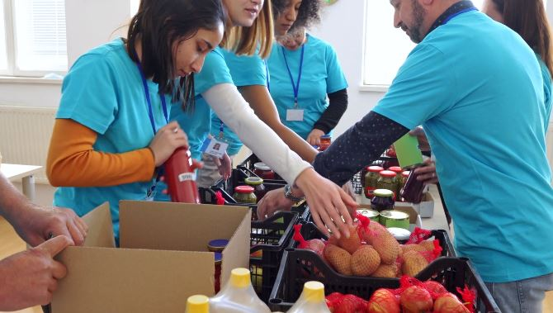
Questions?
Please add questions to the chat or raise your hand.

