Slide 1


Making the Most of R&P Resources
May 10, 2023

Slide 2
Presenters
Joe-Ann Touma, R&P Data Specialist
Sarah Evans, Assistant Director, R&P

Slide 3
Learning Objectives
By the end of this session, you will be able to:
• Navigate the R&P page of MRSConnect to locate key training resources that can be incorporated into your site’s R&P staff onboarding and training plans
• Locate case file form templates and translations to use at your site
• Understand how to find R&P best practice ideas to implement in your program
• Find USCCB created tools such as policy checklists, R&P Case File Monitoring Tool and Addendum, and more

Slide 4

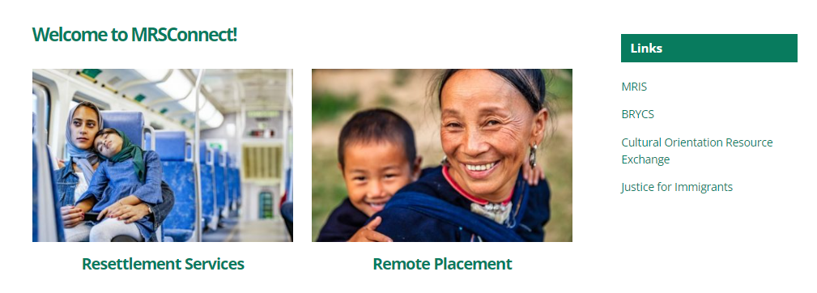
Resettlement Services tab
Throughout today’s presentation, the green star will draw attention to new resources!
Today, we will mostly focus on the R&P tile of the “Resettlement Services” section of MRSConnect.
Note that Remote Placement programs will want to check out the “Remote Placement” tab, which has more specialized resources for Remote Placement programs.

Slide 5
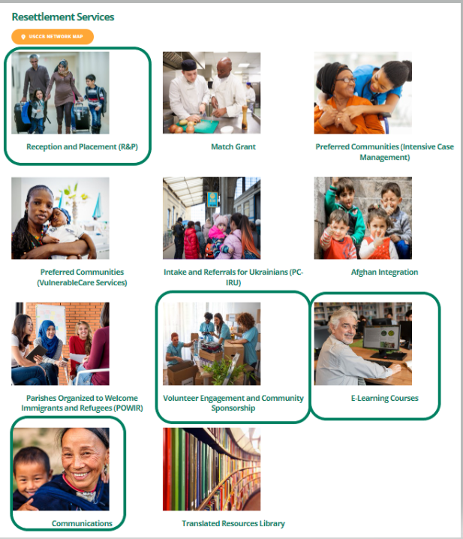
Resettlement Services tiles
While the Reception & Placement (R&P) tile is where we’ll spend most of our time, we’ll also explore some resources on the Volunteer Engagement and Community Sponsorship tab
Some of the resources we’ll discuss today are also available on the tabs below
E-Learning Courses
Communications

Slide 6
Overview of Resources
Today, we’ll focus on resources that an R&P case manager would want to find on MRSConnect.
We will have a few slides at the end of the presentation that focus more on administrative resources, such as policy templates, quarterly consultation information, etc. Categories of resources we’ll look at today:
R&P Cooperative Agreement
Resources for New Staff
Resettlement Connection
E-Learning
Attached Refugee Minors (ARM) and Refugee Youth
Volunteer Engagement and Community Sponsorship
Case File Forms and Review Tools
R&P Period Report Resources
Program Management Resources

Slide 7
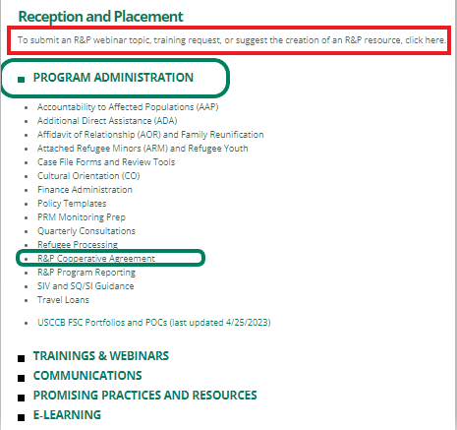
R&P Cooperative Agreement
Under Reception & Placement → Program Administration, you will find “R&P Cooperative Agreement”
When you click on the title, you will see the most recent version of the R&P Cooperative Agreement. If the Department of State revises the Cooperative Agreement during the year, USCCB/MRS will send out a notice about the changes.
In April 2023, PRM revised the R&P Cooperative Agreement language about follow-up needed with the local Social Security office, if the client does not receive their EAD Receipt Notice in a timely way

Slide 8
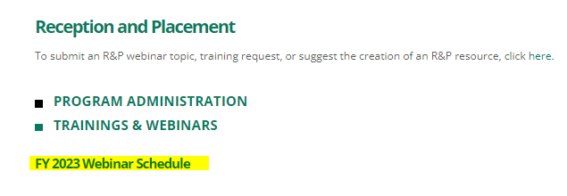
Resources for New Staff: Slide 1 of 2
When you click on the FY 2023 Webinar Schedule, you will get the list of USCCB/MRS’ scheduled webinars for the fiscal year (October – September)
Note that webinars may be added, canceled, or rescheduled, based on network need
Registration links for USCCB/MRS webinars are sent out in the Resettlement Connection a few weeks before the webinar
The learning outcomes for USCCB/MRS webinars are also listed
Please respond in the poll:
Where do you need to report the learning outcomes for the webinars that you attend?

Slide 9

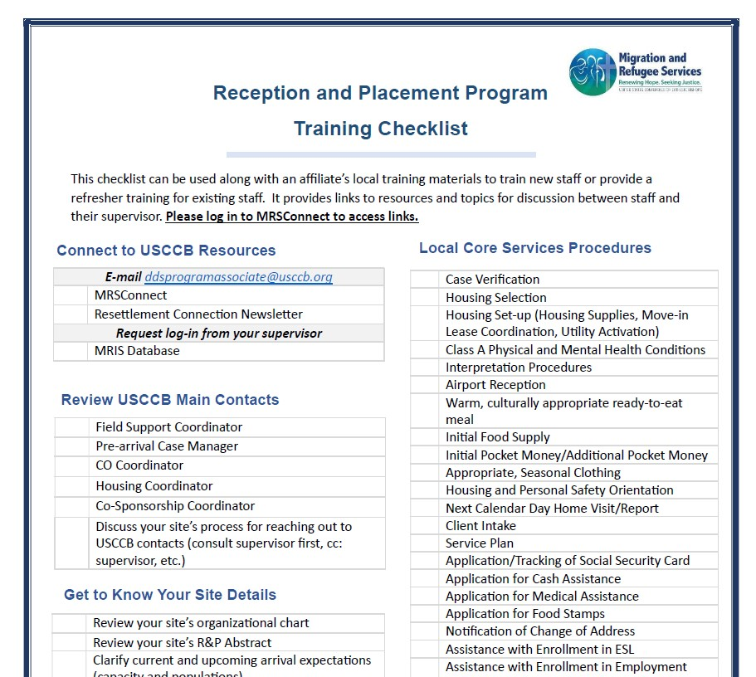
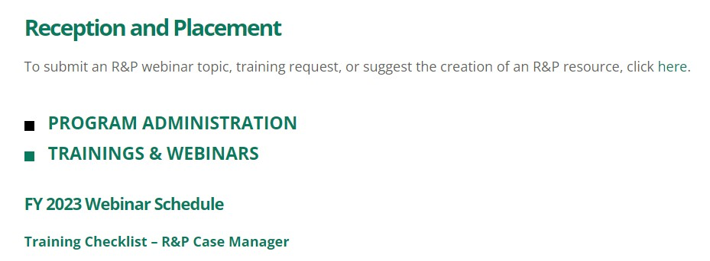
Resources for New Staff: Slide 2 of 2
Brand-New USCCB Resource:
Reception and Placement Program Training Checklist

Slide 10
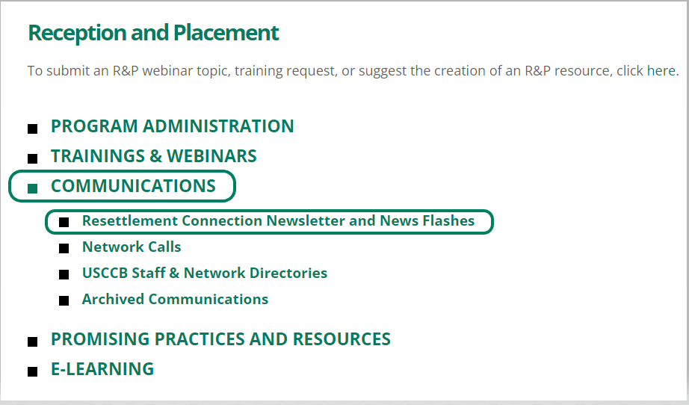
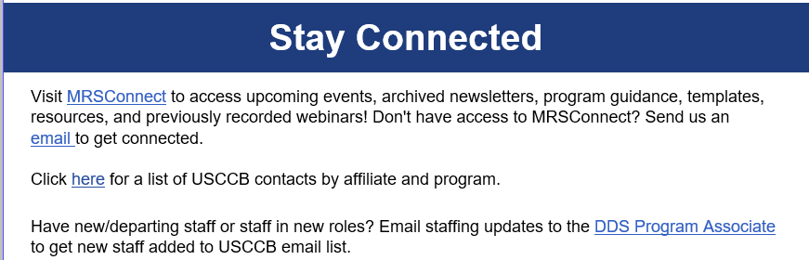
Resettlement Connection
This reminder is at the very bottom of every Resettlement Connection (RC) – we want to make sure all new staff are getting the RC!
USCCB/MRS stores the full archive of weekly Resettlement Connection newsletters under Communications → Resettlement Connection Newsletter and News Flashes
(A “News Flash” is sent out from USCCB if there is time-sensitive information to communicate)

Slide 11
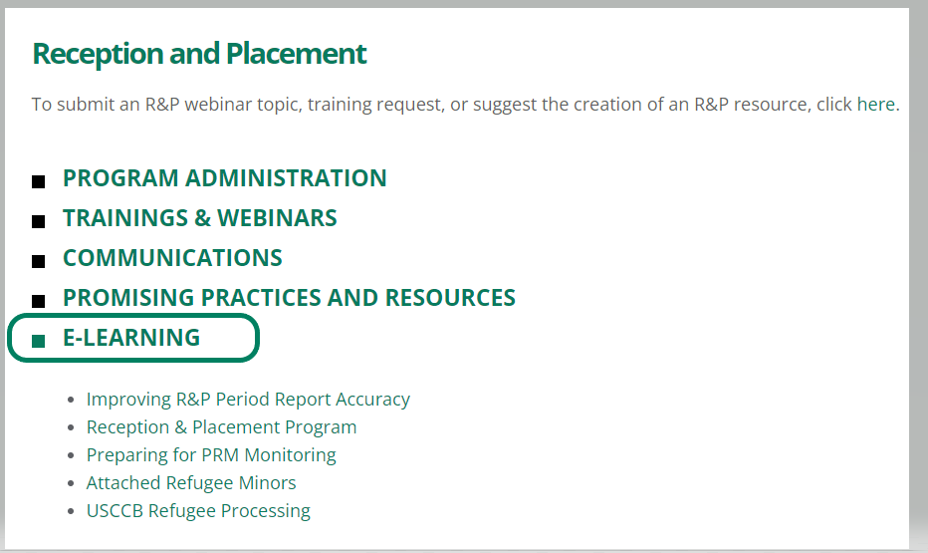
USCCB/MRS E-Learning Courses
Under Reception & Placement → E-Learning, you will find USCCB/MRS’ R&P e-learning courses
USCCB/MRS is working to update our Improving R&P Period Report Accuracy and Reception & Placement e-learning courses!
Updates coming soon to the R&P Period Report and R&P e-learning courses!

Slide 12
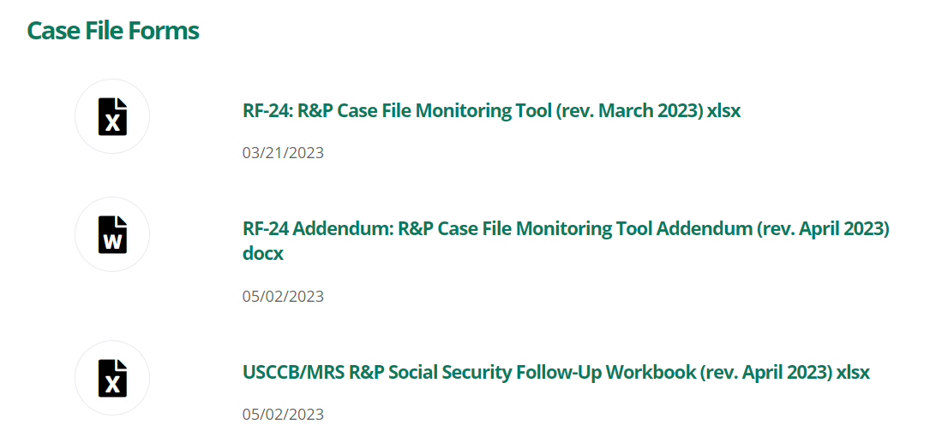
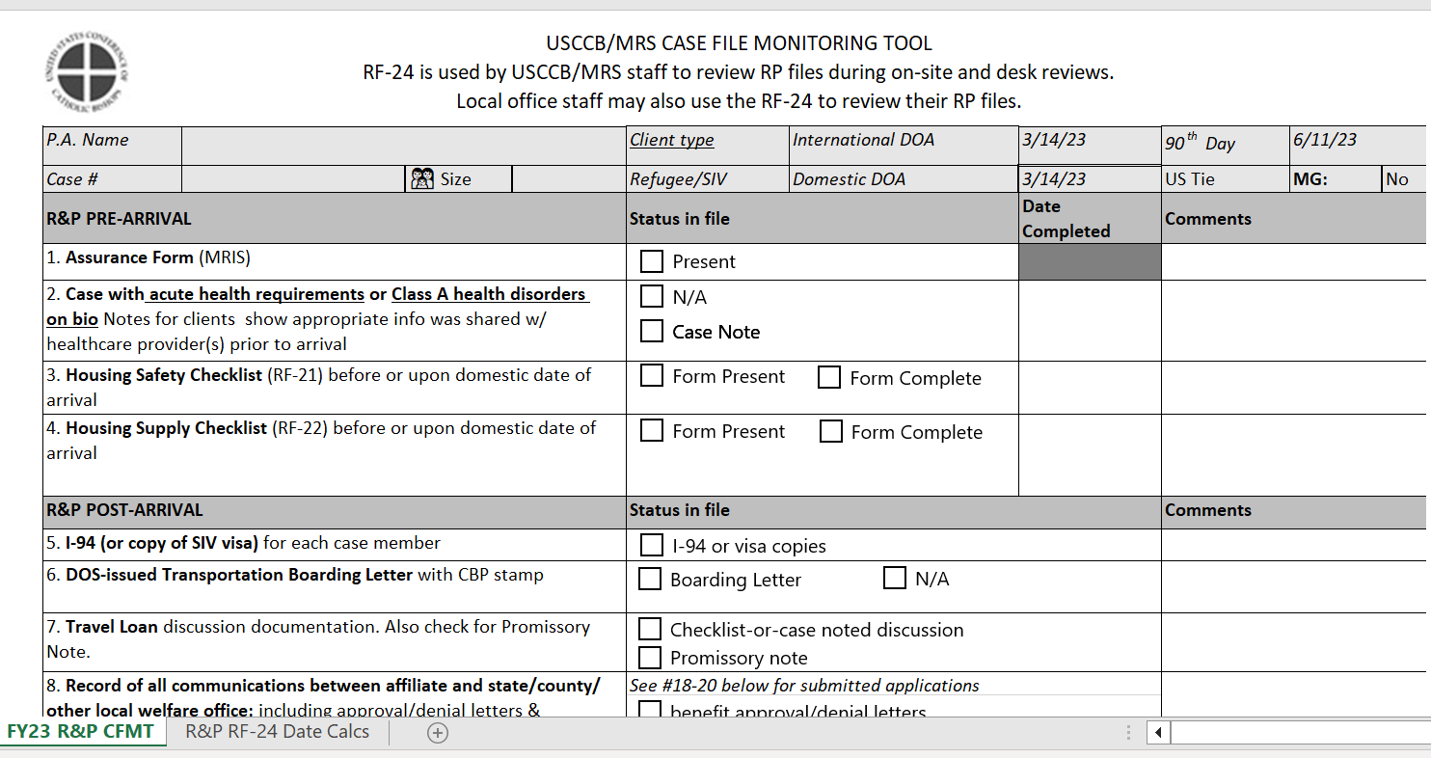
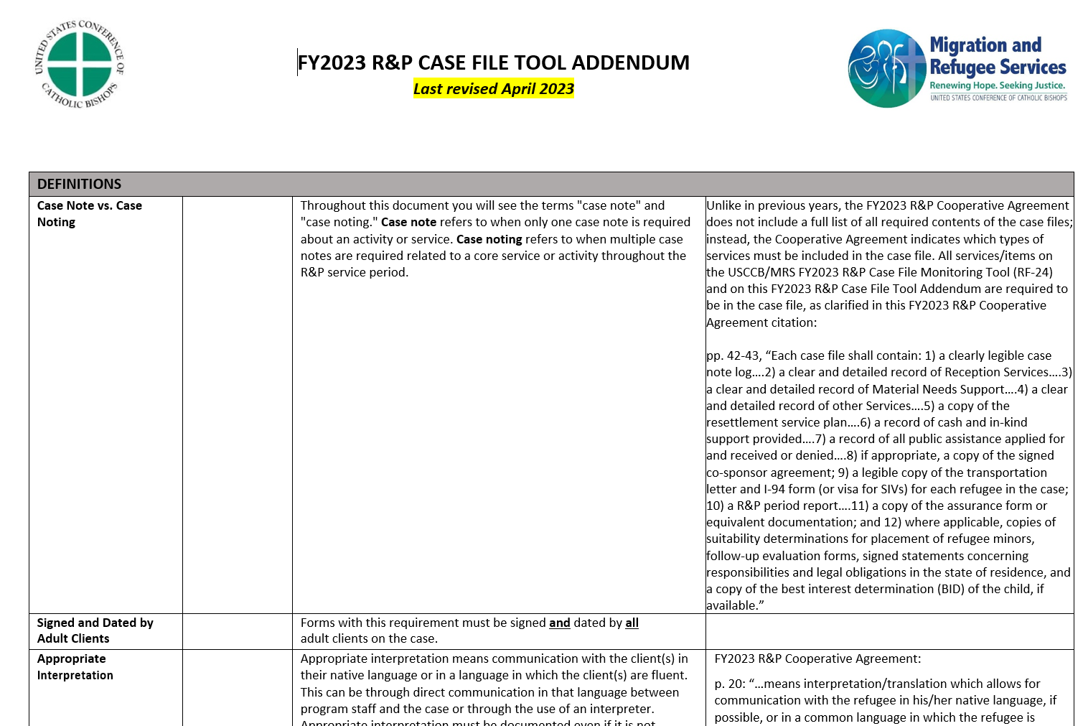
R&P Case File Review Tools
The RF-24: R&P Case File Monitoring Tool (rev. March 2023) and the RF-24 Addendum: R&P Case File Monitoring Tool Addendum (rev. April 2023) are USCCB/MRS’ tools to review your affiliate’s R&P case files
There will be more information about the Social Security Follow-Up Workbook later in this presentation!

Slide 13
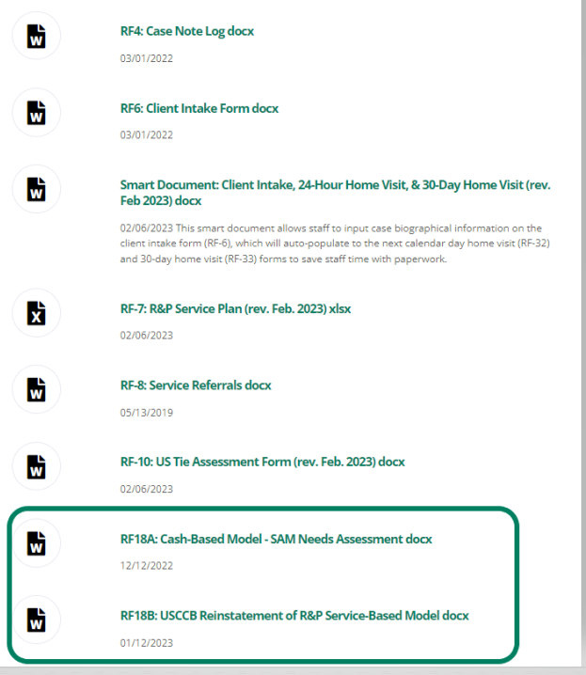
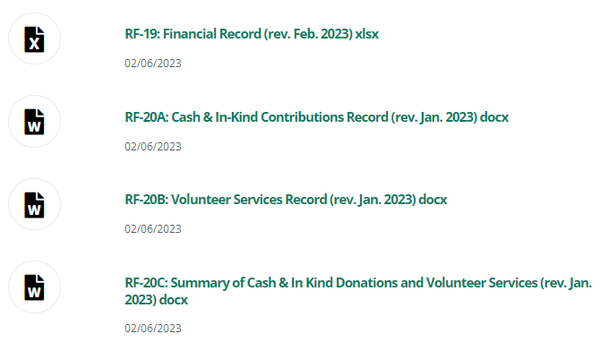
R&P Case File Forms (Slide 1 of 2)
Case management forms
Financial forms

Slide 14
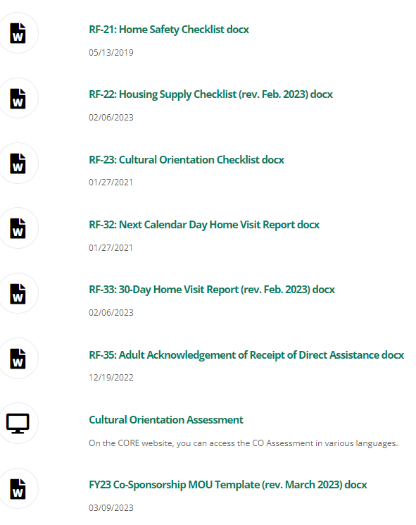
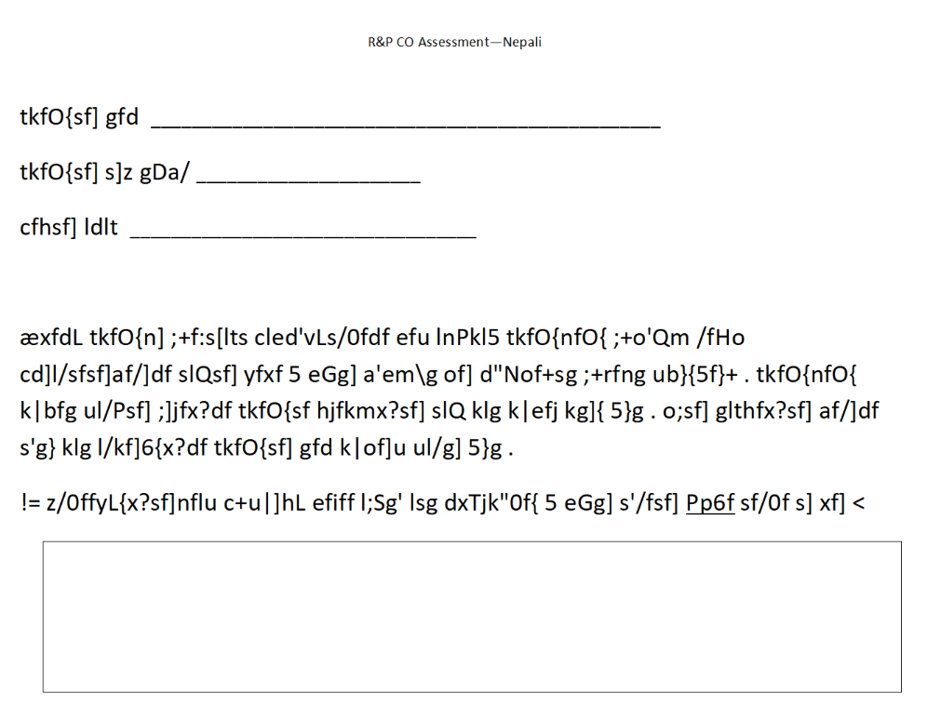
R&P Case File Forms (Slide 2 of 2)
Additional case management forms, including a link to the CORE Model Assessment
Nepali CORE Model Assessment
USCCB/MRS requires each adult R&P client to complete the CORE Model Assessment at the end of their cultural orientation

Slide 15
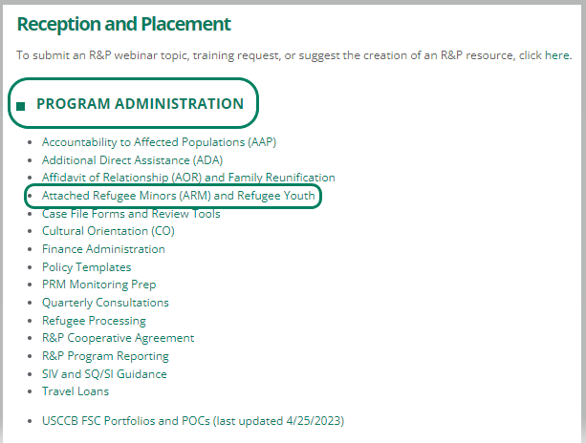
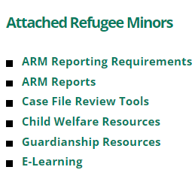
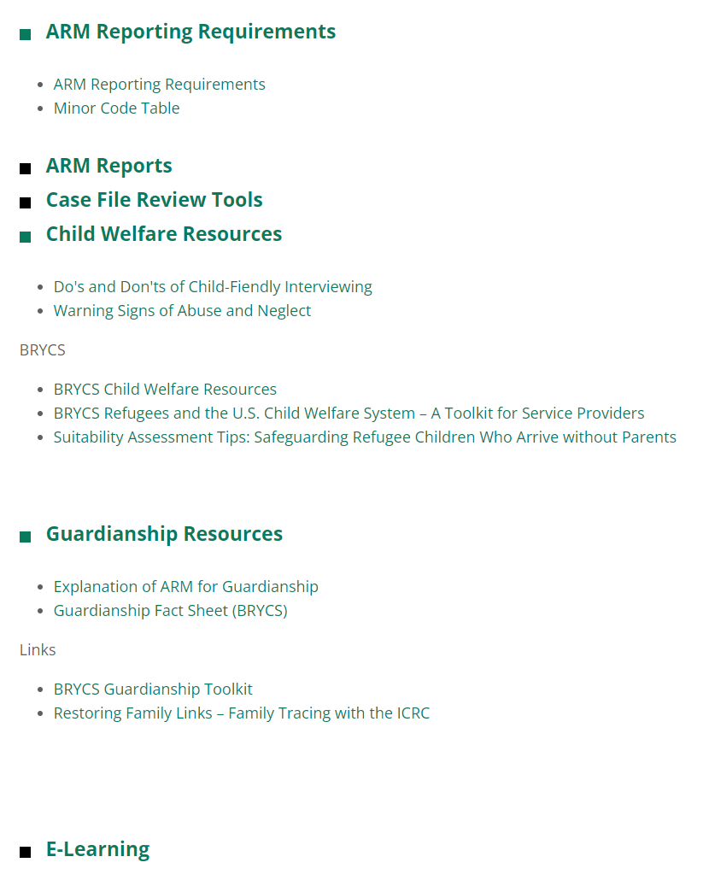
Attached Refugee Minors (ARM)
and Refugee Youth
The attached refugee minor (ARM) page has a mix of compliance (reporting, minor codes, etc.) and child-welfare information (child-friendly interviewing tips, guardianship resources, etc.)

Slide 16



Volunteer Engagement & Community Sponsorship Tile under Resettlement Services
Friendly Reminder:
Co-Sponsorship is an R&P Program!

Slide 17
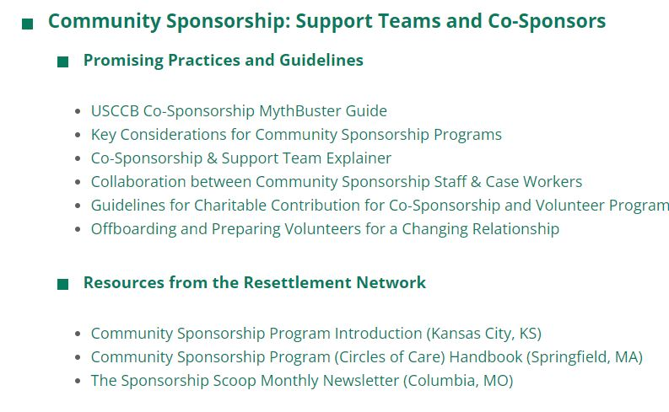
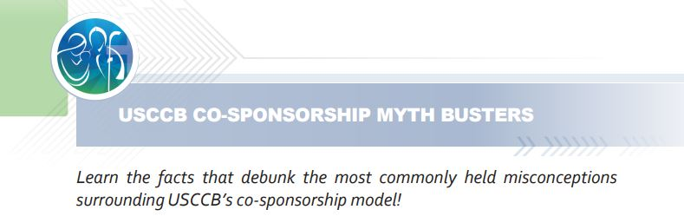

Community Sponsorship: Support Teams and Co-Sponsors

Slide 18
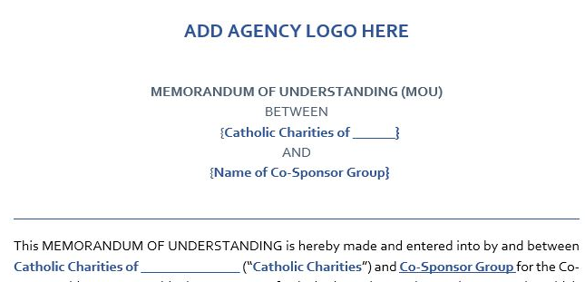
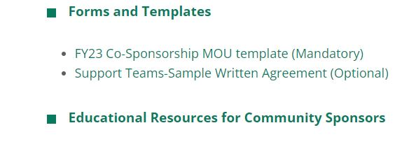

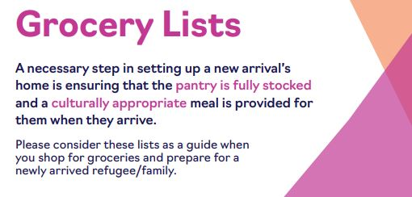
Community Sponsorship: Support Teams and Co-Sponsors

Slide 19
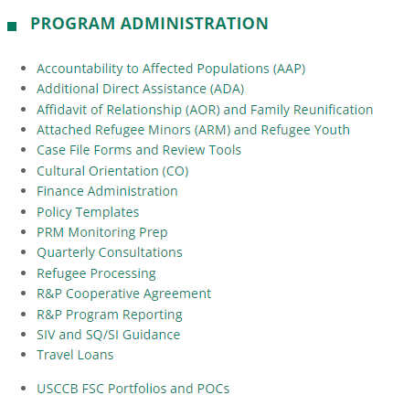
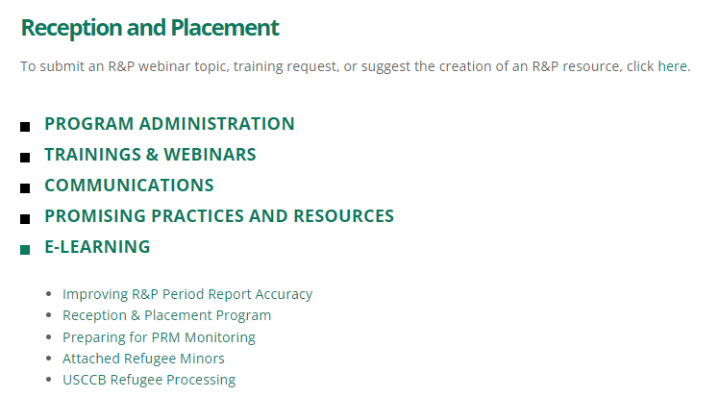
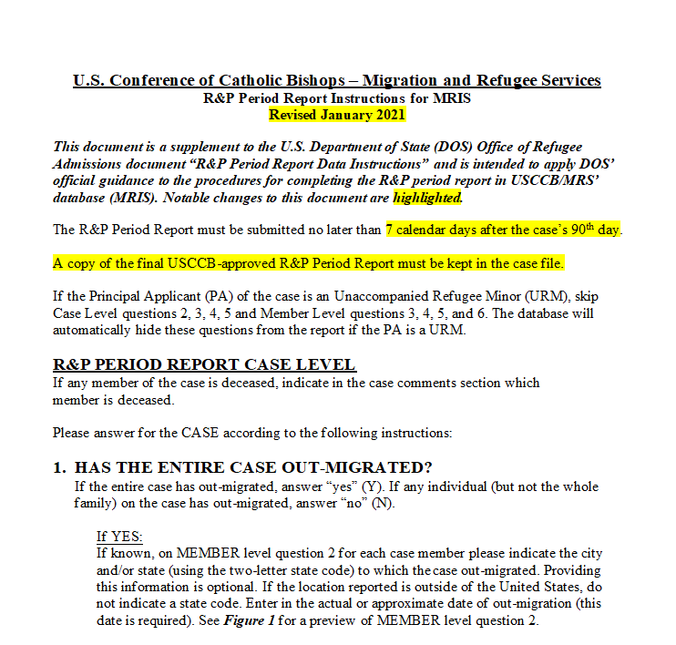
Finding R&P Period Report Resources
MRSConnect
Resettlement Services
Reception and Placement (R&P)
1
USCCB/MRS R&P Period Report Guidance (January 2021)
2
E-Learning Course: Improving R&P Period Report Accuracy

Slide 20
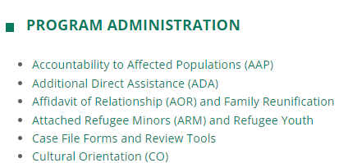
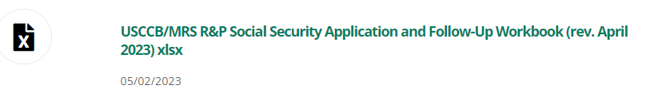
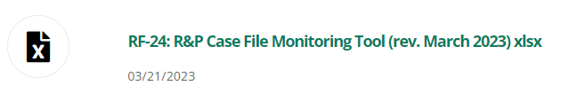
Other Useful Resources
Support with determining delays & required services for Social Security Cards, Post-Arrival Transfer cases, and Out-Migration cases:
MRSConnect
Resettlement Services
Reception and Placement (R&P)
3
USCCB/MRS Social Security Application and Follow-Up Workbook (rev. March 2023)
4
USCCB/MRS RF-24 R&P Case File Monitoring Tool (rev. March 2023)
Social Security Service Delay Determination
Post-Arrival Transfer Cases
Out-Migration Cases

Slide 21
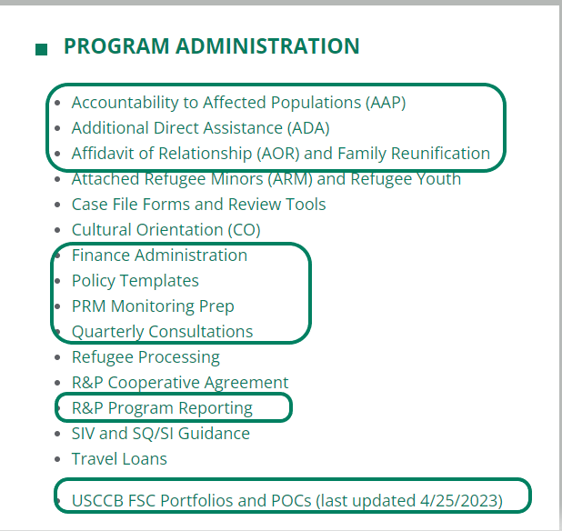
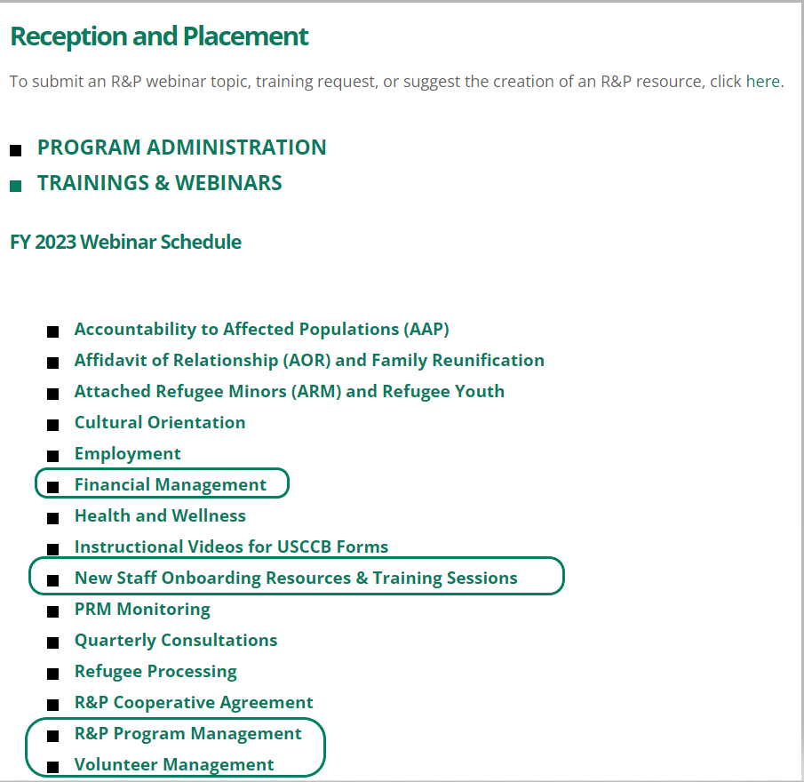
Useful Tabs for Program Managers

Slide 22

Questions?
Please add questions to the Q&A box or raise your hand.

