Slide 1


March 8, 2023
Updated Social Security Card Procedures in FY2023 CA

Slide 2
We could launch this right away as a regular Zoom poll
and people can answer as they sign in.
This slide would be deleted.)
Are Social Security Cards arriving on time for your agency?

Slide 3





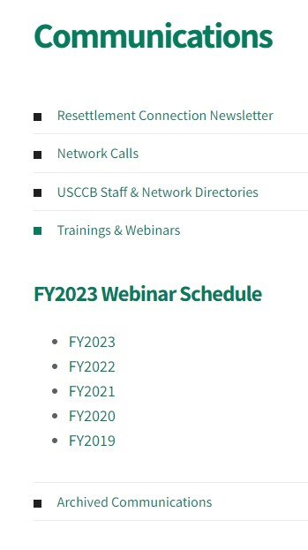
After the Webinar
Slides & Notes
Recording

Slide 4
How we'll communicate today:
Questions in the Q&A box
Comments and thoughts in the Chat

Slide 5


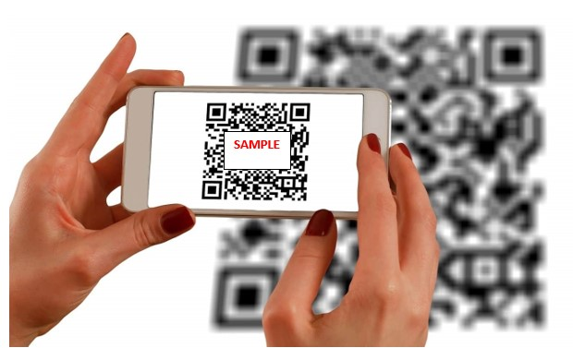
How we'll communicate today...
Use your phone to communicate during the webinar.
Would you answer our question?
  No app necessary!
  Answers will appear on screen
  Answers are anonymous by default.

Slide 6


What issues are you having with Social Security Cards?
ⓘ Start presenting to display the poll results on this slide.

Slide 7


Presenters
Sarah Evans
Assistant Director, R&P
Ciara Bennese
R&P Field Support Coordinator

Slide 8
Learning Objectives
By the end of this webinar, you will be able to:
Understand how to use MRIS to determine relevant case information for Social Security card follow-up;
Describe the three application/follow-up procedures for Social Security Cards described in the FY23 R&P Cooperative Agreement;
Explain how to document Social Security card application/follow-up in the R&P case file

Slide 9
Documents to Know
EAD Receipt Notice
Social Security Card (SSC)
Also called the Form I-797C, this is a notice of action from the USCIS, and in the case of refugee cases, this is a notice of a forthcoming Employment Authorization Document (EAD).
An official document that has a person's Social Security Number (SSN), which is a unique identifier used by the SSA. The card acts as official documentation of the SSN.
P1 EAD Receipt Notice Example
Visa 93 EAD Receipt Notice Example

Slide 10
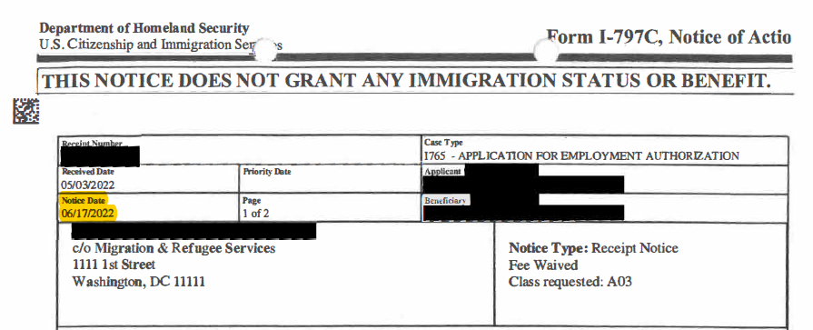
Documents to Know
This is the top portion of the EAD Receipt Notice, redacted for PII purposes
Note the highlighted "Notice Date," this is the date referenced throughout this training

Slide 11
Documents to Know
USCCB has asked PRM and USCIS to confirm where on the EAD Receipt Notice you can locate the confirmation of whether or not a Visa 93/Follow-to-Join case has requested the SSC ("Affiliates should check the USCIS EAD Receipt Notice to verify if the SSC was requested.") USCCB/MRS will send out the answer in Resettlement Connection!

Slide 12
Or, we could put this question here.
This would be a regular Zoom poll versus a Slido.
Are Social Security Cards arriving on time for your agency?

Slide 13

Approximately how long is it taking for your agency to receive EAD Receipt Notices?
ⓘ Start presenting to display the poll results on this slide.

Slide 14
What issues are you having with EADs/EAD Receipt Notices?
ⓘ Start presenting to display the poll results on this slide.

Slide 15
Section One: Determining Case Type Using MRIS

Slide 16
Using MRIS to Determine Case Type
Agencies can use MRIS to determine the case type by looking at the case's Bio Data Acceptance Form
The case designation is in the field titled "Priority" and will either say P1, P2, P3, SV, 93, or PR (new priority type – parolees approved for walk-in R&P benefits)
If you have any questions about case designation/case priority, agencies should contact their assigned Pre-Arrival Case Manager (PACM)

Slide 17
Different Case Designations
P1: Individual referrals by a US embassy/UNHCR/NGO
P2: Group referrals of specific groups by certain criteria
P3: Family reunification of designated nationalities via AOR
SV: Special Immigrant Visa holders; Amerasians
93: Follow-to-Join family reunification via I-730
PR: Parolees approved for walk-in R&P benefits

Slide 18
Different Case Designations
P1: Individual referrals by a US embassy/UNHCR/NGO
P2: Group referrals of specific groups by certain criteria
P3: Family reunification of designated nationalities via AOR
SV: Special Immigrant Visa holders; Amerasians
93: Follow-to-Join family reunification via I-730
Scenario #1
Scenario #2
Scenario #3
"PR" cases – will need assistance to apply for EAD* (*and possibly to schedule biometrics appointment) and SS card

Slide 19
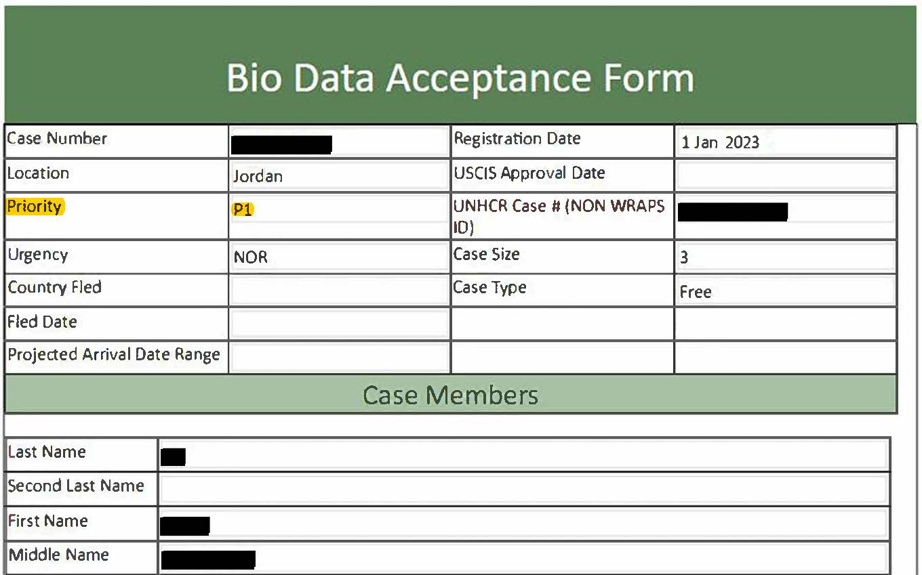
BioData Example: "P1"

Slide 20
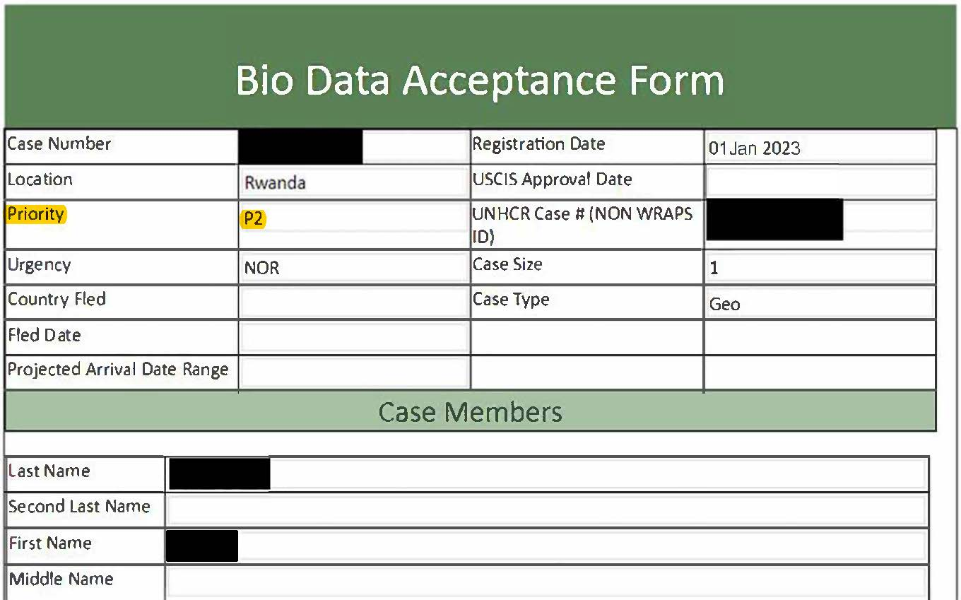
BioData Example: "P2"

Slide 21
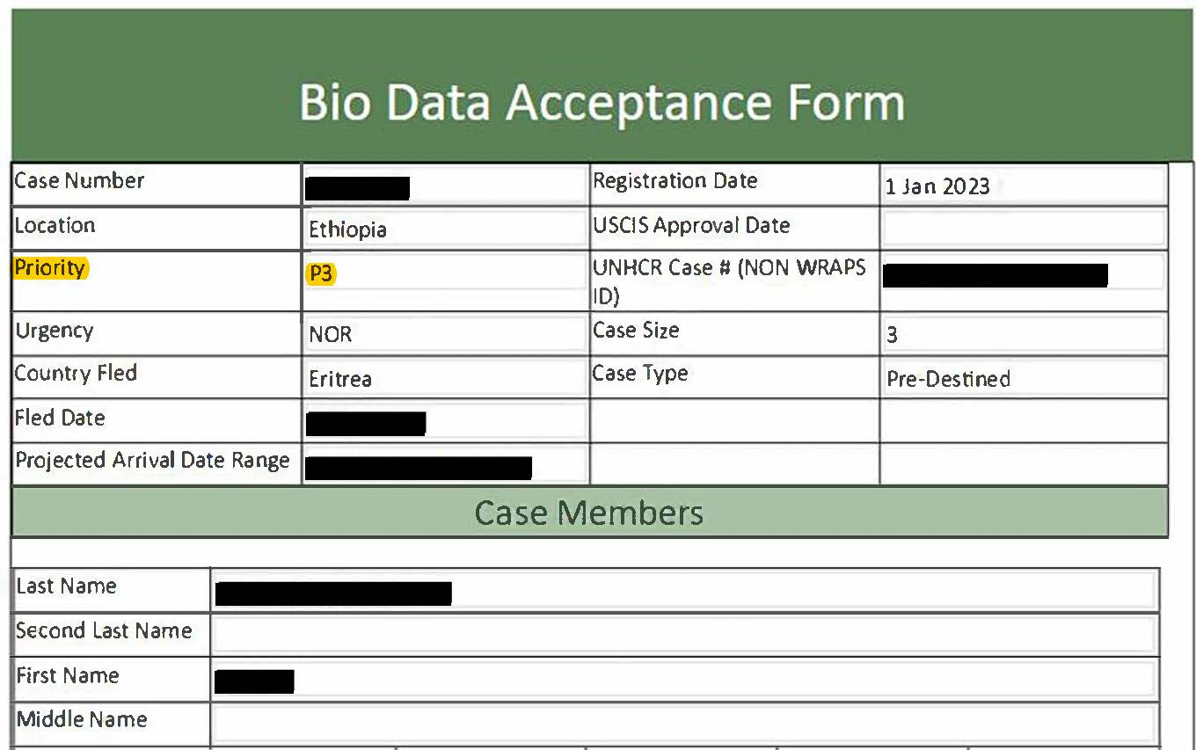
BioData Example: "P3"

Slide 22
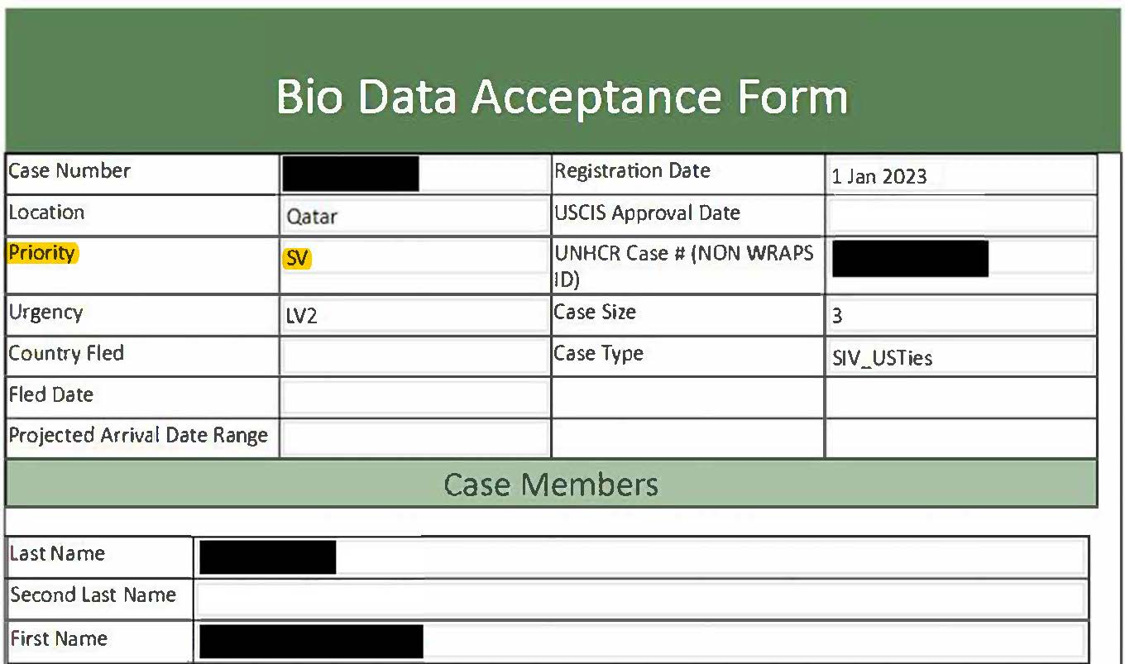
BioData Example: "SV"

Slide 23
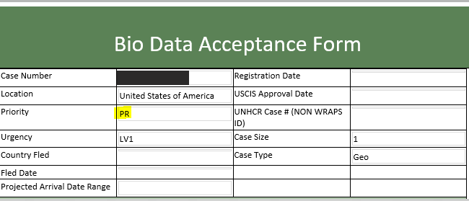
BioData Example: "PR"

Slide 24
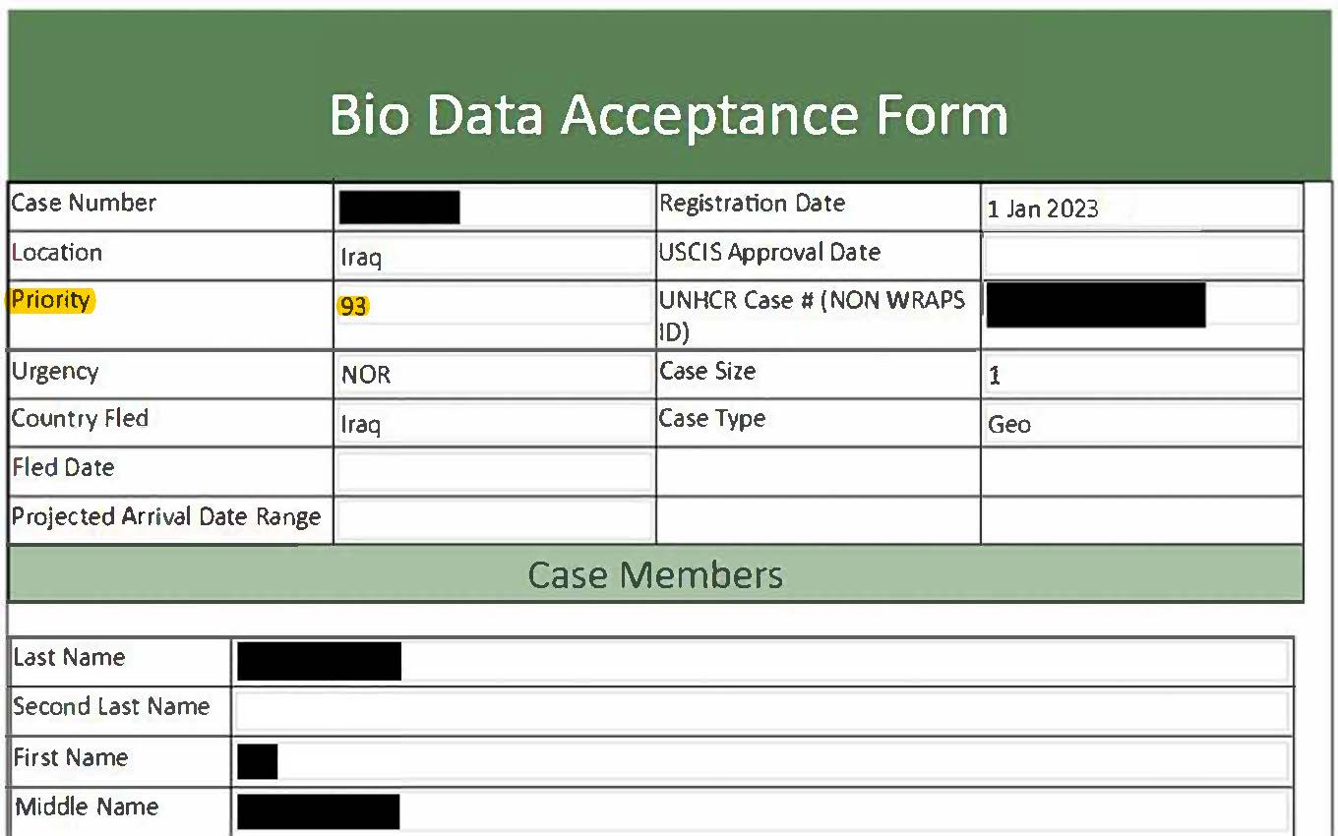
BioData Example: "93"

Slide 25
Section Two: The 3 Kinds of Procedures

Slide 26
Phrases to Know
"Notice Date"
This date is listed on the EAD Receipt Notice (see highlighted date on the example form)
This is the date the communication was generated by USCIS – it also represents the date the client information was fully entered into USCIS’ system/transmitted to SSA

Slide 27
Scenario #1: Refugees (P1/P2/P3)
“a. Refugees: Social Security Cards (SSCs) should be received by mail within 14 working days after the Notice Date on the Employment Authorization Document (EAD) Receipt Notice from USCIS. The EAD Receipt Notice should arrive via mail within three (3) weeks after the date of domestic arrival. If the SSC is not delivered by 14 working days after the Notice Date on the EAD Receipt Notice, affiliates should contact the local Social Security Field Office within three (3) working days either to schedule an appointment or to directly follow up and consult whether a new application is necessary." - FY2023 R&P Cooperative Agreement (pp. 35-36)

Slide 28
Scenario #1: Refugees (P1/P2/P3)
Timeline:
Case arrives (domestic date of arrival or DDOA = the date they arrive in their city of resettlement)
EAD Receipt Notice should arrive by mail within 3 weeks of DDOA
Case manager locates the Notice Date on the EAD Receipt Notice
Agency waits 14 working days after the Notice Date for the Social Security Card (SSC) to arrive by mail
If the SSC does not arrive by the 14th working day from the Notice Date, the agency has 3 working days to contact the local SS Field Office

Slide 29
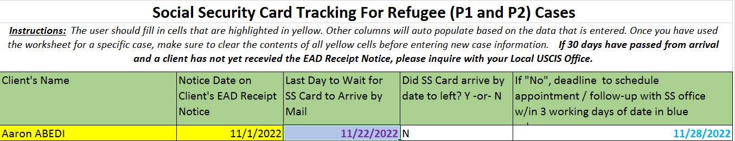
Scenario #1 (Refugees): Example
DOA for this example is 9/14/2022
11/1/2022 is manually entered in the first box – this is the Notice Date on the EAD Receipt Notice
This generates 11/22/2022 and 11/28/2022, giving agencies a timeline to expect the SSC or follow-up
11/22/2022 is 14 working days from the Notice Date and is the last day to wait for the SSC to arrive by mail
If the SSC has not arrived by mail within the 14 working day timeframe (by 11/22/2022), the agency will have 3 working days (until 11/28/2022) to contact the local SS Field Office

Slide 30
Scenario #2: LPRs (SIVs, Amerasians)
“b. LPRS (SIVs, Amerasians): SSCs should be received by mail within three (3) weeks after the date of domestic arrival. If the SSC is not delivered within this timeframe, affiliates should contact the local Social Security Field Office within 3 working days either to schedule an appointment or to directly follow up and consult whether a new application is necessary;" - FY2023 R&P Cooperative Agreement, p. 36

Slide 31
Scenario #2: LPRs (SIVs, Amerasians)
Timeline:
Case arrives
EAD Receipt Notices are not mentioned for LPRs – these clients do not need EADs/EAD Receipt Notices upon arrival, since their LPR status grants them work authorization
Agency waits to see if SSC arrives via mail within 3 weeks of arrival*
If the SSC does not arrive within 3 weeks of arrival, agency has 3 working days to contact the local SS Field Office
*PRM has clarified: for SIV clients who apply for walk-in R&P benefits, the 3-week waiting period for their Social Security card will start on their date of arrival, not their date of assurance for walk-in benefits – for LPRs, this process is tied to their arrival, not their assurance date
There could be a gap of several weeks between arrival and assurance, and the card could have gone to an old address – document all follow-up!
USCCB has asked PRM to confirm whether 3-week waiting period is based on int’l or domestic DOA

Slide 32
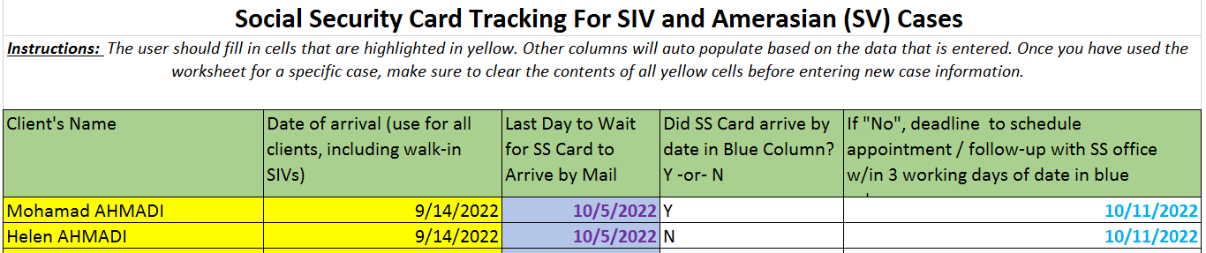
Scenario #2 (LPRs): Example
DOA for this example is 9/14/2022
10/5/2022 is autogenerated as 3 weeks from date of arrival, this is the last day to wait for the SSC to arrive by mail before taking action
10/11/2022 is 3 working days after 10/5/2022 and the deadline for agencies to contact the local SS Field Office if the SSC did not arrive by 10/5/2022

Slide 33
Scenario #3: Visa 93/Follow-to-Join (FTJ)
“c. Visa 93/Follow-to-join cases: These cases are facilitated by either RSC Africa, RSC Asia, or various Consular Sections, thus, the I-765 completion process may vary. Affiliates should check the USCIS EAD Receipt Notice to verify if the SSC was requested. If the SSC was requested, the card should arrive within 14 working days after the Notice Date on the EAD Receipt Notice. If the SSC was not requested, affiliates should contact the local Social Security Field Office within 3 working days either to schedule an appointment or to directly follow up and consult whether a new application is necessary." - FY2023 R&P Cooperative Agreement, p. 36

Slide 34
Scenario #3: Visa 93/Follow-to-Join
Timeline:
Case arrives (domestic date of arrival or DDOA = the date they arrive in their city of resettlement)
EAD Receipt Notice arrives approximately 3 weeks after domestic arrival (may vary)
Agency checks EAD Receipt Notice for confirmation that the SSC has been applied for
  If SSC was applied for, agency waits 14 working days from the Notice Date on the EAD Receipt Notice
  If SSC was not applied for, the agency should contact the local SS Field Office within 3 working days
USCCB has asked PRM to clarify:
The language on the EAD Receipt Notice that will tell us whether or not the client has requested their SSC
“If the SSC was not applied for, the agency should contact the local SS Field Office within 3 working days” – within 3 working days of what date?
Are we seeing big delays between the Notice Date + the date the case manager is physically reviewing the Receipt Notice (what USCCB has sometimes called “Reviewed Date”)?

Slide 35
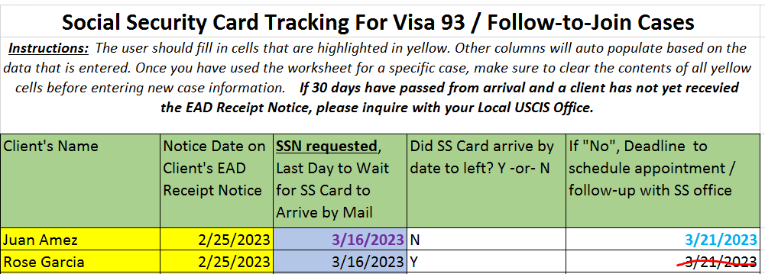
Scenario #3 (Visa 93/FTJ) Example (Part 1)
SSC Was Applied For:
For this example, we are looking at a case where it was clear, from the EAD Receipt Notice, that the SSC was requested by these clients
3/16/2023 is 14 working days from the Notice Date on the EAD Receipt Notice (2/25/2023 for this example); this is the last day that agencies should wait for the SSC to arrive by mail before taking action
3/21/2023 is 3 working days after 3/16/2023 and the deadline for agency staff to contact their Local SS Field Office to file a new application or inquire on the card's status if the SSC did not arrive by 3/16/2023
Note that for Rose Garcia, since her SS card arrived by 3/16/2023, the agency would not need to follow up with the SS office (assuming there is no issue/error with Rose’s card); since her son Juan’s SS card did not arrive by 3/16/2023, the agency would need to follow up by 3/21 on Juan’s card

Slide 36
Scenario #3 (Visa 93/FTJ): Example (Part 2)
SSC WAS NOT Applied For:
USCCB has asked PRM to clarify:
The language on the EAD Receipt Notice that will tell us whether or not the client has requested their SSC
“If the SSC was not applied for, the agency should contact the local SS Field Office within 3 working days” – within 3 working days of what date?
Are we seeing big delays between the Notice Date + the date the case manager is physically reviewing the Receipt Notice (what USCCB has sometimes called “Reviewed Date”)?
Once USCCB/MRS has more clarification on this language, we will provide an example in Resettlement Connection!

Slide 37
Section Three: Case File Documentation

Slide 38
Scenario #1: Refugees (P1/P2/P3)
To achieve compliance in documenting the SSC process, the case file must contain all of the following:
Documents (for each case member, as applicable):
Case Notes:
Case note indicating receipt/review of EAD Receipt Notice
Case note if the SSC does not arrive on time
Case note if staff contacted the Local SS Office and all related happenings (application, case inquiry result, delays, receipt of card)
Case notes that each step in the process has been discussed with the client(s) with appropriate language interpretation
Copy of USCIS EAD Receipt Notice
Record of SSN
Copy of application or application receipt if the SSC needs to be applied/re-applied for
Copies of any relevant emailed/mailed communications related to this process

Slide 39
Scenario #2: LPRs (SIVs, Amerasians)
To achieve compliance in documenting the SSC process, the case file must contain all of the following:
Documents (for each case member, as applicable):
Case Notes:
Record of SSN
Copy of application or application receipt if the SSC needs to be applied/re-applied for
Copies of any relevant emailed/mailed communications related to this process
Case note indicating the timeframe of waiting for the SSC
Case note if the SSC does not arrive on time
Case note if staff contacted the Local SS Field Office and all related happenings (application, case inquiry result, delays, receipt of card)
Case notes that each step in the process has been discussed with the client(s) with appropriate language interpretation

Slide 40
Scenario #3: Visa 93 (Follow-to-Join)
To achieve compliance in documenting the SSC process, the case file must contain all of the following:
Documents (for each case member, as applicable):
Case Notes:
Case note indicating receipt/review of EAD Receipt Notice
Case note that SSC was or was not applied for
Case note if the SSC did not arrive on time
Case note if staff contacted the Local SS Field Office and all related happenings (application, case inquiry result, delays, receipt of card)
Case notes that each step in the process has been discussion with the client(s) with appropriate language interpretation
Copy of USCIS EAD Receipt Notice
Record of SSN
Copy of application or application receipt if the SSC needs to be applied/re-applied for
Copies of any relevant emailed/mailed communications related to this process

Slide 41
Contacting Relevant Offices
Missing EAD Receipt Notice
When a refugee/Visa 93/Follow-to-Join client's EAD Receipt Notice does not arrive within 3 weeks of their domestic arrival date, USCCB recommends that agencies follow up with USCIS directly.
You can contact USCIS by finding your Field Office at the bottom of this webpage or calling the USCIS Help Line at 800-375-5283.
Missing SSC
When a refugee client's SSC does not arrive when expected, USCCB recommends that agencies contact their local SS Field Office.
You can identify you local SS Field Office by using this webpage or calling the SSA Help Line at 800-772-1213.

Slide 42

Questions?
Please add questions to the Q&A box or raise your hand.

