Slide 1
Essential Steps of the Case Management Process
February 22, 2023

Slide 2
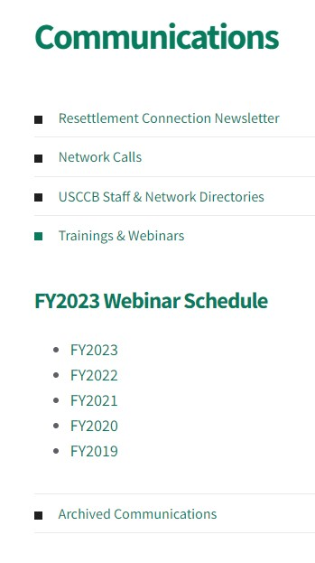
After the Webinar
Slides & Notes
Recording

Slide 3
How we'll communicate today:
Questions in the Q&A box
Comments and thoughts in the Chat

Slide 4
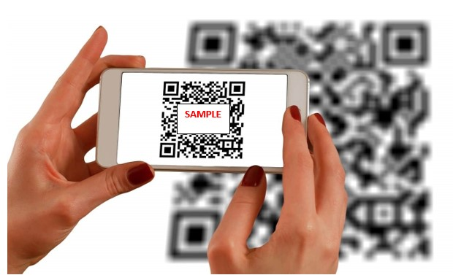
How we'll communicate today...
Use your phone to communicate during the webinar.
Where are you joining from today?
No app necessary!
Answers will appear on screen
Answers are anonymous by default.

Slide 5
Where are you calling in from?
ⓘ Start presenting to display the poll results on this slide.

Slide 6
Introduction
Amy Krach, Refugee Child Protection Coordinator, will be your facilitator today.

Slide 7
Overview
Today we’ll discuss:
Goals of Case Management
Strengths Based Case Management
Case Management Process Best Practices:
Initial Engagement
Assessment
Planning
Facilitation
Tracking and Evaluation
Termination

Slide 8
Learning Objectives
Understand how to apply a Strengths-Based perspective to your work as a Case Manager
Know the stages of the Case Management Process and your roles in each stage
Learn some best practices to improve effectiveness in each stage of case management

Slide 9
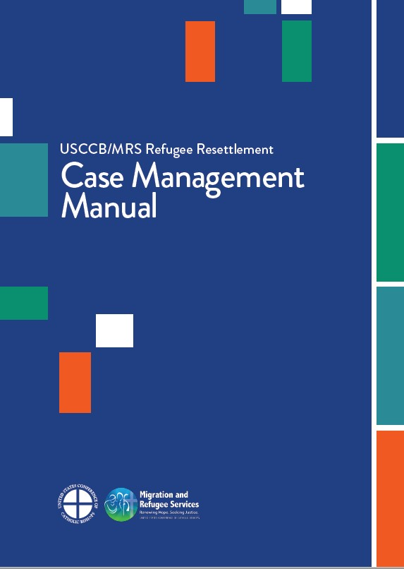
Today’s content is based on USCCB’s newly-released Case Management Manual
Copies coming your way
MRS Connect

Slide 10
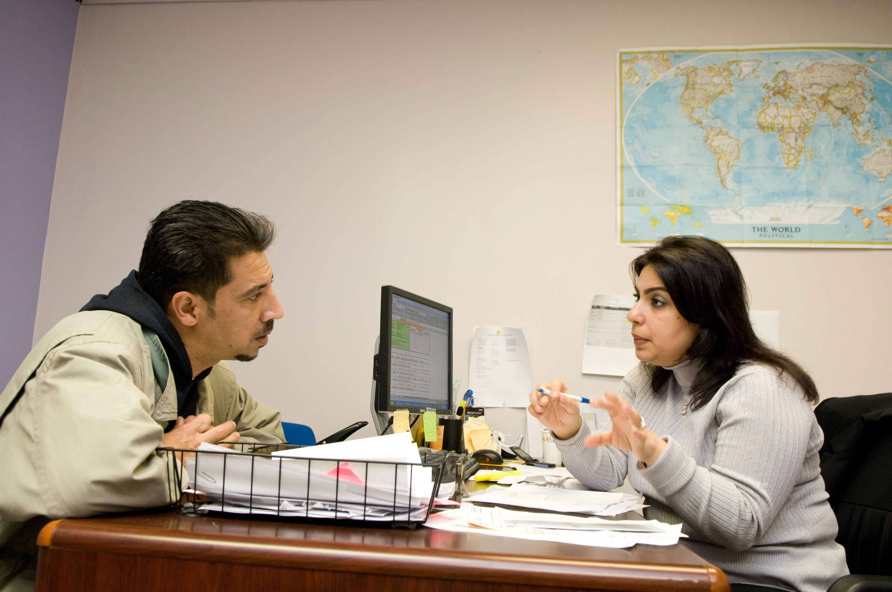
What is Case Management?
"Case Management is a collaborative process which: assesses, plans, implements,
co-ordinates, monitors and evaluates the options and services required to meet an individual's health, social care, educational and employment needs, using communication and available resources to promote quality, cost effective outcomes." - UK Case Management Society

Slide 11
Goal of Case Management
To promote overall client well-being and autonomy through the development of support networks including:
Self-care:
Individual client skill development
Professional care:
Involving professional service providers
Mutual care:
Involvement of client's social network
Notes:
Reminds us that we’re never operating alone as a case manager – working in partnership with client and other providers. While, at first, you may take on a greater portion of the work, the ultimate goal of your case management practice should be to leave clients with the confidence and skills to support themselves and continue to seek support from various service providers and their social network.
So the further along we are in our services, typically the less we would be responsible for as we develop these different support networks.

Slide 12
Strengths-Based Case Management

Slide 13
Strength-Based Case Management
All people have strengths to overcome adversity
People are experts of their own experiences
Emphasizes the capabilities and strengths of a client rather than just needs. Strength-based case managers believe:
Every person's environment has strengths
Hopefulness matters
Notes:
If we’re focusing only on needs or problem areas, In turn, that's what a client is going to see in themselves and their situation which can be really overwhelming. So we're helping reframe our and our client's viewpoint to look for the many traits of a client and their community that are going to help them succeed. This does not mean that we deny or minimize problems and struggles, but rather that we're acknowledging those struggles with empathy at the same time that we're encouraging existing strengths to overcome these struggles.
Every individual, family, and community has inner resources and strengths - Case managers can identify, encourage, and support growth of strengths. Strengths should be identified in client assessment, incorporated into service planning and goal setting, and encouraged throughout the service period .
There are resources in the client's community and environment that can be used to support their needs and case managers can help identify and facilitate access to those resources.
People are experts of their own experiences - Collaboration is the only way of working with clients – case managers are client's supporters, not leaders. We always want to encourage and support them in doing as much as possible for themselves, and then we're stepping in to fill in any gaps.
Hopefulness matters – a case manager holds hope for their client and can help clients hold hope for themselves. The ability to hope for the future will help a client even when they are meeting many challenges.

Slide 14
Benefits to the Strength-Based Approach
Goal-oriented and helps clients see how they can succeed
Honors a client's unique assets including culture
Empowers client to see themselves as in control
Helps to form a trusting partnership
Notes:
It's important to take this approach because in a new, challenging situation, it can be more difficult for a client to recognize and utilize their own strengths.
Goal oriented and helps a client to identify steps to success by thinking about their internal strengths and external resources available to them, and how those will support their goal achievement
We want to celebrate each client's uniqueness including their culture and background and help clients to see how those different unique aspects will help them achieve their goals in their new community.
This approach helps remind clients that they are the ones in control. We should help them feel empowered to set their own goals and work towards them, and we are there to accompany and offer support in that journey.
Lastly, we are demonstrating that we respect a client's uniqueness and we believe they have the right and abilities to determine their own future, and this respect and appreciation we show helps with building a trusting relationship and helps the client to remember that we take a team approach to our work.

Slide 15
How to assess client strengths
Formal and informal methods
If a client has trouble identifying strengths:
Reframe problem to focus on client's potential
What would others say your strengths are?
How have you gotten through past difficulties?
Provide your own observations
Think of strengths holistically
Skills, abilities, and talents
Education and employment experiences
Interest areas/ hobbies
Relationships and community connections
Mindset, attitude, resilience
Beliefs: spiritual, cultural, etc.
Ability to ask for help
Notes:
R&P service plan – assessment section has a section related to strengths
Interest areas – what something you enjoyed doing in your home country? What's something that captures your interest? What's something that brings you joy? - could be cooking or playing a sport or gardening. Hobbies and interests can be essential coping mechanisms in stressful situations and engagement with these interests can support overall well-being. But also could be utilized in finding a job or helping a client build community (cooking for a job in food industry; joining a soccer or sport team for building a social network)
Relationships – both current and potential. What are potential ways the client could form social connections in their area – and this is where thinking about what they are interested in can be helpful and also if there are opportunities for the client to connect with a cultural or faith community of similar background.
A client's mindset can be hugely helpful in our work together. All of our clients have encountered many difficulties and persevered in their journey and that's essentially what it means to have resilience. So we want to affirm client's resilience and remind them how much they've overcome so they can see that strength in themselves.
Spiritual and religious beliefs and practices can be a huge source of hope and strength for many people.

Slide 16
A pause for questions.

Slide 17
The Case Management Process

Slide 18
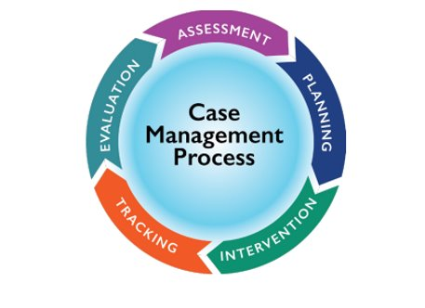
Case Management Process
The cycle of case management includes:​
Initial Engagement​
Assessment​
Planning​
Facilitation​
Tracking and Evaluation​
Termination

Slide 19
Initial Engagement

Slide 20
Building a Trusting Partnership
Welcoming, empathetic, and warm presence
Treat a client as a person first, client second
Get curious: Approach each client as a learner
Be patient: trust takes time
Notes:
A trusting relationship throughout the case management process is key to engaging clients and earning buy-in. From intake to termination, provide clients with a confidential, understanding, and empathetic environment to share their stories, concerns, and feelings.
We are an essential part of client's integration and some of the first impression clients have of their new community and people in the US, so we want to make clients feel welcome and safe by presenting as warm, friendly, and empathetic. So we should responding to client's concerns with compassion, practicing reflective listening to show clients that they're understood, and helping clients to feel safe through a peaceful demeanor.
When building a relationship we don't want to jump straight into business mode without getting to know our clients a bit. So we should start our relationship and each session with some questions to get to know the client and get a sense of how they're doing to show we care about them as a person. So for example, asking a client about what they enjoy, about their family and important relationships, even as simple as learning their favorite dish from their home country.
We want to approach each client with curiosity. Only in learning more about their culture and background and values can we learn the best way of working together. We respect that a client's culture and any previous traumatic experiences are going to impact our work together, and so we try to be aware and understanding of these areas in particular. Taking the stance of a learner helps us to avoid making assumptions about clients and encourages us to get to the root of what's going on with a client.
Be patient: It may take time for a client to trust you and your agency, and we may need to frequently remind clients of their rights and work to uphold these rights.

Slide 21
Introduce Role and Set Expectations
Provide an accurate picture of:
"My job is to help you access the support and services you need to feel secure, supported, and prepared to meet your needs in your new community. Our work together will last for X months. We will work together to determine the resources, services, and information you need for self-sufficiency. We will then make and carry out a plan which will include responsibilities for me, you, and other community connections. These are the hours I can communicate via phone or email. I may not be able to respond right away, but will try to get back to you within 1-2 business days. I will visit you in your home to start, but will ask you to come into the office more soon."
Process of working together
Required program services and priorities
Program time frame
Communication methods
Client rights and responsibilities

Slide 22
Assessment

Slide 23
Assessment Process
Steps of Assessment:
Complete client intake to determine eligibility for services
Establish eligibility and accept the individual for services
Complete comprehensive assessment including:
Client’s self-care capacity and human service needs
Client’s social network and its capacity to meet client’s needs
Service providers and community resources and their capacity to meet client's needs
Notes:
Determination of eligibility into various programs is often already completed when a case is assured to your agency. But you will be assessing whether a client is eligible and a good match for long-term case management programs and what social services they are eligible for.
Typical service providers, but also think about how volunteers or community organizations such as faith communities could play a role.

Slide 24
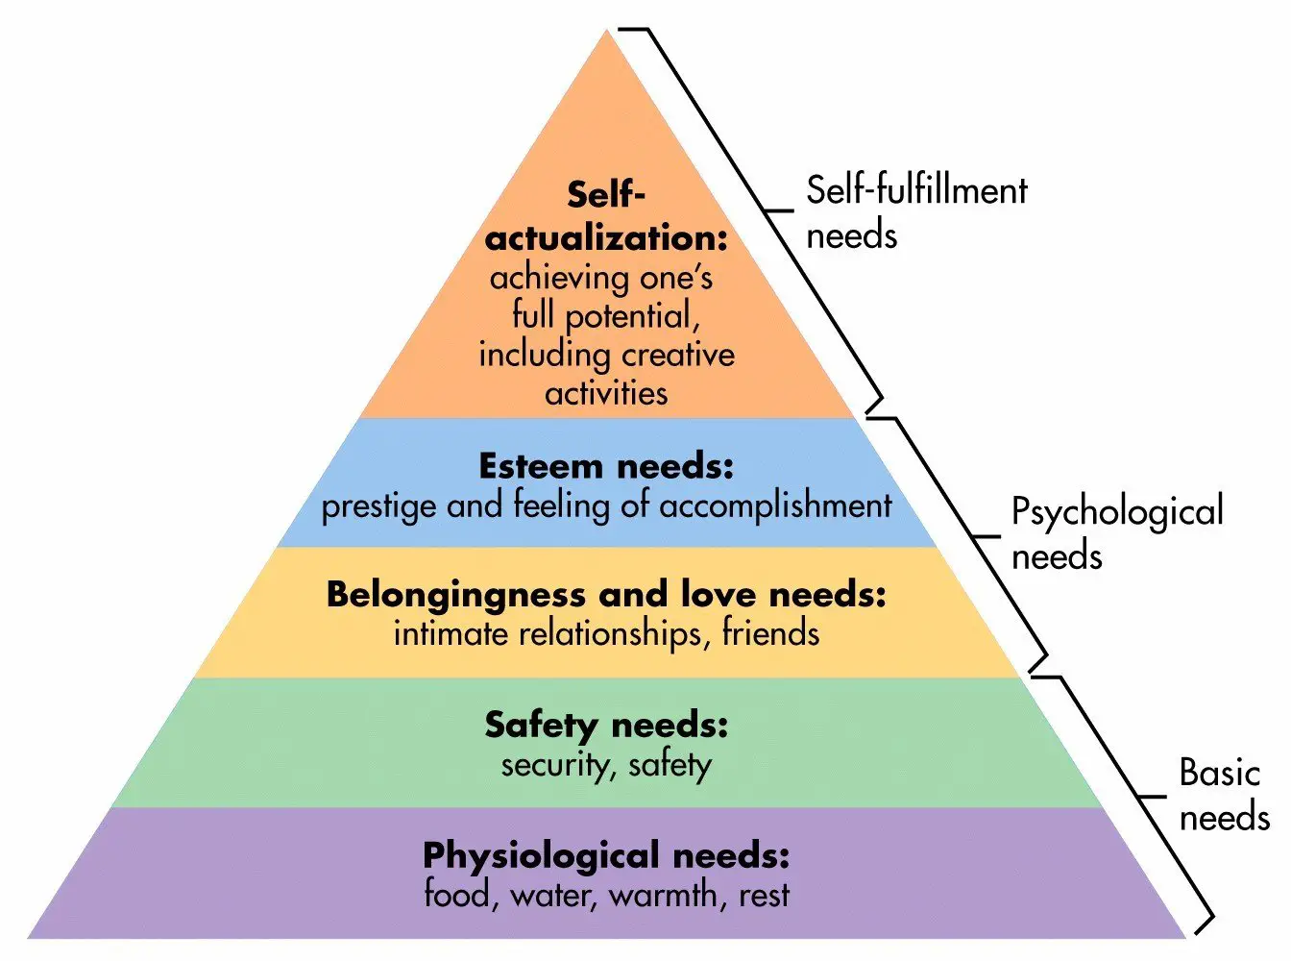
Assessments – What to Consider
Assess: What are the needs and which are priorities?​
Access: What are the client's internal and external resources and how can they be utilized?​
Triage: When is a situation outside of our scope or expertise?
Notes:
Assessing needs is essential to inform a thorough service plan. But of course we also know that we likely will not be able to resolve all needs and desires during the service period, so we want to begin to work with clients to prioritize needs – this process will continue as you're developing the service plan. A needs assessment should be thorough, so whether you're using the R&P service plan assessment or one specific to your agency we should be assessing all areas that contribute to self-sufficiency ranging from basic needs such as housing, food, clothing, household items, and health and mental health status, to education needs and goals, English abilities, employability, understanding of US laws and culture, immigration legal needs and more. Some of these needs will naturally have to be prioritized as they fit into required program services, but beyond that we may need to work collaboratively with clients to prioritize needs. One way to help clients prioritize needs when they have many is by using Maslow's hierarchy of needs as a framework. This framework suggests that meeting basic survival and safety needs such as shelter, food, and appropriate healthcare then allows individuals to focus on psychological needs such relationships and belonging in a community and also esteem needs or having a feeling of accomplishment perhaps through work or education. Finally, one can focus on achieving their full potential such as through seeking a more fulfilling career or engaging in creative activities. So this is a basic framework of how to think through needs prioritization, but that's not to say that some of these goals couldn't be pursued at the same time - for example you could be helping the client to develop community connections and supports from early in the service period even as you're working to address more basic needs like housing and employment.
Access to internal and external resources. So we're assessing for strengths like we talked about before, which clients may need some help with. We're also thinking about resources in the client's community so for example if they have a US tie that can offer support or if you have very dedicated volunteers that can offer support in specific areas for the client.
Triage – there may be specialized needs that are pressing but that we can't meet directly on our own. Examples are health or mental health issues, substance use, disabilities, serious family conflict, or other vulnerabilities and risk factors. Because these impact a client's most basic needs for safety and survival they are going to impact client's abilities to accomplish all other goals. Therefore, these needs to be addressed first and foremost and they will most often requires internal or external referrals to agencies and individuals that can offer specialized support for these needs. We wants to ensure these unique needs are addressed as soon as possible so we should be aware of available services in our community such as counseling services for mental health or substance use, and in some cases we might need to advocate for clients to ensure the urgency of a referral is understood and a client can be accepted for appropriate services right away.

Slide 25
Service Planning

Slide 26
Client Considerations in Planning
Values: what clients consider most important
Mindset and Attitude: client's feelings about a given situation
Skills: Level of various abilities that support self-sufficiency
Ability and Willingness to Accept Help
Other Strengths
Notes:
Service plan should be informed by various client attributes -
Values: Get a sense of what clients consider the most important as these will likely be the goals they want to focus on. As much as possible, beyond providing core services, we would want to prioritize the areas that are most valuable to a client.
Attitude: Some clients may have very positive outlooks, while others may have trouble remaining hopeful, and these clients might need some extra words of encouragement.
Skills: Some clients might have abilities that they will be able to accomplish much more on their own with less support from us. We want to encourage clients in utilizing as many of these skills as possible and only step in to fill gaps as needed. So we don't want to assume and just do something for a client – which is why we'll decide with clients who will be responsible for different service tasks.
We also have to cater our services based on a client's ability and willingness to accept help. And then as much as possible we want to be encouraging the growth of other strengths identified in assessment.
An understanding of all these factors will help us create with the client a service plan that prioritizes what's most important to the client (to the extent possible) and also provides the appropriate level of support for meeting different client needs.

Slide 27
Developing the Service Plan
Together with client, prioritize needs and identify strengths​
Describe required services to clients. Consider how/ whether program requirements meet client needs​
Outline how needs will be addressed through service delivery​
Create (with and not for the client) goals and broken-down objectives​
Reach understanding and agreement on the roles and responsibilities of all involved
Establish timeframes for goal achievement
Develop and sign contract​
Adjust as needed throughout the service period
Inform clients of various options to give sense of choice
Help the client to practice customs that preserve cultural identity
Create SMART goals
Keys to success:
Notes:
Our programs have required services that we must complete. Many agencies have documents that help you to readily explain core services to clients. Educate a client about how these services will meet their needs. If there are any needs that go unaddressed, you can explain to a client that you're there to first help meet the most pressing needs for the client's well-being and self-sufficiency but you will do your best to support other goals directly as time allows or at least attempt to provide referrals for something that falls outside of the core program services.
Going over with the client the specific steps needed to achieve a goal. To involve client in goal setting it can be helpful to ask about their knowledge in an area including experiences with similar systems in their home country. For example, what to they know about health services here and how did they access health services in their home country – you can compare this with what the process will be like in the US and discuss skills they already have and also new knowledge areas/ skills you will need to work on together.
When establishing timeframes, it can also be helpful to start to create a schedule or calendar for clients so they can see when various meetings or service activities will be completed. You can continue to add to this through the service period.
What are goals vs. Objectives. Goals are the broader, big picture ideas of what a client wants to achieve. Objectives are goals broken down into smaller pieces – so the steps needed to get to the goal. Objectives should be SMART so we want them to be specific or detailed, we want to be able to track or measure them, they should be attainable within the service period, relevant to client's underlying goal of achieving self-sufficiency, and there should be an end date by which the goal will be achieved.

Slide 28
Service Plan Contents
Goals and objectives for increasing well-being
Service activities and expected outcomes​
Who is responsible for each activity​
Dates for actions to be completed ​
Schedule of time and place for certain activities​
Signature of case manager and client
Notes:
Who - Client, Case Manager, or other social networks (US Ties, Volunteers, etc.)
Identification of any social networks expected to participate

Slide 29
Gas is off.
Bill pay process
Get gas turned back on
Large gas bill to pay
Client Scenario
Let’s look at:
Who will do what when?
Meet the need by breaking it down into small steps.
Large bill
Gas disconnect notice
Notes:
To illustrate some of the other roles, we are going to go through a client scenario. A client's gas has been disconnected and they are not sure about the bill pay process, but of course they want to get it back on as soon as possible. When we're planning with a client how to handle this, you may be involved in different ways with the process depending on the client's abilities and supports.

Slide 30
Service Plan SMART Goals
Specific, Measurable, Attainable, Relevant, Timebound
Notes:
Here’s an example of SMART goals. We have an overarching goal with a final completion date and very specific action steps on how to get there. Case Manager is more heavily involved in this scenario and then plans to give the client the chance to do it on their own for the next month but will follow up to ensure it was completed successfully.

Slide 31
Facilitation

Slide 32
Facilitation
Facilitation Roles
Information Specialist
Linking & coordinating services
Advocating for clients
Educator
CMs facilitate completion of activities that support client goals
Roles and involvement vary depending on client skills and supports
Notes:
Next, we’ll look at the different roles and use the client scenario with the gas bill to see how each role is carried out. With each of these roles, you will have a different level of involvement.

Slide 33
Information Specialist
Strategies
Become familiar with local resources
Learn resource eligibility
Internal resource list
Review resources in staff meetings
Learn referral and service process
Develop relationships with agencies
Divide and conquer
Invite outside agencies to present
Notes:
The more you know about local resources and service providers the better you'll be able to serve each client's unique needs and the easier your job will become as you'll be able to be more efficient with making referrals. In the gas bill example, we want to be familiar with the providers and processes so we can best help the client.
Become familiar with local resources through our own research of local agency handouts, web databases, etc. and collaboration with other staff.
Learn requirement for eligibility: Newly arrived clients may not meet requirements for accessing certain resources. Example: If a clients want to enroll immediately in university classes, CM should assess whether the client can realistically enroll in classes (considering constraints related to finances, language ability, residential status, etc.)
Learn referral and service process: this is often a learn by doing area, but we want to make note of our process so we can share with other staff.
Develop and maintain relationships with agencies -For example, finding a key contact that has been helpful and staying in touch with that contact at organizations such as state welfare agencies, health clinics, and schools.
A best practice is having an existing internal resource list that contains information about local resources and details on how you can help a client to access them. Collaborate with other staff to develop this.
Review resources: What resources are you using and which work really well? Any new resources that have been discovered? Any referrals that were not completed or there were communication challenges?
So many resources to stay on top of, so it can be helpful to divide up resource knowledge by area and have different staff focus one area such as medical resources, transportation resources, education resources, etc.
Invite outside agencies to present – helps us to get a better understanding of their offerings, referral process, and supports relationship development

Slide 34
What are some ways your agency stays on top of local resources? (Staff meetings, resource list, divide and conquer, agency presentations, other ideas?)
ⓘ Start presenting to display the poll results on this slide.

Slide 35
Educator
Determine skill needs
Explain process
Demonstrate process
Let client practice
Evaluate client’s understanding
Money order
Locations
How money orders work
Where you can pay
Sample money order
Practice on sample
Complete actual money order
“Teach Back”
Client reviews process
Notes:
In the example plan we wrote before, we were in the educator role. We noticed that the client needed to learn some skills to be able to take care of their gas bill.
Determine the skills a client needs to learn: see they are unsure about how to complete a money order and where to go.
Explain the process in detail: how money orders work and informing the client of options of where they can pay
Demonstrate the process: we show them how to put the skill into practice.
Allow the client the opportunity to practice with our oversight and direction if needed.
Evaluate client's understanding – have them teach the skill back to you and correct/ clarify as needed

Slide 36
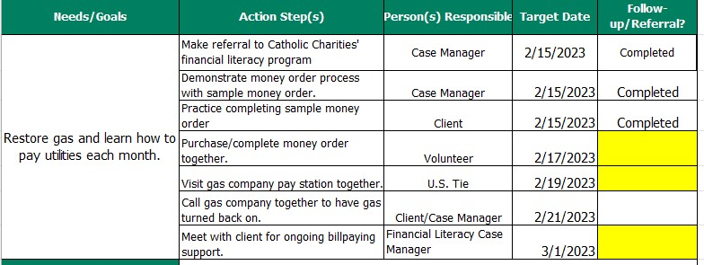
Linking and Coordinating Services
Support first interaction
Share information
Assure tasks are completed
Document Steps
Ensure client understands referral
Ensure connection
For referrals
Notes:
Another major role in the facilitation stage involves linking clients to services and resources and coordinating to ensure all services are delivered appropriately and on time. In the gas bill example, we might add in some other people in the client’s network to assist, so we are a little less directly involved. We’ll just follow up on the yellow boxes.
When linking clients to a new service provider or volunteer or program, as needed, we provide support for the first interaction (such as assisting with paperwork or accompanying the client to their first appointment). We also may need to share client information and collaborate with the service provider with the client's permission. This could include information about the unique needs of your client/ nature of their situation. This area is especially needed when working with volunteers and mentors from the community or other agencies not accustomed to working with refugees. Check in to assure tasks are completed. Document each step of this process to have a written record of follow-up and show that the client was served
Ensure client understands what the referral was for to emphasize the importance of following through and check in to make sure a referral was accepted, and figure out with the client what is needed to ensure they are able to access services and meet those needs.

Slide 37
Advocating for Clients
Advocacy helps ensure clients have equitable access to services (within your agency or in the community)
Effective advocacy can include:
As needed, involving those in positions of authority to help resolve issues
Supporting a client in seeking culturally appropriate services
Working within an organization's existing structures to raise an issue
Consulting first with those responsible for service delivery
School must provide interpretation
Does school have a grievance process?
Start closest to student
Escalate to supervisor and school admin
Notes:
Advocacy is especially needed if a service provider is not responsive to a client’s needs. But advocacy can be done within your organization, too. As a direct service provider, you bring unique knowledge to the table that can help make your organization better. For example, if you're noticing a pattern of a gap in services, you should bring this to your supervisor and to staff meetings to problem-solve together. Or if you're knowledgeable on a particular culture, you could share a training on how best to serve that community of clients.
One example is that schools are required to provide any information related to a child's education in a language that parents can understand. So if you knew this was not happening, you could advocate for your client by starting closest to the student – could be reaching out to the child's teacher or if you have another contact in the school – we want to do this respectfully and assume that this was a mistake and not an intentional disregard for the client. Throughout this process you would want to keep your supervisor aware and if the your first line of contact does not respond, you may ask them to step in for support to go up the chain of command, taking the matter to school administration or even if needed, to your local school board.

Slide 38
A pause for questions.

Slide 39
Tracking & Evaluation

Slide 40
Tracking
To track client's progress: identify indicators and develop a tracking timeline
Purpose of tracking: to ensure service delivery is effective and timely
Additional client needs that arise
Essential tracking areas:
Progress towards goals and objectives
Progress of others involved in service delivery
Services provided and how they addressed client’s needs
Notes:
To track client's progress toward goals, Case Managers should identify indicators during the planning phase and develop a tracking timeline. For example, it could be looking at the indicators on your own every week and reviewing them biweekly with a client. The service plan is meant to be a living document so checking in regularly is key.
These essential tracking areas inform whether the service plan needs to be altered to meet client's needs.

Slide 41
Tracking Methods
Informal tracking: Assessing progress by communicating with and observing clients, social network members, and service providers
Formal tracking: Using tools to gather information and to evaluate outcomes of the planned intervention
Example: Case File monitoring tools
Example: 30-Day Knowledge Check
Notes:
Informal tracking is what you're doing the most as a case manager - Information is obtained from individuals and case records. We want to regularly check in directly with our client, looking back at the service plan to monitor progress and reevaluate as needed. We also should be communicating with other service providers and involved parties such as U.S. ties and volunteers when they have designated action steps in the service plan to ensure they have completed those actions.
Example would be the MRS Case File Monitoring tools to ensure you have met program requirements for services and documentation.
Another example being utilized by one of our site uses a tool they developed to check in on client's understanding of different important topics at the 30-day mark. The case manager goes through a series of statements with the case manager to verify that they understand essential topics, like what to do in case of an emergency, their need to adjust their status to permanent residents in a year, that they can’t drive a car without a license, etc. Using some tools like this can help add some structure and agency-wide consistency to tracking.

Slide 42
Evaluation
Reflecting on what went well and any challenges and barriers to service delivery
Client satisfaction
Areas to assess:
Attainment of goals
Effectiveness of case management services
Gaps in services
What went well and what didn't
Example:​​
Goal: Attend follow-up health appts.
Gap: Transportation access
Solutions: Medicaid taxi education, volunteer support, public transit practice
Notes:
Formal evaluations of programs are usually not being carried out by case managers, and evaluation may not be an area you feel you have much time to focus on. But taking time to reflect on what went well and what the challenges were to service delivery is key to improving your own service delivery methods and identifying gaps in services or challenges that might need to be addressed by the whole program.
Were the goals achieved? If not, why?
Gaps in services: If you identify unmet needs and challenges, you want to discuss with your team of how you and the whole staff can best fill in the gaps.
Effectiveness of case management services: Did all parties make a positive difference in the areas of identified need?
Client satisfaction: We are not typically delivering client satisfaction surveys but we should still be checking in with clients about what they are finding helpful in our work together and if any issues are arising? We want to encourage clients to be honest and open with us and when they complete client satisfaction surveys, because their honesty helps us to improve our services for all clients.
What went well and what didn't - for example identifying service providers that could accept referrals right away and were easy to communicate with or an area that you found volunteer support helpful. You want to make note of this for yourself for future reference, but also sharing these with other staff so that they can incorporate your learnings into their work.
For example: If a client attends their initial health screening but you realize they were frequently not making it to follow-up appointments after initial screening, you want to assess what could have been done differently to prevent this. You realize that transportation was the biggest barrier for this client. So that's something to bring up at your staff meeting or to your supervisor and you could discuss the best ways to provide additional support in this area and troubleshoot together to find solutions such as providing further education on use of the Medicaid taxi, utilizing volunteer support for the first few rides, or practicing using public transit together for this route. So a case manager might need extra resources for this or someone else in the agency may be able to carry out some of these tasks.

Slide 43
Termination

Slide 44
Termination for a Smooth Transition
Final meeting protocol:
Share and remind about resources available
Review and affirm progress
Say goodbye
Finalize referrals for ongoing needs
Transitioning client to new program:
Encourage client's relationship with new CM
Provide essential client info
Facilitate an introduction
Continue communication with new CM as needed
Introduce concept of termination early and reinforce
Notes:
Say goodbye – honor the relationship that you’ve built. Find your own process that feels right – I know with the clients I worked with, I wrote them a letter at the end of our time together to say goodbye and to affirm the progress I had seen them make.

Slide 45
Recap
Today we discussed:
Goals of Case Management
Strengths Based Case Management
Case Management Process Best Practices:
Initial Engagement
Assessment
Planning
Facilitation
Tracking and Evaluation
Termination

Slide 46
What’s next?

Slide 47
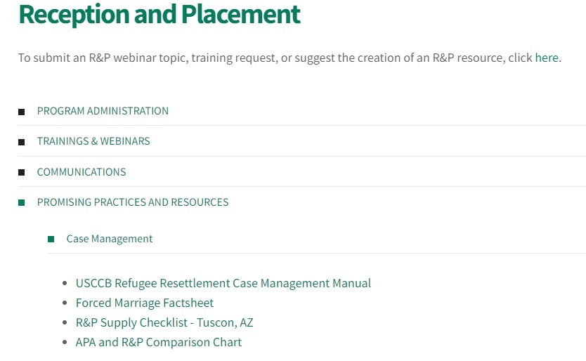
Continue Learning!
Check out our Case Management Manual on MRS Connect to go more in depth on these topics.

Slide 48
Continue Learning!
Join us for another essential Case Management Webinar on March 16
“Best Practices for Writing Effective Case Notes”
Registration link will be in the Resettlement Connection!

Slide 49
Questions?
Please add questions to the Q&A box or raise your hand.

