Slide 1

Family Reunification:
Overview of the AOR (Affidavit of Relationship) Programs

Slide 2
Presenter:
Alice Ngamije
Program Coordinator, Family Reunification
USCCB - MRS
angamije@usccb.org
Phone: 202-541-3327

Slide 3

Learning
Objectives
Screen individuals and advise them on their family reunification/AOR options
Know the different eligibility requirements for P3, FSU, RIF and CAM AORs
By the end of this webinar, you will be able to:
Identify common mistakes made when filing AORs and how to avoid them

Slide 4
Agenda
1
Key Terms
5
P2 FSU and RIF Iranian Lautenberg AOR programs
2
Family Reunification Overview
6
Common mistakes when filing AORs
3
P3 AOR program
7
Available Resources
4
P2 CAM AOR program
8
Q&A

Slide 5
Key Terms
AOR
Affidavit of Relationship: refers to the application itself or the program
US-Tie (or Anchor): initiates the application process through a local resettlement agency
UST
Refugee Processing Center: contracted by the Department of State to provide guidance on filing AORs and vet submitted AORs (P3 and CAM)
QP
Qualifying Parent (or Anchor): the petitioner for CAM program, initiates the process in the US through a local resettlement agency
RPC
FSU
Former Soviet Union (include countries like Ukraine, Belaru, Moldova…)
RIF
Refugee Information Form, another name for the Iranian AOR application
Resettlement Support Center: Overseas processing agency for refugees in a given region. EX: RSC Africa, RSC Asia, RSC Latin America etc.
PA
Principal Applicant: listed on the AOR as the primary individual with a qualifying relationship to the UST/Anchor. Typically the head of household
RPC

Slide 6
Family Reunification
Overview
Family Reunification is a recognized process for many eligible individuals based in the US to petition for family members/relatives overseas, with the goal of reunification. An Affidavit of Relationship is an application that allows for the reunification process to take place. Family reunification (FR) programs under the US Refugee Admissions Program that qualify for Reception and Placement (R&P) services:
P3 AOR
P2 FSU AOR
P2 IRANIAN AOR
P2 CAM AOR

Slide 7
P3 Program
Overview
The P3 AOR program provides a means for those who entered the US as a refugee, SIV recipient, or were granted asylum, to apply on behalf of eligible family members overseas for the purpose of family reunification.
FY 2021
President Biden issued a revised Presidential Determination and expanded eligibility to all nationalities, including stateless persons.
Special Immigration Visa (SIV) status included as eligible.

Slide 8
P3 Program
The Anchor (petitioner):
18y/o or older
Refugee
Asylee
Special Immigrant Visa (SIV) holder
Must apply within 5 years of arrival in the US/since status was granted
Program open to all nationalities
Qualifying Family Members (overseas applicants listed on the AOR)
Spouse
Parents
Unmarried children under 21 y/o
Must be located outside country of origin
Must have valid refugee or asylee Proof of Registration (POR)
Notes:
In cases where siblings are under 21y/o, unmarried and still in the care of a parent, they can be added as derivatives of the parent, as long as the parent is listed as a Qualifying Family Member on the AOR.
P3 applications aren’t generally processed in-country.
For Example: if an Afghan SIV anchor wants to apply for his wife, the spouse would have to be outside of Afghanistan and be registered as a refugee in her current country of residence.
Note: Parole is not an eligible legal status, therefore Afghan parolees are not eligible for P3

Slide 9
P3 Program
Proof of Registrations (POR) exceptions and Country of Residence Restrictions:
QFMs in the following countries do not have to provide PORs:
USRAP is currently not processing P3 AORs for those refugees residing the following countries:
Pakistan, Malawi, Mauritius,
Mozambique, Benin, Ghana,
Liberia, Mali, Senegal, Sierra Leone
Syria, Iran , Turkey, Yemen,
Bangladesh, Libya, Canada,
Norway, any EU member country

Slide 10
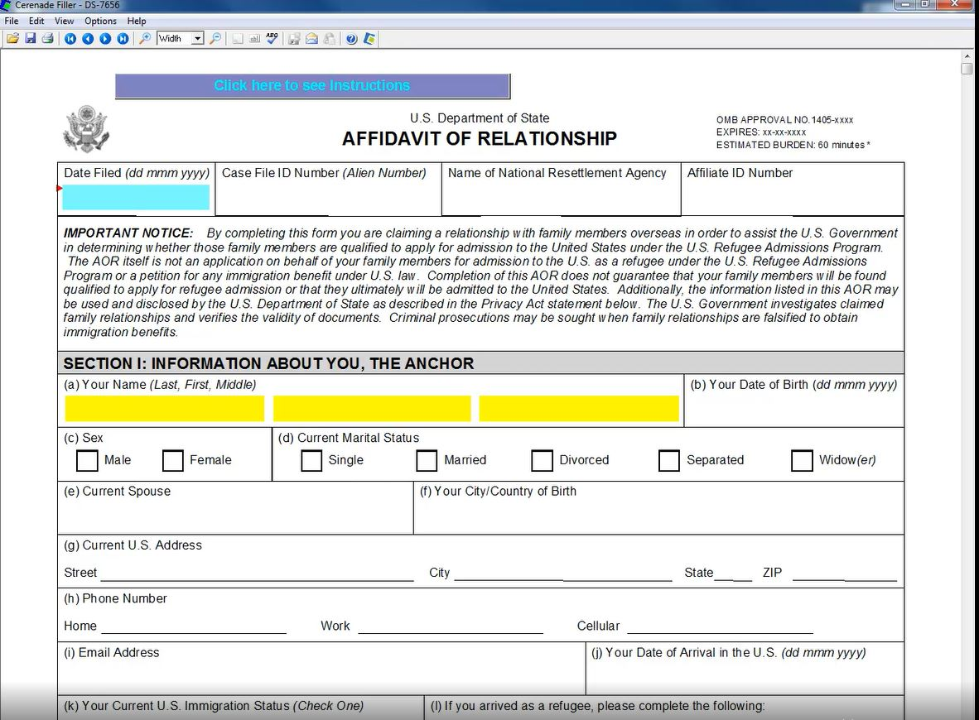
P3 AOR:
Form DS-7656

Slide 11
Completing a P3 AOR
Use the latest version of Form DS 7656 (.far file format)
Must be fully typed, including signature page
Must be completed in Cerenade Filler, then saved as a PDF file (download Cerenade filler here)
Email AORcommunication@usccb.org to request a copy of the DS 7656 form

Slide 12
Central American Minors (CAM) Program
Overview
Established in November 2014
Provides a legal pathway for eligible individuals in the United States to claim a relationship with their eligible children and relatives for the purpose of family reunification
Program closure in 2017
March 2021
Reopening of the program in two phases
- Phase 1: reopening eligible old CAM cases
- Phase 2: accepting new CAM AORs

Slide 13
CAM Program
US-based Qualifying Parent (QP) must be:
18 years old or older
Lawfully present in the United States (example: Lawful Permanent Resident/LPR ; Parole ; Temporary Protective Status/TPS ; Pending Asylum applicant..)
Eligible relationship with QCH
Qualifying Child (QCH)
Unmarried
Under 21 years old
Nationals of El Salvador, Guatemala, and Honduras
Must reside in one of the Northern Triangle countries above
Notes:
Full list of eligible legal status for CAM:
Lawful Permanent Resident (LPR)
Temporary Protected Status (TPS)
Parole
Deferred Action (DACA)
Deferred Action (Non-DACA)
Deferred Enforced Departure
Withholding of Removal
Pending U Non-Immigrant Applicants (pending status acquired before May 15th 2021)
Pending Asylum Applicants (pending status acquired before May 15th 2021)
This list is also available on MRSconnect AOR page, with examples of various documents a QP can show to prove their status
Eligible Relationships between QP and QCH: biological, legal guardian, adoptive, and step relationships
A child who is already in the US cannot be eligible to submit a new CAM application. We’ve had cases where a CAM application was submitted to us, then we were informed that the child had crossed the border into the US. Unfortunately in cases like that, the CAM processing can no longer continue since the child is already in the US.

Slide 14
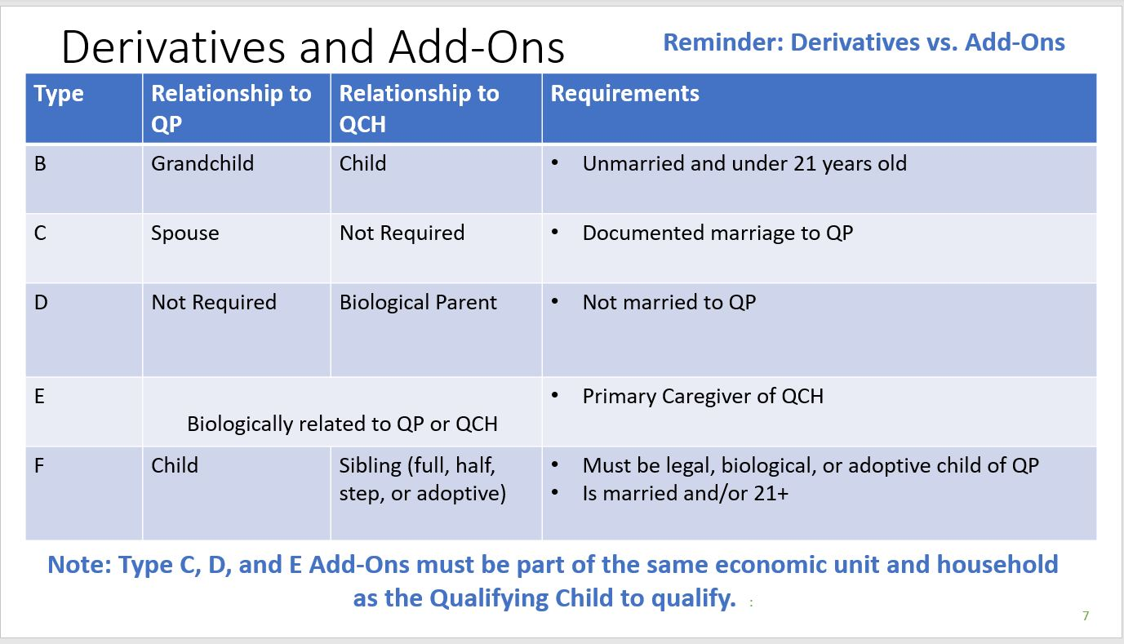
CAM Program
Notes:
Aside from the QCH, additional family members can be added on a CAM AOR:
QCH’s child
QP’s spouse (type C)
QCH’s other biological parent (Type D)
QCH’s caregiver (type E)
siblings of the QCH who are married or over 21 (type F)

Slide 15
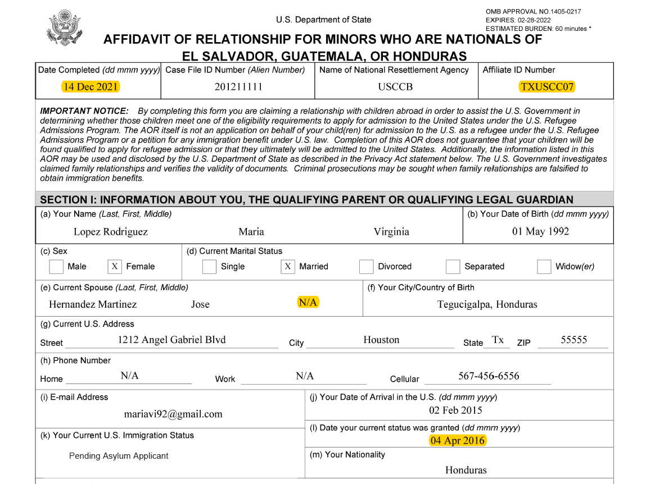
CAM AOR: Form DS-7699

Slide 16
Completing a CAM AOR
Use the latest version of Form DS 7699 (.far file format)
Must be fully typed, including signature page
Must be completed in Cerenade Filler, then saved as a PDF file (download Cerenade filler here)
Email AORcommunication@usccb.org to request a copy of the DS 7699 form

Slide 17
CAM Program
KIND (Kids in Need of Defense)
Organization devoted to the protection of unaccompanied and separated children.
KIND received PRM award to assist with CAM AOR filings.
Will work directly with qualifying parents and complete CAM AORs on behalf of affiliate
offices across all 10 national resettlement agencies.
Currently accepting referrals
Notes:
the recorded training on KIND referrals, available on MRS Connect.

Slide 18
Lautenberg Program
Overview
First Enacted in 1989
Provides a pathway for members of historically persecuted religious groups from Ukraine and other countries from the Former Soviet Union to be reunited with family members already living in the U.S. In 2004, the amendment was expanded to include religious minorities from Iran.
Must be extended annually for new applications to be submitted.
FY 2022
Reauthorized for last fiscal year in March 2022.
Submission deadline was September 30th 2022.
New Lautenberg applications are not currently being accepted.

Slide 19
Eligibility: US-Tie (petitioner)
FSU Lautenberg
RIF/Iranian Lautenberg
Must be 18 y/o or older
Legally reside in the United States as a:
Refugee
Asylee
LPR
US citizen
Must be a first-degree relative:
Spouse
Parent
Child
Siblings
Grandparent
Grandchildren
Must be 18 y/o or older
Legally reside in the United States as a:
Refugee
Asylee
LPR
US citizen
Has not filed more than two(2) RIFs for friends or non-immediate family members (cousins, aunts, uncles, relatives by marriage and/or distant relatives etc).”

Slide 20
Eligibility: Principal Applicant (overseas family member)
FSU Lautenberg
RIF/Iranian Lautenberg
FSU nationality/citizenship (including Ukrainian, Belarusian, Russian, Moldovan, etc)
Must have qualifying relationship with anchor
Part of qualifying religious/ethnic minority:
Jews (including Tats and Karaims)
Evangelical Christians
Ukrainian Greek Catholic
Members of the Ukrainian Autocephalous Church
Note: for Ukrainian Greek Catholic and Ukrainian Autocephalous Church, participation must have begun by 1989 and must have been public, active and continuous
Iranian nationality/citizenship. Must be a resident of Iran at the time of application
Can be a relative or friend of the anchor
Must be 18y/o or older
Part of qualifying religious/ethnic minority:
Christians
Jews
Baha’is
Zoroastrians
Mandaeans
Notes:
Full FSU Countries: Armenia, Azerbaijan, Belarus, Estonia, Georgia, Kazakhstan, Kyrgyzstan, Latvia, Lithuania, Moldova, Russia, Tajikistan, Turkmenistan, Ukraine and Uzbekistan.

Slide 21
Completing a FSU AOR
Use the latest FSU AOR Form (editable Word document, will be available on MRS Connect)
Must be fully typed
* Signature page: both handwritten signatures are electronic signatures are accepted, no preference

Slide 22
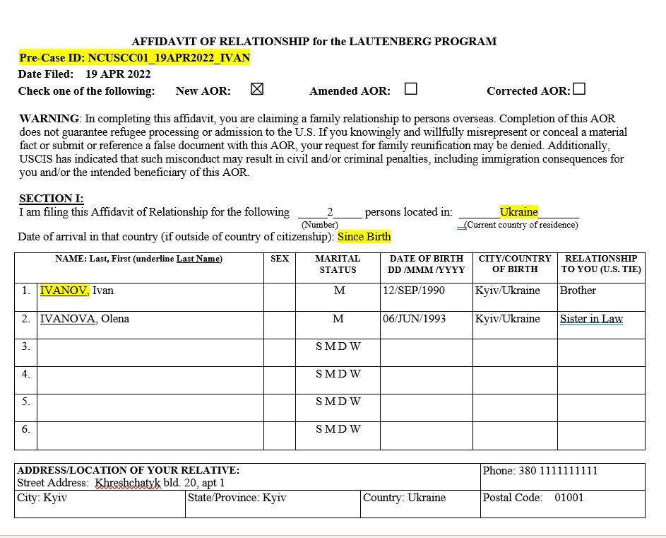
FSU AOR

Slide 23
Completing a RIF AOR
Use the latest RIF Application Form (fillable PDF, will be available on MRS Connect)
Must be fully typed
*Signature page: handwritten signatures are preferred (however, electronic signatures can also be accepted)

Slide 24
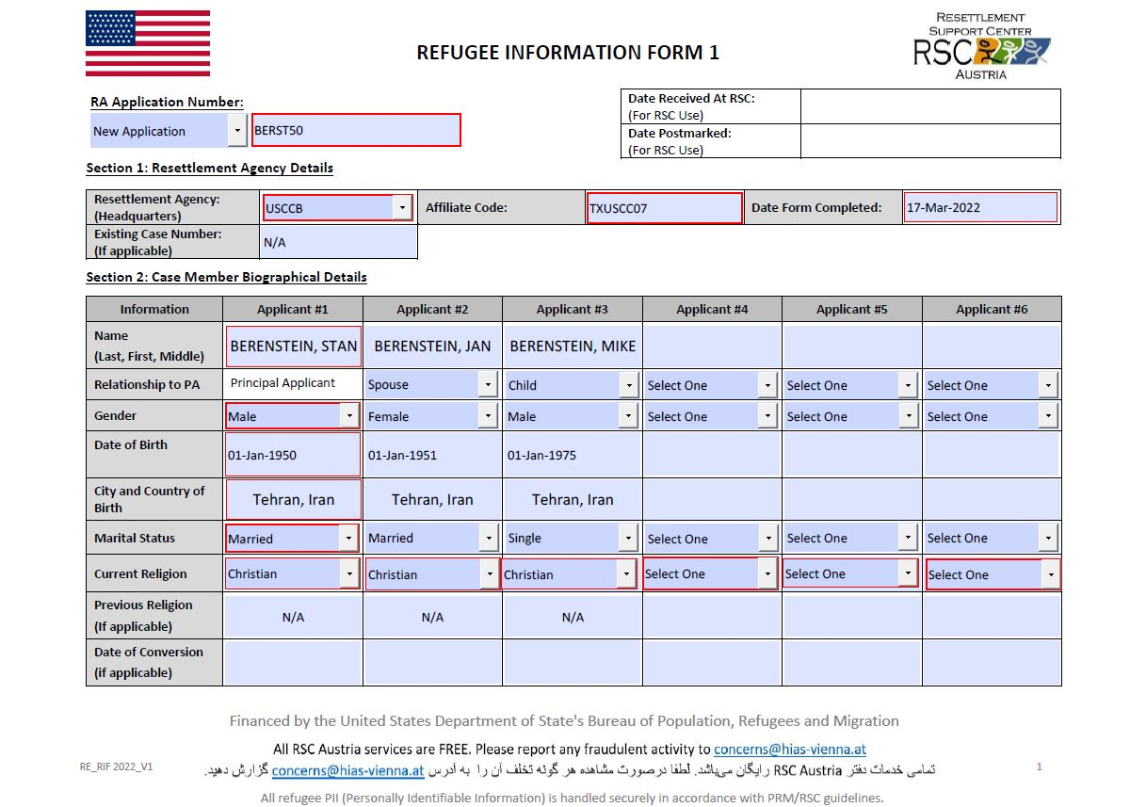
RIF AOR

Slide 25

Common Mistakes
on AORs
Tips to avoid them
Common Mistakes
Mistakes
Tips to avoid them
01
Name spelling errors
Always check and verify that name listed on AOR match with documents provided
If error is on document, provide a comment
02
Form not properly filled out/missing N/As
Review program resources to get familiarized with filling out AORs
If inapplicable, put N/A
03
Invalid supporting documents
Provide clear, legible documents, reduce glare in photos
Verify if documents are valid (non-expired)
04
Missing comments to explain a unique situation
Provide required comments (depending on the program)
Use space dedicated for explanations and comments for anything unusual

Slide 26

Available Resources &
Contact Information
MRSConnect Affidavit Of Relationship (AOR) page
KIND referral form link (for CAM program)
If you're having technical problems accessing/filling out/ submitting the KIND referral form, you can contact KIND’s toll-free number at +1 (855) 477-9998, or email them at solicitantesCAM@supportkind.org​
Afghan Family Reunification Information
Form DS-4317: reunification option for Afghan Parolees
USCCB contact for AORs
AOR Inquiries/questions: AORcommunication@usccb.org
AOR Submissions: AOR@usccb.org

Slide 27
January 19th, 2023
Thank you!
Notes:
We have come to the end of the presentation, if you have any questions about any part of the presentation, feel free to ask.
Thank you!

Slide 28

January 19th, 2023
Q&A
Notes:
We have come to the end of the presentation, if you have any questions about any part of the presentation, feel free to ask.
Thank you!

