Slide 1





Making the Most of
MG Resources

Slide 2
1
MG Program Operations Manual
Case cannot already be economically self-sufficient
MG Program Operations Manual
2
ORR Status and Documentation Guide
ORR Status and Documentation Guide
3
Case File Monitoring Tool & Addendum
Resources
4
Case File Form Templates and Translated Forms
Today we’ll review:
5
Enrollment Waiver Form & Instructions
6
MG Eligibility & Enrollment Workbook
7
MG Cash Allowance Workbook
8
Promising Practices & Resources
Promising Practices & Resources
9
New Staff Onboarding Sessions

Slide 3
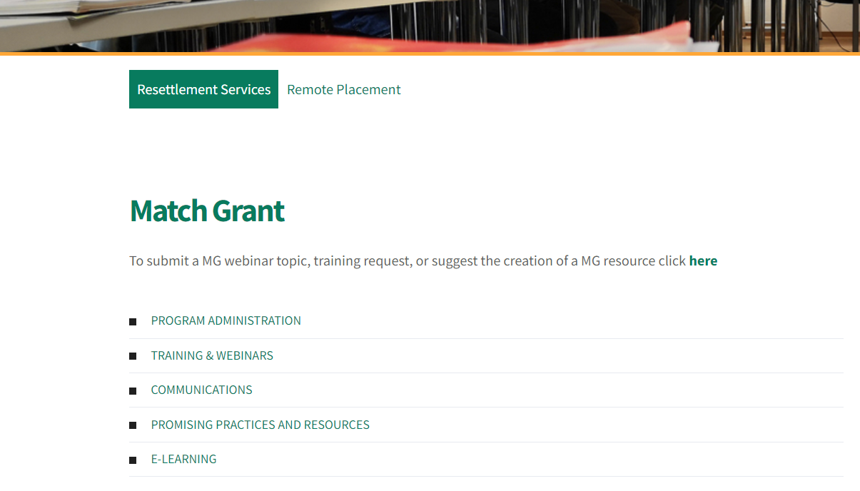
MG Page of MRSConnect

Slide 4
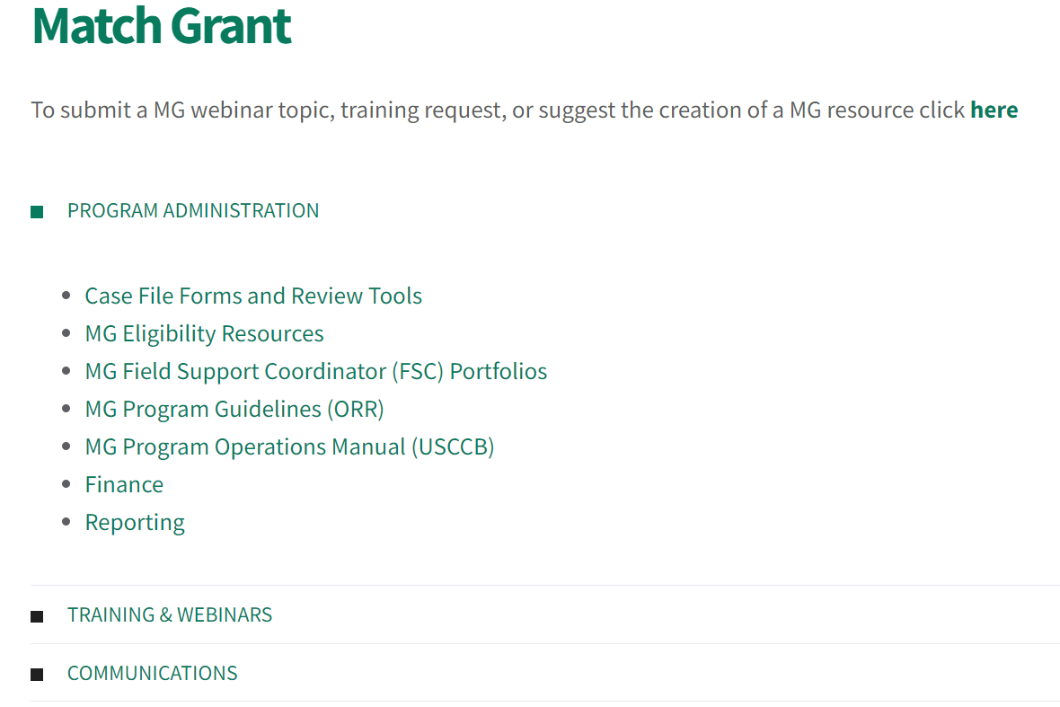
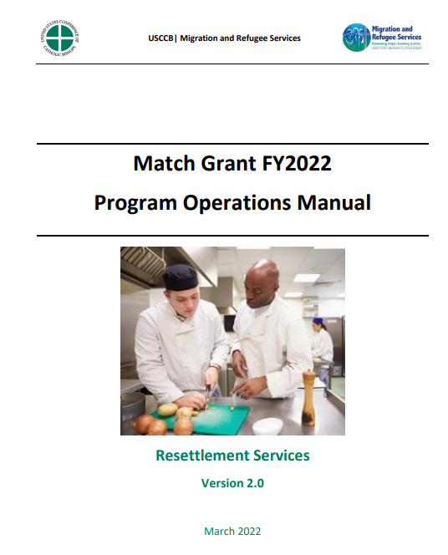
MG Program Operations Manual

Slide 5
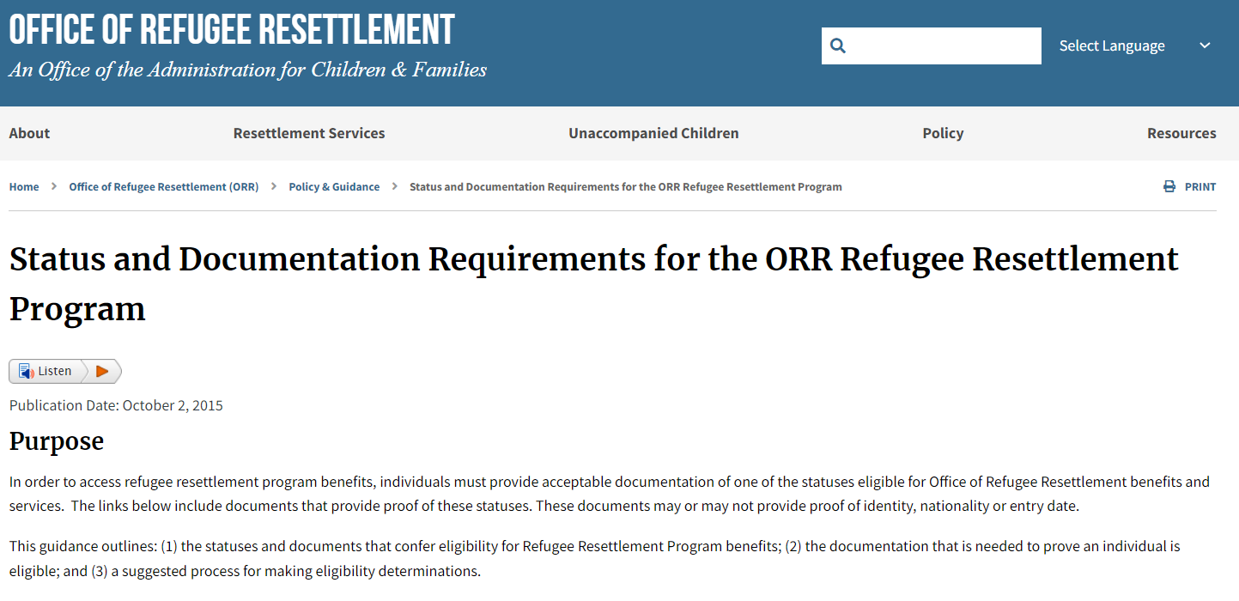
MG Eligibility Resources in MRSConnect
ORR Documentation Guide:
https://www.acf.hhs.gov/orr/policy-guidance/status-and-documentation-requirements-orr-refugee-resettlement-program

Slide 6
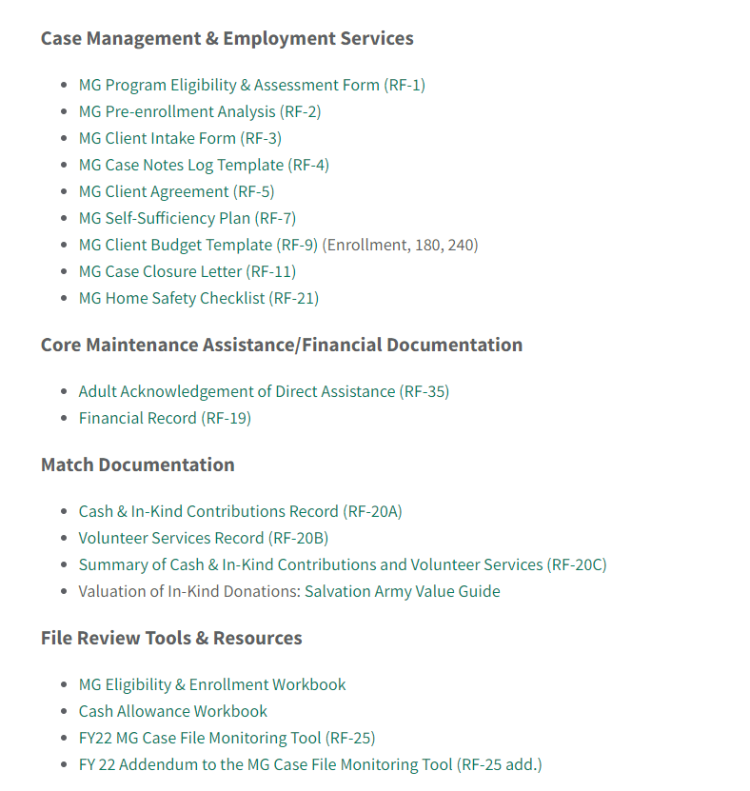
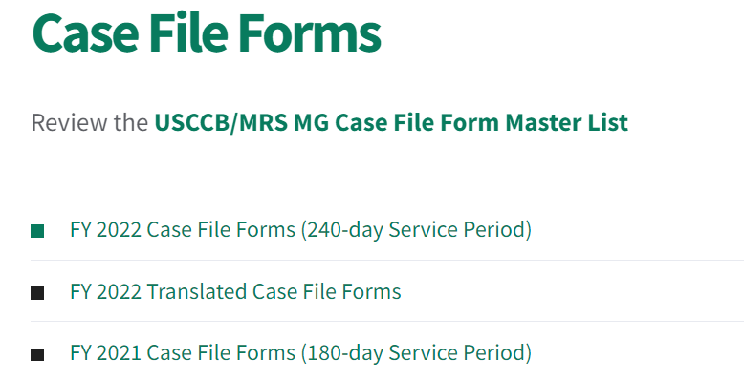
Case File Monitoring Tool and Addendum
1.
2.
3.

Slide 7
Case File Form Templates
1.
3.
2.

Slide 8
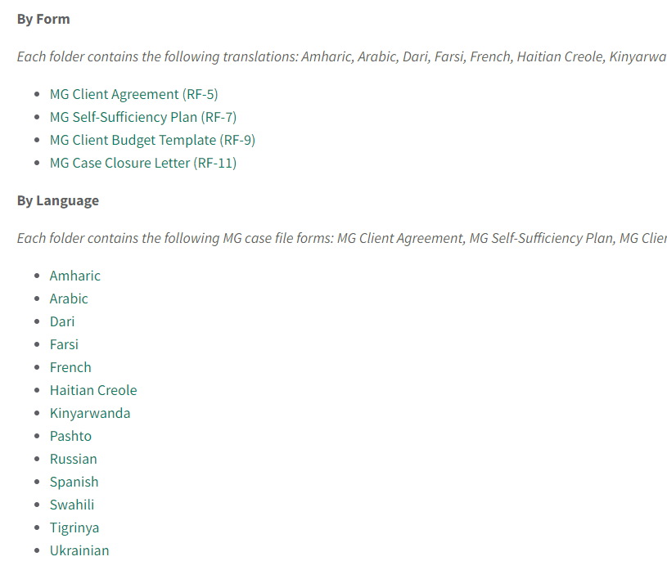
Case File Monitoring Tool and Addendum
1.
3.
2.

Slide 9
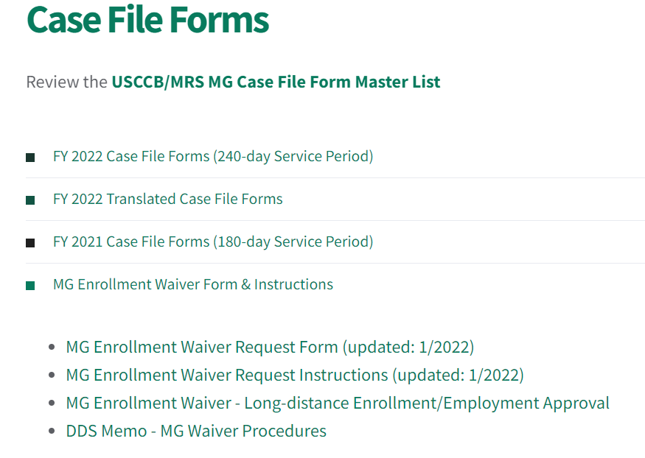
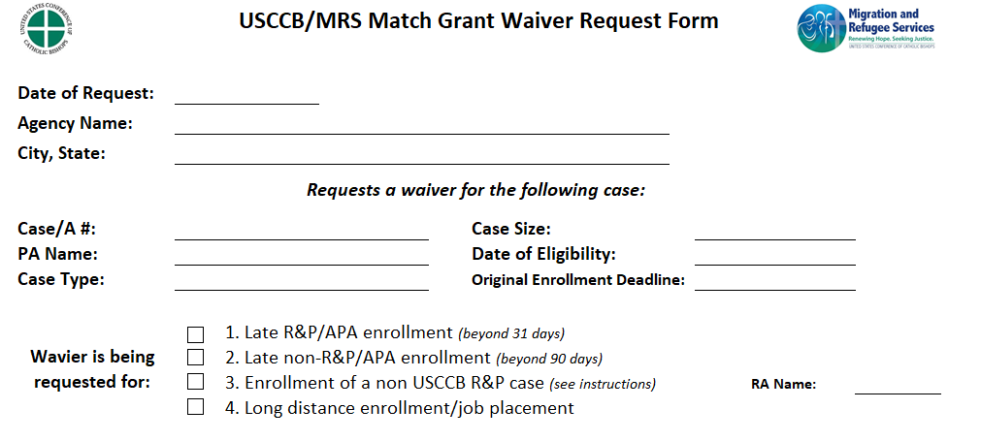
Enrollment Waiver Form & Instructions
1.
2.

Slide 10
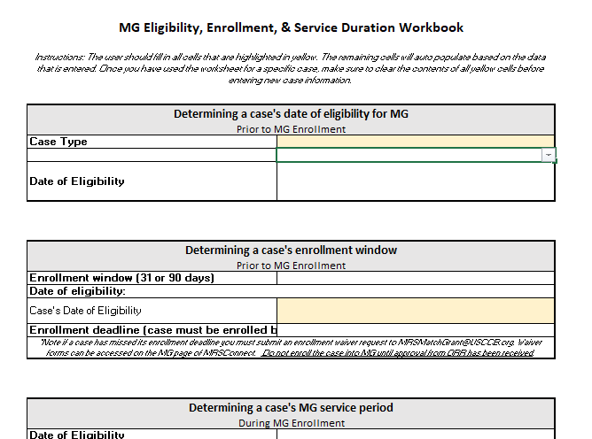
MG Eligibility & Enrollment Workbook

Slide 11
MG Cash Allowance Workbook

Slide 12
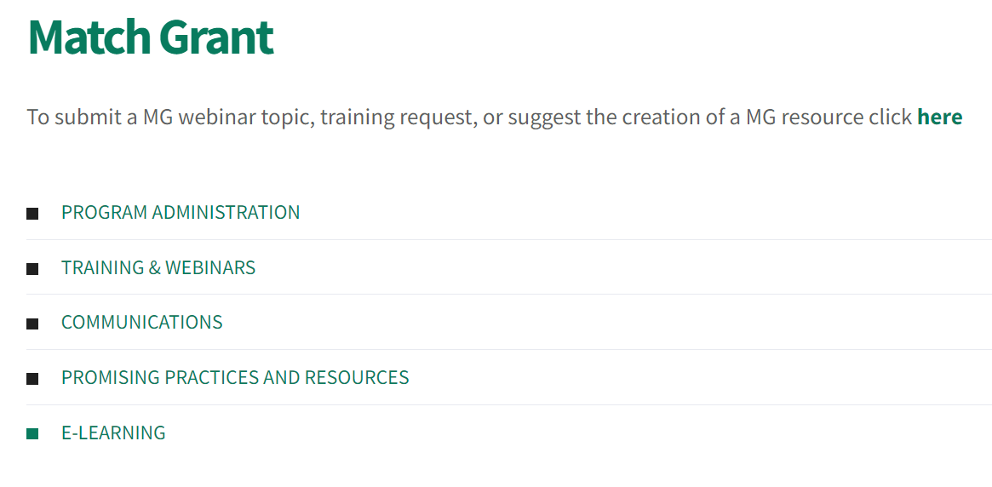
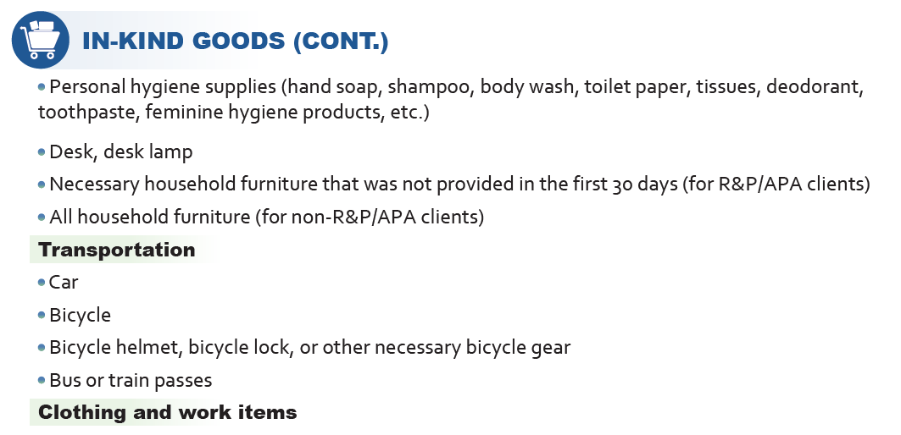
Promising Practices & Resources
Example: Match Ideas List

Slide 13



Thank you!
Do you have any questions?

