Slide 1





Developing Client Budgets (Enrollment, 180 & 240)
Match Grant
August 17, 2022

Slide 2
Zoom Features
Interact with presenters and attendees by:
Typing into the chat box
Asking questions in the Q&A
Raising your hand
The Zoom toolbar is at the bottom of your screen!

Slide 3

Introduction
Field Support Coordinator, Match Grant Caitlin Harrison is our facilitator today!
Caitlin

Slide 4
1
Purposes of MG Budgets
Case cannot already be economically self-sufficient
MG Program Operations Manual
2
Enrollment Budget
ORR Status and Documentation Guide
3
180, 240, and Adjustment Budgets
Agenda
4
Making Self-Sufficiency Determinations
Today we’ll review:
5
Proof of Employment
6
Non-Case Member Income & Expenses
Slides and webinar recording will be posted on MRSConnect
7
Self-Employed Clients
8
Promising Practices & Resources
Budgets as a Financial Literacy Tool
9
Budget Translations

Slide 5
List MG Guidelines requirements as they relate to MG client budgets
Learning
Objectives
Understand how to utilize MG client budgets to confirm MG program eligibility and make self-sufficiency determinations
Explain how to document employment income
By the end of this webinar, you will be able to:
Describe how to use the budget development process as a tool for client financial literacy

Slide 6
Client Budgets
Purposes of client budgets:
Document case’s income and expenses
1
Assist in determining whether a case has achieved economic self-sufficiency
2
Key part of clients’ financial literacy training
3

Slide 7
Client Budgets
When to complete client budgets:
  Enrollment
  Day 180
  Day 240 or case closure
  Adjustment budgets
    As needed, for major changes to the client’s financial situation (moves out of U.S. tie’s home, starts job and becomes self-sufficient, etc.)
    Required when ending cash allowance or core maintenance assistance due to self-sufficiency
Required
If applicable

Slide 8
Client Budgets
Budgets must:
  Be completed on or shortly after enrollment, day 180, day 240
  List monthly expenses and income
  Be completed with all adult clients
  Be signed & dated by all adult clients, staff, and interpreter (if used)
You can use USCCB template or an agency version with the same info.

Slide 9
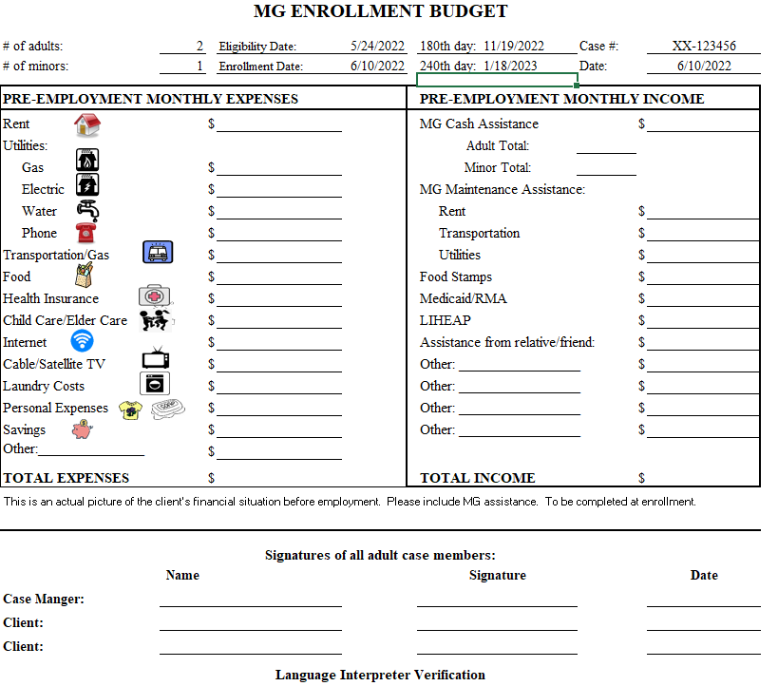

Slide 10
Cash Allowance
440
400
Minimum required amount:
  $50/week per adult
  $10/week per minor
For monthly budgets, can use estimate of 4 weeks/month
For payments, must calculate weekly, not monthly
40

Slide 11
Rent & Utilities
1,450
440
400
Rent expenses should be backed up by lease or letter
Estimate monthly utilities expenses based on bills or similar previous cases
Include LIHEAP if enrolled
Paying clients’ phone bills is an allowable MG expense, but not required as part of utilities
0
40
100
0
1,450
50
100
0

Slide 12
Transportation & Food
1,450
440
Agency is required to provide (or ensure that clients receive) food and transportation until case is self-sufficient
Food income = monthly SNAP/WIC benefits utilized
Food expenses = monthly amount of SNAP/WIC benefits spent + any out-of-pocket food expenses
400
0
40
100
0
1,450
50
45
45
100
575
575
0

Slide 13
Health
1,450
440
400
Include consistent, ongoing health expenses
Health expenses = monthly amount of Medicaid/RMA benefits spent + any out-of-pocket health expenses
Medicaid/RMA = monthly benefits utilized
0
40
100
0
1,450
50
45
45
100
575
575
25
25
0

Slide 14
Other Expenses
1,450
440
Estimate other expenses at enrollment or for near future:
  Child/elder care
  Internet
  TV
  Laundry
  Personal Expenses
  Savings
400
0
40
100
0
1,450
50
45
45
100
575
575
25
25
0
0
50
0
0
125
0

Slide 15
Assistance from
Relative/Friend
1,450
440
400
Include consistent, ongoing financial assistance
Note the source of funds
0
40
100
0
1,450
50
45
45
100
575
575
25
25
0
0
50
200 (PA’s aunt)
0
0
125
0

Slide 16
Total
Income & Expenses
1,450
440
400
Add up totals for income and expenses
USCCB budget template automatically calculates totals
Enrollment budget should show that client’s income (including MG assistance) is enough to cover expenses
0
40
100
0
1,450
50
45
45
100
575
575
25
25
0
0
50
200 (PA’s aunt)
0
0
125
0
2420
2835

Slide 17
Signatures
1,450
440
400
Staff signature
All adult clients’ signatures
Interpreter signature
0
40
100
0
1,450
50
45
45
100
575
575
25
25
0
0
50
200 (PA’s aunt)
0
0
125
0
2420
2835
Layla Hasan
Lsyla Hassan
6/10/2022
Ahmad Noor
Ahmad Noor
6/10/2022
Fatima Noor
Fatima Noor
6/10/2022

Slide 18
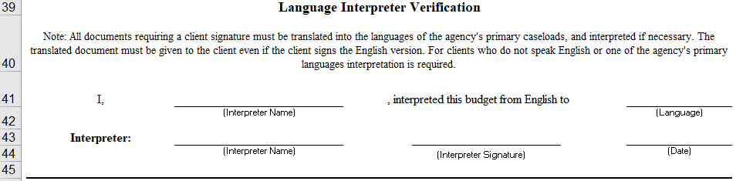

Slide 19
Client Budgets: 180, 240, and Adjustment
Day 180 and 240 budgets must contain a self-sufficiency determination
Must have proof of employment (pay stubs) to verify any employment income on budgets
If creating an adjustment budget, case notes should indicate reason

Slide 20
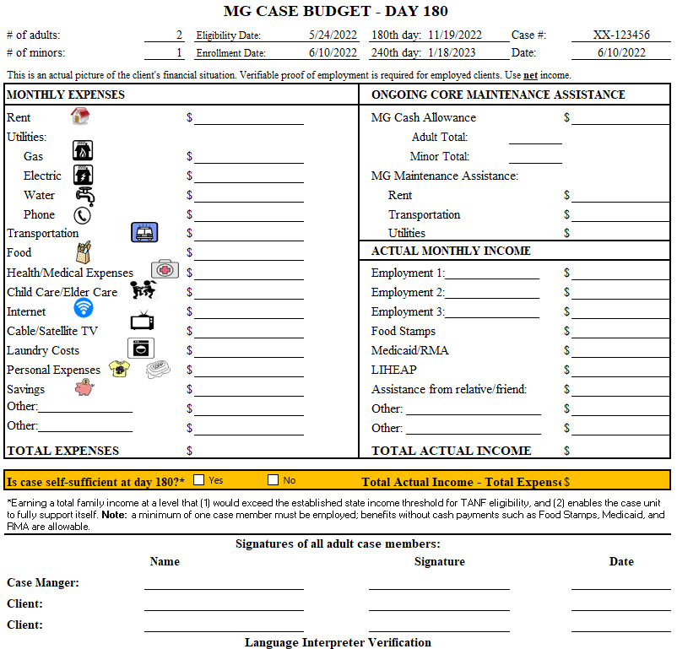
11/19/2022
List ongoing MG assistance on budget, but do not include it in the income calculation when determining self-sufficiency
USCCB budget template (Excel) does not include core maintenance assistance or cash allowance in the auto-calculations of total income

Slide 21
180/240 Budget: Unemployed
11/19/2022
1,450
0
If client is not working, 180/240 budget may be similar to enrollment budget
  Still must create new budget!
Cash allowance will end at day 180
Common items with changes:
  Utilities (new costs or LIHEAP)
  Transportation
  Personal expenses
  Assistance from friend/relative
0
0
0
100
0
1,450
50
45
45
0
575
25
0
50
0
575
0
25
200
100
0
200
2495
900
-1595

Slide 22
At least one case member must be
legally employed.
1
Making Self-Sufficiency Determinations
Case’s net income meets or exceeds expenses (use budgets!)
2
To determine that a client has achieved economic self-sufficiency the following conditions must be met:
Verifiable proof of employment that confirms that case’s income must be in the file.
3
Case’s income is above the TANF eligibility threshold for your state.
4

Slide 23
180/240 Budget: Unemployed
11/19/2022
1,450
0
If client is not working, 180/240 budget may be similar to enrollment budget
  Still must create new budget!
Cash allowance will end at day 180
Common items with changes:
  Utilities (new costs or LIHEAP)
  Transportation
  Personal expenses
  Assistance from friend/relative
0
0
0
100
0
1,450
50
45
45
0
575
25
0
50
0
575
0
25
200
100
0
200
2495
900
X
-1595

Slide 24
180/240 Budget: Employed
11/19/2022
Cash allowance will end at day 180 or when case becomes self-sufficient (whichever is sooner)
Agency no longer required to provide core maintenance assistance once case is self-sufficient
Employment income:
  Must be based on verifiable proof of employment (pay stub)
  Must be net income
  Must use accurate calculation of net income, not round number estimate
  Income for all adults from all jobs
SNAP amount may decrease once employed
Clients may wish to contribute to savings once employed – include savings goal on budget
1,450
0
0
0
0
100
0
0
50
0
45
0
575
25
2348
0
50
0
375
0
25
200
100
200
2695
2848
X
153

Slide 25
Proof of Employment
Proof of Employment
Verifiable proof of employment = a pay stub, a letter from an employer, or another document
Must show client’s employment, hours worked, wage, and compliance with U.S. Federal Tax Regulations

Slide 26
Proof of Employment
Purposes of proof of employment:
Confirms the employment income reported on the budget (and thus, the self-sufficiency determination) is accurate
1
2
Confirms tax compliance

Slide 27
Proof of Employment
Proof of employment required if client reports employment on budget
  Separate pay stub for each client and each job
  Copy in the case file
Must reflect appropriate timeframe:
  Within 30 days of day 180 and day 240
  Not just the first pay stub

Slide 28
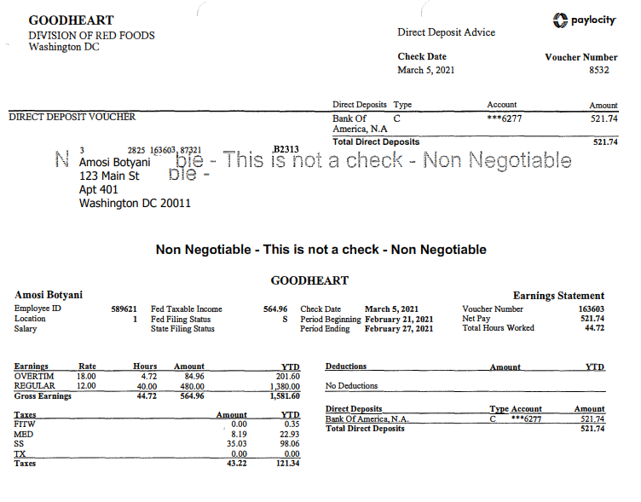
Understanding Pay Stubs
Must show:
Client’s employment
Hours worked
Wage
Compliance with U.S. Federal Tax Regulations
Budgets use net income, not gross income

Slide 29
Proof of Employment
A case that does not provide verifiable proof of employment cannot be reported as “self-sufficient”
Scenario: Today is day 180 and I am meeting with a case to complete their budget. The client started working just a few days ago and has not received their first pay stub yet. If I believe their income will exceed expenses, can I count them as self-sufficient?
Answer: Yes. Estimate their net income on the budget. Once they receive pay stubs, update the budget with the true net income. If you later learn that the case is not self-sufficient, contact your MG Field Support Coordinator to update the self-sufficiency outcome on the 180-day report.

Slide 30
Calculating Monthly Net Income from Pay Stubs
Use a consistent, reasonable method for calculating monthly net income
Do not use hourly wage x hours worked per month (gross income)
If a pay stub shows overtime hours, check if overtime hours are consistent before including on budget
If you use a complicated formula, explain in case notes or on budgets

Slide 31
Calculating Monthly Net Income from Pay Stubs
Pay Frequency | Options for Monthly Net Income Calculation
Weekly | Weekly net income x 4 Average of multiple weekly pay stubs x 4 Weekly net income x 52 ÷ 12 Average of multiple weekly pay stubs x 52 ÷ 12
Biweekly | Biweekly net income x 2 Average of multiple biweekly pay stubs x 2 Biweekly net income x 26 ÷ 12 Average of multiple biweekly pay stubs x 26 ÷ 12
Semi-monthly | Semi-monthly net income x 2 Average of semi-monthly pay stubs x 2
Monthly | Monthly net income Average of multiple monthly pay stubs

Slide 32
Jobs Pre-Enrollment
Economic Self-Sufficiency
Earning total household income through employment that:
    Exceeds the household’s expenses
    Exceeds the TANF eligibility threshold for your state
Jobs Pre-Enrollment
A client or someone in their economic family unit can have a job at MG enrollment, but they cannot already be self-sufficient
If a client or someone in their economic family unit already has a job, complete a budget before enrollment to check if income exceeds expenses

Slide 33


Non-Case Member Income & Expenses
Economic family unit = a group of related or unrelated persons who share housing and all significant income and expenses
Scenario | Include non-case member income & expenses on MG budget? | MG can cover all expenses, including from non-case members?
1. Client(s) live with non-case members outside of their economic family unit
2. Client(s) live with non-case members within their economic family unit who are not receiving public cash assistance (TANF, RCA, SSI)
3. Clients living with non-case members within their economic family unit who are receiving public cash assistance (TANF, RCA, SSI)
New USCCB guidance document will be released soon!

Slide 34
1
Non-Case Member
1,450
If non-case members are within the client’s economic family unit, include expenses and income on budget
(unless they are receiving public cash assistance)
If case is already self-sufficient before MG enrollment, case cannot be enrolled into MG
If case is not self-sufficient before MG enrollment, case can be enrolled into MG
0
100
0
50
45
575
575
25
25
0
0
50
0
Non-MG spouse employment income
2152
0
125
0
2420
2752
Could this case be enrolled into MG?
Layla Hasan
Lsyla Hassan
6/10/2022
Ahmad Noor
Ahmad Noor
6/10/2022
Fatima Noor
Fatima Noor
6/10/2022

Slide 35
Non-Case Member
1
1,450
What about this case? Could they be enrolled into MG?
0
100
0
50
45
575
575
25
25
0
0
50
0
Non-MG spouse employment income
1152
0
125
0
2420
1752
Layla Hasan
Lsyla Hassan
6/10/2022
Ahmad Noor
Ahmad Noor
6/10/2022
Fatima Noor
Fatima Noor
6/10/2022

Slide 36
Self-Employed/Independent Contractor Clients
Some clients may choose to work as “independent contractors”
Common jobs include Uber/Lyft drivers, food delivery drivers
Independent contractors do not receive typical pay stubs with taxes withheld
Taxes are not paid until the self-employed client files their taxes (1099)
On self-employed clients’ budgets, still must use net income
  Estimate how much the client will owe in annual taxes
  Divide that into monthly payments and deduct from monthly gross income

Slide 37
Self-Employed/Independent Contractor Clients
Still must collect proof of employment (shows income & tax compliance)
Proof of income
Bank statements to verify the client’s monthly income
or
Portal/app page showing employee earnings or payouts (if available)
Proof of tax compliance
1099 form (if available during MG period)
or
W9 form + signed statement indicating that the client received an explanation of their tax obligations and that they agree to file income taxes

Slide 38
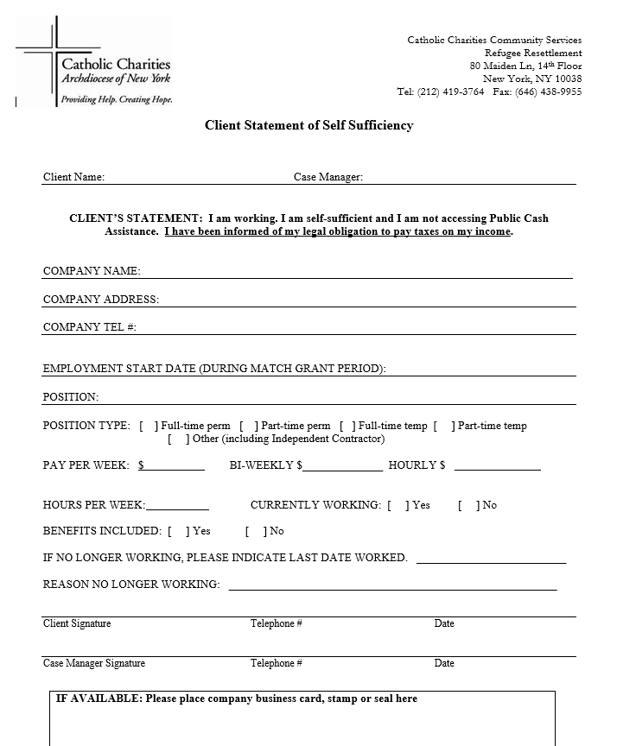

Slide 39
Budgets as a Financial Literacy Tool
Use budget creation as part of financial literacy training
Discuss:
  How much income from employment case needs to be self-sufficient
  Importance of savings & money for emergencies
Ask if client knows:
  Their own expenses/income
  When their next rent/utilities payments are due
  How to submit rent/utilities payments
  How they will cover payments (if ending MG and not employed)

Slide 40
Budget Translations
If any of the adult case members do not speak English, the budgets must be interpreted to ensure understanding
If a client speaks one of your agency’s primary caseload languages, the budgets must also be translated into the client’s language
  Primary caseload = 20% or more of MG clients

Slide 41
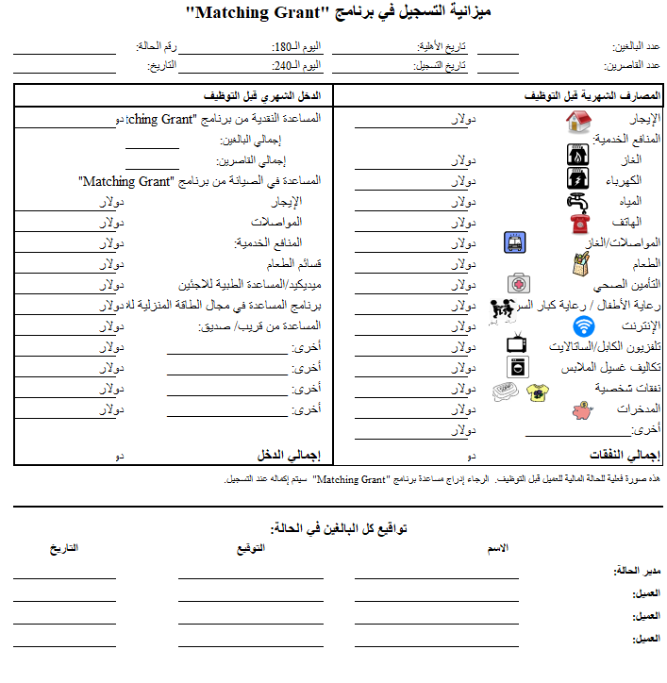
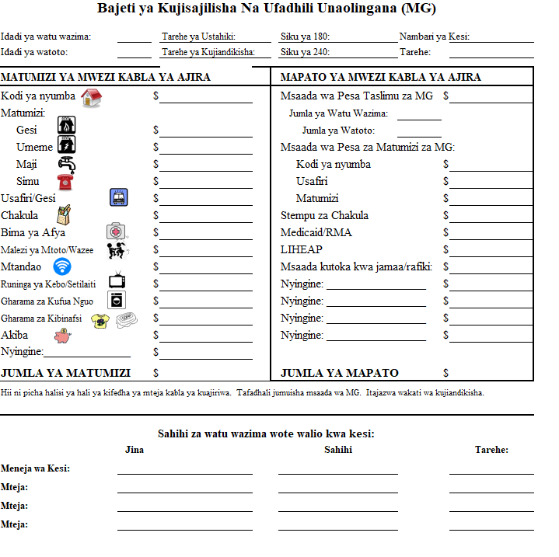
Budget Translations

Slide 42



Questions?
Slides and webinar recording will be posted on MRSConnect

