Slide 1
June 15. 2022
Cultural Orientation
Community of Practice
FY 2022
Q3
Notes:
Hello, thanks for joining us today for our Quarter 3, CO Community of Practice.

Slide 2
Today’s Agenda
1
CORE Updates
2
Provision, Assessment and Documentation reminders
3
Logistic and Cognitive Load Tips
4
Affiliate Share: Whole Office Approach
Notes:
Today I’m going to…
Before we get started, let’s review some housekeeping items. This meeting is being recorded and will be hosted on MRSConnect as well as emailed to you.
Please use the chat feature or unmute yourself to join the discussion portion of today’s meeting. If things get too hairy, I’ll have you raise your hand and then call on your to unmute.

Slide 3
CORE Updates
User Testers Needed for CORE's newly updated CO O&Is! –Complete CORE’s survey by 5PM EST on June 24 to express interest! Selected users will be notified the week of June 27.
Settle In Website Replaces COREnav.org - The CORE Resettlement Navigator website will become unavailable on June 15th. After this time, if users visit the old site, they will be automatically directed to the Settle In website.
NEW Video and Fact Sheet on U.S. Laws for Newcomers
Notes:
CORE is seeking domestic CO providers to participate in user testing around newly updated Cultural Orientation Objectives and Indicators approved by PRM. The Domestic CO Objective and Indicator (CO O&I) User Testing will provide an opportunity for U.S.-based resettlement staff who deliver or have delivered Cultural Orientation to review, verify, and identify training and resources for the updated and approved CO O&Is. Users WILL NOT add, remove, or edit the language of the CO O&Is. You should have received an email with more information about the project, including a one-page Domestic CO O&I User Testing Overview and a CO O&I User Testing FAQ document. If you have not, shoot me an email and I’ll make sure to get it to you.
The new Settle In website is now live and ready for use by refugees and other newcomers resettling to the United States. This website replaces the existing CORE Resettlement Navigator website. With resources in ten languages, including Dari and Pashto, the new look and feel of the website harmonizes with CORE's other refugee-facing platforms, the Settle In app, and Settle In Facebook. Additionally, its design aims to address newcomer digital and language literacy needs through better navigation, more visuals, and showcasing of video content. To ensure a smooth transition for users, CORE will update all its resources to direct users to Settle In.
Watch and share CORE’s new U.S. Laws: Rights & Responsibilities video and fact sheet with newcomers. These resources provide basic information about U.S. laws and can also assist in facilitating further discussions about newcomer rights and responsibilities during Cultural Orientation. Available in: Arabic, Burmese, Dari, English, Kinyarwanda, Pashto, Russian, Spanish, and Swahili.
Before I move on any questions?

Slide 4
CO Provision, Assessment & Documentation Reminders
EVERY ADULT (18 years and older) R&P, APA and SIV recipient must receive CO on required topics
CO should be initiated within the first 30 days and can be extended up to 90 days as needed.
The Cultural Orientation Objectives and Indicators outline the 15 topics and corresponding content objectives and learning indicators approved by PRM. None of these topics are optional. There are separate O&Is for RP and APA.
There is a separate CO checklist RF-23 for RP clients and APA-09 for APA clients.
The CORE model assessment is only required for RP clients. APA clients are exempt.
Assessments should be given at the end of CO provision.
Notes:
Any questions?

Slide 5
Logistics and Cognitive Load
Cognitive load is a real concern. There are a lot of topics to cover. And clients need this information when their attention may be divided as their living circumstances are significantly changing and their mental resources are likely stretched.
A single session should not exceed four hours in duration and should include times for breaks in order to manage cognitive load for clients.
Don’t over do it on the first day. Typically, during intake, we see “The Role of the Resettlement Agency” being discussed and “Refugee Status”.
Bundle like topics and consider weekly sessions. If a client misses a session, schedule a make up.
Utilize a hybrid approach, a mix of in person class and 1-1, and virtual class and 1-1, and home visits

Slide 6
Logistics and Cognitive Load
The following chart on the right is a condensed R&P schedule which may serve as a guideline and time-table for topic teaching.
The CO provider’s main priority is to cover each CO topic and focus on key content and themes that are considered the most important for clients to know and do regardless of their backgrounds. (e.g. self-sufficiency, cultural adjustment, realistic expectations, and learning English)
Notice how the topics are bundled, the associated R&P CORE service, experiential components, timeframe, and location
Cultural Orientation Topic | Associated R&P Core Service or Activity | Timeframe/ Day(s) | Location
1. Pre-Arrival Orientation | 24 Hour Home Visit | 1 | Client Home
2. Role of the Resettlement Agency | Intake | 2 | Office
3. Refugee Status | Intake | 2 | Office
4. Health & Hygiene | TB Test, COVID testing Immunizations, Medical Screening | 4 to 8 | Health Department, Doctor Office
5. Public Assistance & Your New Community | City Tour | 3 to 4 | In the City
6. Education & English | School Enrollment | 8 to 14 | School
7. Employment | Job Orientation | 7 to 10 | Office
8. Housing | 24 Hour Home Visit | 1 | Client Home
9. Transportation | Bus Orientation | 3 to 4 | In the City
10. Safety | 24 Hour Home Visit | 1 | Client Home
11. U.S. Laws | Intake | 2 | Office
12. Budgeting & Personal Finance | Open Bank Account | 15 to 30 | Bank
13. Cultural Adjustment | City Tour | 3 to 4 | Office

Slide 7
Developing CO Programming
Key recommendations for developing CO programming based on current research include:
Repetition across resettlement journey & bundling services instead of stand-alone form of programming | Whole-Office Approach to Cultural Orientation Resources for Community Partners and Sponsors
Leverage social capital (i.e. community members and volunteers) to disseminate messaging | Resources for Community Partners and Sponsors Promising Practice: Including Guests from the Community Promising Practice: Using Volunteers for Community Orientation
Utilize digital learning platforms to disseminate messaging and give participants control of their learning process | Promising Practice: Delivering Effective Remote Cultural Orientation How to Integrate Digital Technology in Cultural Orientation
Recognize the diversity of refugee populations. Providing programming that uses a demographic-specific approach, rather than a one-size-fits-all | About Refugee Populations and Working with Refugees How to Create Interactive One-on-One Cultural Orientation Promising Practice: Delivering Gender-Segregated Cultural Orientation

Slide 8
Whole Office Approach
Beth Carney
Supervisor of Education & Outreach
Catholic Charities Indianapolis
Notes:
For today, we’ll focus a bit more on the whole office approach. We’ve been encouraging a whole office approach for some time and I’m excited to have Beth Carney from CC Indianapolis talk to you today about how they’ve implemented it, including some of the challenges that have arisen.
Again, this approach is meant to reinforce CO messaging and improve cognitive load. Is it NOT meant to take the place of stand alone CO sessions.
With that, I’ll turn it over to you Beth!
.

Slide 9
Whole Office Approach
Purpose
Goals
Purpose
Goals
To create a collaborative contribution in delivering accurate, consistent, and repetitive key CO messaging in smaller, manageable segments to newly arrived clients.
Identify what a client already knows and build upon their knowledge of CO Topics
Identify client goals and important information
Reduce client cognitive overload
Increase client engagement with staff
Incorporate CO messaging into every client TouchPoint (TP)
Provide relevant CO messaging during specific TPs
Help staff identify they are already delivering CO
Create consistent messaging
Incorporate CO messaging into 60-90 days TPs
Incorporate CO messaging into volunteer TPs
Improve retention
Maintain a manageable workload for staff

Slide 10
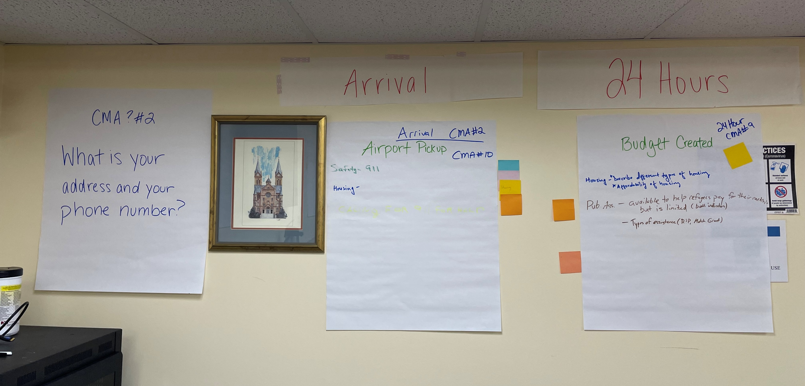
Whole Office Approach
Workshop #1
Purpose
Timeline
Identified TouchPoints
Placed on timeline
Honorine Scenario/Post-Its
Teams mapped out on timeline questions asked
Identified staff associated with TPs
CORE O&Is
CORE Model Assessment Qs
Notes:
PRIOR TO WORKSHOP #1- Staff were asked to participate in CORE 3-week training and online courses!
Timeline
Pre-arrival, Arrival
24 Hours
7-10 Days
30 Days
30-60 Days, 60-90 days, 90+ Days
Identified TouchPoints
Placed on Timeline
Honorine Scenario
Teams mapped out when Questions could be asked
Identified Who is involved with specific TPs
CORE’s O&Is
Placed specific O&I’s where it might be talked about
CMA Questions
THIS ACTIVITY WAS SO HELPFUL FOR OUR STAFF TO SEE A BIG PICTURE!

Slide 11
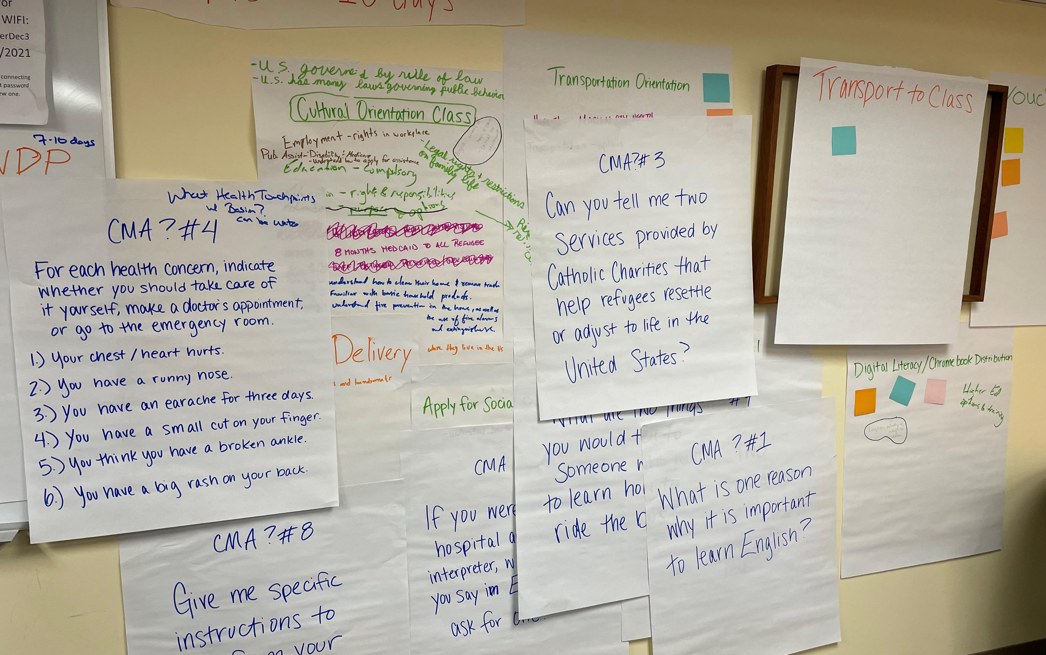
Whole Office Approach
Purpose

Slide 12
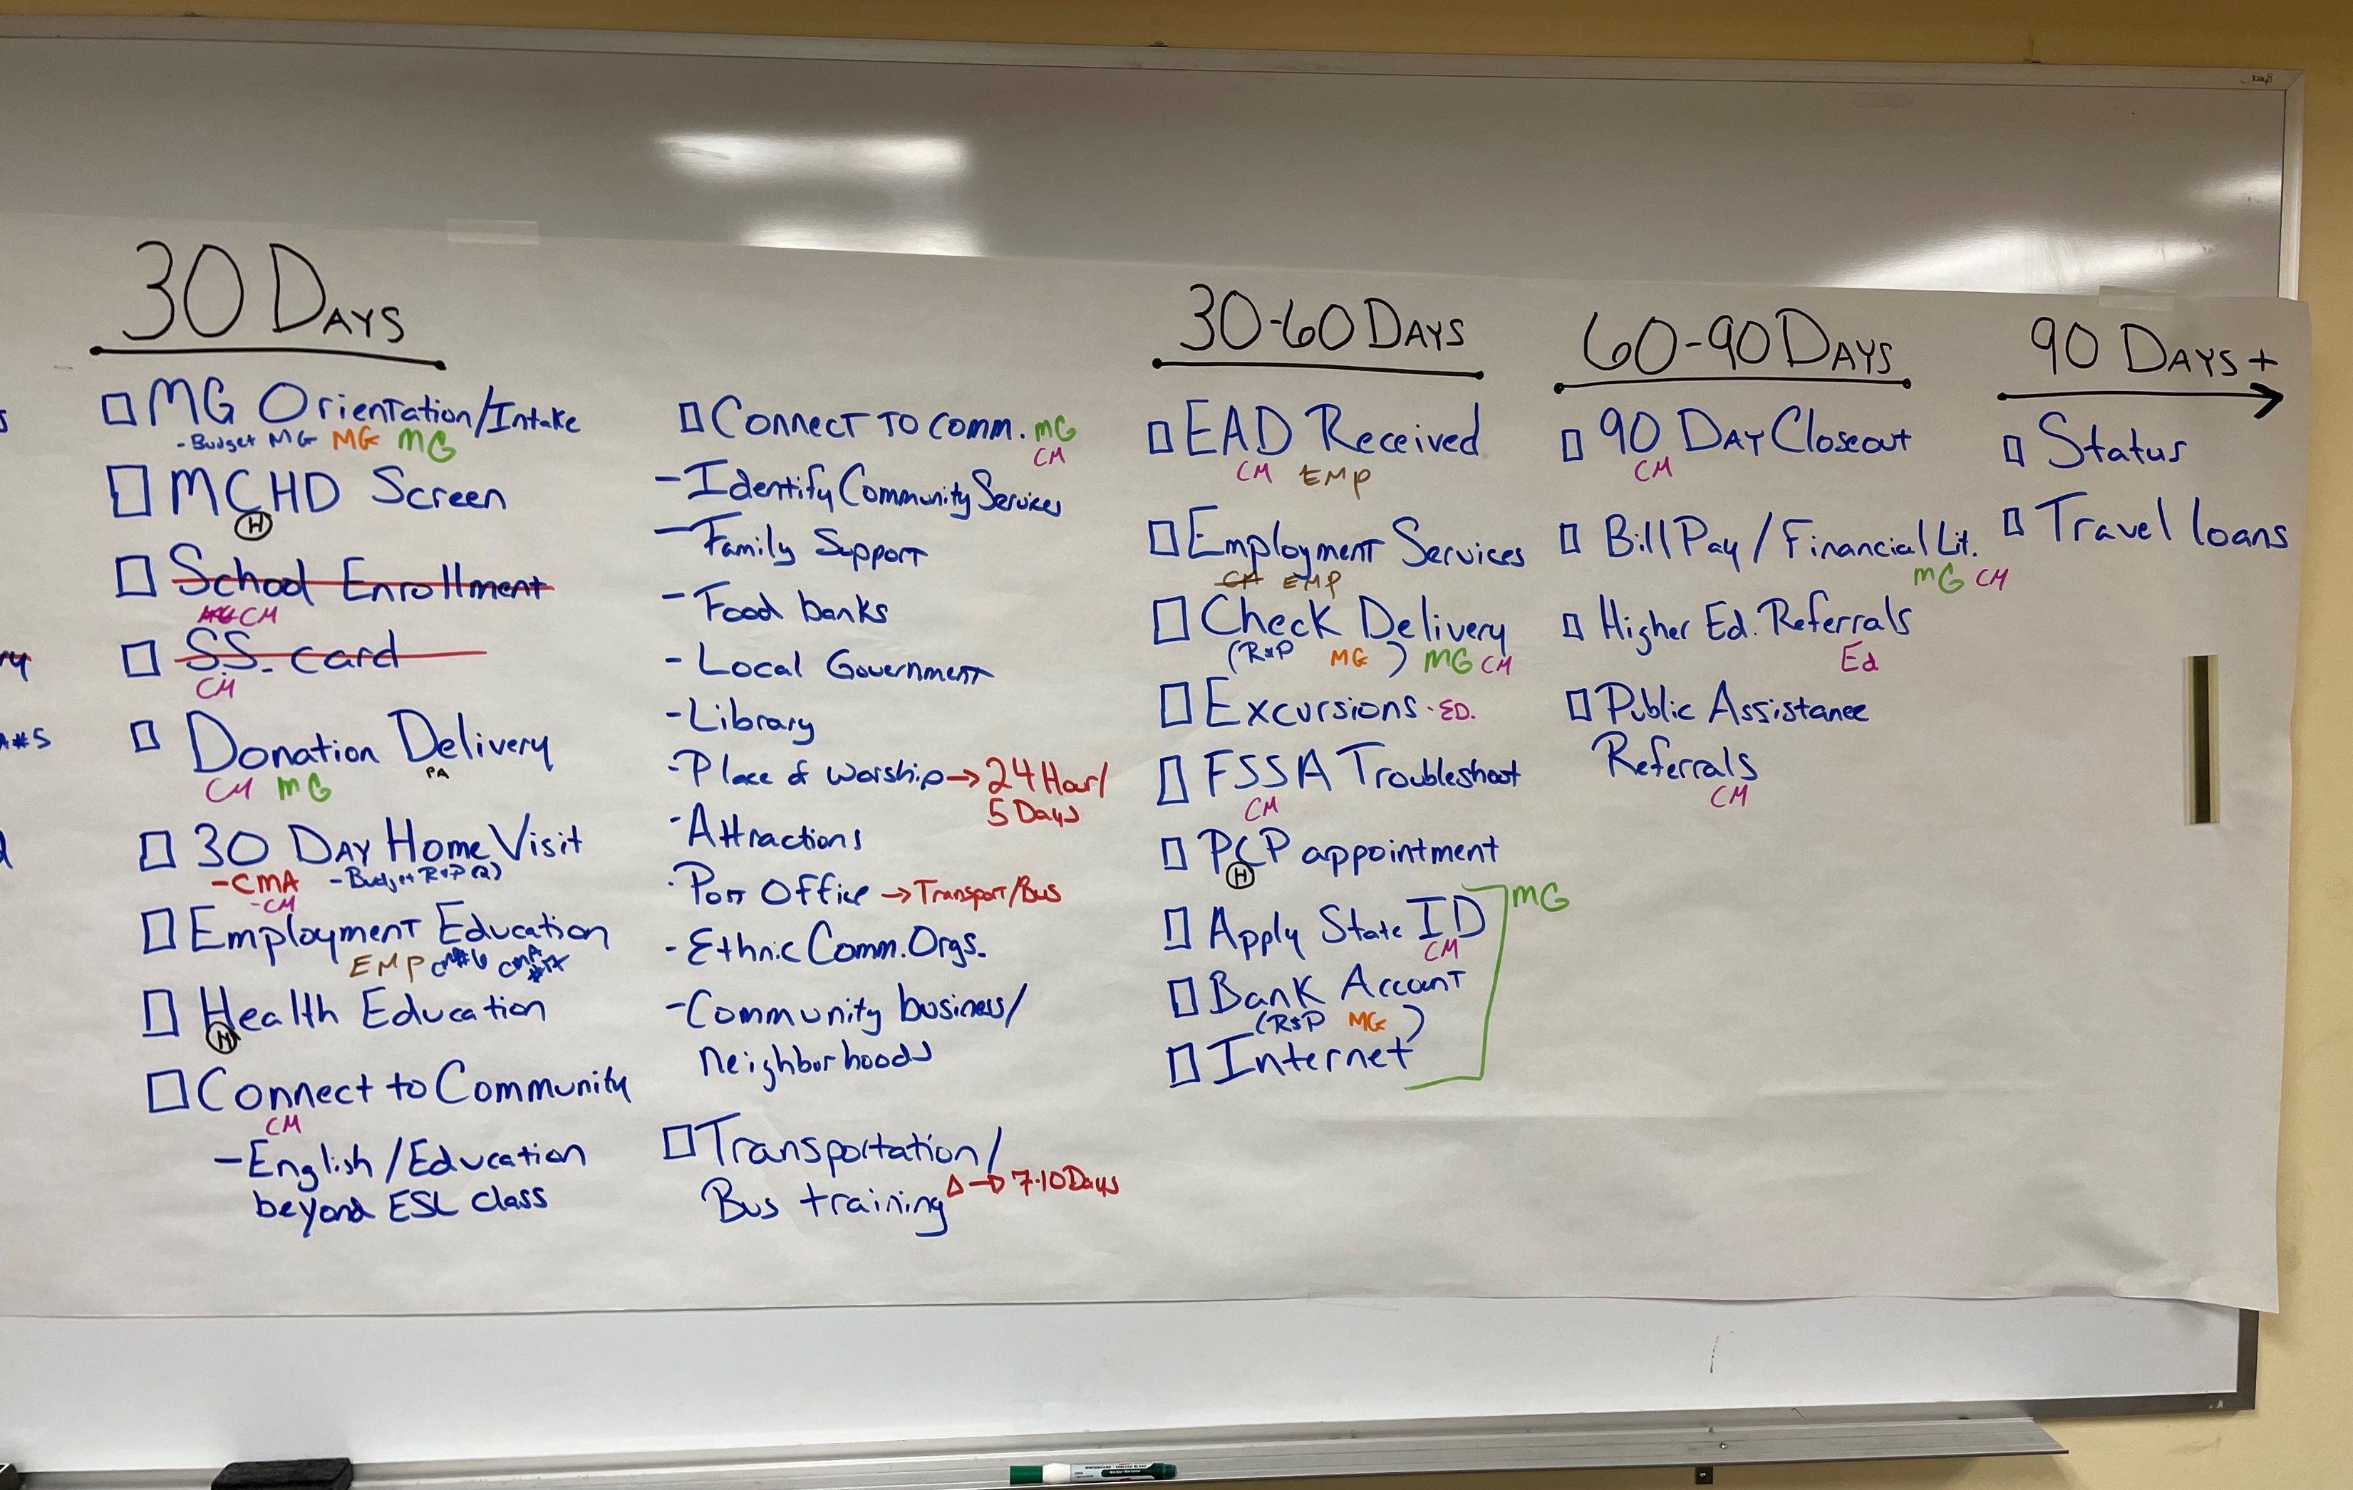
Whole Office Approach
Workshop #2
Purpose
TouchPoints for every Case
Missed
Needed
MG
Outlined what is needed to know in first 24 hours, 7-10 days, 30 days etc.
Know the CMA!
Learn more about resources available
Notes:
Day 2 Training
Confirm Touchpoints
Every Touchpoint completed for every case
What are optional Touchpoints (note as Optional)
Note MG specific Touchpoints (MG)
Reminder of what CO class is like and why we are doing CO using a Whole Office Approach
Orientation (What is needed to know in the first 7-10 days after arrival)
Role of the Resettlement Agency
Public Assistance
U.S. Laws
Transportation
Reading Dx, Assessment, & Referrals
5 Minutes with each Supervisor
Informed Consents (United Way & any others)
Look at every Touchpoint on the Map
Heavy TPs (24 hour visit, Orientation, 30 Day Home Visit, & Beyond 30 Days)
What can be moved from these TPs?
Where to place
Health
Transportation/Bus Training
Employment
Budgets?
MG (10-30 days)
RP
MCHD- Who takes to appts?
Bank Account
Does everyone over 18 able to work receive a bank account?
EAD Cards- Where are these received?
Receipt of Direct Assistance- Is this the same as a Voucher?
Does every client receive?
Check Delivery?
Main points of CO need completed within 30 days. Look at Map and decide where CO in 30 Days + could be placed?
Are the 90 Days+ actual TP by a staff?
Resources- SettleIn App, www.corenav.org
Vision of Pilot Program
6 months
Ideas (ways to integrate- will have better idea after CORE classes)
Feedback
Resources- SettleIn App, www.corenav.org
Get to know the CMA Questions & always ask one at each Touchpoint
Always remind clients what we are doing for them in subtle ways
Next training:
Outline Touchpoints and O&I’s
Documentation
Ideas, feedback/survey,
Always ask a CMA question
CMA- scoring

Slide 13
Whole Office Approach
Where in the Process?
Touchpoint Guides
CO Classes
Purpose
CORE Model Assessment
Created TP Guides
Timely information
Beginning Discussion
TOPICS O&Is
CMA Review
Resources
Documentation
7 Day Orientation
Literacy Classes
Completed by Education Team Member the week of the 30-Day Home Visit
Notes:
Created TP Sheets
All the O&Is split up between TPs within first 30 days
Timely information (Arrival, 24 hour, 7-10 days)
BEGINNING DISCUSSION
Assess what the client knows
Identify what is important to the client to learn about the topics
CORE TOPIC(S) O&I’S
CMA QUESTION(S) REVIEW
RESOURCES- related to TP CO topics
DOCUMENTATION
______________
7 Day Orientation (first full week of arrival)
Small amount of information about the main topics
Identify what is important for the client to learn
Literacy Classes (second full week of arrival to 29 days)
Health/Hygiene
Digital literacy
Employment
___________
CMA

Slide 14
Whole Office Approach
What’s Next?
6 Month Pilot of WOP
Staff Feedback
Add Resources
Continued training for staff
Observation of staff
Continue improving documentation
Add CO messaging to 30-90 Day TPs
Add CO messaging to volunteer TPS
Notes:
Staff Feedback
Add Resources
Continued training for staff
Observing staff & provide feedback
Documentation (work with ETO and USCCB to minimize double entry of information)
Add CO messaging into 30-90 Day Touchpoints
Add CO messaging into Volunteer Touchpoints

Slide 15
Whole Office Approach
Successes & Challenges
Notes:
Many new staff members
Challenges
Training new staff and placing current staff in new roles
Getting everyone onboard & seeing it’s not just responsibility of Education Team to deliver CO
Most TPs in first 30 days are done by case managers (2 new staff) feeling like we are adding more work for them
Adult Learning happens best when it is most practical. Some of the key messaging is more practical after the 30 days of arrival. (Importance of adding CO messaging to 30-90 Day TPS and volunteer TPs
Concern about documentation
Successes
Getting this far in the process has been a huge success.
We have had a few of the classes with staff teaching- opportunity to help our co-workers grow in areas of consistent messaging, not going “rogue” with information
Mapping activity and staff workshops were helpful for staff to see a large picture, have an idea of who/team does what, help bring up questions and find answers
Really helpful feedback from staff
Updated ETO documenting
Help simplify information delivery with TP Guides
Help build team atmosphere

Slide 16
Questions?
We will not be collecting updated CO plans for FY22. However, please make sure you and your staff are familiar with the most recent versions we have on file and it’s never too early to start thinking about updates for FY23.
Upcoming FY22 CO Community of Practice (CoP) calls: September 14 @3PM EST
Please sign up for the CORE newsletter if you haven’t already! https://coresourceexchange.org/contact-us/
Please email jzubko-cunha@usccb.org if staff should be added to or removed from the CO provider contact list

