Slide 1





R&P and MG Financial Documentation
May 10, 2022
Maintaining Source Documentation

Slide 2
1
2
3
Zoom Features
Chat
Q&A
Raise Hand
Interact with presenters and attendees by:
Typing into the chat box
Asking questions in the Q&A
Raising your hand
The Zoom toolbar is at the bottom of your screen!

Slide 3



Introduction
Paul, Emily and Christa will be our facilitators today.
Paul
Christa
Emily
Associate MRS Accounting Director
Assistant Director, Match Grant
Associate Director, DDS

Slide 4
Today’s Agenda
1
What is financial “source documentation” and why is it important?
2
What kinds of source documentation are required in client case files?
3
How to document financial disbursements for R&P and MG Core Services
4
Frequently Asked Questions
5
Resource Review: Case File Monitoring Tools and Addendums

Slide 5
Understand how the Code of Federal Regulations impacts required source documentation
1
Learning
Objectives
Explain what source documentation is required to support client core services
2
By the end of this webinar, you will be able to:
Provide answers to frequently asked questions related to financial documentation
3
Locate the sections in the Case File Monitoring Tools and Addendums that explain financial documentation
4

Slide 6
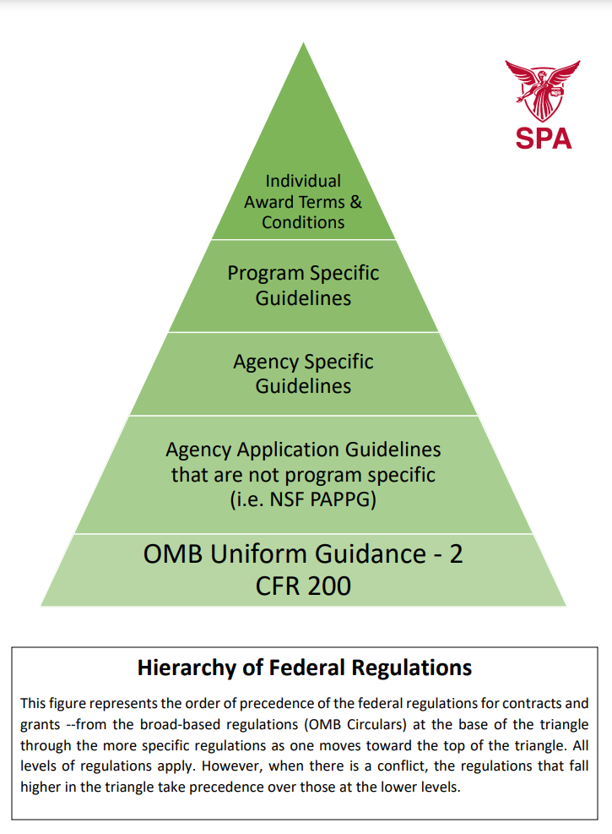
Hierarchy of Federal Regulations

Slide 7
Code of Federal Regulations – Part 200
Uniform Administrative Requirements, Cost Principles, and Audit Requirements for Federal Awards
Subpart A - Acronyms and Definitions
Subpart B - General Provisions
Subpart C - Pre-Federal Award Requirements and Contents of Federal Awards
Subpart D - Post Federal Award Requirements
Subpart E - Cost Principles
Subpart F - Audit Requirements

Slide 8
Source Documentation
What source documentation is required for each financial disbursement made on behalf of a client?
Type of Source Documentation
Purpose
Examples
Proof of obligation/commitment of funds (amount due)
Shows that the agency is required to pay for a good/service. Must include a date.
Lease, bill, invoice
Proof of disbursement of funds
Proof the agency paid for the good/service
Check stubs, receipt
Client Acknowledgement of receipt of funds
Shows that a specific client received the good/service
USCCB RF-35 and RF-19

Slide 9
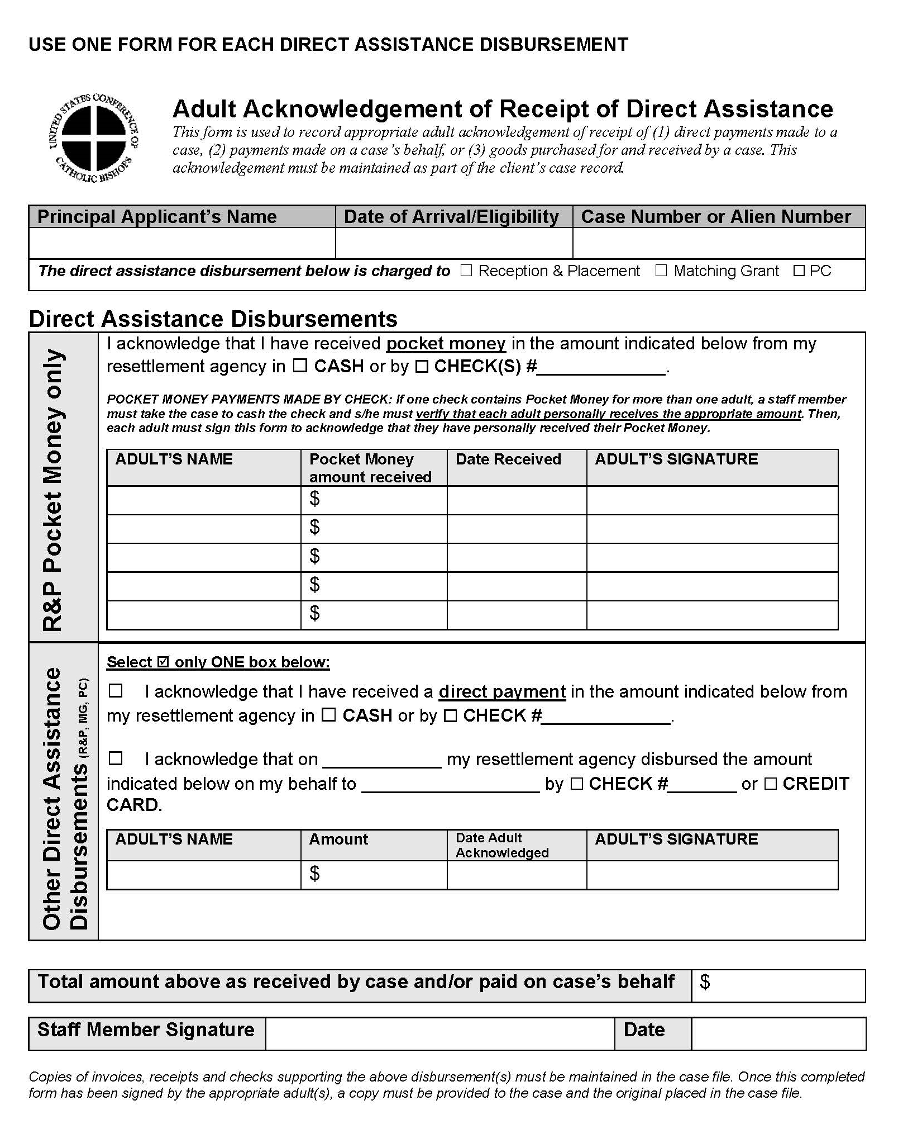
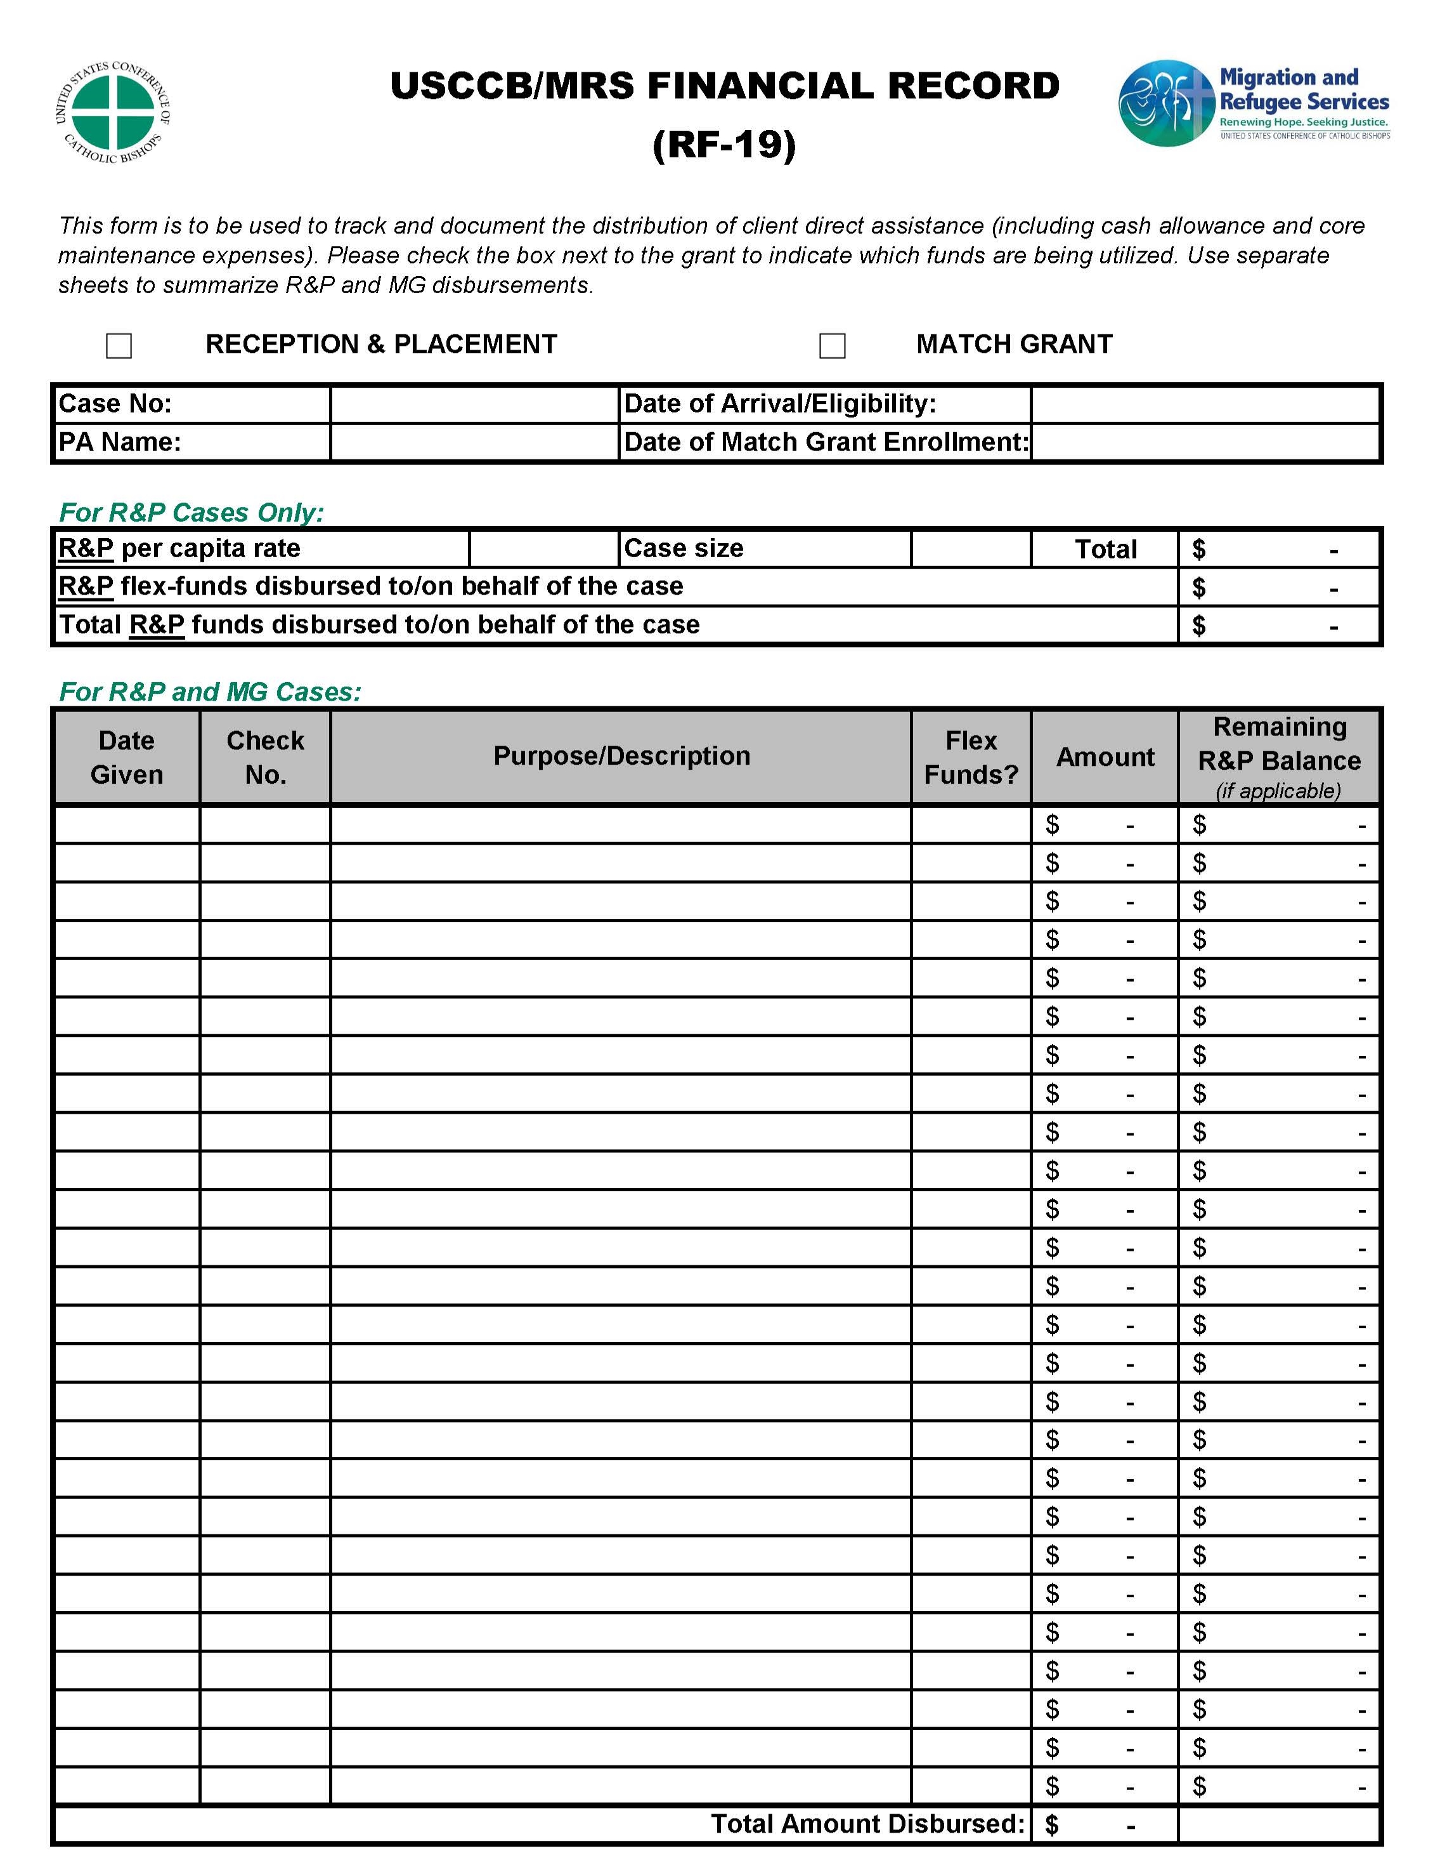
RF-35

Slide 10

Source Documentation for Core Services
Housing
Type of Source Documentation
Purpose
Documentation
Proof of obligation/commitment of funds (amount due)
Shows that the agency is required to pay for a good/service. Must include a date.
Lease or letter from Landlord
Proof of disbursement of funds
Proof the agency paid for the good/service
Check stubs
Client Acknowledgement of receipt of funds
Shows that a specific client received the good/service
USCCB RF-35 and RF-19

Slide 11

Lease or Letter – Scenario 1
Gold Standard – Client has an official lease, W-9 is signed by the landlord
Proof of obligation/commitment of funds (amount due)
The lease is signed by both the client and the landlord.
Proof of disbursement of funds
Landlord signs a W-9 and the rent check is issued directly to the landlord.
Copies of the check stubs must be included in case file.
Client Acknowledgement of receipt of funds
The client must sign an RF-35: Acknowledgement of Direct Assistance and RF-19.

Slide 12
Lease or Letter – Scenario 2
Client not on lease, landlord (or UST) willing to sign unofficial document confirming rent & W-9
Proof of obligation/commitment of funds (amount due)
Informal Letter signed by client and landlord, confirms client is living in residence and is paying $X per month in rent.
Proof of disbursement of funds
Landlord signs the W-9 and the check is issued directly to the landlord.
Copies of the check stubs must be included in case file.
Client Acknowledgement of receipt of funds
The client must sign an RF-35: Acknowledgement of Direct Assistance and RF-19
Additional Documentation
Case notes should be included in the case file explaining the situation. When possible, include a copy of the lease in the case file even if the client is not on it (e.g. client is living with a UST and is contributing towards rent).

Slide 13
Lease or Letter – Scenario 3
Client not on lease, landlord (or UST) willing to sign unofficial document confirming rent, not W-9
Proof of obligation/commitment of funds (amount due)
Informal Letter signed by client and landlord (or UST), confirms client is living in residence and is paying $X per month in rent.
Proof of disbursement of funds
Landlord refuses to sign the W-9.
Check is issued to the client For: rent/housing.
Copies of the check stubs must be included in case file.
Client Acknowledgement of receipt of funds
The client must sign an RF-35: Acknowledgement of Direct Assistance and RF-19.
Additional Documentation
Case notes should be included in the case file explaining the situation.
When possible, include a copy of the lease in the case file even if the client is not on it (e.g. client is living with a UST and is contributing towards rent).

Slide 14
Source Documentation for Core Services
Utilities
Type of Source Documentation
Purpose
Documentation
Proof of obligation/commitment of funds (amount due)
Shows that the agency is required to pay for a good/service. Must include a date.
Bill/Invoice
Proof of disbursement of funds
Proof the agency paid for the good/service
Check stubs/ vendor receipt
Client Acknowledgement of receipt of funds
Shows that a specific client received the good/service
USCCB RF-35 and RF-19

Slide 15

Source Documentation for Core Services
Food
Type of Source Documentation
Purpose
Documentation
Proof of obligation/commitment of funds (amount due)
Shows that the agency is required to pay for a good/service. Must include a date.
Itemized Receipt w/date
Proof of disbursement of funds
Proof the agency paid for the good/service
Receipt with last 4 digits of credit card OR check stubs
Client Acknowledgement of receipt of funds
Shows that a specific client received the good/service
USCCB RF-35 and RF-19

Slide 16

Source Documentation for Core Services
Transportation
Type of Source Documentation
Purpose
Documentation
Proof of obligation/commitment of funds (amount due)
Shows that the agency is required to pay for a good/service. Must include a date.
Itemized Receipt w/date
Proof of disbursement of funds
Proof the agency paid for the good/service
Receipt with last 4 digits of credit card OR check stubs
Client Acknowledgement of receipt of funds
Shows that a specific client received the good/service
USCCB RF-35 and RF-19

Slide 17
Frequently Asked Questions
Seven situations that can be tricky to navigate

Slide 18


FAQ #1: Obligation and Disbursement
What dates should I keep in mind to ensure my agency can seek reimbursement for direct assistance funds provided to/spent on behalf of a case?
Per recent federal guidance on direct assistance and USCCB’s internal financial requirements:
Process checks/issue funds: no later than the last day of the service period.
Provide to client or vendor: no later than 10 calendar days after the service period ends.
Client acknowledgment: no later than 10 calendar days after the service period ends.
R&P Only - Submit reimbursement request in MRIS: no later than 90 calendar days after the service period ends.

Slide 19
FAQ #2: Earmarked vs. Unrestricted Funds
What source documentation is needed for checks/cash provided directly to clients?
Earmarked Funds
Providing a check, cash, or gift card(s) to clients with a purpose that is specified in the case file.
The most common examples are:
in the case notes
on the financial summary sheet
on the client signature form
on the check itself or the check stub
These funds, whether distributed in combination with or separately from pocket money, must be accompanied by source documentation (usually a receipt) in the case file as evidence the funds were spent for the intended purpose.
Pocket Money or Cash Allowance
Providing a check, cash, and/or gift card(s) to clients with the label of pocket money or cash allowance
Other terms your agency might use include:
Pocket cash
R&P-1, MG-1, etc.
MG pocket money/DA
Welcome money (please avoid this one!)
These funds should be disbursed directly to the client with no earmarked purpose other than the examples above to demonstrate compliance with the grant requirements. No receipts are required since clients can spend the funds on anything (even if unallowable)

Slide 20
Poll: How often do you use additional direct assistance to meet client housing, technology, or nutrition needs?
Type into the chat: Never, Sometimes, Often, or Always

Slide 21
FAQ #3: Additional Direct Assistance
What are USCCB’s expectations regarding the disbursement of additional direct assistance?
What are the case file documentation requirements for additional direct assistance?
Disbursement Expectations
Affiliate staff are making purchases, paying vendors, and procuring items on behalf of clients
Additional direct assistance (ADA) funds are not being provided directly to clients
Required Case File Documentation
Signed client acknowledgement form(s) for all expenses paid for by ADA
Receipts, invoices, bills, copy of lease, or letter from landlord outlining the rental/utility arrangement for the case
ADA expenses are included on the financial summary record since they are federal dollars

Slide 22
Continued from previous slide
Rent/Utilities
Technology
Nutrition*
Staff Make Direct Payment to Landlord/U.S. Tie/ Management Company
Staff Purchase In-Person at a Store on Behalf of Clients
Staff Purchase at Grocery Store on Behalf of Clients
Staff Make Direct Payment to Hotel or Airbnb Host
Staff Purchase Online on Behalf of Clients
Staff Purchase at Culturally Appropriate Restaurant or Deli on Behalf of Clients
Staff Make Direct Payment to Water/Gas/Electric Company
Staff Make Direct Payment to Internet Service Provider
Staff cover meal/grocery delivery expenses (cost of food + delivery fees)
*as a last resort, if no other options are available staff may use ADA funds to purchase gift cards to a specific grocery store and provide the gift cards to the client for their independent use

Slide 23
Obligation of Funds
Disbursement of Funds
Photocopy of the gift card(s) front and back to show the intended purpose of the funds
Receipt from when staff purchased the gift card(s) as evidence of the value and justification of the amount noted in the file
FAQ #4: Gift Cards
What case file documentation is required if I purchase gift cards for clients using federal funds?
Client Acknowledgement
Financial Record
Signed/dated form (RF-35 or APA-12) as evidence the client received the gift card. Use one form for each gift card.
The purchase of gift cards using federal funds should be documented on the financial summary sheet (RF-19 or APA-05)

Slide 24




FAQ #5: Bulk Purchases of Items/Gift Cards
What if my agency purchases household goods, supplies, bus passes, gift cards, etc. in bulk rather than on an individual basis?
Document in Individual Case Files
At minimum: list the item on the financial summary sheet, obtain client acknowledgement, and demonstrate proof of value through a receipt of purchase or a photocopy the gift card itself
Maintenance of the Unallocated Portion
Agency tracker of how many items have been purchased and distributed
Staff sign in/out the items (or gift cards), whether adding more to the agency’s stock or taking items/cards for disbursement to clients.
Bonus points: track items/cards using a unique identifier that is directly linked to the specific case receiving it (example: case A received gift card 3)

Slide 25
Poll: Does your agency maintain electronic case files?
Use the "Raise Hand" reaction if your agency does!

Slide 26

FAQ #6: Digital/Electronic Signatures
My agency uses a client-facing database to capture electronic/digital signatures. Is that allowable?
Are we in compliance if clients and/or staff are signing on a tablet or other device using a stylus?
Digital/electronic signatures are allowable as long as the signature is tied to a unique account owned by the signatory that is protected by a username and password.
Signing a digital document using a stylus in the presence of an agency staff member is considered the same as a client signing with a pen and paper.
Hardware/Software Ideas*: Adobe Acrobat Sign, DocuSign, database, tablet, smartphone
(*examples USCCB staff have seen in the field but not an official USCCB endorsement of any hardware/software)
1
2
OR
A
B
Unique ID or Username
Code/Password Protected
Sign with a Stylus
Witnessed by Staff

Slide 27
FAQ #7: Out-Migration (OM) Considerations
Help! A case out-migrated and I’m not sure what resources my agency is on the hook for. What should I know about disbursing funds and requesting reimbursement?
Unallowable Costs
Agency Action Items
Impact on Reimbursement
USCCB does not allow funds to be mailed to out-migrated clients*
Ensure clients understand this prior to out-migrating
Your agency is entitled to reimbursement for actual DA spent before OM
PRM/ORR does not allow federal funds to cover out-migration travel expenses
Remind clients they need to inform the agency if they plan to out-migrate
Your agency is entitled to the full administrative portion of the per capita
*affiliate staff who have been in the network for a while will likely note this policy has changed over the years

Slide 28
A Review of Resources Available on MRSConnect

Slide 29
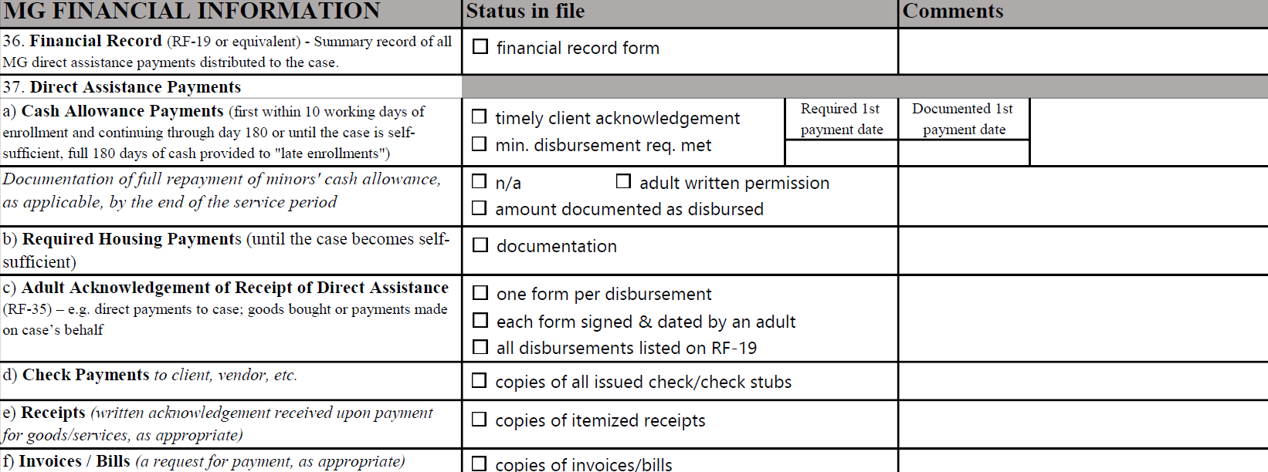
Resource #1a:
MG Monitoring Tool
MG
Program Administration
MG
Case File Forms and Review Tools
Login to MRSConnect

Slide 30

Resource #1b:
MG Addendum
MG
Program Administration
MG
Case File Forms and Review Tools
Login to MRSConnect
MG Addendum to the Case File Monitoring Tool, page 11-12
Receipts, Invoices, and Bills | USCCB/MRS expects programs to follow the Uniform Guidance finance practices for case file documentation. 45 CFR 75.302(b)(3) on financial management is particularly relevant. | 45 CFR 75.302(b)(3) - Financial Management: (b) The financial management system of each non-Federal entity must provide for the following (see also §§200.333 Retention requirements for records, 200.334 Requests for transfer of records, 200.335 Methods for collection, transmission and storage of information, 200.336 Access to records, and 200.337 Restrictions on public access to records): (3) Records that identify adequately the source and application of funds for federally funded activities. These records must contain information pertaining to Federal awards, authorizations, obligations, unobligated balances, assets, expenditures, income and interest and be supported by source documentation.

Slide 31
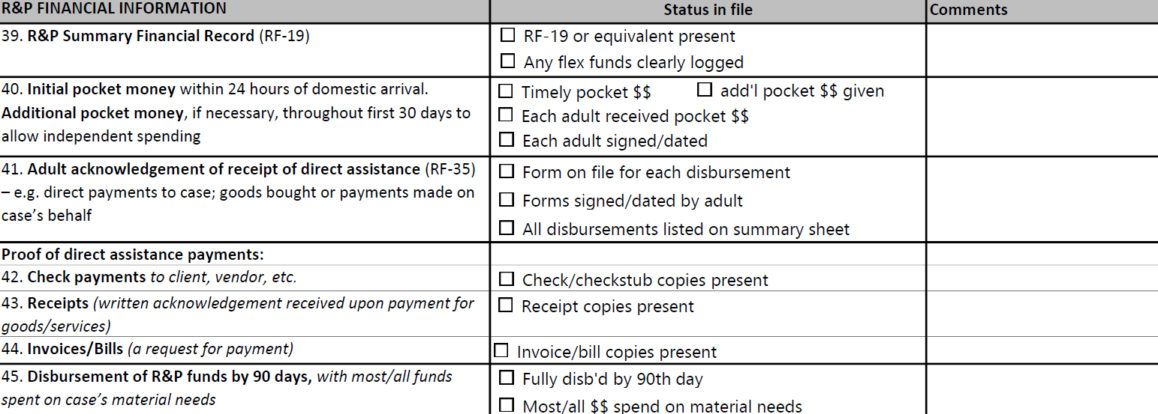
Continued from previous slide
Resource #2a:
R&P Monitoring Tool
Login to MRSConnect
R&P
Program Administration
R&P
Case File Forms

Slide 32
Continued from previous slide
Resource #2b:
R&P Addendum
Login to MRSConnect
R&P
Program Administration
R&P
Case File Forms
R&P Addendum to the Case File Monitoring Tool, page 1
Financial Documentation (federal funds and private contributions or donations) | USCCB/MRS expects programs to follow the Uniform Guidance finance practices for case file documentation. 2 CFR 200.302(b)(3) on financial management is particularly relevant. | Uniform Guidance 2 CFR 200.302(b)(3): (b) The financial management system of each non-federal entity must provide for the following (see also §§200.333 Retention requirements for records, 200.334 Requests for transfer of records, 200.335 Methods for collection, transmission and storage of information, 200.336 Access to records, and 200.337 Restrictions on public access to records): (3) Records that identify adequately the source and application of funds for federally funded activities. These records must contain information pertaining to federal awards, authorizations, obligations, unobligated balances, assets, expenditures, income and interest and be supported by source documentation.

Slide 33
Q&A Session
What questions do you have for us? Please type questions into the Q&A box or raise your hand to be unmuted.

Slide 34



May 10, 2022
Thank you!
Do you have any questions?

