Slide 1

April 19th, 2022
Lautenberg Program Webinar:
Filing FSU and RIF AORs

Slide 2
Presenter:
Alice Ngamije
Program Associate, Family Reunification
MRS – USCCB
angamije@usccb.org

Slide 3
1
2
3
Zoom Features
Chat
Q&A
Raise Hand
Interact with presenters and attendees by:
Typing into the chat box
Asking questions in the Q&A
Raising your hand
The Zoom toolbar is at the bottom of your screen!

Slide 4

Today’s Agenda
1
Key terms
2
Lautenberg program: overview and eligibility
3
Completing a RIF and FSU AOR
4
FSU and RIF AOR submission process
5
Rejected AOR cases: what to do

Slide 5

Learning
Objectives
Understand current eligibility requirements for the Lautenberg programs
Avoid common mistakes made when filing AORs
Identify supporting documents needed
Know what to do if your AOR case gets rejected
By the end of this webinar, you will be able to:

Slide 6
Key Terms
AOR
Affidavit of Relationship
US-Tie (or Anchor): initiates the application process through a local resettlement agency
UST
RSC
Resettlement Support Center
RIF
Refugee Information Form, another name for the Iranian AOR application
FSU
Former Soviet Union
PA
Principal Applicant: listed on the AOR as the primary individual with a qualifying relationship to the Anchor
Notes:
AOR: refers to the program or the actual application form depending on the context.
RSC: Resettlement Support center is the agency that conducts further processing of the AOR overseas. They also issue rejection letters when a case is found to be non-compliant.
FSU is an acronym for former soviet union countries.

Slide 7
The Lautenberg Program
Overview
First Enacted in 1989
The Lautenberg Amendment provides a pathway for members of historically persecuted religious groups from Ukraine and other countries from the Former Soviet Union to be reunited with family members already living in the U.S. In 2004, the amendment was expanded to include religious minorities from Iran. The Lautenberg amendment must be extended annually for new applications to be submitted.
March 2022
The Lautenberg program was reauthorized for this fiscal year on March 15th 2022. New applications can be submitted. Submission deadline is September 30th 2022.

Slide 8
Eligibility: US-Tie
FSU AOR
RIF/Iranian AOR
Must be 18 y/o or older
Legally reside in the United States:
  Refugee
  Asylee
  LPR
  US citizen
Must be a first-degree relative:
  Spouse
  Parent
  Child
  Siblings
  Grandparent
  Grandchildren
Must be 18 y/o or older
Legally reside in the United States:
  Refugee
  Asylee
  LPR
  US citizen
Has not have filed more than three (3) RIFs for friends or non-immediate family members (cousins, aunts, uncles, relatives by marriage and/or distant relatives etc).”
Notes:
Individuals other than the Principal Applicant (PA) may be eligible if they reside in the same household as the Principal Applicant and are part of the same economic unit.
Example:
If an Anchor applies for a sibling who is married with two children, (spouse and/or unmarried children under 21 years old) can be added to the application

Slide 9
Eligibility: PA
FSU AOR
RIF/Iranian AOR
FSU nationality/citizenship (including Ukrainian, Belarusian, Russian, Moldovan, etc)
Must have Qualifying relationship with anchor
Part of qualifying religious/ethnic minority:
  Jews (including Tats and Karaims)
  Evangelical Christians
  Ukrainian Greek Catholic
  Members of the Ukrainian Autocephalous Church
  Note: for Ukrainian Greek Catholic and Ukrainian Autocephalous Church, participation must have begun by 1989 and must have been public, active and continuous
Iranian nationality/citizenship. Must be a resident of Iran at the time of application
Can be a relative or friend of the anchor
Must be 18y/o or older
Part of qualifying religious/ethnic minority:
  Christians
  Jews
  Baha’is
  Zoroastrians
  Mandaeans

Slide 10
Completing a RIF and
FSU AOR

Slide 11
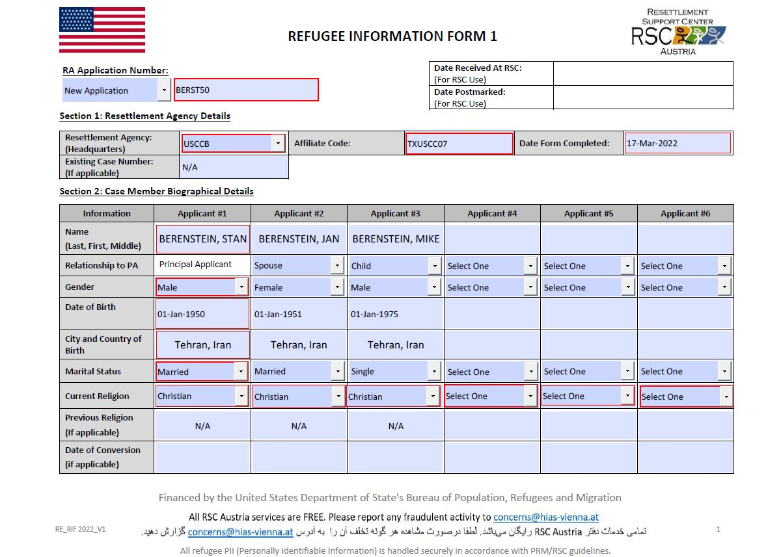

RIF AOR, section 1 and 2
Page 1
RA Application Number: First three letters of PA’s last name + first two letters of PA’s first name + last two digits of PA’s birth year
Put correct affiliate code for your office
Each applicant has their own column and are assigned a number (applicant #1, applicant #2 etc)

Slide 12
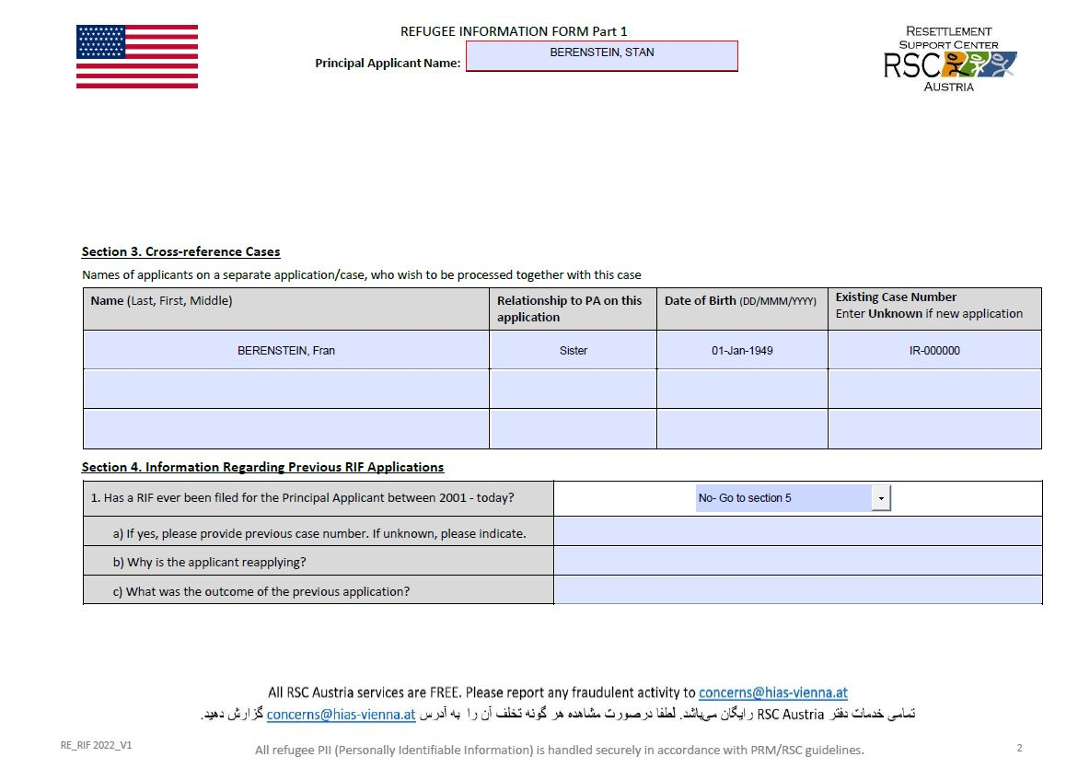
RIF AOR, section 3 and 4
Page 2
Other applicants (not listed in Section 1) can be listed here to be processed together
List existing case number, if applicable and known. If new application, put “Unknown”
Previous RIF filed for PA: provide case number and reason for reapplying

Slide 13
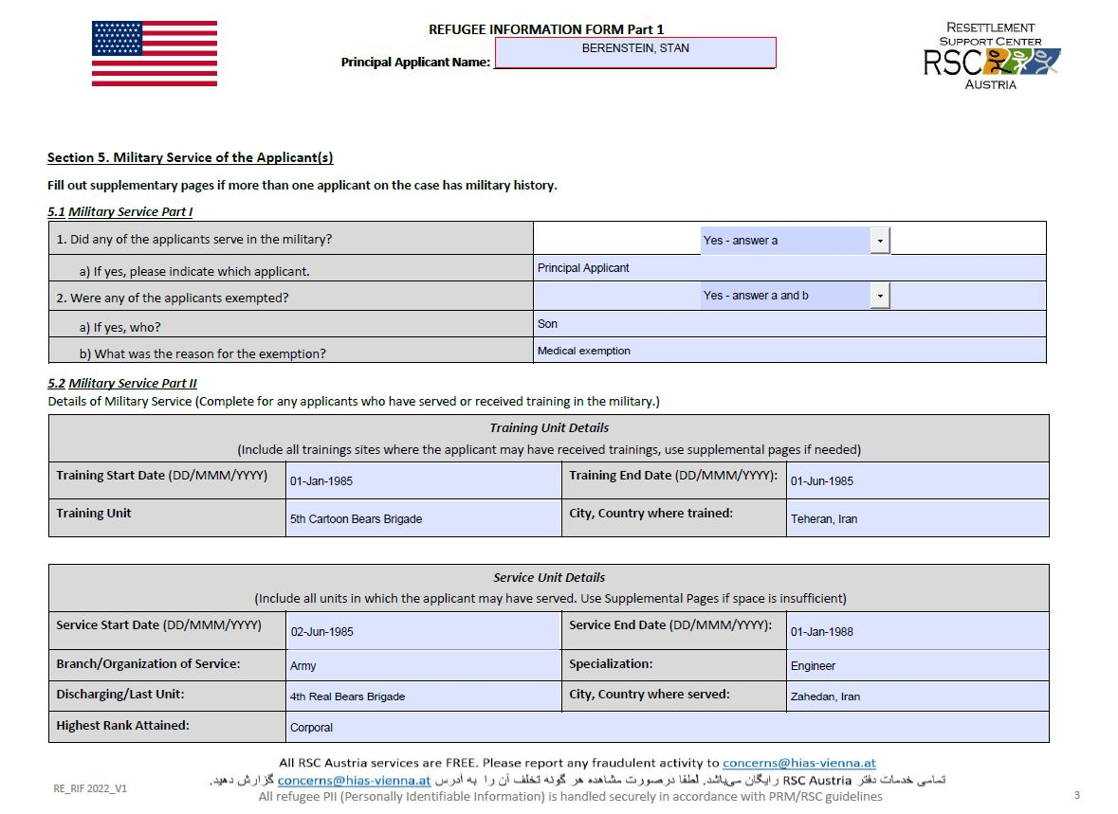
RIF AOR, section 5
Page 3
Information about Military Service. To be completed for any applicant who has served or received training in the military.
Additional pages are provided for additional applicants

Slide 14
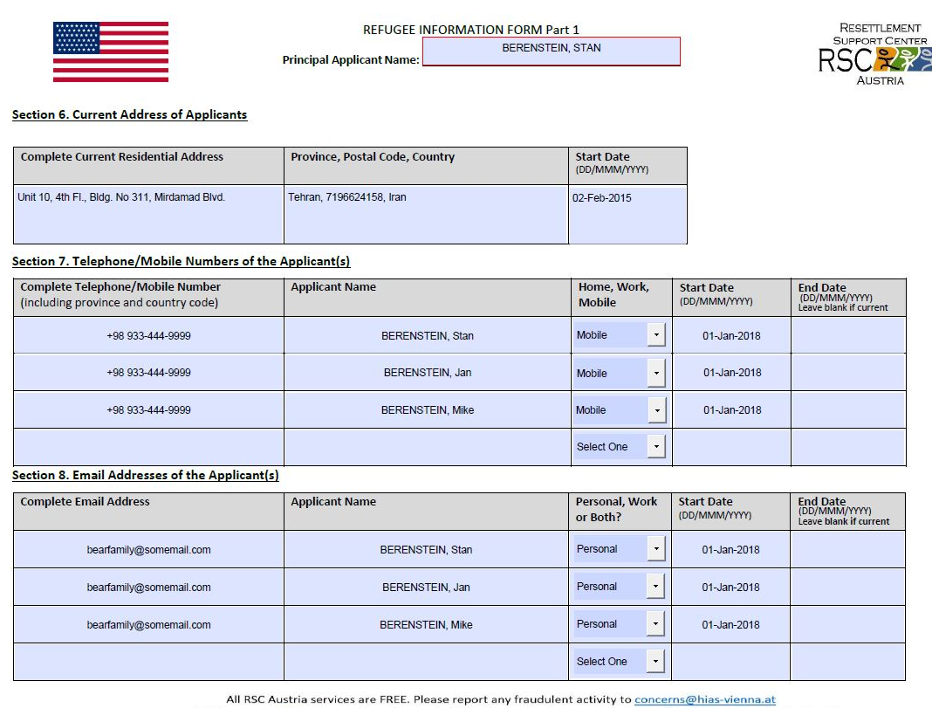
RIF AOR, section 6, 7 and 8
Page 4
Include a complete address
List phone number and email for each applicant listed

Slide 15
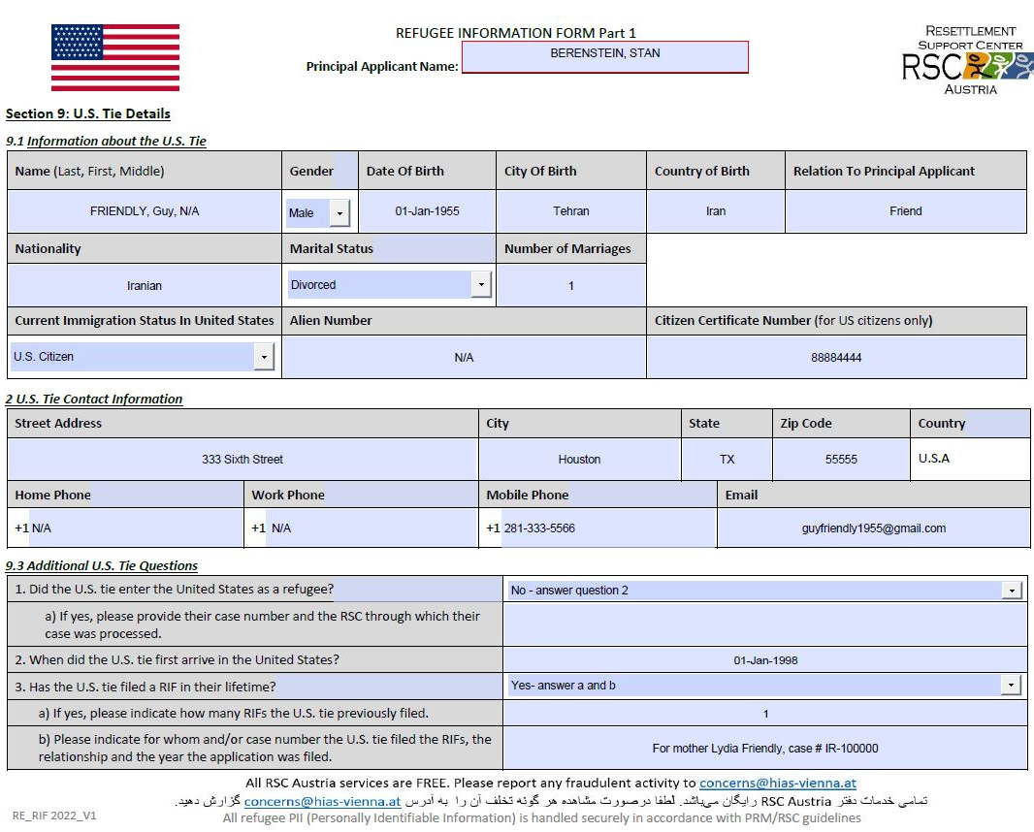
RIF AOR, section 9
Page 5
Complete information for the UST
If the UST came to the US as a refugee, provide case processing information (case number, name of RSC)
Number of RIF filed must be accurate

Slide 16
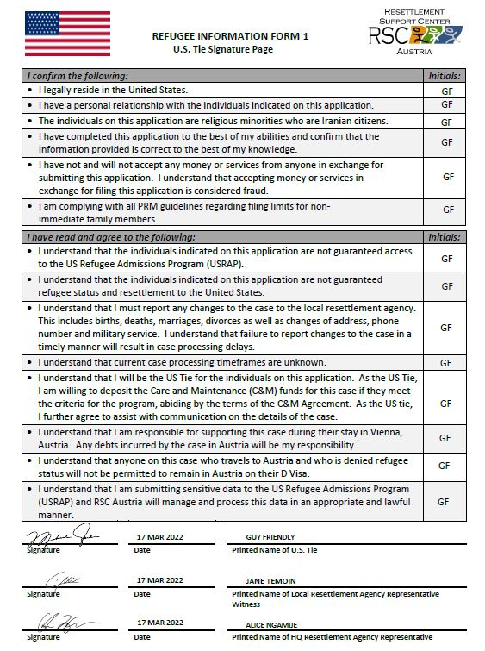
RIF AOR, signature page
Page 6
UST must put initials for each phrase to confirm understanding
Handwritten signatures needed

Slide 17
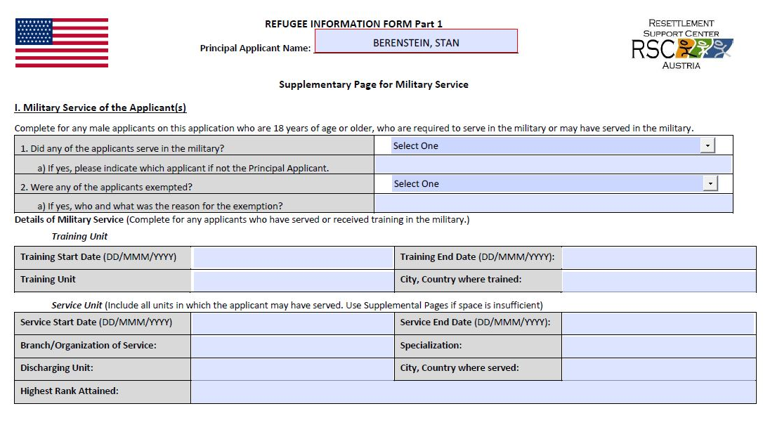
RIF AOR, supplementary pages
Page 7
Additional pages for applicants to use
If not needed, leave blank

Slide 18
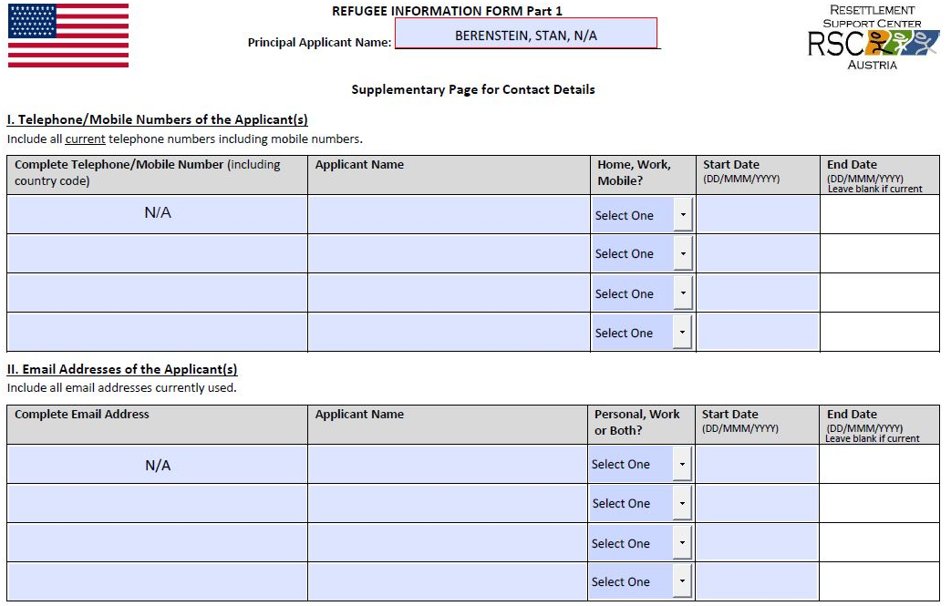
RIF AOR, supplementary pages
Page 8
Additional pages for applicants to use
If not needed, leave blank

Slide 19
Required Documents: RIF AOR package
RIF1 and UST signature page
Proof of legal residence for UST
A copy of the completed (X’s marked, name filled in) application checklist
A certified translation of each required document not in English
Birth Certificate of each case member, all pages
All pages of all current passports for case members
National ID for each case member, back and front
*Color passport photos for each case member (Pending guidance from RSC Austria)
Religious Identification Documents
  Ex: if Christian, a baptism certificate or certificate of membership issued by a church. If Mandean, front and back of Mandean card.
10. Other documents as applicable:
  Ex: Missing Document Statement; For every male applicant over 18, front and back of military service card or military exemption card.
Notes:
Birth certificates
Marriage certificate
Passports
Proof of US Citizenship (US passport or naturalization certificate)

Slide 20
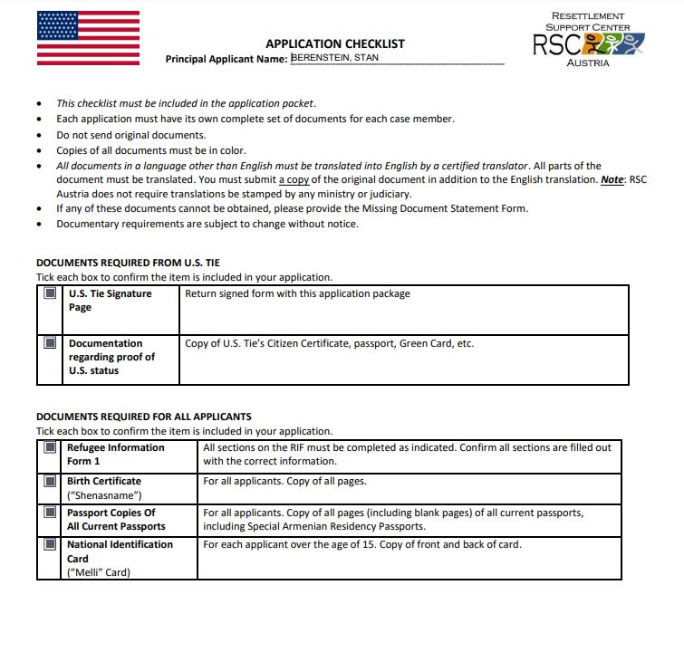

Slide 21
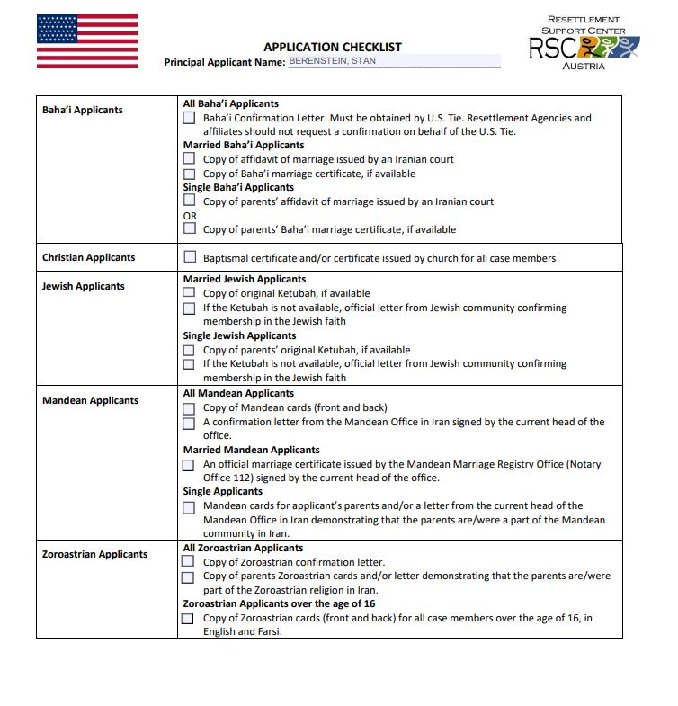
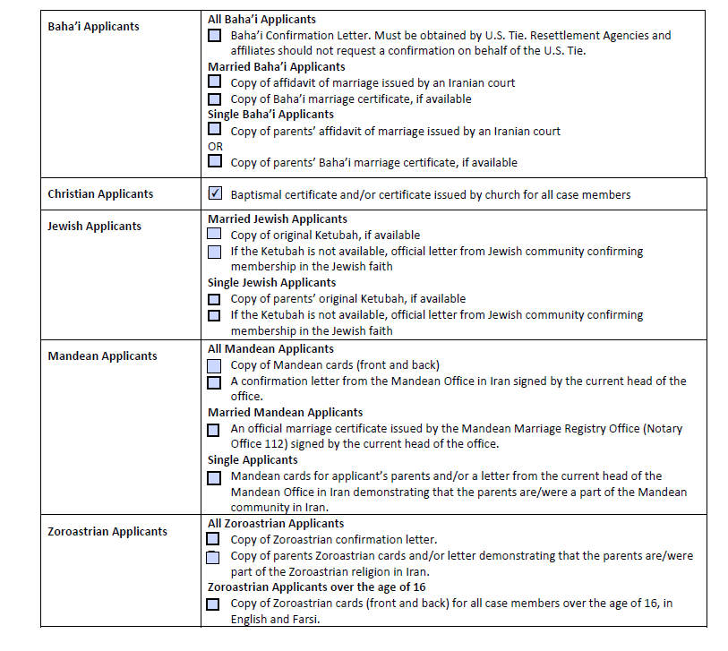

Slide 22
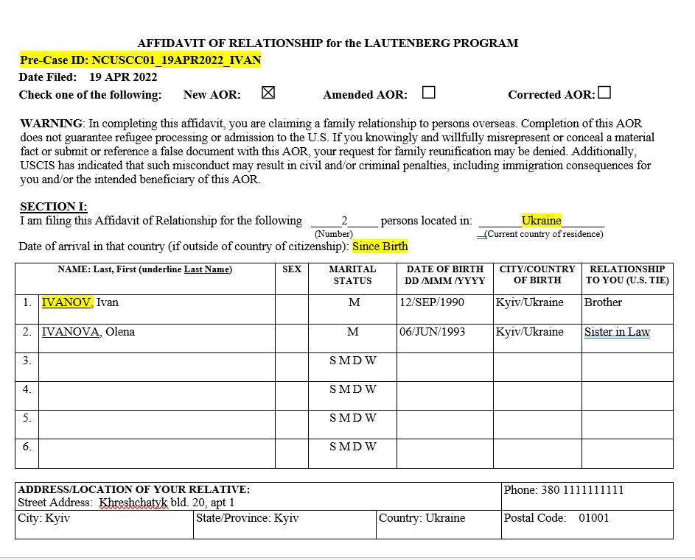
FSU AOR, section I
Page 1
Put correct Affiliate Code
Pre-case ID: Affiliate Code_Date completed_First four letters of UST’s last name
List current country of residence, even if it is different from country of citizenship
Last names should be underlined, no middle name should be listed in this section

Slide 23
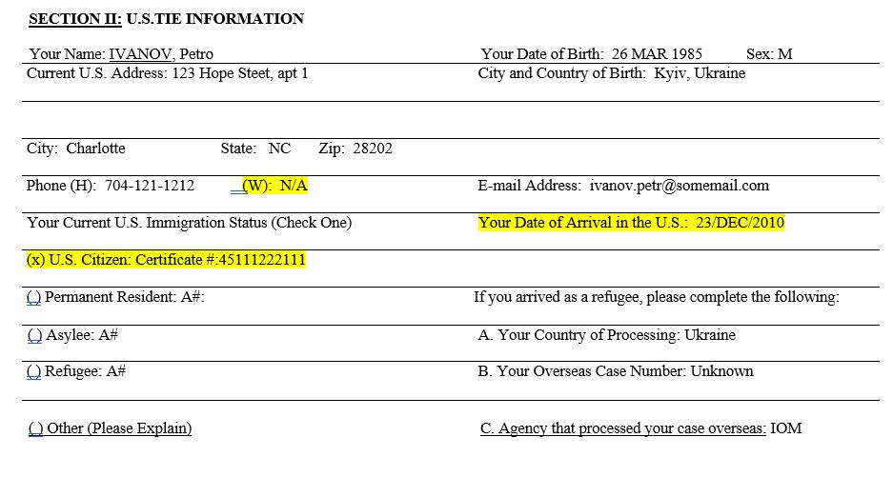
FSU AOR, section II
Page 2
Address must be as complete as possible
Select the correct/current immigration status for the anchor (ex: entered the USA as a refugee but is now a US citizen, check US Citizen).
Throughout the AOR, use correct format for dates dd.mmm.yyyy
All applicable fields should be filled out. When not applicable, put “N/A”. When information is not known, put “Unknown”

Slide 24
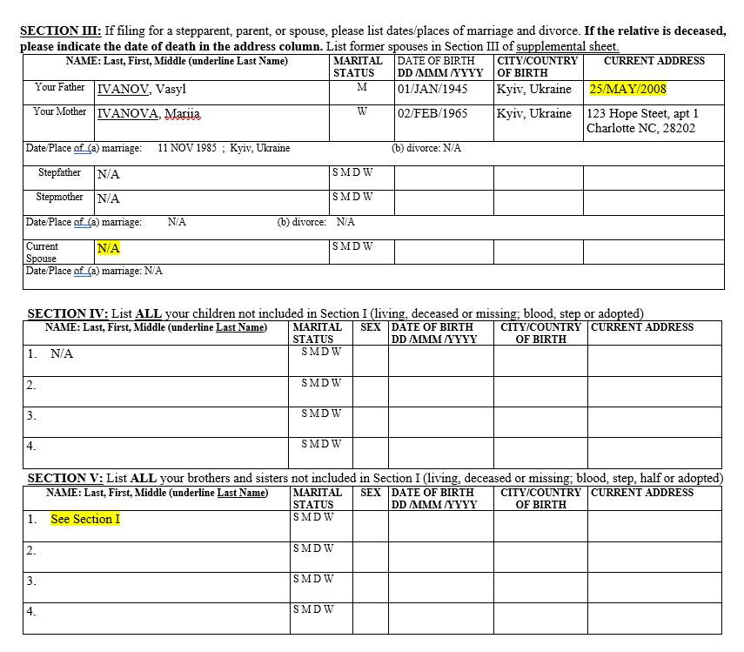
FSU AOR, sections III - V
Page 3
List parents' information, even when not applying for them.
If a parent is deceased, list a date of death in the current address field.
List Current Spouse, if applicable
If the anchor’s only children/siblings are the ones listed in section 1, put “See Section 1”. If not, list additional ones in Section IV and V or put N/A

Slide 25
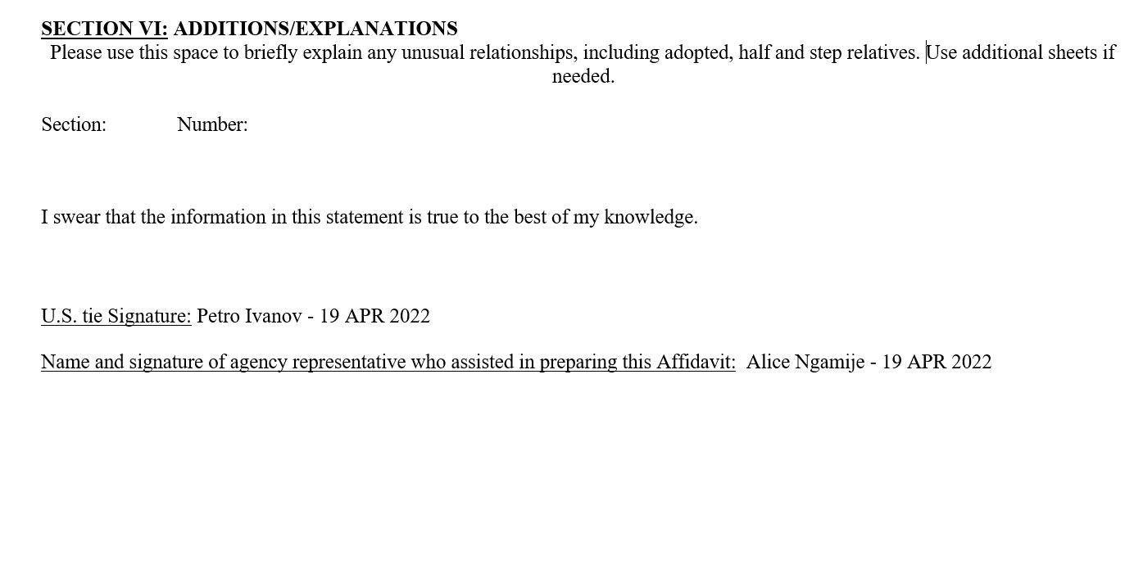
FSU AOR, sections III - V
Page 4
Use this space for additional comments/ clarifications if needed
Handwritten and electronic signatures allowed
Mandatory signatures for both UST and local resettlement representative, cannot be left blank

Slide 26
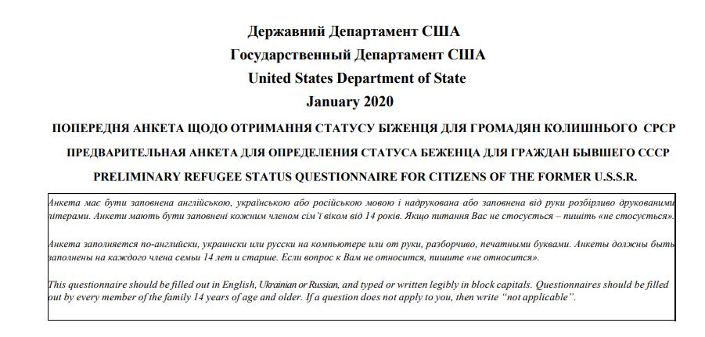
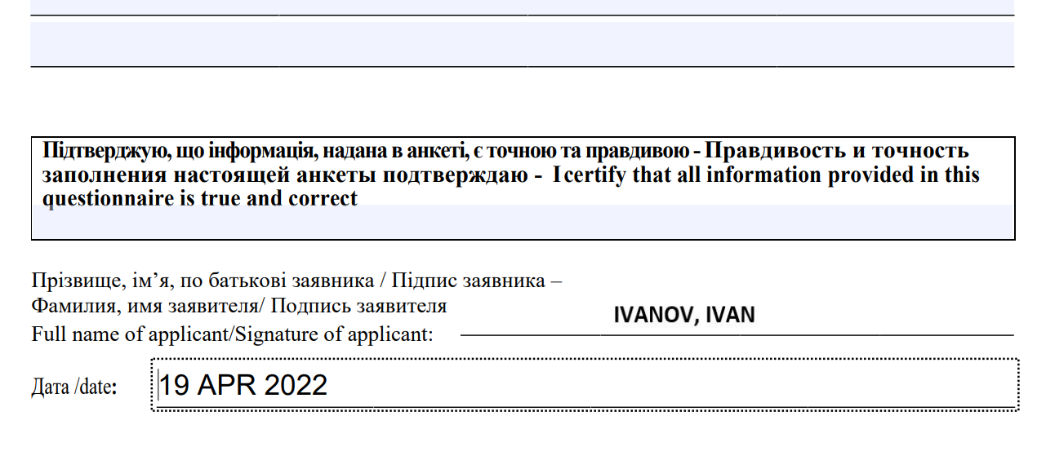
Preliminary Questionnaire (PQ)
Must be completed by applicants listed on FSU AOR (14 y/o and above)
31 questions, instructions in Ukrainian, Russian and English
Information and signature must be of applicants, not UST
Handwritten signatures preferred, but not mandatory. Applicants’ signature on PQ is optional

Slide 27


Passport Photos
Face forward, ears visible, white background or solid color
No visible shadows
USCIS Passport Photo tool,
access it here
SEQ #1
IVANOV, Ivan
12 SEP 1990
SEQ #2
IVANOVA, Olena
06 JUN 1993

Slide 28
Required Documents: FSU AOR package
Affidavit of Relationship (AOR)
Preliminary Questionnaire (PQs)
Proof of legal status of U.S tie in the United States (Naturalization certificate, LPR card, I-94 etc)
Proof of relationship (Birth certificate, marriage certificate, Divorce certificate, Proof of name change etc)
Proof of identity of AOR beneficiaries (passports, birth certificate)
Full frontal U.S. passport size photos
Notes:
Birth certificates
Marriage certificate
Passports
Proof of US Citizenship (US passport or naturalization certificate)

Slide 29
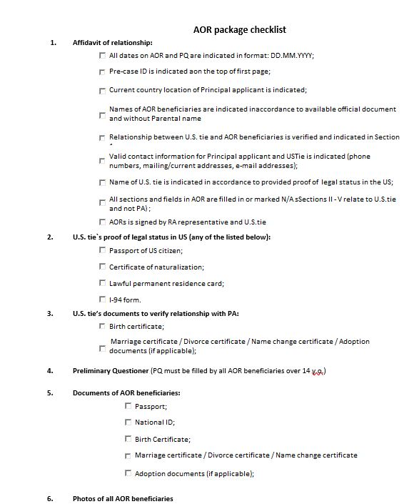

Slide 30

Tips on avoiding common mistakes when filing AORs
Follow requirements for each program
Verify that each field is completed or is marked with N/A
Check for names/spelling errors. Spelling should match documentation provided
Document copies must be clear and readable
Utilize resources on MRSConnect AOR page (must have an MRSConnect account and be logged in)

Slide 31
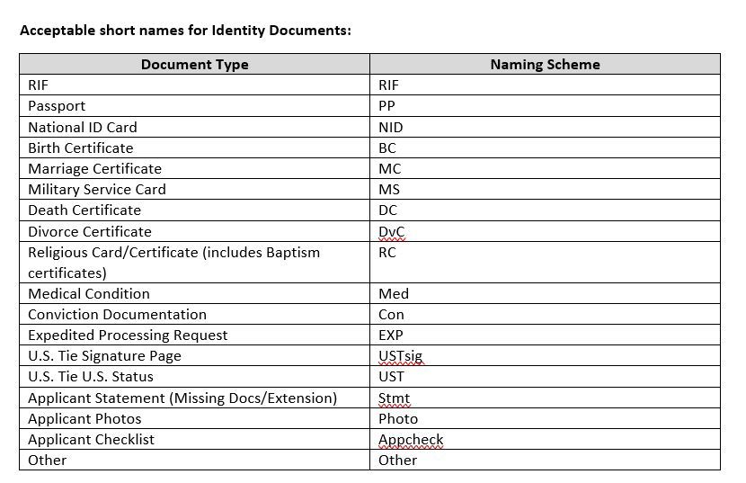
Lautenberg AOR Submission: RIF
Verify Applicant Checklist to ensure all required documents are included
Each document must be its own pdf file
Save AOR file and documents using the proper naming convention
Send email to USCCB with all required files attached
Can be sent as a zip folder or multiple emails
Indicate the RA Application Number in the subject line. Ex: New RIF AOR Submission - BERST50
USCCB submission mailbox: AOR@usccb.org
USCCB inquiry mailbox: AORcommunication@usccb.org
Notes:
RA Application Number: first three letters of the PA last name, the first two letters of PA first name, and the last two digits of year of birth.
For example, Joe Smith (YoB: 1960) would be: SMIJO60.

Slide 32
Lautenberg AOR Submission: FSU
Save AOR file and documents using the proper naming convention
Only one PDF is needed
Send email to USCCB with all required files attached
Can be sent as a zip file
Indicate Pre-case ID in the subject line.
Ex: New FSU AOR Submission – NCUSCC01_12APR2022_IVAN
If anchor intends to submit multiple AORs, additional AOR must include a 1, 2, 3, etc. after the final part of the Pre-Case ID
USCCB submission mailbox: AOR@usccb.org
USCCB inquiry mailbox: AORcommunication@usccb.org

Slide 33
AOR Rejection Letter: What To Do?
USCCB will notify you of a rejection for your case
Re-vetting of the entire AOR
90 days correction deadline
Reach out to UST, make corrections AOR and/or provide all additional documents requested
Send corrected AOR early

Slide 34
Note on pending Lautenberg
AOR cases
Existing FSU Lautenberg AOR cases:
Case processing has continued through the Resettlement Support Center (RSC) Eurasia. If applicants are unable to attend the scheduled activity in the specified location, they should inform RSC Eurasia as soon as possible.
Applicants can write to RSC Eurasia at
ICC@iom.int for case update inquiries or to inform the RSC of new location/contact details, if those have changed. If applicants have completed all processing steps and are in a location where IOM can organize their departure, the RSC will inform them of their next steps
Existing Iranian Lautenberg AOR cases:
D Visa processing continues to be on hold.
If you have clients who have pending RIF cases and who need to update their documents (ex: expired passports), you can send those to: AORcommunication@usccb.org and we will update them with RSC Austria
Notes:
IRAN: D Visas are not currently being issued for the purpose of the Iranian Lautenberg program and we do not know when it will resume. Austria and the United States have to reach a diplomatic agreement to allow the process to continue the same way it was before, For find new alternatives. We will make sure to inform our affiliates whenever there is an update regarding this situation.
FSU: The RSC anticipates that some activities will be delayed due to the situation in Ukraine. Once applicants are scheduled for a processing activity, they will receive specific information related to that activity.

Slide 35
Thank you!

Slide 36

April 19th, 2022
Questions?

