Slide 1
December 14th, 2021
CAM PROGRAM WEBINAR:
Filing a CAM AOR

Slide 2
Presenter:
Alice Ngamije
Program Associate, Family Reunification
MRS – USCCB
angamije@usccb.org

Slide 3
1
2
3
Zoom Features
Chat
Q&A
Raise Hand
Interact with presenters and attendees by:
Typing into the chat box
Asking questions in the Q&A
Raising your hand
The Zoom toolbar is at the bottom of your screen!

Slide 4
Today’s Agenda
1
Key terms
2
CAM program: overview and eligibility
3
Completing a CAM AOR
4
Tips to avoid common mistakes
5
CAM AOR submission

Slide 5
Learning
Objectives
Understand current CAM program requirements
Recognize who qualifies as a QP, a QCH, a derivative and/or an add-on
Identify supporting documents needed
Avoid common mistakes when filing a CAM AOR
By the end of this webinar, you will be able to:

Slide 6
Key Terms
Affidavit of Relationship
Central American Minors
AOR
CAM
Refugee Processing Center
QP
Qualifying Parent
RPC
RSC
Resettlement Support Center
QC/QCH
Qualifying Child

Slide 7
The CAM Program
Overview and Eligibility
Established in November 2014
Provides a legal pathway for eligible people in the United States to claim a relationship with their children and relatives in Honduras, Guatemala and El Salvador for the purpose of family reunification
Program closure in 2017
March 2021
Reopening of the program in two phases
- Phase 1: reopening eligible old CAM cases
- Phase 2: accepting new CAM AORs
Eligibility requirements are specific for each person listed on the CAM AOR
Notes:
CAM was started in 2014 to give at-risk children in El Salvador, Guatemala, and Honduras the opportunity to come to the United States as refugees
Yes. On March 10, 2021, the Departments of State and Homeland Security announced the reopening of CAM. The reopening has two stages.

Slide 8
Individuals on a CAM AOR
Qualifying Parent (QP)
Qualifying Child (QC or QCH)
Biological Parent
Legal Guardian
Stepparent
Biological Child
Adopted Child
Stepchild
Derivatives
Add-Ons
Type B – QCH’s child
Type C – QP’s spouse
Type D – QCH’s other parent
Type E – Primary caregiver
Type F – QCH’s adult sibling

Slide 9
Qualifying Parent (QP)
Eligibility
Relationship with QCH
At least 18 years old
Lawfully present in the United States with a eligible legal status for CAM
Does NOT need to be a national of El Salvador, Guatemala or Honduras
Note
A proof of legal status should have a valid expiration date.

Slide 11
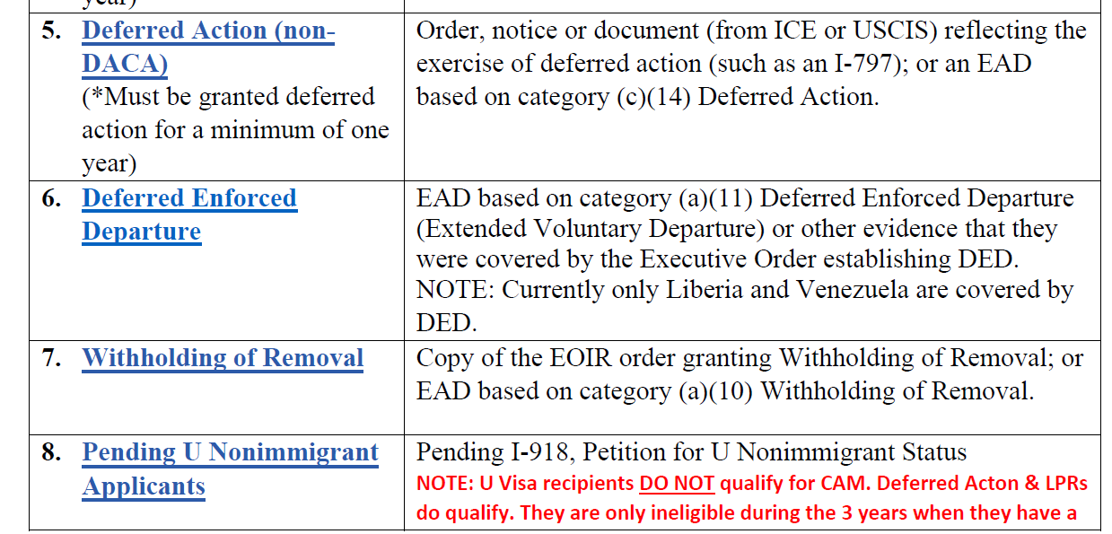

Slide 12
Qualifying Child (QCH)
Eligibility
Under 21 years old
Unmarried
Must be a national of El Salvador, Guatemala or Honduras
Must reside in one of the Northern Triangle countries (does not have to be country of nationality)

Slide 13
Derivatives and Add-ons
Type | Relationship to QP | Relationship to QCH | Eligibility Requirements
B | Grandchild | Child | Unmarried and under 21 years old
C | Spouse | Not Required | Documented marriage to QP
D | Not Required | Biological Parent | Not married to QP Affidavit of Support needed Additional documents that provide evidence of caregiver relationship
E | Biologically related to QP or QCH |  | Primary Caregiver of QCH Affidavit of Support needed
F | Child | Sibling (full, half, step, or adoptive) | Must be legal, biological, or adoptive child of QP Is married and/or 21+
Note
Derivatives derive their status from the QCH, while the add-Ons have to demonstrate their own refugee claims

Slide 14
Type C, D, E,F and their families
Type C-2 ; D-2; E-2 and F-2: Spouses
Type C-3; D-3; E-3; F-3: Children (must be under the age of 21)
Families derive their status from their add-ons, therefore if a type D is ultimately approved as a refugee via the CAM program, D-2 and D-3 individuals (spouse and children) will also be approved.
Note
A QP cannot apply for any derivative/add-on without a QCH included on the CAM AOR

Slide 15
Supporting Documents
Birth certificates are required for all beneficiaries
Type C , D, E must all be part of the same economic unit and household as the QCH to qualify
Type E requires additional evidence of caregiver relationship
Affidavit of Support form I-134

Slide 16
Affidavit of Support: form I-134
Can be found on the USCIS website
You can download the PDF document here and instructions here
Required for Type D and E
One per add-on family group
Ex: Type D, Type D-2 and Type D-3 only need to submit one I-134 form

Slide 17
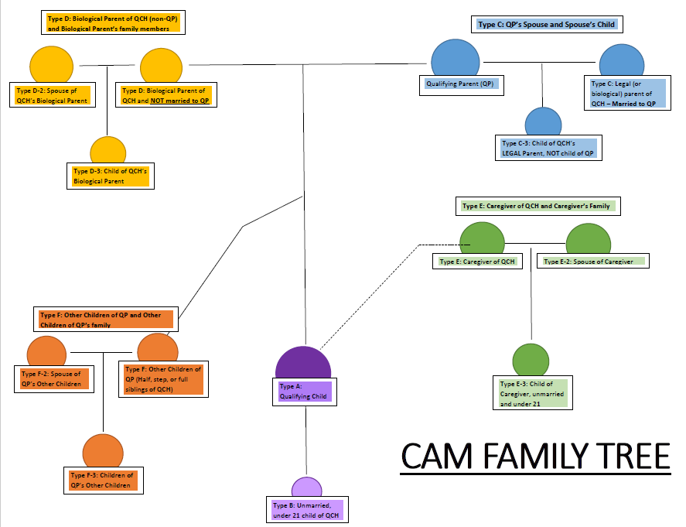

Slide 18
Questions?

Slide 19
Completing a CAM AOR
Use the latest version of Form DS 7699 (.far file format)
Must be fully typed, including signature page
Must be completed in Cerenade Filler, then saved as a PDF file (download Cerenade filler here)
Please email AORcommunication@usccb.org to request a copy of the DS 7699 form

Slide 20
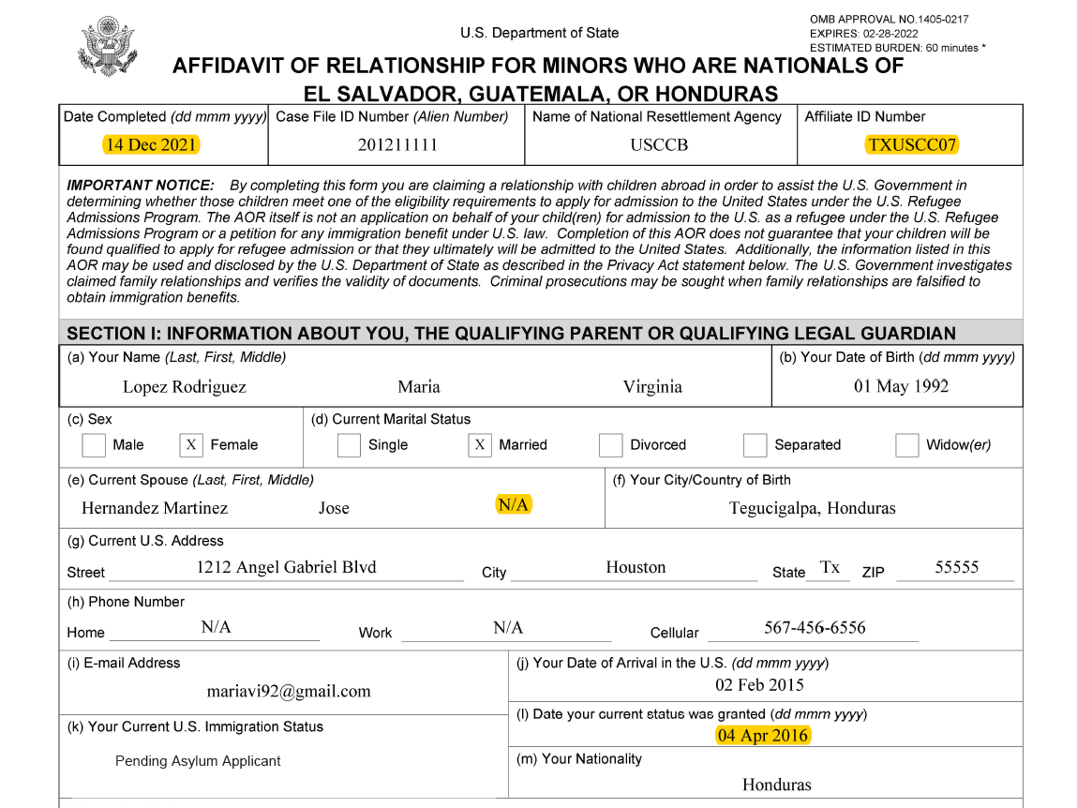
Form DS-7699, section I
Page 1
Use correct format for dates dd.mmm.yyyy
Put correct Affiliate Code
QP’s information should match the documents provided
Current legal status of QP accurately selected
All applicable fields should be filled out. When one is not applicable, put N/A

Slide 21
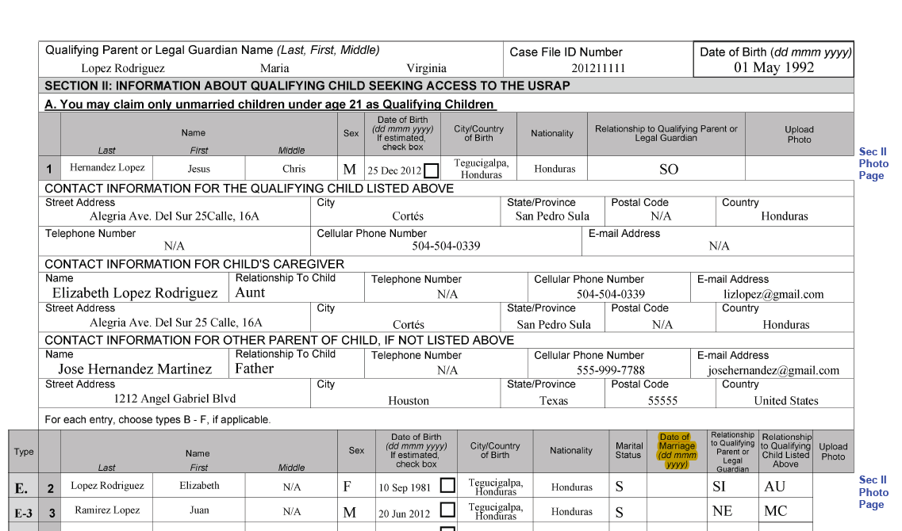
Form DS-7699, section II
Page 2
If there are multiple QCHs, must be listed from oldest to youngest
Should list both city and country of birth, not just one or the other
Address must be as complete as possible
If the other parent information is unknown, a supporting comment must be included
If there is only one QCH on the AOR, put N/A in Section II A, II B, II C, II D and II E

Slide 22
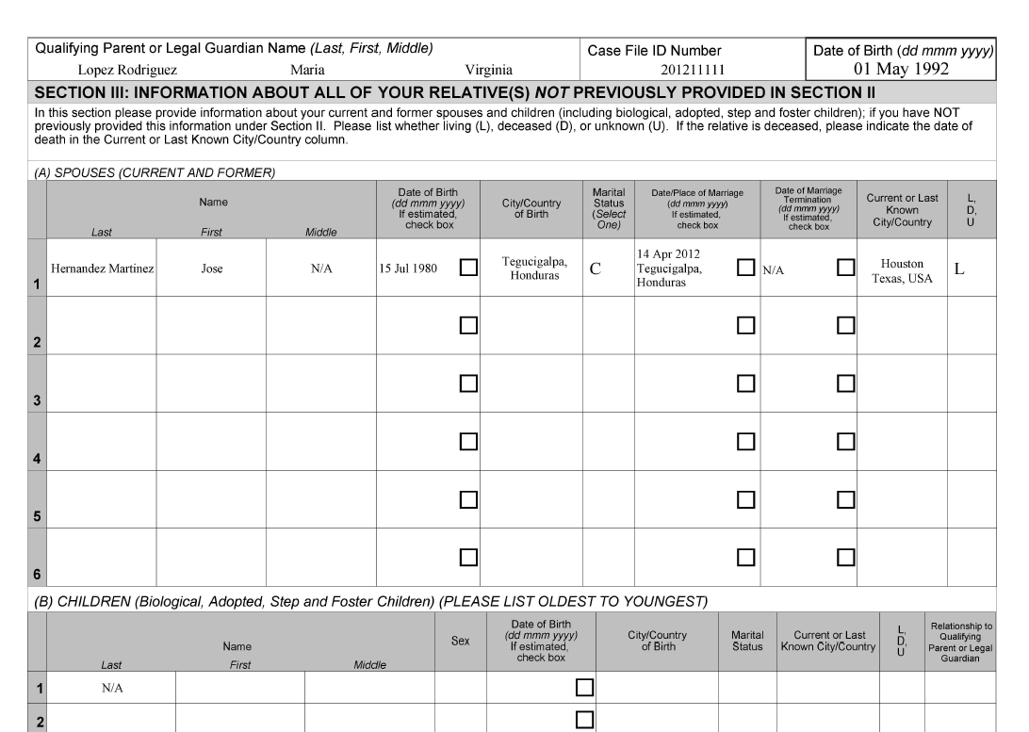
Form DS-7699, section III
Page 3
List all spouses, current and former
List all other children from oldest to youngest

Slide 23
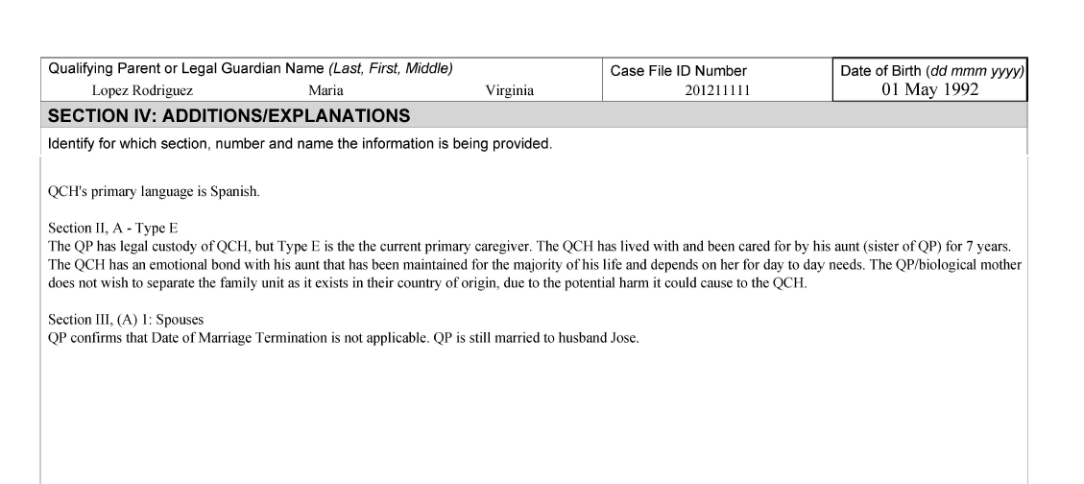
Form DS-7699, section IV: Additions/Explanations
Page 4
Use this space for additional comments/ clarifications needed

Slide 24
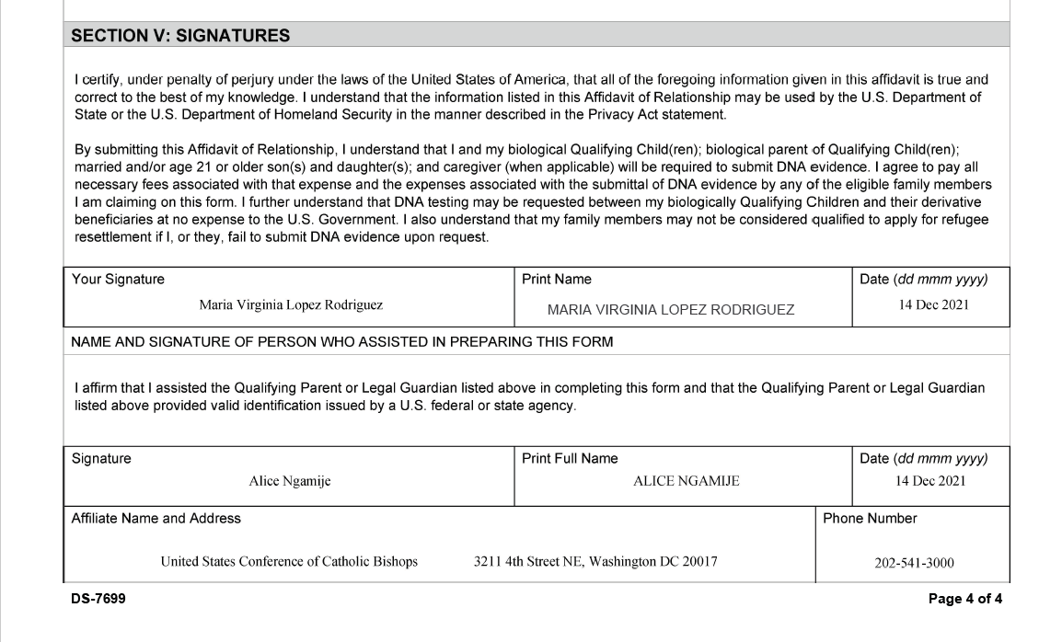
Form DS-7699, section V
Page 4
No handwritten signatures, electronic signatures only
Signature date should match with date completed on Section 1

Slide 25
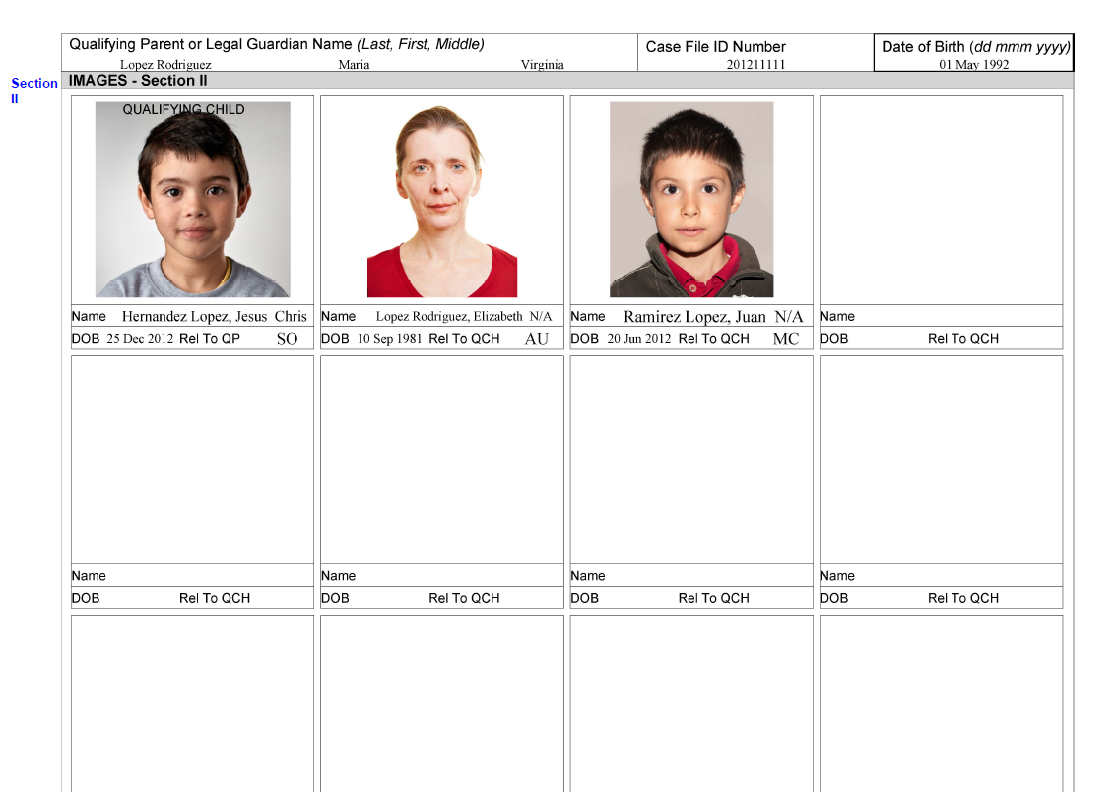
Form DS-7699, section V
Page 4
Face forward, ears visible, white background or solid color
No visible shadows
Passport photo files: .bmp or .tif
USCIS Passport Photo tool,
access it here

Slide 26
Tips on avoiding common mistakes
while filling out the DS 7699
Verify that each field is completed or is marked with N/A or “Unknown”
Check for names/spelling errors
Verify supporting documents
Utilize the following resources on MRSConnect:
CAM Handbook
Documentary Evidence for CAM
CAM Checklist

Slide 27
CAM AOR Submission
File Naming Convention
New AOR: [Affiliate code] – [Date Completed listed on the DS form] – [First four letters QP’s Last Name]
Example: TXUSCC07-Dec142021-LOPE
Corrected AOR Example: TXUSCC07-Dec142021-LOPE Corrected
Amended AOR Example: TXUSCC07-Dec142021-LOPE Amended
Supporting Documents:
Example: SD 1 TXUSCC07-Dec142021-LOPE
Save AOR as PDF
Use the right format when naming the files
Send the full package to USCCB
USCCB submission mailbox: AOR@usccb.org
USCCB inquiry mailbox: AORcommunication@usccb.org

Slide 28
Thank you!

Slide 29
December 14th, 2021
Q&A

