Slide 1
APA Network Call
November 17, 2021

Slide 2
USCCB Network Arrivals Update
Weekly APA Pipeline Stats | As of 11/10/2021​ | As of 11/17/2021​
Current USCCB APA Capacity​ | 11,030 ind. | 11,030 ind.
Total USCCB APA Individuals Assured​ | 7,295 ind.​ | 9,425 ind. (cumulative)
Total APA Individuals Selected by USCCB, Awaiting Assurance | 3,834 ind. | 1,764 ind.
APA Individuals Traveled to Final Destination​ | 4,045 ind. | 4,957 ind. (45% of capacity)
Total Assured Not Traveled​ | 3,250 ind. | 4,484 ind.
Ready for Departure​ | 1,016 ind. | 1,960 ind.

Slide 3
APA Statistics
Total Number of Evacuees: 84,128
Total Afghan Parolees (including SIV applicants): 69,870
Evacuees at Lily Pads: 2,630
Evacuees at Safe Havens: 46,259
Departures from Safe Havens: 35,252
Total Affiliate Arrivals: 19,314
Total Assurances: 26,319
Total Ready for Departure From Bases: 9,672

Slide 4
APA Travel Plans
With almost all cases assured, Refugee Processing Center working on a travel schedule for all APA cases
Safe Haven closures:
Last group of Afghan nationals departing Fort Lee today
Fort Bliss and Quantico to be emptied out by 2nd week in December
Atterbury, Pickett, and Holloman to be emptied out in Dec-Jan
Fort Dix and Fort McCoy to be emptied out in February

Slide 5
Informational Update
SSA Updates
PRM has shared that IOM expects to mail the vast majority of outstanding SS cards during the last week of November through the first week of December. If you need urgent receipts of application in the meantime, connect with your local SSA.
Housing on Demand
PRM is working with General Services Administration (GSA) on a program called Housing on Demand. GSA will work to secure extended stay and executive suite type of temporary housing as a last resort to support RA’s. PRM is working with an initial list of 36 cities for this program. USCCB will share details and next steps as soon as we receive them.
APA Award
USCCB’s updated APA award was received today. The full Capacity Development Funding request that was submitted was approved. We will be working over the next few days to get award letters out to all agencies.

Slide 6
Informational Update
MRIS APA Build
The MRIS team is in the final stages of testing the APA build
Post-arrival transfers
Please reach out to your site’s pre-arrival case manager (PACM) to see if transfer is possible on a case-by-case basis. For walk-in APA cases transfers are allowable if the original assurance agency agrees to the transfer. For non-walk-in cases (e.g., clients who out-migrated during their service period) transfer is unlikely.
Guest Speaker
Ardiane Ademi from Catholic Charities Archdiocese of Galveston-Houston will share about her team’s experience with the APA program and various challenges they’ve worked to overcome over the past few months.

Slide 7
Catholic Charities of the Archdiocese of Galveston-Houston
Afghan Placement and Assistance Program

Slide 8
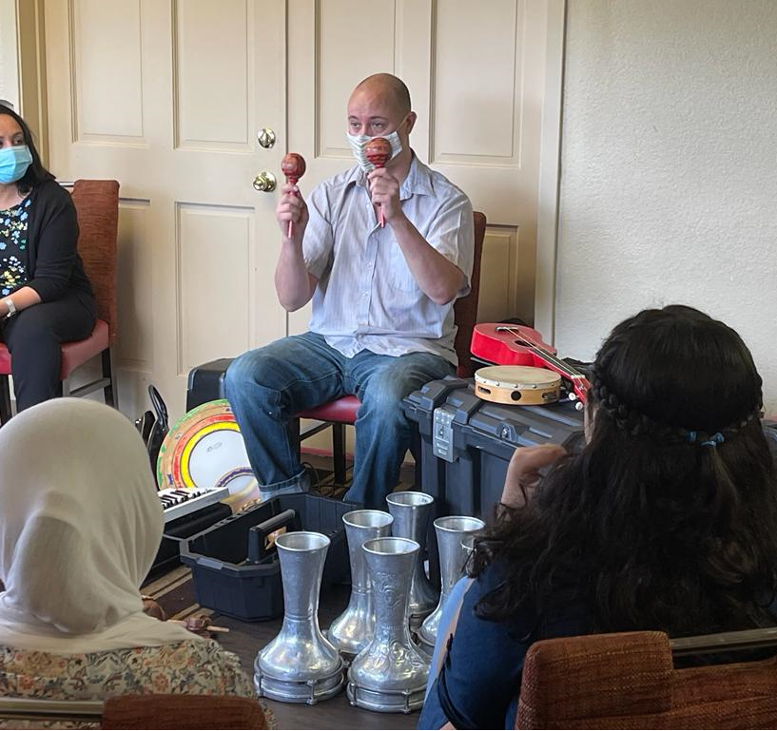
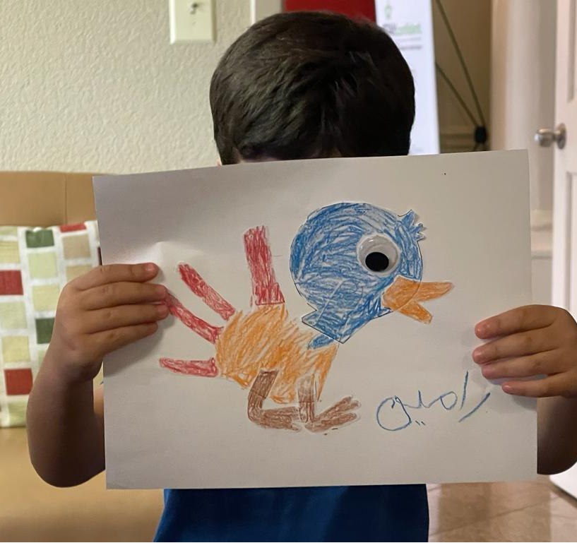
APA Program Overview
Houston Refugee Consortium to resettle 4,000 Afghan Parolees
Support of Senior Management
Resettlement of 124 NYT staff and their families from Kabul Bureau
Staff Structure
Department has grown from 37 to 65
Traditional case management adjusted as we work on hiring enough staff
Teams within the department responsible for different pieces of the APA process (i.e. SAS team helping with SNAP applications, RSI team helping with school registrations, accounting clerks helping with financial distributions, etc.)
Use of interpreter services for RCA and MG teams
Organized logistics for airport pick up
Partnership with Extended Stay America
Catholic Charities office at hotel
48 hours visit at hotel
Culturally appropriate food distributions from food pantry twice a week
Intakes in hotel conference room
ESL classes in hotel conference room
Use of Houston Afghan Resettlement Fund
https://houstonafghanhelp.org
Partnership with local Afghan Groups and local churches
Assistance of volunteers
Assistance of support services of CC in setting up apartments

Slide 9
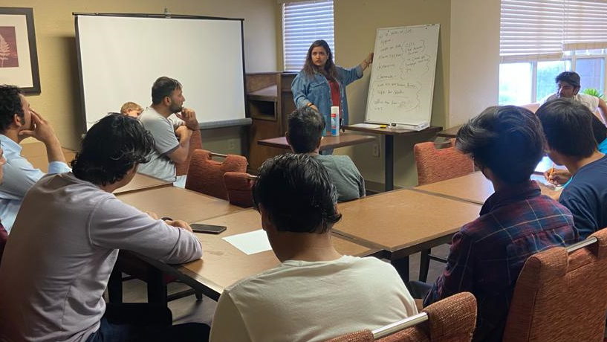
Challenges
Retrieval of I-94
Missing documents needed for SNAP applications
Appointments with SSA office
Organizing second dose of vaccinations and school registrations
Staff shortage
Mental health support

Slide 10
Resources & Training
APA Network Calls - Register here
December 1 (Regularly scheduled USCCB network call December 15)
January 5, 19
February 2, 16
Resources
Staff Mental Health and Secondary Trauma guide
Webinars
Community Sponsorship: Sharing Promising Practices and Lessons Learned
Thursday, December 2 @3:00pm ET
Register here

Slide 11
Thank you!
See you next Wednesday!

