Slide 1
APA Network Call
November 10, 2021

Slide 2
USCCB Network Arrivals Update
Weekly APA Pipeline Stats | As of 11/3/2021​ | As of 11/10/2021​
Current USCCB APA Capacity​ | 11,030 ind. | 11,030 ind
Total USCCB APA Individuals Assured​ | 4,949 ind.​ | 7,295 ind. (cumulative)
Total APA Individuals Selected by USCCB, Awaiting Assurance | 957 ind. | 3,834 ind.
APA Individuals Traveled to Final Destination​ | 3,287 ind. | 4,045 ind. (36.7% of capacity)
Total Assured Not Traveled​ | 1,665ind. | 3,250 ind.
Ready for Departure​ | 390 ind. | 1,016 ind.

Slide 3
APA Assurance Sprint Update
With the exception of a few cases, USCCB has placed all of our pre-assigned cases with USCCB affiliates and community partners
Goal is for affiliates in non-impacted locations to assure all cases by COB tomorrow (Thursday, November 11)
Goal is for impacted locations to assure all cases by COB Tuesday, November 16.
Goal of assurances frontloading exercise is to meter arrivals between now and February 15 to enable better planning and preparation.

Slide 4
Refugee Travel Update
To help expand APA capacity, PRM has paused new R&P refugee bookings until January 11, 2021.
Exceptions to the bookings pause include:
Follow-to-join (V93/I730s), P3, CAM, and P2 I-130s
SIVs
Urgent/protection/medical cases
USRAP will observe usual annual holiday travel moratorium for all refugee cases from December 17th through January 10th.

Slide 5
Informational Update
APA and PC Awards
USCCB continues to hear from PRM and ORR that we should be receiving our APA and PC Supplemental awards imminently.
USCIS Updates
USCIS recently announced fee exemptions and streamlined processing for Afghan Nationals. Information on this will be going out in an APA Update this afternoon. This includes a fee waiver and specific mailboxes for those filing the I-765 (EAD) off of the safe haven and I-485, among others.

Slide 6
Documentation Updates
I-94
CBP One App seems to be working for most offices.
EAD
IOM reports that they have mailed out 75% of the EAD’s out for those who have arrived at final destination and have started mailing walk-in EADs.
SSN
All SSN’s should be generated by SSA “by the end of this week”, which should mean that your local office will be able to see them in the system and provide you with a receipt for benefits applications purposes.
Local SSA Coordination: Tom Mrosko, Migration and Refugee Services Cleveland
EAD and SSN Swaps
For now continue to reach out to your PACM to coordinate mailing EADs/SSNs to the correct location. PRM will be issuing revised guidance on this procedure shortly.

Slide 7
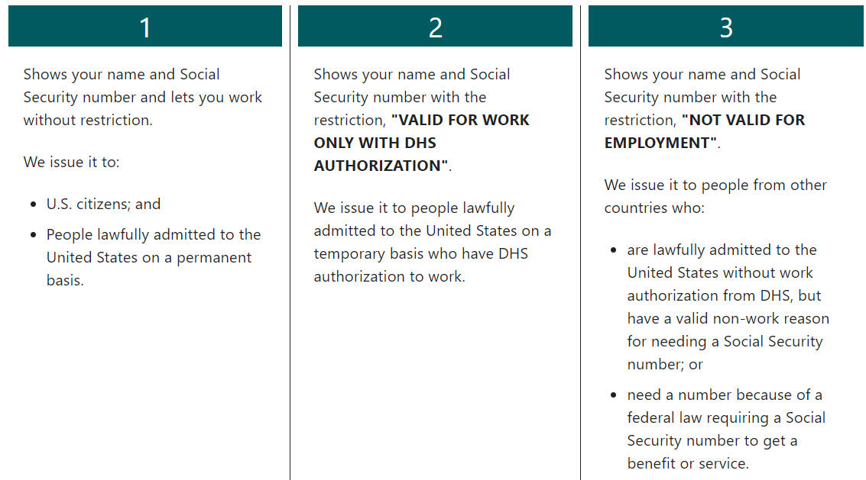
Types of Social Security Cards

Slide 8
Walk-In Updates
Walk-In Stats
Within the USCCB network, 131 cases/291 individuals have been approved for APA benefits.
Updated APA Walk-In Guidance
On Friday (11/5), PRM changed the guidance on the service period for APA walk-ins. Normally, the APA service period begins the date of arrival at the final destination. For walk-in cases, the date of assurance (approval by PRM for walk-in benefits) marks the initiation of APA service provision. It is allowable to begin preparations to serve the case in advance of their approval at the agency’s own financial risk as reimbursement will not be possible if the case is eventually not approved for APA benefits. Walk-ins may be a good fit for the Cash-Based Model, especially if they are able to navigate the community on their own or through the support of others. The updated walk-in guidance (“APA Walk-In Procedures”) can be found on MRSConnect under APA > Program Administration > Operational Guidance > Walk-In.

Slide 9
Resources & Training
Future of APA Network Calls - weekly or bi-weekly?
Webinars
Community Sponsorship: Sharing Promising Practices and Lessons Learned
Thursday, December 2 @3:00pm ET
Register here
Switchboard blogpost: Emergency Rental Assistance Programs: Opportunities for Refugees and other ORR-Eligible Clients
Hiring Afghan Humanitarian Parolees: What Service Providers and Employers Need to Know
Wednesday, November 17 @2:30pm ET
Register here

Slide 10
Thank you!
See you next Wednesday!

