Slide 1
APA Network Call
October 20, 2021

Slide 2
USCCB Network Arrivals Update
Weekly APA Pipeline Stats | As of 10/13/2021​ | As of 10/20/2021​
Current USCCB APA Capacity​ | 7,872 ind.​ | 11,033 ind.​
Total USCCB APA Individuals Assured​ | 3,156 ind.​ | 3,646 ind.​ (cumulative)
Total APA Individuals Selected by USCCB, Awaiting Assurance​ | 1,131 ind.​ | 863 ind.​
APA Individuals Traveled to Final Destination​ | 931 ind.​ | 1,874 ind.​ (cumulative)
Total Assured Not Traveled​ | 2,225 ind.​ | 1,772 ind.​
Ready for Departure​ | 1,318 ind.​ | 863 ind.​

Slide 3
Arrivals Update – Parolee Stats
As of October 15, 7,790 Afghans remain at the overseas lily pads awaiting evacuation to the US
53,500 at US military base safe havens awaiting departure
8,000 total departures from safe havens, of which 2,400 are independent departures
Evacuations flights out of Kabul have resumed
IOM’s after-hours phone number (917-645-2313)

Slide 4
Informational Update
USCCB’s FEMA/DHS Resettlement Liaison
Introducing Anita Wamble (Anita.Wamble@fema.dhs.gov)
APA Feedback calls themes
DHS proposal to speed the pace of arrivals
Current pace and model of arrivals is untenable
Temporary and longer-term housing support is needed
Interest in the “One Stop Shop” idea
Documentation is a huge challenge
ORR Afghan RSS, RSI and RHP Supplemental Funding Allocation

Slide 5
Guidance Reminders & Updates
Interpretation
Preferred to use an independent interpreter when possible, however using a case member or U.S. tie for interpretation is allowable if you include in the case note for that service/activity the reason why independent interpretation was not possible.
“Appropriate language interpretation/translation” means interpretation/translation which allows for communication with the program beneficiary in his/her native language, if possible, or in a common language in which the program beneficiary is fluent. Appropriate language interpretation/translation that promotes gender equality shall be provided by an individual who is not associated with the program beneficiaries (i.e., family member, U.S. tie), to the extent possible. Staff and/or independent paid and volunteer interpreters (not associated with the program beneficiary) may be used. In-person interpretation is preferred, although telephonic interpretation may be used, if necessary.
Airport Pickup
U.S. ties can complete airport pickup on their own (no need for staff or an interpreter to be present if not possible, just include explanation in the case notes).

Slide 6
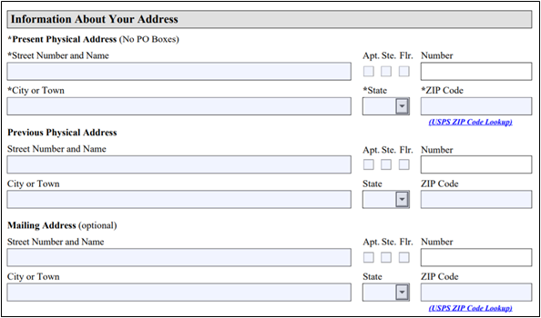
Guidance Reminders & Updates
AR-11s
Ensuring documentation reaches your clients while also complying with U.S. law
If clients are staying in the hotel/temporary housing for 10 days or more: use the hotel address as the present physical address, IOM address as the previous address, and affiliate address as mailing address.
If clients are staying in the hotel/temporary housing for 1-9 days before moving to permanent housing: wait for the clients to move to permanent housing and submit the AR-11 within 10 days of the move – use the permanent housing address as the present physical address and the IOM address as the previous address.
AR-11s

Slide 7
Guidance Reminders & Updates
I-94s
New – Required Chart for Requesting Follow-Up on APA I-94s (guidance as of 10/19/21)
Since Afghan evacuees are arriving as parolees rather than refugees, CBP will likely not use the A# to link the parolee to their i94.
Before reaching out to USCCB, please try each of the following to pull up the client's i94 on CBP's webpage: https://i94.cbp.dhs.gov/I94/#/home
The Tazkera# (no dashes)
The Passport# (with and without the "P" in front of the numbers)
The A# (with and without the A in front); and
The wristband# (if applicable)
If you cannot pull up the i94 this way , please fill in the chart below to the best of your ability and send to APA_Documentation@usccb.org. Please copy-and-paste the chart into an encrypted email, or encrypt the Word document attachment. This chart is also located on MRSConnect as a Word document: https://mrsconnect.org/wp-content/uploads/2021/10/APA-I-94-Follow-Up-Request-Chart.docx

Slide 8
Policy Update
Fiscal Year 2022 Presidential Determination
PD of 125,000 released on October 8; prior year's capacity will continue to be utilized through December 2021.
Afghan Adjustment Act (AAA)
An AAA has not yet been introduced, but the USCCB is working together with national partners to get it introduced and potentially included in the final Fiscal Year 2022 appropriations bills.
Evacuate Our Allies (EOA) Virtual Advocacy Days
EOA coalition is having virtual advocacy days on November 9–10, 2021, to increase awareness of and support for the AAA. Invitation to participate will be forwarded to the network for those interested.

Slide 9
Ideas & Resources
APA Network Calls
APA Network Calls extended 4 more weeks: October 27- November 17
Register here
Webinars
ORR: COVID-10 Emergency Rental Assistance (ERA) Program
Thursday, October 21 at 1:00pm ET, join here (password = 12345)
Switchboard: Who Are the Afghan Newcomers? Understanding the Background and Socio-Cultural Strengths and Needs of Afghan Evacuees to the U.S.
Tuesday, October 26 at 2:00pm ET, Register here
Resources
Effects of Moving (Currently in English, USCCB translating into Dari and Pashto)
Reminder: APA FAQ document updated weekly on MRSConnect

Slide 10
Thank you!
See you next Wednesday!

