Slide 1
CAM Overview

Slide 2
Lesson Overview
Review
Overview
Eligibility
DS-7699
Things to Remember
Common Errors/Inquiries
DNA Overview Preview
Q&A

Slide 3
Lesson Objectives
At the end of this lesson you will be able to:
Understand CAM eligibility and program requirements
Avoid commonly made mistakes during CAM submissions

Slide 4
CAM Overview

Slide 5
Recall that…
The USRAP P-2 CAM provides a pathway for certain persons in the United States to claim a relationship with their children and add-ons (qualifying family members) in Honduras, El Salvador and Guatemala for family reunification.
Important documents:
DS-7699
Proof of Legal Status
Birth Certificates
Marriage Certificates
Affidavit of Support
Additional supporting documents

Slide 6
Recall that…
Process begins with the Resettlement Agencies working with a Qualifying Parent to submit an application
RPC vets the application and ensures all relevant paperwork and basic eligibility requirements are met.
RSC gets more information from the applicants abroad, including DNA for testable relationships.
RAVU reviews the case and determines whether processing will continue.

Slide 7
Eligibility

Slide 8
Individuals on an AOR Submission
Anchor and QCH
Qualifying Child
Derivatives
Type B
Add-Ons
Type C
Type D
Type E
Type F
Qualifying Parent

Slide 9
Qualifying Parent – Anchor
Eligibility:
Parents must file a form DS-7699 and be qualified to file this form
At least 18 years old
Does NOT need to be a national of El Salvador, Guatemala, or Honduras
Lawfully present in the United States with a status of:
Permanent Resident Status
Temporary Protected Status Grantee
Parolee for whom parole has been authorized for at least one year
Deferred Action for Childhood Arrivals (DACA) Recipient
Deferred Action (non-DACA) Recipient
Deferred Enforced Departure Recipient
Withholding of Removal Grantee
Pending I-589 “Application for Asylum and Withholding of Removal” filed before 05/15/21
Pending I-918 “Application for U Nonimmigrant Status” filed before 05/15/2021
Note: Acceptable Proof of Eligibility should have a valid expiration date.
Notes:
Subject to change per PRM – any new ones we should get example documents (U-Visa, pending asylum) for to include in presentation – so the RAs know what proof of status

Slide 10
Qualifying Parent – Anchor
Proof of Lawful Status and accompanying paperwork – approved documents will be located on Rsharenet as “CAM Proof of Legal Status Documentary Evidence”
Notes:
Pull up Proof of Status Guide

Slide 11
Qualifying Child
Eligibility:
Child of the Qualifying Parent
Unmarried
Under the age of 21
National of El Salvador, Guatemala, or Honduras
Does not have to live in their country of nationality, but must live in one of the three Northern Triangle countries
Notes:
Confirmed that individual must be in one of the three countries

Slide 12
Derivatives and Add-Ons
Reminder: Derivatives vs. Add-Ons
Type | Relationship to QP | Relationship to QCH | Requirements
B | Grandchild | Child | Unmarried and under 21 years old
C | Spouse | Not Required | Documented marriage to QP
D | Not Required | Biological Parent | Not married to QP Affidavit of Support provided
E | Biologically related to QP or QCH |  | Primary Caregiver of QCH Affidavit of Support provided
F | Child | Sibling (full, half, step, or adoptive) | Must be legal, biological, or adoptive child of QP Is married and/or 21+
Note: Type C, D, and E Add-Ons must be part of the same economic unit and household as the Qualifying Child to qualify. :
Notes:
Type B = Derivative
Types C, D, E, and F = Add Ons
SEE HANDBOOK

Slide 13
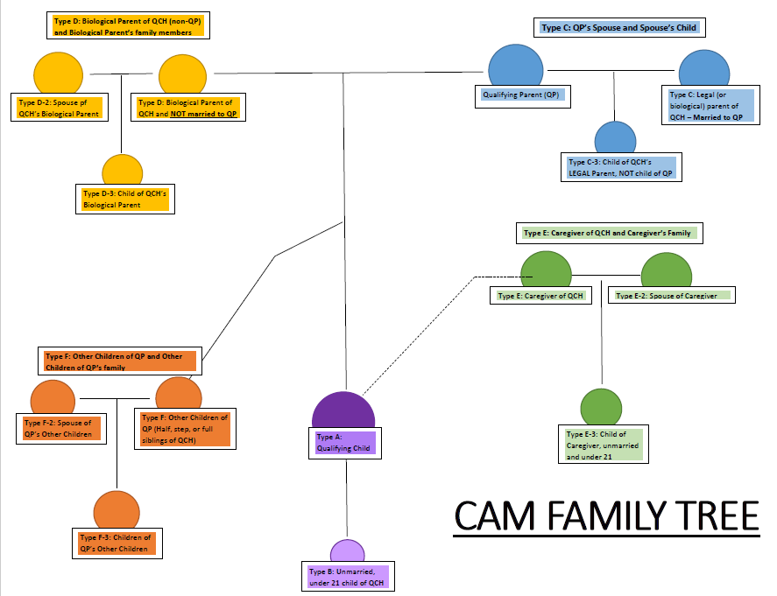

Slide 14
Comments, Documents, Eligibility
Type | Relationship to QP/QCH | Comments? | Supporting Documents? | Eligibility
B | Grandchild Child | No | Birth Certificate | Unmarried and under 21 years old
C | Spouse Not required | No | Marriage certificate | Legal and documented marriage to QP
Note:
All beneficiaries on a CAM application MUST have a birth certificate
Any application where the QCH is a step or adoptive child of the QP must have adoption paperwork or marriage certificate included – especially if other Add-Ons/Derivatives are gaining access through this adopted/step QCH.
Notes:
Hidden since the Handbook provides many details about this
Type B = Derivative
Types C, D, E, and F = Add Ons

Slide 15
Comments, Documents, Eligibility
Type | Comments? | Supporting Documents? | Relationship to QP/QCH | Eligibility
D | Yes | Affidavit of Support | Not required Parent | Not married to QP
E | Yes | Affidavit of Support – Additional documents that provide evidence of caregiver relationship | Biologically related to one | Primary Caregiver of QCH
F | Yes | Affidavit of Support | Child Sibling | Must be legal, biological, or adoptive child of QP Is married and/or 21+
Note:
All beneficiaries on a CAM application MUST have a birth certificate
Any application where the QCH is a step or adoptive child of the QP must have adoption paperwork or marriage certificate included – especially if other Add-Ons/Derivatives are gaining access through this adopted/step QCH.
Notes:
Type B = Derivative
Types C, D, E, and F = Add Ons
Want a supplemental resource for Types – will clearly state what is required at time of application (eligibility, documents, comments) – derivative and add-on wheel – providing it before the

Slide 16
Which Add- On Types require comments?
First attempt to answer this question should come from the CAM-P3 Handbook which outlines every requirement for each individual on the CAM application
With that said….
Type E and Type F Relatives require comments
The first is providing a statement noting the relationship between the Add On and Qualifying Child
The second, which only relates to Type E Add Ons, describes how the primary caregiver is related to the Qualifying Parent or the Qualifying Child.
A comment is necessary if someone other than the QCH’s parent has legal custody of the Qualifying Child. Additional supporting documents will be required.

Slide 17
Eligibility of Derivatives/Add-Ons
Remember…
Type B Derivatives derive their refugee status from the QCH. If the Type B does not qualify, none of the following Add-Ons will either.
Add-On Types C, D, E, and F must prove their own independent refugee claims.

Slide 18
Types C, D, E, F and their qualified families
D-2, E-2, and F-2 – SPOUSES of Add-Ons
Example 1: a QCH’s biological mother who is not married to the Qualified Parent (Type D) may include her husband on the application as a Type D-2
Note: Type C-3 can include children (under 21 and unmarried) of the Type C Add-On that are not the children of the QP or legal siblings of QCH
Notes:
Note: Type C-3 can include children (under 21 and unmarried) of the Type C Add-On that are not the children of the QP or legal siblings of QCH

Slide 19
Types C, D, E, F and their qualified families
C-3, D-3, E-3, and F-3 – CHILDREN of Add-Ons
Example 2: a QCH’s caregiver (Type E) may include her children (under 21 and unmarried) on the application as a Type E-3
Example 3: the QCH’s sibling (QP’s other child) (Type F) wants to bring her family (spouse and unmarried children) – Types F-2 and F-3
Notes:
Note: Type C-3 can include children (under 21 and unmarried) of the Type C Add-On that are not the children of the QP or legal siblings of QCH
- Note that these individuals could be their own QCH

Slide 20
Eligibility of Derivatives/Add-Ons
Remember…
Note that the family members of Type C, D, E, and F Add-Ons derive their status from their respective Add-On. So if a Type D gains access to the USRAP via the CAM program, so will the D-2 and D-3 individuals on the application.

Slide 21
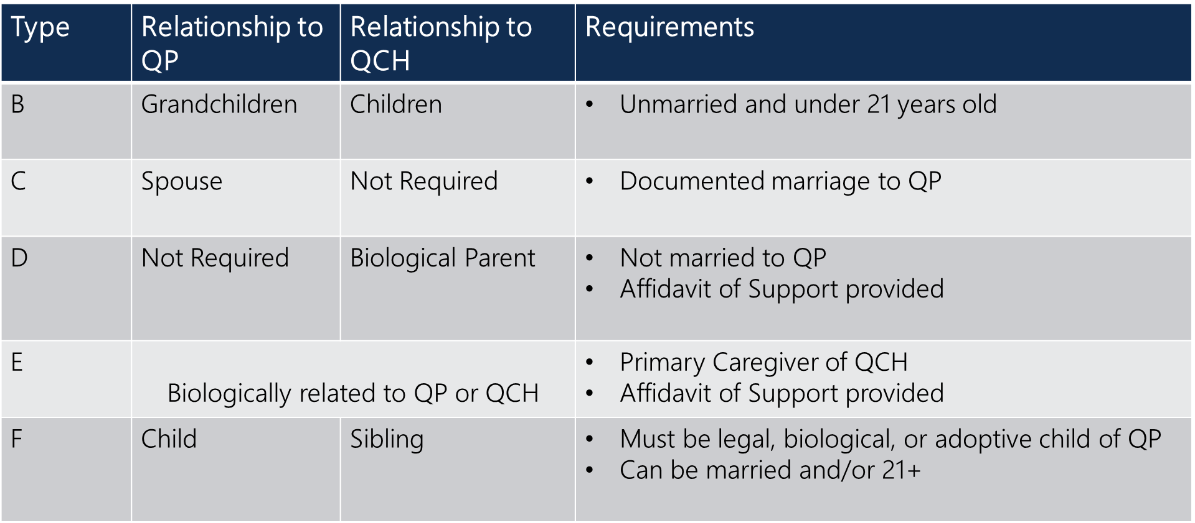
Quiz time ☺
1. Sarah is the QP. Her son Alex lives in Guatemala with his grandmother, who is also Sarah’s mother. What type of Add-On is Alex’s grandmother, if she lives in the same economic unit and household as Alex and is responsible for taking care of him?
Type E
Type F
Type C
Type A
Notes:
Add a question related to what type of document is necessary for this type?

Slide 22
John is the QP. His daughter Alexis lives in Honduras with her biological mother Susan. Susan and John are not married. If John wants to include Susan as an Add-On to the application, which derivative type is she?
Type F
Type C
Type A
Type D

Slide 23
Katelin is the QP. She is the mother of Ryan - the QCH. In 2021, Katelin adopted a 12 year old girl named Adrianna. The adoption was legal and Katelin gives her resettlement agency the official paperwork. If Katelin wants to include Adrianna on the AOR application, how should the Add-On type be marked?
Type F
Type F-3
Type D-3
Type E-3
Notes:
Note/question -> could she also be her own QCH since she is a 12 y.o. in the Northern Triangle?

Slide 24
Heather is the QP. She is married to Rafael, who is not the biological father of the QCH, Sammy. Rafael has four other children, two of which are over 21 and married and two of which are not. If Heather wants to include Rafael’s children on the application, how should you mark that Add On type?
Type F-3
Type C-3
Type D-3
Type E-3
Hint: C-3, D-3, E-3, and F-3 – CHILDREN of Add-Ons
Notes:
If you’re getting confused, remember that the first thing you should identify is Rafael’s relationship to the QCH. If he isn’t the biological parent, he must be a Type C. And if he is trying to bring his CHILDREN, it must be a C-3.

Slide 25
DS-7699

Slide 26
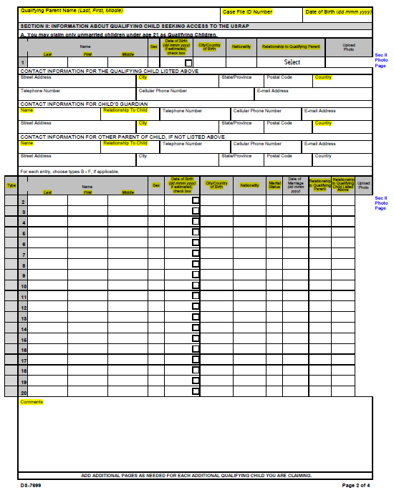
DS Form

Slide 27
Tips and Tricks from the Vetting Checklist
Things to Remember:
USCIS Interview
Type B to F relatives and any of their derivatives (as described before) must be interviewed by USCIS with the Qualifying Child. If the Qualifying Child and a type B to F relative(s) are unable to be interviewed together, only the Qualifying Child would receive a USCIS refugee interview.
Comments, Comments, Comments!!
Almost all discrepancies can be resolved through comments!
We understand POR can be incorrect, just note it in Section II or Section IV.
Comments on Type C/D/E/F (see next slide)

Slide 28
Example Comments in Section IV

Slide 29
Tips and Tricks from the Vetting Checklist
Things to Remember:
Type F vs. Type E
Only one Type E relative and his/her derivative(s) may be listed on the form unless the Qualifying Children listed on the form live in different households. Each Qualifying Child that lives in a separate household from another listed Qualifying Child would be allowed to list one separate primary caregiver.
A Type F Add-On (a married or age 21 or older child of the QP) could also be a Type E Relative if they are the primary caregiver of the QCH. However, this would preclude any other caregiver from being included on the application for that QCH.

Slide 30
Tips and Tricks from the Vetting Checklist
Immigration Status must match documents provided
Remember slides 11-13 and the Proof of Legal Status Reference Document
If you select Lawful Permanent Resident and a Green Card is not provided, the AOR will be rejected. Similarly, if you select Lawful Permanent Resident and an I-797 is provided, the AOR will be rejected.
Guardian and QCH Address must match
The contact information for the QCH’s Guardian must be the same as the QCH’s contact information. If this information does not match, a comment must be provided.
If the guardian information is Unknown/N/A, the guardian is not a blood relative, or the QCH is independent and living on their own, a comment must be provided.

Slide 31
Important to Remember…
Marriage and Birth Certificates
Birth certificates: general requirement for all individuals on the application
Marriage certificates: “For any current or previous marriages of the Qualifying Parent, Caregiver, or sons and daughters, please provide a copy of the marriage certificates and/or divorce documents.
Requirements of Step-Child Relationships:
If you are filing for a stepchild, a copy of the marriage certificate to that child's parent must be provided.
Furthermore, the marriage creating the step relationship must have occurred before the child's 18th birthday.
Finally, the marriage must have existed on the date the QP completed this form and must continue at the time of admission to the United States.
Requirements for Adopted Child(ren)
If you are filing for an adopted child, please provide a copy of the adoption papers.
Furthermore, an adopted child must have been in the legal custody of and resided with the adopting parent or parents for at least two years and been legally adopted before his/her 16th birthday
The above documents are required for any parent-child adoptive or step-relationship that is claimed between any individuals on the application (incl. any additional family members of Type A, B, C, D, E, or F relatives).

Slide 32
Common Rejection Reasons
Spouse in Section I and then Section III – auto-populated!
Chronological birthdates
Hairline and ears visible
Affidavit of Support not submitted
Anchor Proof of Legal Status is wrong or does not match selection on DS Form
Chronology of Caregiver Relationship or description of relationship between Caregiver to QP or QCH not provided
Justification comment not provided or not sufficient
Derivative Type is incorrect
No valid documents submitted for proof of relationship
Not filled out completely
QCH cannot be married or over 21
Notes:
Will keep a running document of these – will be reviewed in the fall ☺

Slide 33
Affidavit of Support Document (I-134)
As of now, an Affidavit of Support Document is required for all AOR applications that include a Type D or Type E Add-On Type.
This document can be found on the USCIS website by searching for I-134 Affidavit of Support.
A submission will be rejected if the AOS is not provided – and it is a very common reason that an application is rejected!
Notes:
Pending Nicole

Slide 34
Question and Answer

