Slide 1
CO Programming
For Refugee Youth
Community of Practice
March 2020

Slide 2
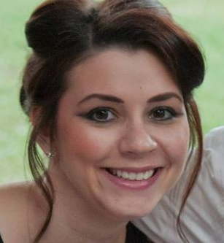
FACILITATORS
Jacquelin Zubko-Cunha
Cultural Orientation Coordinator
USCCB
Notes:
NOTE FOR CIARA: Swap out my photo/info with yours

Slide 3
Roll Call
To confirm attendance, select your affiliate’s city and state.
Notes:
NOTE FOR CIARA: This is already set up in the poll area. You may have to clear it and then launch. Just gives folks a min to reply and then verbally thank a handful for joining.

Slide 4
File Share
Select the document
Click “Download File”
Notes:
NOTES FOR CIARA:
-ICMC Youth Lesson plan on S:\DDS\Jacquelin Zubko-Cunha\CO\CoP (tags for quarter, year, topic)\FY20 Q2
-Also should be getting the program curriculum from Jennifer Escue- cc’d you on that email

Slide 5
AGENDA
USCCB Updates
Upcoming Census
CORE Exchange Report Out
Discussion: CO Programming for Refugee Youth
CC Nashville
Additional Resources
Upcoming CoP Calls

Slide 6
USCCB Updates
Time to review your CO plans/policies
Model Assessment
COLM Action items
Create a shared activity bank
Develop a shared photo bank
Collect rubrics, resources, and methods for observing and monitoring CO
Expand CO Communications pilot and offerings on CORE site
Review O&Is
Review Model Assessment
Notes:
1) Jacqui will collect policies when she returns from maternity leave. (approximately end of May)
2) Jacqui has spoken to each of you and you should all now officially be using the model assessment, at least as a post test, in your CO instruction. Again, one assessment per adult’s case file. If your site had previously tweaked this assessment or adapted it to be more locally specific, you should now have those questions as supplemental questions to the main model assessment. We appreciate your cooperation on this!
3) On our last CoP call, Jacqui mentioned the 6 action items that came out of CORE’s Cultural Orientation Leader’s Meeting in December. These are some updates:
Create a shared activity bank- CORE is working on this and will hopefully have a more detailed update for our next CoP.
Develop a shared photo bank – CORE is beginning to explore this but likely won’t prioritize until later in the year.
Collect rubrics, resources, and methods for observing and monitoring CO- CORE collected these from other CO Leaders and is now in the process of consolidating them to be able to share them out along with a general update to the CO providers toolkit.
Expand CO Communications pilot and offerings on CORE site- An overall report is currently in review and will soon be disseminated.
Review both overseas and domestic objectives and indicators (O&Is)- A taskforce is being created. If you are particularly interested in aiding this review, please email Jacqui.
Review Model Assessment- We know many of you are interested in contributing to this and Jacqui does have your names. At this time, the CO leaders are going to start with reviewing the O&Is before moving to the model assessment, since the O&Is affect the assessment. CORE also has intentions to do training on the model assessment this year.

Slide 7
Reminder: Upcoming Census
Reminder: Be thinking about how to relay info regarding the upcoming Census to your clients
Editable outreach templates, from Switchboard, include a postcard and a flyer that can be customized with your organization’s logo and contact information. Available in 11 languages.
Webinar Recording*: https://bit.ly/2uVnbFm
Census Language Guides: https://bit.ly/2UIYPsE
Census Informational Questionnaire: https://bit.ly/37cXgWE
Census Activities and Lesson Plans: https://bit.ly/2UMh4xt
Census Bureau Response Outreach Area Mapper (ROAM): https://www.census.gov/roam
Census 2020: https://www.2020census.gov/
Census Counts: https://censuscounts.org/
Notes:
*Webinar recording- your colleagues in Syracuse shared some great ideas they’re doing to prepare clients!
If others have additional census resources to share, please email me and I’ll be sure to share them with the wider network.

Slide 8
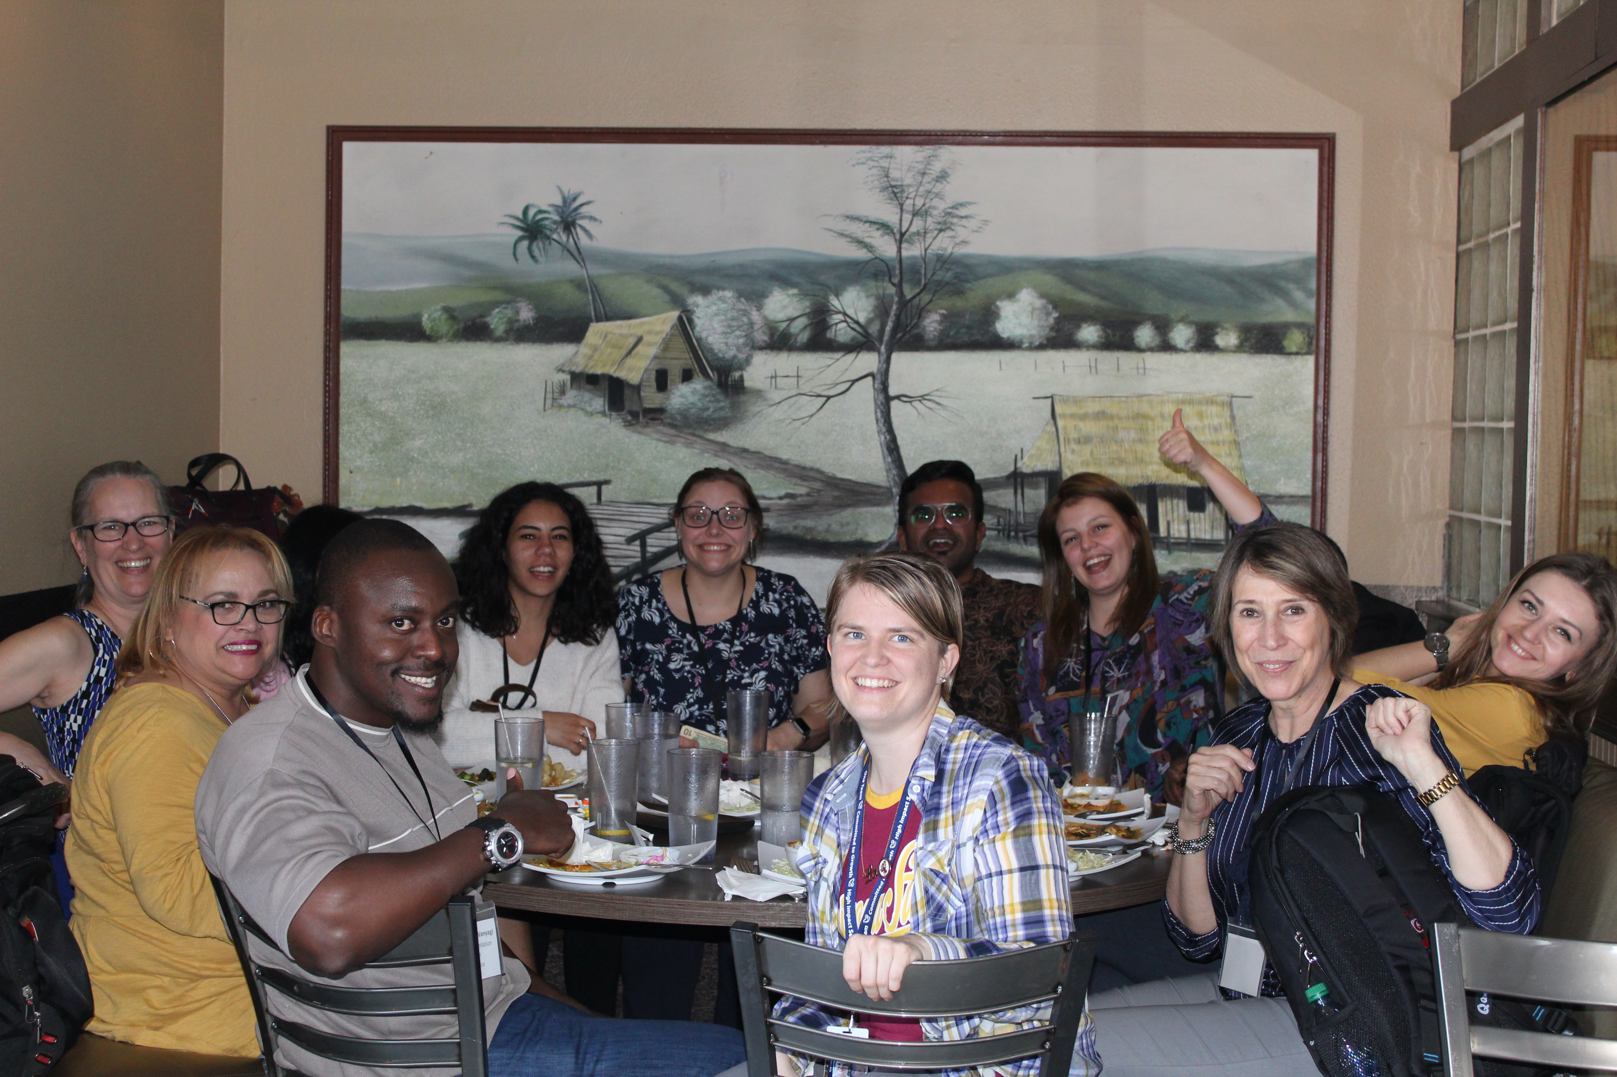
CORE Workshop Exchange Report Out
A weeklong series of workshops and knowledge exchange between CO trainers from overseas RSCs and domestic RAs
Notes:
CORE’s Overseas CO Provider Workshop and Cultural Orientation Knowledge Exchange Workshop took place in February in two cities—Phoenix and Seattle. Many Thanks to our Phoenix affiliate for hosting a site visit for the overseas participants! The knowledge the trainers gained about your agency and the resettlement experience in the U.S. was invaluable.
Thank you also to Fort Worth for your participation which helps to strengthen the CO continuum and in turn the resettlement experience for American newcomers.
We have Alice, Donia, Nina, and Kitty on the line from these 2 sites. Would you all like to share any take aways with the larger network?
Stay tuned for additional events like these!
Fort Worth:
Alice akigera@ccdofw.org (CONFIRMED)
Donia dchehade@ccdofw.org (CONFIRMED)
Phoenix:
Fader, Nina <NFader@cc-az.org> (CONFIRMED)
Marquez, Kitty <kmarquez@cc-az.org>(CONFIRMED)

Slide 9
Affiliate Share: Catholic Charities of Tennessee
Objective: Aims to prepare school-age refugee youth to successfully enter the local school system and to assess their needs for further school case management. (*See file share box for curriculum)
Notes:
Cc’d you on email to Jennifer Escue jescue@cctenn.org
Would like her make any edits she wants, add a few photos, expand on the evaluation/outcomes part, Also get the curriculum and add it to the file share box and to S:\DDS\Jacquelin Zubko-Cunha\CO\CoP (tags for quarter, year, topic)\FY20 Q2

Slide 10
Affiliate Share: Catholic Charities of Tennessee
Program meets 4 days/week for the first 2-3 weeks post-arrival
Set up to mimic the school structure (the children meet the agency mini-bus, just as they will meet their regular school system, they are in a classroom setting getting hands-on practice in school routines)
Additional sections covering classroom culture, emergency English, assessments & grades, homework, behavior expectations, hygiene, weather/time, school personnel, and how to address potential challenges (bullying, feeling sick, not understanding, etc.)
Youth graduate from the program and are given a backpack and school supplies
Parents attend a one day school orientation
The Refugee School Readiness Specialist can also assess whether or not each child might have special needs or challenges which will require additional school case management.

Slide 11
Affiliate Share: Catholic Charities of Tennessee
Resources: Worked with local school system to create a curriculum.
Funding: RSIG
Staffing: 1 School Readiness Specialist/Youth Case Manager and 1 social work intern. All staff are trained in working across cultures and trauma-informed principles.
Evaluation/Outcomes: Post-tests
95% of children receive a score of 80% or above on a post-test that measures their knowledge of school orientation topics

Slide 12
Additional Resources
Story of Me: An Orientation Workbook for Refugee Youth https://coresourceexchange.org/wp-content/uploads/2019/09/Story-of-Me-An-Orientation-Workbook-for-Refugee-Youth.pdf
Videos for Learning About Refugee Youth http://www.culturalorientation.net/learning/populations/youth/videos-for-learning-about-refugee-youth
School’s Out Washington https://cdn.shopify.com/s/files/1/0515/3189/files/RSIG_Youth_Resource.pdf
ICMC Istanbul Youth Lesson Plan (*See file share box)

Slide 13
Upcoming CoP Calls
June 17, 2020 @ 3PM EST
September 16, 2020 @ 3PM EST
Notes:
Thank you to those that signed up for CORE’s Delivering Interactive CO One-on-One virtual practicum. We will do a report out during our next call.
Don’t need to name these- just for internal knowledge.
Charlotte
Cincinnati
Dayton
Fort Wayne
Fort Worth
Indianapolis
Las Vegas
Lincoln
Louisville
Rochester
Rockford
Salt Lake City
Set up a poll: Of the following topics, which would you also like to discuss during our next call?
Digital literacy programs/sessions/curriculum as part of CO
Reaching elderly clients
Delivering CO to Low Literacy populations
Other? ______________
Close out, thank everyone for joining. Remind them a recording will be sent around and added to MRS Connect.

