Slide 1
Domestic
Violence
Community of Practice
September 2019

Slide 2
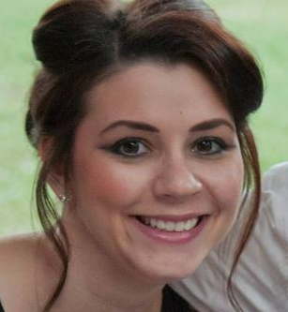
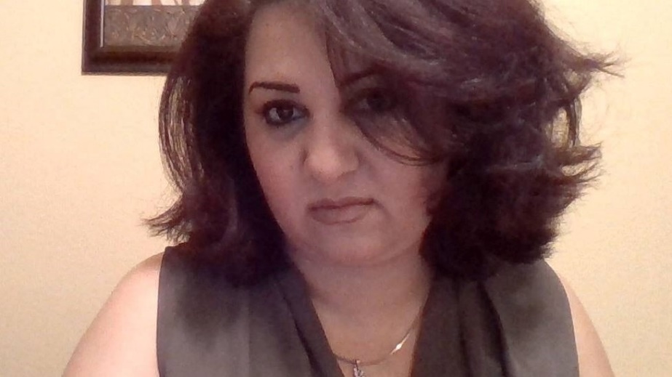
FACILITATORS
Jacquelin Zubko-Cunha
Cultural Orientation Coordinator
USCCB
Saghar Roshan
R&P Director
Catholic Charities of San Antonio

Slide 3
Roll Call
To confirm attendance, select your affiliate’s city and state.

Slide 4
File Share
Select the document
Click “Download File”

Slide 5
AGENDA
CO Objectives and Indicators: US Laws
Discussion: Domestic Violence
Upcoming CoP Calls

Slide 6
CO Objectives and Indicators
U.S. LAWS
CONTENT OBJECTIVE | LEARNING INDICATORS
The U.S. is governed by the rule of law | Participants understand that they have a responsibility to know American laws Participants understand that they have accountability under the law
There are legal rights and restrictions related to family life | Participants understand laws and norms for the use of alcohol, tobacco, drugs, and firearms Participants understand laws and norms related to sexual harassment
There are rights and responsibilities related to U.S. residency and citizenship | Participants know laws regarding domestic violence Participants know laws regarding child supervision, neglect, and abuse, including acceptable methods of disciplining a child
There are rights and responsibilities related to U.S. residency and citizenship | Participants are aware of basic civil rights (e.g., right to free speech, assembly, worship, legal assistance) Participants understand that when they become citizens they will have the right to vote Participants understand the importance of selective service registration and implications if they do not register Participants understand that breaking the law may affect their legal status

Slide 7
Trends & Challenges
Many sites dealing with the challenge of domestic violence, specifically within the Congolese community
Some instances have led to police and CPS involvement
Compounded by alcohol abuse
Some husbands do not want their wives participating in CO, or accompany them
Other challenges?

Slide 8
Salt Lake City & Rockford
SALT LAKE CITY-The state of Utah and Salt Lake City are very supportive of the refugee population. A Utah State police officer (who is assigned to work with refugees) teaches their U.S. Laws & Policies CO class, which includes a discussion on domestic violence. A corresponding handbook (including all PPTs) is given to each client. (*see download pod)
ROCKFORD- Also utilizes a lot of community organizations in CO to help build trust. Currently, they call upon legal services to conduct DV classes and the local African Women’s Group holds a “women’s only” class on knowing your rights.

Slide 9
Phoenix & Northampton
PHOENIX- My Sister’s Place, a domestic violence shelter also run by CCCS Phoenix, allows the resettlement department to make direct referrals. If you don’t have this kind of assess, they advise meeting regularly with local DV and CPS resources to build relationships and increase their awareness of incoming newcomer populations.
NORTHAMPTON- Divides up the R&P funds equally between the husband and wife within a family unit and encourages separate bank accounts and then a family account. Of course, not all families want to organize their finances this way, but the option has worked well so far.

Slide 10
Portland, Tucson & Richmond
PORTLAND: Clients are provided with local resources during their emotional wellness/culture shock/mental health class – which also includes resources for DV. This is also provided in the Women’s Rights CO class they facilitate. In general, the conversation about DV/emotional issues is facilitated through discussion. (*see download pod)
TUCSON: Caseworkers have attended this webinar and incorporated it into their CO- “Healthy Moms Happy Babies: Healing Approaches to Preventing and Responding to Domestic Violence in Home Visitation Programs”
RICHMOND- Offers clients family counseling.

Slide 11
Additional Resources
CORE is in the process of revising their Congolese backgrounder
BRYCS: Refugee Children Exposed to Intimate Partner Violence: Doubly Vulnerable
BRYCS: Domestic Violence Resources for Newcomer Clients & Resources for Service Providers
ECDC: Domestic Violence and the Impact on the Mental Health of Refugee Women
USCRI: brochures translated into many languages on the topic & Addressing Family Violence across programs and cultures (*see download pod)
ODJFS: Safe, Smart and Healthy Videos available in multiple languages covering domestic violence and substance abuse
Child Welfare Information Gateway: Cultural Competence in Domestic Violence Services
CORE: Promising Practice: Gender-Segregated CO Sessions – This resource provides guidance on how to assess and implement gender-segregated CO sessions.
Additional Resources or Best Practices?
Email jzubko-cunha@usccb.org

Slide 12
Upcoming CoP Calls
December 18, 2019 @ 3PM EST
March 11, 2020 @ 3PM EST
June 17, 2020 @ 3PM EST
September 16, 2020 @ 3PM EST

