Slide 1
Cultural Orientation
Community of Practice
June 2019

Slide 2
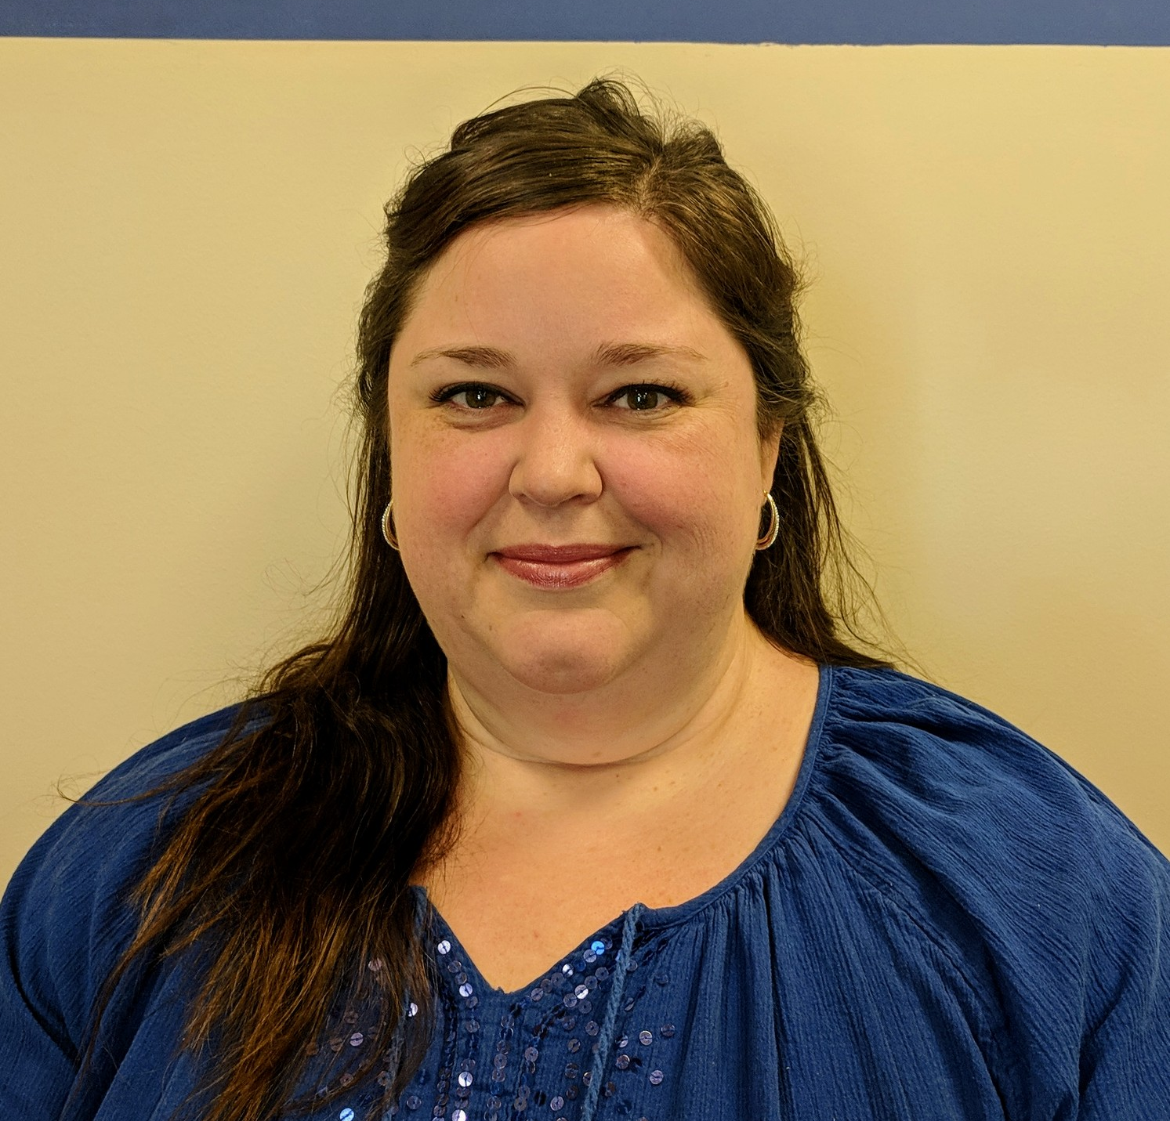
FACILITATORS
Jenifer Call
Cultural Orientation & Citizenship Coordinator
Sacramento Food Bank & Family Services
Saghar Roshan
R&P Director
Catholic Charities of San Antonio

Slide 3
Roll Call
To confirm attendance, select your affiliate’s city and state.

Slide 4
File Share
Select the document
Click “Download File”

Slide 5
AGENDA
Introducing USCCB’s Cultural Orientation Coordinator
CO Objectives and Indicators: Learning English
Discussion: Learning English
Upcoming CoP Calls

Slide 6
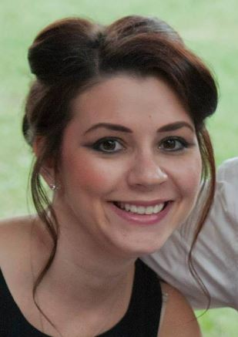
INTRODUCING
Jacquelin Zubko-Cunha
Cultural Orientation Coordinator
USCCB
JZubko-Cunha@usccb.org

Slide 7
CO Objectives and Indicators
ENGLISH
CONTENT OBJECTIVE | LEARNING INDICATORS
For both adults and children, learning English is critical to successful adjustment in the U.S. | Participants can list reasons why learning English is important for successful adjustment in the U.S. Participants can acknowledge that learning English is their responsibility
Learning English will take time and the process may vary from person to person | Participants can acknowledge that they should not delay employment, enrolling in school, applying for assistance, or participating in community life until they have learned English Participants know their rights to interpretation services (e.g., in hospitals, schools, and courts) Participants are aware that children may learn English faster than adults Participants are aware that the relative fluency in English among members of the family may lead to changes in family roles
There are a variety of ways to learn English | Participants understand that they will be referred to free classes by the local resettlement agency, but these classes may have a waiting list and/or the schedule or location of the classes may not be ideal Participants are aware of other types of ESL classes for which there may be a fee to participate Participants understand the importance of attending ESL consistently Participants can name additional ways that they can learn English outside of formal classes

Slide 8
Sacramento Food Bank and Family Services
After a discussion on the reasons to learn English and available ESL classes, we discuss other ways to practice English.
I then distribute the handout to each student and ask them to circle 3 ways that they like to practice English or that they think would work well for them
There is a blank square so that they can add their own idea(s) that may not be included on the handout.
Then each person shares some of their preferences or ideas
Everyone is given the homework assignment to try at least one of the things they circled and report back at our next class (this works well for people who have had some exposure to English which most of our SIVs have. For those with very little or no exposure, and/or no native language literacy, just a discussion with pictures and practice of a basic phrase).

Slide 9
Catholic Charities Atlanta
“One resource our agency uses to emphasize the importance of learning English is enrolling them into ESL classes. Our office is located next door to IRC who provides free ESL class for all refugees. Within the first week of arrival, we make sure that our clients are enrolled. Whenever our client wishes to meet with us we normally schedule it after their classes. Clients will go to class in the morning, but if they work first shift, there is a community college located near where most of them live that also provide free ESL classes. If that was ever the case we help them enrolled there too.”

Slide 10
Catholic Charities Houston
For us at CCGH , we recognize the following.
As we all know, Refugees enter the workforce within the first 30 to 90 days. Although everyone recognizes the need to study English, many refugees find it extremely difficult to find the time and energy to attend classes since they may be working more than one job and commuting long distances while simultaneously maintaining a family and adjusting to life in the United States. Most of them become interested when they are closer to applying citizenship.
They have different learning styles depending where they come from or whether they had previous education. Some use storytelling methods, repeating after the teacher or show and tell which include memorization and this needs teachers who are very patient
We have found that when we incorporate daily activities items to the classroom such as finance, parenting issues and Employment issues this makes them interested in the ESL activities.
Continues funding for clients who have been here over a year is huge issue, if we had funding we would provide ESL to all at different times and also provide transportation and child care

Slide 11
Upcoming CoP Calls
Wednesday, September 25 @ 3:00pm EST

