Slide 2
Eligibility

Slide 3
Individuals on an AOR Submission
Anchor and QCH
Qualifying Child
Derivatives
Type B
Add-Ons
Type C
Type D
Type E
Type F
Qualifying Parent

Slide 4
Qualifying Parent – Anchor
Eligibility:
Parents must file a form DS-7699 and be qualified to file this form
At least 18 years old
Does NOT need to be a national of El Salvador, Guatemala, or Honduras
Lawfully present in the United States with a status of:
Permanent Resident Status
Temporary Protected Status Grantee
Parolee for whom parole has been authorized for at least one year
Deferred Action for Childhood Arrivals (DACA) Recipient
Deferred Action (non-DACA) Recipient
Deferred Enforced Departure Recipient
Withholding of Removal Grantee
Pending I-589 “Application for Asylum and Withholding of Removal” filed before 05/15/21
Pending I-918 “Application for U Nonimmigrant Status” filed before 05/15/2021
Note: Acceptable Proof of Eligibility should have a valid expiration date.
Notes:
Subject to change per PRM – any new ones we should get example documents (U-Visa, pending asylum) for to include in presentation – so the RAs know what proof of status

Slide 5
Qualifying Parent – Anchor
Proof of Lawful Status and accompanying paperwork – approved documents will be located on Rsharenet as “CAM Proof of Legal Status Documentary Evidence”
Notes:
Pull up Proof of Status Guide

Slide 6
Qualifying Child
Eligibility:
Child of the Qualifying Parent
Unmarried
Under the age of 21
National of El Salvador, Guatemala, or Honduras
Does not have to live in their country of nationality, but must live in one of the three Northern Triangle countries
Notes:
Confirmed that individual must be in one of the three countries

Slide 7
Derivatives and Add-Ons
Reminder: Derivatives vs. Add-Ons
Type | Relationship to QP | Relationship to QCH | Requirements
B | Grandchild | Child | Unmarried and under 21 years old
C | Spouse | Not Required | Documented marriage to QP
D | Not Required | Biological Parent | Not married to QP Affidavit of Support provided
E | Biologically related to QP or QCH |  | Primary Caregiver of QCH Affidavit of Support provided
F | Child | Sibling (full, half, step, or adoptive) | Must be legal, biological, or adoptive child of QP Is married and/or 21+
Note: Type C, D, and E Add-Ons must be part of the same economic unit and household as the Qualifying Child to qualify. :
Notes:
Type B = Derivative
Types C, D, E, and F = Add Ons
SEE HANDBOOK

Slide 8
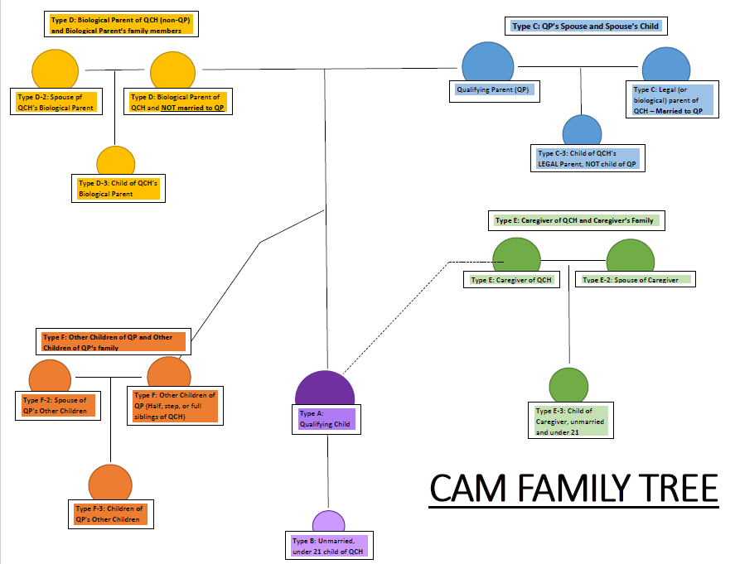

Slide 9
Comments, Documents, Eligibility
Type | Relationship to QP/QCH | Comments? | Supporting Documents? | Eligibility
B | Grandchild Child | No | Birth Certificate | Unmarried and under 21 years old
C | Spouse Not required | No | Marriage certificate | Legal and documented marriage to QP
Note:
All beneficiaries on a CAM application MUST have a birth certificate
Any application where the QCH is a step or adoptive child of the QP must have adoption paperwork or marriage certificate included – especially if other Add-Ons/Derivatives are gaining access through this adopted/step QCH.
Notes:
Hidden since the Handbook provides many details about this
Type B = Derivative
Types C, D, E, and F = Add Ons

Slide 10
Comments, Documents, Eligibility
Type | Comments? | Supporting Documents? | Relationship to QP/QCH | Eligibility
D | Yes | Affidavit of Support | Not required Parent | Not married to QP
E | Yes | Affidavit of Support – Additional documents that provide evidence of caregiver relationship | Biologically related to one | Primary Caregiver of QCH
F | Yes | None | Child Sibling | Must be legal, biological, or adoptive child of QP Is married and/or 21+
Note:
All beneficiaries on a CAM application MUST have a birth certificate
Any application where the QCH is a step or adoptive child of the QP must have adoption paperwork or marriage certificate included – especially if other Add-Ons/Derivatives are gaining access through this adopted/step QCH.
Notes:
Type B = Derivative
Types C, D, E, and F = Add Ons
Want a supplemental resource for Types – will clearly state what is required at time of application (eligibility, documents, comments) – derivative and add-on wheel – providing it before the

Slide 11
Which Add- On Types require comments?
First attempt to answer this question should come from the CAM-P3 Handbook which outlines every requirement for each individual on the CAM application
With that said….
Type E and Type F Relatives require comments
The first is providing a statement noting the relationship between the Add On and Qualifying Child
The second, which only relates to Type E Add Ons, describes how the primary caregiver is related to the Qualifying Parent or the Qualifying Child.
A comment is necessary if someone other than the QCH’s parent has legal custody of the Qualifying Child. Additional supporting documents will be required.

Slide 12
Eligibility of Derivatives/Add-Ons
Remember…
Type B Derivatives derive their refugee status from the QCH. If the Type B does not qualify, none of the following Add-Ons will either.
Add-On Types C, D, E, and F must prove their own independent refugee claims.

Slide 13
Types C, D, E, F and their qualified families
D-2, E-2, and F-2 – SPOUSES of Add-Ons
Example 1: a QCH’s biological mother who is not married to the Qualified Parent (Type D) may include her husband on the application as a Type D-2
Note: Type C-3 can include children (under 21 and unmarried) of the Type C Add-On that are not the children of the QP or legal siblings of QCH
Notes:
Note: Type C-3 can include children (under 21 and unmarried) of the Type C Add-On that are not the children of the QP or legal siblings of QCH

Slide 14
Types C, D, E, F and their qualified families
C-3, D-3, E-3, and F-3 – CHILDREN of Add-Ons
Example 2: a QCH’s caregiver (Type E) may include her children (under 21 and unmarried) on the application as a Type E-3
Example 3: the QCH’s sibling (QP’s other child) (Type F) wants to bring her family (spouse and unmarried children) – Types F-2 and F-3
Notes:
Note: Type C-3 can include children (under 21 and unmarried) of the Type C Add-On that are not the children of the QP or legal siblings of QCH
- Note that these individuals could be their own QCH

Slide 15
Eligibility of Derivatives/Add-Ons
Remember…
Note that the family members of Type C, D, E, and F Add-Ons derive their status from their respective Add-On. So if a Type D gains access to the USRAP via the CAM program, so will the D-2 and D-3 individuals on the application.

