Slide 1





June 24, 2021
Quarterly Consultations:
Requirements, Implications and Trends
How to make the most of your QCs and refugee integration strategy!

Slide 2
1
2
3
Zoom Features
Chat
Raise Hand
Unmute
Interact with presenters and attendees by:
Typing into the chat box
Raising your hand
Unmute at the end
The Zoom toolbar is at the bottom of your screen!

Slide 3
Associate Director of Diocesan Development and Support at USCCB
Program Officer for Domestic Resettlement at the Department of State/PRM
Introduction
Christa Ross and Kiera Berdinner will be your facilitators today.
Christa
Kiera

Slide 4
Today’s Agenda
1
QC Requirements
2
QC Compliance Implications
3
Network QC Trends
4
Refugee Integration Strategy

Slide 5
Recall R&P Cooperative Agreement requirements regarding QCs
1
Learning
Objectives
Identify network trends related to Quarterly Consultations
2
Describe Quarterly Consultation compliance implications
3
By the end of this webinar, you will be able to:
List Quarterly Consultation reporting processes in the DQNR
4
Describe what PRM looks for in a good integration strategy
5

Slide 6
Required Participants
Required Topics
State-Level
  State Refugee Coordinator
  State Refugee Health Coordinator
Local/County Level
  Governance
  Public Health
  Welfare/Social Services
  Public Safety (law enforcement)
  Public Education
YTD arrivals and projections
Arriving refugee populations
Stakeholder capacity to serve actual and projected arrivals
Integration to support refugee participation in civic life (including implementation of integration strategy)
Issues that might prevent resettlement
QC Basics
Note: One QC must take place in preparation of submitting affiliate abstracts during the NOFO process

Slide 7
Conduct a phone call or in-person discussion of each required quarterly consultation topic with all absent required participant(s). Can be one-on-one or in a group.
1
Follow-Up With Missing Participants
Send an email to the participant(s) after your discussion, including staff from other local resettlement affiliates if applicable. List all topics discussed.
2
This boosts our network-wide compliance!
(expanded indicator)
3
Report the follow-up discussion date(s) on your DQNR.
Describe these processes in future monitoring and be prepared to provide supporting documentation.
4

Slide 8
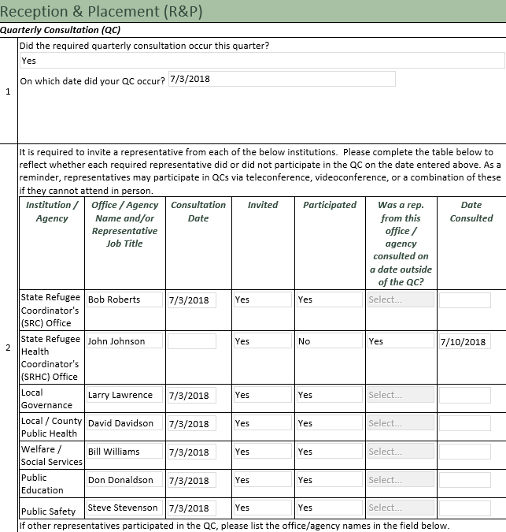
DQNR Reporting
If follow-up occurred with missing required participants:
Indicate whether they were invited to the main QC
Select that they did not participate in the main QC, which office/agency they represent, and the date of the follow-up discussion
If an alternate representative was in attendance in lieu of the primary representative the alternate should be listed here as a participant in the original QC
  Example: Deputy SRC attends instead of SRC = compliant. List the Deputy SRC’s info in this section and indicate they participated (SRC follow-up not required)

Slide 9


Network Trends
Network-wide stats for FY21 Q2 – Great job USCCB network!
  100% of sites held a consultation regarding Q2 topics
  97.5% held it within the Q2 timeframe
  97.5% discussed all required agenda topics
  Public safety is still the most challenging attendee to get
    57.5% attendance (traditional)
    90.0% when factoring in follow-up (expanded)
  The USCCB network is trending better with overall follow-up: 70.0% expanded compliance in Q1 and 77.5% expanded compliance in Q2
Keep In Mind These Definitions
Traditional compliance: All topics discussed + all participants attended the same QC
Expanded compliance: All topics discussed + all participants contacted during the quarter

Slide 10



Why QCs Matter: #1
#1: Strengthened Services for Clients
Better coordination across stakeholders results in better resettlement services for clients
Building a community-wide foundation promotes refugee integration across a variety of contexts (health, education, employment, etc.)
When stakeholders coordinate to prepare for arrivals fluctuations/new demographics, systems respond more easily = services are still provided on-time

Slide 11


#2: Network-wide Objectives and Indicators
During affiliate monitoring, quarterly consultations will not be considered compliant during affiliate monitoring even if you follow-up with all required participants who could not attend the original meeting.
However, follow-up will lead to meeting the overall network performance indicator, increase USCCB’s ranking, and could lead to a larger R&P projection for your site and/or the USCCB network.
Follow-up can occur in coordination with other local resettlement affiliates for any shared required participants (example: the three affiliates in your town place families within the same school district so you would all have the same public education participant).
Why QCs Matter: #2

Slide 12
Refugee Integration Strategy
Guest Speaker: Kiera Berdinner, PRM Program Officer
What does PRM look for in a good strategy?
Current Resources
Word Document
Considerations for Assessing Strategies for Integration
(chat & debrief email)
MRSConnect
QC requirements, ideas for alternate contacts, and sample agendas (click here)
Webinar
QC Webinar Series
Part 2: Conversations With the Network
Wed. 6/30 @ 2pm ET
(register here)

Slide 13

June 24, 2021
Thank you!
Do you have any questions?

