Slide 1
New Social Security Application Procedure: SSN Applications Initiated via Form I-765 for START Cases
USCCB
Resettlement Services

Slide 2
Presenters
Colleen Tighe
Associate Director,
Processing Operations

Slide 3
Learning Objectives
At the end of this webinar, you will be able to…
Understand the new SSN application procedure for START cases
Better understanding what the START database is and the timeline for case transition from WRAPS to START
Determine whether a case is in WRAPS or START
Determine which case arrivals will require post-arrival vs pre-arrival SSN application

Slide 4
Refugee Data Management
What is WRAPS?
What is START?
Interface with MRIS

Slide 5
How Will START Impact Affiliates?
Additional resettlement preference info for cross-reference cases
Change in Case Number
SSN applications will be automated
WRAPS Case Number: | START Case Number:
XX-123456 | XX-00123456

Slide 6
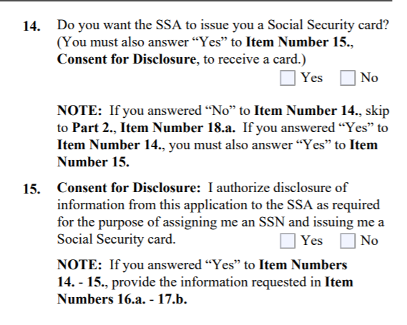
I-765 and SSN Application
X
X

Slide 7
SIV and Visa 93 Cases
The new SSN application procedure does NOT apply to the case groups below even if they have START Case Numbers:
Follow-to-join refugee cases. These are also known as FTJ-R, I-730 or Visa 93 cases. They are identified on the Bio Data Acceptance Form as having a processing Priority of “93”.
Amerasian cases. These cases are processed in Vietnam and can be identified on the Bio Data Acceptance form as having an “SV” processing Priority. They also have a Case Number prefix of “VM”.
Special Immigrant Visa (SIV) cases. These cases are identified on the Bio Data Acceptance Form as having an “SV” processing Priority and typically have a Case Number prefix of “AF” or “IZ”.

Slide 8
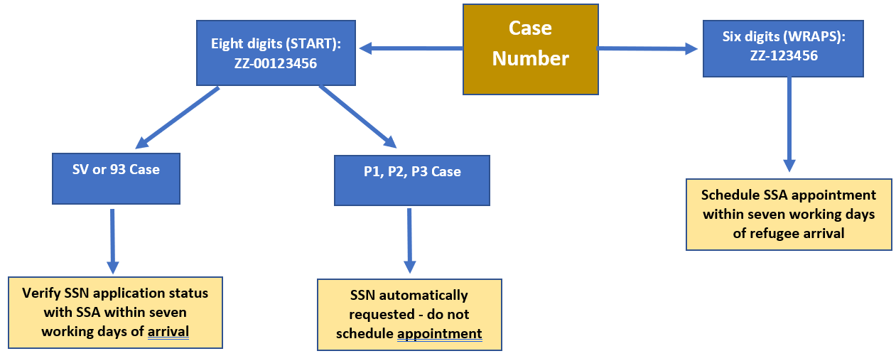
SIV and Visa 93 Cases

Slide 9
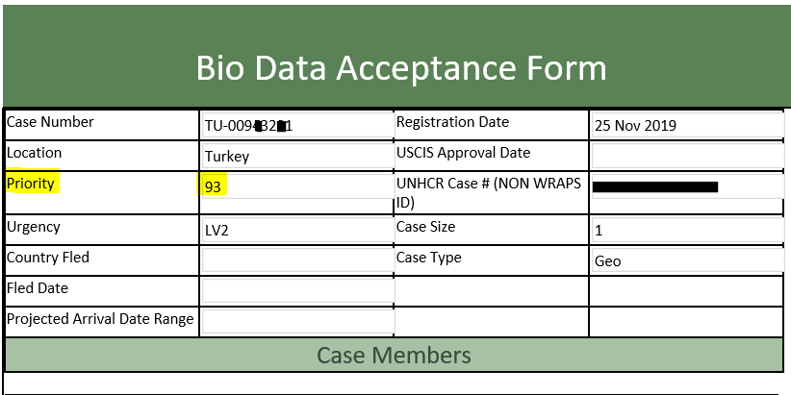
SIV and Visa 93 Cases
Example of a Visa 93 START Case:

Slide 10
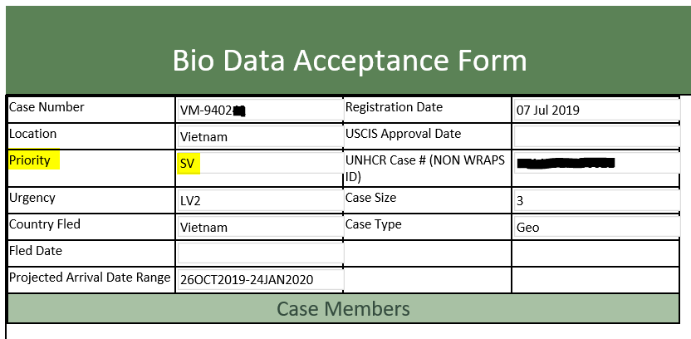
SIV and Visa 93 Cases
Example of an Amerasian WRAPS Case:

Slide 11
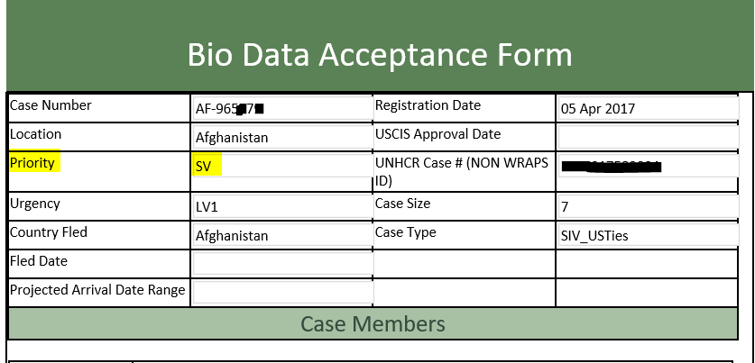
SIV and Visa 93 Cases
Example of a Special Immigrant Visa (SIV) WRAPS Case:

Slide 12
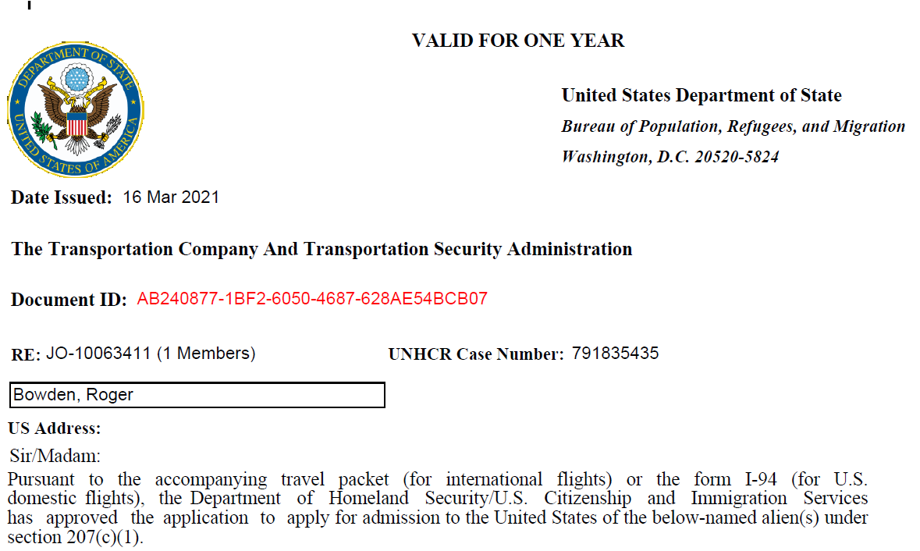
Global Boarding Letter

Slide 13
Overview of START Transition
2021
January | March | May | July | August-September | October | November
Austria ~4,100 non-closed cases | Latin America ~1,100 non-closed cases | Eurasia ~7,800 non-closed cases | Africa ~37,500 non-closed cases | Middle East and North Africa ~48,000 non-closed cases | Asia ~7,500 non-closed cases | Turkey and the Middle East ~7,600 non-closed cases

Slide 14
Questions???
Any questions?
Unmute by pressing *6 on your phone or type in the chat box!
You can also email ctighe@usccb.org or your FSC with any more questions.

