Slide 1
April 14, 2021
Housing Safety and Maintenance
Promising Practices

Slide 2
1
2
3
Zoom Features
Chat
Q&A
Raise Hand
Interact with presenters and attendees by:
Typing into the chat box
Asking questions in the Q&A
Raising your hand
The Zoom toolbar is at the bottom of your screen!

Slide 3
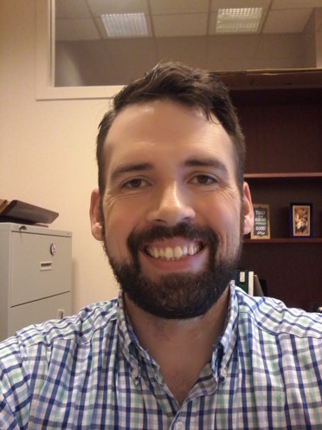
Introduction
Field Support Specialist David Thomson is our facilitator today!
David

Slide 4
Today’s Agenda
1
Review basic home safety check documentation requirements
2
Listen to promising practices from our guest speakers

Slide 5
Reiterate case management requirements related to resolving identified home safety concerns
1
Learning
Objectives
Adapt promising practices provided by colleagues in the network to provide safe housing
2
By the end of this webinar, you will be able to:
Apply practices outlined in discussions
3

Slide 6
Overview of Requirements
Number
FY 2021 CA Citation
1
Cooperative Agreement 3.b.6)d) pages 1-2
ensure that provision of [core] services is well-documented in case files: Material needs support and services for at least 30 days, including the provision of: safe, sanitary, and affordable housing
2
Cooperative Agreement II.g.4)a)i.-viii. pages 33-34
The Recipient shall provide or ensure that the refugees assigned to it are provided…Upon arrival and for a period of not less than thirty (30) days after arrival, decent, safe, and sanitary housing based on federal housing quality standards or local or state standards if local or state standards are higher than federal standards and the following…
Notes:
Poll #1

Slide 7
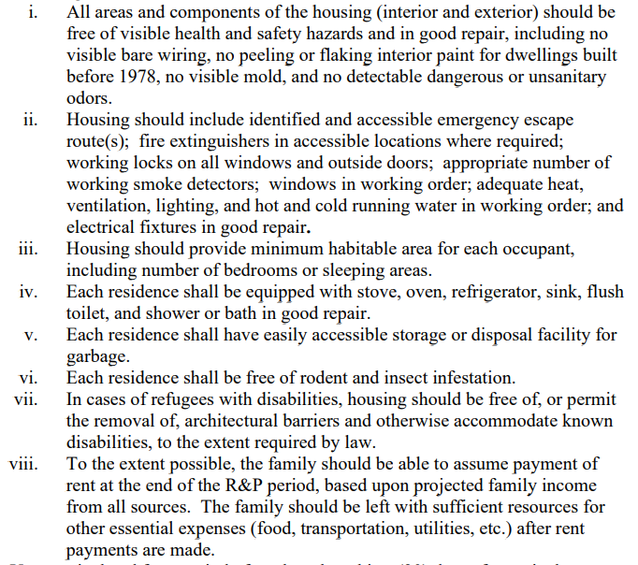
Cooperative Agreement II.g.4)a)i.-viii. pp. 33-34
FY 2021 CA Citation

Slide 8
Home Safety Checklist
#1
Documentation
NOTE: for service timelines based on the assurance date (ex. Walk-in SIVs), this check should occur by the date of assurance
A completed Home Safety Checklist that demonstrates a home safety check took place no later than the Domestic Arrival Date of the refugee case.
If completed as part of a move to permanent housing the home safety check must occur:
When the program was aware of the move prior to the client moving - By the date of client’s move to permanent housing.
When the client completes their move prior to notifying the program - the same day the program is made aware of the move.

Slide 9
Home Safety Checklist
#2
Promising practice
For clients staying with U.S. Ties, it is recommended that discussions with the U.S. Tie prior to client arrival take place in the U.S. Tie’s home.
This provides an opportunity to evaluate the home of the client’s initial stay.
Reminder: During the pandemic, this housing check can be in-person or virtually, in compliance with local and organization policy.

Slide 10
Housing Maintenance
#1
If issues affecting the safety and sanitation of the housing are identified:
This should be reflected in the home safety checklist
Steps taken to remedy these issues should be case noted. This could take two forms:
Detailed case noting of issue and steps taken to resolve
A brief case note of issue that references resolution details on the home safety checklist.
Notes:
Poll #2

Slide 11
Housing Maintenance
#1
Housing quality during monitoring visits
When federal and USCCB monitors review housing quality, they review both case file documentation AND the state of the client’s home during live home visits. To ensure that client housing is properly maintained, include the below as part of client interactions:
Inform clients about how to notify landlords of maintenance requests
Teach clients the importance and methods of appropriate home cleanliness habits

Slide 12
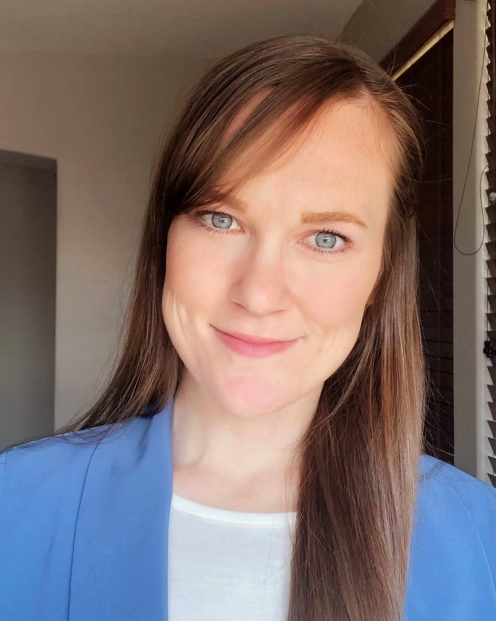
Phoenix, Arizona
R&P Program Manager
Kitty Marquez
Cultural Orientation Specialist
Rachel Jensen

Slide 13
Securing safe housing
#1
Find New Apartment Complexes
Search online for vacancies

Slide 14
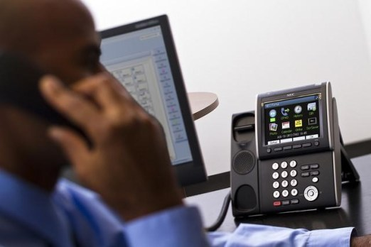
Securing safe housing
#2
Find New Apartment Complexes
Check their record with the city

Slide 15
Securing safe housing
#3
Find New Apartment Complexes
Visit during off hours

Slide 16
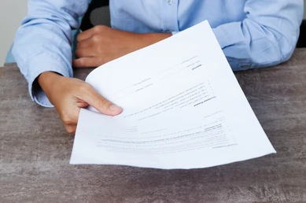
Securing safe housing
#1
RA-Apartment Partnerships
Provide info about our organization

Slide 17
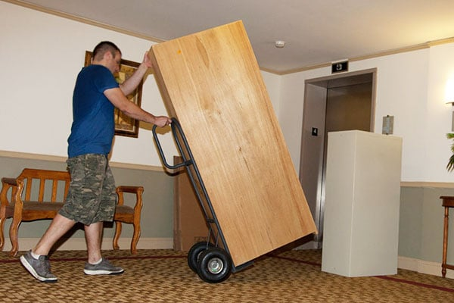
Securing safe housing
#1
New Arrivals
Set-up and inspection prior to arrival

Slide 18
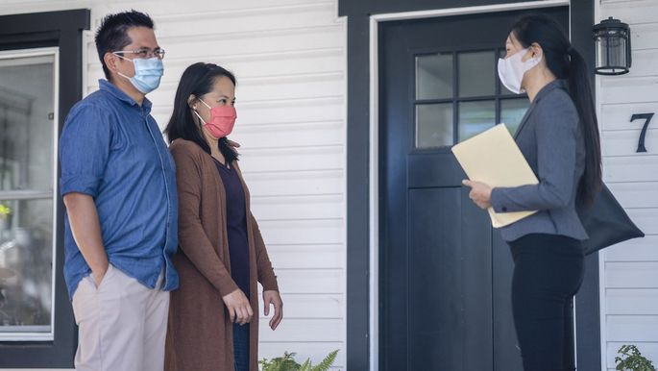
Securing safe housing
#2
New Arrivals
Case manager does home orientation on arrival day

Slide 19
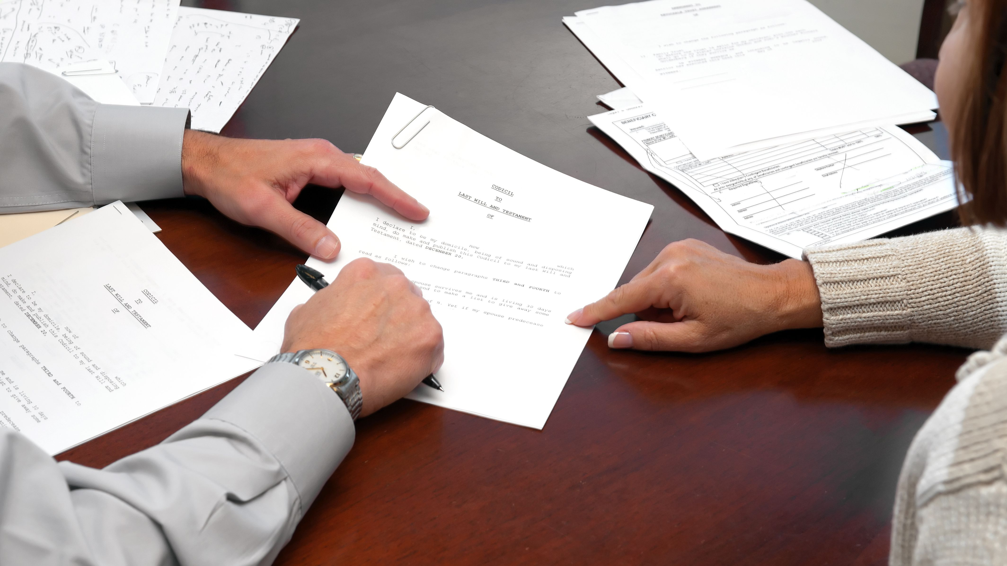
Securing safe housing
#3
New Arrivals
Review rules and lease during next day home visit

Slide 20
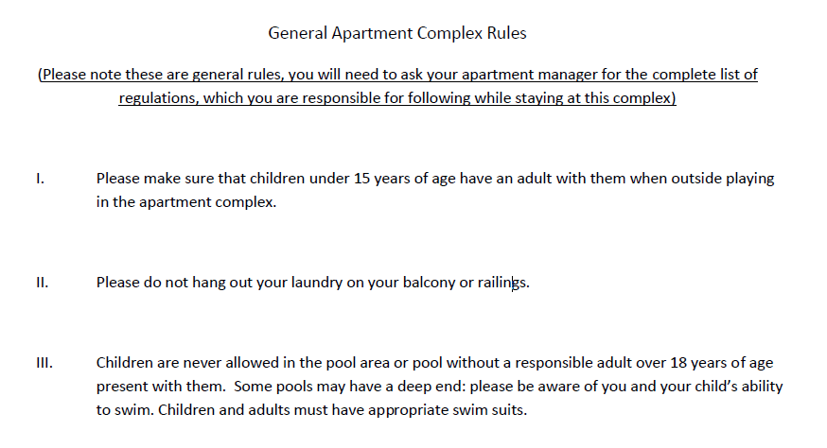
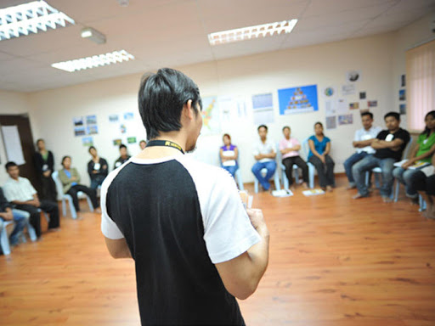
Assisting clients
#1
Ensure clients understand their responsibilities
Apartment complex rules for clients
Provide Cultural Orientation

Slide 21
Assisting clients
#1
Cultural Orientation
Responsibility
Safety
Prevention
Lease
Maintenance
Contacts
Appliances
Water
Emergency services
Fire
Pests
Bathroom

Slide 22
Assisting clients
#2
Cultural Orientation

Slide 23
Assisting clients
#3
Cultural Orientation

Slide 24
Assisting clients
#4
Cultural Orientation

Slide 25
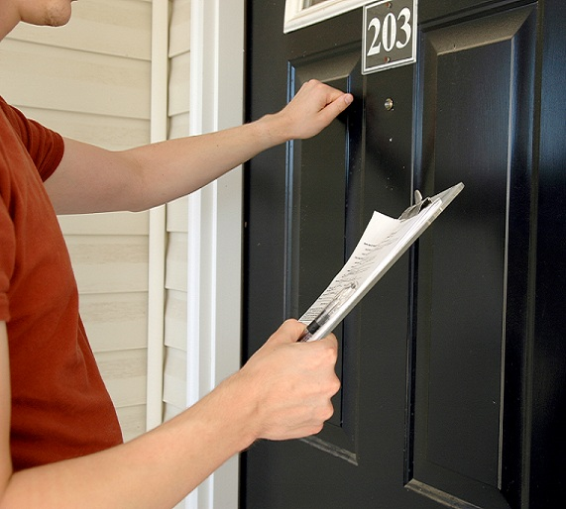
Assisting clients
#1
Follow-up
Case management follow-up as needed

Slide 26
Discussion
#1
Let’s take a moment to share practices you all follow to ensure client housing is safe and well-maintained.

Slide 27
April 14, 2021
Thank you!
Do you have any questions?

