Slide 1
Housing
Housing

Slide 2
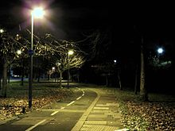
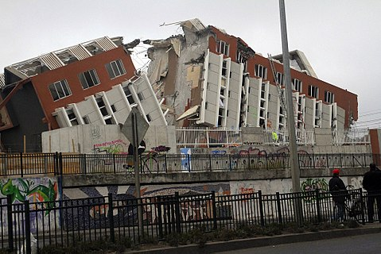
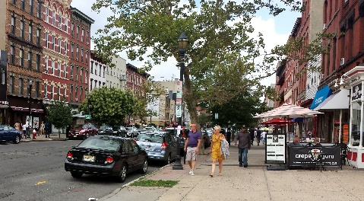
Finding a safe apartment
Is it near work or school?
Are there lights to see at night?
When I viewed the apartment was there mold, cracks, holes, bugs, and clean premises?
Is it an open space instead of in an alley?

Slide 3
An affordable apartment
Your rent and utilities should be about 30% of your monthly income.
Income | Amount
Wages from work | $1200
Income A | $200
Income B | $100
If it is more than 30%, you will have a difficult time paying for other things.
income = $1500
x 0.3
$450

Slide 4
An affordable apartment
Your application could be denied if you do not have proof of a high enough income.

Slide 5
What is a lease?

Slide 6
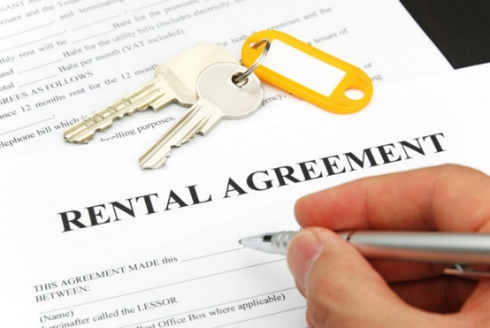
Signing a lease
Your name MUST be on the lease
You are agreeing to live at that place for that amount of time
There will be some fees/rules in the lease about ‘breaking the lease’
You will follow the apartment complex and lease rules
You will have access to the amenities and maintenance
Notes:
You cannot live in a friends apartment or have a friend stay with you without the complex knowing you are staying a period of time longer than a week
No smoking in the apartment or being destructive because you are responsible for the property now
http://refugeedevelopmentcenter.org/life-skills-resources/ - accompanying materials - Arabic, Burmese, English, Farsi, Nepali, Somali, Spanish, Swahili – Housing – what to look for in a lease
https://www.vaprojectlife.org/wp-content/uploads/sites/3/2015/06/Sample-Rental-Agreement1.pdf

Slide 7
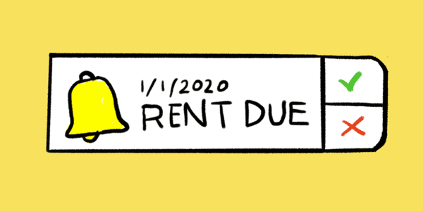
Signing a lease
The lease will say how much rent is and when it is due. This amount can’t change until after the lease is finished.
The lease will say the number of people living in the apartment
Notes:
You cannot live in a friends apartment or have a friend stay with you without the complex knowing you are staying a period of time longer than a week
http://refugeedevelopmentcenter.org/life-skills-resources/ - accompanying materials - Arabic, Burmese, English, Farsi, Nepali, Somali, Spanish, Swahili – Housing – what to look for in a lease
https://www.vaprojectlife.org/wp-content/uploads/sites/3/2015/06/Sample-Rental-Agreement1.pdf

Slide 8
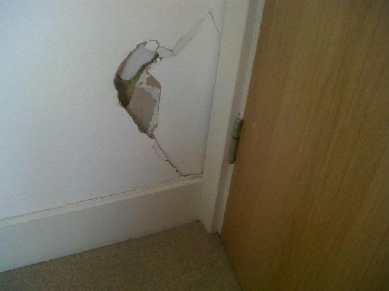
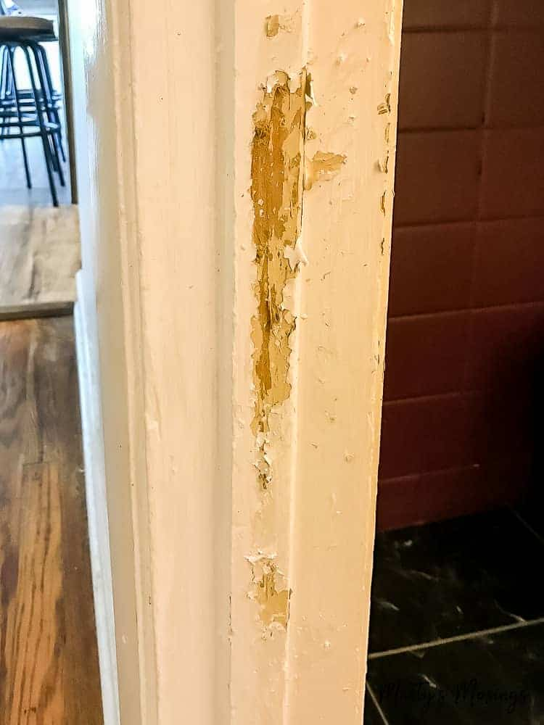
Signing a lease
The lease will say the condition of the apartment.
Check if there are any problems before you move in and make sure it is on your lease.
Notes:
You cannot live in a friends apartment or have a friend stay with you without the complex knowing you are staying a period of time longer than a week
No smoking in the apartment or being destructive because you are responsible for the property now
http://refugeedevelopmentcenter.org/life-skills-resources/ - accompanying materials - Arabic, Burmese, English, Farsi, Nepali, Somali, Spanish, Swahili – Housing – what to look for in a lease

Slide 9
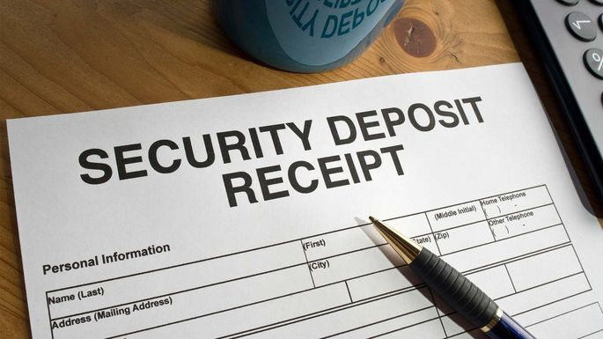
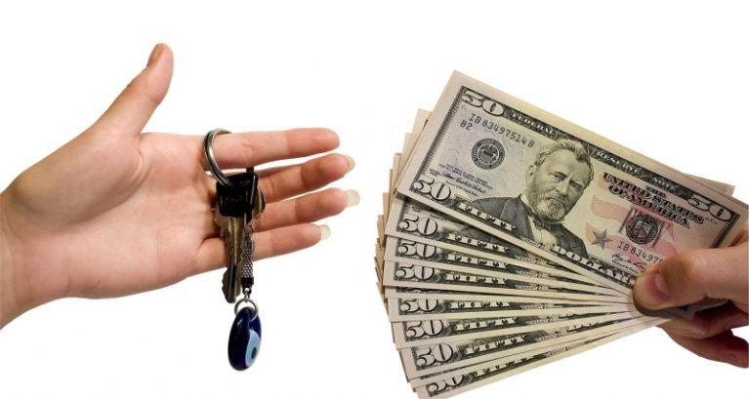
Security deposit
You need to pay a set amount or 1 or 2 months of rent
You will receive that money back when you move out and the apartment is in the same condition
If you damage anything or move out early, your landlord can keep some or all of that money
Notes:
You cannot live in a friends apartment or have a friend stay with you without the complex knowing you are staying a period of time longer than a week
No smoking in the apartment or being destructive because you are responsible for the property now
http://refugeedevelopmentcenter.org/life-skills-resources/ - accompanying materials - Arabic, Burmese, English, Farsi, Nepali, Somali, Spanish, Swahili – Housing – what to look for in a lease

Slide 10
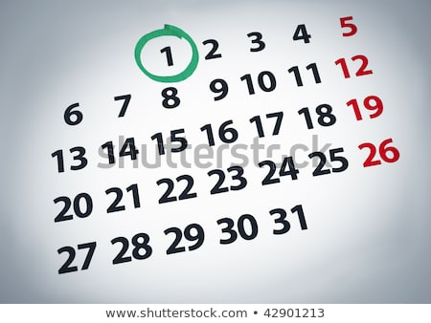
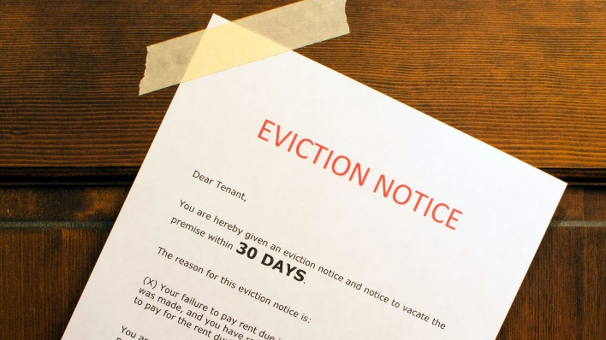
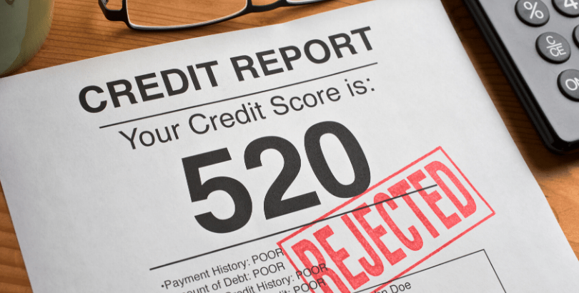
Rent
It is important that you save enough to make this payment
Rent is usually due on the first of every month.
Not paying rent on time can result in late fees or in the most extreme case, being evicted or having your credit affected
Notes:
Remind them to save their stipend and to use it for rent only
http://refugeedevelopmentcenter.org/life-skills-resources/ - accompanying materials - Arabic, Burmese, English, Farsi, Nepali, Somali, Spanish, Swahili – Housing – vocabulary list and tenant-landlord contact log

Slide 11
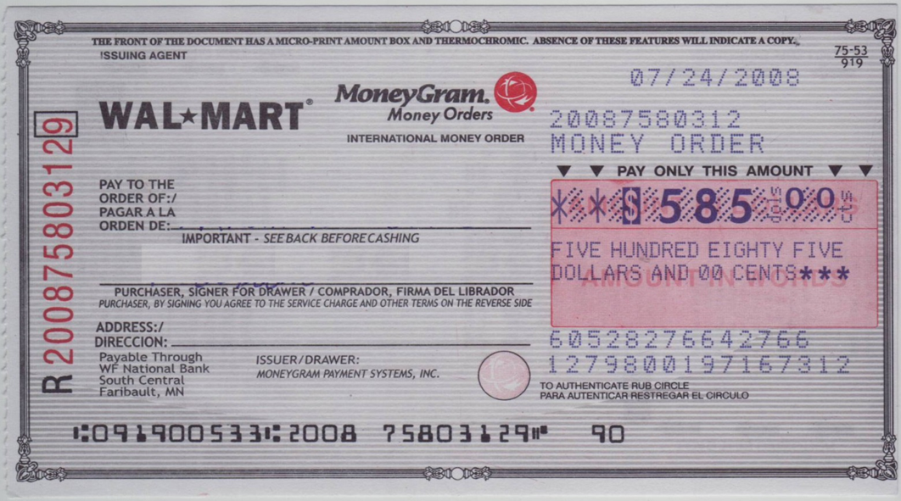
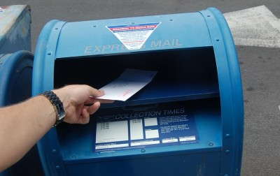
Rent
You need to find out how to pay rent and where to send it.
If you pay by mail, make sure you mail it a few days before the deadline so it will not be late.
Notes:
Remind them to save their stipend and to use it for rent only
http://refugeedevelopmentcenter.org/life-skills-resources/ - accompanying materials - Arabic, Burmese, English, Farsi, Nepali, Somali, Spanish, Swahili – Housing – vocabulary list and tenant-landlord contact log

Slide 12
Breaking a lease
If you want/need to leave your apartment before the last month of your lease, you are “breaking” the agreement
Landlords will charge a fee for this, plus you might have to pay remaining months of rent
You do not get security deposit back
Notes:
Exact amount for breaking the lease will be written into the lease agreement

Slide 13
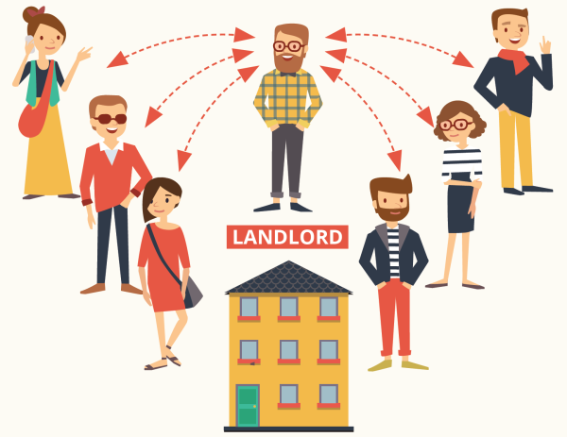
Landlord’s responsibilities

Slide 14
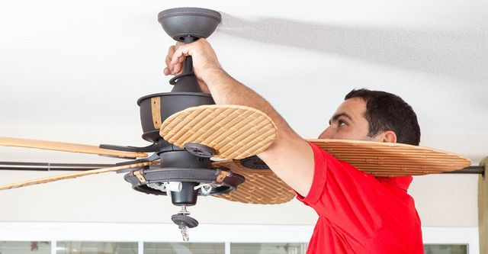
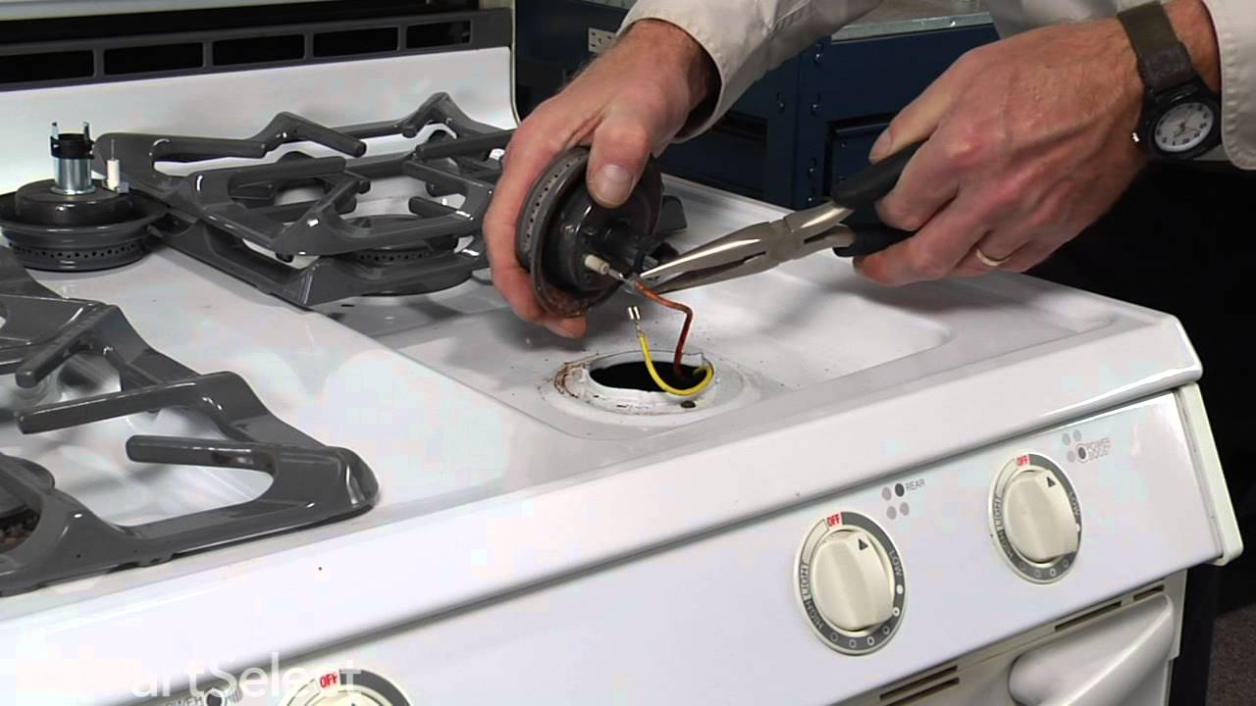
Landlord’s responsibilities
Notes:
The lease explains not only that the tenant has responsibilities, but the landlord does also. The lease is a legal document to protect everyone.

Slide 15
What do you do if ….
the hot water stops working?

Slide 16
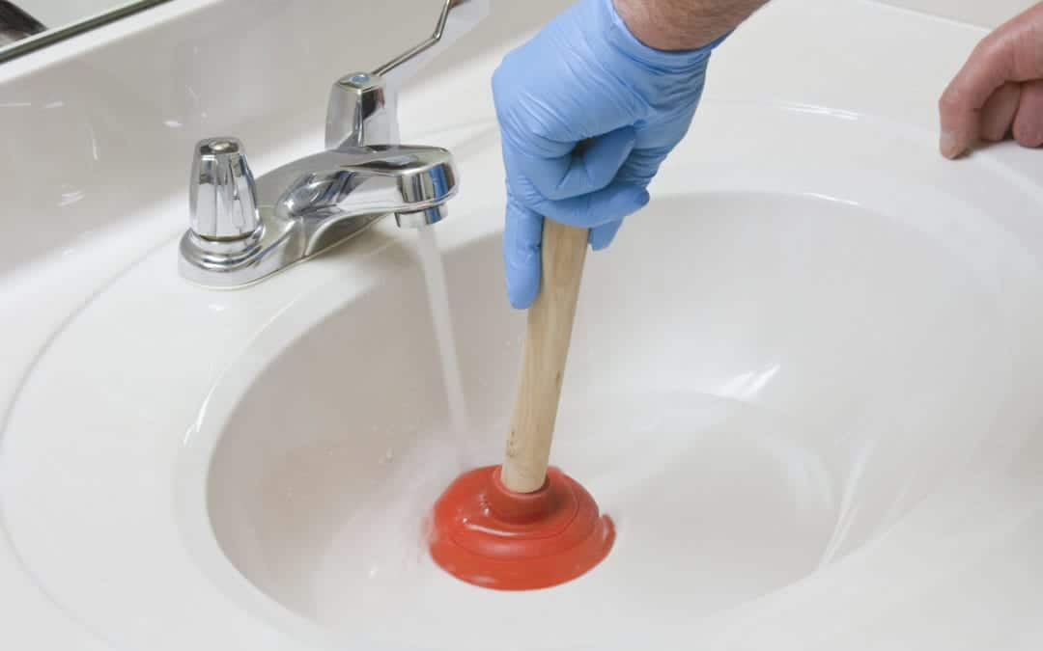
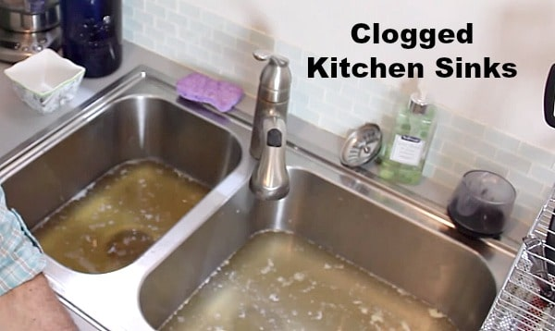
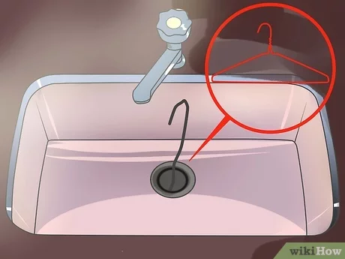
What do you do if ….

Slide 17
What do you do if ….
a pipe starts leaking?

Slide 18
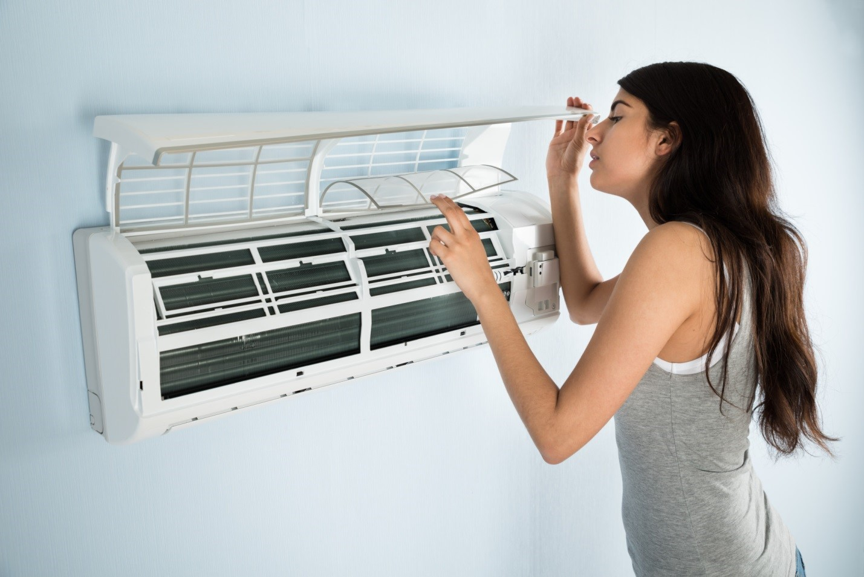
What do you do if ….
the air conditioner breaks?

Slide 19
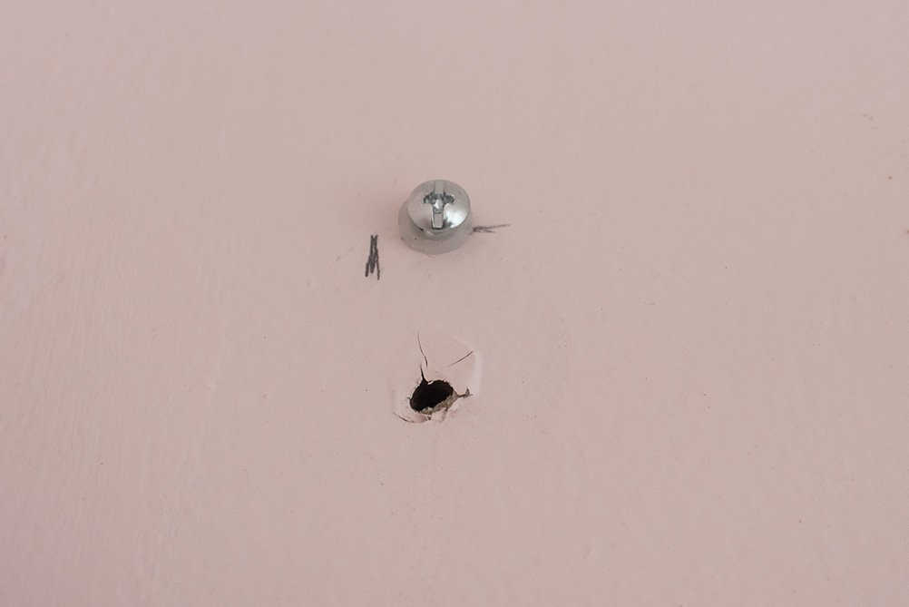
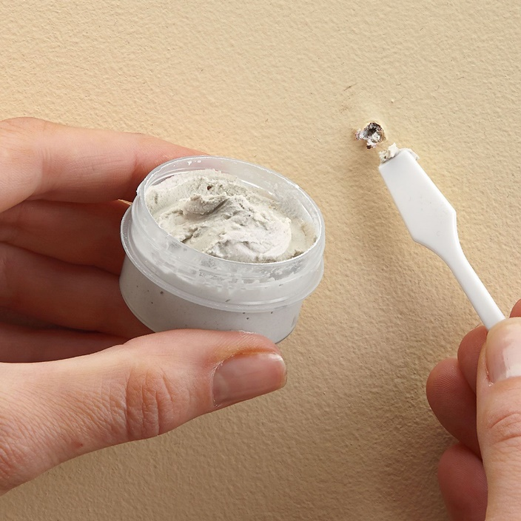
What do you do if ….
there’s damage on the wall?

Slide 20
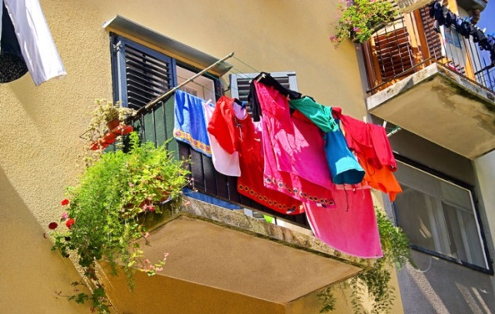
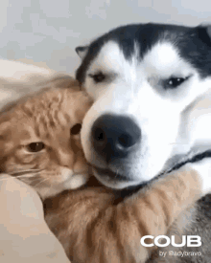
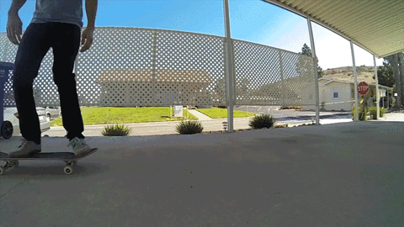
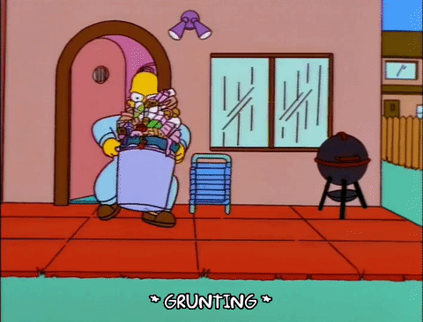
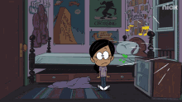
Apartment Rules

Slide 21
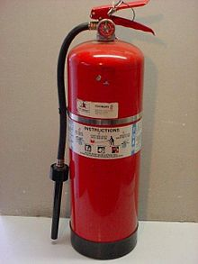
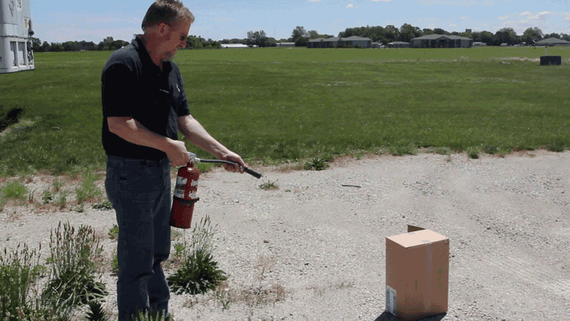
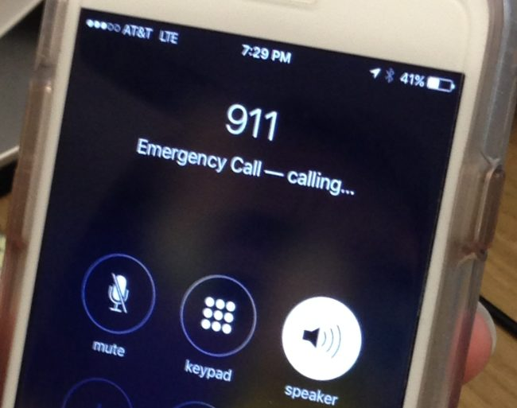
In Case of Fire
Know where your fire extinguisher is and how to use it before cooking
If you are unable to put out the fire, call 911 immediately and exit the house

Slide 22
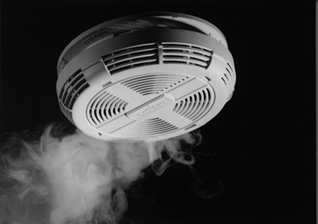
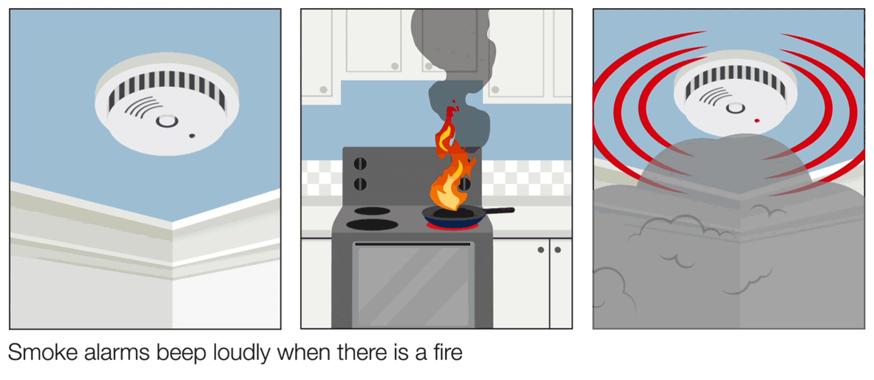
Smoke Detectors
There are several smoke detectors in your apartment.
These detectors beep loudly if they detect smoke.
If you hear a smoke detector noise, safely find the source and then if it’s a fire call 911.
Make sure that the smoke detector has a full battery.
Contact your landlord immediately if the smoke alarm makes a small beeping noise.
EXAMPLE https://youtu.be/4gryBwY5Bfw

Slide 23
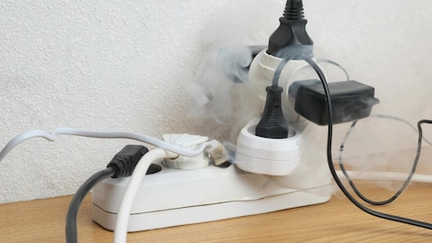
Electricity
Turn off lights and air conditioner when you leave
Lower electric bill
If you ever cannot afford your electric bill or other bills, you can get 1 time/year emergency assistance by applying for LIHEAP
Do not overload a power strip
Less risk of fire
Notes:
https://www.acf.hhs.gov/ocs/low-income-home-energy-assistance-program-liheap

Slide 24
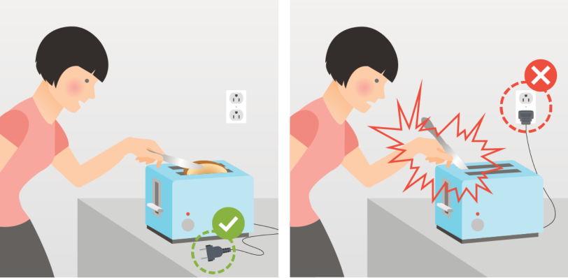
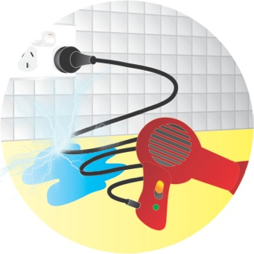
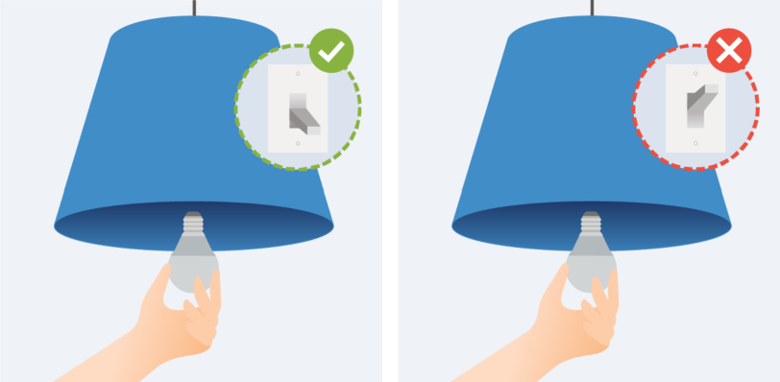
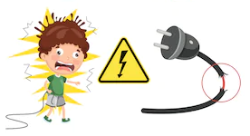
Dangers
Notes:
https://liheapch.acf.hhs.gov/help

Slide 25
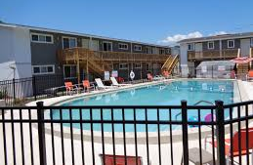
Pool Safety
Never swim alone, or while under the influence of alcohol or medications
Know where children are at all times
If you leave the pool area, take the children and belongings with you
Always have a “designated watcher”

Slide 26
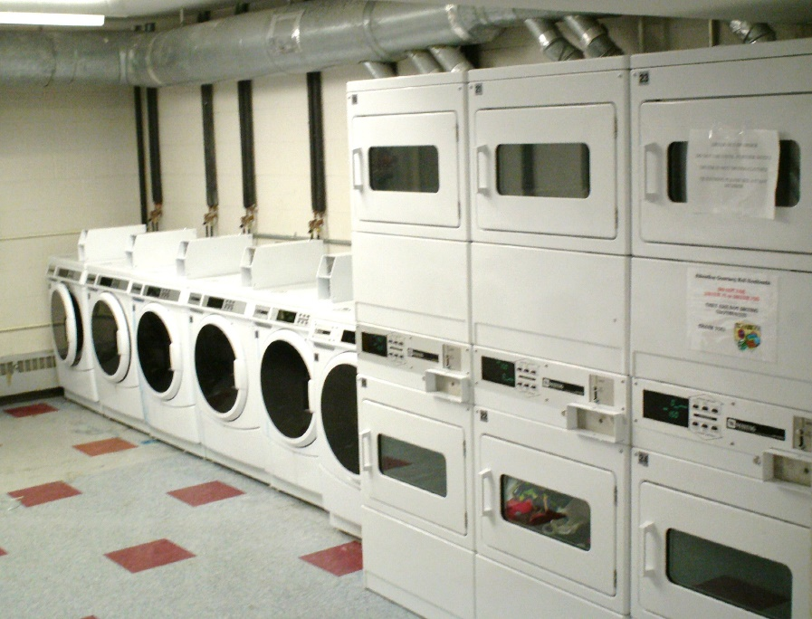
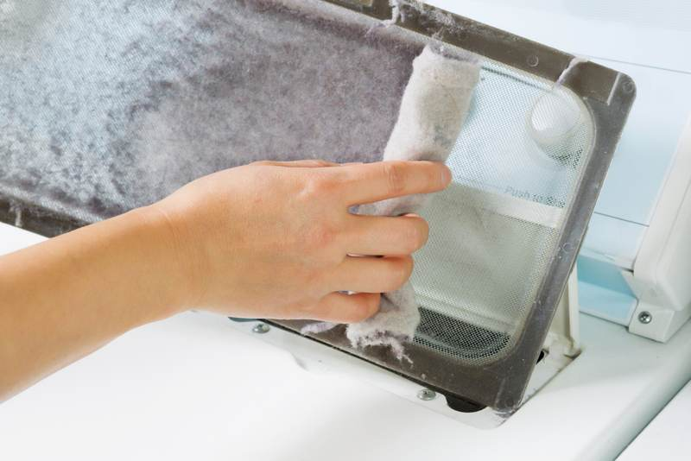
Laundry Room
You may have the washer and dryer in your unit, but you may have a laundry facility for the community
Some require quarters or a laundry card with money on it to pay for each load – approximately $1.25-1.50 each
Put in your own detergent
Remember to take your clothes out on time
Take the lint out of the trap

Slide 27
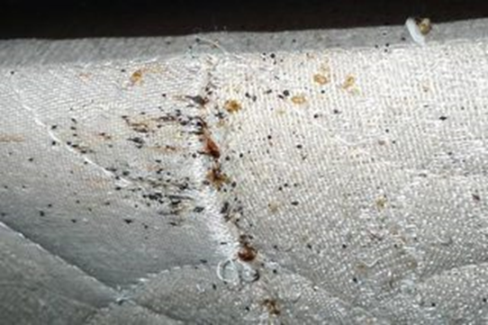
Problems
Watch for bed bugs in used furniture that you bring into your home.
Keep your mattress off the ground.
Ants and roaches – clean up spills, crumbs and vacuum frequently.
Notes:
http://refugeedevelopmentcenter.org/life-skills-resources/ - accompanying materials - Arabic, Burmese, English, Farsi, Nepali, Somali, Spanish, Swahili – Housing – roommate agreement and compatibility

Slide 28
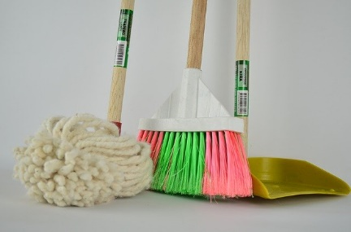
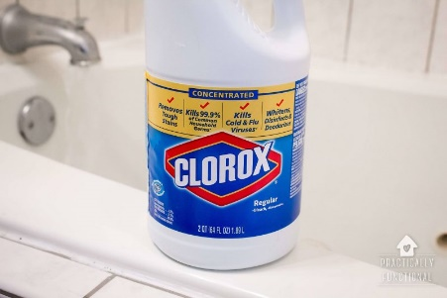
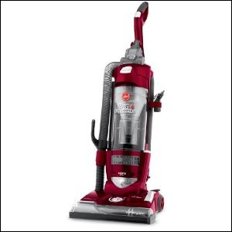
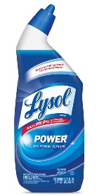
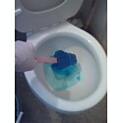
Cleaning
Supplies:
Broom & Mop
Vacuum
Anti-bacterial wipes
Paper towels
Bleach
Toilet bowl cleaner
Dish soap
You will be charged a fee if you do not leave the apartment completely clean at move-out
Notes:
http://refugeedevelopmentcenter.org/life-skills-resources/ - accompanying materials - Arabic, Burmese, English, Farsi, Nepali, Somali, Spanish, Swahili – Housing – roommate cleaning schedule

Slide 29
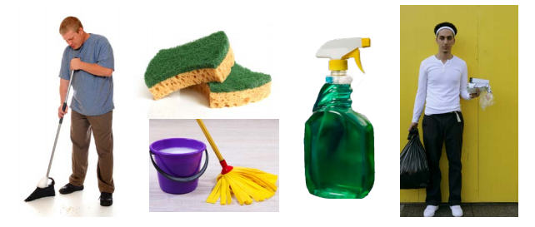
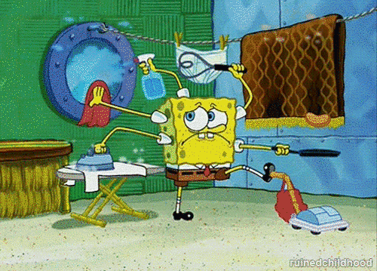
Cleaning
You are responsible for keeping your home clean.
Find out where/when you bring trash and recycling.

Slide 30
Food!

Slide 31
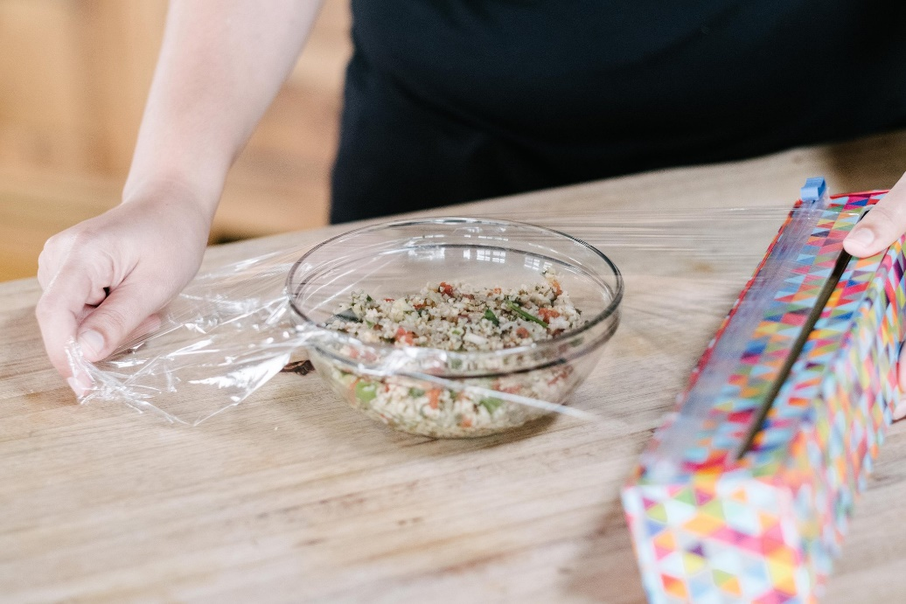
Food
Make sure you cover and refrigerate food so that it will not go bad and insects will not be a problem

Slide 32
Food
Don’t leave dirty dishes in your sink or you may get insects like cockroaches

Slide 33
Fairness
You cannot be discriminated against because of national origin, sexual orientation, gender or religion
If your landlord is mistreating you or making you do extra things that other residents do not do:
Review the terms in your lease
Report them for discrimination
Ask about your tenant rights
Southwest Fair Housing Council
888-624-4611
Or other tenant advocates

Slide 34
Resources
https://corenav.org/en/programs/cultural-orientation/housing/
Making Your Way: Housing pp 199-239
http://coresourceexchange.org/wp-content/uploads/2019/09/Story-of-Me-An-Orientation-Workbook-for-Refugee-Youth.pdf
Healthy Homes (germs, cleaning, smoke detector, thermostat, led paint, bed bugs) http://refugeedevelopmentcenter.org/healthy-homes-videos/
Notes:
Some of these resources have translations so check them out

