Slide 1
February 18, 2021
Quality Assurance 101
Tools and Strategies for Success
Notes:
Hi everyone, welcome to our webinar today, ‘Quality Assurance 101’. We are going to discuss tools and strategies that remote placement community partners can use to ensure quality services. Before we get started I know a lot of you all are located in states that are experiencing some weather related crises, particularly in Texas, and surrounding states, just wanted to let you all know that we are thinking of you and please don’t hesitate to reach out if you have any questions or concerns.

Slide 2
Introduction
Elizabeth Cirin Cione
Remote Placement Coordinator

Slide 3
1
2
3
Zoom Features
Chat
Q&A
Raise Hand
Interact with presenters and attendees by:
Typing into the chat box
Asking questions in the Q&A
Raising your hand
The Zoom toolbar is at the bottom of your screen!

Slide 4
Define quality assurance
1
Learning
Objectives
Conduct a self-assessment on your agency’s quality assurance practices
2
By the end of this webinar, you will be able to:
Identify how case file review, client home visits, client feedback and staff training improve your service provision
3
Understand what tools and resources are available to assist you with quality assurance
4

Slide 5
What is Quality Assurance?
Quality assurance refers to the tools and methods remote placement community partners can utilize to ensure the quality of services provided to clients.
What are examples of quality assurance activities?
R&P Case File Review
Client Home Visits
Client Feedback Methods
Staff Training
Notes:
Quality assurance refers to the tools and methods remote placement community partners can utilize to ensure the quality of services provided to clients.
No matter how many clients an agency resettles each year, quality assurance can greatly benefit the resettlement program and clients. · Quality assurance helps to identify errors and avoid problems, as well as highlighting best practices and agency strengths.
Today we are going to discuss a few examples of quality assurance activities that complement the R&P program. They include:
R&P Case File Review
Client Home Visits
Client Feedback Methods
Staff Training
Quality assurance can be intimidating or overwhelming if you don’t have a plan in place but after today you will be able to leave his training with some strategies and ideas to create a system that works for you. Every partner is different, and has different capacities and challenges. No matter how many staff you have or extra hours in the month to dedicate to QA, there is strategy for you.

Slide 6
Continuous Quality Assurance
What do we need to introduce? What are we not doing?
What tools do we need to get us there?
What is a realistic timeframe?
Incorporate results of your assessments, revise as needed!
PLAN
Orient and train staff.
Get started!
REVISE
IMPLEMENT
ASSESS
What is working, what isn’t? What needs to be changed?
Notes:
Effective quality assurance is continuous, and adaptive. It’s helpful to view QA as a cycle, one in which we plan, implement, assess, revise and restart that cycle as needed. Without these steps, jumping into QA can be overwhelming and exhausting, and lead to poor outcomes, staff burnout, and lack of direction.
The first step in our QA cycle is to plan. During this stage we will do a lot of thinking, and ask a lot of questions. What do we need to introduce? What are we not doing? What tools do we need, and what is a realistic timeline? This planning stage should include staff at multiple levels, and be as collaborative as possible.
The second step is to train staff on the plan, and implement it! Abide by the timelines you set in planning stage to get a feel for whether or not they are realistic.
After implementation period, we will want to take a step back and assess. How did that go? What worked, what didn’t? Is there anything we need to change?
And finally, once we have evaluated our system, we need to revise it. These quality assurance systems should be flexible, and respond to events like staff turnover, higher or lower arrivals, or a change in agency programming.

Slide 7
Self - Assessment
Instructions:
Answer the poll questions to complete a self-assessment on your agency’s quality assurance activities. This will help community partners identify what quality assurance procedures they have in place and areas for growth.
Reflect…
What are my agency strengths?
What are areas for growth?
What is the biggest challenge my agency has to improve quality assurance procedures?
What resources do I need?

Slide 8
Case File Review
Case file review is the story of the client’s resettlement in the United States. The case file is made up of the case note log, client identification, service forms and financial records. A quality case file will contain a record of all core services and client contact, and the information contained in the file will not be contradictory. Good documentation will be present, clear, legible for all members, and contain all signatures and dates.
Case files protect both agency and the client.
For a refresher on what is required to be in the case file, review the E-Learning Module on MRSConnect
Notes:
Let’s examine some of the quality assurance methods available to community partners and how this relates to improved service provision. First we will begin with case file review. As you know, a case file is a required part of our documentation efforts. If you need a refresher on what should be contained in the case file, please check out the Reception and Placement E-Learning course on MRSConnect.
The case file contains a record of all services and client contact for a particular case, it is truly the story of the client’s resettlement. When someone who has never worked on the case before opens up the file, they should be able to read that story, and understand what happened. The case file is made up of the case note log, client identification, service forms and financial records. A quality case file will contain a record of all core services and client contact, and the information contained in the file will not be contradictory. Good documentation will be present, clear, legible for all members, and contain all signatures and dates. Case file documentation can feel tedious, but it’s helpful to think of it as a way to protect both the client and the agency.

Slide 9
How do I review a case file?
Management Review
Group/Peer Review
Works for agencies of all sizes
Helps to identify big picture trends
Serves as opportunity for ongoing training
Promotes consistency
Issues should be discussed and reviewed with staff as appropriate
Have staff review either the same file or each other’s files
Empowers program staff
Ideal for agencies with multiple staff or volunteers
Helps to reinforce requirements and clarify misunderstandings
Allows for best practices to be shared and learned
Notes:
Let’s discuss some strategies for case file review. It’s important to mention that not every strategy will work for every community partner. All of these strategies are tools, feel free to add or adapt as necessary!
First up is management review, which entails having agency management review some or all case files. Who is considered management will be different for every agency, but it should be someone with leadership of the RPP program. When managers review case files, it helps to identify big picture trends across all cases, and serves as an opportunity for ongoing staff training. This is a great way to promote consistency across case managers or volunteers. The key to success for management review is for issues to be discussed and reviewed with staff in a timely manner. I recommend building in space and time to follow up on future files to make sure the issues identified are resolved.
Group and Peer Review is when a group of staff review the same file or each other’s files. When reviewing the same file, it helps to build consistency and also source different perspectives. I may miss something, but my colleague could pick up on it, and this is a great way for us to learn from each other and also empower each other. This strategy may be ideal for agencies with multiple staff or volunteers. This method facilitates the sharing of best practices in a more dynamic way than having a manager involved. Let’s say I struggle with completing refugee service plans,perhaps when I review my colleague’s case file, I notice how detailed and thoughtful their plans are. This opportunity to review my peer’s file has now resulted in me learning some best practices and hopefully strategies to improve my case files.

Slide 10
How do I review a case file?
Spot Check
Self Review
Spot checks are completed to review one item or one form across multiple files
Can be a team or individual activity
Able to be completed frequently and efficiently
Confirms compliance with a particular service
Great activity for team meetings
Staff can utilize RF-24 to review their own case files
Helps staff to catch errors before a manager does
Ideal to review a file before case closure
Should not be only method of case file review
Notes:
Spot checks are one of my favorite quality assurance activities, because it is easily adaptable and can be done by an agency no matter their size. Spot checks work by checking one item or one form across multiple files, such as pulling five case files and reviewing only their cultural orientation documentation. This can be done as a team or individual activity, and it works really well as openers for team meetings.
And then self review is probably the most common form of case file review, which involves having staff review their own case file. When staff use the USCCB RF-24 Case File Monitoring Tool, it helps them to identify errors before a manager does. This is a good exercise to do before a case is closed. However, as it does not provide any manager or peer feedback, it should not be the only method of case file review.

Slide 11
Reflecting: Case File Review
What challenges do you have to implementing case file review?
What best practices do you have to share with the group on case file review?
Notes:
Let’s open this up for some reflection. I have two questions up on the slide, and I would encourage you all to submit some thoughts in the chat if you are comfortable doing so.
What challenges do you have to implementing case file review?
And what best practices do you have to share with the group on case file review?

Slide 12
Best Practices: Case File Review
Make it happen! Set timeframes and involve the team, make it reoccurring.
Recruit volunteers if staff have limited time.
Introduce dedicated case noting hours.
Use tools like RF-24, Case Note Log Template, or internal resources for consistency.
Include accounting/finance staff when possible.
Use client appointments as an opportunity to grab missing documents and signatures.
Complete R&P Program Report with case file open.
Explain delays. Better to be late than to not be there at all.
Consider the client. Would they agree with the telling of their story?
Fix your findings. Issues identified should be resolved. Reach out to USCCB if errors are ongoing.
Notes:
Let’s take a look at some best practices for case file review.

Slide 13
Client Home Visits
Completing additional home visits outside of required visits helps to ensure clients are satisfied with their services, grievances are resolved, and that all services were completed.
Client home visits empower refugees to self-advocate for their families.
Notes:
Now that we’ve discussed case file review, let’s move on to conducting client home visits. According to the Cooperative Agreement, clients must be visited within two business days of arrival and receive an additional home visit within 30 days. Minor cases and cases that move within the R&P period have additional home visit requirements. Completing additional, non-required client home visits is a strong quality assurance method that helps ensure refugees have received all required services. For a breakdown of home visit requirements, please complete the “Reception and Placement” and “Attached Refugee Minors” courses on MRSConnect.
Completing additional home visits out side of those required visits helps to ensure clients are satisfied with their services, grievances are resolvesd, and that all services were completed. Client home visits ultimately help refugees self advocate for their families. Now a quick disclaimer, completing client home visits during the COVID 19 pandemic may not be possible, but you could substitute out a home visit for a telephonic video conference or phone call, and you will get the same results.

Slide 14
Case Study
What could be the implications if missed?
How did QA help this situation?
Your program director visits a percentage of arrivals each year. Before the visit, she reviews the case file. For today’s visit, she cannot find the selective service registration for the case’s adult son.
When the PA and adult son are asked about selective service, they say they do not know what selective service is and cannot recall registration. Upon returning to the office, director debriefs with case manager and it is discovered that the selective service was not completed. Client was brought in the next day to register.

Slide 15
Best Practice: Client Home Visits
Why complete additional visits?
Who should complete additional visits?
Builds trust
Repair breakdown in communication
Identifies issues and provides pathway for resolution
Complements case file review
Best practice is for agency staff, or volunteer who did not serve as primary case worker
This allows space for the client to offer honest feedback

Slide 16
Best Practice: Client Home Visits
What do I need to do to prepare?
When should I complete client home visits?
Best practice is to visit at the midpoint or towards the end of the service period when most or all services have been completed
Helps to confirm that housing is still in good shape
Chance to check on client well being
Opportunity to review finances before Day 90
Easy way to identify if any CO topics need to be reviewed
Schedule a time with clients
Make sure clients understand purpose of visit
Arrange for interpretation
Review case file
Use sample interview (Quality Assurance Toolkit or agency version)

Slide 17
Examples of Questions
What is your phone/address in English?
In what ways has your case manager helped you?
How much are your receiving each month in public benefits?
Who is helping you find employment?
Did you receive interpretation at your health screening?
When were your children enrolled in school?
Is everything working in your home?
Are you happy with the quality of services you have received?
What questions do you have for me?

Slide 18
Reflecting: Home Visits
What are the main challenges that your clients face during their R&P Period? How could client home visits help with these trends?
What best practices do you have to share with the group on client home visits?

Slide 19
Client Feedback
Client feedback is a crucial tool in our quality assurance process, as it allows agencies to seek opinions and thoughts from the population they directly serve. Feedback should be reviewed, and inform future service delivery.
We use positive feedback to reinforce our programming and negative feedback to identify areas for improvement.
Notes:
Next we are going to discuss Client feedback.

Slide 20
Case Study
How are problems from two years ago impacting services today?
How could client feedback have helped?
A family arrives to rejoin their U.S. Tie, who was resettled by the community partner two years ago. Within a few days, the case manager notices that the PA of the case has very negative opinions of the agency’s procedures. The PA frequently tells the case manager that he does not want any outside interpreters and insists on using his U.S. Tie at all appointments, which leads to delays in service provision.
After several weeks of case management disruption, the case manager asks why PA has a problem with using agency interpreters. PA explains that while he himself has never had an issue with the interpreters, his U.S. Tie had many problems with the quality of interpretation that the agency used two years ago. The U.S. Tie felt he did not understand what services were being provided to him and would have liked to have better interpreters. The U.S. Tie had communicated this experience to PA and PA was afraid it would be repeated with his case.

Slide 21
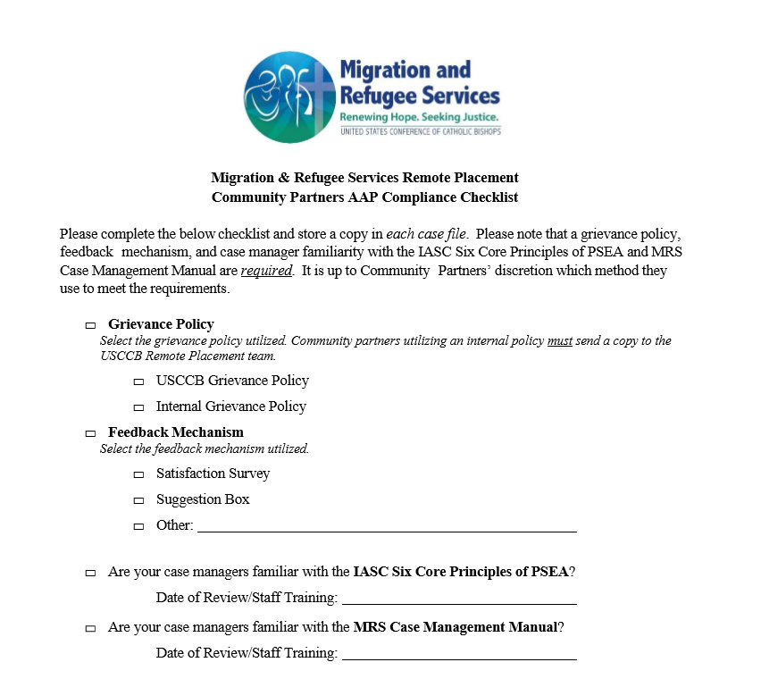
AAP Compliance Checklist
Feedback Mechanisms:
Satisfaction Survey
Standardized option
Not time intensive
Identifies trends and areas for growth
Clients may prefer anonymous option
Space for positive and negative feedback
Suggestion Box
Informal option that allows for anonymity
Should be kept in an accessible yet safe space
Clients should be oriented on box’s existence
5 minutes
Notes:
USCCB requires community partners to utilize the Accountability to Affected Populations (AAP) Compliance Checklist, which highlights that a grievance policy, feedback mechanism and case manager familiarity with the MRS Case Management Manual are required. Effective October 1, 2020, USCCB will also require familiarity with the IASC’s Six Core Principles of PSEA. Ensuring your agency has implemented the AAP Compliance Checklist is a great first step to utilizing client feedback in your quality assurance process.

Slide 22
Reflecting: Client Feedback
How could your agency benefit from seeking client feedback?
What are the ways that your agency seeks client feedback now?

Slide 23
Best Practices: Client Feedback
If collecting feedback seems overwhelming, utilize the USCCB resources.
Inform clients at intake/CO/home visits of feedback mechanisms.
Seek informal feedback throughout the R&P Period: “Are you satisfied with the services we have provided so far?”
Implement surveys as a part of the 90th day case closure process.
Feedback mechanism should be reviewed and analyzed on a frequent basis.
Designate one point person for reviewing and analyzing mechanisms, even a volunteer!
Incorporate R&P feedback activities with larger agency efforts.
Consider more advanced efforts, such as a client focus group.

Slide 24
Staff Training
Staff should receive ongoing training of relevant R&P issues to ensure compliance with the Cooperative Agreement and to help build best practices in case management.
Staff learning and training on R&P issues should be frequent and ongoing, not only when new staff are brought on at the agency

Slide 25
Strategies for Staff Training
Have all staff complete E-Learning Courses
Utilize webinars and trainings available
Encourage staff to present on successes/best practices
Allow staff space to provide feedback
Discuss QA findings with staff

Slide 26
Reflecting: Staff Training
What training on refugee resettlement and R&P issues are new staff provided?
What types of ongoing training or professional development opportunities are provided?

Slide 27
Continuous Quality Assurance
What do we need to introduce? What are we not doing?
What tools do we need to get us there?
What is a realistic timeframe?
Incorporate results of your assessments, revise as needed!
PLAN
Orient and train staff.
Get started!
REVISE
IMPLEMENT
ASSESS
What is working, what isn’t? What needs to be changed?
Notes:
Effective quality assurance is continuous, and adaptive. It’s helpful to view QA as a cycle, one in which we plan, implement, assess, revise and restart that cycle as needed. Without these steps, jumping into QA can be overwhelming and exhausting, and lead to poor outcomes, staff burnout, and lack of direction.
The first step in our QA cycle is to plan. During this stage we will do a lot of thinking, and ask a lot of questions. What do we need to introduce? What are we not doing? What tools do we need, and what is a realistic timeline? This planning stage should include staff at multiple levels, and be as collaborative as possible.
The second step is to train staff on the plan, and implement it! Abide by the timelines you set in planning stage to get a feel for whether or not they are realistic.
After implementation period, we will want to take a step back and assess. How did that go? What worked, what didn’t? Is there anything we need to change?
And finally, once we have evaluated our system, we need to revise it. These quality assurance systems should be flexible, and respond to events like staff turnover, higher or lower arrivals, or a change in agency programming.

Slide 28
Drafting a Quality Assurance System
We hope that this webinar has given you some ideas about how to begin, strengthen, or re-assess your agency’s quality assurance systems.
Quality Assurance Toolkit

Slide 29
Review of Tools on MRSConnect:
Quality Assurance Toolkit
RF-24 Case File Monitoring Tool
2. Sample Case Note Log
3. Sample Client Home Visit Questionnaire
4. AAP Compliance Checklist
5. Client Satisfaction Survey
Please send us your internal tools and resources!

Slide 30
Coming soon…
Sample R&P Case File
A sample case file will soon be available to Remote Placement Community partners on MRSConnect.
This resource is a great training tool and reference point.
We recommend printing and keeping on hand.
Keep an eye out for updates in upcoming Resettlement Connections

Slide 31
Thank you!
Do you have any questions?

