Slide 1





December 17, 2020
PRM Monitoring Prep
For Sites Due in FY21, FY22, or are Overdue

Slide 2
1
2
3
Zoom Features
Chat
Raise Hand
Yes/No
Interact with presenters and attendees by:
Ask questions in the chat box
Use non-verbal gestures (e.g. Raising your hand, yes/no)
The Zoom toolbar is at the bottom of your screen!

Slide 3
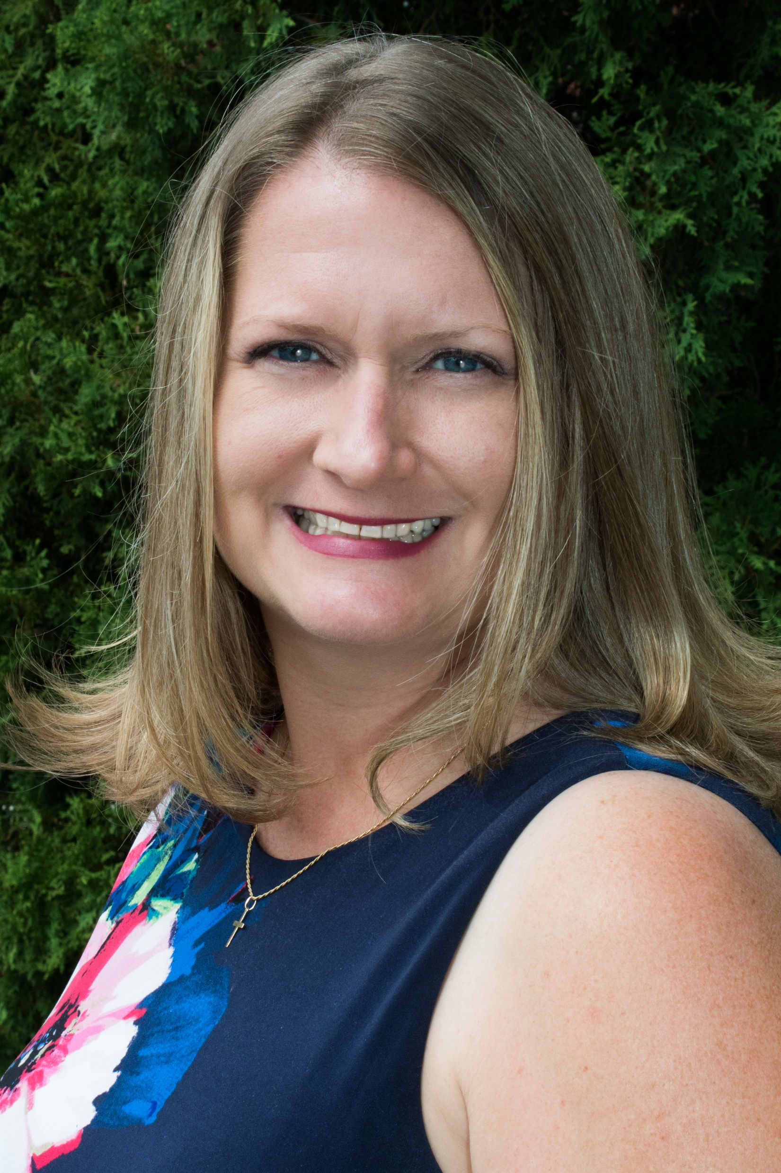
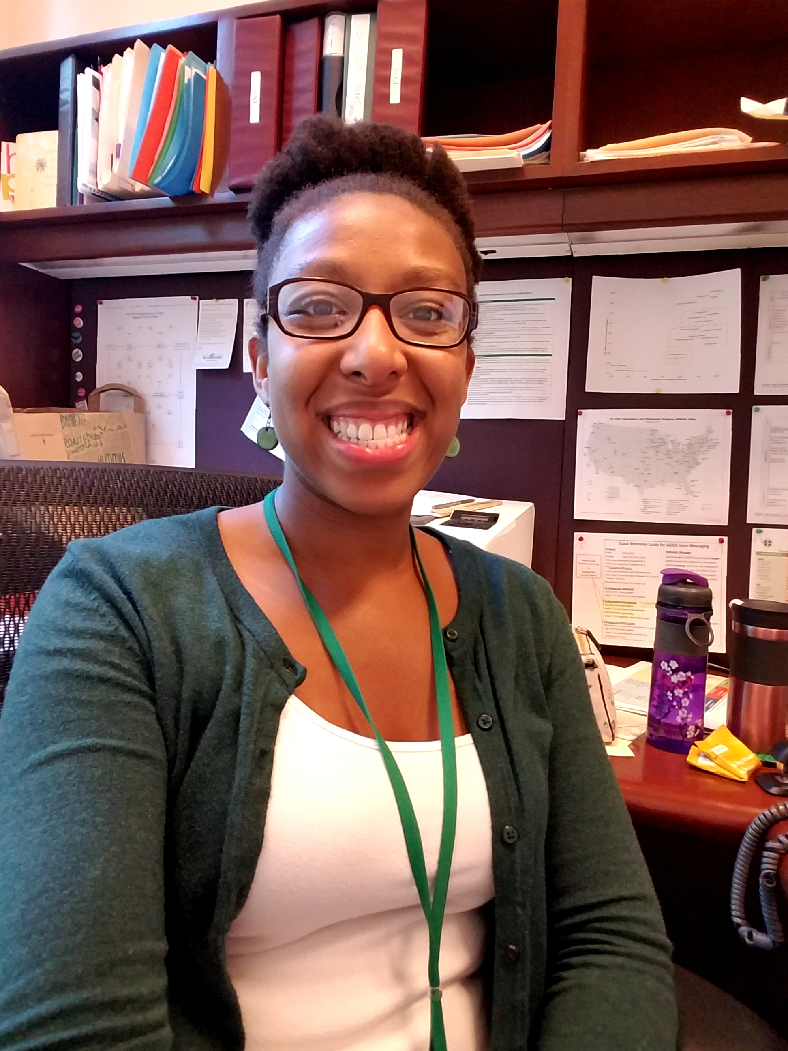
Introduction
Photo Goes Here
Photo Goes Here
Marjean
Christa Ross, Associate Director of Diocesan Development and Support, will be your facilitator.
Marjean Perhot, Division Director of Refugee and Immigrant Services, will be joining as a guest speaker.
Christa

Slide 4
Today’s Agenda
1
Affiliate Monitoring – Broader Impacts
4
How to Prepare – Action Items for RDs
2
PRM and USCCB Monitoring Components
5
Resettlement Director Interview Practice
3
Guest Speaker – Marjean P. (Boston, MA)
6
Questions and Answers

Slide 5
Understand the importance of PRM affiliate monitoring outcomes
1
Learning
Objectives
Summarize PRM’s and USCCB’s monitoring and follow-up process
2
By the end of this webinar, you will be able to:
Identify administrative documentation, staff preparation activities, and general time requirements needed to prep for monitoring
3
Complete the pre-monitoring questionnaire and mock staff interview process for resettlement directors and case managers
4

Slide 6


Affiliate Monitoring – Broader Impacts

Slide 7
PRM Affiliate Monitoring
PRM HQ Monitoring
The Four Factors
PRM visits each affiliate on a five-year cycle to audit compliance with the Cooperative Agreement. Currently behind schedule.
Following every grant cycle, PRM conducts intensive monitoring of OSR reports, R&P period reports, DQNRs, ARM reports, etc.
PRM evaluates performance based on these main areas
R&P Proposal Score
Other Indicators
Greatest weight given to Affiliate Monitoring!
Each year USCCB submits a proposal (NOFO) and affiliate abstracts as part of a competitive application. The abstract includes your site’s monitoring ratings.
Findings resolved within 3 months related to:
Training deficiencies
Providing core services
Refugee understanding of CO topics

Slide 8
PRM Affiliate Monitoring
PRM HQ Monitoring
Tips coming shortly!
Resolve Findings
Familiarize yourself with your last OSR/PRM reports. Implement corrective actions in your Program Strengthening Plans (PSPs).
Affiliate Prep
Steps you can take to increase our network ranking and your affiliate capacity
R&P Proposal Score
Other Indicators
Affiliate Abstracts
Note the strengths and best practices of your agency/program.
Prioritize
Pay special attention to findings related to training, provision of core services, and refugee understanding of CO topics

Slide 9
PRM & USCCB Monitoring Components

Slide 10

PRM Monitoring (before COVID-19)
PRM Affiliate Monitoring Visits usually last 2 days and are conducted by 2 contract monitors. PRM notifies USCCB/MRS approximately 2 weeks in advance with only 1 week to complete the pre-monitoring questionnaire.
Agenda typically includes:
Case File Review (15 R&P files)
Interview with Resettlement Director
Review of training plan and training log
Review of quarterly consultation agenda and DQNR
Review of policies
Interview with Case Managers and/or other staff
4 client home visits

Slide 11
USCCB Monitoring (before COVID-19)
OSRs usually last 4-5 days and are conducted by an FSC
Pre-monitoring questionnaire (R&P and MG) – 3-4 weeks to complete
Agenda typically includes:
Case File Review
In Advance: 12 R&P and 3 MG files
On-Site: 3 R&P files and 2 MG files
Review of staff training plan and required policies
Meeting with ED
Meeting with Diocesan Bishop (if available)
Discussions with Resettlement Staff, SRC, SRHC, and other stakeholders as appropriate
Staff Interviews
4 client home visits

Slide 12
USCCB Remote Monitoring
RSRs usually last 4-5 days and are conducted by an FSC (same)
Review of staff training plan and required policies (same)
Meetings with Resettlement Staff, SRC, SRHC, bishop, and staff interviews will be conducted by Zoom, Microsoft Teams, or conference call
Home visits will be conducted by WhatsApp or conference call
Interpretation is tricky to coordinate
Easiest option: interpreter is in-person with client, but socially distanced
Interpreter, client, and USCCB/MRS staff all use WhatsApp to do a 3-way video call
USCCB arranges for phone interpretation with our contract interpreters to interview clients. Afterwards the clients use WhatsApp to show the USCCB/MRS reviewer their living conditions.
Case file review
All files reviewed in advance: 15 R&P and 5 MG files
Timeline: 5 business days to scan and upload to secure OneDrive folder

Slide 13
Guest Speaker – Marjean Perhot
RD in Boston, MA

Slide 14
How to Prepare – Action Items for RDs

Slide 15
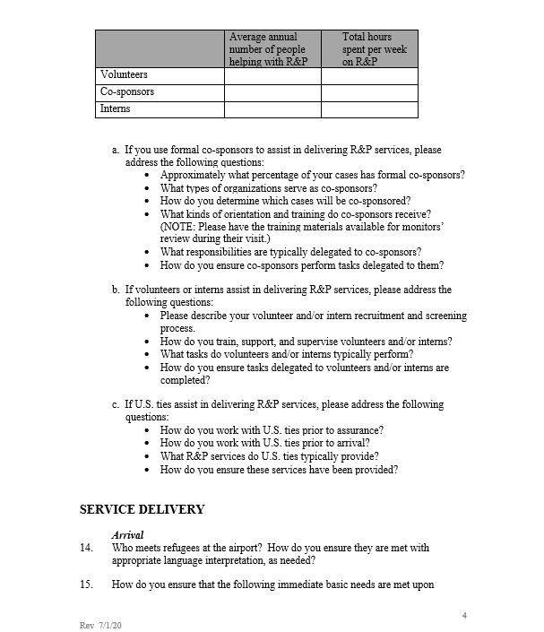
Action #1
Complete the PRM Monitoring Questionnaire
Photo Goes Here
Complete the PRM affiliate monitoring questionnaire in advance of monitoring notification, preferably the FY before your site is due for monitoring.
Submit to USCCB/MRS for program-specific feedback and recommendations (optional)

Slide 16
Completing The Questionnaire
Read through your program’s policies, training plan, recent monitoring reports, and R&P abstract and keep them nearby as you complete the questionnaire
Respond to all parts of the question – most questions are asking for multiple pieces of information
Remember the Cooperative Agreement requirements as you write your responses. If your practices differ from the requirements, it is helpful to think through ways to bring your program into compliance in case PRM asks about it
Review the PRM questionnaire template provided as one of the webinar resources. It contains tips on how to complete some of the trickier questions.

Slide 17
* Indicates USCCB/MRS has a template or guidance available on MRSConnect
Action #2 – Collect Required Documents
Client-Centered
Financial Disbursement
Procedures/Records
Client Grievance Policy
Direct Assistance Policy*
CO Policy* +
CO Assessment*
Protection against Sexual Exploitation and Abuse (PSEA) Policy
Pocket Money Policy*
Training Plan* +
Staff Training Logs*
AAP Policy* +
Evidence of Implementation
Flex Fund Policy*
Last 4 QC Agendas +
Last 4 DQNRs*

Slide 18


Action #3 – Review Monitoring Reports
Read through your program’s most recent OSR and PRM monitoring reports as a refresher on R&P performance outcomes and which aspects of the program will be evaluated.
Review the PSPs associated with these reports, paying special attention to the corrective actions and timelines.
If any findings are still unresolved, identify key reasons why and prepare to discuss with PRM if they ask.

Slide 19
Action #4 – Practice Interview Responses
Ensure your program’s CO sessions reinforce PRM’s R&P performance indicators
Resettlement directors, program managers, case managers, and employment staff who support R&P should practice answering PRM’s interview questions
Performance Indicator: Refugee understands the effects of moving
Have you ever received trainings on how to work with interpreters?
How do you follow-up on the progress of your clients?
Client Interviews
Staff Interviews
RD Interview

Slide 20
Action #5 – Highlight Program Strengths
Think about your program’s best attributes and be prepared to share them with the monitors
Consider sharing with PRM any best practices or innovative solutions that might be helpful to other sites
Summarize important relationships you have in the community, with employers, within your own agency, and with parishes and/or the diocesan bishop
Wrap-Around Services
Volunteer Activities
POWIR and LDS Support
Cash and In-Kind
COVID-19 Response

Slide 21
Resettlement Director Interview Practice

Slide 22
RD Interview Practice
1
2
3
Break Into Groups
Answer Each Question
Regroup and Share
Purpose: to become familiar with some of the interview questions and hear multiple ways of responding
Instructions:
You will automatically be placed into small groups. Take turns answering each question amongst yourselves. For one of the questions pick someone to share their answer with the larger group.
Interview Questions
Who meets/picks up clients from the airport?
Start with RD whose name is first in alphabetical order
How and when do you conduct case file review?
Start with the RD who has been in their position the longest
Bonus Question: What is your biggest challenge?
Start with the RDs in the western-most time zone
15 minutes in small groups

Slide 23
Questions and Answers

Slide 24



December 17, 2020
Thank you!
Please contact your FSC with any site-specific questions!

