Slide 1
January 14, 2021
Cultural Orientation
Documentation
FY 2021

Slide 2
Zoom Features
1
2
3
4
Chat
Q&A
Raise Hand
Polls
Interact with presenters and attendees by:
Typing into the chat box
Asking questions in the Q&A
Raising your hand
Answering polls
The Zoom toolbar is at the bottom of your screen!

Slide 3
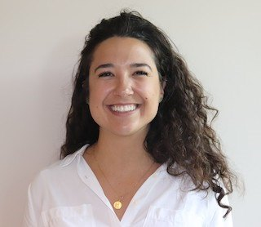
Introduction
Peyton
Peyton Smith, Education and Learning Coordinator

Slide 4
Today’s Agenda
1
Examine common CO findings
2
Review USCCB’s CO provision and assessment policy and documentation requirements
3
Discuss successes and challenges of administering the Model Assessment
4
Offer tips/resources for improving CO performance outcomes

Slide 5
List common CO findings
1
Learning
Objectives
Describe the case file documentation requirements for CO provision and assessment
2
By the end of this webinar, you will be able to:
Identify tips and resources for improving CO performance outcomes
3

Slide 6
Common CO Findings (slide 1 of 2)
Some CO topics are case noted, but not all
Case notes do not clearly document that all adults were present during CO lessons
Match Grant or state-funded employment class is used for “Employment” CO
Notes:
We’ll begin by reviewing some of the common CO findings over the past 2 years, which will give context to why we made changes to the policies/documentation requirements we will cover shortly.
#1 and #2 will hopefully be remedied with the new FY21 requirement of the CO checklist and corresponding case note. Remember that case notes should be very clear if all adult members of a case were present - if your case note only specifically names the PA of the case, a monitor will assume only the PA was present at the interaction.
For #3, we want to emphasize that Match Grant and state funding employment classes are different than employment CO sessions, and should not count as CO. Cultural orientation is an R&P core service, and so it must be completed with R&P-funded staff time; you can’t double-dip and use another funding source to fulfill R&P core service requirements.

Slide 7
Common CO Findings (slide 2 of 2)
“N/A” is listed for a CO topic
There is no documentation of interpretation being provided
The client missed some assessment questions, but it is not clear that staff followed up with them
Notes:
4) All adult clients must receive cultural orientation on all 15 topics listed in the Cooperative Agreement. You cannot pick and choose based on the client’s individual situation. Here are some common examples:
Even if a client does not plan to go to work, they must still receive cultural orientation about employment.
Even if a client does not have school-aged children, they must still receive the education session of CO.
Even if a client doesn’t intend to use public transport – or there isn’t much public transportation in your community - the topic must still be covered.
5) The CORE Model Assessment does not clearly include a line for this –we suggest using the comment lines at the top. The case note about the assessment is another place to document interpretation.
6) If a client does not answer an assessment question correctly, staff should document their efforts to help the client master the information.

Slide 8
USCCB Policy & Documentation Requirements
Cultural Orientation Provision
Every adult refugee and SIV recipient must receive CO on required topics within the R&P Period.
The Cultural Orientation Objectives and Indicators outline the topics and corresponding content objectives and learning indicators approved by PRM.
CO should be initiated within the first 30 days and can be extended up to 90 days as needed.*
CO must be provided with appropriate language interpretation.
Required Documentation
1
CO Checklist RF-23
2
A Case Note
3
MRIS R&P Period Report
Notes:
PROVISION Requirements…
Exceptions caused by COVID-19 delays may apply: Just a reminder that the COVID-19 tile on MRSConnect has Remote Case Management guidance for R&P and MG, which provides information about how to document any delays in service because of COVID-19, and what follow-up would be expected.

Slide 9
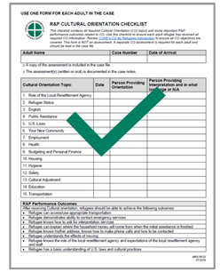
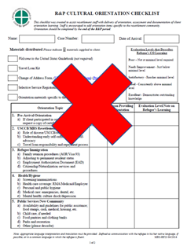
FY 2021 New Requirements
CO Checklist (RF-23) & Case Note
USCCB/MRS Cultural Orientation Checklist (RF-23)- A separate completed form for each adult member of a case; documents when all 15 CO topics were provided, the person providing orientation, and the person providing interpretation if needed.
A case note for each adult member of the case, OR a combined case note that clearly references each adult, documenting the completion of all 15 CO topics, as outlined in the CA, and referral back to the CO Checklist (RF-23).
Note the USCCB/MRS R&P Case File Monitoring Tool (RF-24) needs to be updated to reflect that the CO Checklist is now required – stay tuned!
Notes:
On the RP Case File Monitoring Tool- need to make clear this is pending an update which will be released later, CO requirements are outdated now
Example of case note: “___ and ___ attended all CO classes and received training on all 15 CO topics. See CO checklist”

Slide 10
USCCB Policy & Documentation Requirements
Cultural Orientation Assessment
Affiliates are required to use the CORE Model R&P CO Assessment to administer a formal, individual assessment for each adult member of a case with appropriate language interpretation.
Available in written or oral form in main resettlement languages
The assessment should be given after CO is completed and before the end of the R&P period.
Any additional or site-specific assessment questions should be in supplement to the CORE Model Assessment.
Required Documentation
1
CORE Model Assessment and Follow-up
2
A Case Note
3
MRIS R&P Period Report

Slide 11
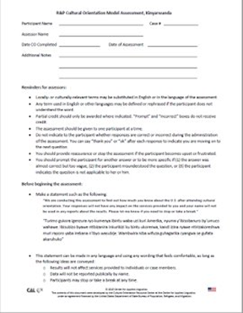
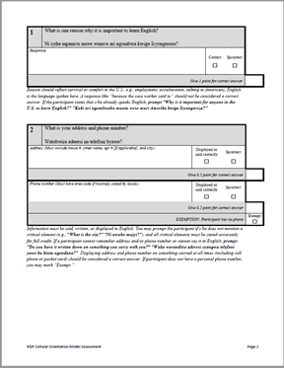
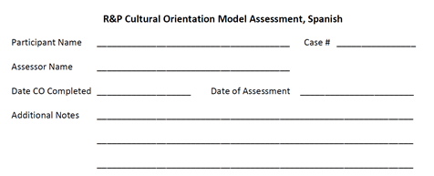
FY 2021 New Requirements
CORE Model Assessment & Case Note
CORE Model Assessment- A copy of the scored individual assessment for each adult member of a case (*consider using the additional notes section to document interpretation provided).
A case note for each adult member of the case OR a combined case note that clearly references each adult, documenting when and how understanding was assessed, including appropriate use of language interpretation, and any missed questions/follow-up needed, and when follow-up was provided.
Notes:
The purpose of conducting the assessment on the affiliate end.
To better equip refugees for self-sufficiency
To identify trends in refugees’ answers/knowledge
To identify ways to improve CO delivery
To identify improved methods for memory retention

Slide 12
FY 2021 New Requirements
MRIS R&P Period Reporting
Purpose:
To be compliant with requirements set forth by the Cooperative Agreement
To track refugees’ understanding & retention of CO topics
To identify trends across USCCB affiliates as well as any technical assistance needs
It is important for CO providers to closely review CORE’s Cultural Orientation Assessment Handbook and Training which offers guidance on using the CORE Model Assessment and calculating scores.
Notes:
Indicate “Yes” if the client received instruction on all required cultural orientation topics with appropriate language interpretation. Otherwise, answer this question “No” and select the applicable barrier(s) to providing cultural orientation to this client. You may select more than one barrier.
Enter the client’s TOTAL Score from the CORE Model Assessment: _____ out of ____. The score is recorded on the final page of the assessment. Note, the written and oral versions score a bit differently.
Select the mechanism used to deliver CO to the client. CO may have been delivered in a classroom setting, remotely, or during a home visit(s). If more than one mechanism is applicable, please select the mechanism used most often to deliver CO to the client
We have often been asked what constitutes a passing score:
From CORE-there is no universal “passing score” for the Model Assessment. Some questions allow for partial credit and even exemption, which can make the total number of points available vary from one participant to another, so a “passing score” may be different from one person to another.
Ideally, all refugees who attend CO should be able to answer all the questions correctly at the end of the R&P period. It is like a test for a driver’s license, where the best outcome is that all new drivers understand the rules of the road perfectly.
The Model Assessment, is a stand-alone tool, and not used to evaluate CO programs as a whole – so answer honestly!
The person completing the R&P period reports may not always be the person doing the assessment, so everyone needs to be aware of this requirement.

Slide 13
Improving CO Documentation
USCCB CO Policy & Guidance (New): https://mrsconnect.org/resettlement-services/reception-and-placement-rp/policy-templates/
CO Checklist RF-23: https://mrsconnect.org/resettlement-services/reception-and-placement-rp/case-file-forms/
CORE Model Assessment (found on the RP page>Promising Practices and Resources>CO)
USCCB CO Policy Template (Updated): https://mrsconnect.org/resettlement-services/reception-and-placement-rp/policy-templates/
CO Objectives and Indictors (found on the RP page>Promising Practices and Resources>CO)
CORE Domestic CO Assessments: https://coresourceexchange.org/reception-and-placement-domestic-assessments/

Slide 14
Case File Compliance Activity

Slide 15
Case Information
Case Members: Omar (35 yrs), Sarah (34 yrs), & Lina (3 yrs)
DOA: 1/1/2021
Case size: 3
Scenario #1
Date | Program/ Funder | Service Mode | Who provided language interpretation? | Activity / Progress / Service NOTES | Staff member
1/15/21 | R&P | Office Visit | Paid Interpreter | Cultural Orientation: Clients attended CO classes with a paid Arabic interpreter. See CO checklist. | Emma Smith
1/22/21 | R&P | Office Visit | Paid Interpreter | Cultural Orientation: Clients attended their second CO class with a paid Arabic interpreter. See CO checklist. | Emma Smith
1/29/21 | R&P | Office Visit | Paid Interpreter | Cultural Orientation: Clients attended their third CO class with a paid Arabic interpreter. See CO Checklist. | Emma Smith
Case file includes:
2 completed CO checklists
2 completed and scored CORE assessments
R&P Period Report with CO data
Notes:
Poll: Does this case file meet the case file documentation requirements for CO?
Answer: NO – There needs to be a case note for each adult member of the case, OR a combined case note that clearly references each adult, documenting that they both completed completion of all 15 CO topics, and referral back to the CO Checklist (RF-23). The CO assessment is also not mentioned in the case notes.

Slide 16
Case Information
Case Members: Omar (35 yrs), Sarah (34 yrs), & Lina (3 yrs)
DOA: 1/1/2021
Case size: 3
Scenario #1
Date | Program/ Funder | Service Mode | Who provided language interpretation? | Activity / Progress / Service NOTES | Staff member
1/15/21 | R&P | Office Visit | Paid Interpreter | Cultural Orientation: Sarah and Omar attended CO classes with a paid Arabic interpreter. See CO checklist. | Emma Smith
1/22/21 | R&P | Office Visit | Paid Interpreter | Cultural Orientation: Sarah and Omar attended their second CO class with a paid Arabic interpreter. See CO checklist. | Emma Smith
1/29/21 | R&P | Office Visit | Paid Interpreter | Cultural Orientation: Sarah and Omar attended their third CO class with a paid Arabic interpreter. Both clients completed all 15 topics (see CO checklist) and completed the written assessments. Both clients scored a 11/11. | Emma Smith
Case file includes:
2 completed CO checklists
2 completed and scored CORE assessments
R&P Period Report with CO data
Notes:
This meets all CO case file documentation requirements. Notice that in this one we wrote out both clients names. This is a best practice.

Slide 17
Case Information
Case Members: Omar (35 yrs), Sarah (34 yrs), & Lina (3 yrs)
DOA: 1/1/2021
Case size: 3
Scenario #2
Date | Program/ Funder | Service Mode | Who provided language interpretation? | Activity / Progress / Service NOTES | Staff member
1/15/21 | R&P | Office Visit | Paid Interpreter | Cultural Orientation: Sarah and Omar attended CO classes with a paid Arabic interpreter. See CO checklist for lessons covered. | Emma Smith
1/22/21 | R&P | Office Visit | Paid Interpreter | Cultural Orientation: Sarah and Omar attended their second CO class with a paid Arabic interpreter. See CO checklist for lessons covered. | Emma Smith
1/29/21 | R&P | Office Visit | Paid Interpreter | Cultural Orientation: Sarah and Omar came for their final CO class. They both completed all 15 topics. See completed CO checklist. They both took the oral CORE assessment, which are both in the case file. Sarah scored a 11/11 and Omar scored a 5/11. | Emma Smith
Case file includes:
2 completed CO checklists
2 completed and scored CORE assessments
R&P Period Report with CO data
Notes:
These are the only case notes in the whole file related to CO.
Poll: Does this case file meet the case file documentation requirements for CO?
Answer: NO – the third case note indicates that Omar scored a 5/11 on the CO assessment. However, there is not indication in the case notes that follow up occurred to ensure he understood the topics.

Slide 18
Scenario #2
Date | Program/ Funder | Service Mode | Who provided language interpretation? | Activity / Progress / Service NOTES | Staff member
1/15/21 | R&P | Office Visit | Paid Interpreter | Cultural Orientation: Sarah and Omar attended CO classes with a paid Arabic interpreter. See CO checklist for lessons covered. | Emma Smith
1/22/21 | R&P | Office Visit | Paid Interpreter | Cultural Orientation: Sarah and Omar attended their second CO class with a paid Arabic interpreter. See CO checklist for lessons covered. | Emma Smith
1/29/21 | R&P | Office Visit | Paid Interpreter | Cultural Orientation: Sarah and Omar came for their final CO class. They both completed all 15 topics. See completed CO checklist. They both took the oral CORE assessment, which are both in the case file. Sarah scored a 11/11 and Omar scored a 5/11. | Emma Smith
2/5/21 | R&P | Office Visit | Case Manager | Cultural Orientation Follow-up: CM met with Omar to review the missed questions on the assessment and discussed relevant CO topics to ensure a complete understanding. CM speaks the native language as Omar. | Dunya Al-Dahi
Case file includes:
2 completed CO checklists
2 completed and scored CORE assessments
R&P Period Report with CO data
Notes:
Adding a case note regarding CO follow-up would ensure that this meets all CO documentation requirements.

Slide 19
Improving CO Outcomes
Cultural Orientation Assessment Handbook
Section 4: Using Assessment Data
Notes:
The CO Assessment Handbook includes helpful information for administering the assessment such as timing, format, use of prompts, as well as scoring and follow-up. It also has a great section on using assessment data.
Assessment scores can help you see what parts of your CO programming may need tweaked to improve overall outcomes. For example, you might find a need to improve the effectiveness of a particular activity or to choose certain topics to emphasize in greater depth for particular client populations. The assessment data may also help you make decisions about staffing and staff training. Additionally, CO curriculum can be adapted for certain populations who may have challenges understanding and retaining key information.
We are working on developing a report in MRIS that can help you do this as well as disaggregate CO assessment outcome data to examine how different groups compare to each other:
Older and younger refugees
Men and women
Refugees from different ethnic/linguistic backgrounds
Refugees with prior education/literacy and those without
Refugees with U.S. ties and refugees with no U.S. ties
High and low CO attendance rates
CO Mechanism (e.g., classroom, home visit, remote)
In the meantime, you could consider using a simple excel tracker such as this, if you are not doing so already.

Slide 20
Improving CO Outcomes
Effective Practice Series https://coresourceexchange.org/effective-practice-series/
Notes:
Reminder of all the good stuff on CORE’s site under “Teach” and “Learn“ Specifically, in the Learn menu, the Effective Practice Series that includes step-by-step guidance on how to assess, supplement, and apply new practices to enhance Cultural Orientation learning and engagement. Current guides include using volunteers, delivering effective remote CO, how to create interactive 1-1 CO, including guests from the community, delivering gender-segregated sessions, and integrating digital technology.

Slide 21
Improving CO Outcomes
Resource Round-up: Multilingual Tutorials on Zoom and Other Online Platforms https://switchboardta.org/blog/resource-round-up-multilingual-tutorials-on-zoom-and-other-online-platforms/
Overcoming Barriers to Adult Education: Strengths-based Strategies for Effective Enrollment and Retention https://switchboardta.org/resource/info-guide-overcoming-barriers-to-adult-education-strengths-based-strategies-for-effective-enrollment-and-retention/
Cognitive Load and Memory Poster https://switchboardta.org/resource/cognitive-load-and-memory/

Slide 22
Reminders
The guidance covered in this webinar can be found on MRS Connect.
We are currently in the process of reviewing the updated CO policies you submitted and will be in touch with any questions, comments, or concerns.
Upcoming USCCB Webinar: Follow Up - Changes to the FY2021 Cooperative Agreement, January 27, 2021 at 2PM EST
Upcoming FY21 CO Community of Practice (CoP) calls:
March 24, 2021 at 3PM EST
June 16, 2021 at 3PM EST
September 15, 2021 at 3PM EST
Please email jzubko-cunha@usccb.org if you should be added to the CO provider contact list for important updates & resources!

Slide 23
Thank you!
Please contact Jacquelin Zubko-Cunha
(jzubko-cunha@usccb.org) with any CO-related questions!
Do you have any questions?

